Slide 1
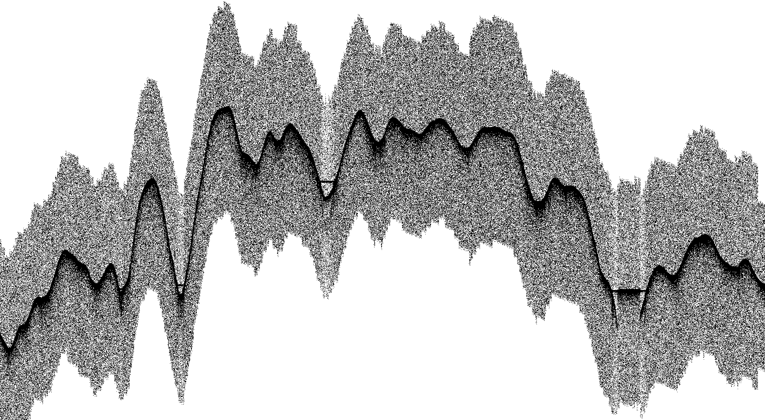
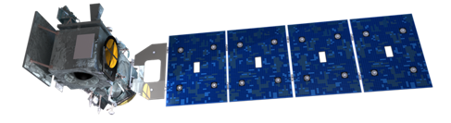
ICESat-2 Quick Looks
Dr. Aimée Gibbons
ICESat-2 Project Science Office
October 28, 2026

Slide 2
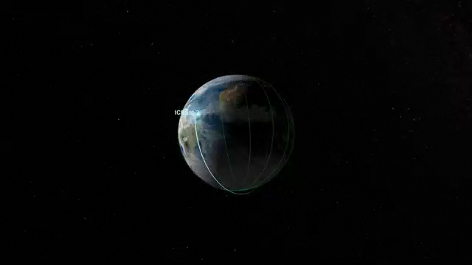
ICESat-2 Measurement Concept
ATLAS: Advanced Topographic Laser Altimeter System
Measures photon round trip time-of-flight
2.48 Trillion laser pulses transmitted since 1 October 2018
92-degree orbit inclination angle
Coverage spans 88º N to 88º S
Repeat polar tracks every 91 days
Reference Ground Track plans:
https://icesat-2.gsfc.nasa.gov/science/specs

Slide 3
ICESat-2 Measurement Concept
Single laser pulse split into 6 beams (gtx). Single-photon sensitive detection.
Single laser pulse at 532 nm (green)
11 m footprint diameter
0.7 m along-track spacing
3.3 km spacing between pairs provides spatial coverage
90 m pair spacing for slope determination (2° yaw)
High-energy beams (4x) for better performance over low-reflectivity targets
Solar array: Sailboat or airplane (shown)
Footprint Size: 11m
PRF: 10 kHz (0.7 m)

Slide 4
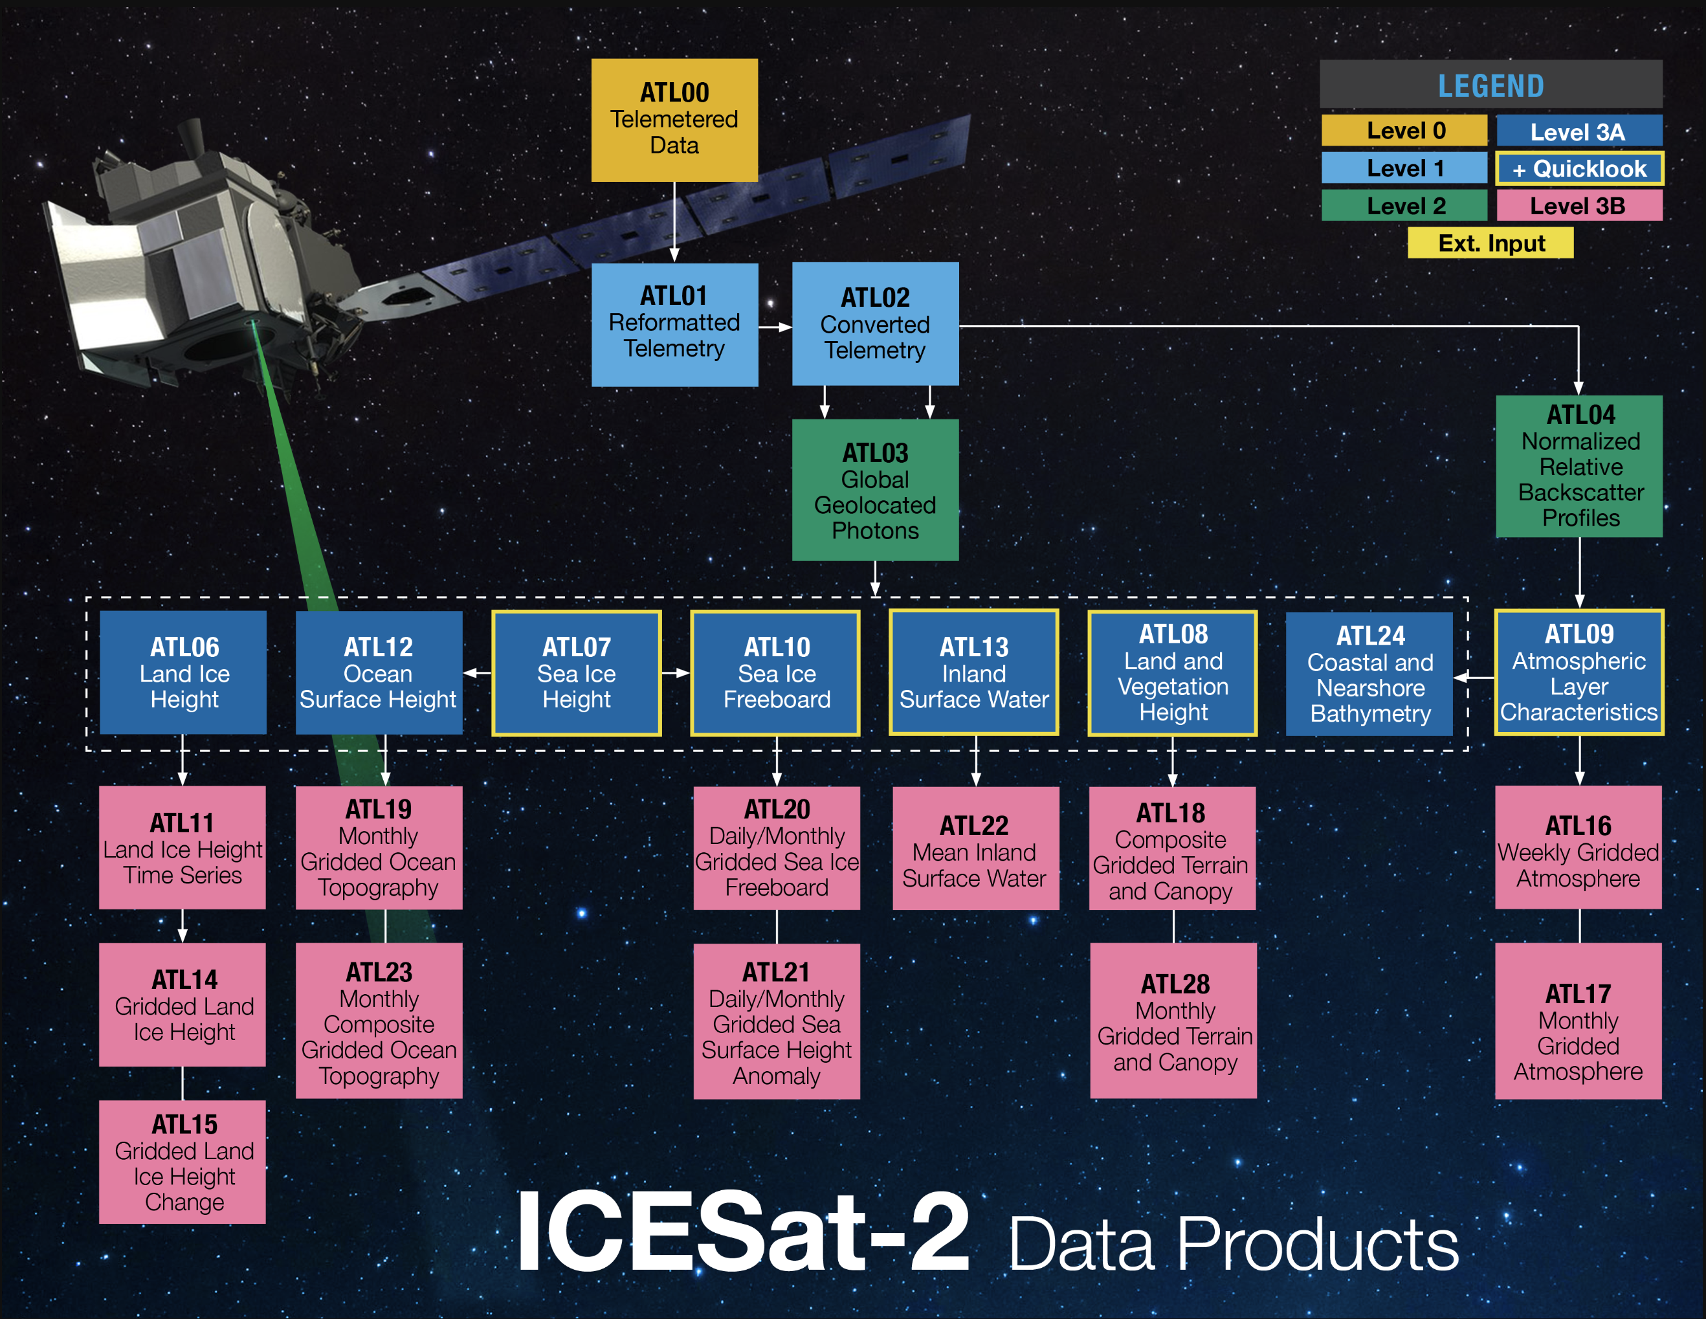
What are IS2 Quick Looks?
Quick Looks (QL) originally made for internal verification of instrument health
Scientific community requested QLs be available to enable faster science*
Along-track QL products available
  ATL08QL: Veg/land
  ATL09QL: Atm layers
  ATL07QL: Sea ice height
  ATL10QL: Sea ice freeboard
  ATL13QL: Inland water
https://nsidc.org/data/icesat-2/products
*Accuracy caveats apply
Notes:
ATL03 are the geolocation photon data upon which all the other products are built

Slide 5
Standard Data vs. Quick Looks
 | Standard Data | Quick Look
Processing | Geolocation modeled for ~2 months | Geolocation predictions
Latency | 2-3 months | 3-5 days
Uncertainty (Varies with surface slope, off-point angle) | ATLAS Measurement Error Height ~ 17 cm Along-track ~ 5 m Across-track ~ 5 m Validation Error Geolocation 3.5 m ± 2.1 m Magruder, et al. (2021). https://doi.org/10.1029/2020EA001414 | Additional Uncertainty Height ~ 2.5 m Along-track ~5 m (bckwd), ~105 m (fwd) Across-track ~ 4-15 m Known biases vary with time, spacecraft orientations (s/c orient, solar array)
POD/PPD Degrade Flag | Accurately covers all periods where geolocation may be degraded due to spacecraft maneuvers (e.g. DMUs) | Generally covers degraded periods, but may not provide full, accurate flagging
POD: Pointing Orbit Determination
PPD: Precision Pointing Determination
Notes:
ATLAS measurement error is conservative for simplest case – flat, uniform surface, low-off point angle

Slide 6
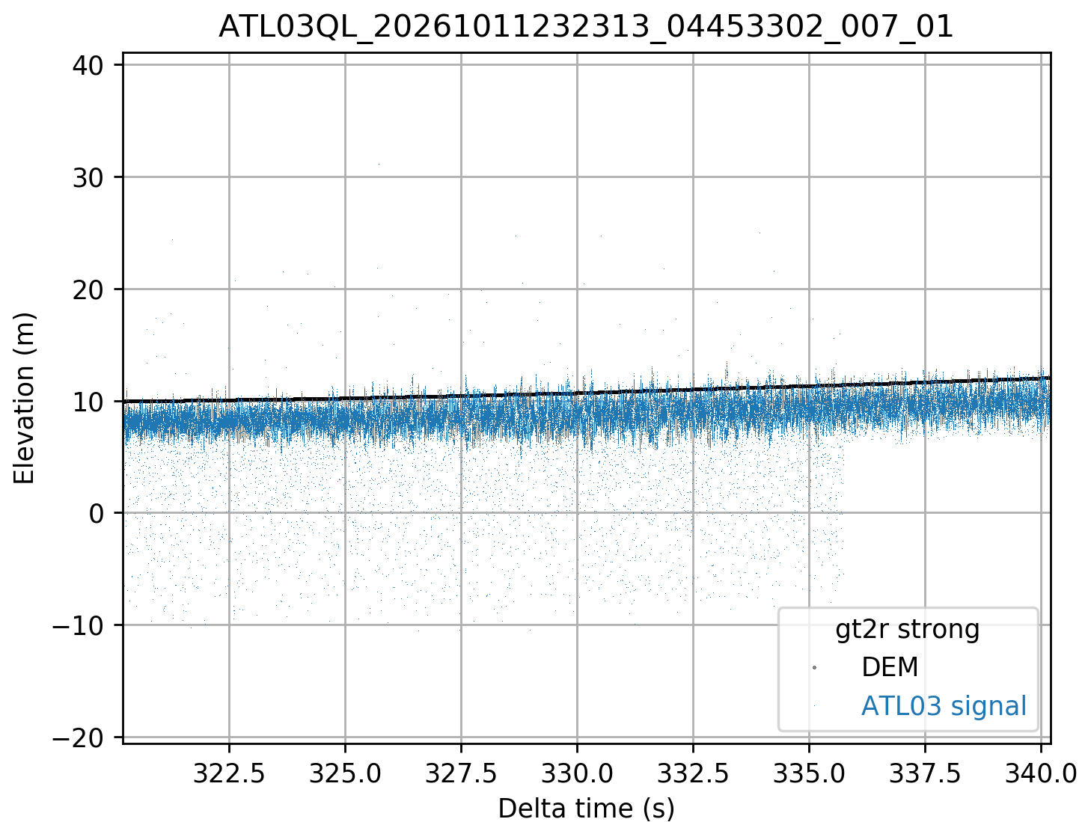
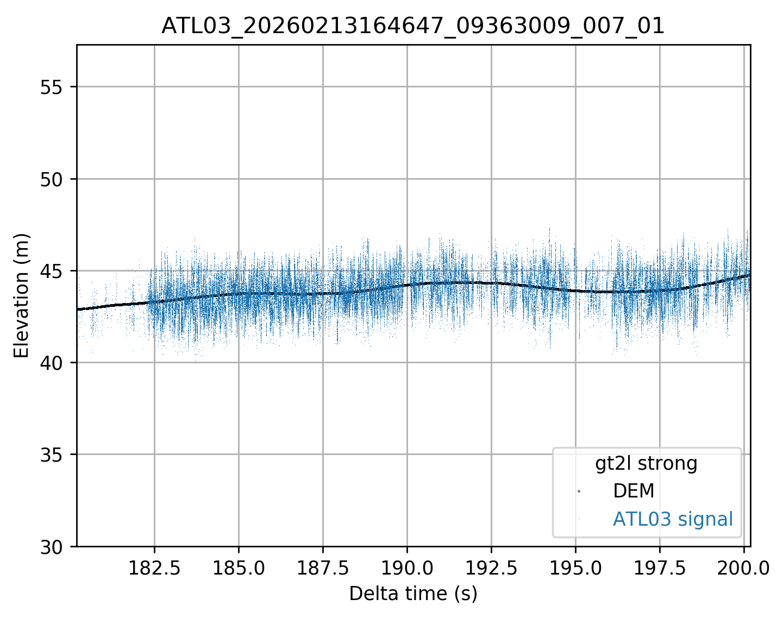
What do QLs look like: ATL03*
Quick Look
Standard
Minor deviations from DEM
Systematically offset from DEM
Spot 3
Spot 3
*ATL03QL data not publicly available

Slide 7
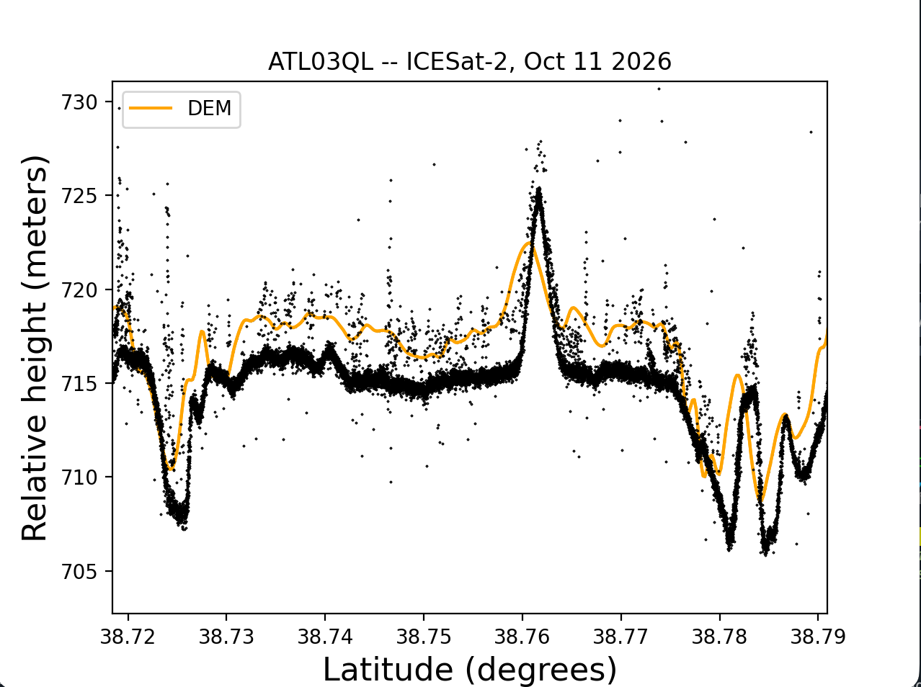
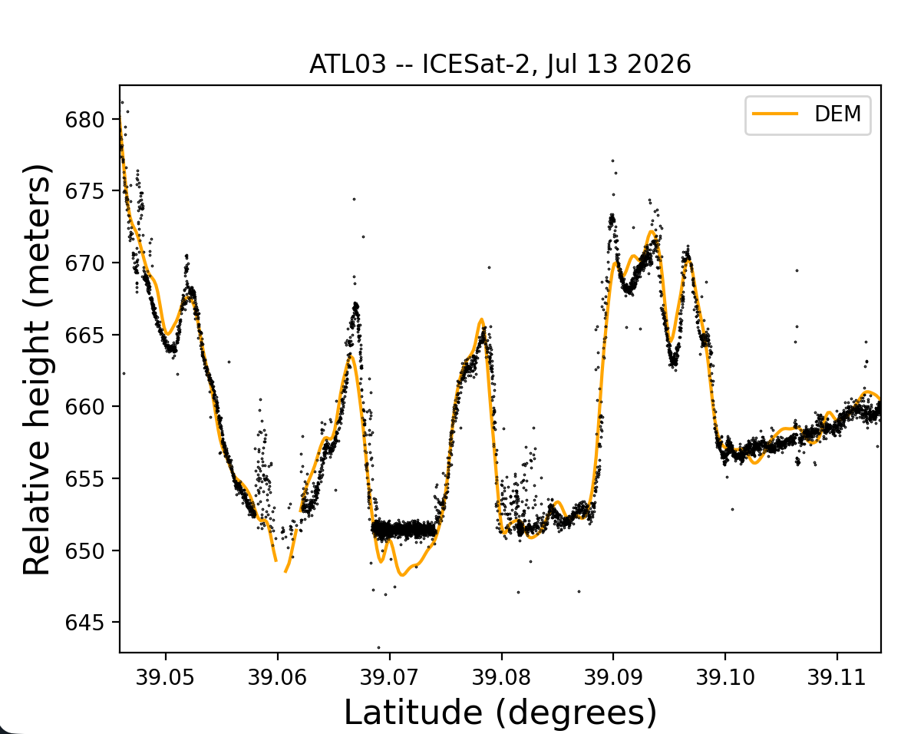
What do QLs look like: ATL03*
Quick Look
Standard
Minor deviations from DEM
Systematically offset from DEM
*ATL03QL data not publicly available

Slide 8
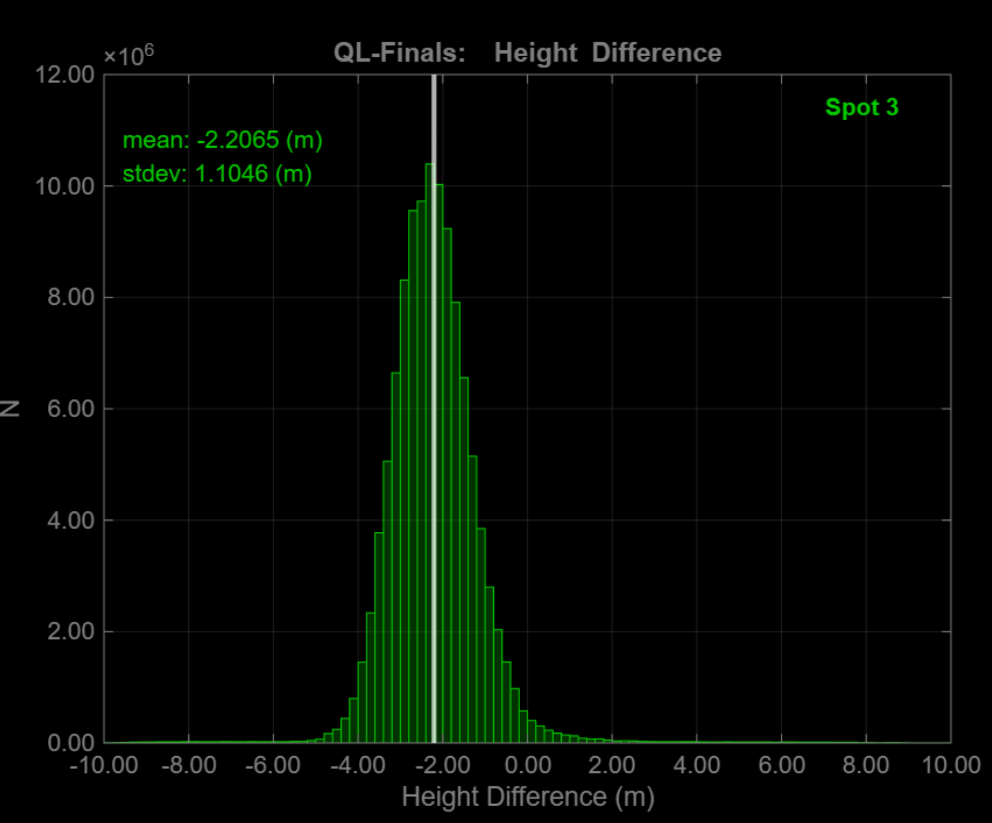
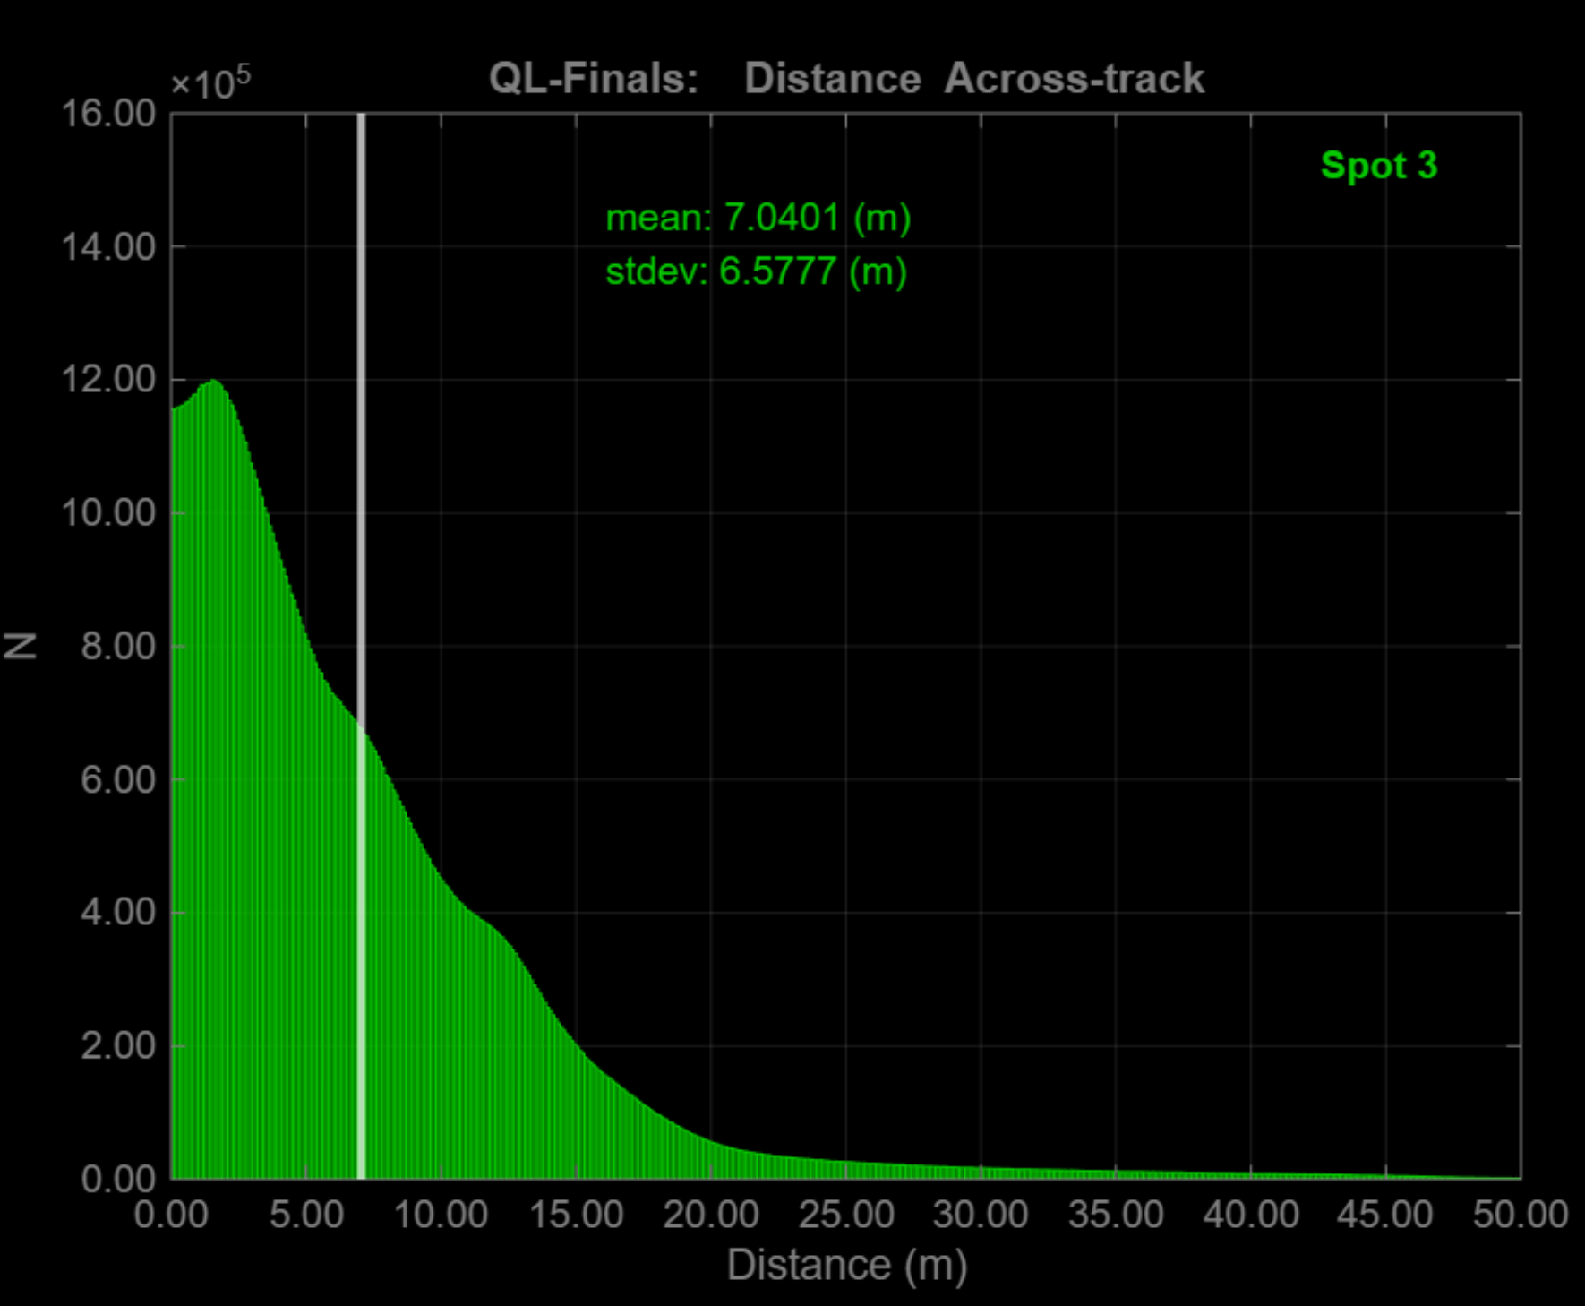
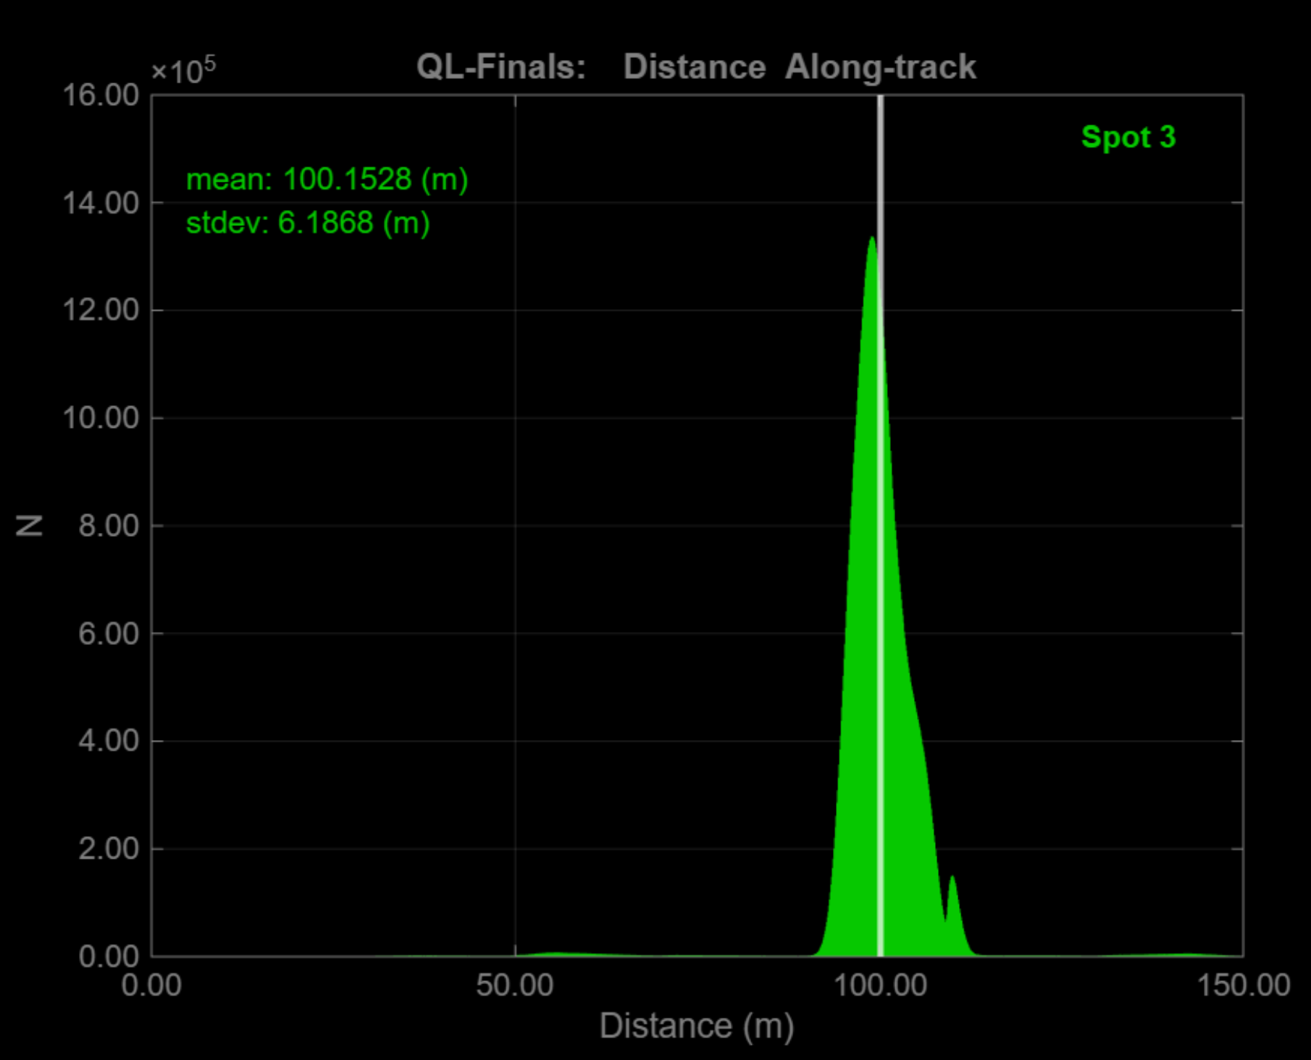
What do QLs look like: ATL03*
Histogram of differences between QuickLook and standard ATL03 data for height, across, and along-track
  14,751 granules: Sept 12 – Nov 19, 2025
  Solar array: airplane orientation
  Yaw: forward (+x)
Different solar array (airplane, sailboat) and yaw (±x)
orientations yield different results (slide 5)
QL-Final: Height
QL-Final: Across-track
QL-Final: Along-track
Mean: -2.21 m
StDev: 1.10 m
Mean: 7.04 m
StDev: 6.58 m
Mean: 100.15 m
StDev: 6.19 m
Courtesy of A. Ivanoff
*ATL03QL data not publicly available
Notes:
*Day boundaries in QLs can get weird and fixed in standard data

Slide 9
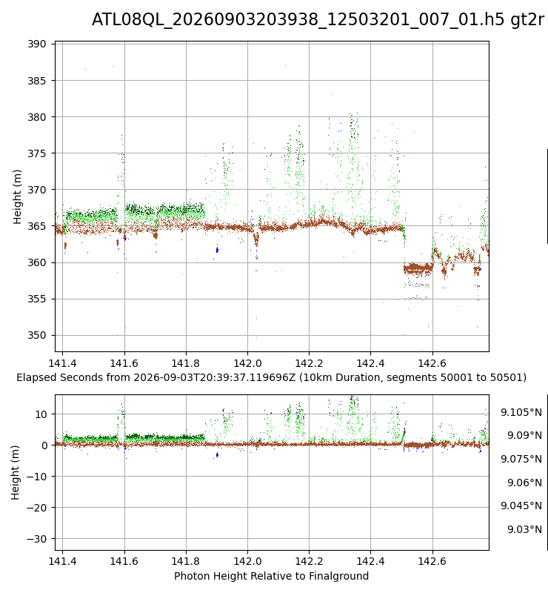
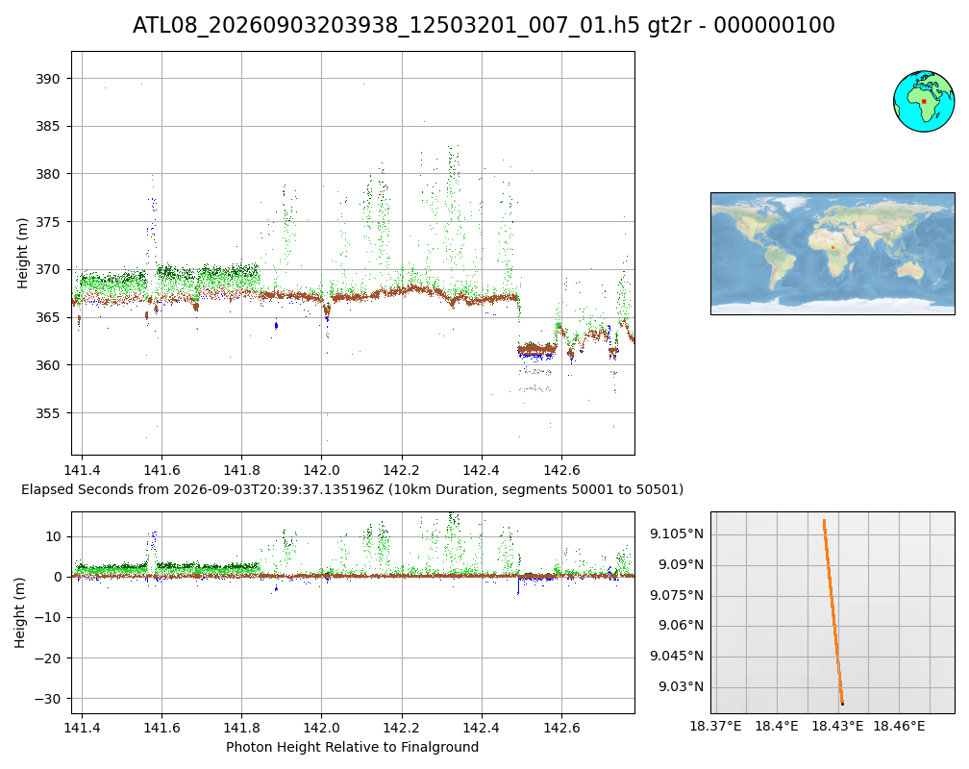
What do QLs look like: ATL08
Quick Look
Standard
Absolute height
Relative height
Courtesy of B. Jelley

Slide 10
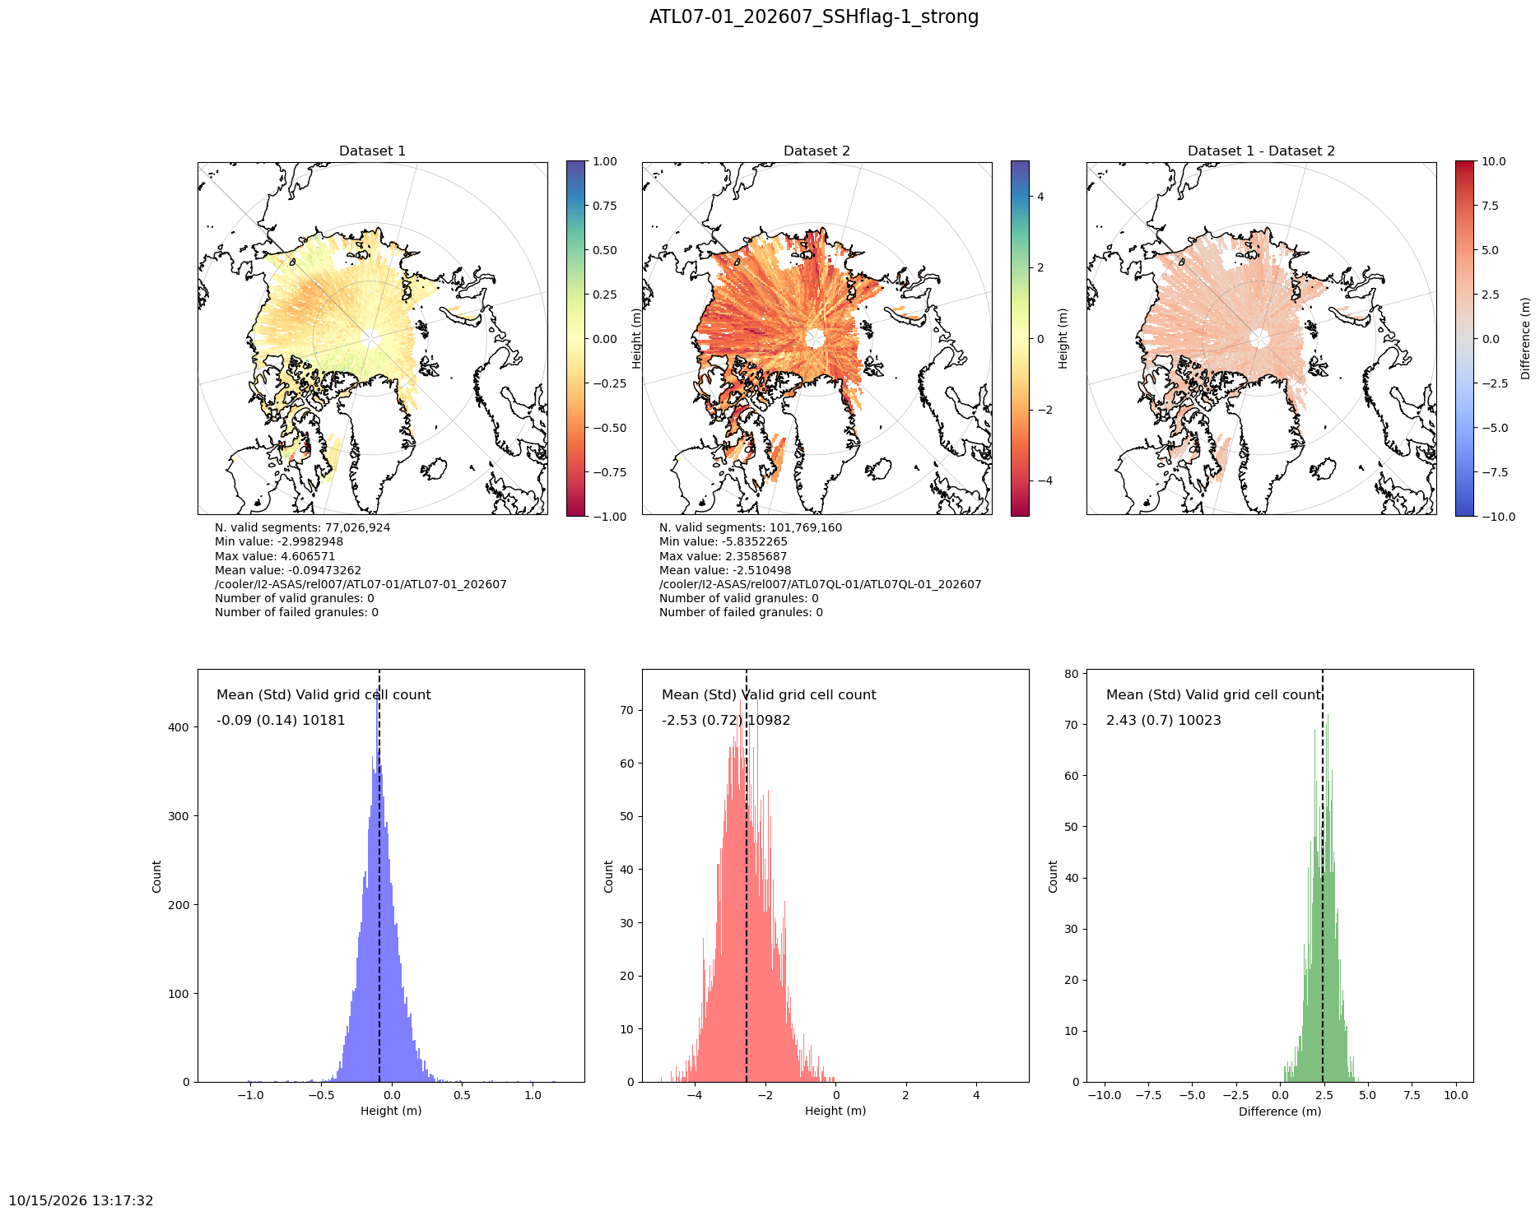
What do QLs look like: ATL07 July 2026
Standard
Quick Look
Difference
Mean difference = 2.43 m
Courtesy of J. Wimert

Slide 11
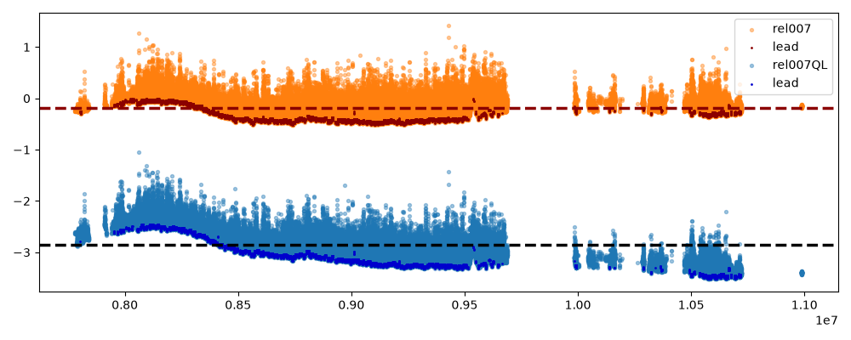
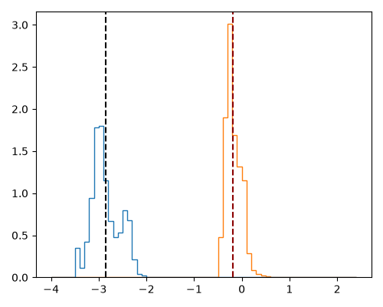
What do QLs look like: ATL07 July 2026
Sea ice and lead heights in an along-track profile for ATL07 (orange) and ATL07QL (blue) on July 16, 2026
Courtesy of J. Wimert

Slide 12
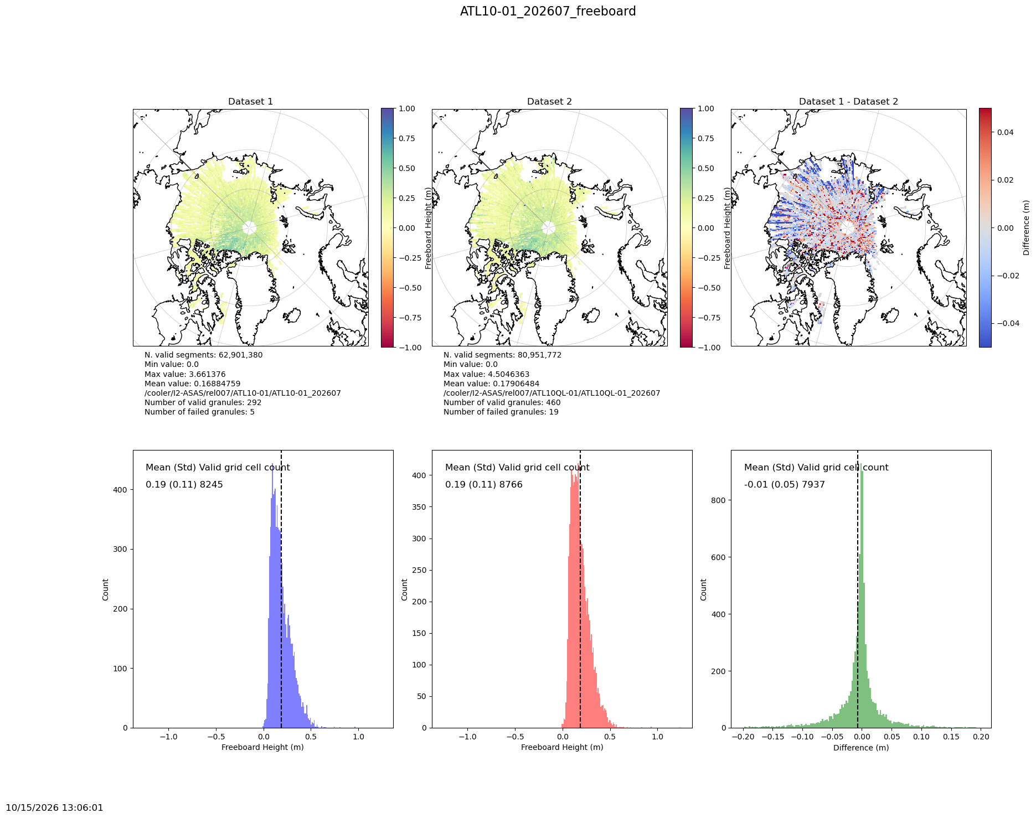
What do QLs look like: ATL10 July 2026
Standard
Quick Look
Difference
Mean freeboard
difference = -0.01 m
Courtesy of J. Wimert
Notes:
QL's show about a 2-3 cm additional uncertainty and the LL's are closer to 1 cm additional uncertainty.

Slide 13
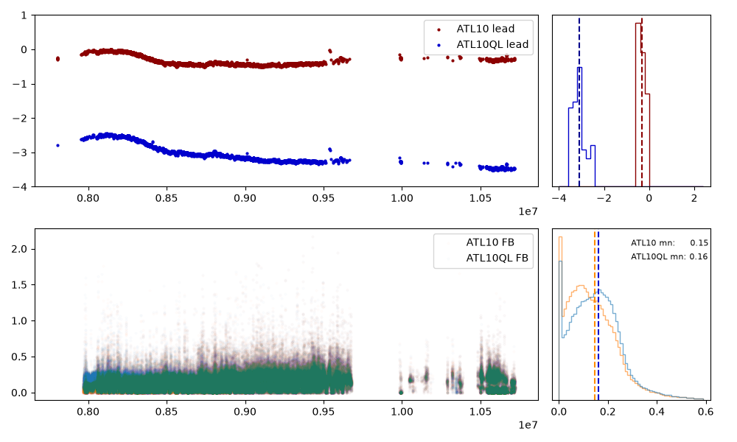
What do QLs look like: ATL10 July 2026
Lead height (top) and sea ice freeboard (bottom) in an along-track profile for ATL10 (red) and ATL10QL (blue) on July 16, 2026
Absolute height
Freeboard relative height very similar between QLs and standard data
Relative height
Courtesy of J. Wimert

Slide 14
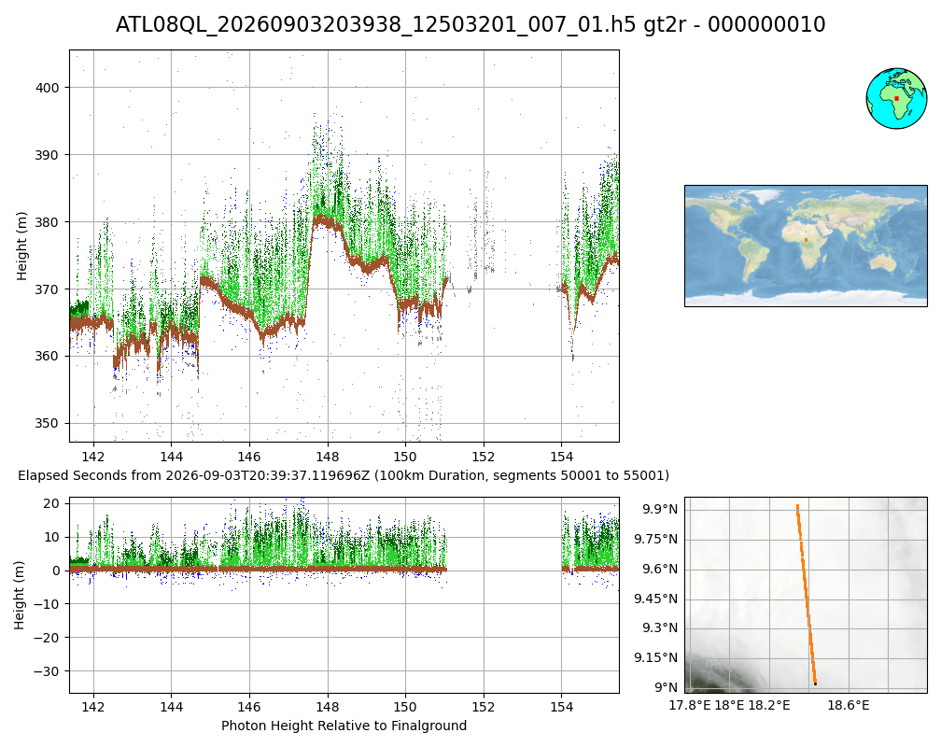
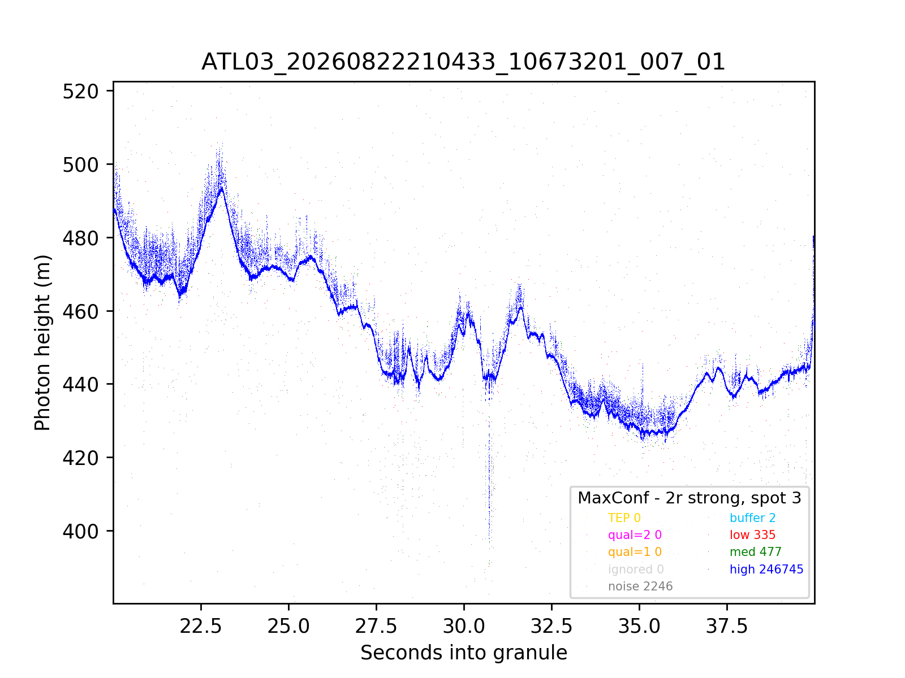
Quick Look Takeaways
Quick Look data are the fastest-available for ICESat-2: 3-5 day latency
  Expedited latency prioritized over absolute geolocation accuracy
    Known time-varying bias in height, along, and across track distances compared to standard data
    Degrade periods due to spacecraft maneuvers may not be fully indicated
Quick Look strengths
  Relative height e.g. sea ice freeboard (ATL10QL)
  Signal strength and spatial resolution
  Feature identification
So why don’t we get ATL03QLs???...

Slide 15
Preview: Low Latency (LL) Data
LL height and geolocation fidelity very close to final standard data
  Height differences compared to finals up to 1 cm
  Along, across track differences are sub-meter
  Exactly matching POD/PPD degrade flags
  Sliding geolocation modeling solution ~2-month window gives LLs a good solution, but not the *best one* (standard data products)
4-7 day total latency from data collection
  Improved height and geolocation is a trade off for additional 1-4 days of latency compared to QuickLooks
ATL03LL now available!
ATL06LL and LL for all other along-track QL products follow (by early 2027)

Slide 16
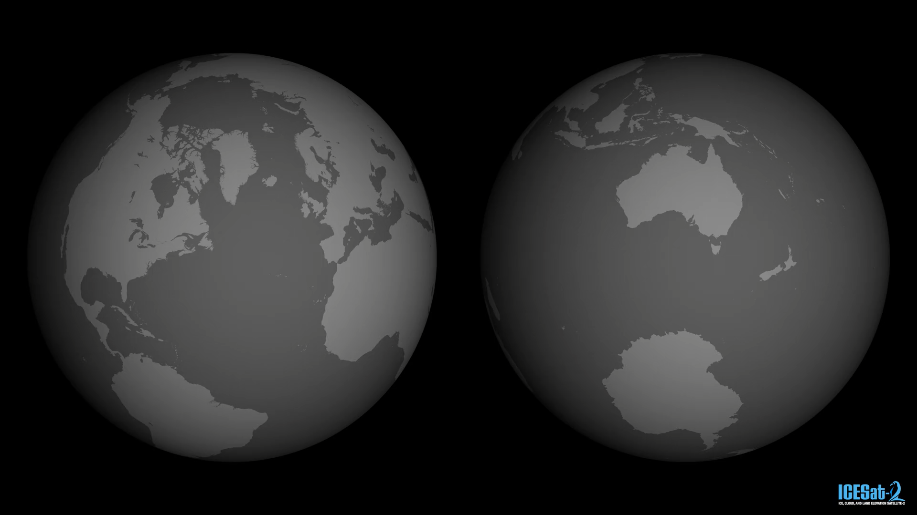
Thank you
https://svs.gsfc.nasa.gov/5616/
Website: https://icesat-2.gsfc.nasa.gov/
Data: https://nsidc.org/data/icesat-2
Track plans:
https://icesat-2.gsfc.nasa.gov/science/specs
Tutorials:
https://github.com/ICESat-2/icesat2-cookbook
Email: aimee.c.gibbons@nasa.gov

Slide 17
Backup

Slide 18
Standard vs. QL vs. LL
 | Standard Data | Quick Look | Low Latency
Processing | Geolocation modeled for ~2 months | Geolocation predictions | Geolocation modeled for sliding ~2 months
Latency | 2-3 months | 3-5 days | 4-7 days
Uncertainty (Varies with surface slope, off-point angle) | ATLAS Measurement Error Height ~ 17 cm Along-track ~ 5 m Across-track ~ 5 m Validation Error Geolocation 3.5 m ± 2.1 m Magruder, et al. (2021). https://doi.org/10.1029/2020EA001414 | Additional Uncertainty Height ~ 2.5 m Along-track ~5 m (bckwd), ~105 m (fwd) Across-track ~ 4-15 m Known biases vary with time, spacecraft orientations (s/c orient, solar array) | Additional Uncertainty Height ~ 1 cm Along-track ~ 1 m Across-track ~ 1 m Small biases in different spacecraft orientations
POD/PPD Degrade Flag | Accurately covers all periods where geolocation may be degraded due to spacecraft maneuvers (e.g. DMUs) | Generally covers degraded periods, but may not provide full, accurate flagging | Matches Standard Data

Slide 19
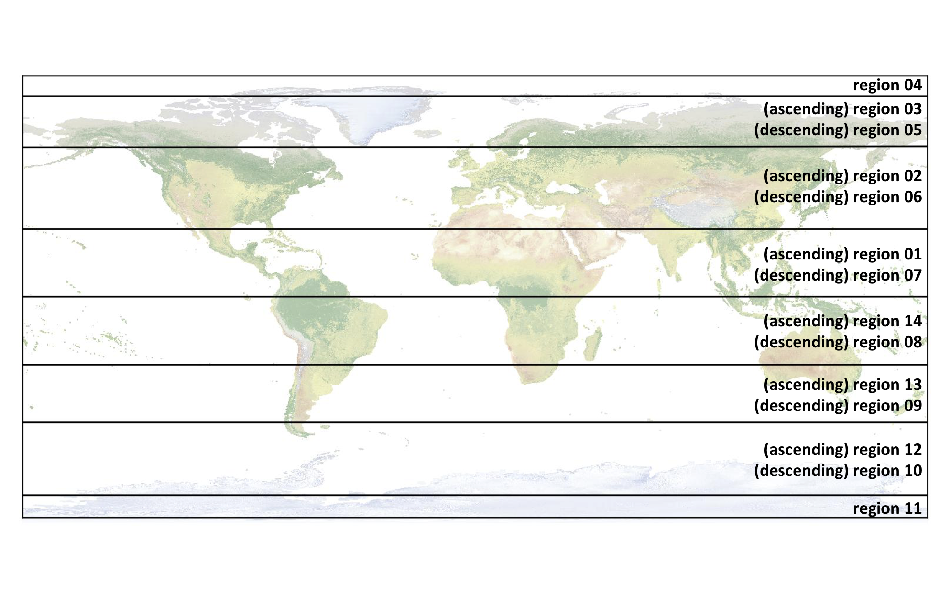
ATL03 Files
One Reference Ground Track (RGT) = one orbit
14 regions in each RGT, divided up by latitude and spacecraft ascending/descending
File name format ATL03_YYYYMMDDHHMMSS_RGTXccrr_rel_vr.h5
  YYYYMMDD = Year, month, date
  HHMMSS = Hour, minute, second
  RGTX = 4-digit RGT (0001-1387)
  cc = 2-digit cycle number (1 cycle = 91 days)
  rr = 2-digit region number
  rel = release number (currently 007)
  vr = version number

