Slide 1


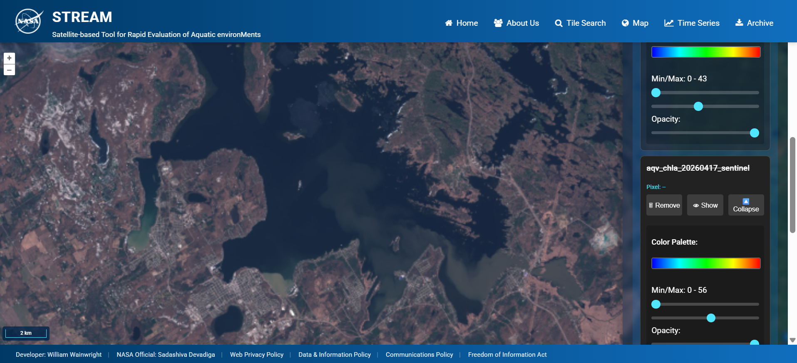




Monitoring Inland and Coastal Water Quality across the Entire U.S. with NASA’s STREAM
William Wainwright, Ryan O’Shea,
Akash Ashapure, Arun Saranathan
Science Systems and Applications Inc. (SSAI)
Freshwater Sensing Program
NASA Goddard Space Flight Center / Code 619
Landsat-8/OLI
Lake Erie; Sister Island, USA

Slide 2
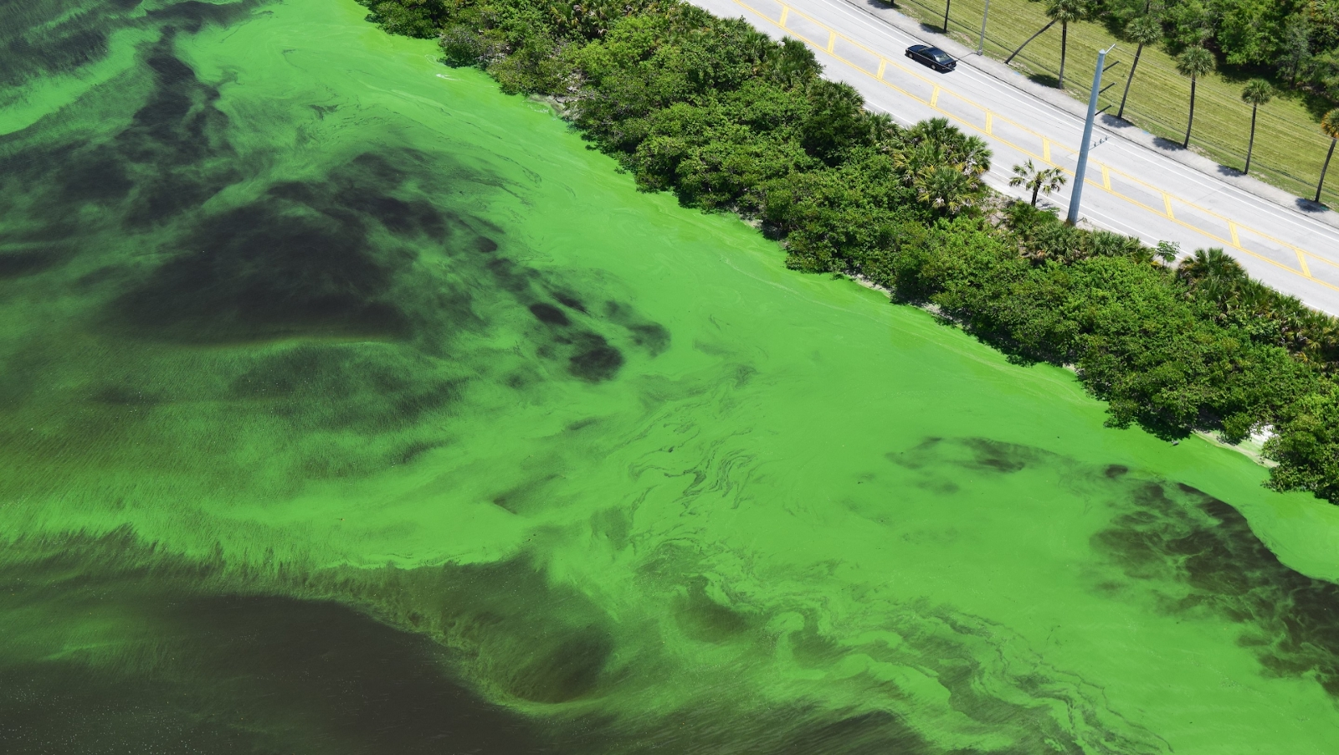
STREAM Motivation
Florida Atlantic University
Water Quality Management
Earth Observation
Timeliness
OLI/MSI/OLCI
HICO/PRISMA PACE/OCI
Ecosystem
Harmful Algal Blooms
(HABs)
Representative Sampling
Public Health
Toxins, hypoxia, & scums
Temporally & Spatially Consistent Observations
Quantify & characterize
Simultaneously estimate biogeochemical parameters & IOPs
Recreation/
Tourism
Issue warnings & implement remediation efforts
Inform in situ sampling & remediation efforts
Water Resources
Stumpf, et. al.. (2016). Challenges for mapping cyanotoxin patterns from remote sensing of cyanobacteria. Harmful Algae, 54, 160-173
Kudela, R. M. et al. Harmful Algal Blooms. A Scientific Summary For Policy Makers (IOC/UNESCO, 2015).

Slide 3
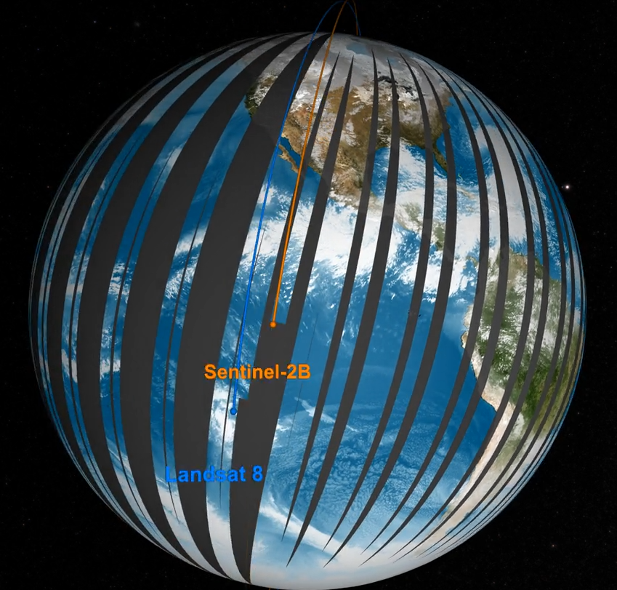




Freshwater and littoral imaging from space: MDN supported sensors
HICO
PACE
MODIS
HICO
Commercial
Satellites
(Planet)
PRISMA
EMIT
Landsat Next
2010
2015
2020
2025
MODIS
(2000)
SeaWiFS
VIIRS:
SNPP/J1/J2
Landsat-8
Sentinel-3A
Landsat-9
Envisat
Sentinel-2A
Sentinel-2B
Sentinel-3D
Sentinel-3B
Sentinel-2D
Sentinel-3C
Sentinel-2C
Coming Soon
MDN
STREAM
Coming Soon to STREAM
Radiometrically capable sensors
Daily observations
Different spatial/spectral capabilities
NASA Scientific Visualization Studio
Robust workflow for producing seamless products over fresh and coastal estuaries

Slide 4
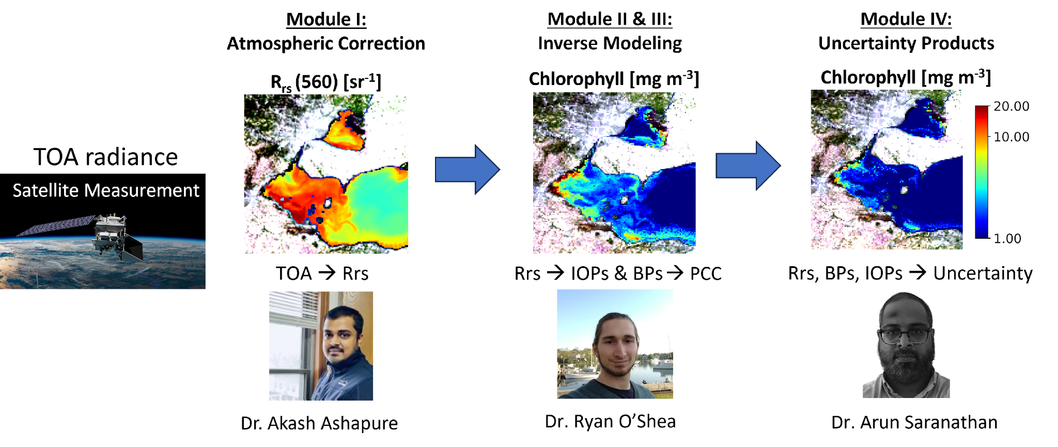
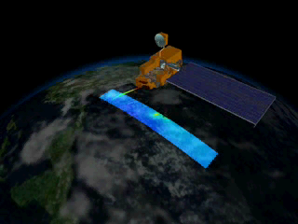
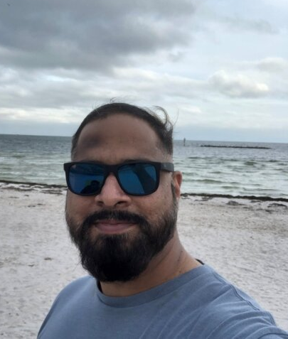

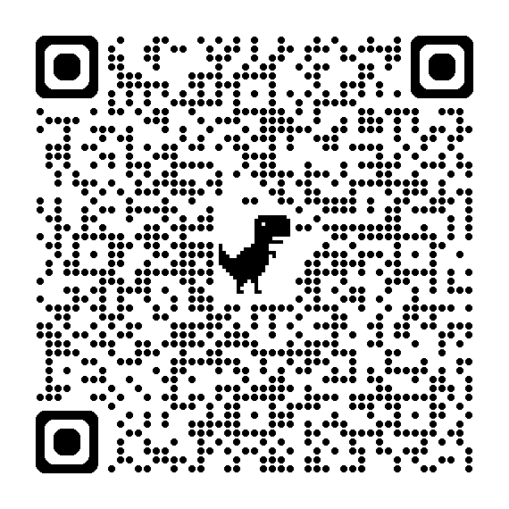
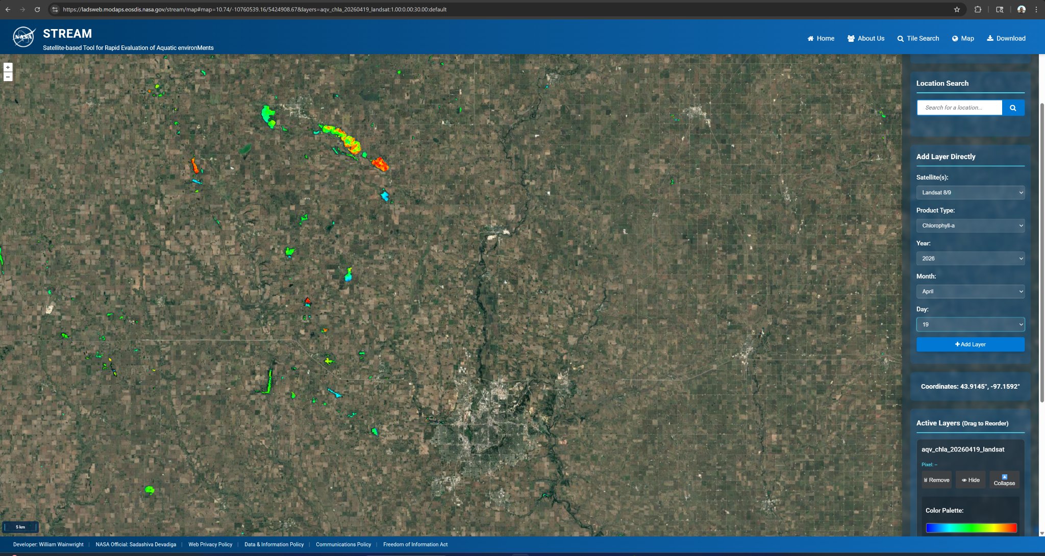

Aquaverse: An Aquatic Inversion Scheme for Remote Sensing of Fresh and Coastal Waters
Satellite Measurements
NASA ARSET Training
STREAM
STREAM: Stakeholder Access
Mr. Will Wainwright
Sensors at various levels of support include PACE/OCI, EMIT, Sentinel-2/MSI, Sentinel-3/OLCI, Landsat-8/9/OLI, MODIS, VIIRS, and Planet/SuperDove.

Slide 5
Aquaverse: An Aquatic Inversion Scheme for Remote Sensing of Fresh and Coastal Waters

Slide 6
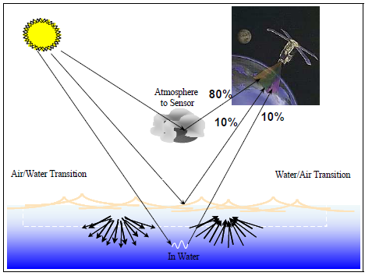
Atmospheric Correction
It is the most challenging processing component.
A large fraction of useable signal originates from scattering and absorption within the atmosphere.
The goal is to approximate remote-sensing reflectance (Rrs).

Slide 7
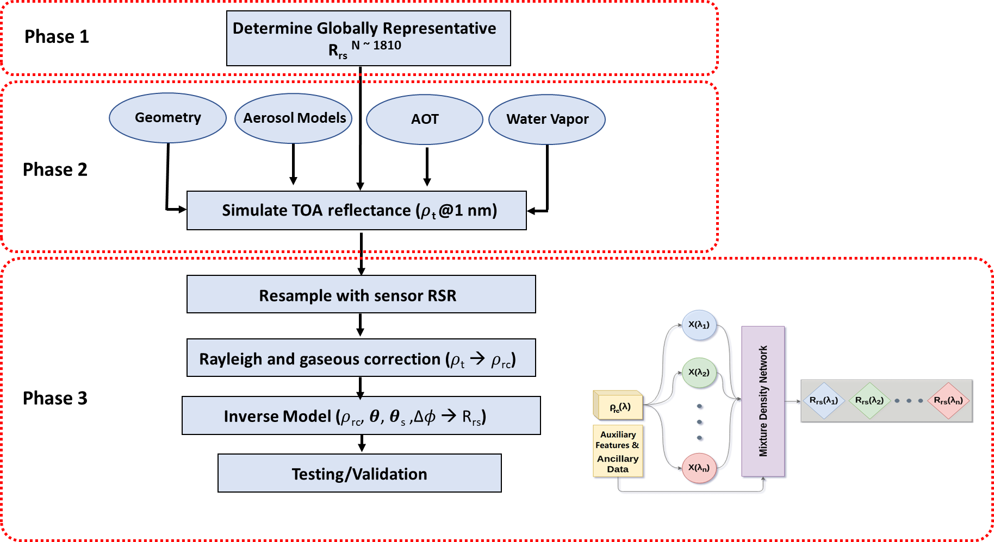
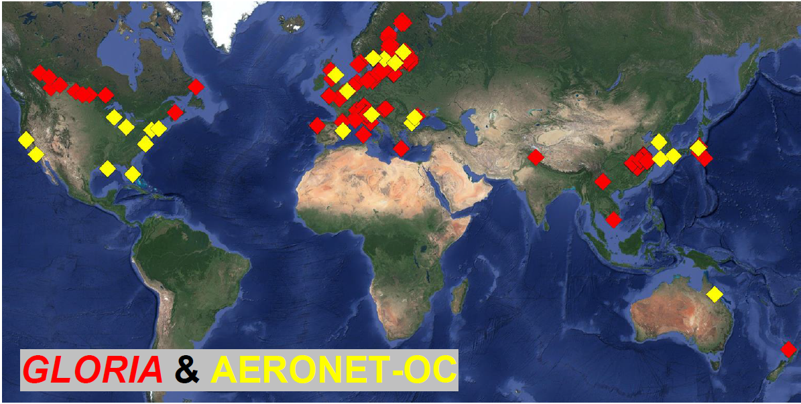
Aquaverse: Atmospheric Correction Model Development

Slide 8
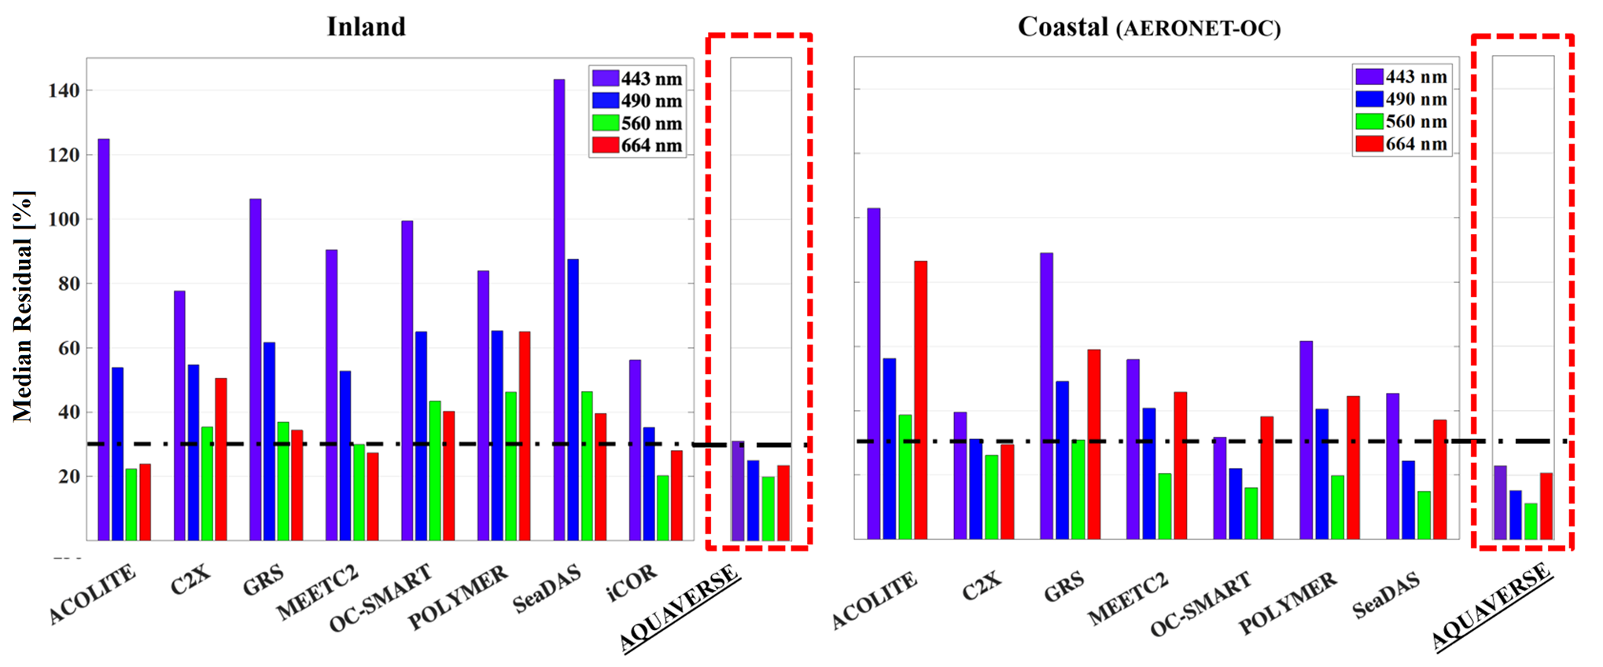
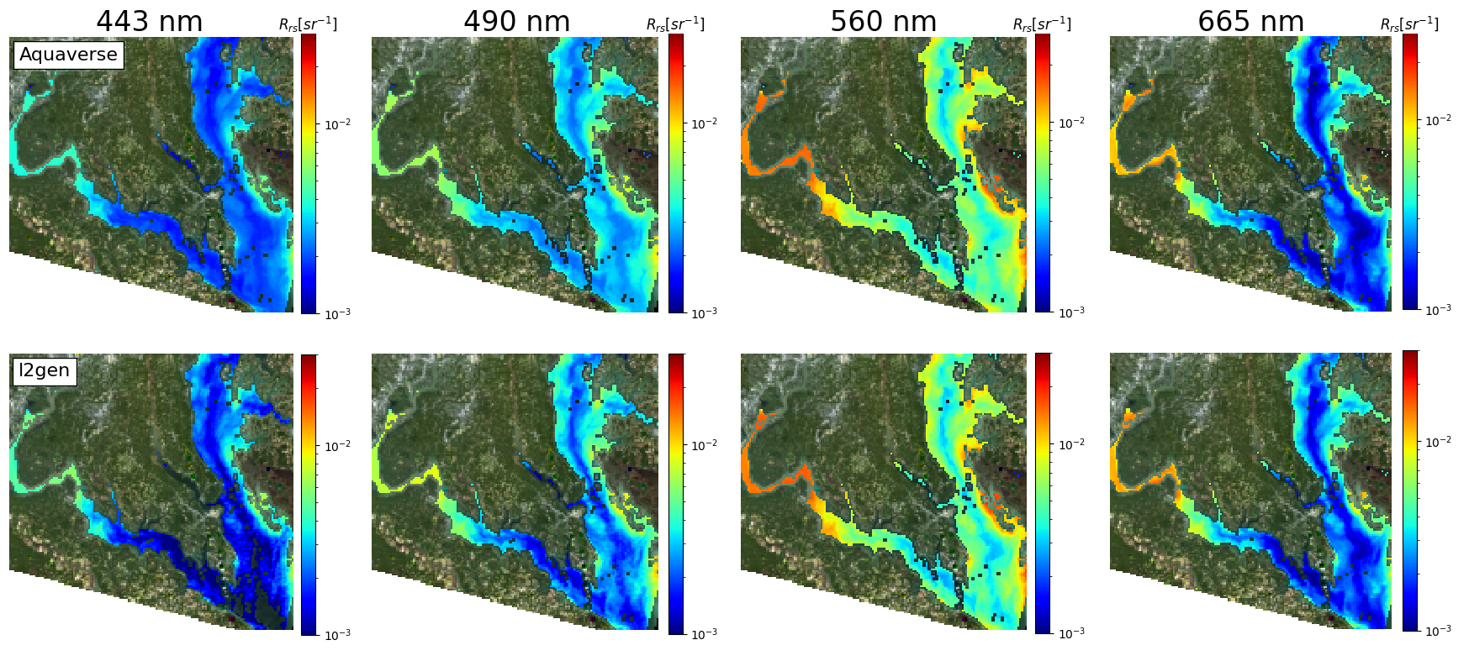
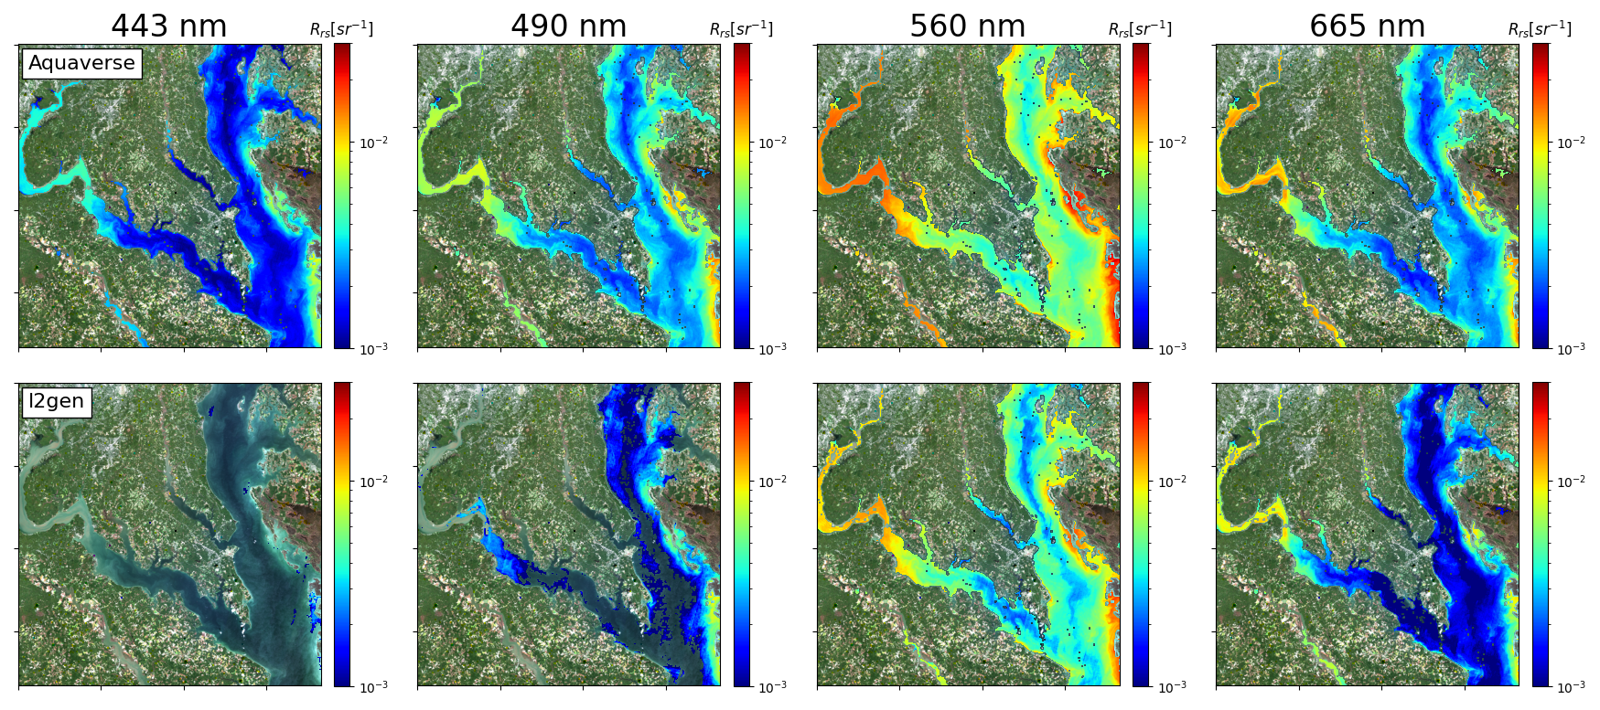
Performance Assessment
Aquaverse: Atmospheric Correction Performance Assessment
OLI
MSI
Near simultaneous Rrs retrieval from OLI and MSI over Chesapeake Bay (10/17/2020)
Undergoing revisions for Frontiers in Remote Sensing

Slide 9
Aquaverse: An Aquatic Inversion Scheme for Remote Sensing of Fresh and Coastal Waters

Slide 10
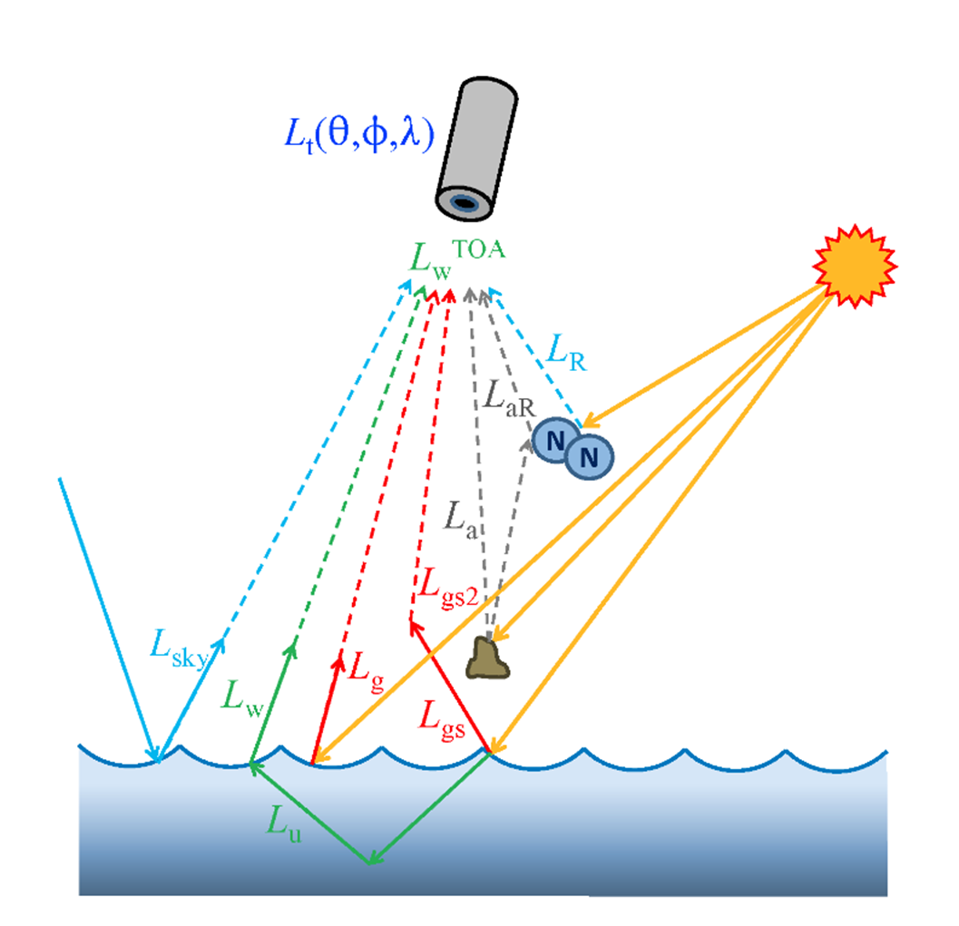
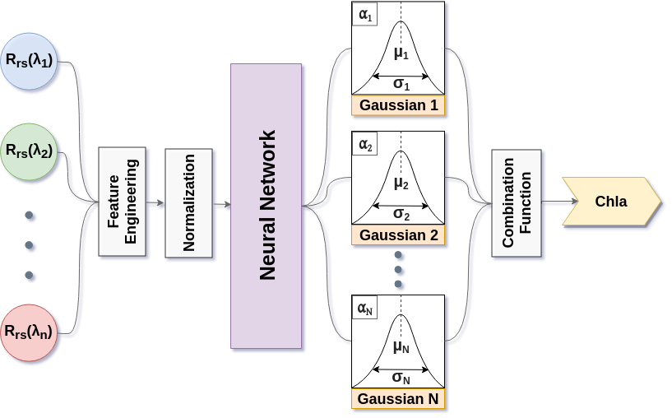
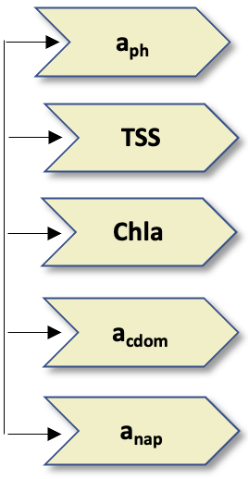
How STREAM Works
Mixture Density Network (MDN)
  Rayleigh scattering & gaseous absorption
  Compensate for aerosol with first MDN
  Retrieve Chla, TSS, and Zsd with second MDN
Chla

Slide 11
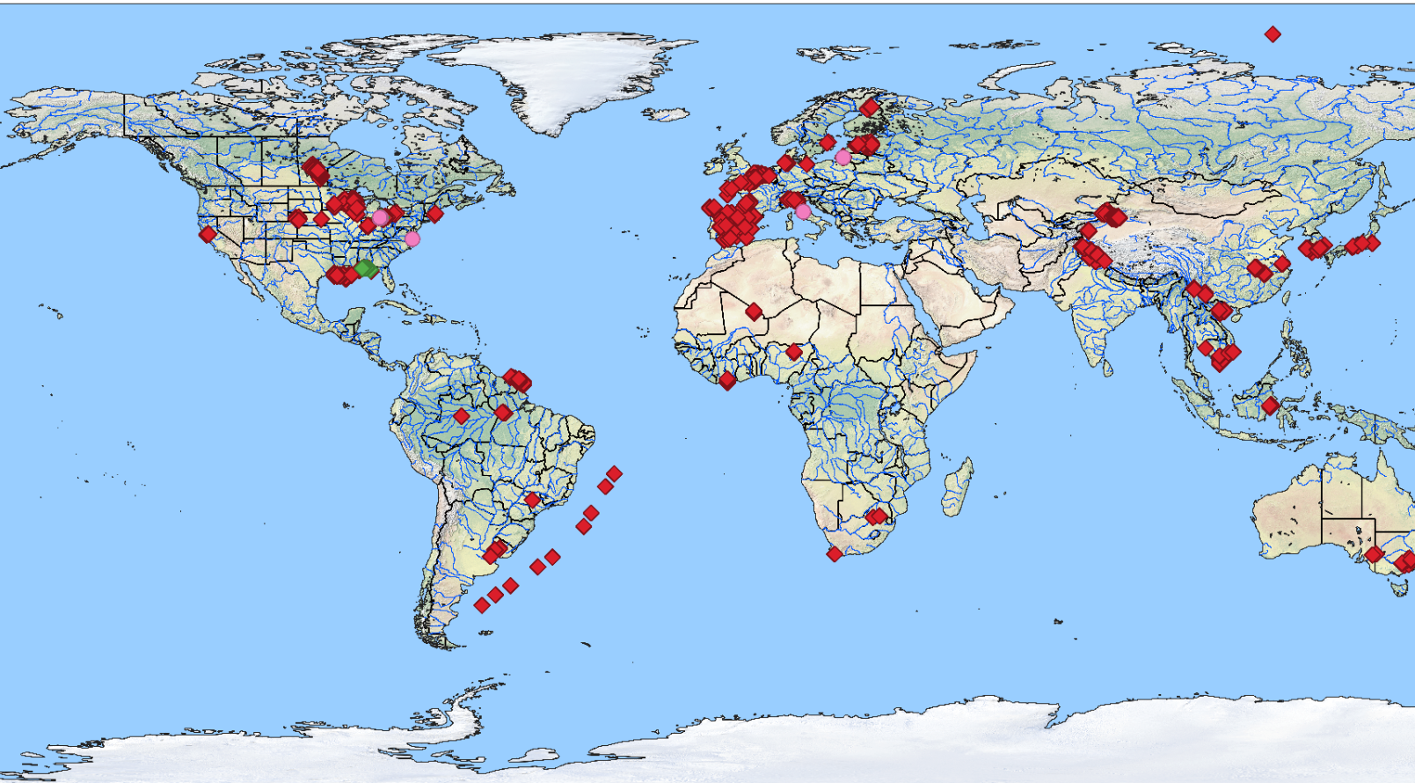
Aquaverse training data: Large (N>~10,000) Globally Distributed In situ Dataset¹:
IOPs & biogeochemical parameters from coastal and inland waters
In situ measurement & hyperspectral R_{rs}
In situ measurement & R_{rs} + satellite R_{rs}
In situ sampling + satellite R_{rs}
¹Lehmann, M.K., et al. GLORIA - A globally representative hyperspectral in situ dataset for optical sensing of water quality. Scientific Data. https://doi.org/10.1038/s41597-023-01973-y.
O’Shea et al. 2023 (Remote Sensing of Environment)

Slide 12
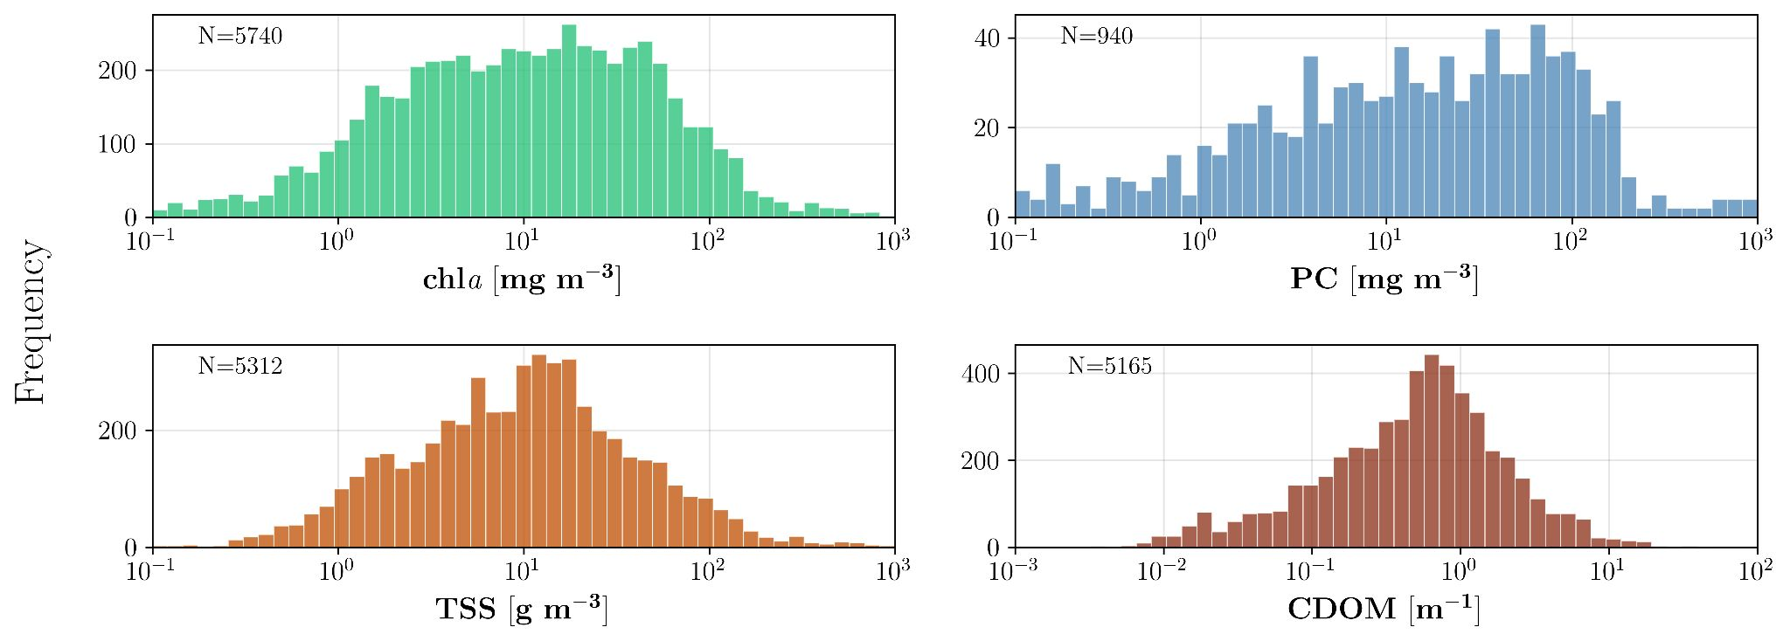

Validation – GLORIA & AERONET-OC
Over 7500 hyperspectral RRS
  1nm intervals from 350-900nm
Coastal and inland water bodies
Co-located in-situ water quality indicators
Over 25 years of temporal coverage
GLORIA:
Lehmann, M.K., Gurlin, D., Pahlevan, N. et al. GLORIA - A globally representative hyperspectral in situ dataset for optical sensing of water quality. Sci Data 10, 100 (2023). https://doi.org/10.1038/s41597-023-01973-y.
ARSET Training: Monitoring Water Quality of Inland Lakes using Remote Sensing
AERONET-OC:
Aerosol Robotic Network-Ocean Color
O’Shea et al. 2023 (Remote Sensing of Environment)

Slide 13

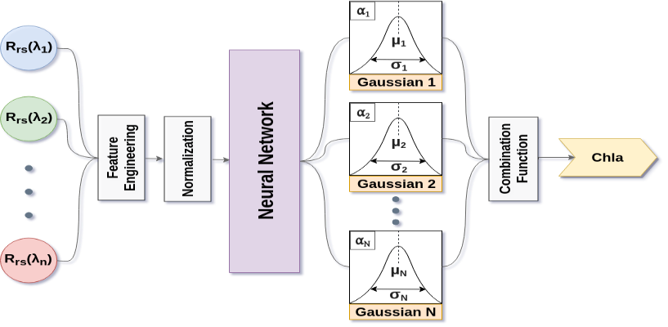
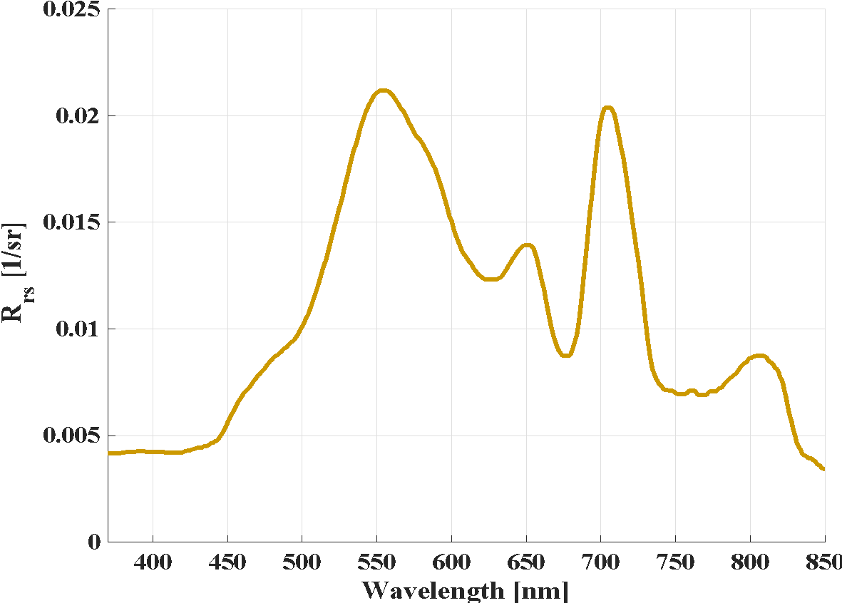
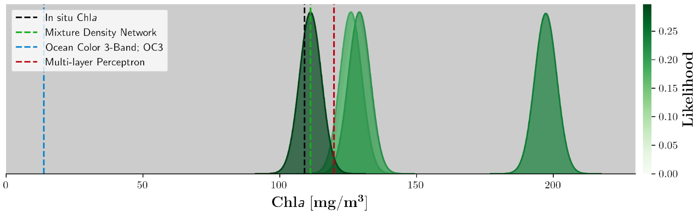
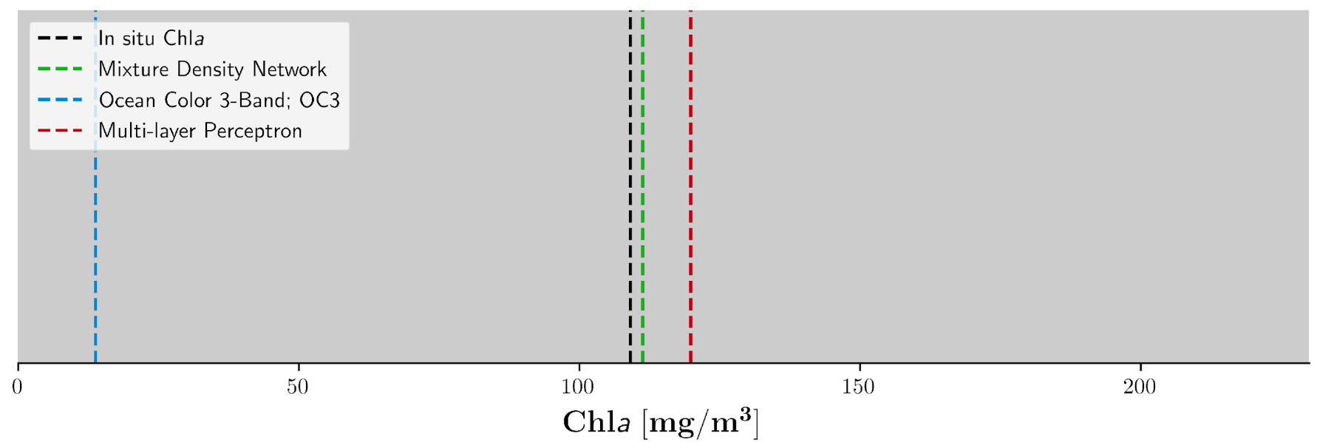


Aquaverse core algorithm: Mixture Density Networks (MDNs)
Standard Machine Learning Model
Set of Gaussians
Water color spectrum
Chla

Slide 14
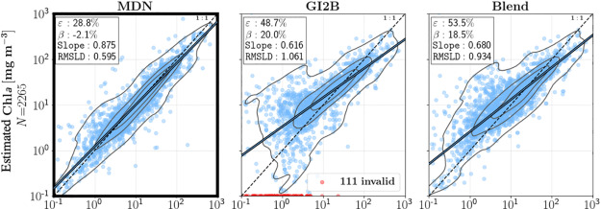
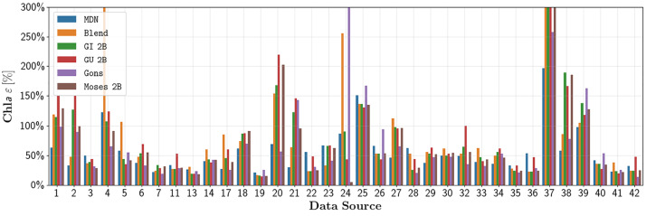
Aquaverse: Mixture Density Networks (MDNs) in situ performance
30% accuracy on 50/50 training/testing split
~50% accuracy on Leave-one (region)-out (LOO) validation
With in situ dataset & satellite RSR we can rapidly train models (even prior to launch)
Pahlevan et al. RSE (2022)

Slide 15
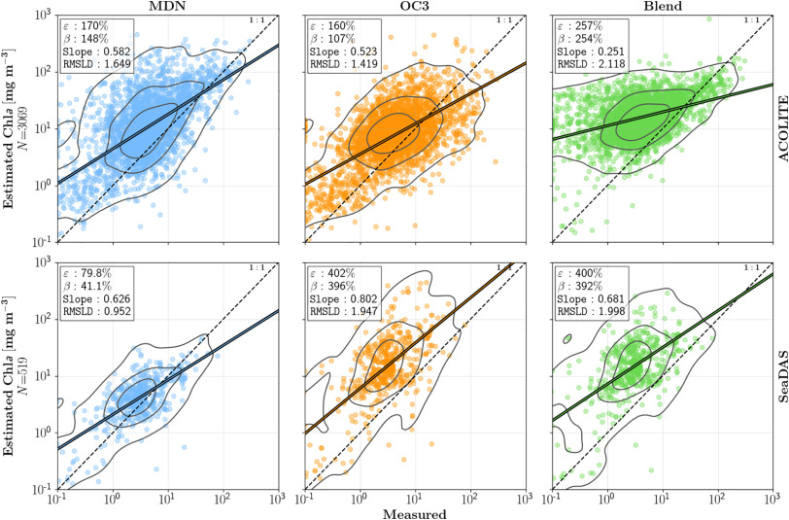
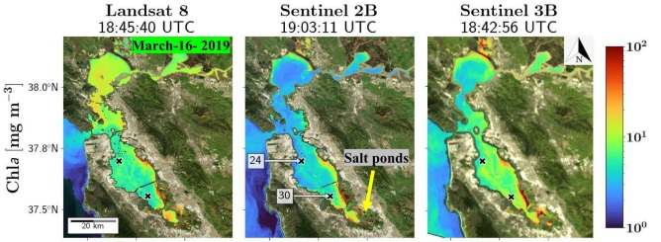
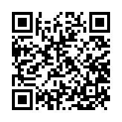
Aquaverse: Mixture Density Networks (MDNs) Satellite Performance
Atmospheric correction uncertainties limit WQP retrieval accuracy
Python tutorials for models
AC uncertainties greatly impact retrieval accuracy
Pahlevan et al. RSE, 2022

Slide 16

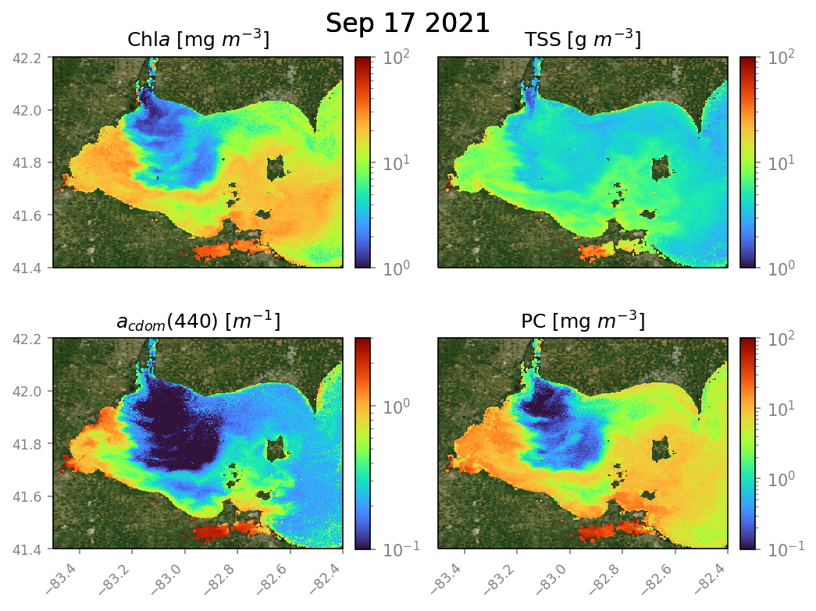
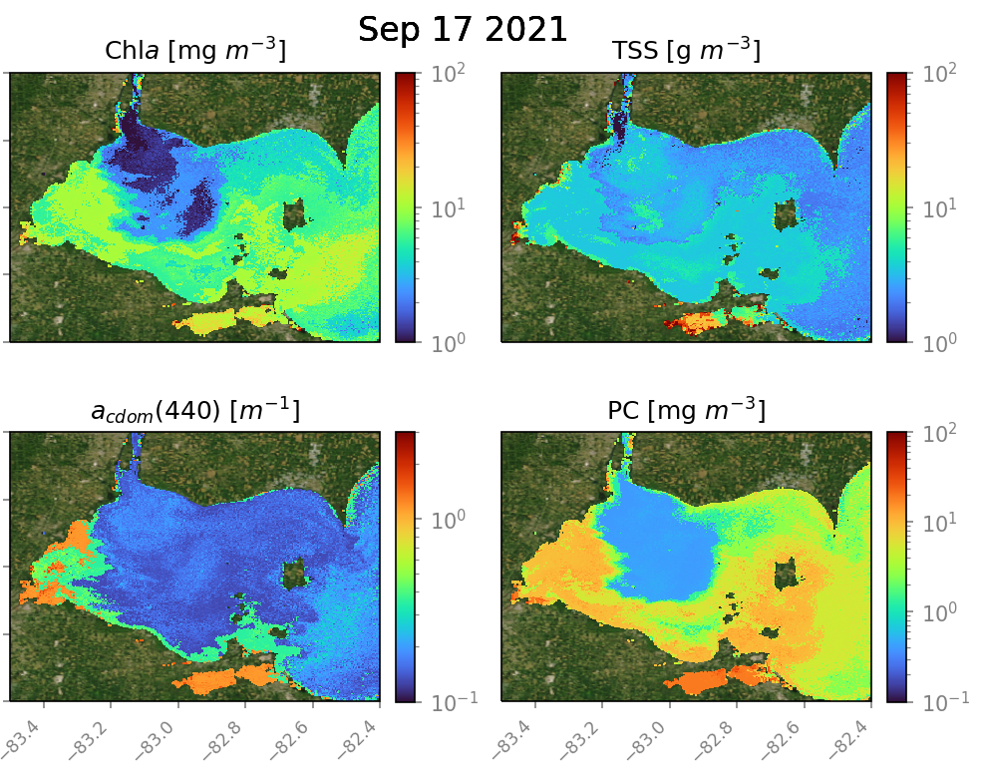
OLCI
Examples from OLCI: products & uncertainties
Estimates
Uncertainties
SeaDAS-processed imagery

Slide 17
Aquaverse: An Aquatic Inversion Scheme for Remote Sensing of Fresh and Coastal Waters
Satellite Measurements
NASA ARSET Training
STREAM
STREAM: Stakeholder Access
Mr. Will Wainwright
Sensors at various levels of support include PACE/OCI, EMIT, Sentinel-2/MSI, Sentinel-3/OLCI, Landsat-8/9/OLI, MODIS, VIIRS, and Planet/SuperDove.

Slide 18
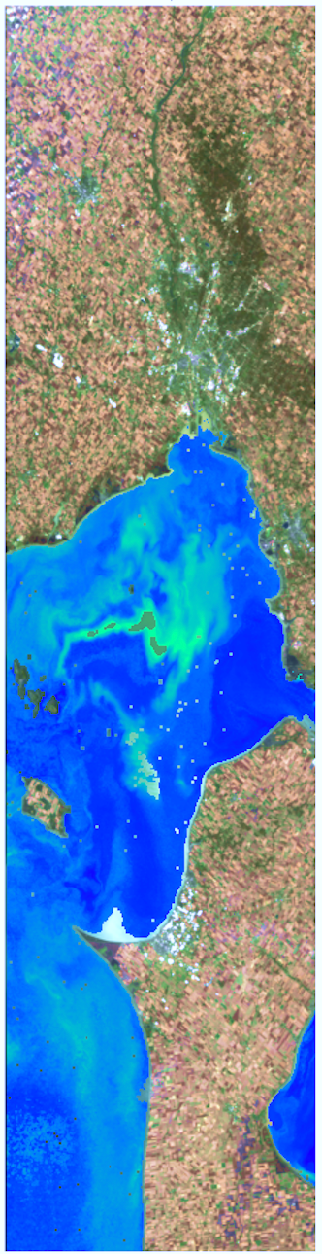
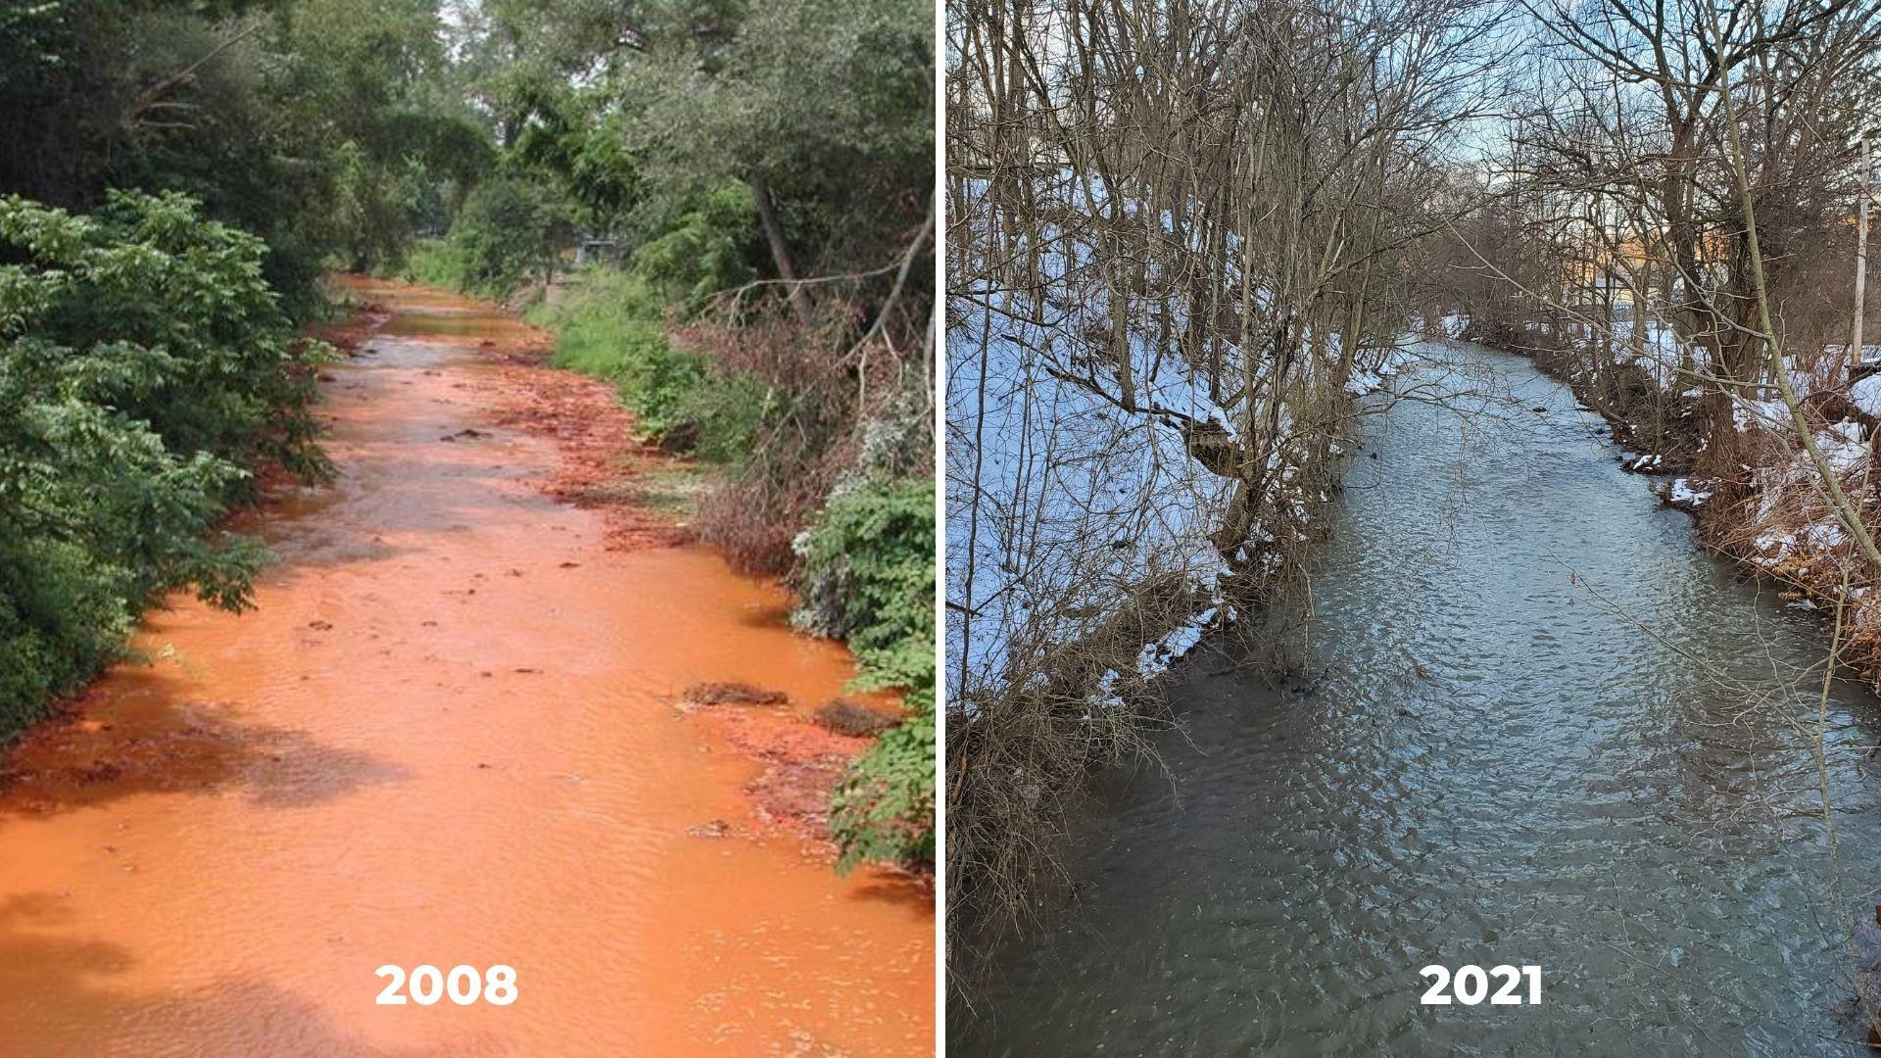
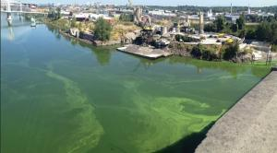
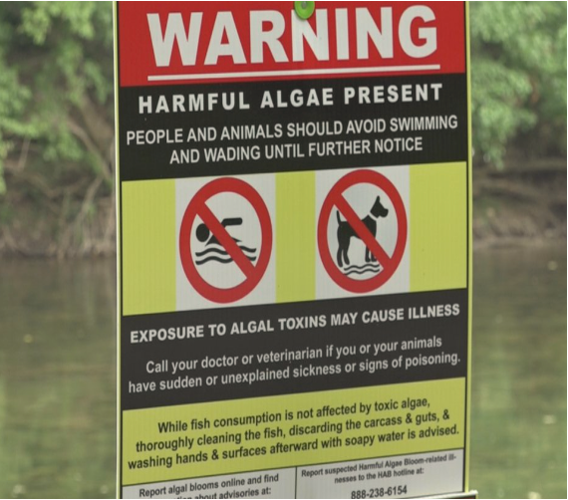
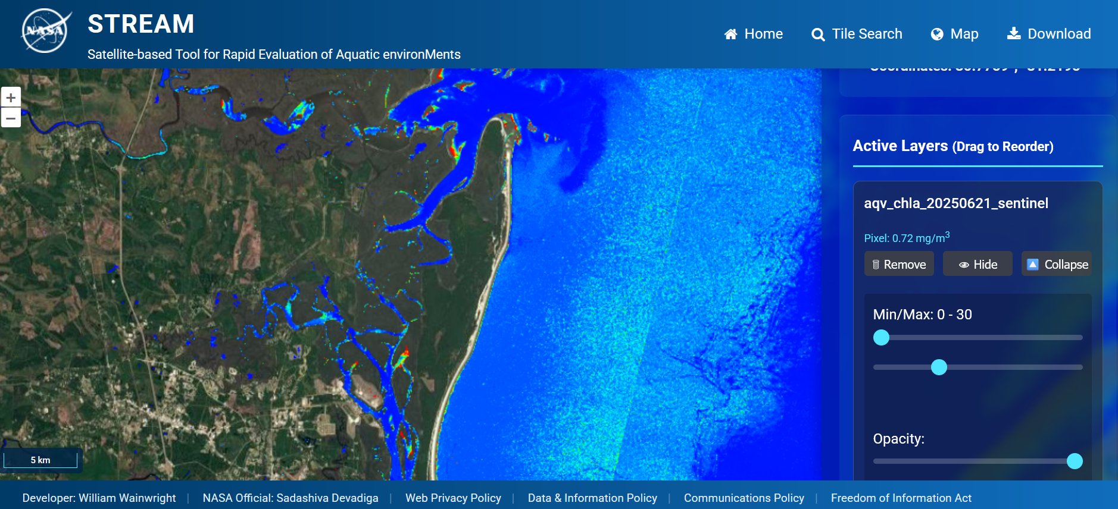
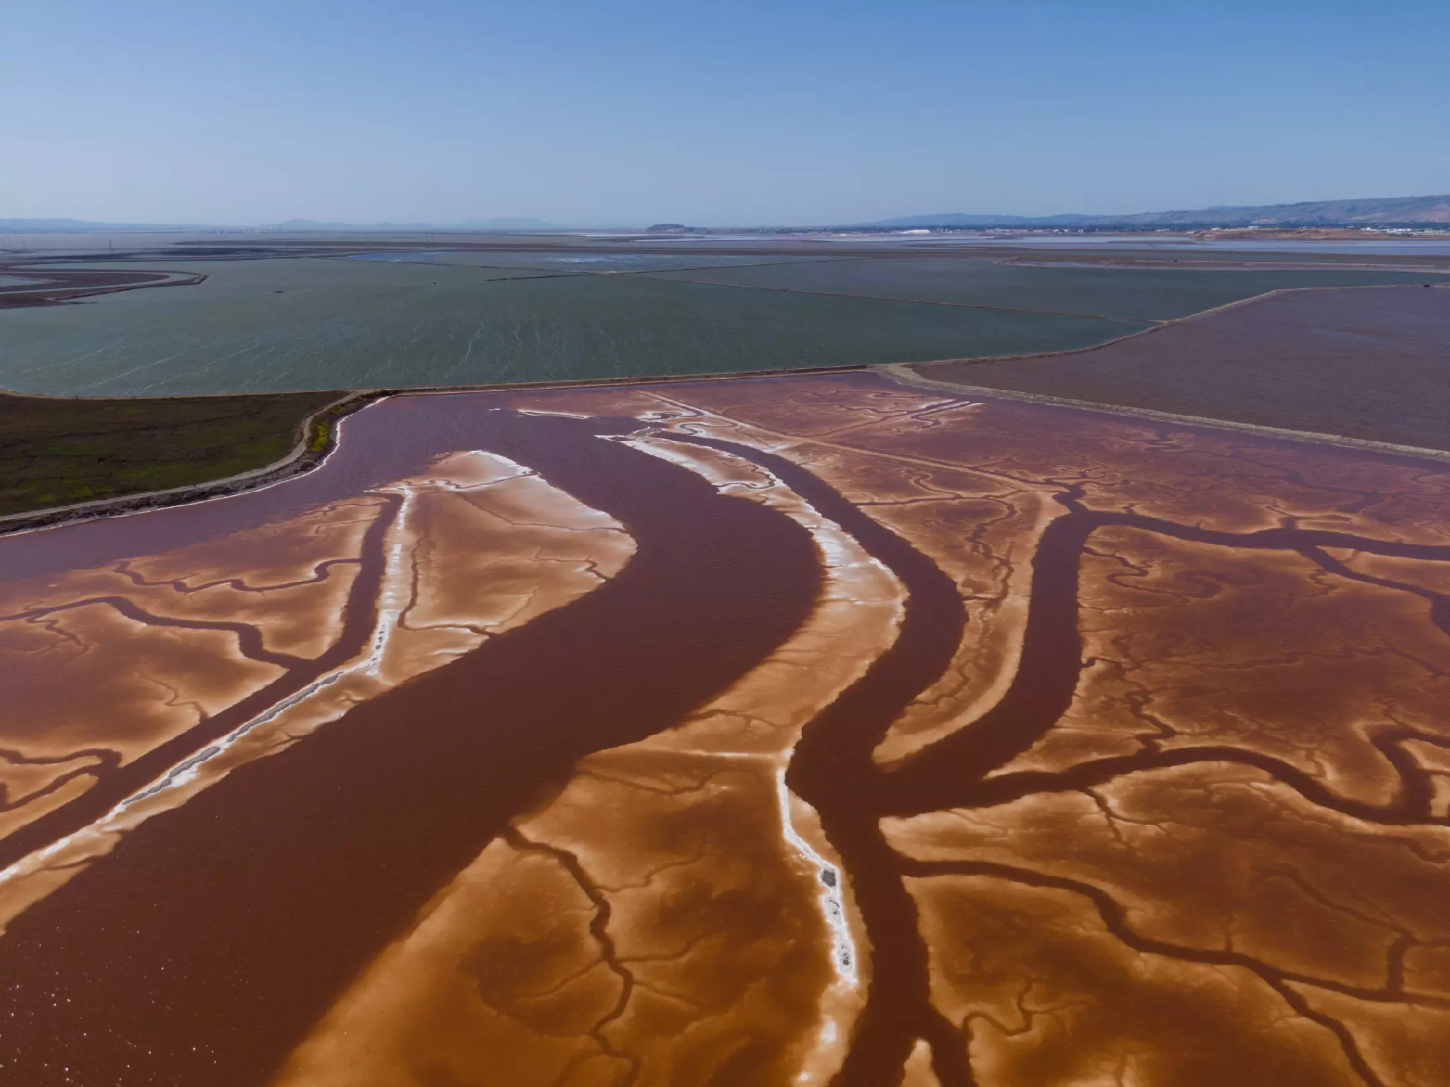
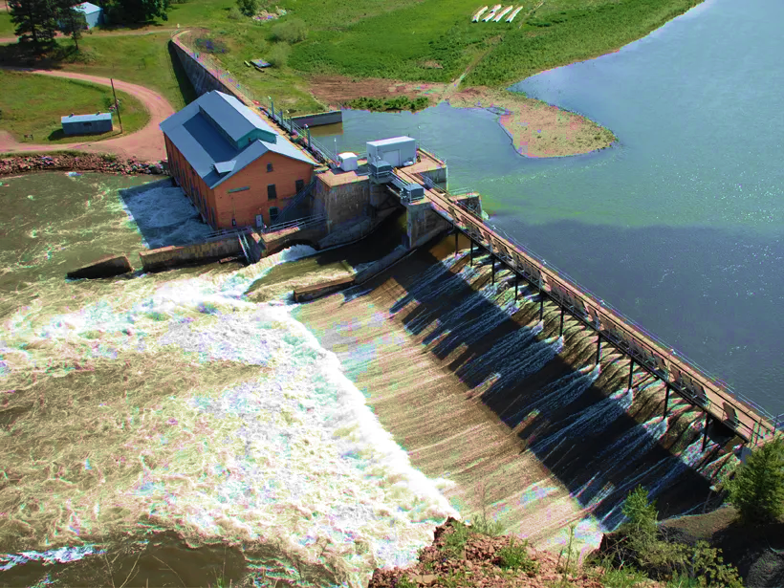
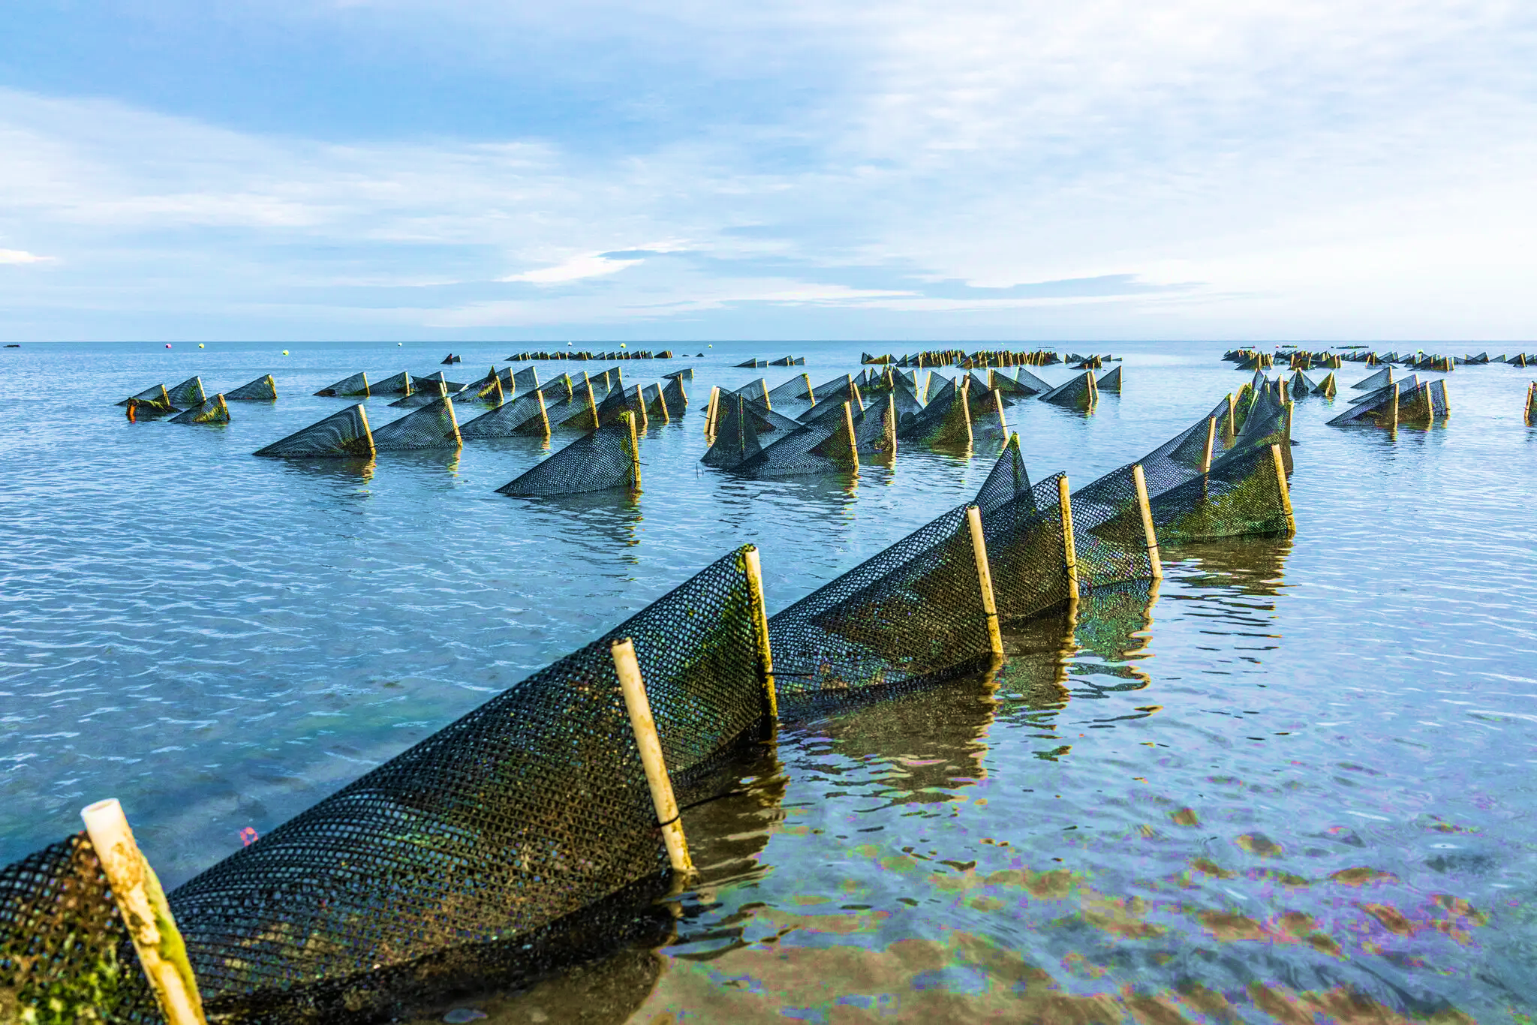
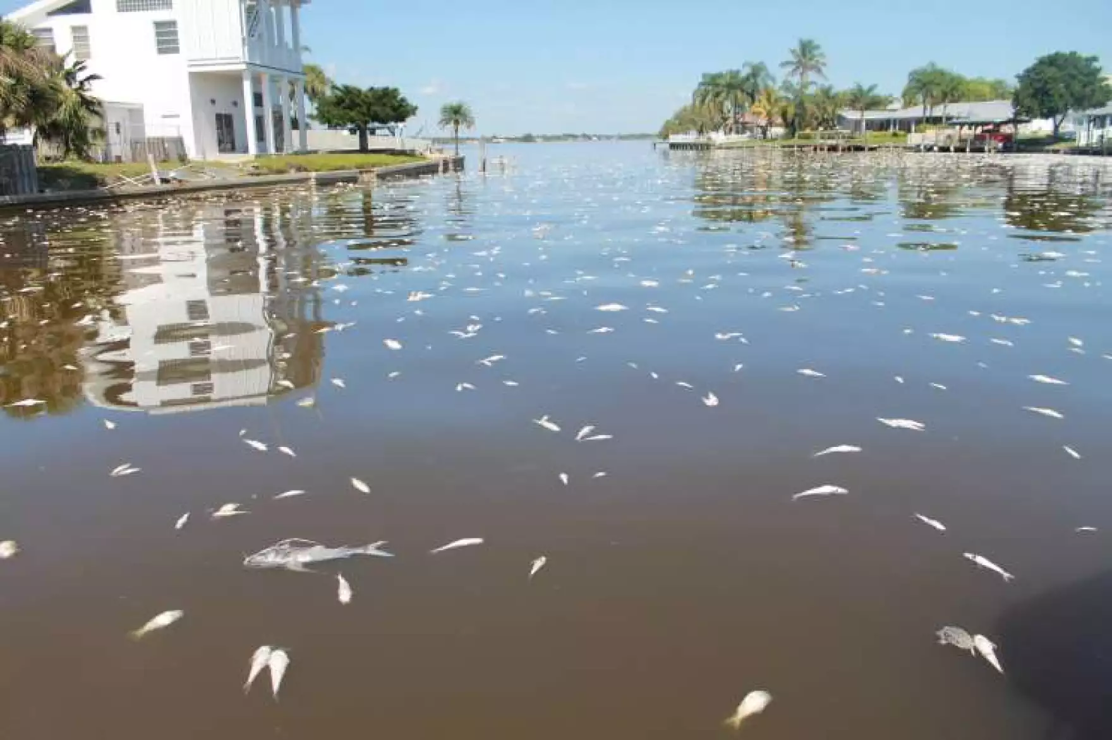
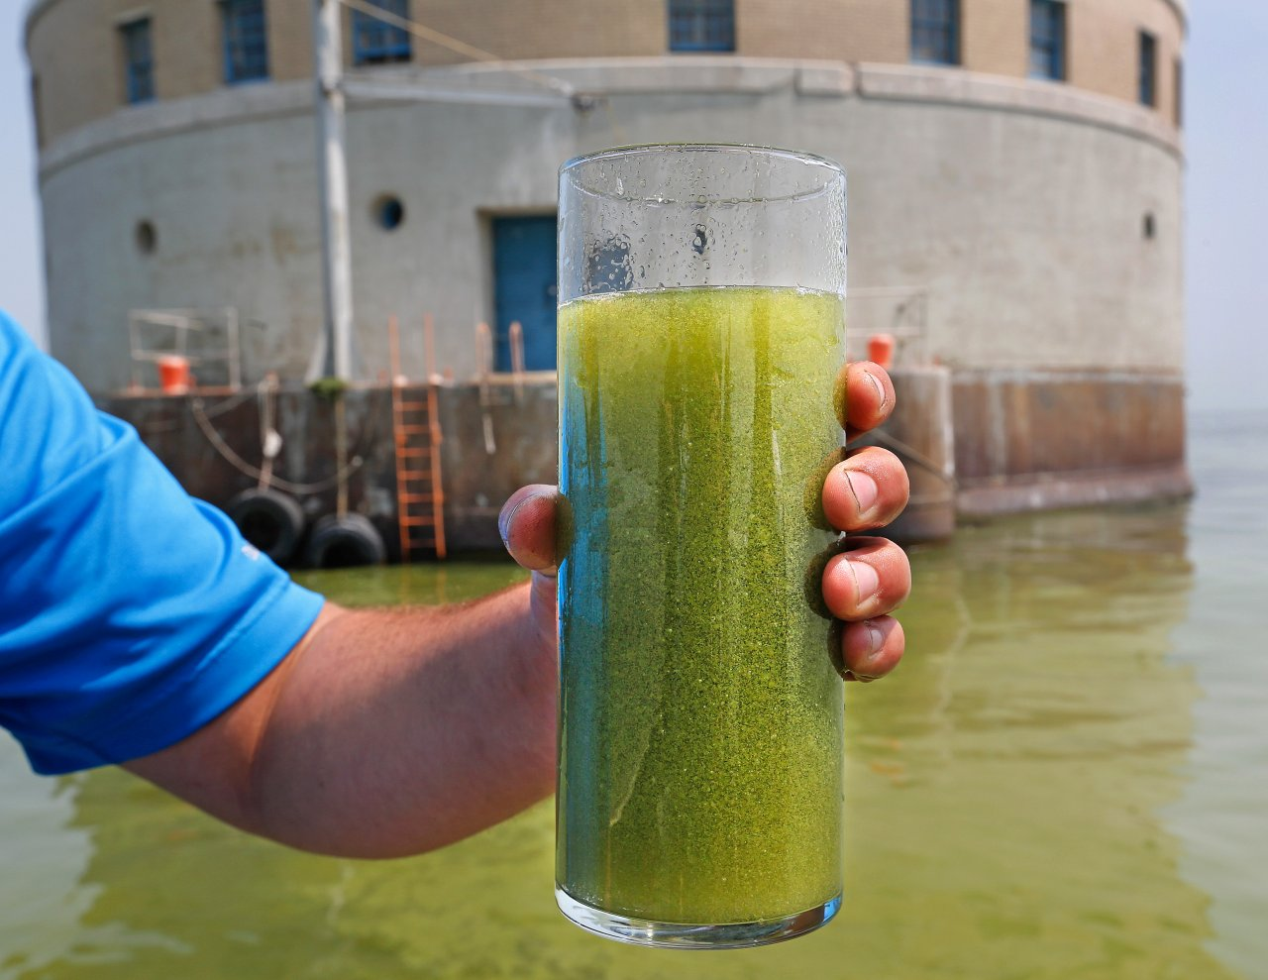
Accidental
Discharge
HABs
Ecosystem
HABs
Health
Restoration
Dam Operations
Aquaculture
HABs
Hypoxia
HABs
Drinking Water
Photo credit: PA Dept. of Environmental Protection; LA Times. San Francisco salt pond A12; Fish kill in March in Cocoa Beach. NY Times; NY Times. Flip bags containing oysters in Cape Cod Bay; Ohio EPA; American Whitewater/Hydropower; Virginia Department of Health; USDA Natural Resources Conservation Services.

Slide 19
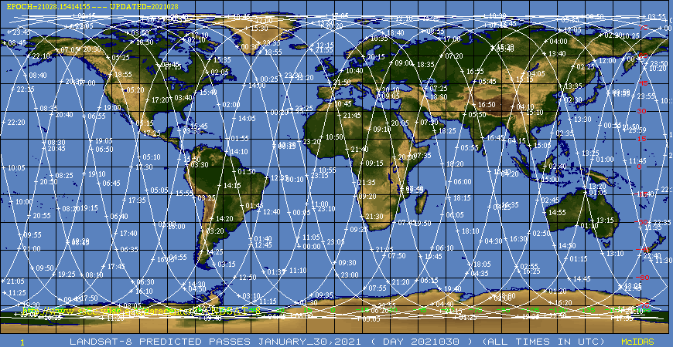
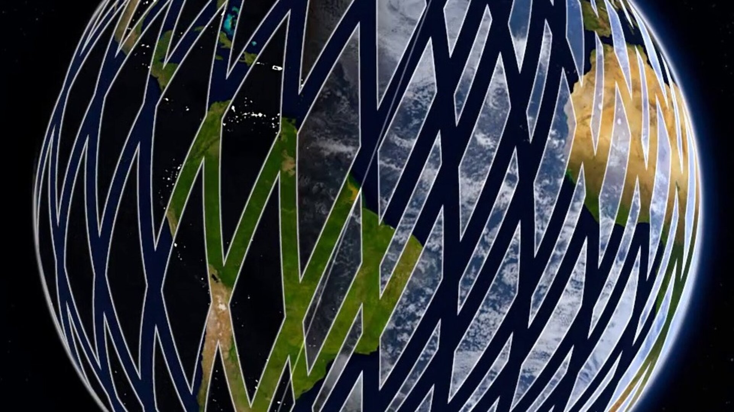
Satellites and Sensors Utilized by STREAM
Landsat 8 & Landsat 9
Sentinel-2 A, B, & C
Satellites | Sensors | Resolution
Landsat 8 & 9 | Operational Land Imager (OLI & OLI2) | 185 km Swath; 30 m 8-Day Revisit
Sentinel-2A, -2B, and -2C | Multi Spectral Imager (MSI) | 290 km Swath; 10 m, 20 m, 60 m; 5-Day Revisit

Slide 20
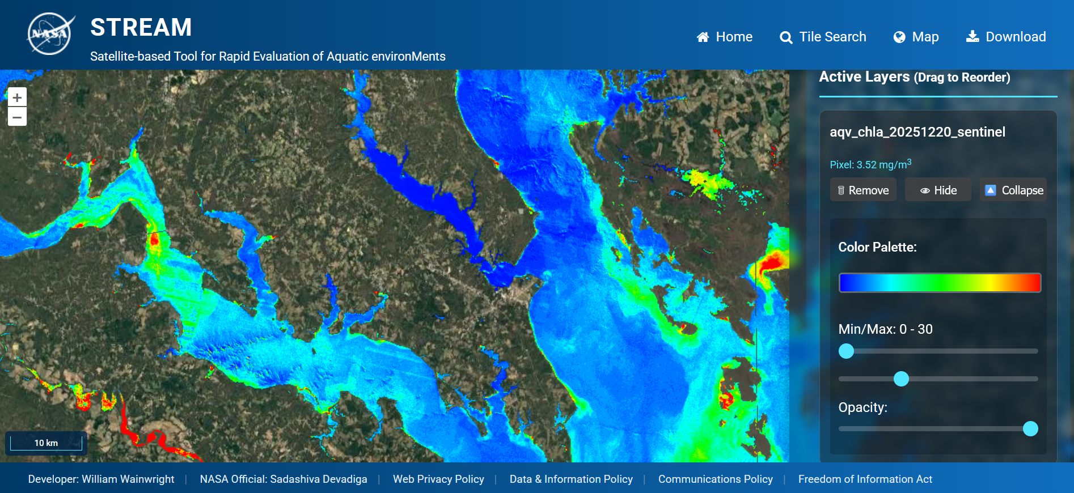
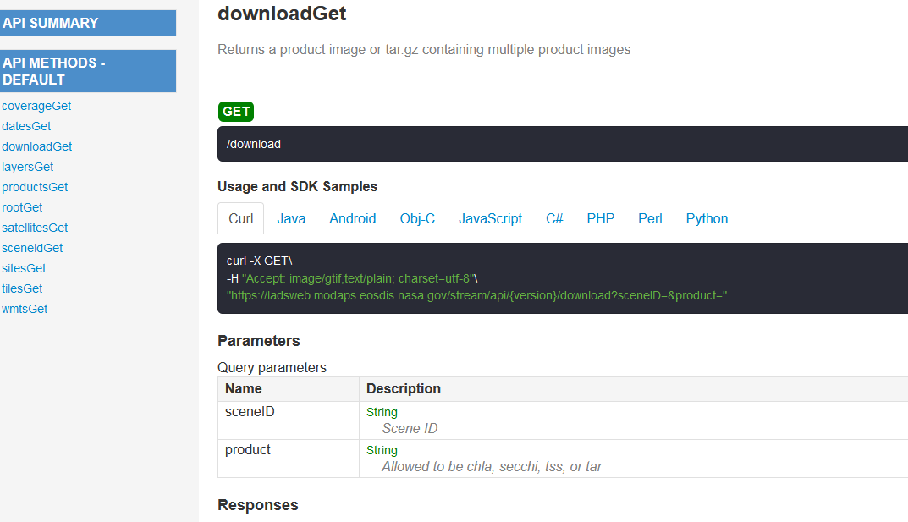
Website & API
Interactive map
  OpenLayers
  WMTS tile service
Archive of daily processing
  June 2024 – Present
  CONUS, Hawaii, Alaska
  Select regions outside US
RESTful API
  Documentation included
  Query and download
Time series tool
  Generate plots on demand

Slide 21

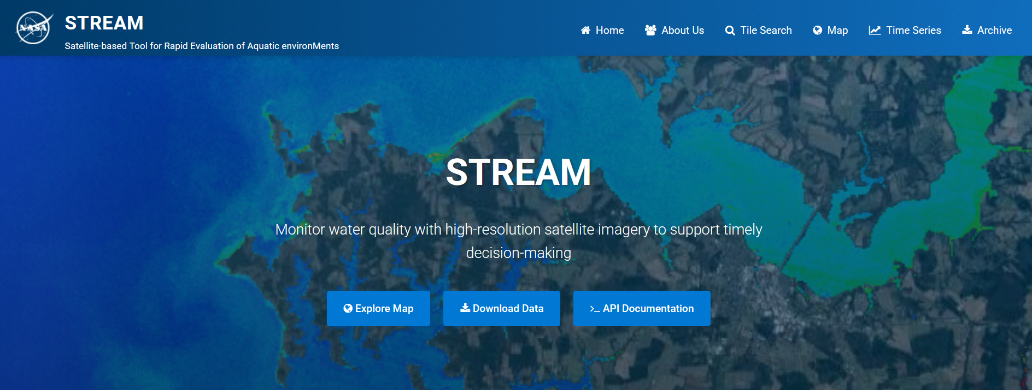
STREAM Usage Example
https://ladsweb.modaps.eosdis.nasa.gov/stream/

Slide 22
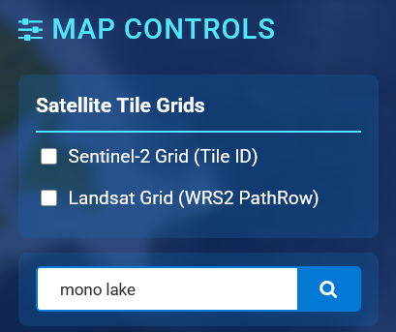
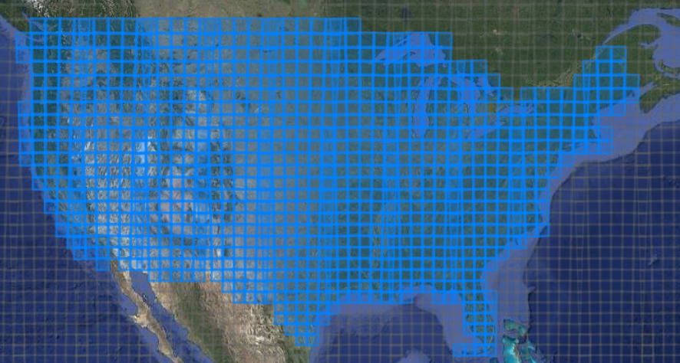
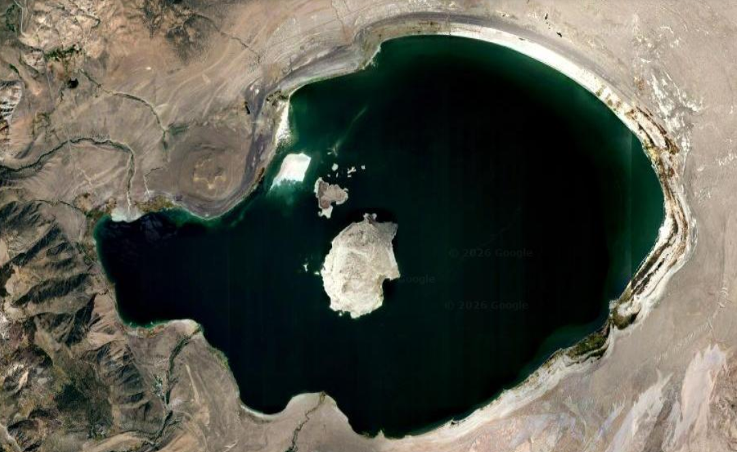
Navigation
x
Which satellite tiles are covered by STREAM

Slide 23
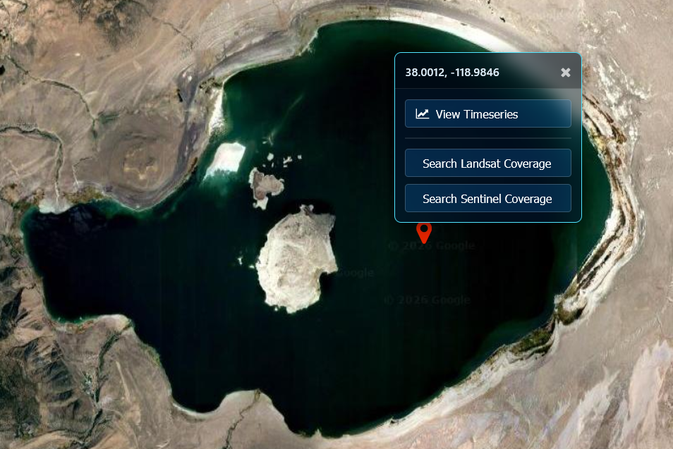
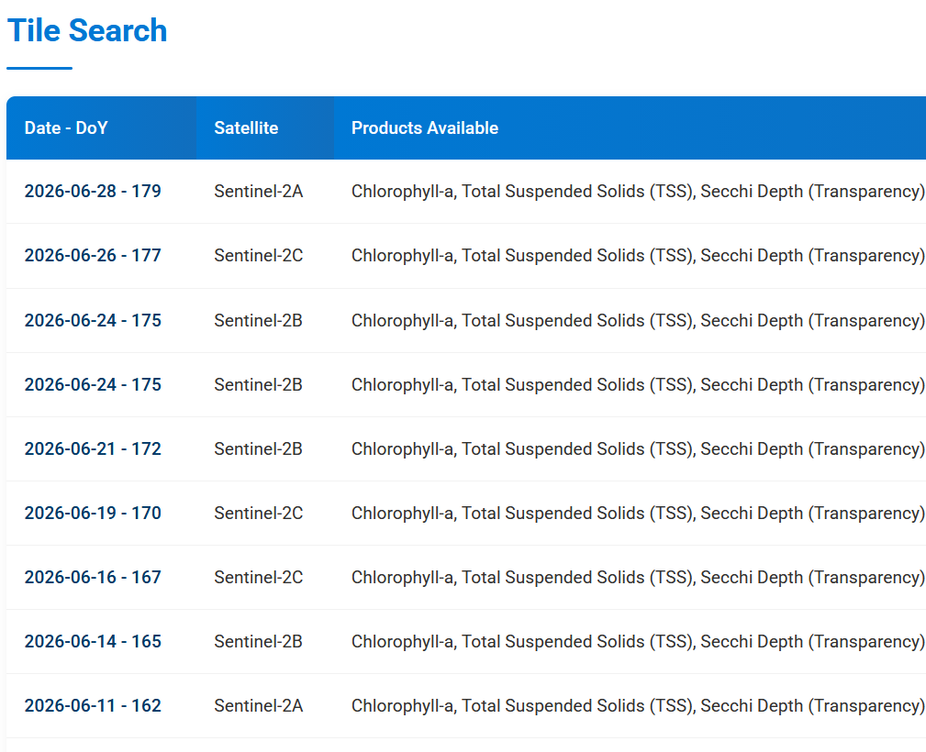
Search For Data
Click anywhere to drop a pin
And see results for that satellite

Slide 24


Download Full Resolution Tiles
Click to download individual product .TIFs or a zip

Slide 25
Visualize on Map
Or link back to the map with mosaic pre-loaded!

Slide 26


Adjusting the Layer
Expand the options for this layer to change color palette, min/max scaling, and opacity
Hover any pixel for a live readout

Slide 27


Adding More Layers
Expand “Add Layer Directly” to add another layer, for example including RGB in addition to chla
Drag to reorder layers (topmost shows on top) and click hide/show to quickly toggle them

Slide 28


Viewing Timeseries
Click anywhere to drop a pin like before
Or visit the Time Series page and enter your coordinates

Slide 29


Generating Timeseries
Enter start and end date and select products
Hit Generate, and watch the plot populate in seconds!

Slide 30

Viewing Timeseries
Hover a point to see the RGB preview, and hit the “Download CSV” button to use the data externally

Slide 31


API Use
Documentation and example script for RESTful API

Slide 32
Future Products and Features
Sea Surface Temperature
  Derived from Landsat 8/9 TIRS
Improved Temporal Resolution
  PACE and Sentinel-3
  Domain Adaptation to harmonize products between sensors
Interactive Map Overhaul
  Simpler navigation between days
  Automatically load RGB for selected date
  Toggle products quickly without leaving the map

Slide 33


ACKNOWLEDGEMENT
United States Geological Survey
Landsat Science Team
NASA Earth Science Programs
Ocean Biology and Biogeochemistry
Remote Sensing of Water Quality
PACE Science and Applications Team
EMIT Science and Applications Team
Commercial Small Satellite Data Acquisition
Applied Sciences, Sustainable Development Goals
Try STREAM Yourself!

