Slide 1

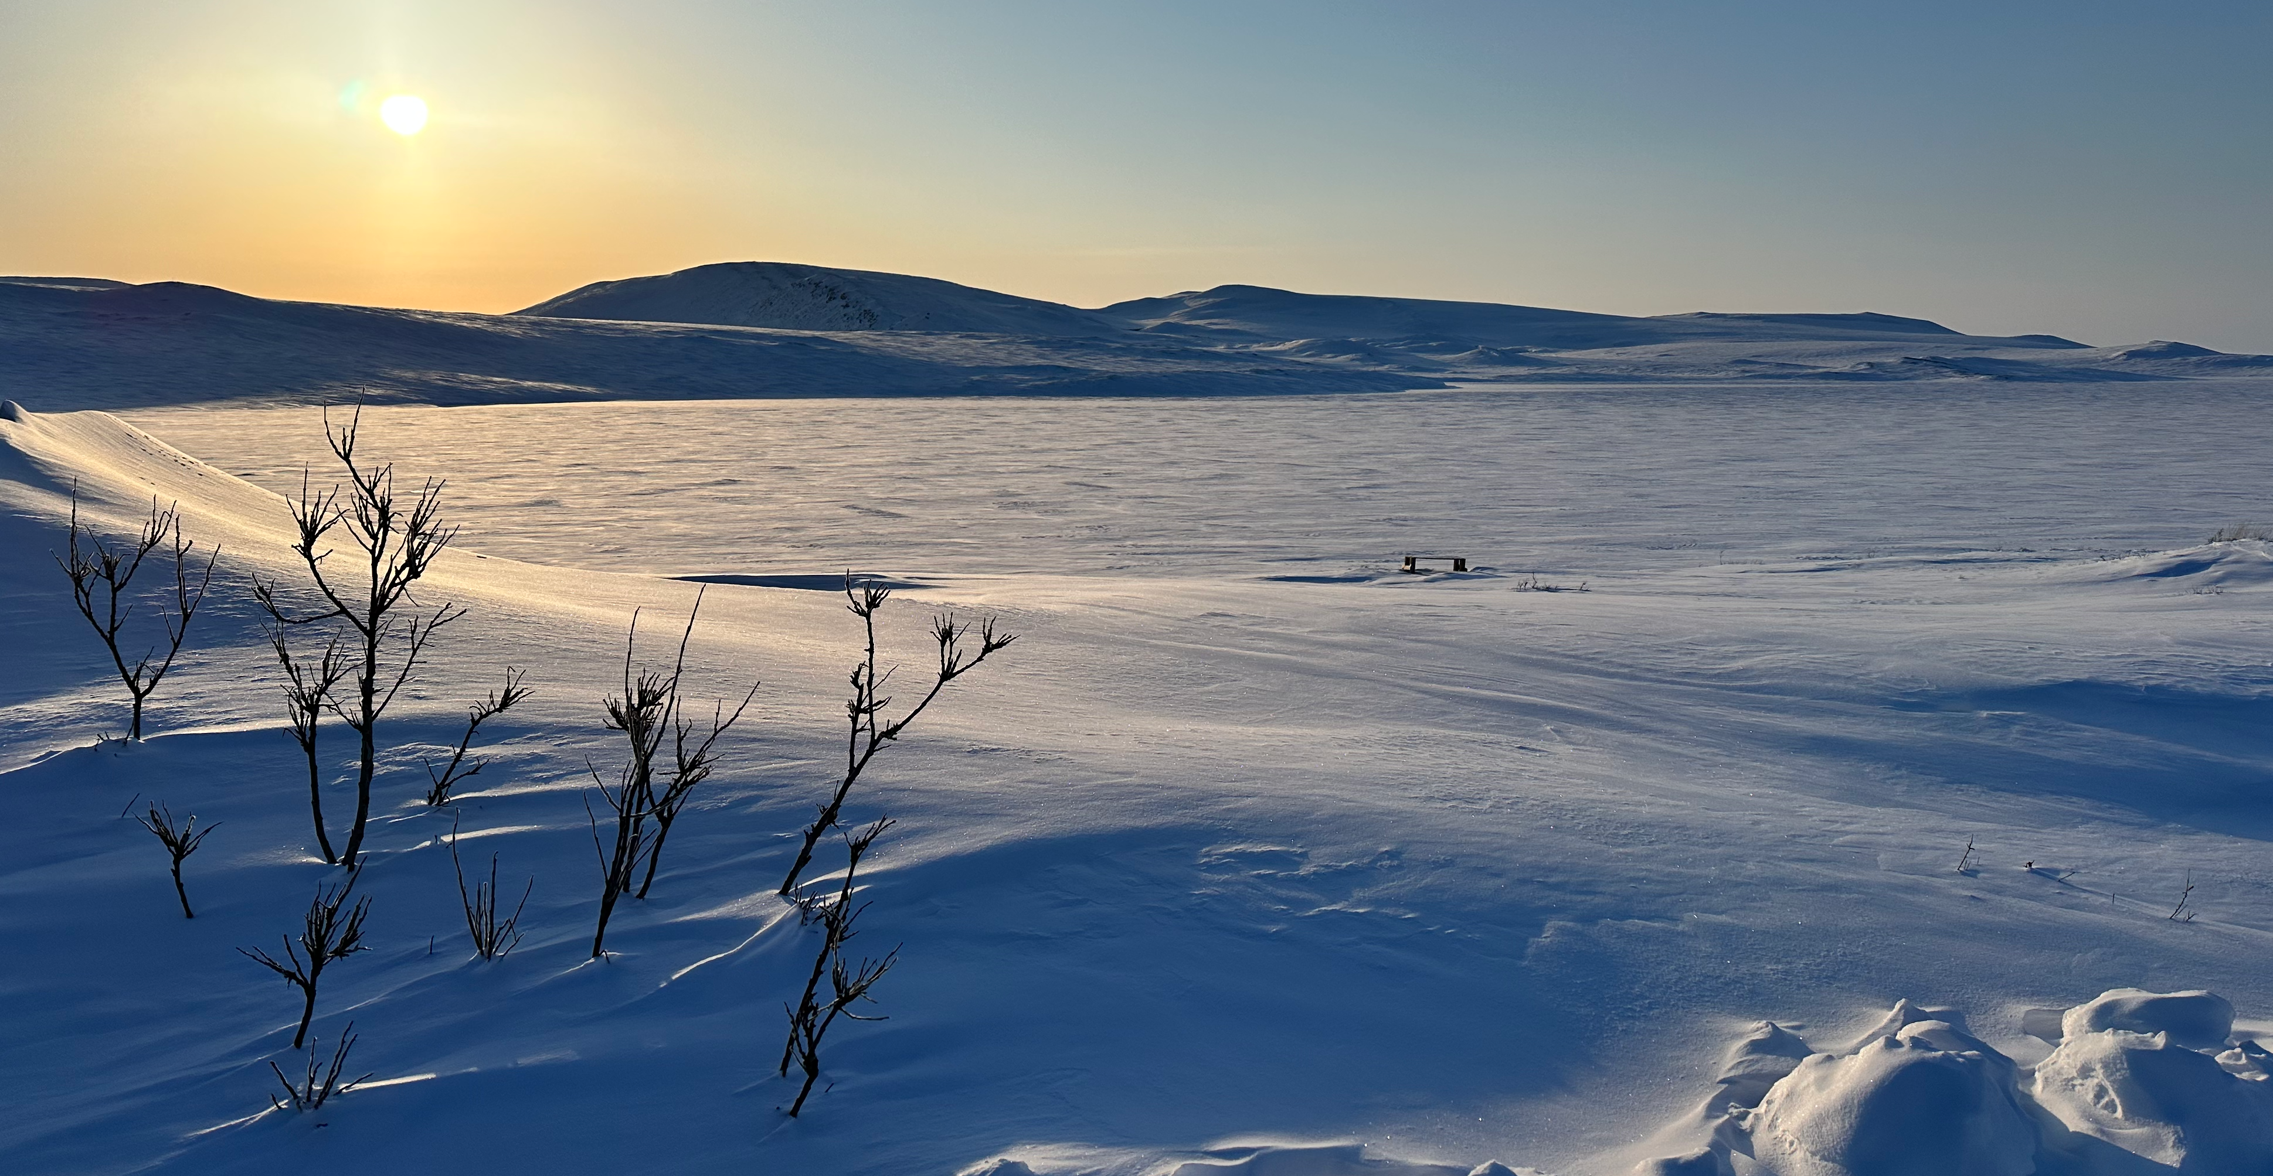
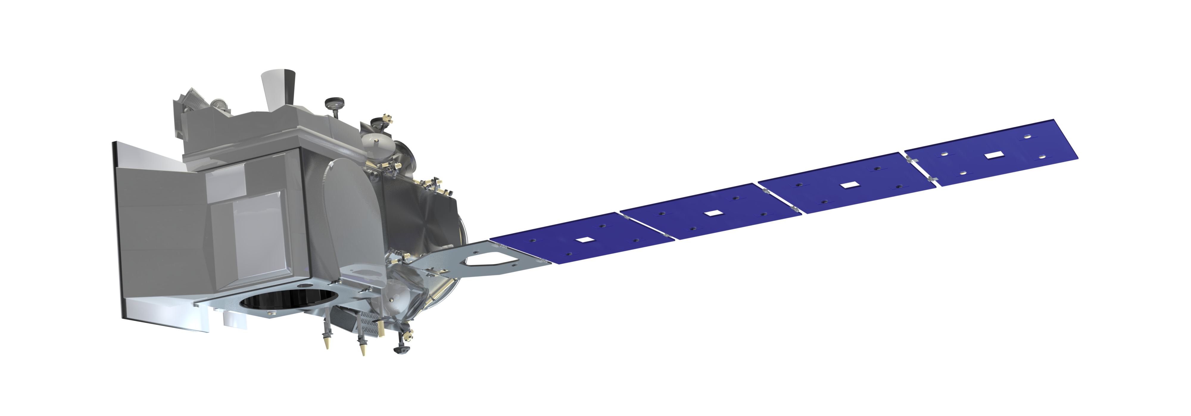

ICESat-2-Snow: Performing
Your First Snow Depth
Retrieval With Satellite Lidar
Zachary Fair
Earth System Science Interdisciplinary Center, University of Maryland
Hydrological Sciences Laboratory, NASA Goddard Space Flight Center

Slide 2
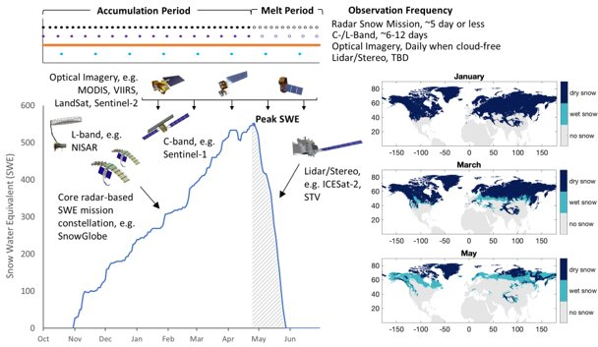
Why measure snow depth with ICESat-2?
From Carrie Vuyovich
Snow depth can be used to estimate snow water equivalent (SWE), which is important for water resources.
To meet science and stakeholder needs, we need to assess available satellites that provide snow depth or SWE.
There is a NASA effort to examine all operational satellites that measure snow throughout the water year (distributed mission concept).
Spaceborne lidar (e.g., ICESat-2) is an essential piece of a distributed mission for snow depth!
EDGE
ICESat-2 = I Can Estimate Snow depth in All Terrain – 2 an extent

Slide 3
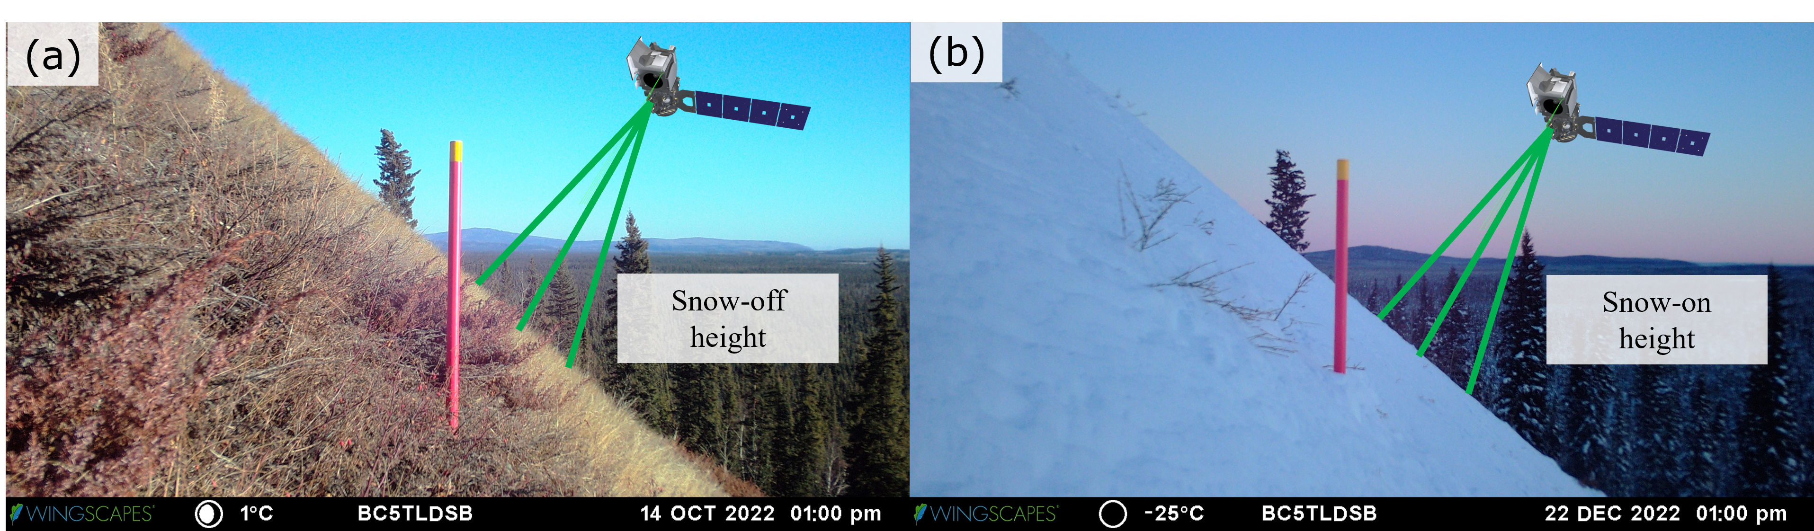
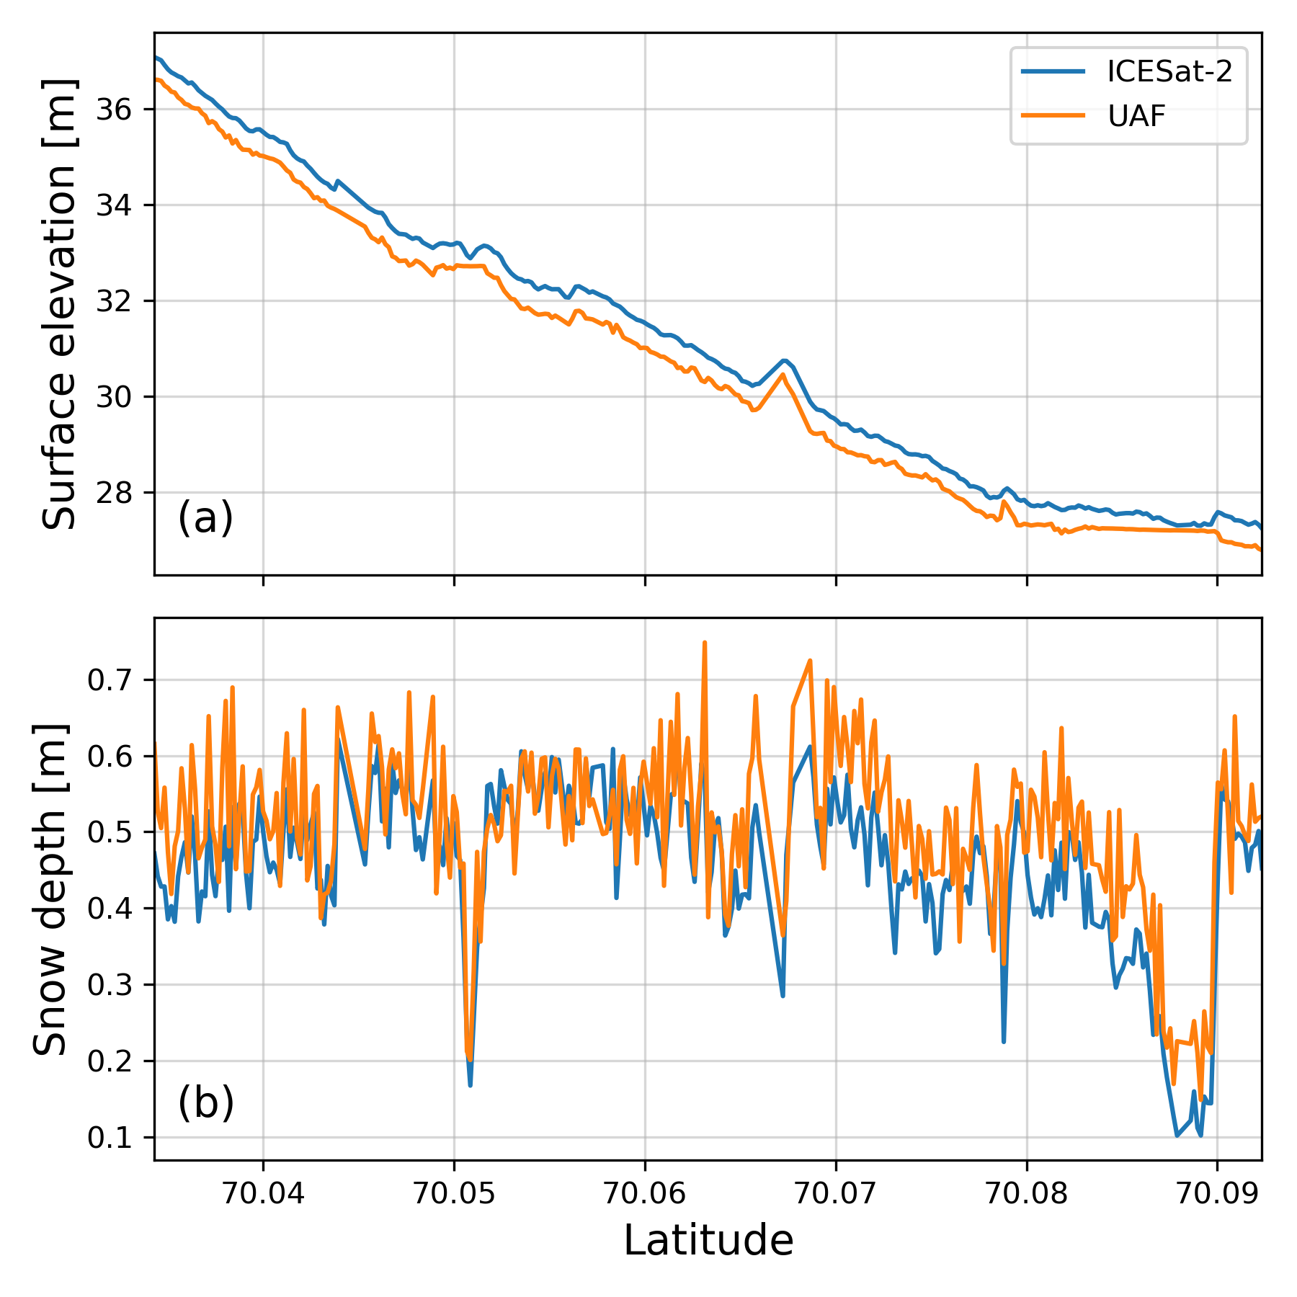
What is needed to get snow depth?
We will be using a method called differential altimetry, where we take the difference in surface elevation measurements from different parts of the year.
For an ICESat-2 snow depth, we need:
  ICESat-2 observations from the winter (snow-on) season.
    Useful data products: ATL03, ATL06, ATL08, SlideRule Earth
  Surface elevation observations from the spring/summer (snow-off) season.
    Digital elevation models (DEMs) from airborne lidar (SnowEx, 3DEP), ArcticDEM, etc.
  (Optional) Validation data for the snow depth measurements.
    SnowEx field campaigns, SNOTEL stations, Airborne Snow Observatory (ASO)
In this example, we will use:
  SlideRule Earth to access ICESat-2 data.
  ArcticDEM for our snow-off surface elevations.
  Airborne lidar from the SnowEx campaigns to validate our ICESat-2 snow depths.
(above) Fig. 5 from Fair et al., (2025b)
(below) Fig. 7 from Fair et al., (2025b)
Snow-on height
Snow-off height

Slide 4
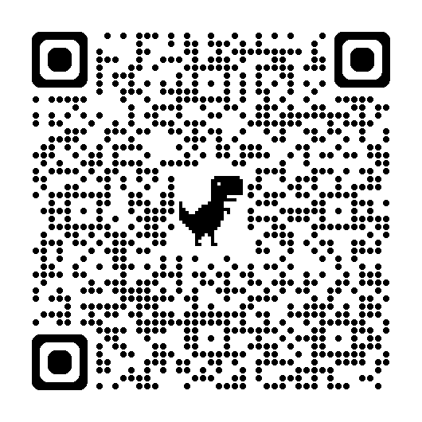
ICESat-2 Depth Retrieval Example
The code for this example is available here:

Slide 5
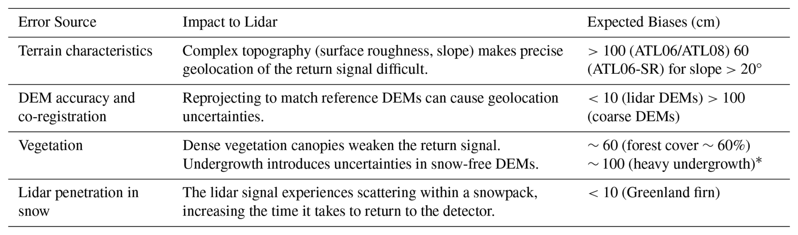
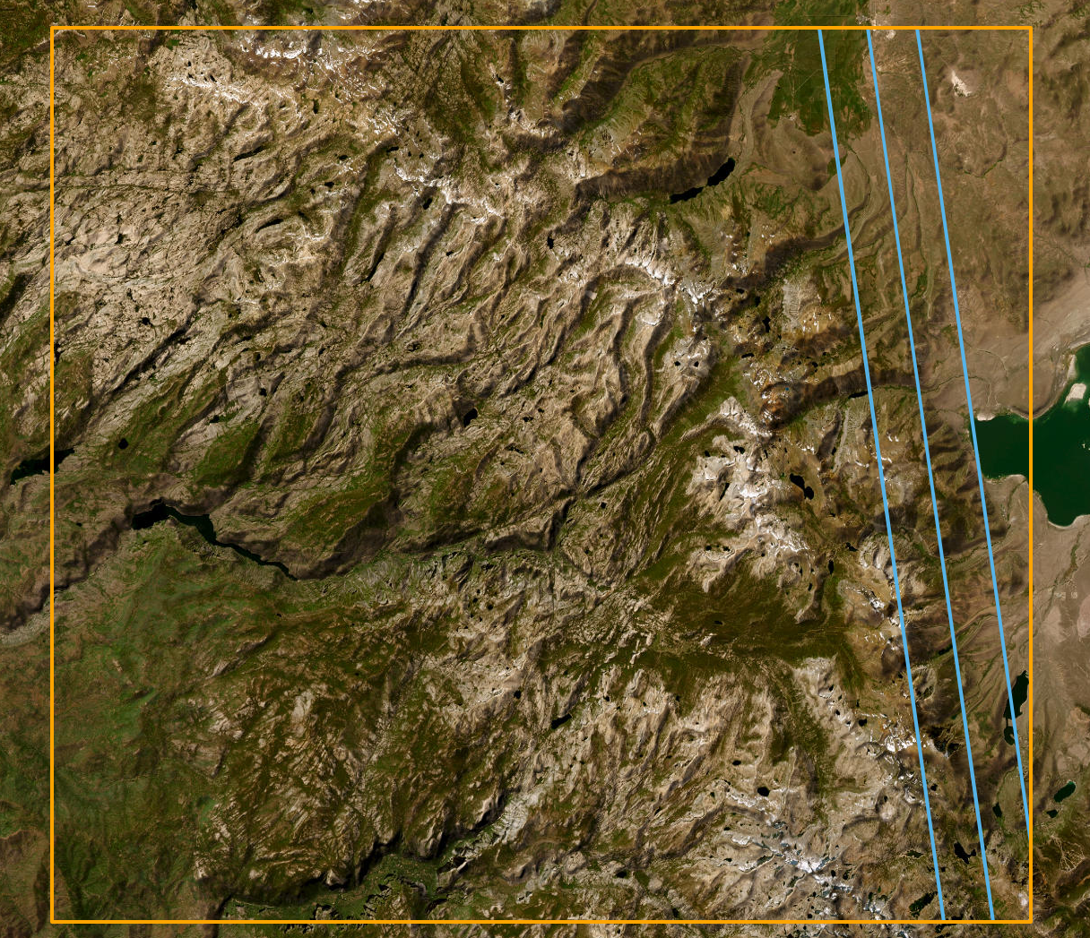
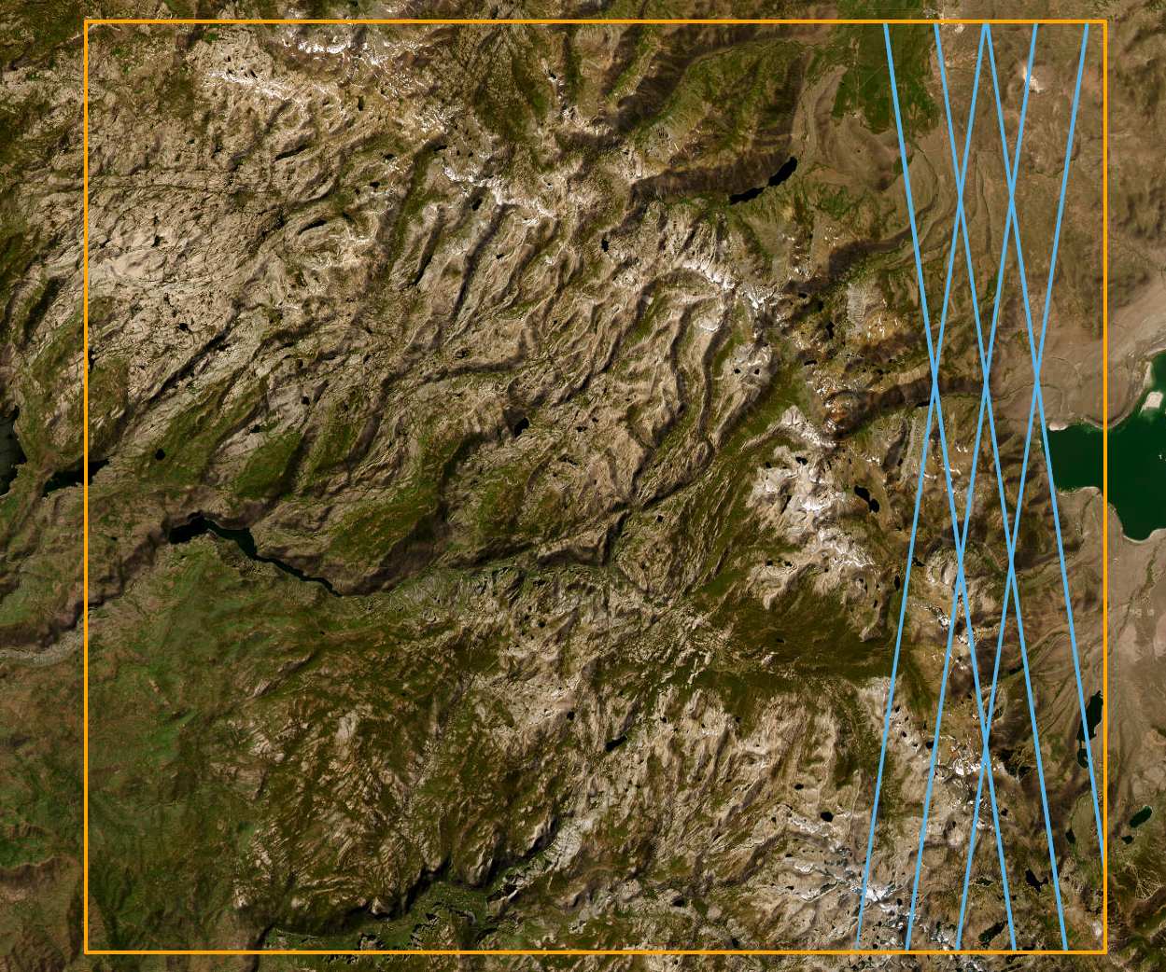
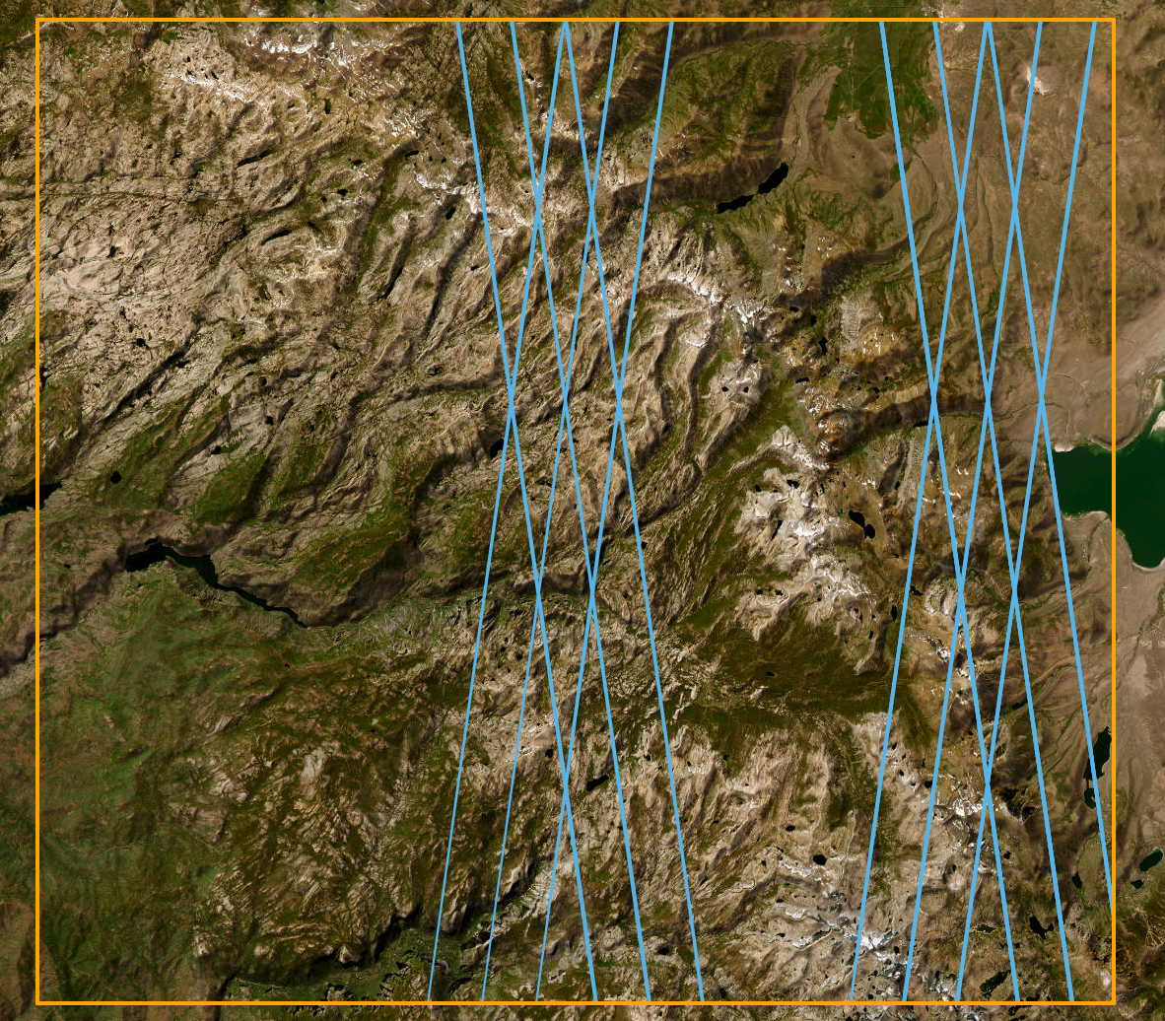
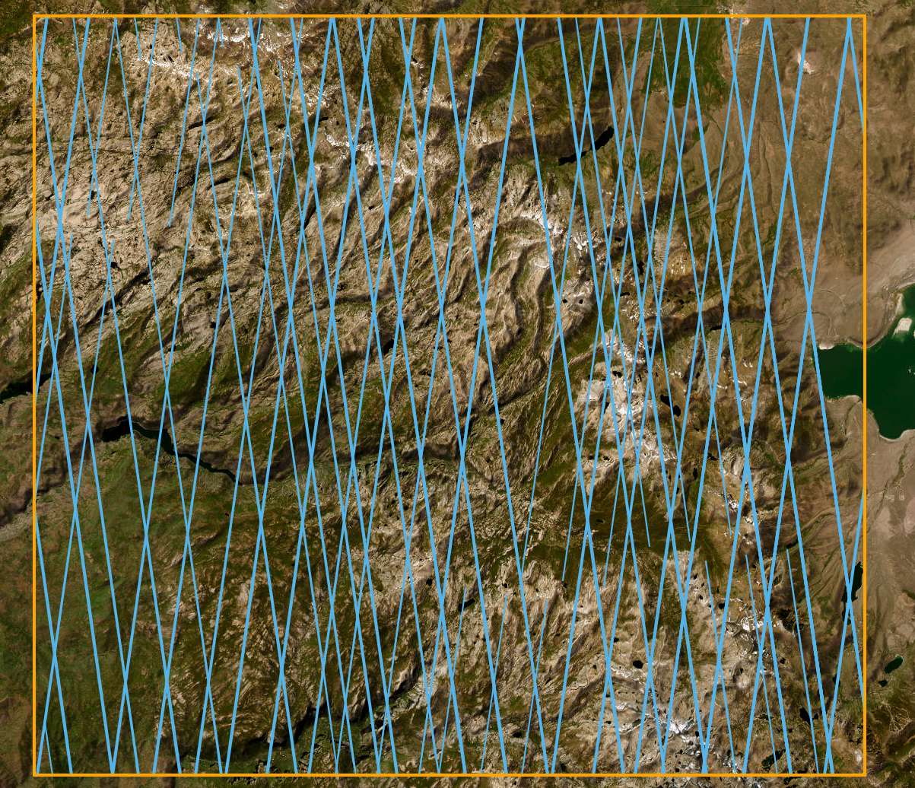
Additional Considerations
ICESat-2 = I Can Estimate Snow in All Terrain – 2 an extent
For scientists:
  ICESat-2 data can be quickly accessed with earthaccess, icepyx, and SlideRule Earth
  Snow-off DEMs can be obtained most easily through earthaccess (SnowEx DEMs) and SlideRule Earth (ArcticDEM, 3DEP)
  Snow depth accuracy is best in the tundra; forest and mountain biomes bring additional challenges.
For stakeholders:
  ICESat-2 repeat frequency is ~91 days – roughly once per season. Coverage is better at basin-wide scales.
  The beams are small relative to a basin – the beam footprint is ~11 m, with 3.3 km between each pair of beams.
  Tasking orders, statistical modeling techniques, and repeatability patterns can help to close data gaps.
Table 4 from Fair et al., (2025)
1 Day
1 Week
1 Month
1 Year

Slide 6
Links and References
Links
References
Contact: zfair@umd.edu or zachary.fair@nasa.gov
SlideRule: https://client.slideruleearth.io/landing
ICESat-2 snow tutorial:
Fair, Z., Vuyovich, C., Neumann, T., Larsen, C. F., Stuefer, S., Mason, M., & May, L. (2025). Characterizing ICESat-2 snow depths over the boreal forests and tundra of Alaska in support of the SnowEx 2023 campaign. Water Resources Research, 61, e2024WR039076. https://doi.org/10.1029/2024WR039076
Fair, Z., Vuyovich, C., Neumann, T., Pflug, J., Shean, D., Enderlin, E. M., Zikan, K., Besso, H., Lundquist, J., Deschamps-Berger, C., and Treichler, D.: Review article: using spaceborne lidar for snow depth retrievals: recent findings and utility for hydrologic applications, The Cryosphere, 19, 5671–5691, https://doi.org/10.5194/tc-19-5671-2025

