Slide 1
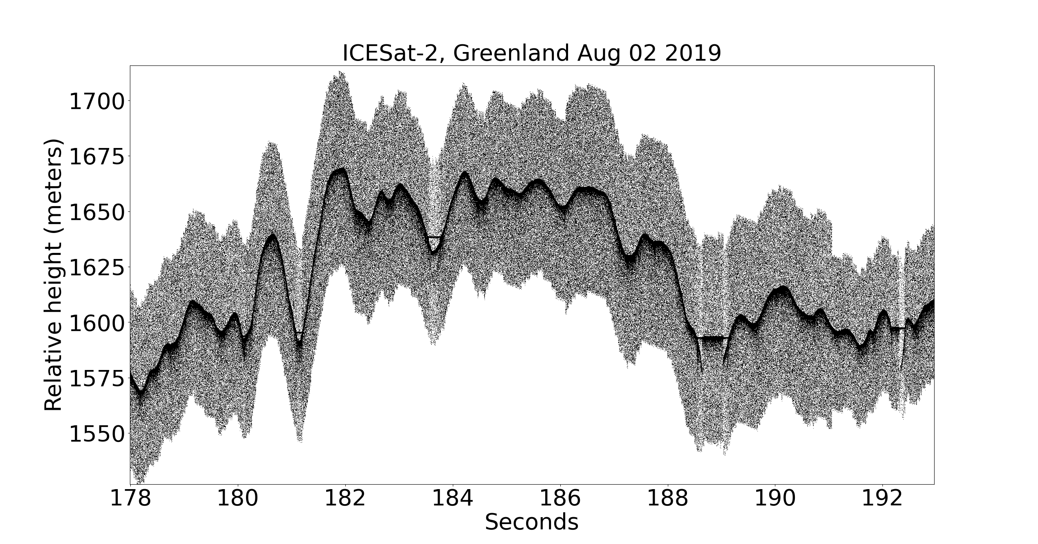
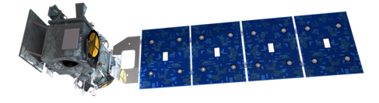
ICESat-2 and ATL03
Laser Altimetry Applications for a Changing World:
Measuring Snow Depth with ICESat-2
Aimée Gibbons
April 29, 2026

Slide 2
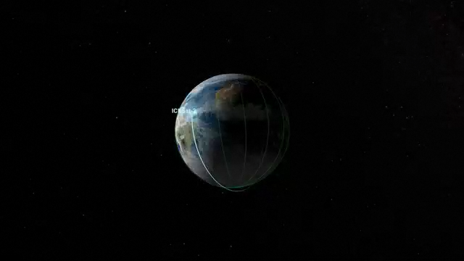
ICESat-2 Measurement Concept
ATLAS: Advanced Topographic Laser Altimeter System
Measures photon round trip Time-of-Flight
2.34 Trillion laser pulses transmitted since 1 October 2018
532 nm laser pulse (green)
11 m footprint diameter
0.7 m along-track spacing
92-degree orbit inclination angle
Coverage spans 88º N to 88º S
Repeat polar tracks every 91 days
Reference Ground Track plans:
https://icesat-2.gsfc.nasa.gov/science/specs

Slide 3
ICESat-2 Measurement Concept
Single laser pulse at 532 nm, split into 6 beams (gtx). Single-photon sensitive detection.
Footprint Size: 11m
PRF: 10 kHz (0.7 m)
3.3 km spacing between pairs provides spatial coverage
90 m pair spacing for slope determination (2° yaw)
High-energy beams (4x) for better performance over low-reflectivity targets.

Slide 4
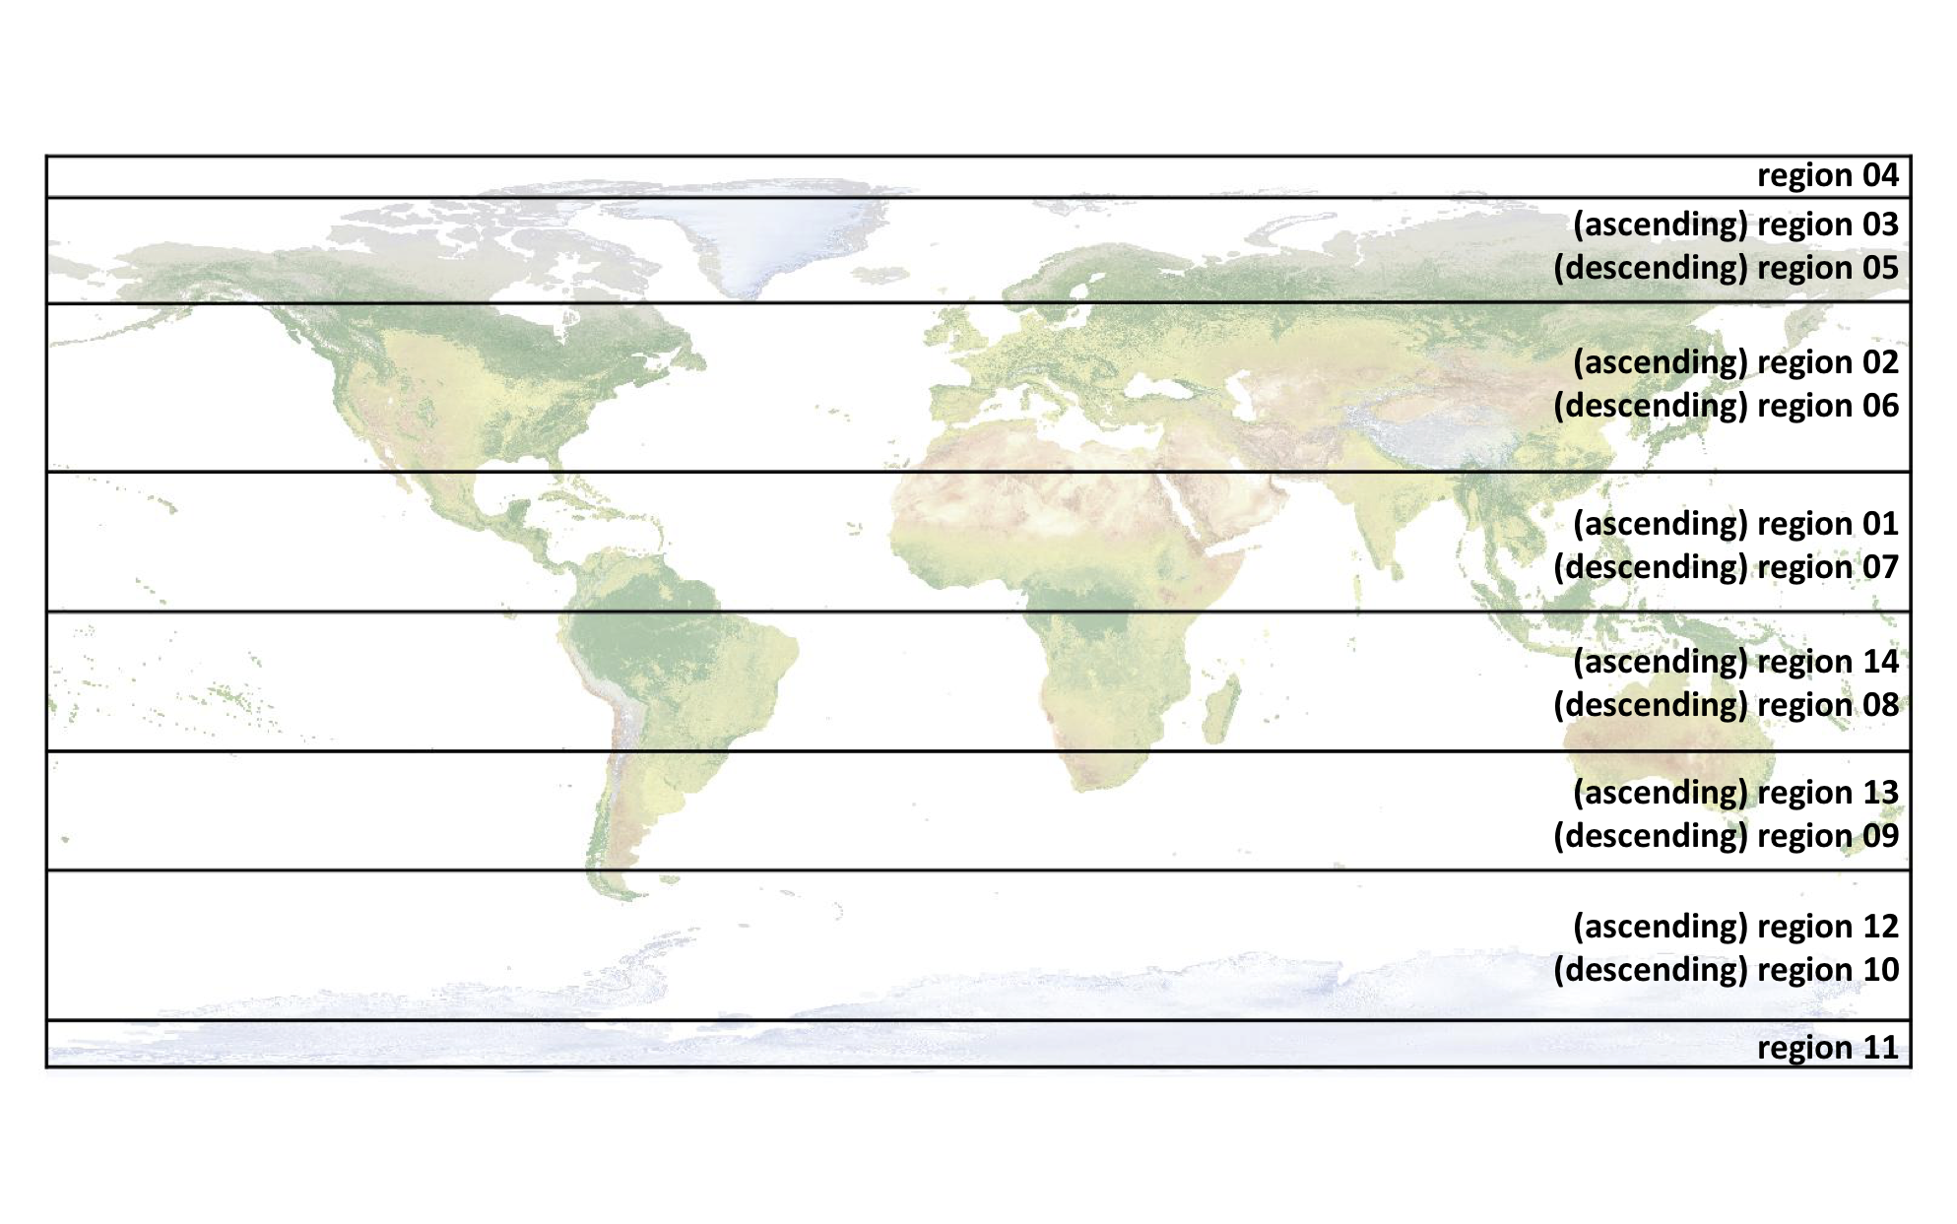
ATL03 Files
One Reference Ground Track (RGT) = one orbit
14 regions in each RGT, divided up by latitude and spacecraft ascending/descending
File name format ATL03_YYYYMMDDHHMMSS_RGTXccrr_rel_vr.h5
  YYYYMMDD = Year, month, date
  HHMMSS = Hour, minute, second
  RGTX = 4-digit RGT (0001-1387)
  cc = 2-digit cycle number (1 cycle = 91 days)
  rr = 2-digit region number
  rel = release number (currently 007)
  vr = version number

Slide 5
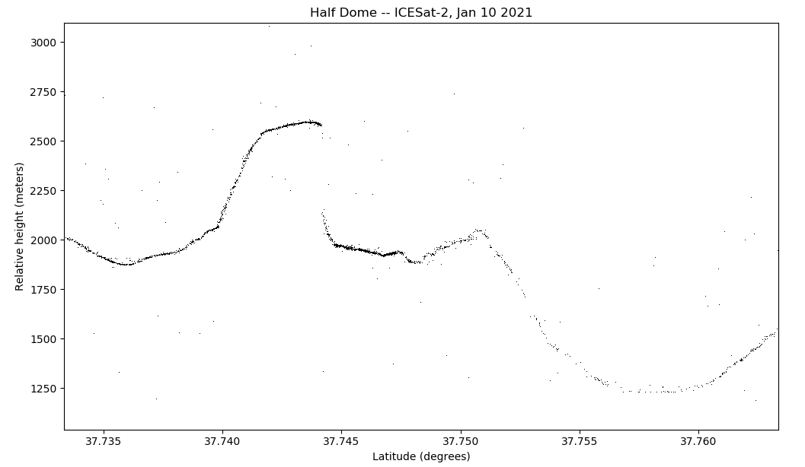
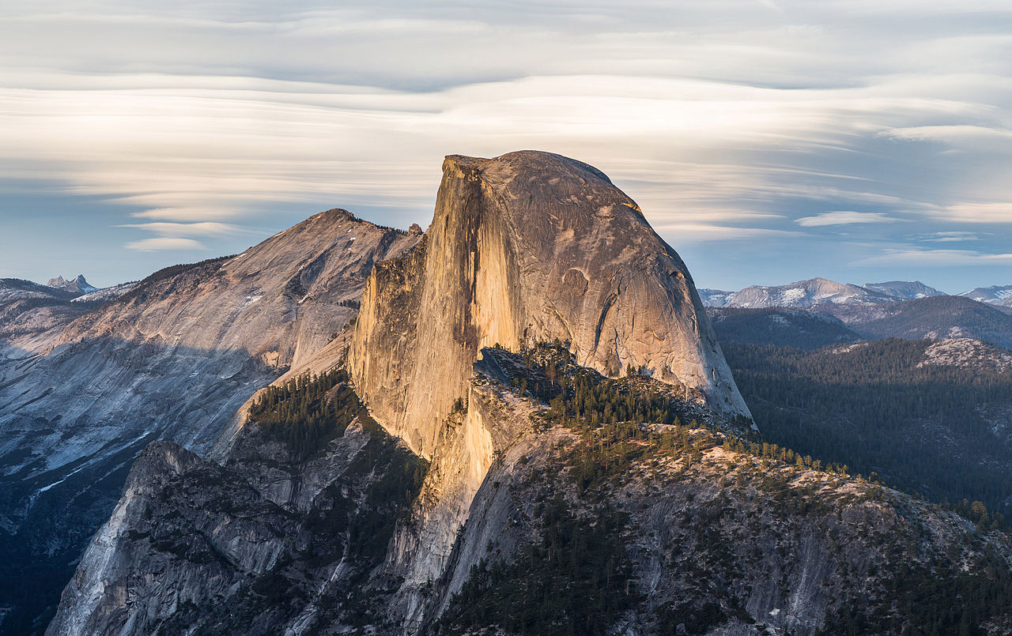
ATL03: What’s Inside
gtx = Generic term for 6 beams
  gtx = gt1l, gt1r, gt2l, gt2r, gt3l, or gt3r
Photon-rate data in /gtx/heights/
  Longitude (lon_ph)
  Latitude (lat_ph)
  Height (h_ph)
  Signal confidence (signal_conf_ph) – likely surface (low, medium, high), noise
  Quality flag (quality_ph) – indicates photons likely due to instrument effects
Geosegment rate data (20 m along-track) in /gtx/geolocation/
  Geolocation degrade flag (podppd_flag) – Indicates degraded geolocation data solutions, e.g. spacecraft maneuvers

Slide 6
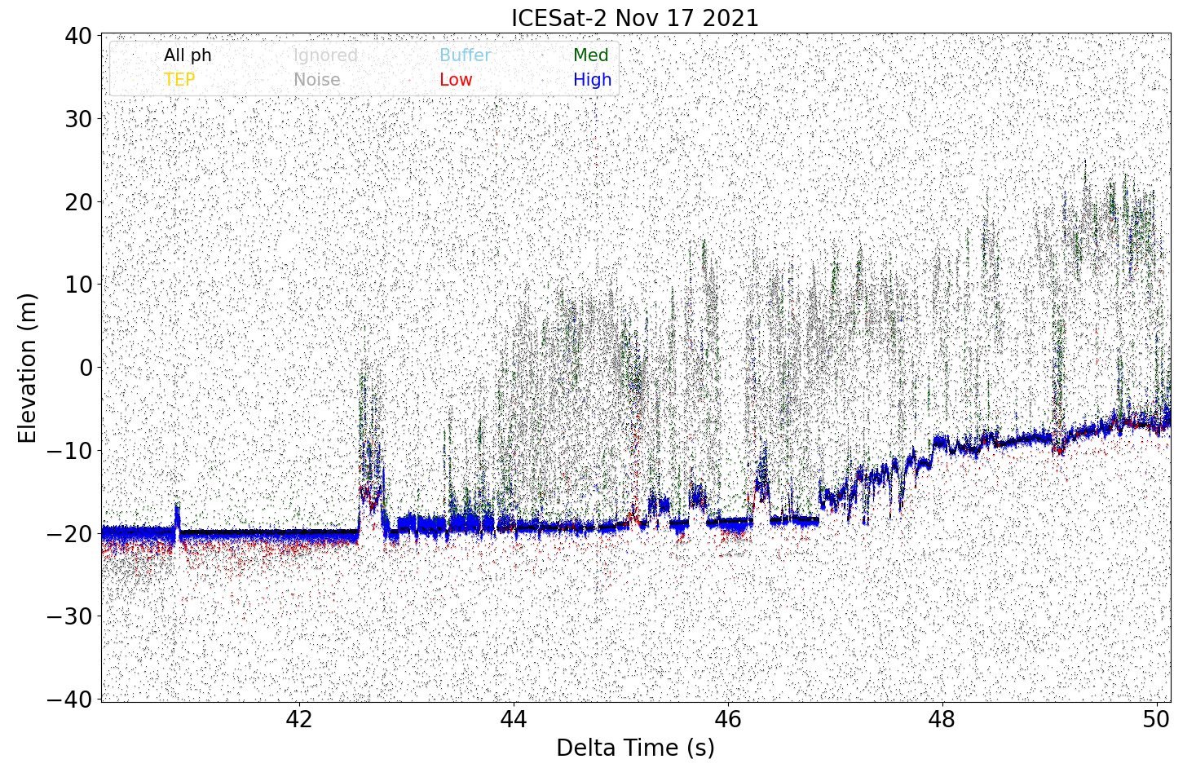
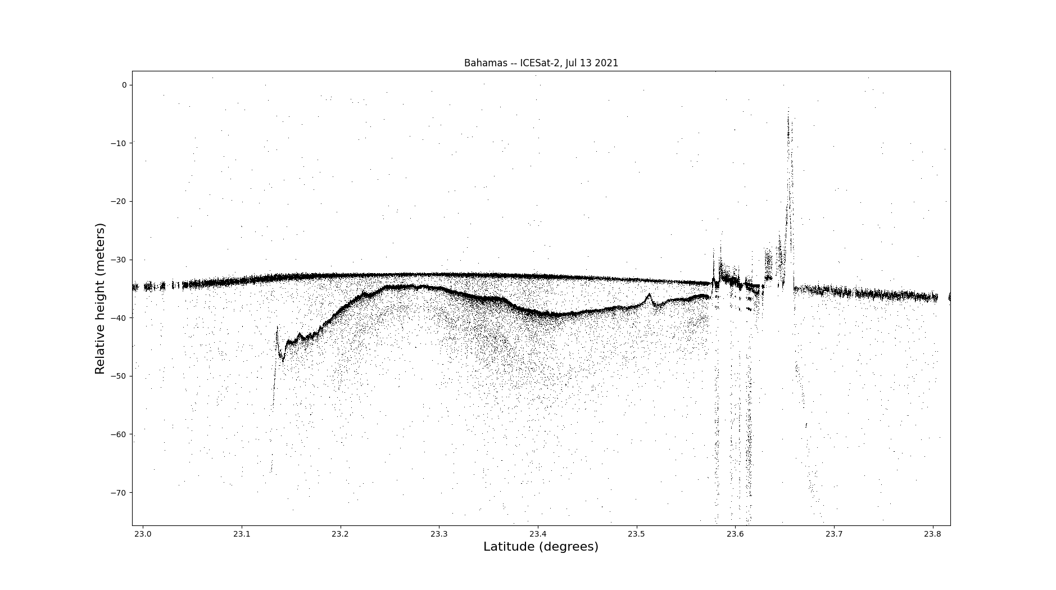
ATL03: What’s Inside
Vegetation
Island
Ocean surface
Bathymetry
Water
ATLAS instrument effects
Forest floor
Background rates differ in day (high background) and night (low background) collection

Slide 7
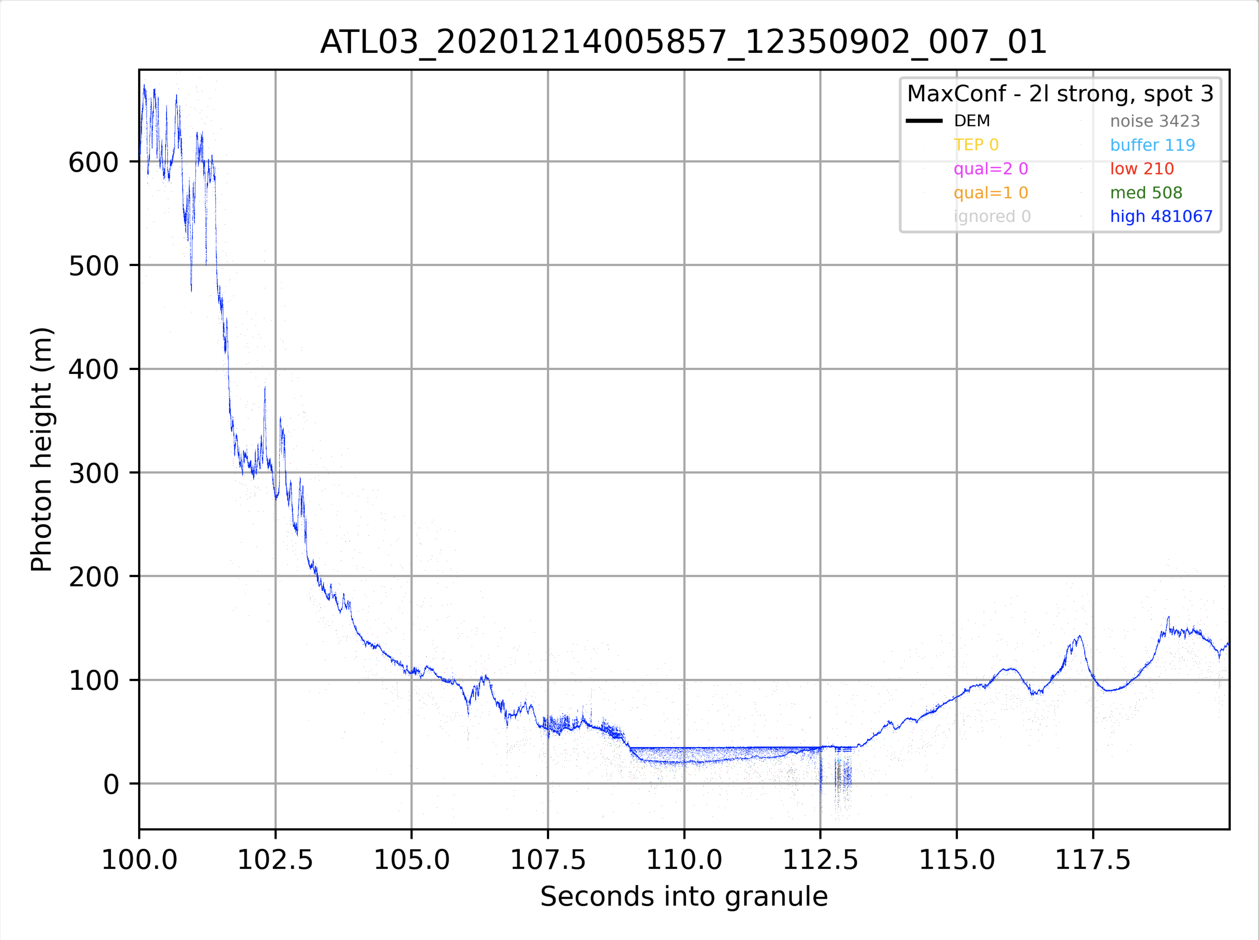
ATL03: What’s Inside
Ice sheet
Mountain terrain
ATLAS instrument effects
Water
Melt ponds
Bathymetry
Background rates differ in day (high background) and night (low background) collection

Slide 8
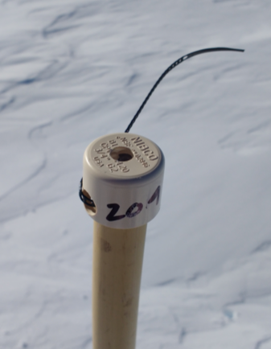
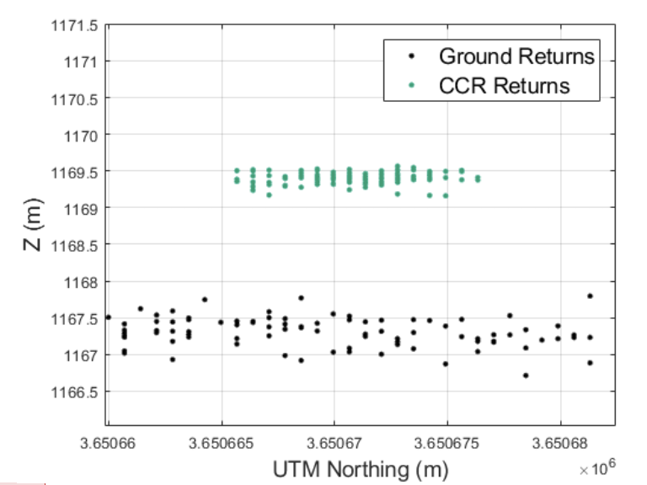
How good are the data?
88ºS Antarctic Traverse
(3 kinematic GPS surveys)
88ºS Corner-cube retro-reflector arrays
ATL03 (low slope): 5 cm vertical accuracy, 13 cm precision
ATL06: 3 cm vertical accuracy, 9 cm precision
Brunt et. al, (2019, 2021)
Average horizontal accuracy (geolocation) : 3.4 m ± 2.5 m
Average footprint diameter: 11.3 m ±0.8 m
Magruder et. al, (2021)

Slide 9
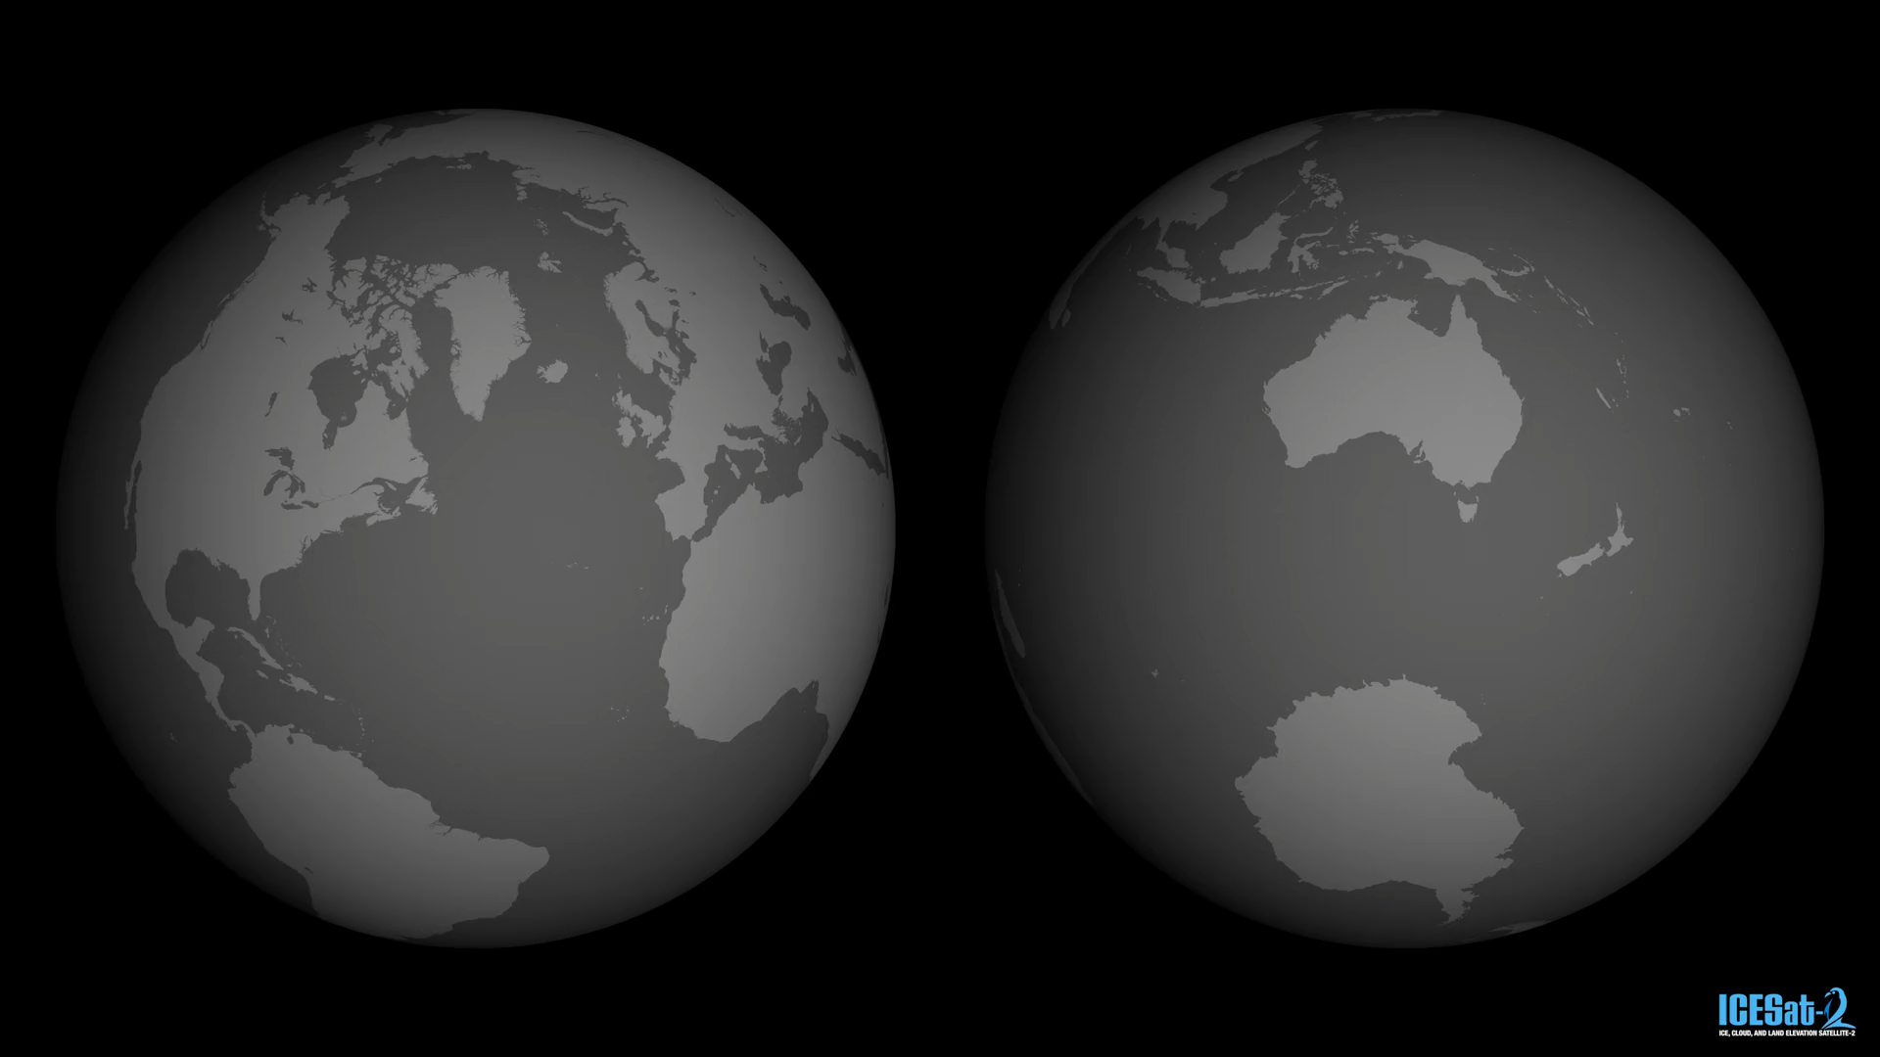
Thank you
https://svs.gsfc.nasa.gov/5616/
Website: https://icesat-2.gsfc.nasa.gov/
Data: https://nsidc.org/data/icesat-2
Track plans:
https://icesat-2.gsfc.nasa.gov/science/specs
Tutorials:
https://github.com/ICESat-2/icesat2-cookbook
Email: aimee.c.gibbons@nasa.gov

Slide 10
Extras
Tips on how to use ATL03 data

Slide 11
More on ATL03 data – yaw flips and spots
ATL03 data is organized by gtx (gt1l, gt1r, gt2l, gt2r, gt3l, gt3r)
  Within each beam pair (e.g. gt1l, gt1r) is a strong and a weak beam. Which is strong/weak changes with spacecraft orientation (yaw flips). Strength across gtxl/gtxr are consistent – if gt1r is a strong spot, then gt2r and gt3r are also strong spots.
    sc_orient parameter tells you spacecraft orientation (1 = forward, 0 = backward)
      1 = forward: gtlx are weak beams
      0 = backward: gtlx are strong beams
  Pro tip: use ATLAS spot number when possible. These do not change with spacecraft orientation!
    ATLAS spot numbers 1-6. Spots 1, 3, 5 are strong beams. Spots 2, 4, 6 are weak beams.
    Spot 1 = gt1l in sc_orient = 0
    Spot 1 = gt3r in sc_orient = 1
    You can find ATLAS spot number in the /gtx/ attributes of the H5 file

Slide 12
More on ATL03 data – signal confidence
ATL03 has a signal confidence parameter at the photon rate /gtx/heights/signal_conf_ph
  This is a photon-by-5 array, where each column corresponds to
    Land
    Ocean
    Sea ice
    Land ice
    Inland water
  These are based on aggregating photons and histogramming in along-track and height space, using parameters specific to each surface type. signal_conf_ph may or may not be useful for coral detection
The /gtx/heights/quality_ph parameter aims to flag photons that are likely due to ATLAS instrument effects. Values > 0 are photons that may be ATLAS artifacts.

