Slide 1












SeaBASS Updates
NASA Ocean Color Research Team (OCRT)
May 9, 2023
http://seabass.gsfc.nasa.gov
Notes:
1

Slide 2
Topics / Outline
Staff Updates
Data Archive Updates
  Contact Us Reminders
  Everything You Wanted to Know About Experiments
    Help us customize your page!
  How to Avoid The Most Common Submission Issues
  New Flow Cytometry TM (& other updates)
  Suggestion: Who to List in "Investigators" Metadata
3. Validation Update
Notes:
Today I’ll be speaking about a few updates from SeaBASS data archive, part of Ocean Biology DAAC at NASA Goddard
I’m Chris Proctor, manager of SeaBASS. The core SeaBASS team also includes Inia Soto Ramos, who is our wonderful data manager many of you have interacted with to submit your datasets. David Norris is our main developer and works on web and software tools.
Extended team also includes several other close collaborators, including analysis and QA/QC provided by members of the Field Support Group (Antonio named them in his presentation)
Collaboration with Violeta Sanjuan Calzado who is leading efforts to produce a new version of the NOMAD algorithm dataset
Noah Vegh-Gaynor who develops science software and other projects
Various other OBPG scientists and developers who are assisting with validation and other projects

Slide 3
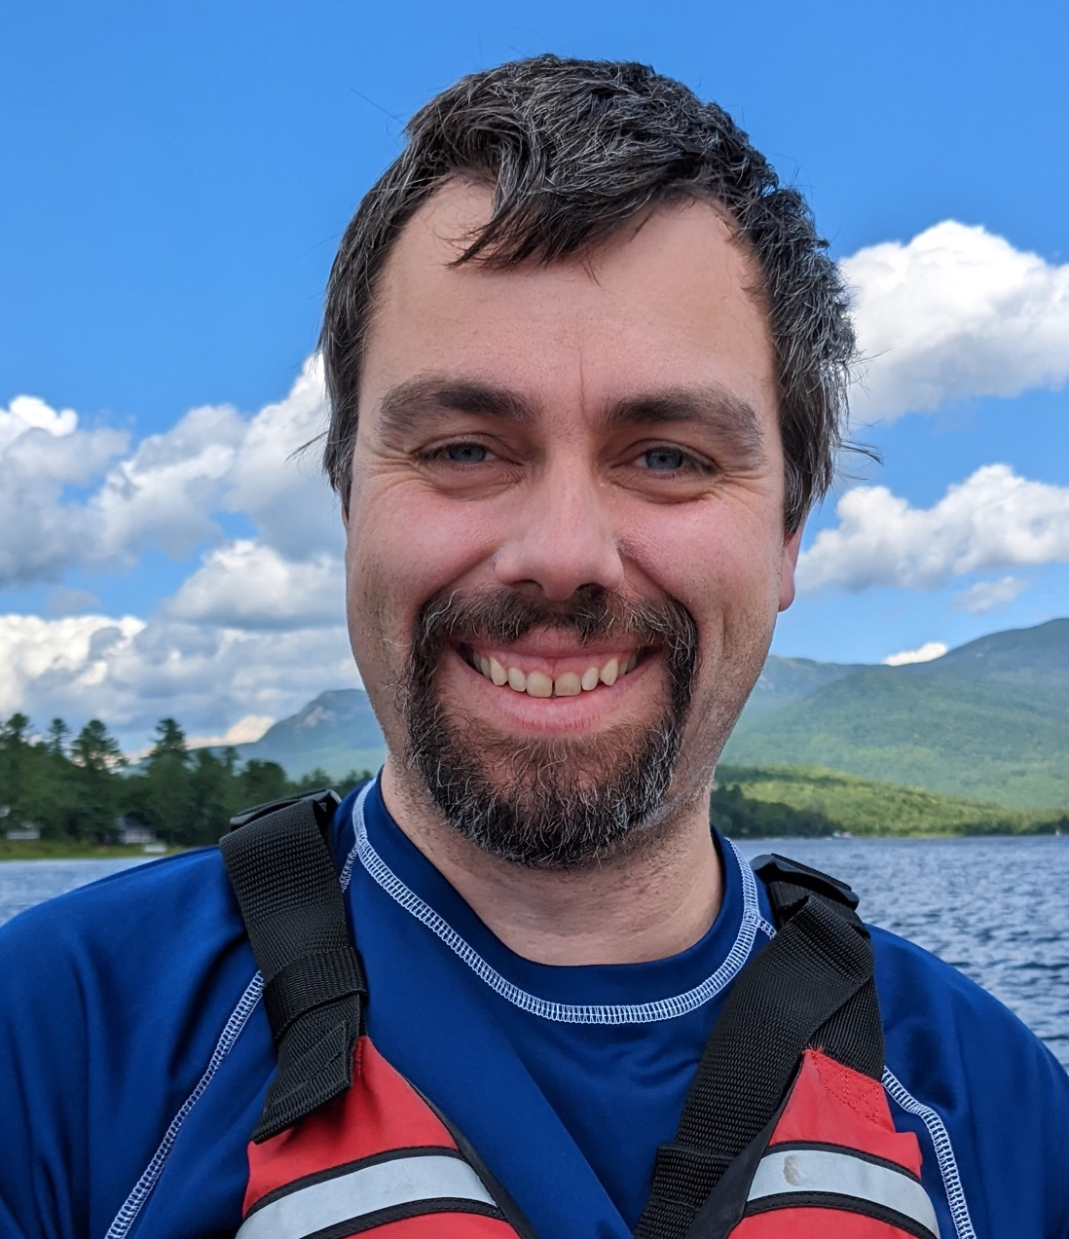
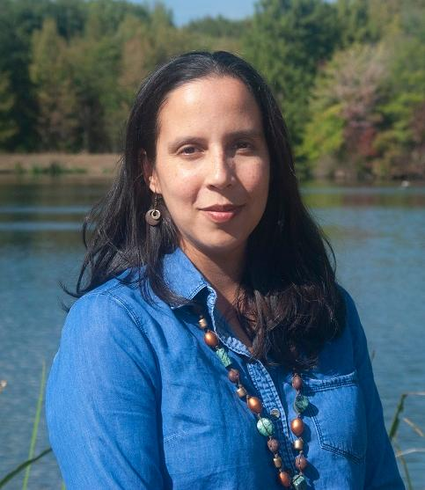
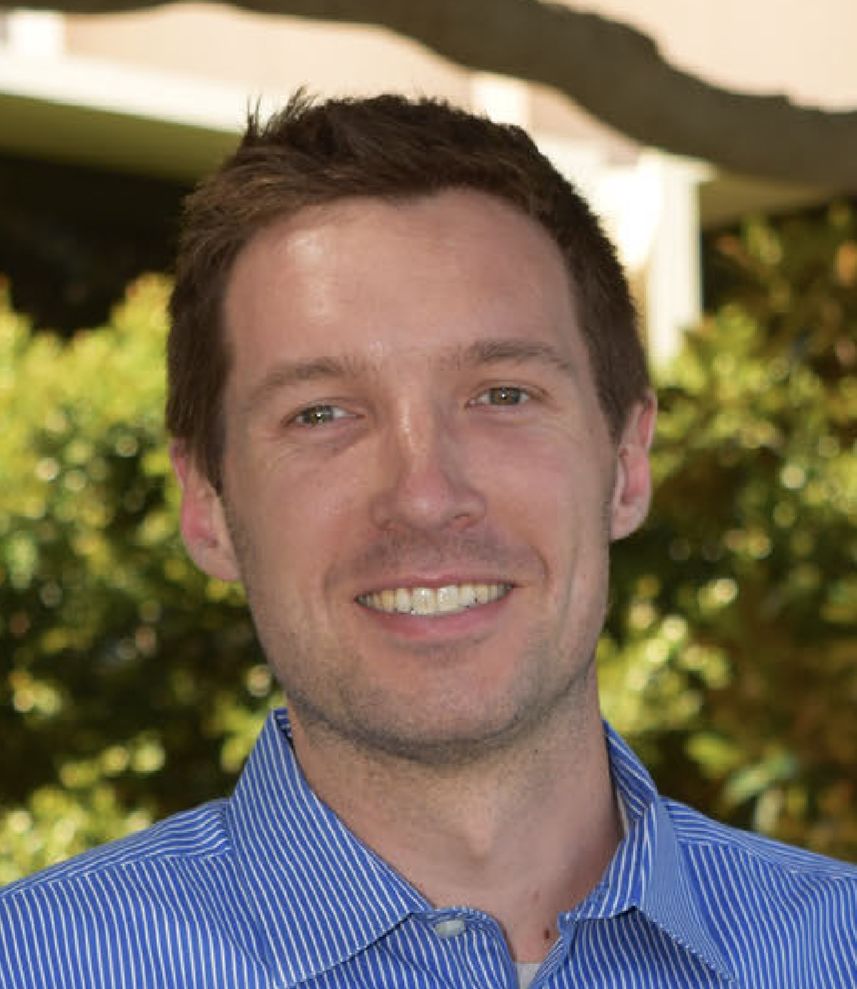
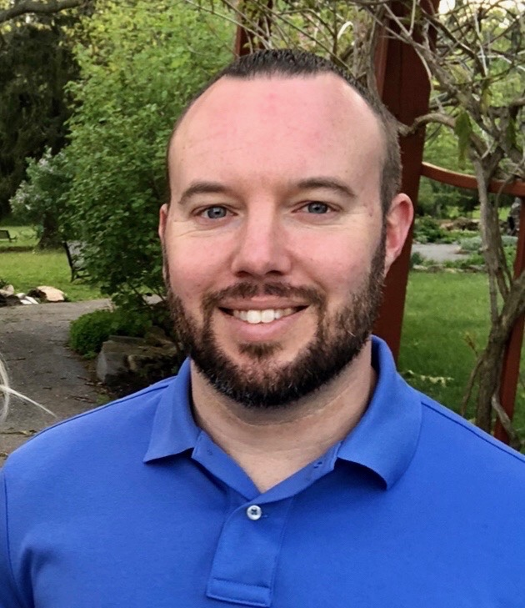
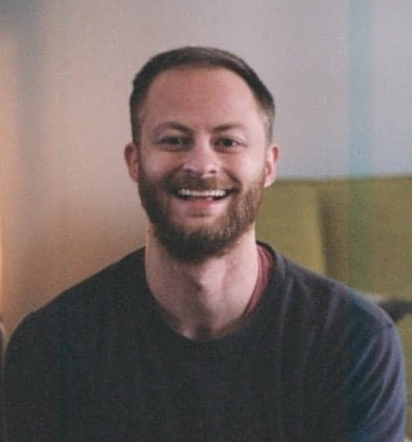
Staff Update
Welcome Mike!
Chris Proctor
SeaBASS manager
Inia Soto Ramos
Lead data manager
Mike Maniscalco
Data manager
Extended SeaBASS team includes many others!
NOMAD leader (Violeta Sanjuan Calzado)
Field Support Group Subject Matter Experts
PACE Validation Leads and other contributors
David Norris
Developer
Noah Vegh-Gaynor
Developer
Notes:
Today I’ll be speaking about a few updates from SeaBASS data archive, part of Ocean Biology DAAC at NASA Goddard
I’m Chris Proctor, manager of SeaBASS. The core SeaBASS team also includes Inia Soto Ramos, who is our wonderful data manager many of you have interacted with to submit your datasets. David Norris is our main developer and works on web and software tools.
Extended team also includes several other close collaborators, including analysis and QA/QC provided by members of the Field Support Group (Antonio named them in his presentation)
Collaboration with Violeta Sanjuan Calzado who is leading efforts to produce a new version of the NOMAD algorithm dataset
Noah Vegh-Gaynor who develops science software and other projects
Various other OBPG scientists and developers who are assisting with validation and other projects

Slide 4
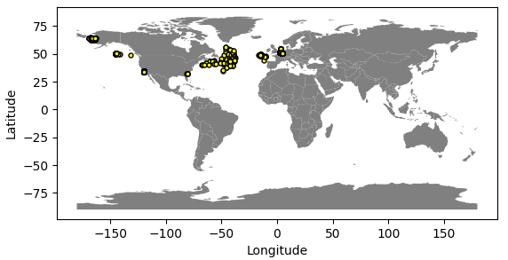
Recently Archived Data Summary
3000 data files from 60 cruises archived Oct ‘22 – April ‘23

Slide 5
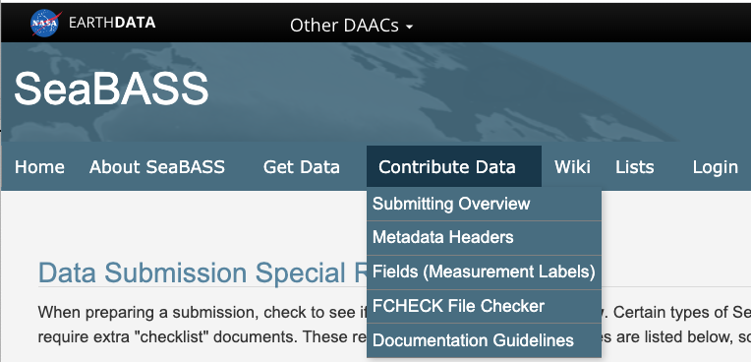
Contact Us When Planning Submissions
General questions (data format and requirements)
Register new project info (Experiments, DOI)
Register or update SFTP accounts
Email our data managers!
seabass@seabass.gsfc.nasa.gov
Notes:
Next few slides are for anyone who is new to submitting data to SeaBASS, or otherwise are just reminders for our experienced submitters
Contact us! On the SeaBASS main menu there are submission instructions, including the seabass email address that goes to multiple teammembers
You’ll end up emailing us to:
Set up or make changes to your SeaBASS submitter account (so that you can transmit data to us)
Also, discuss datasets. We need to collect a short list of information to register new projects, and we also want to discuss datasets so we can use standardized field names and metadata (or create new ones when that’s necessary

Slide 6

Dataset Naming
Help us pick good Experiment & Cruise names for your new datasets
Experiment names → DOIs = permanent
If collaborating, use the same names
FYI, for new Experiments, we will ask you for:
  Short name
  Long name
  Cruise names (at least one)
  Measurement date range (if known)
  PIs
  Data Types
Thinking_about_writing.png by sOER Frank is licensed by CC BY 2.0
Notes:
Whenever you have a NEW project, we need you to help by thinking ahead and helping pick good names
Experiments are the long-term research project – for this metadata we ask for either an acronym, or short-name.
Experiment names become part of SeaBASS’s DOIs which are permanent
Coordinate with any collaborators so you use the same cruise/field-campaign/deployment names

Slide 7
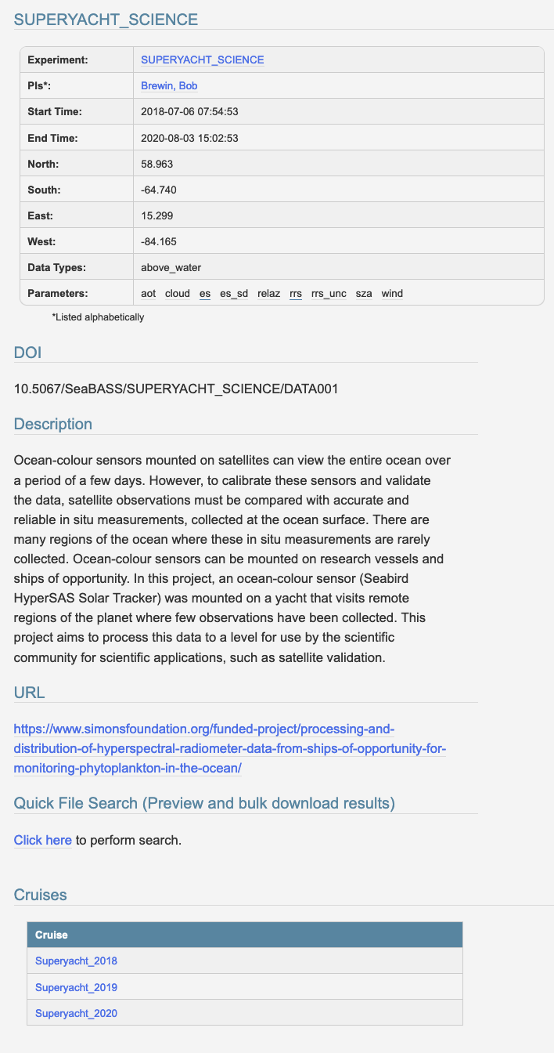
You Can Help Customize Your Experiment Page!
1. Description
2. External Links (optionally provide URLs to other pages, or resources)
Notes:
Datasets in SeaBASS are organized by Experiments (long-term research project)
All the data from individual cruises or deployments gets linked back to the overall experiment. Every Experiment in SeaBASS has at least 1 cruise, and some long-term Experiments have dozens or hundreds.
Every Experiment gets its own webpage, and you can help us customize yours. Every page automatically gets certain sections, including Metadata summary info, the DOI, and there are links to quickly get to the datasets, or to view individual cruises/deployments
You can help provide a written Description, which can summarize the experiment and provide an overview or context or include special information or comments. Here we also spell out the long-name of the Experiment’s acronym, etc.
Additionally, there is an optional section for URLs, so if you’d like you may provide links, for examples, a link to a university project page, or a relevant publication, or a DOI to post-processed dataset elsewhere, etc.

Slide 8
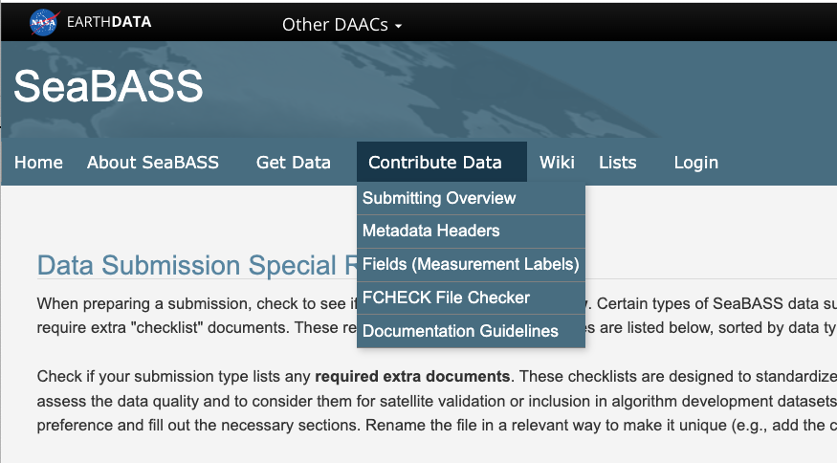
Most Common Submission Issues
  Forgot uncertainties
    Remember to report replicates, blanks, or when averaging, include bincount, stddev, etc.
  Forgot methods summary
    Measurement & processing methods doc (if not covered by checklist)
  Didn’t follow Special Requirements page instructions
    Missing measurement-specific fields or metadata
    Missing checklists or forms
Notes:
Tips for data submitters (but also data users, to let you know what info you should be able to find)

Slide 9
Measurement-Specific Requirements (continued)
Data Contributors: check the special requirements page for instructions relevant to your measurement types:
Fields, headers, and example files
Metadata requirements & checklists
New or recently updated guidelines:
Above-water radiometry
POC
Flow Cytometry
IFCB, UVP
Upcoming:
Microscopy
Notes:
Data submissions can’t be accepted if they are missing required types of data or metadata (e.g,. Absorbance measurements should be part of spectrophotometric datasets). NASA requirements built upon community protocols – metadata & measurements needed for data traceability, reproducibility, and uncertainties. Please review these ahead of time!

Slide 10
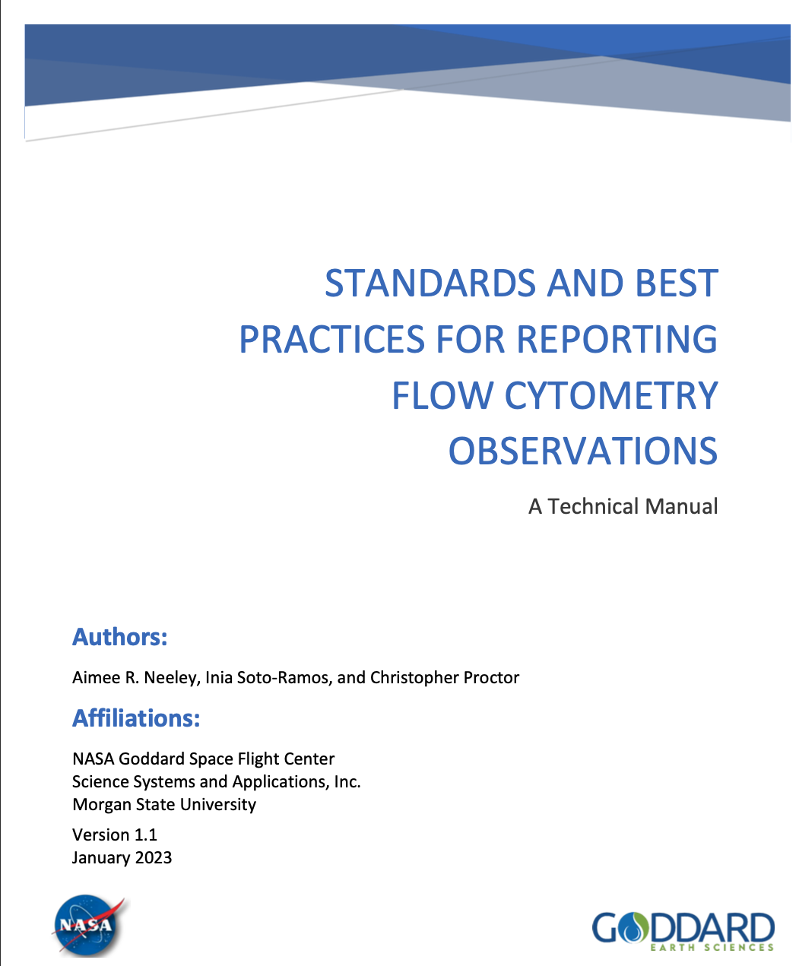
New: Reporting Flow Cytometry to SeaBASS
Provides complex formatting requirements for SeaBASS submissions
Hosted via the Ocean Best Practices website:
we desired rapid public access and having a DOI
Builds upon Standards and Practices for Reporting Plankton and Other Particle Observations From Images
Notes:
OEL staff completed editing and released our “Standards and Best Practices for Reporting Flow Cytometry Observations” (detailing complex submission requirements for SeaBASS, etc.) via the Ocean Best Practices website.
The purpose of this manual is to describe the procedures for reporting data derived from standard flow cytometry methods following the framework established in “Standards and Practices for Reporting Plankton and Other Particle Observations From Images”
In the past we might have published such a document as a NASA TM. However, the process to publish is slow, so we opted for this route for rapid public access and having a DOI.
Our focus was to provide instructions for SeaBASS submissions – we built the instructions upon those established in the wider “Standards and Practices for Reporting Plankton and Other Particle Observations From Images”. others are invited to continue building upon the framework
https://repository.oceanbestpractices.org/handle/11329/2111
Neeley, A.R., Soto-Ramos, I., and Proctor, C. (2022) Standards and Best Practices for Reporting Flow Cytometry Observations, Version 1.0. Greenbelt, MD., NASA Goddard Space Flight Center, 31pp. DOI: http://dx.doi.org/10.25607/OBP-1864

Slide 11
Suggestion for PIs: Be Inclusive with “Investigators” Metadata List
Investigators (Required metadata)
The contributors of the data file. Principal investigator is listed first, followed by any associate investigators, technicians, data analysts, and students, etc.
The SeaBASS team strongly encourages investigators to be inclusive.
Listing additional people simply:
  1) Records acknowledgement
  2) Indexes names for the website’s File Search
If technicians or students are preparing your files, it can be intimidating to even ask if they should be included!
Suggestion for PIs: Have a conversation

Slide 12
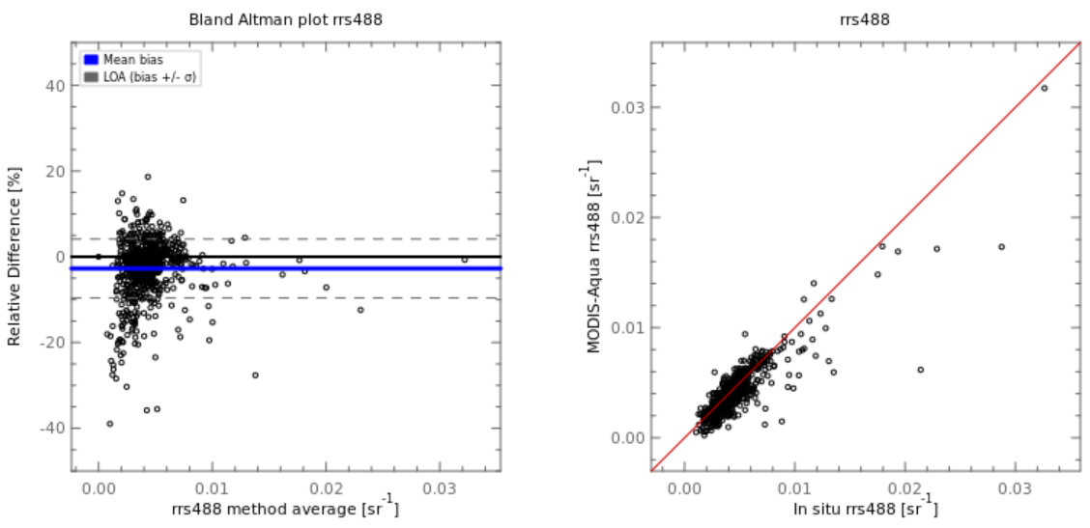
Validation Updates
Ocean Color Reprocessing (R2022) completed
Recent AERONET-OC (V3 level 2.0) Validation update
Current focus: preparing workflows for PACE and catching up with backlogs
Notes:
R2022 validation online
A significant amount of effort going into PACE preparations, particularly getting ready for PACE Validation. New and updated data, code, workflows (and refreshing, working through backlog of older datasets for validation will be releasing those later this year)

Slide 13
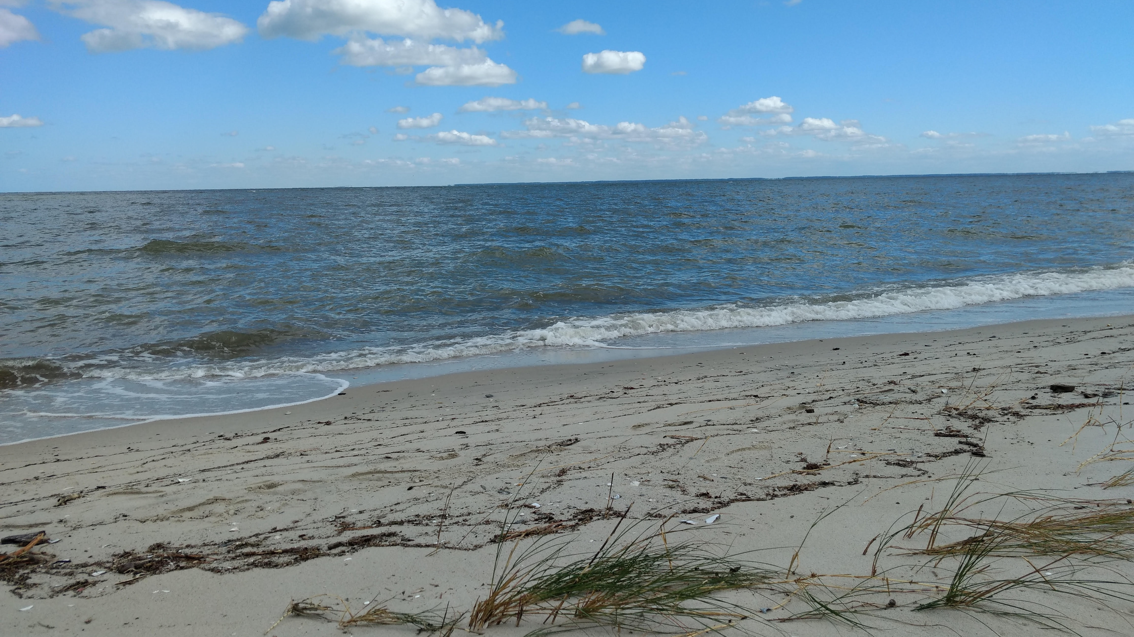
Questions or Comments?
Notes:
That concludes my updates. Looking forward to

