Slide 1
Lidar for ocean research:
Kelsey Bisson, Oregon State University
with support from many, especially Mike Behrenfeld, Emmanuel Boss, Yong hu
CALIPSO & ICESat-2

Slide 2
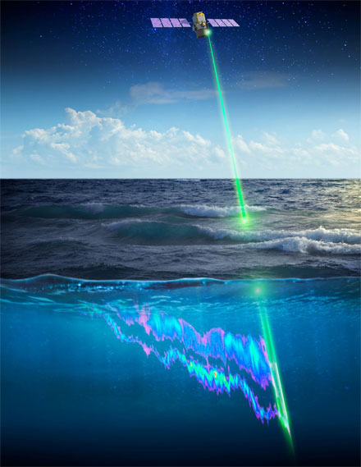
Lidar = light detection and ranging
Why lidar?
Active measurement: Emits photons and measures distance (height) using time of travel & speed of light
Vertical resolution is f(photon frequency)
b_{bp} can be calculated whereafter phytoplankton carbon can be derived
No dedicated ocean lidar satellite in orbit (yet!!)
Tim Marvel, NASA

Slide 3
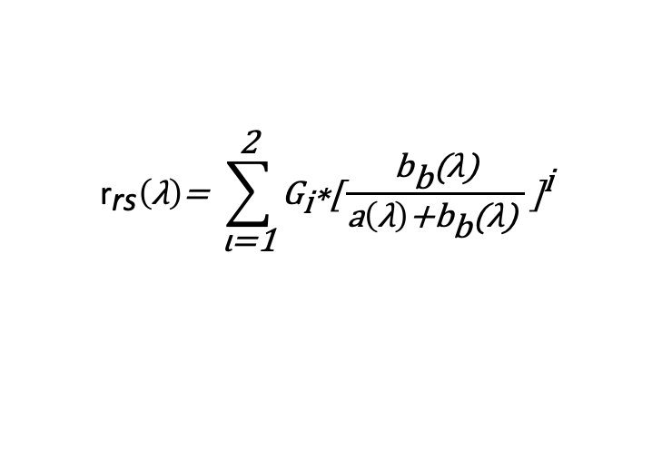

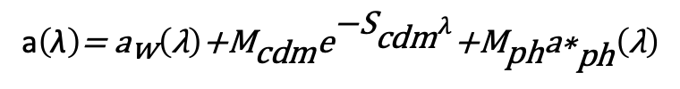
Ocean color observations are indirect measurements
Ocean color measures combined effects of absorption & scattering
No information during night
Retrievals are affected by clouds, aerosols, and low solar zenith angle
r_{rs} Inversion refresher
r_{rs} is ∝ the ratio of scattering to scattering + absorption
$${\text{r}}_{\text{rs}}\left(\text{λ}\right)\text{= }\sum_{\text{ι}\text{=1}}^{\text{2}}{{\text{G}}_{\text{i}}\text{∗[}{\frac{{\text{b}}_{\text{b}}\text{(}\text{λ}\text{)}}{\text{a}\left(\text{λ}\right)\text{+}{\text{b}}_{\text{b}}\text{(}\text{λ}\text{) }}\text{]}}^{\text{i}}}$$
And absorption (a) is the sum of all absorbing constituents (spectrally) and backscattering (b_{b}) is the sum of backscattering from seawater and from particles.
$$\text{a}\left(\text{λ}\right)\text{= }{\text{a}}_{\text{w}}\left(\text{λ}\right)\text{+}{\text{M}}_{\text{cdm}}{\text{e}}^{{\text{−}\text{S}}_{\text{cdm}}λ}\text{+}{\text{M}}_{\text{ph}}{\text{a}\text{∗}}_{\text{ph}}^{ }\left(\text{λ}\right)$$
${\text{b}}_{\text{b}}\left(\text{λ}\right)\text{=} {\text{b}}_{\text{bw}}\left(\text{λ}\right)\text{+}{\text{M}}_{\text{bp}}{ λ}^{\text{−}\text{γ}}$,
March 1, 2023 MODIS Aqua - OBPG
Notes:
Specifically, the measured property is a weighted-integrated value over a relatively shallow depth, it provides no information during the night and retrieval are compromised by clouds, absorbing aerosols, and low Sun zenithal angles.

Slide 4

Lidar satellites for ocean research: We are living off crumbs* from atmospheric & polar satellites!
CALIPSO and ICESat-2 were not launched with intention of studying ocean properties, but have generated great discoveries …
* Very few high level products available for ocean work, so DIY is needed

Slide 5
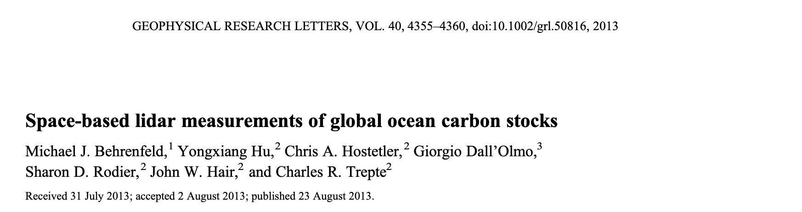
What have we learned so far from CALIPSO and ICESat-2?

Slide 6
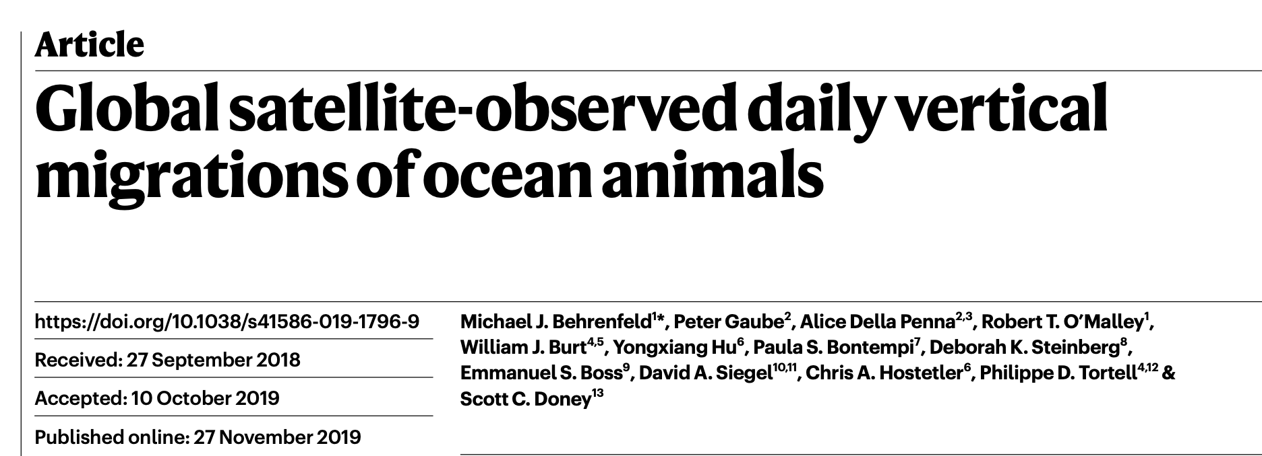
What have we learned so far from CALIPSO and ICESat-2?

Slide 7
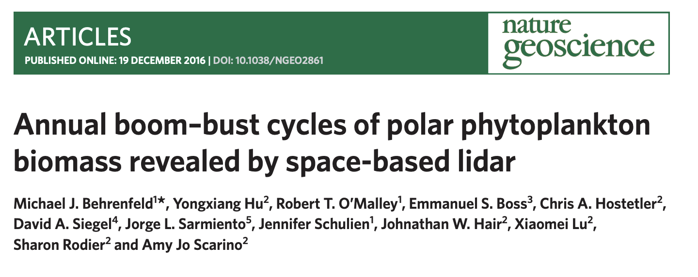
What have we learned so far from CALIPSO and ICESat-2?

Slide 8
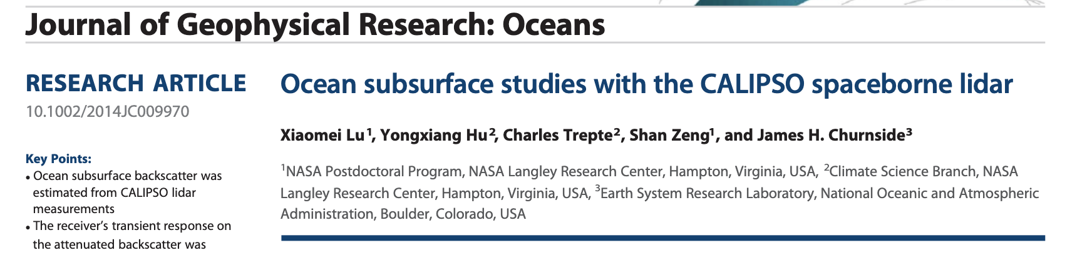
What have we learned so far from CALIPSO and ICESat-2?

Slide 9
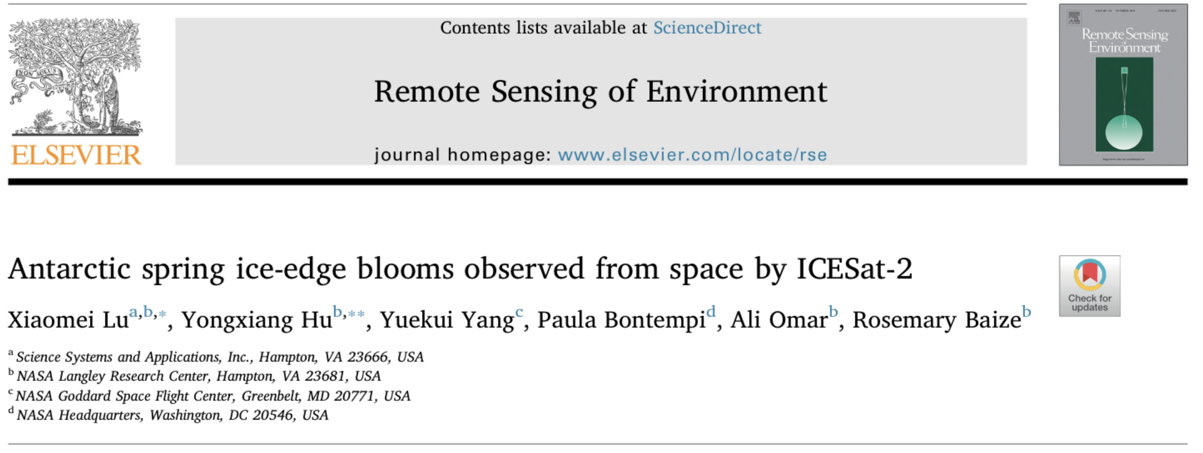
What have we learned so far from CALIPSO and ICESat-2?

Slide 10
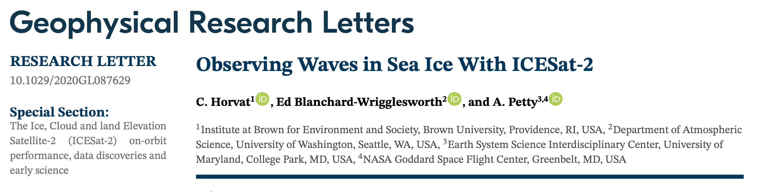
What have we learned so far from CALIPSO and ICESat-2?

Slide 11
What have we learned so far from CALIPSO and ICESat-2?
(2 examples from my work)
CALIPSO
ICESat-2
A global seasonal bias was identified in ocean color R_{rs} after first comparing retrievals to CALIPSO ocean b_{bp} values
(Bisson et al. 2021a, 2021b)
Sea ice leads (fractures) and mean b_{bp} under ice (Argo) strongly covary in the Southern Ocean
(Bisson and Cael, 2021)

Slide 12
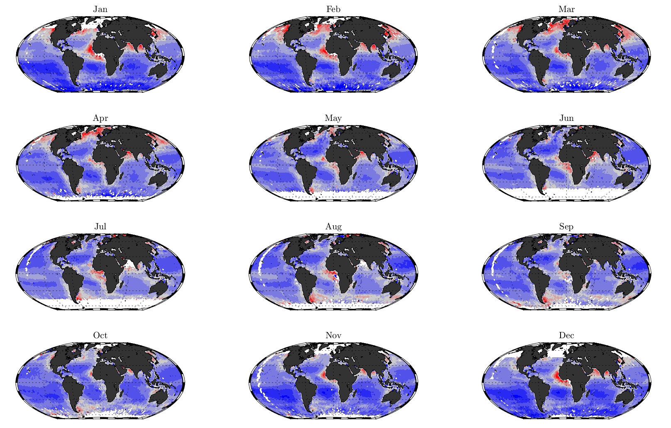

What will we learn next??
Ongoing work to merge global independent values b_{bp} values from lidar directly into Rrs inversion procedure using ocean color data too.
Right, percent difference (-50 to 50%) of CALIOP derived absorption using both MODIS-Aqua and CALIOP data in tandem, compared to MODIS-Aqua absorption at 443 nm.
CALIPSO (CALIOP instrument) b_{bp} data are available online at link to left
Thank you!
(in review)

