Slide 1


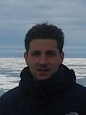

Ocean Biology & Biogeochemistry
Quantifying the global sink of CDOM by photobleaching in the surface ocean using remote sensing
Xiaohui Zhu and Cédric G. Fichot
Department of Earth and Environment, Boston University
Remote Sensing
of Water Quality
Notes:
Hi everyone, I am Xiaohui Zhu, from Boston University. My presentation is ‘Quantifying the global sink of CDOM by photobleaching in the surface ocean using remote sensing.’ This research is done by me and my advisor, Cedric Fichot. It is sponsored by NASA’s remote sensing of water quality program.

Slide 2
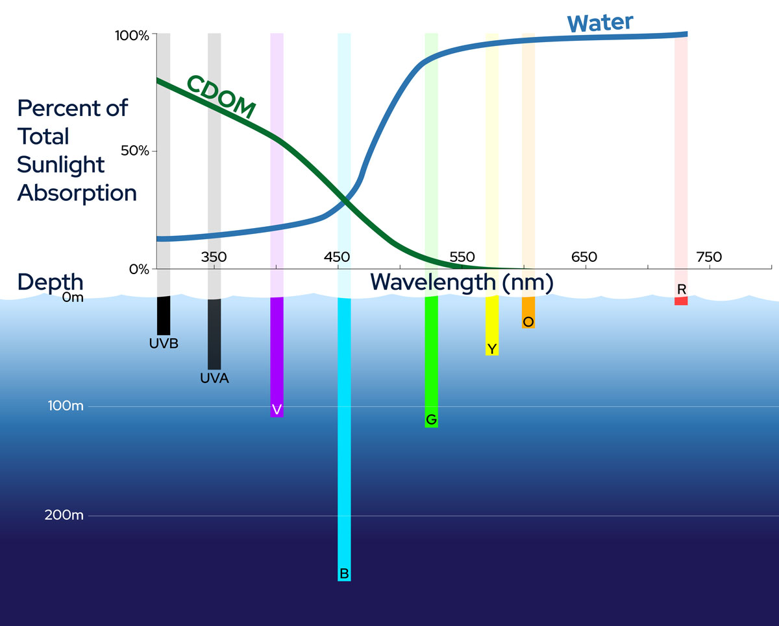
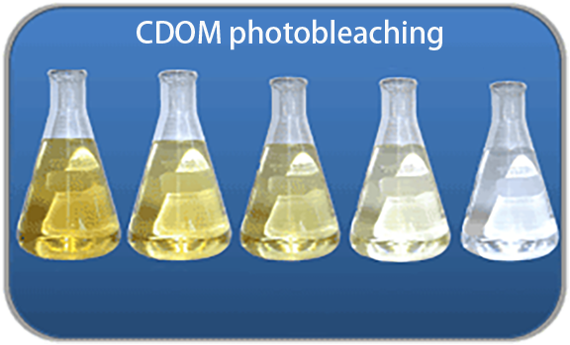
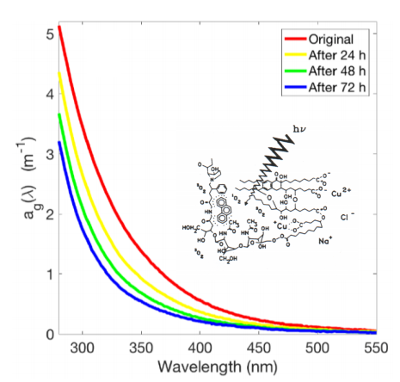
CDOM photobleaching (PB) is ubiquitous and important
PB decreases CDOM absorption
PB regulates PAR availability and UV exposure
PB decouples dynamics of CDOM and DOC
CDOM absorption coefficient
Notes:
We all know CDOM. It has strong absorption in UV and blue band. But, what’s CDOM photobleaching? Absorbed photons can break down CDOM and reduce its light absorption. This process is called CDOM photobleaching and is called PB here. It is important for several reasons. The most important reason is that it regulates the light field in the surface ocean.

Slide 3
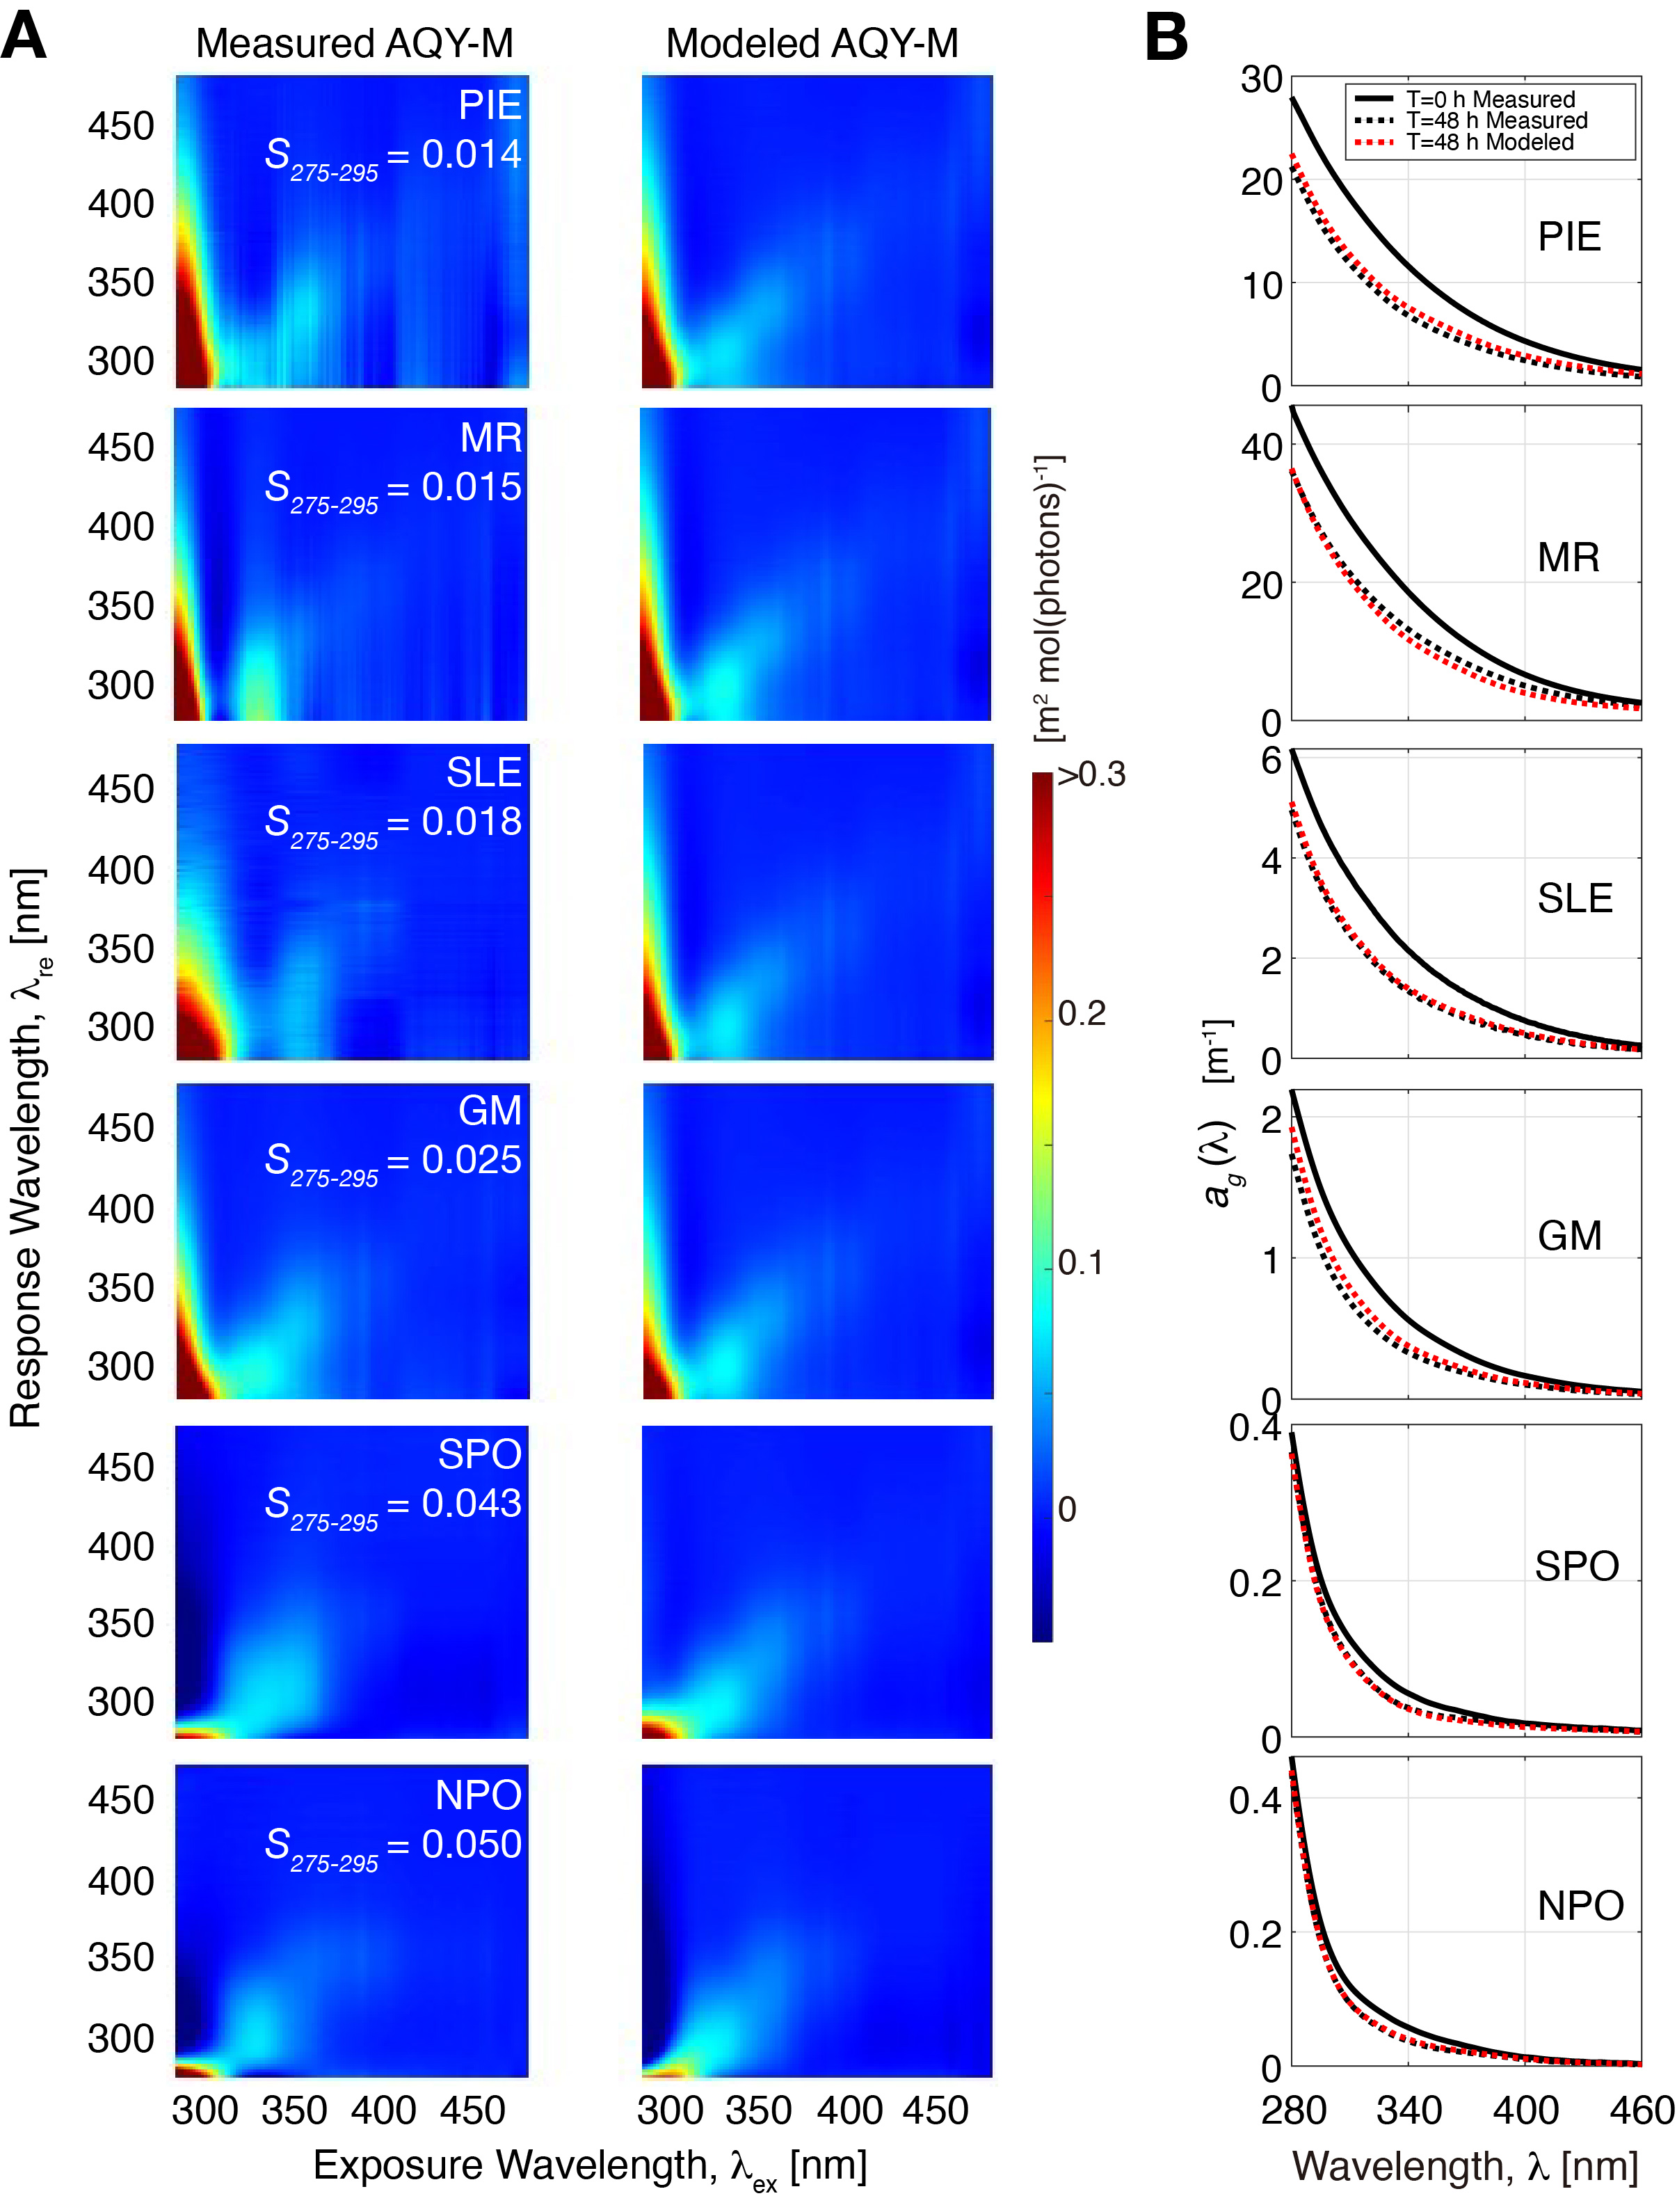
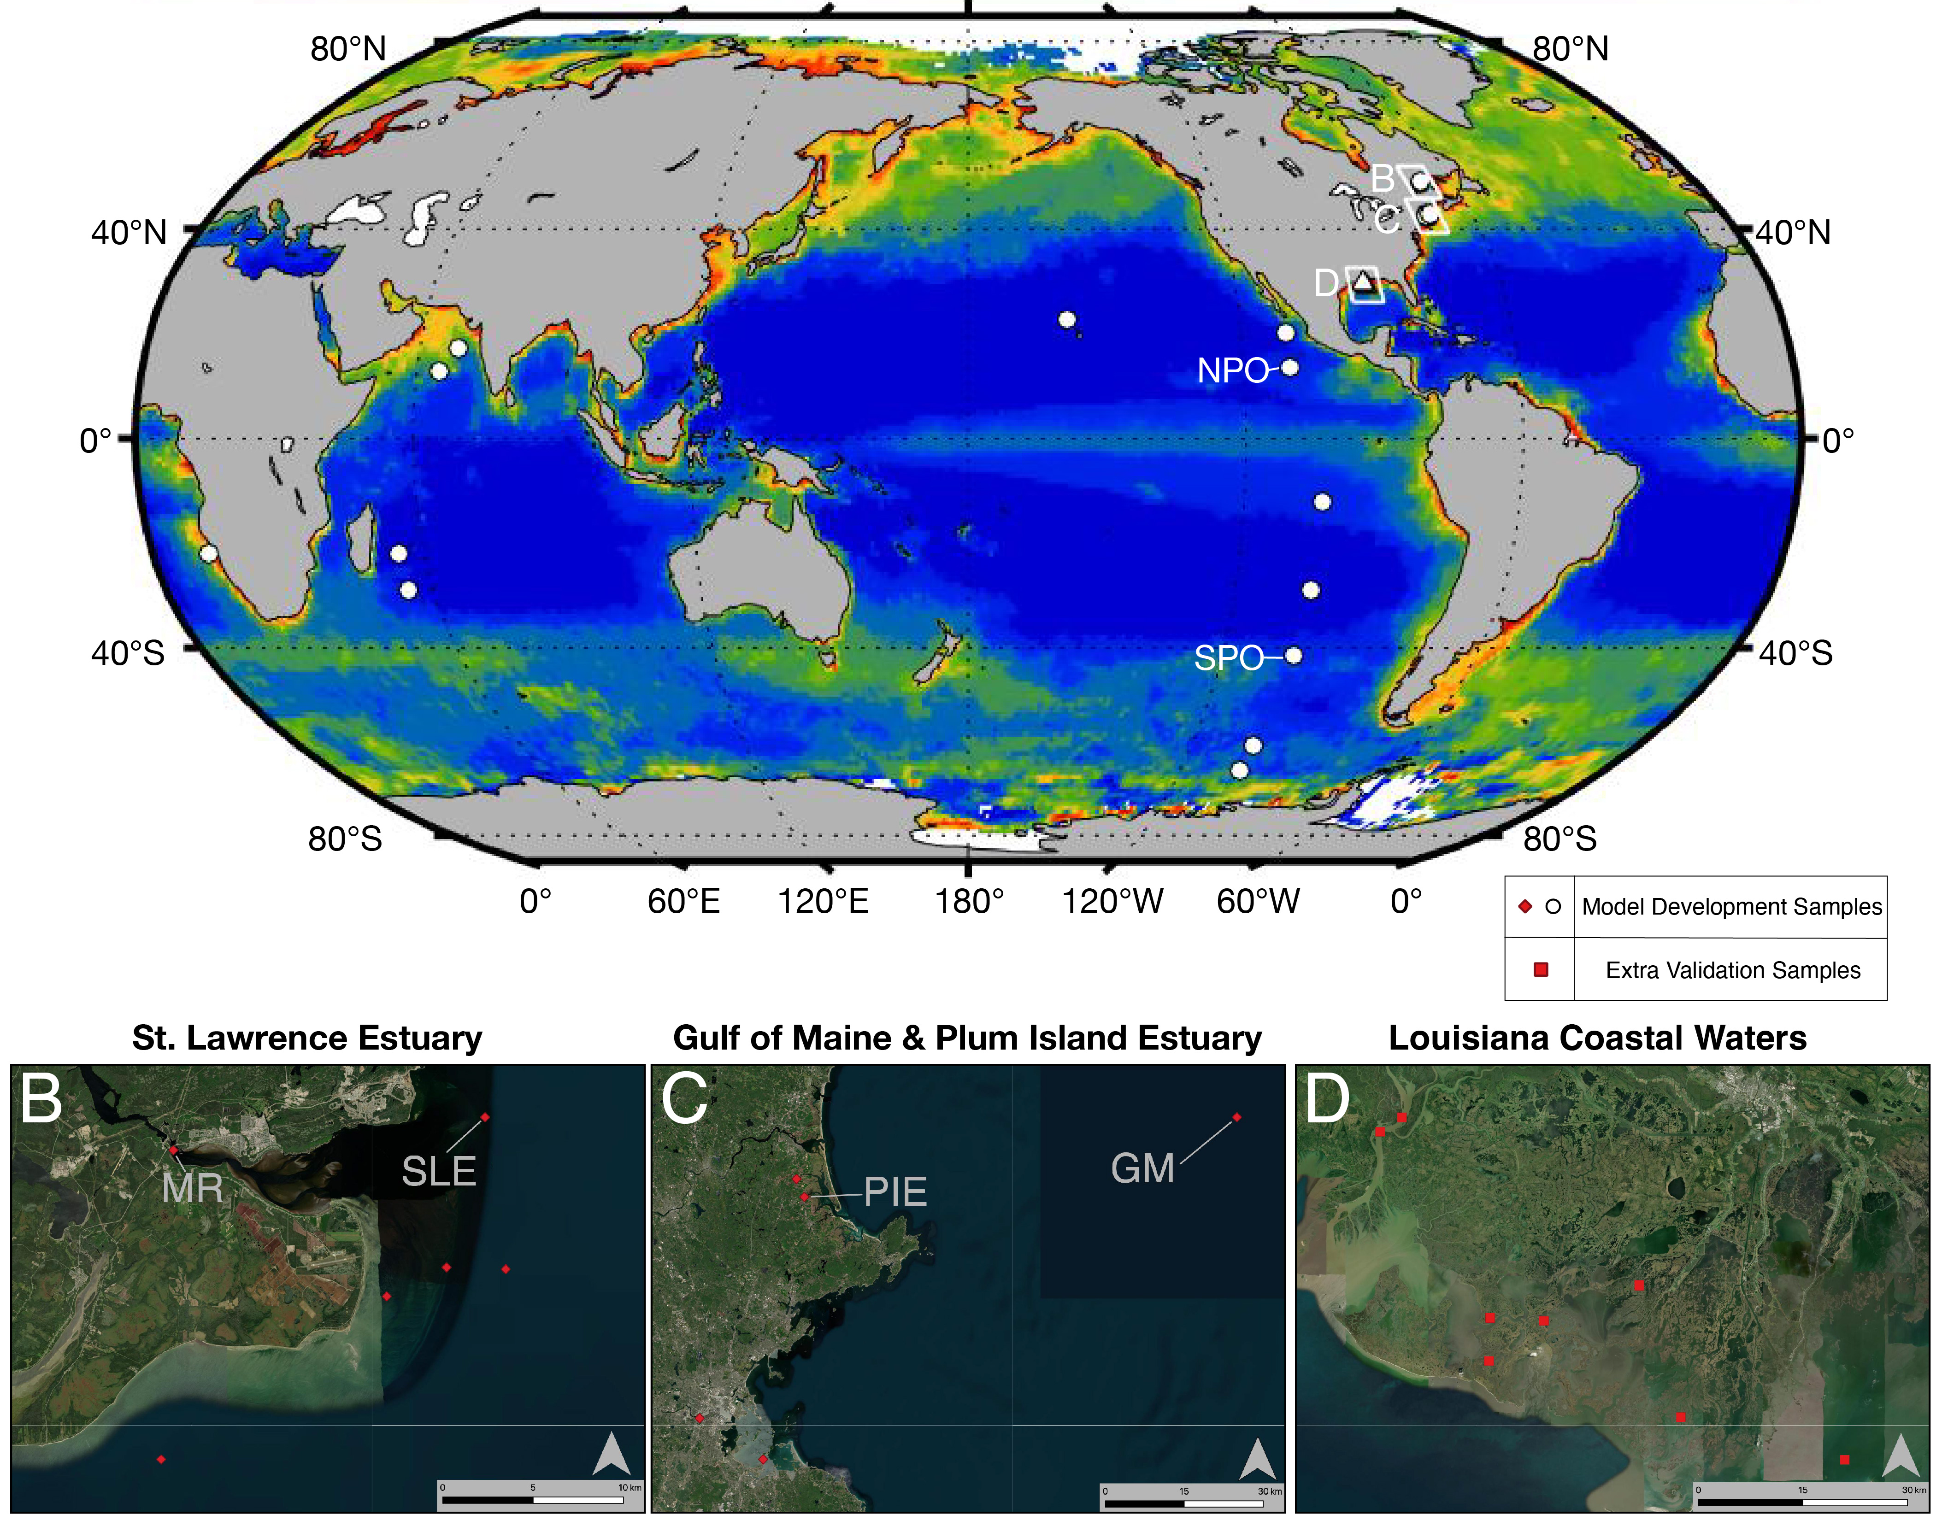
Optical proxy of DOC composition
Solar exposure
Water temperature
Model to predict CDOM PB efficiency
Riverine/Estuarine
Open Ocean
Zhu et al. (in prep) Science of Total Environment
Notes:
We collected divers water samples and did solar incubation experiments to build model to predict photobleaching’s efficiency. The model used three parameters that could be provided by remote sensing products. It represented the magnitude and structure of efficiency matrix in the cross validations. And, then could be used to quantify the photobleaching in surface ocean

Slide 4
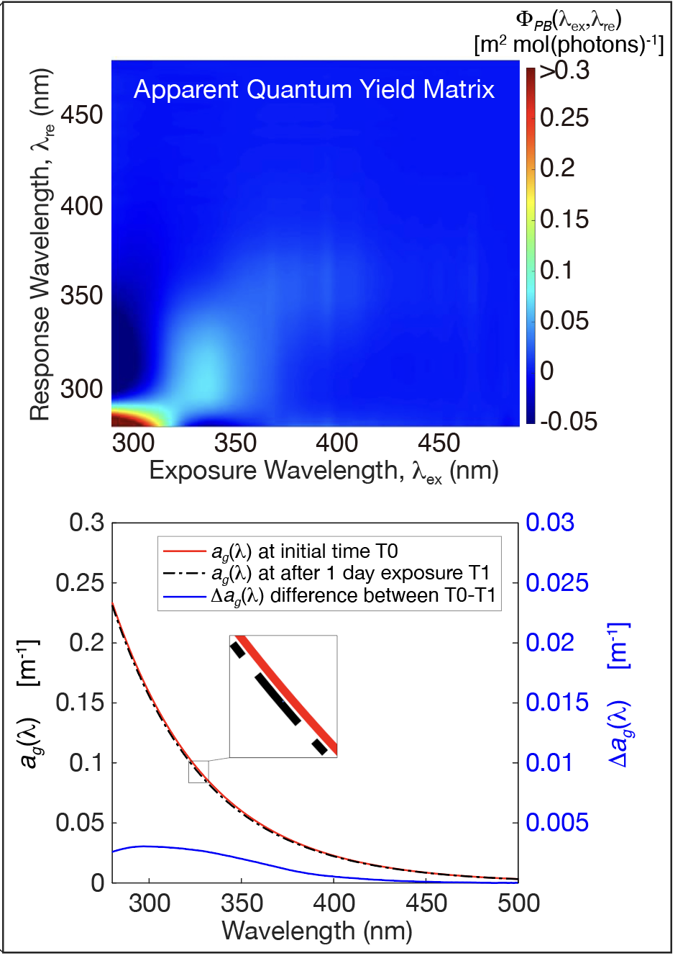
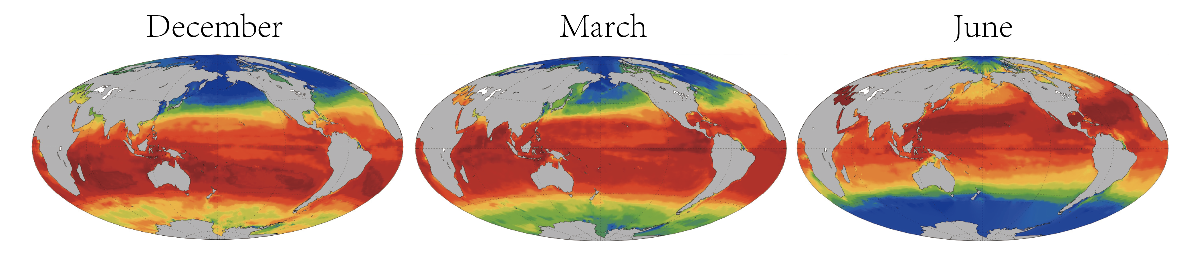
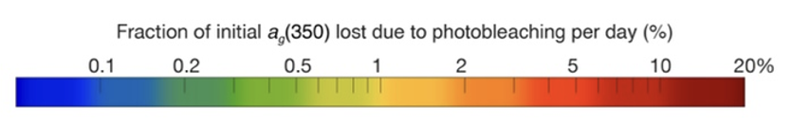
Global climatology of CDOM photobleaching rates
Zhu and Fichot (in prep) GRL
Notes:
Here is a glance of our CDOM photobleaching products. Every pixel in the map is a whole spectrum of the CDOM photobleaching in a single day.

Slide 5
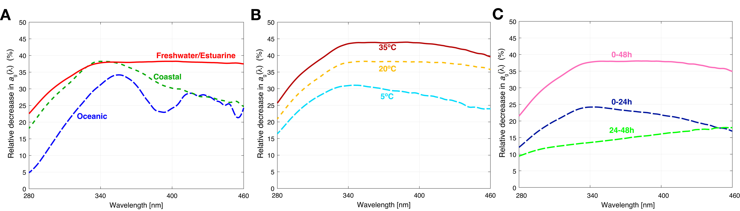
CDOM photobleaching efficiency is very variable
CDOM type
Water Temperature
Incubation Time
Notes:
With these experiments, we have some new finding about photobleaching. It increase from oceanic CDOM to fresh. And, oceanic CDOM shows clear wavelength preference around 360nm. Water temperature’s effect is big but shows no wavelength preference. Photobleaching decrease with incubation time, and the preference switch from short to long wavelength.

Slide 6
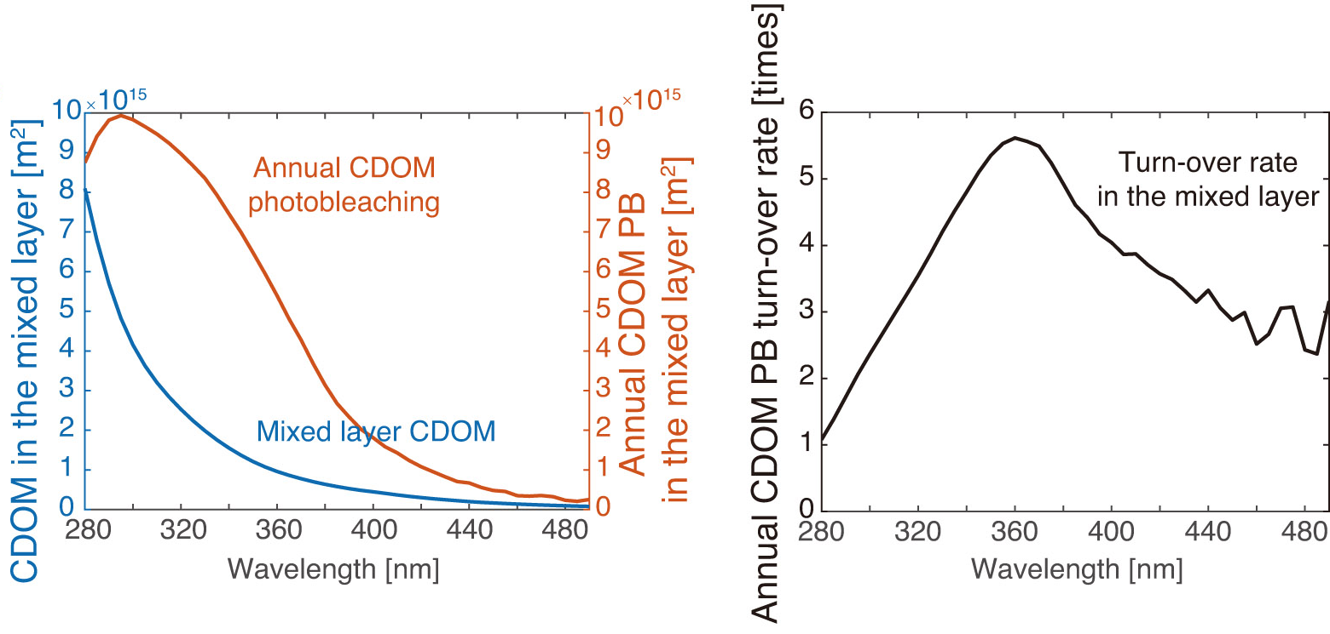
PB turns over CDOM in the mixed layer ~1 to 6 times/year
≈ 1-6% global ocean CDOM
Notes:
Based on our product, we estimate its global annual sink. Photobleaching shows peak around 300nm. The annual CDOM photobleaching is about one to six times of CDOM storage in the mixed layer. It depends on the wavelength, and shows peak near 360nm. The mixed layer CDOM is about 1% of global ocean storage. So the annual sink equals to 1 to 6 % of global ocean CDOM. This value hints that the ocean surface CDOM is in a dynamic balance and in-situ bio-generation is important for the balance.

Slide 7
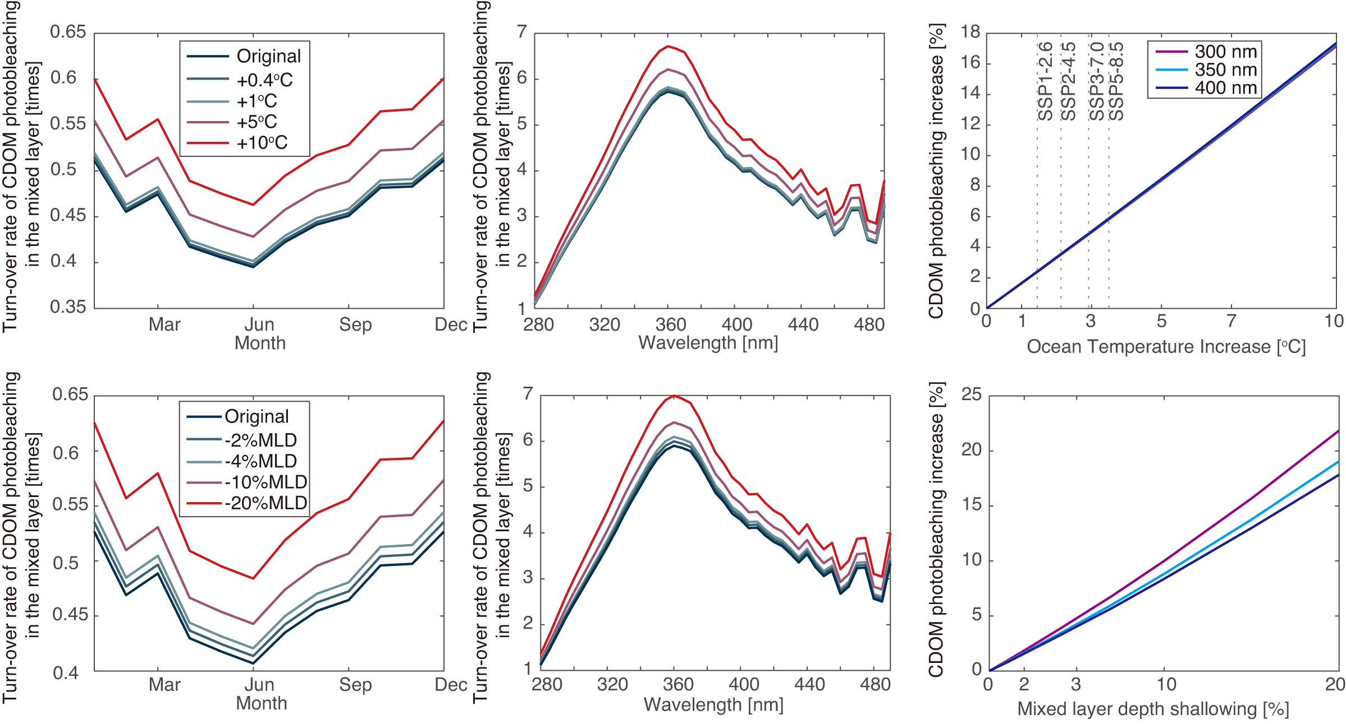
Sensitivity to climate change
Sea surface temperature increase
Mixed layer depth decrease
5.88%
Notes:
We did a quick photobleaching sensitivity to ocean warming. Under the high-emission scenario, sea surface temperature increase about 3.5 degree in this century, and it is 6% photobleaching increase. Mixed layer depth decrease with warmer ocean. It means larger average dose of light and longer light history there. It shows larger impacts on shorter wavelength.
This is a quick test, and this change will interact with feedbacks in surface ocean. The final change might be smaller than this. But, at lease we can expect more photobleaching and less CDOM in the surface ocean in the future.

Slide 8

Remote Sensing of
Water Quality
Karl Kaiser
Chloe Anderson
Matthew Weiser
Josh Harringmeyer
William L. Miller
David Kieber
Simon Bélanger
Thank you!
zhuxh@bu.edu
Notes:
Thanks NASA for sponsoring both the project and my trip to here. Also, very thanks to my wonderful colleagues and cooperators. Without your contribution, I cannot get these samples and do measurement for the global scale research.

Slide 9
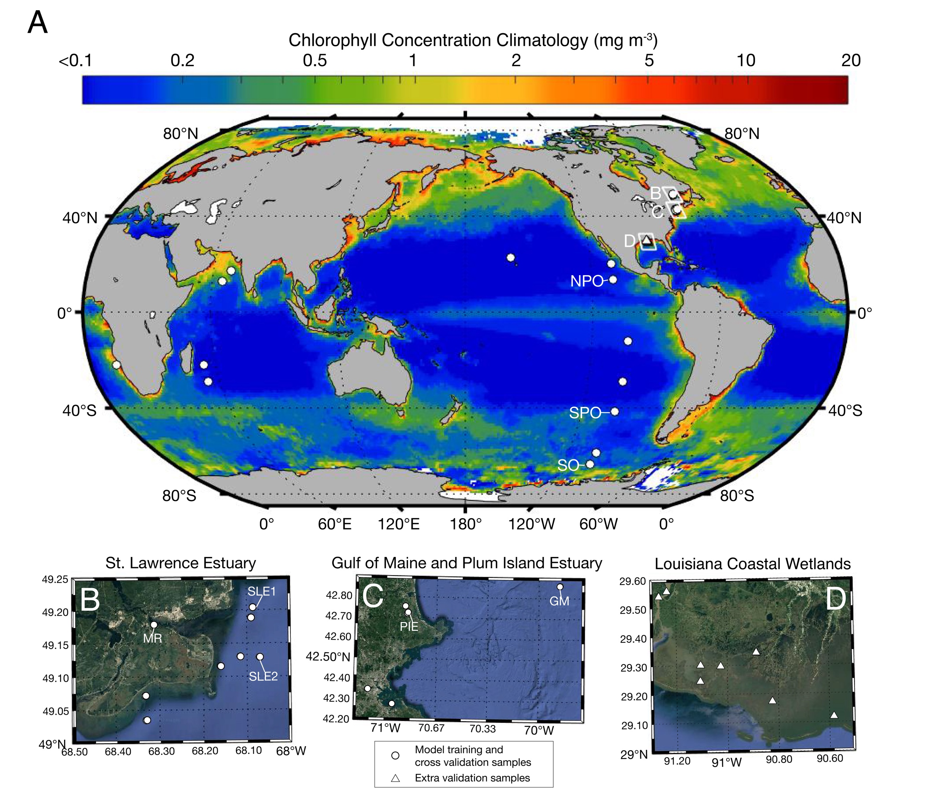
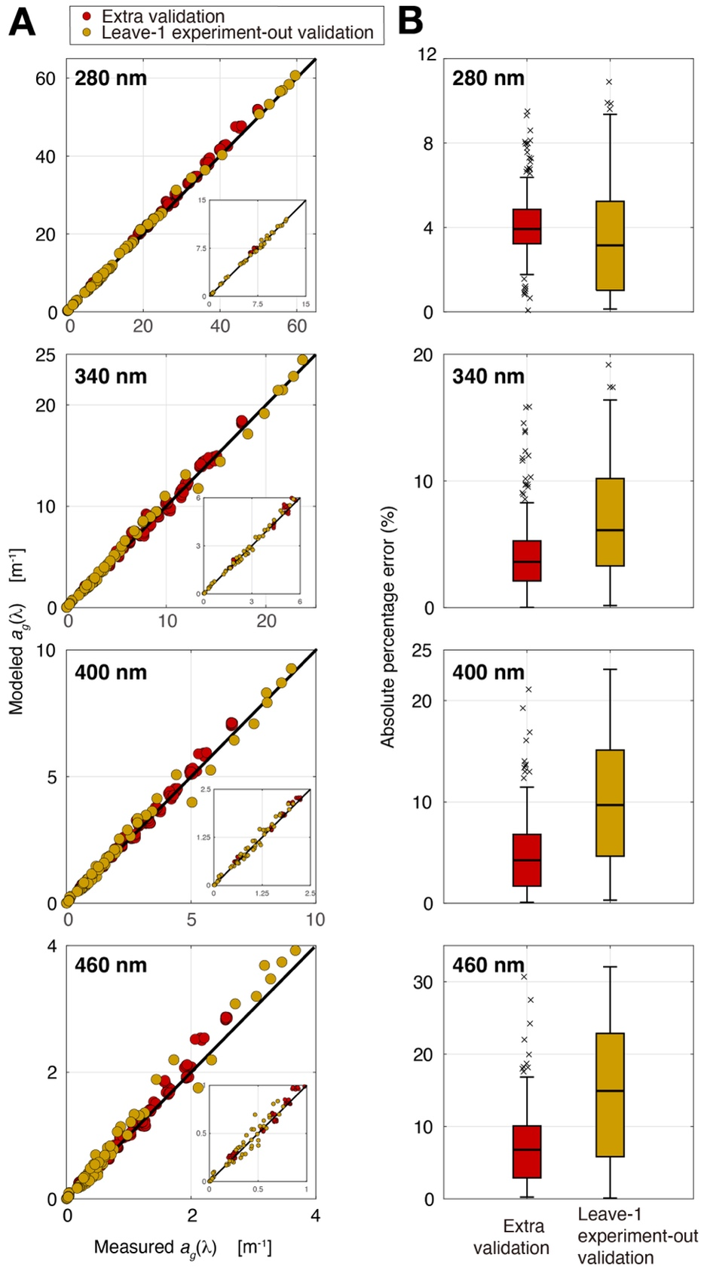
Model to predict PB efficiency
4%
Diverse samples (n=28)
  Rivers, Estuaries, Salt Marshes, Coastal Ocean, Upwelling region, Open Ocean
3 temperature treatments
  5˚C, 20˚C, 35˚C
2 exposure times (dose)
  24 h/48 h solar exposure
Extra validation samples (n=11)
Cross-validation (n=28)
5%
10%
10%
Notes:
To quantify photobleaching, we built a model based on lots solar incubation experiments in the lab. It covers divers samples of different water types. And, they were done in different water temperature and two incubation times. The model is validated with extra samples and cross validation. Its performance meets our need.

