Slide 1




Ocean carbon and oxygen response to Mt Pinatubo
Galen A. McKinley
Earth and Environmental Sciences
Lamont-Doherty Earth Observatory
Learning the Earth with Artificial intelligence and Physics (LEAP)
Columbia University
NASA OCRT, May 8, 2023
Notes:
Though my proposed title included oxygen, I don’t have time to cover it. Glad to talk later!

Slide 2
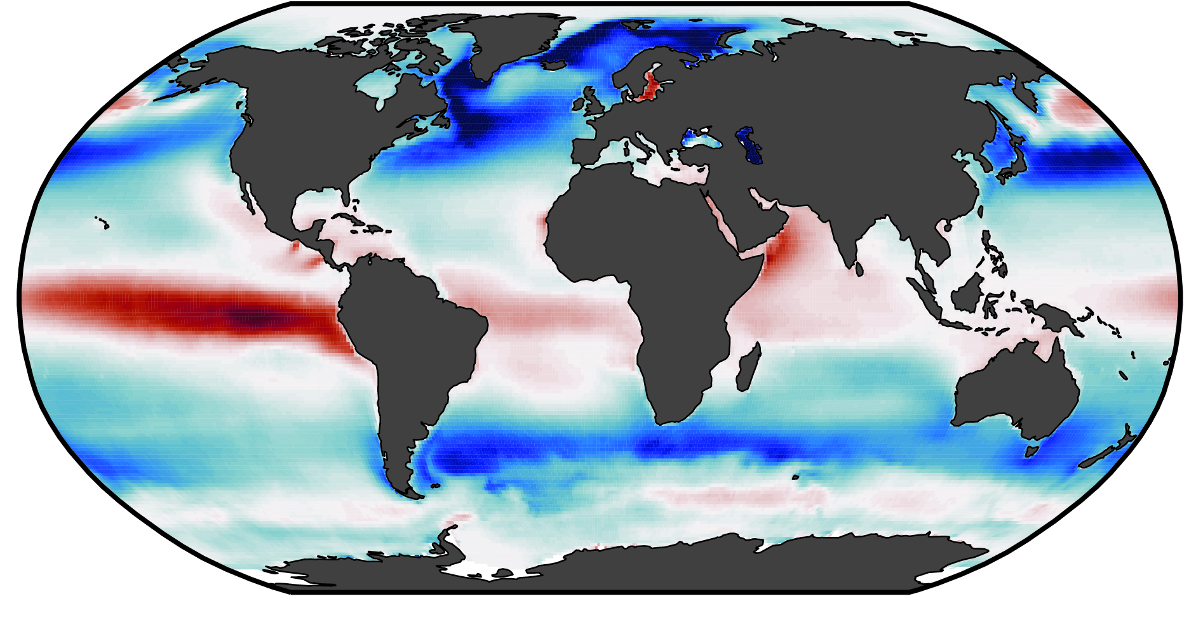
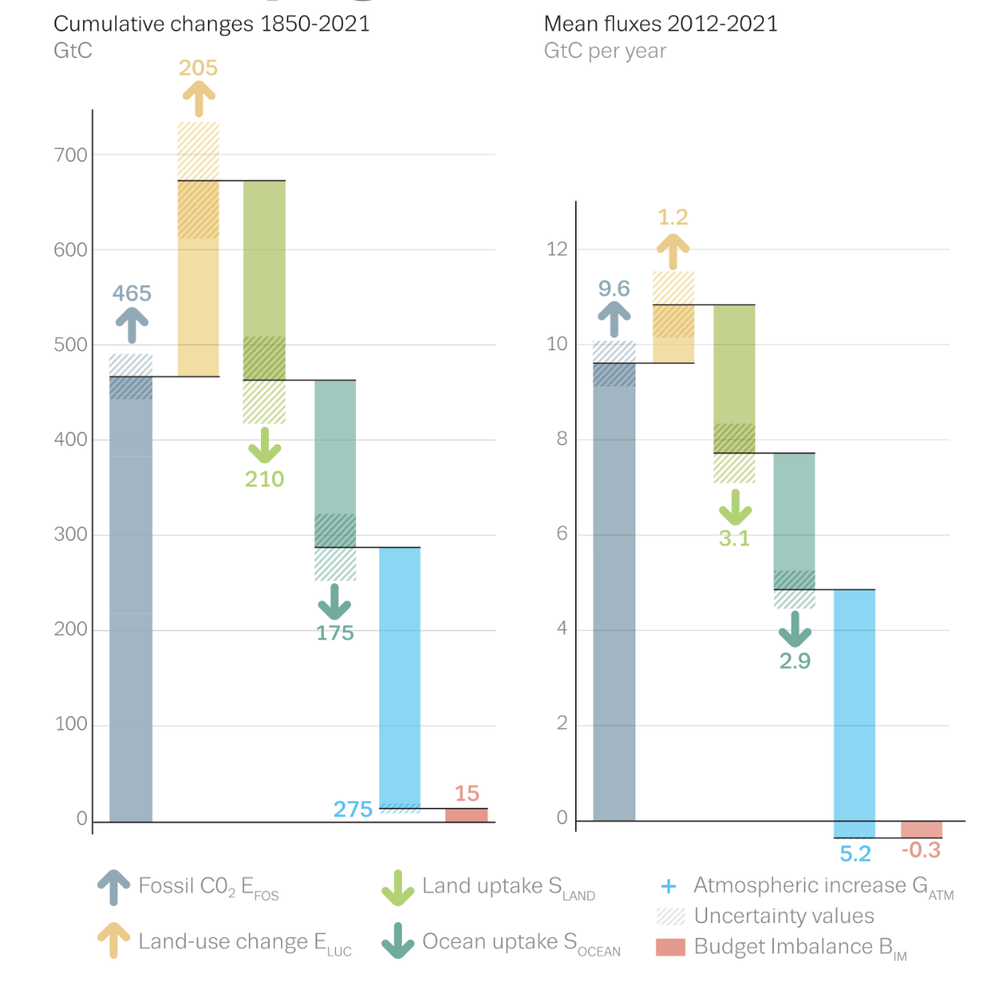
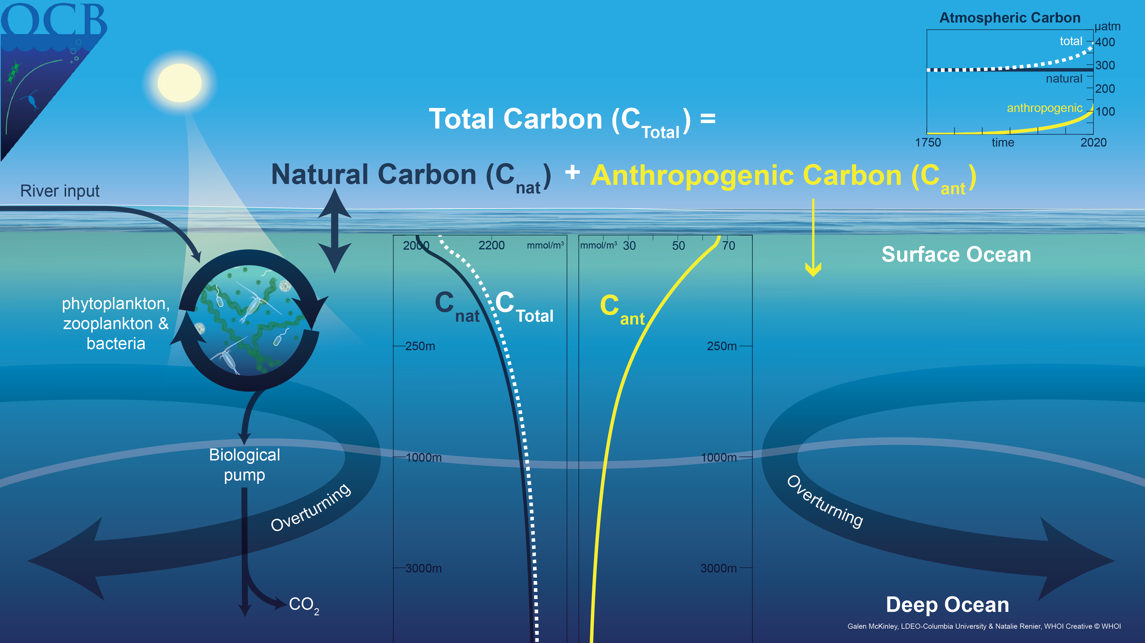
How do we quantify the the ocean carbon sink?
Cumulative Emissions and Sinks
1850-2021
Anthropogenic sink, on top of a vigorous natural cycle
Land Use
Land Sink
Ocean Sink = 38% Fossil CO₂
Fossil CO₂
Atmosphere
Friedlingstein et al. 2022, ESSD
Crisp et al., 2023

Slide 3

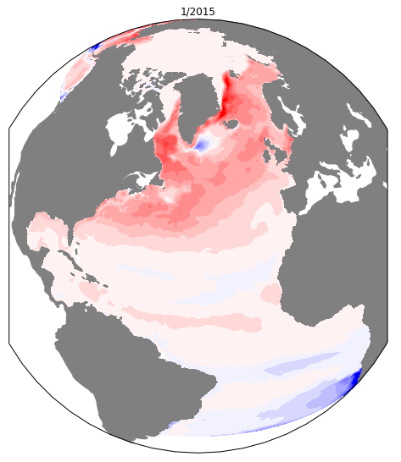
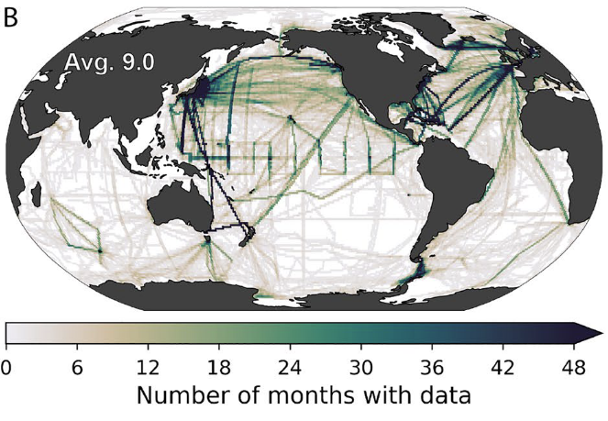

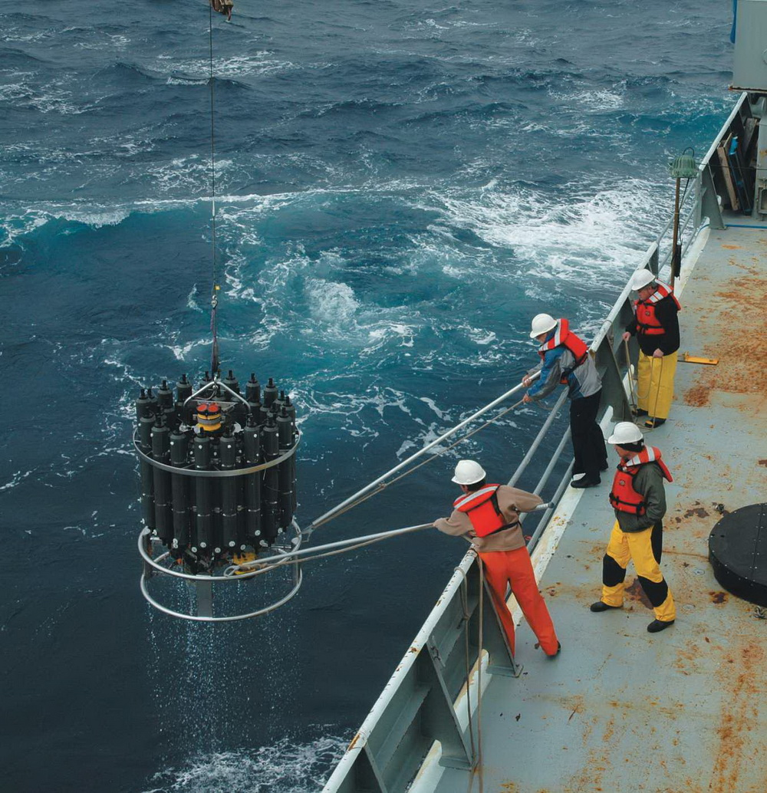
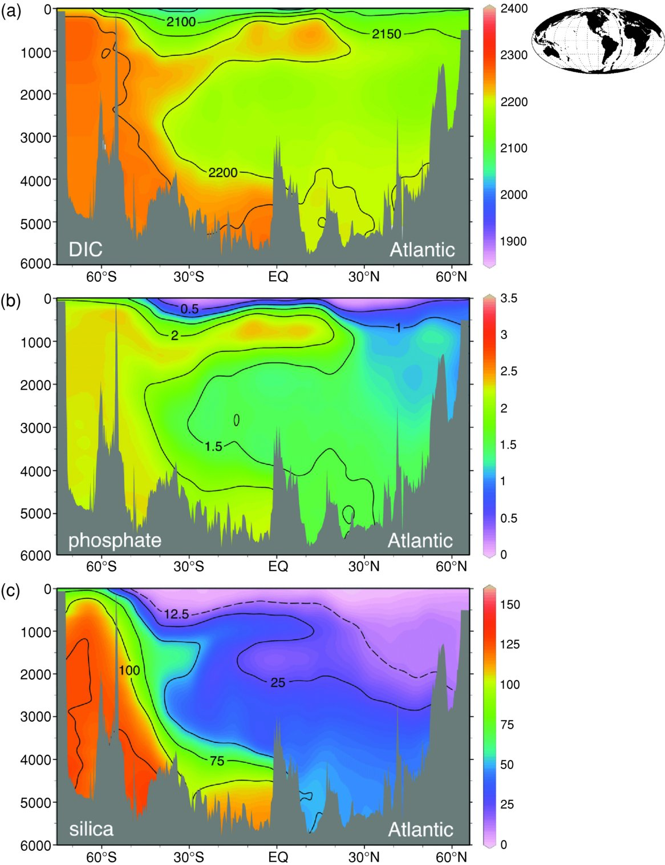
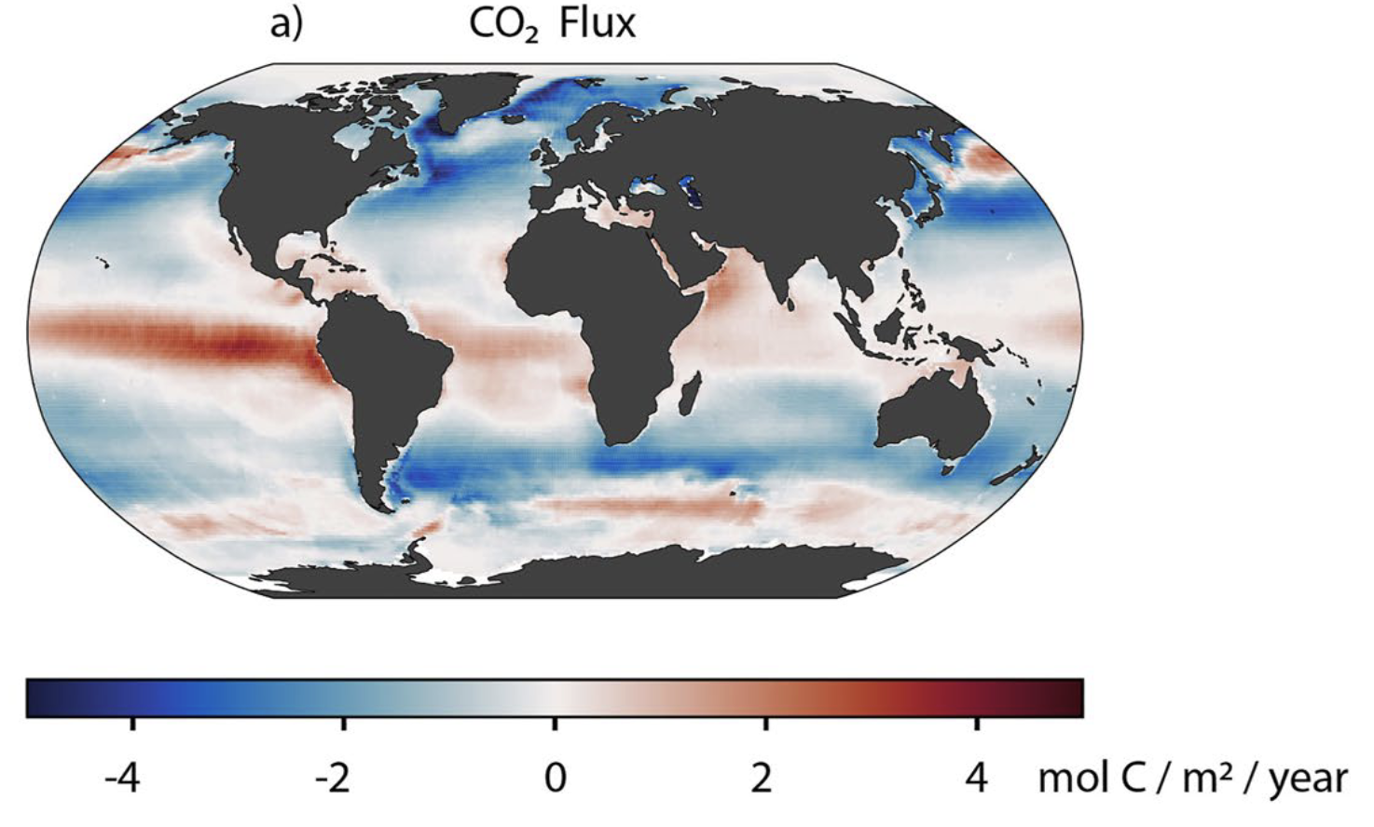
Three independent approaches constrain the ocean carbon sink
1. Interior observations / products
Interior carbon storage
Decadal closure of global budget
Model validation
2. Modeling
Air-sea fluxes
Mechanisms
Projections
3. Surface observations / products
Air-sea fluxes (∼monthly)
Model validation
SOCAT
pCO₂
AI/ML
ASTE-BGC
air-sea CO₂ flux
DIC from GLODAP
Moseley et al, in prep
Notes:
Section: Williams and Follows 2011
CTD: NOAA OAP
Ship: WHOI
Ship: Dalhousie VOS
SOCAT # months Gloege et al. 2021
CO2 flux Bennington et al 2022

Slide 4
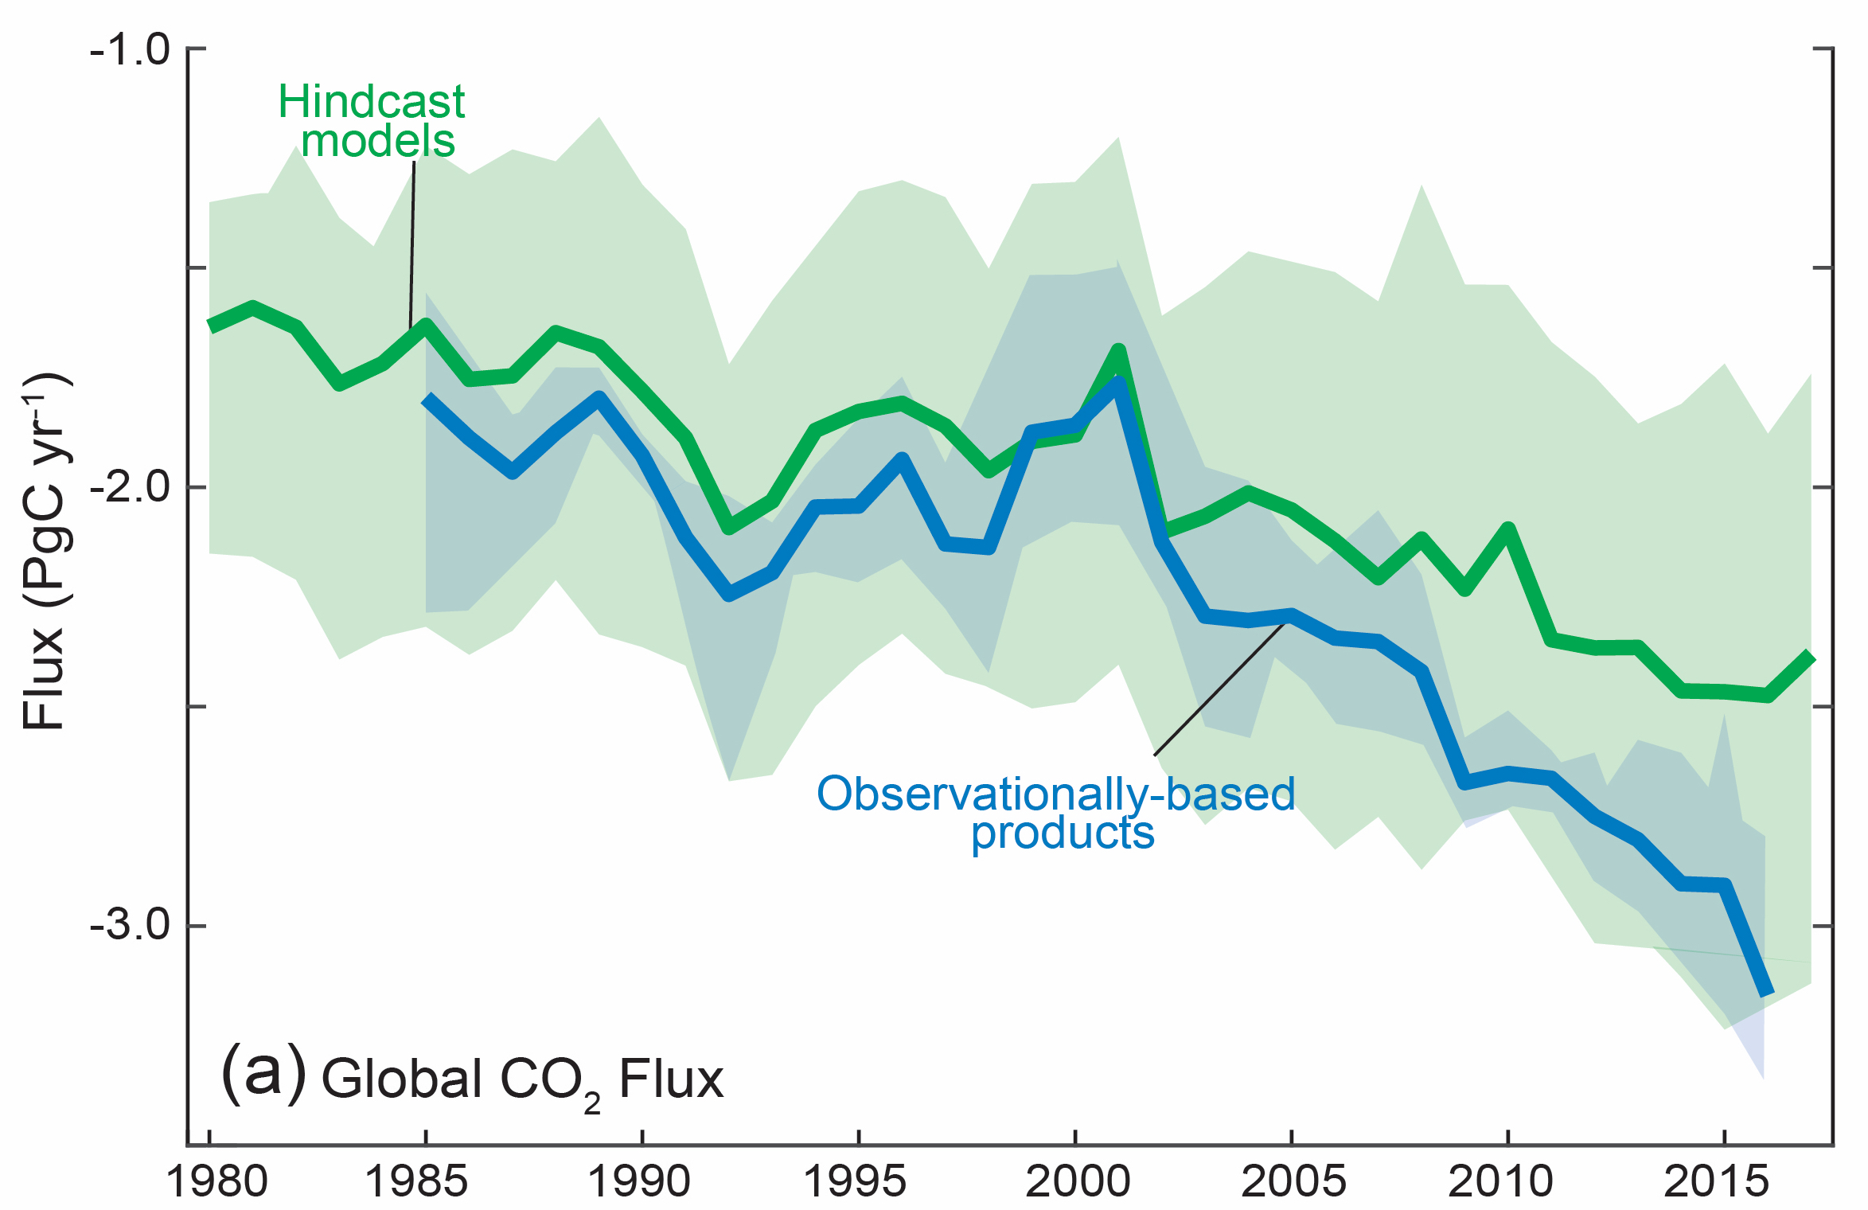
Approaches agree to first order, but uncertainties remain large
Interior
Growing sink
McKinley et al. 2020, AGU Advances
Interior estimate of Gruber et al. 2019, Science
Notes:
Interior is 2.2 +- 0.4 at 2 sigma ,once the natural non-steady is removed and uncertainties accounted for

Slide 5
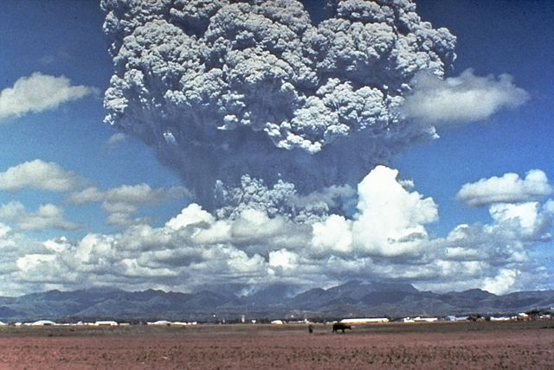
To what degree was the abrupt increase in the ocean carbon sink in the early 1990s due to the eruption of Mt. Pinatubo?
June 1991
Growing sink
By Dave Harlow, USGS - CVO Photo Archives -, https://commons.wikimedia.org/w/index.php?curid=545011
McKinley et al. 2020, AGU Advances

Slide 6
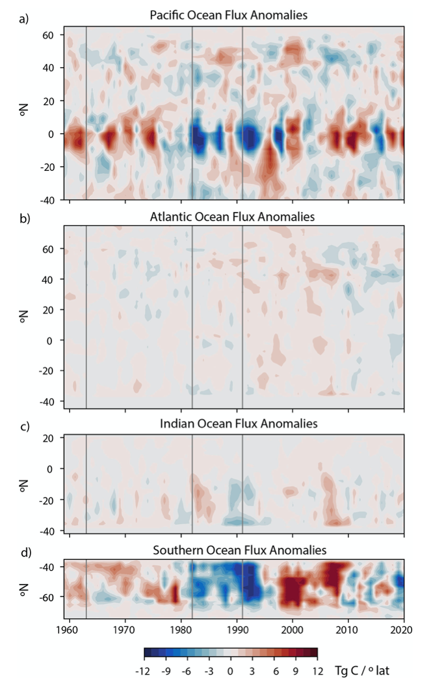
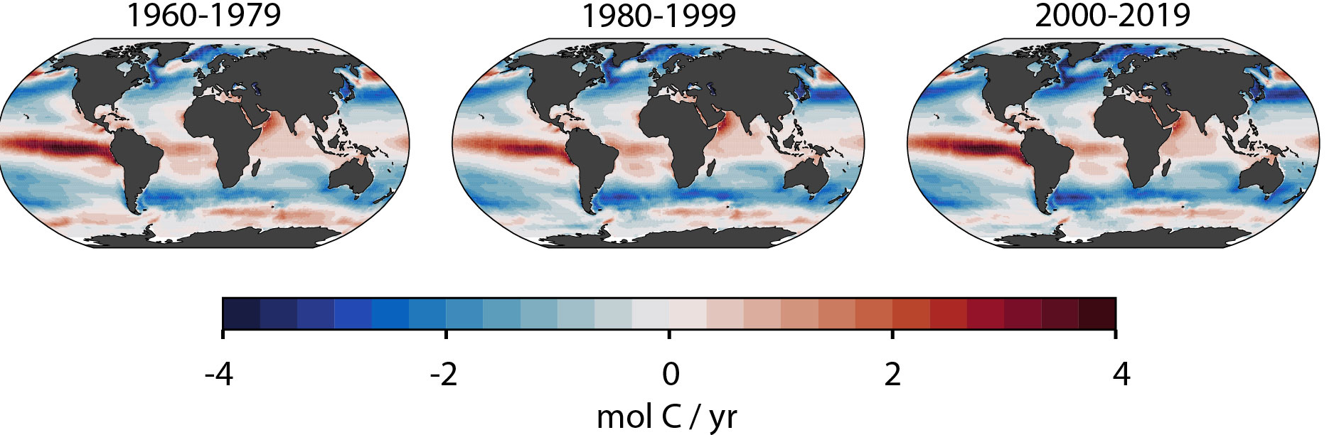
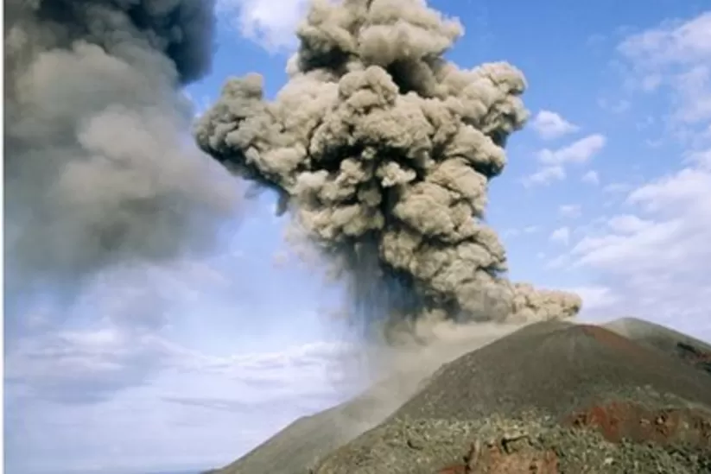
An observation-based product (LDEO-HPD)
Air-sea CO2 flux, 1959-2021
Detrended Basin Flux Anomalies
60 years of monthly 1x1 air-sea CO₂ fluxes from pCO₂ data / machine learning approach using hindcast models as prior
Reveals significant decadal variations; coherent between equatorial Pacific and Southern Ocean
Mt. Pinatubo
Bennington et al. 2022 GRL; Wong et al. in prep
El Chichon

Slide 7
Test the externally forced impact of Mt. Pinatubo on ocean carbon with an CESM-Large Ensemble

Slide 8
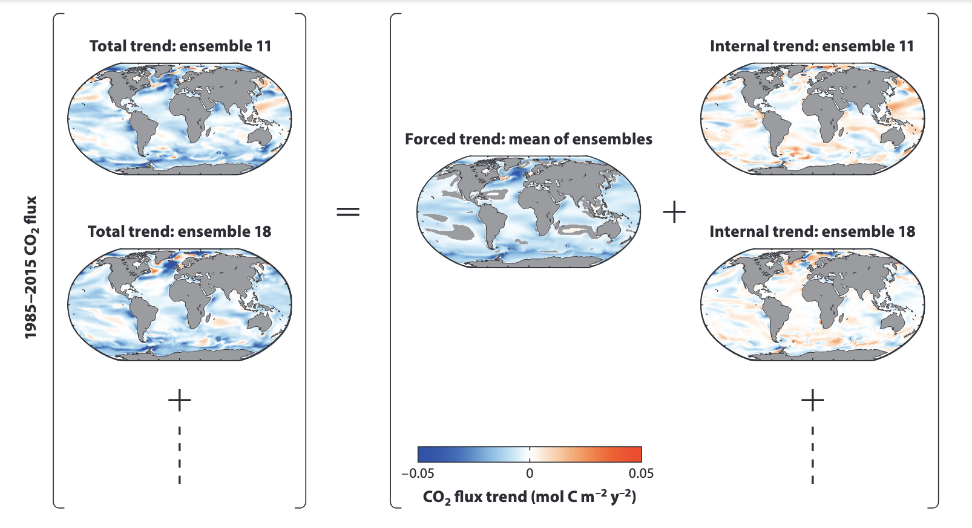
Isolating forced response from internal variability using Earth System Model Large Ensemble
Example: 1985-2015 CO₂ flux trend
Each ESM run has its own stochastic variability (“internal”) and a common “forced” response (due to volcanos, pCO₂^{atm}, etc)
To isolate response to external forcing, run 10s of runs; average to get what is common
(=“forced response”)
Then, for each member:
  Total – forced = internal
McKinley et al. 2017, ARMS

Slide 9
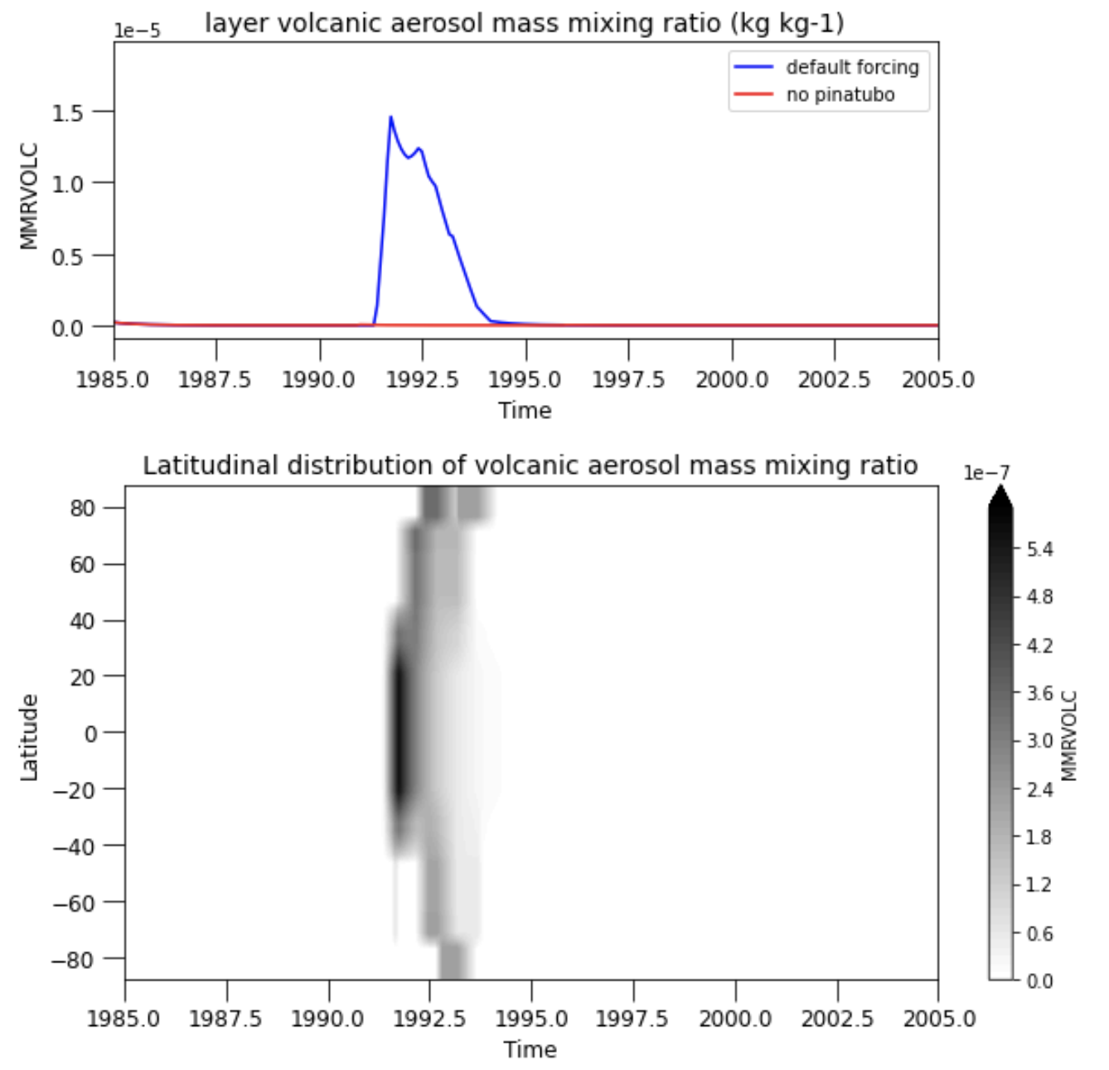
Community Earth System Model – Large Ensemble (CESM-LENS) Experiment Design
  CESM-LENS
  CESM1-Large Ensemble (Kay et al. 2015)
  Historical / RCP8.5 Simulations
  CAM5 atmosphere and POP2 ocean
CESM1-LENS, No Pinatubo
    CESM-LENS, 29 ensembles
    1991-1995 volcanic aerosol mass mixing ratio replaced with non-eruption (1986-1990 values)
Volcanic Aerosol Mass Mixing Ratio
Fay et al. 2023, GBC

Slide 10
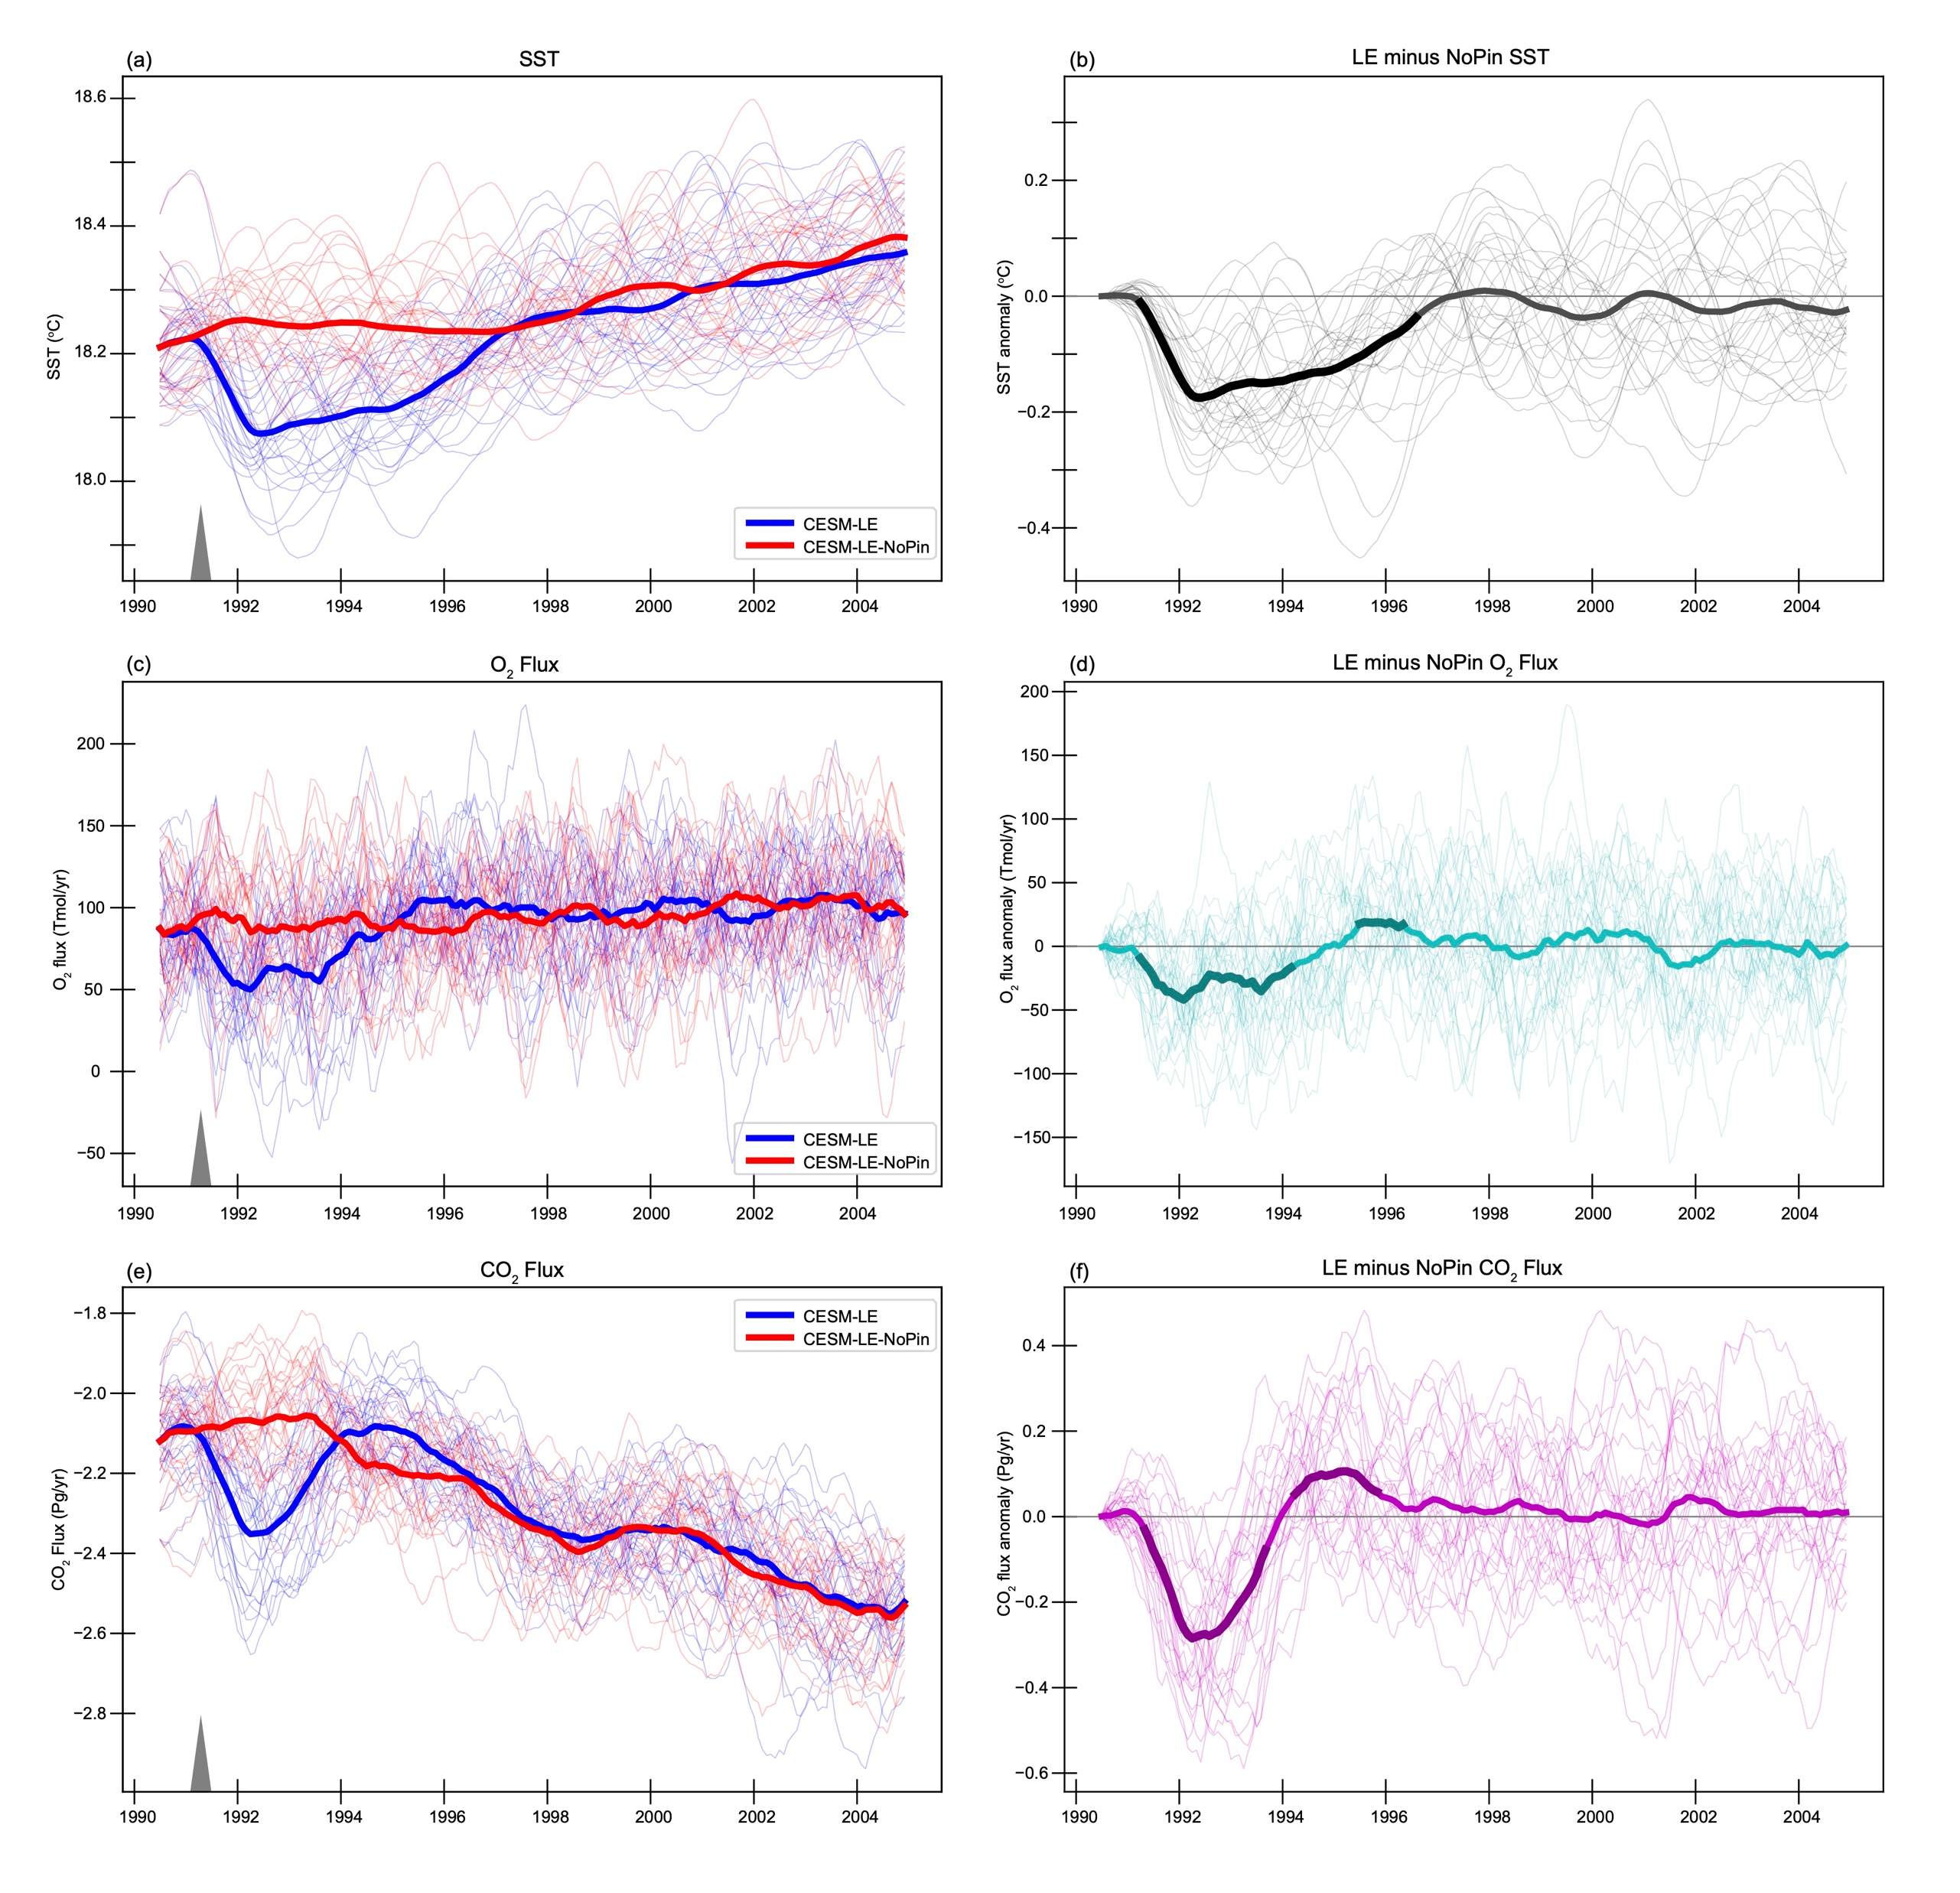
Globally integrated Carbon Flux
Global CO₂ flux (with Pinatubo, without)
Difference (with Pinatubo - without)
Growing sink
Forced global carbon flux anomaly=
0.29 PgC/yr in 1992
Thin lines = 29 ensemble members, each scenario
Bold line = forced response (= ensemble mean)
Fay et al. 2023, GBC

Slide 11
To what degree was the abrupt increase in the ocean carbon sink in the early 1990s due to the eruption of Mt. Pinatubo?
~0.3 PgC/yr
June 1991
Forced global carbon flux anomaly=
0.29 PgC/yr in 1992
Growing sink
By Dave Harlow, USGS - CVO Photo Archives -, https://commons.wikimedia.org/w/index.php?curid=545011
McKinley et al. 2020, AGU Advances

Slide 12
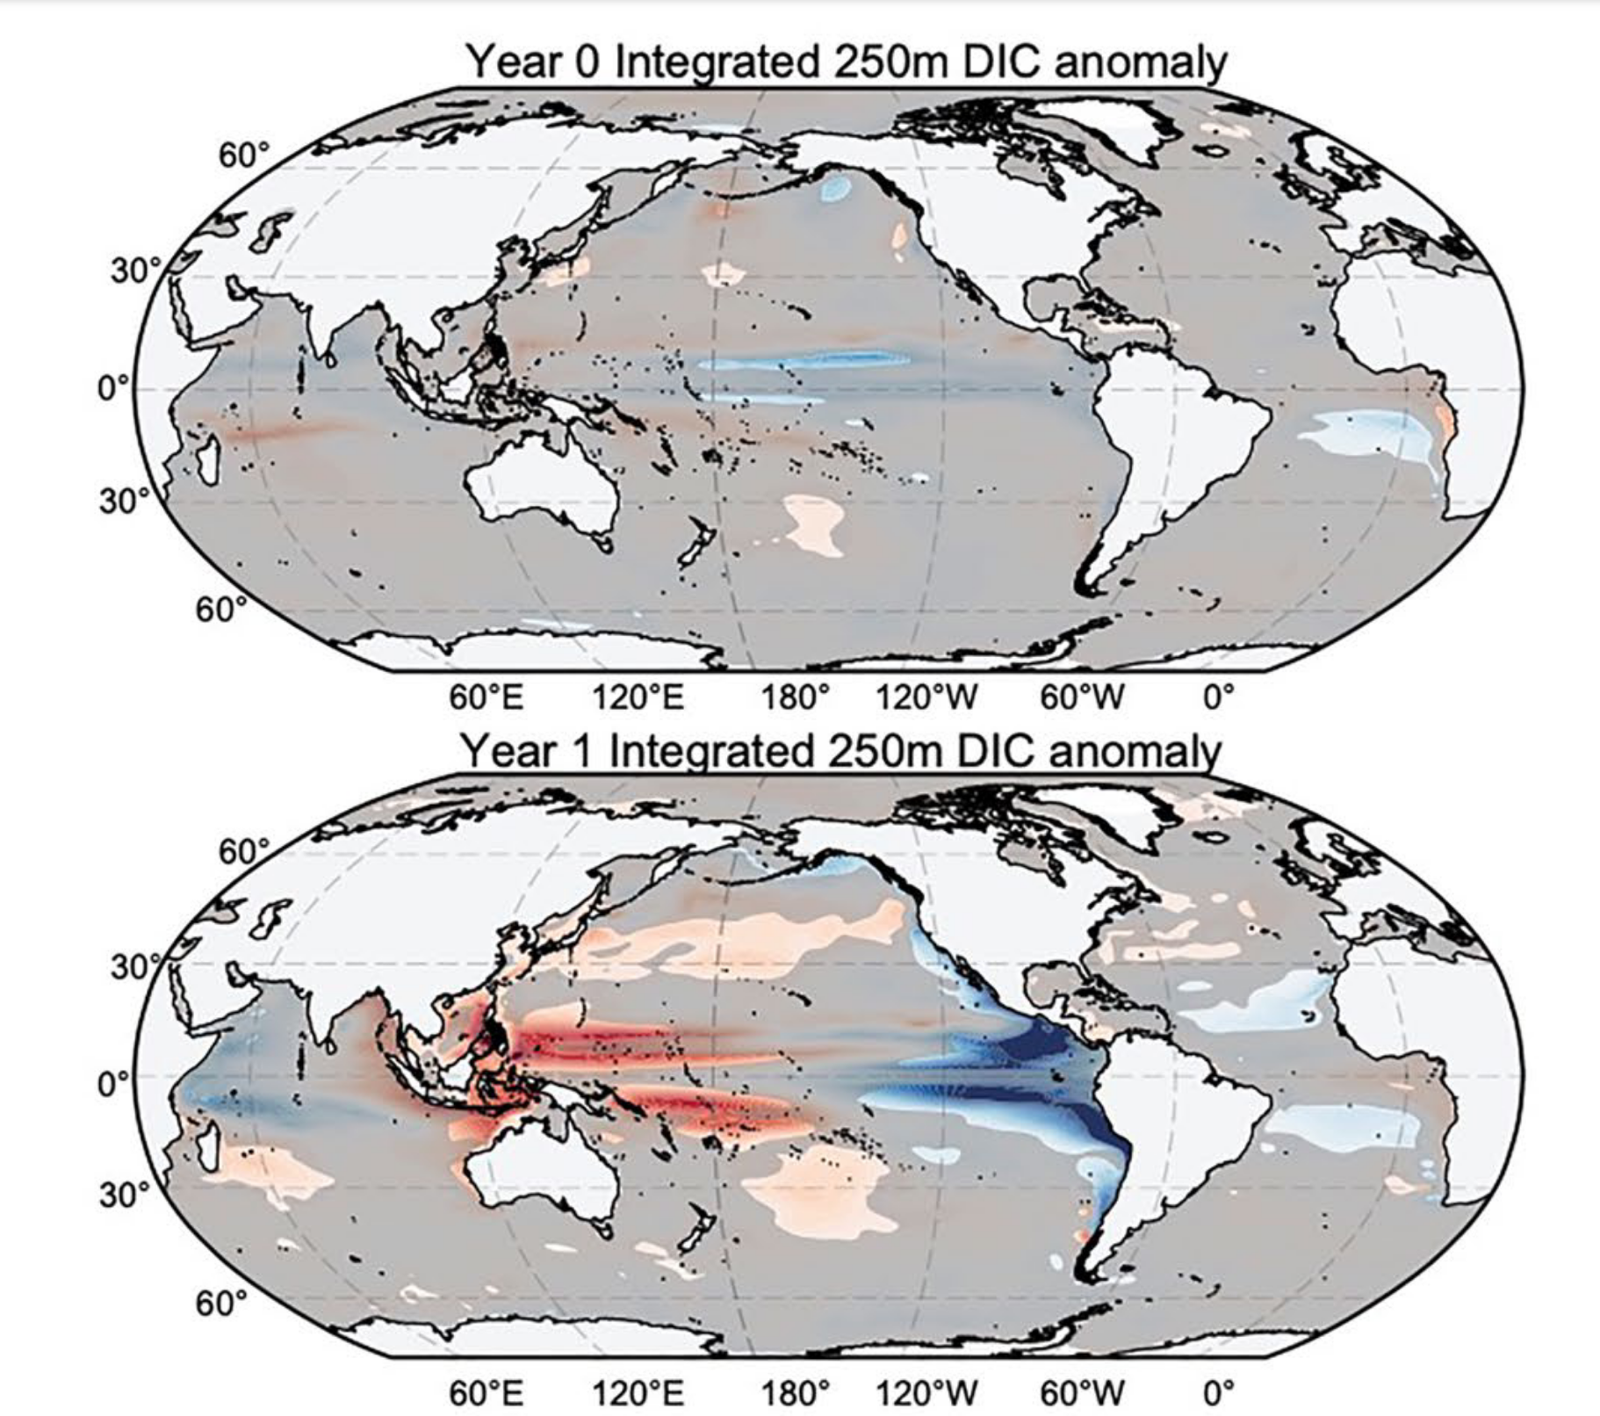
Where does this Mt. Pinatubo forced response occur?
Year 0 upper ocean (0-250m) DIC anomaly
Year 0 =
Jul 91-Jun 92
No significant response in first year (Year 0)
Forced El Niño and positive anomalies in North Pacific mode waters in second year (Year 1)
No significant forced response in Southern Ocean
Year 2, 3 (not shown) show La Niña forced response, no significant forced impact in S. Ocean
Year 1 upper ocean (0-250m) DIC anomaly
Year 1 =
Jul 92-Jun 93
Fay et al. 2023 GBC
Fay et al. 2023, GBC

Slide 13
An observation-based product (LDEO-HPD)
Air-sea CO2 flux, 1959-2021
Detrended Basin Flux Anomalies
If not an externally forced response in Southern Ocean,
then internal variability is likely alternative hypothesis
Mt. Pinatubo
Bennington et al. 2022 GRL; Wong et al. in prep
El Chichon

Slide 14
Next Steps: NASA Carbon Cycle
Ocean carbon sink variability: Internal vs. forced mechanisms
To study internal variability, we are working with the ECCO-Darwin global-ocean biogeochemistry model (with D. Menemenlis, D. Carroll, A. Fay, H. Zhang)
We have extended ECCO-Darwin to span 1985-2022, and completed simulations to distinguish mechanisms of variability
    observed climate, observed atmospheric pCO₂ growth rate
    historical average climate
    constant atmospheric pCO₂ growth rate
Results coming soon!

Slide 15
THANK YOU mckinley@ldeo.columbia.edu

Slide 17
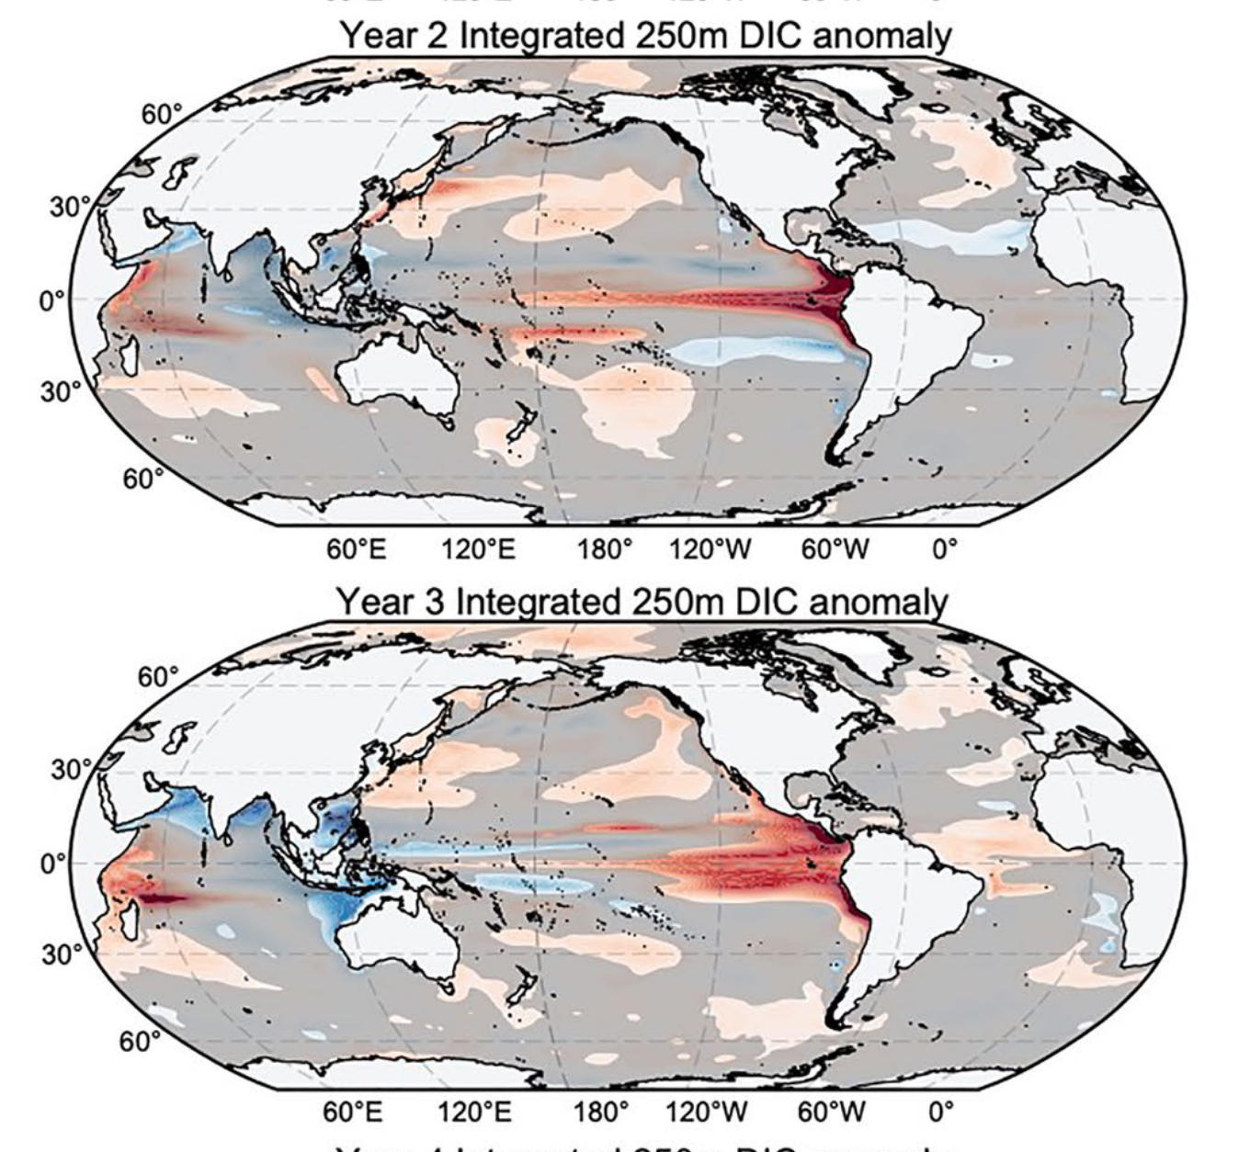
Mt. Pinatubo forced upper ocean DIC anomaly
Year 2 (July 1993-June 1994)
Year 3 (July 1994-June 1995)
Fay et al. 2023, GBC
Notes:
Year 3 (July 1994–June 1995); and Year 4 (July 1995–June 1996).

Slide 18
Results
Global Mean Carbon Flux
Oxygen flux anomaly peaks at 42 Tmol/yr in 1992
Carbon flux anomaly peaks at 0.29 PgC/yr in 1992
Negative flux indicates increase flux INTO the ocean.
Fay et al. 2023 GBC
Notes:
However when we integrate up to the global scale we see that both oxygen and carbon flux anomalies are significantly impacted by the eruption.
Here, the time series are showing individual members in thin lines and the ensemble means in thick lines and all time series have been seasonally detrended and smoothed with a 12 month running mean.
The global mean forced oxygen flux anomaly peaks at negative 42 Tmol yr−1 in 1992 (negative indicating a greater flux in the No Pinatubo ensemble), with an ensemble spread of ±31.5 Tmol yr−1.
The forced carbon flux anomaly reaches negative 0.29 Pg C yr−1 in 1992, with an ensemble spread 0.14 Pg C yr−1.
The ensemble mean anomaly in O2 and CO2 flux is robust at the 95% confidence level for years after the eruption, indicated here with the thicker portions of the teal and magenta lines.
These anomalies in global mean fluxes are consistent with what has been observed in the years few years following the eruption. Observation-based products for carbon show a decline in the rate of carbon flux of 0.2 PgC/yr. Likewise, changes research has reported an estimated 55 Tmol per year was lost in the 1990s.
And I just want to reiterate that with this experiment, the only thing we changed in the model between these two ensembles is the volcanic aerosol mass mixing ratio. So the fact that the forced signal emerging from this large ensemble is consistent with observed changes in these fluxes gives confidence in the conclusion that the eruption of Mount Pinatubo had a large and significant impact on the fluxes of these biogeochemical ocean variables.
Omit:
The global mean fluxes are large initially after the eruption due to the cooling of the surface ocean, but then the increased uptake weakens and rebounds to a significant forced reduction in the flux in years 1994-6 as tea surface temperatures rebound to be indistinguishable between the simulations.

Slide 19
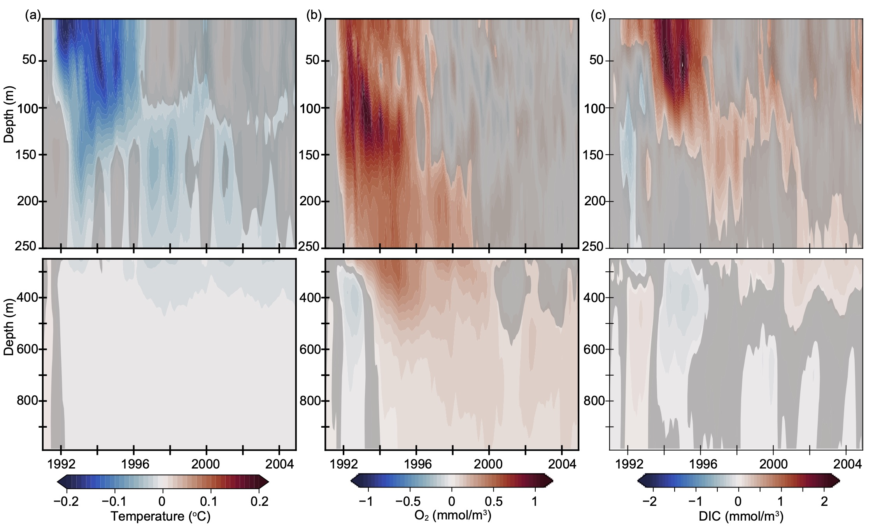
Results
Global inventories
CESM-LE minus CESM-NoPinatubo anomalies
Temperature
Oxygen
DIC
Depth (m)
Negative temperature anomalies indicate a cooling due to the eruption of Pinatubo
Positive oxygen and carbon anomalies indicate a greater amount due to the eruption
Notes:
This impact of increased oxygen and carbon flux is even more pronounced when looking at global inventories for the upper 1000m of the ocean.
Here im showing another view of the impacts of the eruption on heat, oxygen, and carbon storage in the global ocean.
As seen in previous plots, the forced signal anomalies last multiple years in the upper ocean and permanently modify deep ocean temperatures and carbon and oxygen inventories. The cool colors in the temperature plot on the left indicate a cooling in the CESM ensemble that is not replicated in the No Pinatubo experiment. This cooling is largest in the surface levels but does penetrate to depth and significantly cools the ocean interior. This signal persists for the entire length of the simulation.
In the center panel is the global oxygen anomaly showing the immediate uptake of oxygen post-eruption. The anomalies quickly penetrate to depth with the largest anomalies extending down to nearly 500m. By the late 1990s, the surface layers have returned to conditions that are indistinguishable between the two ensembles, however the anomalies of larger oxygen concentrations below 150 to 250m persist. When we look at this regionally, we see patterns of oxygen change are largest across the northern hemisphere, consistent with thermocline ventilation. We actually see a pocket of positive oxygen anomaly traversing the North Pacific after the eruption.
The right hand panel shows the anomalies of dissolved inorganic carbon. The strong positive anomalies are a bit delayed for carbon, with the maximum anomalies emerging in the upper 100m a couple years post eruption. On this global scale, unlike the changes seen in oxygen, persistent positive anomalies in DIC appear to be constrained in the upper layers and do not penetrate below 250m. When looking at these signals regionally, upper ocean DIC anomalies are concentrated in the tropical Pacific, with strong links to ENSO variability.

Slide 20
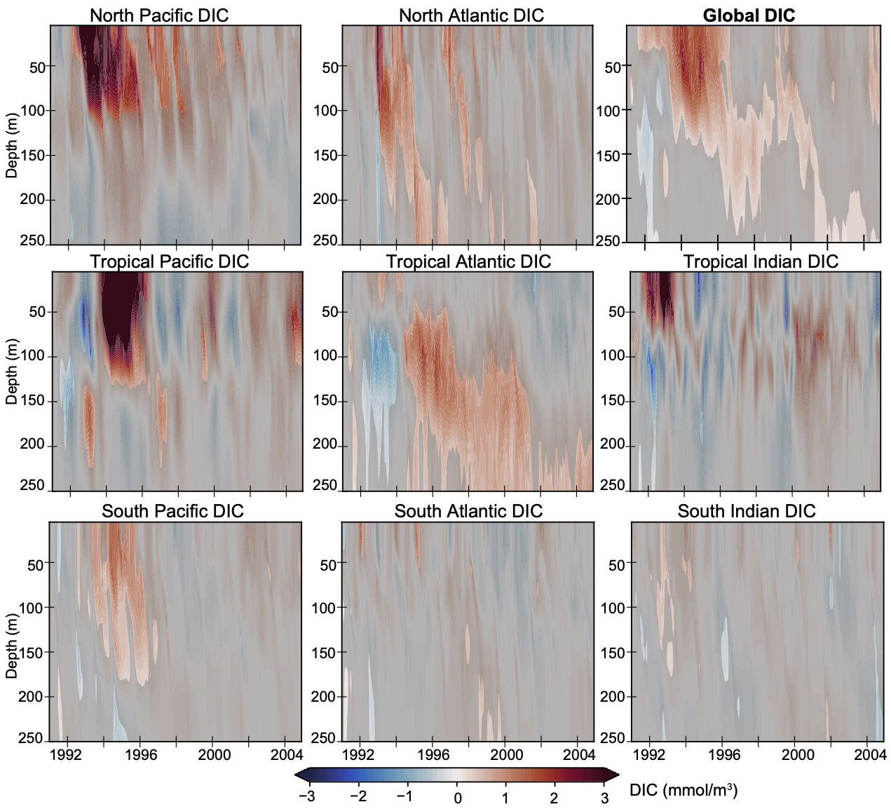
Results
Regional changes

Slide 21
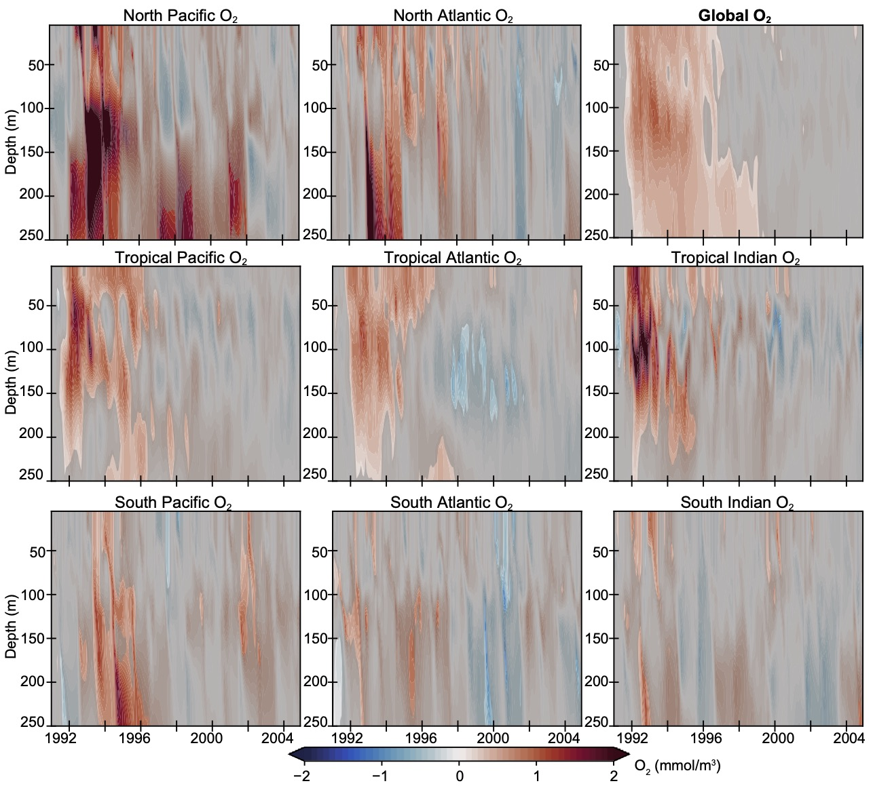
Results
Regional changes
Notes:
Regionally, patterns of oxygen change are largest across the northern hemisphere, consistent with thermocline ventilation, and in the tropics

Slide 22
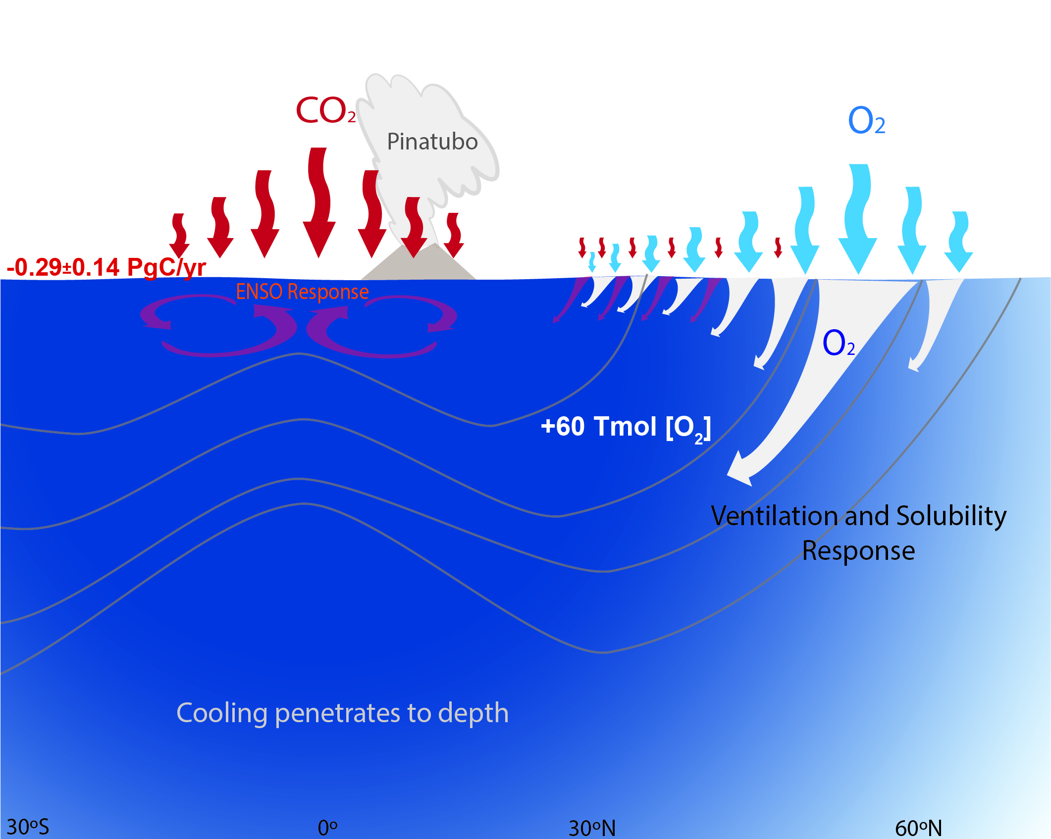
Summary of carbon and oxygen impacts forced by Mt. Pinatubo
The externally forced response is dominated by tropical Pacific and high northern latitudes;
not significant in Southern Ocean
Fay et al. 2023, GBC
30S
0
30N
60N
Notes:
The negative anomaly (cooling) in ocean heat content (OHC) is consistent in timing and magnitude (-3 x 1022 J) with observed anomalies in the early 1990s (Ito et al. 2017). The forced uptake of 100 Tmol of oxygen over 1991-94 (Figure 2, middle right) is large enough to have contributed significantly to the observed hiatus of deoxygenation trends at this time (trends are approximately -100 Tmol/yr since 1980s, Ito et al. 2017).

