Slide 1
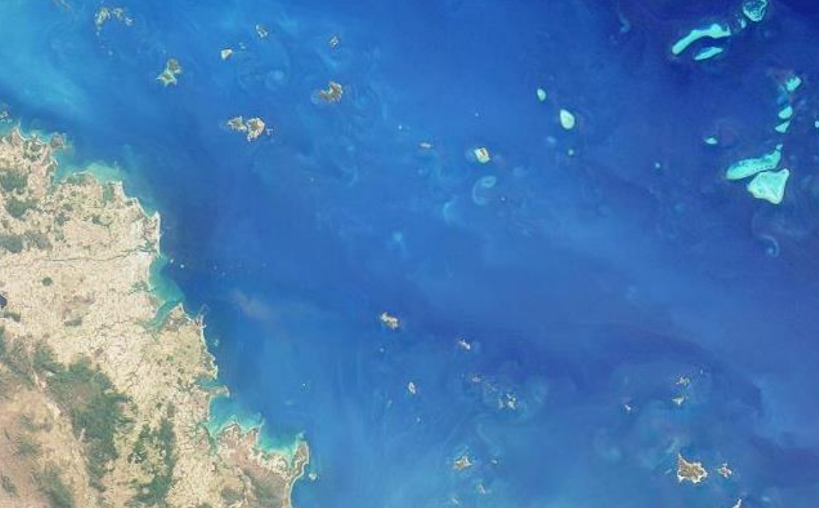


Aquaverse: An Aquatic Inversion scheme for remote sensing of fresh and coastal waters
Akash Ashapure^{1,2}, Nima Pahlevan^{1,2}, William Wainwright^{1,2}, Brandon Smith^{1,2}, Arun Saranathan^{1,2}, Sakib Kabir^{1,2}, Peng-Wang Zhai³
¹ Science Systems and Applications Inc. (SSAI), Lanham, MD 20706, USA
² NASA Goddard Space Flight Center, Greenbelt, MD 20771, USA
³ Physics Department, University of Maryland Baltimore County, Department of Physics, Baltimore, MD, 21250
Session: Existing, emerging, and future of remote sensing
05/09/2023
Ocean Biology and Biogeochemistry, the Carbon Cycle and Ecosystems workshop 2023 College Park MD

Slide 2

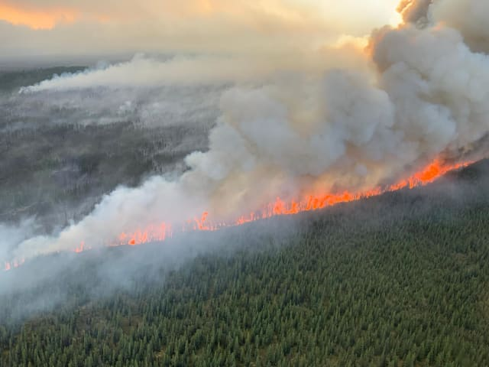
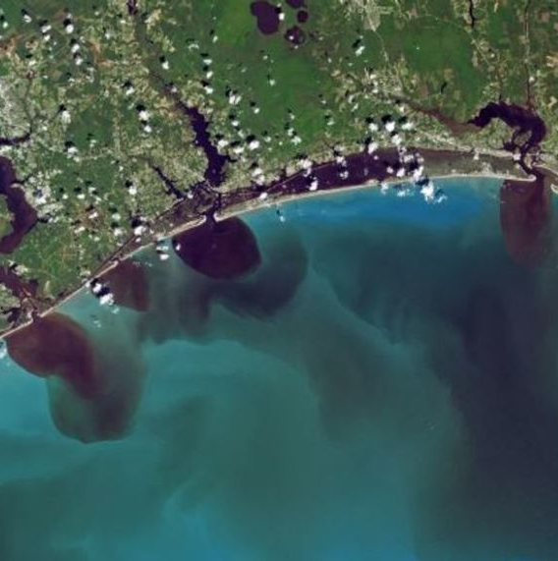
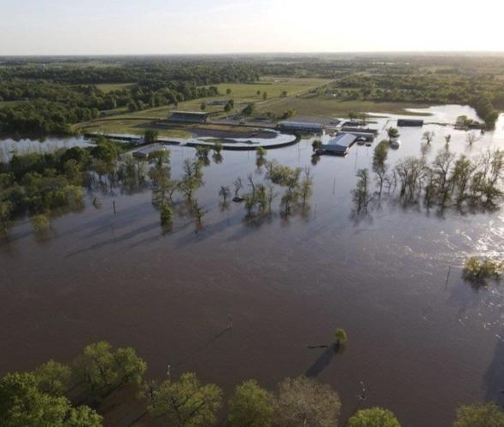
Introduction
Aquatic ecosystem are under threat!
Stressors
  Wildfire, flooding
  Food production, Mining….
Impacts
  Water pollution
  Harmful Algal Blooms
Consequence & implications
  Public health
  Economy

Slide 3
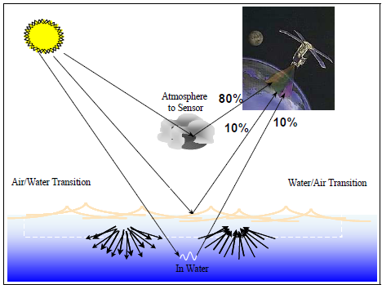
Introduction
Optical satellite datasets are gaining popularity for environmental applications
Atmospheric correction is most challenging processing component
A large fraction of useable signal originates from scattering and absorption within the atmosphere

Slide 4
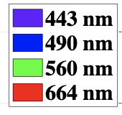


Lessons learned from ACIX-Aqua
Evaluated eight state-of-the-art atmospheric correction methods implemented on Landsat-8/OLI and Sentinel-2/MSI imagery
Inland
Coastal (AERONET-OC)
Goal:
Develop an atmospheric correction processor that outperforms the state-of-the-art.
Target missions:
Landsat-8/OLI and Sentinel-2/MSI
Median Accuracy [%]
MSI - Multispectral Imager
OLI - Operational Land Imager
Pahlevan et al. 2021. ACIX-Aqua: A global assessment of atmospheric correction methods for Landsat-8 and Sentinel-2 over lakes, rivers, and coastal waters. Remote Sensing of Environment, 258, 112366

Slide 5
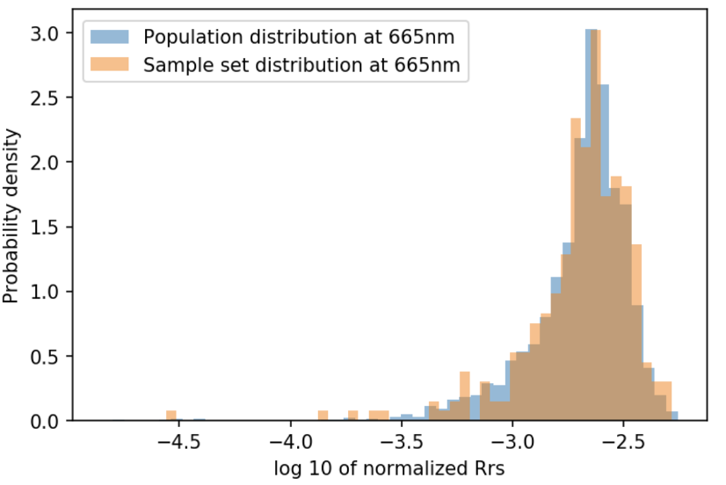
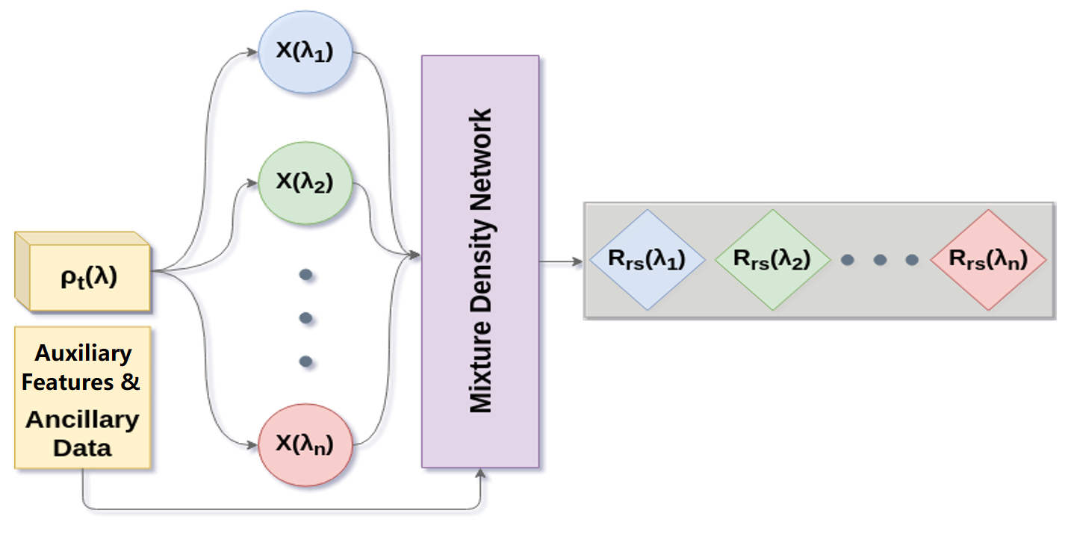
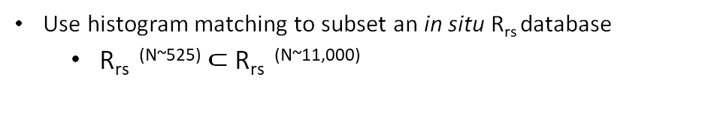
Model development: Mixture Density Networks
Use histogram matching to subset an in situ R_{rs} database
  R_{rs} ^{(N~525)} $⊂$ R_{rs} ^{(N~11,000)}
Determine Globally Representative R_{rs} ^{N ~ 525}
Geometry
Aerosol Models
AOT
Water Vapor
Simulate 𝜌_{t} using a vector RT code (Zhai et al. 2009)
  Incorporate in situ R_{rs} (400 – 800)
  Solar Zenith, View Zenith, Azimuth
  # of Aerosol models: ~ 60 (Ahmad et al. 2010 + Montes et al. 2022)
  AOT(550): 0.01 – 0.7
  Water Vapor: Sub-arc winter, Mid-lat summer, Tropical
Simulate TOA reflectance (𝜌_{t} @5 nm)
Resample with MSI/OLI RSR
Network structure
Inverse Model (𝜌_{t}, 𝜽, 𝜽_{s} ,Δ𝜙 → R_{rs})
Testing/Validation
AERONET-OC
Campaign Data

Slide 6
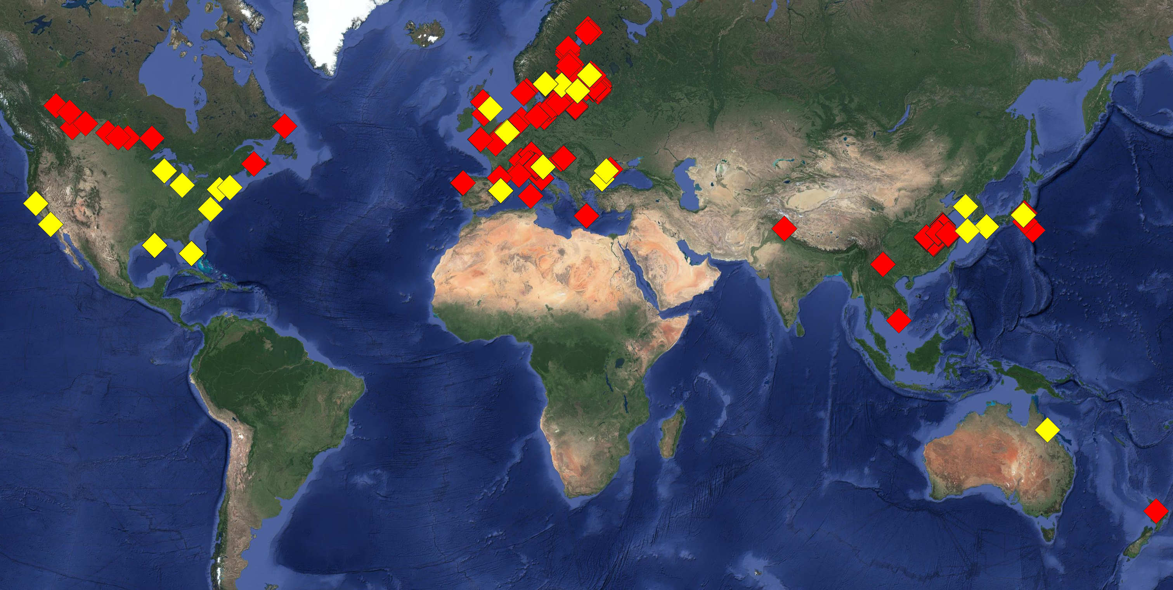
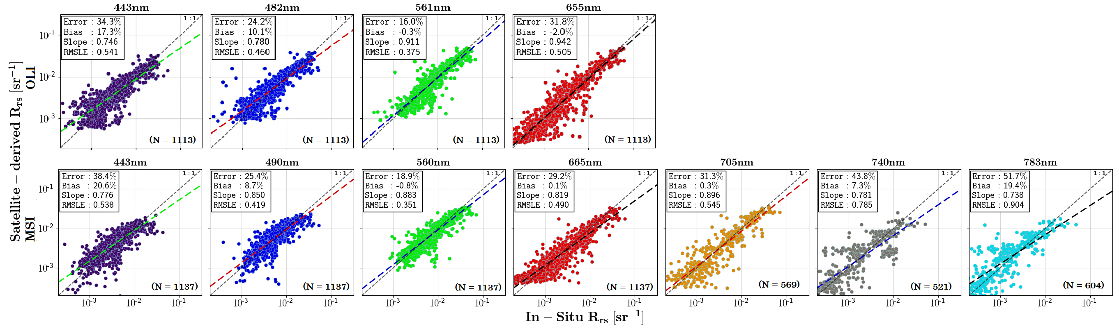
Matchup assessments
Combined AERONET-OC and GLORIA data led to > 1100 OLI and MSI matchups
GLORIA & AERONET-OC
GLORIA dataset source: Lehman et al. 2023 GLORIA - A globally representative hyperspectral in situ dataset for optical sensing of water quality
https://doi.org/10.1038/s41597-023-01973-y

Slide 7
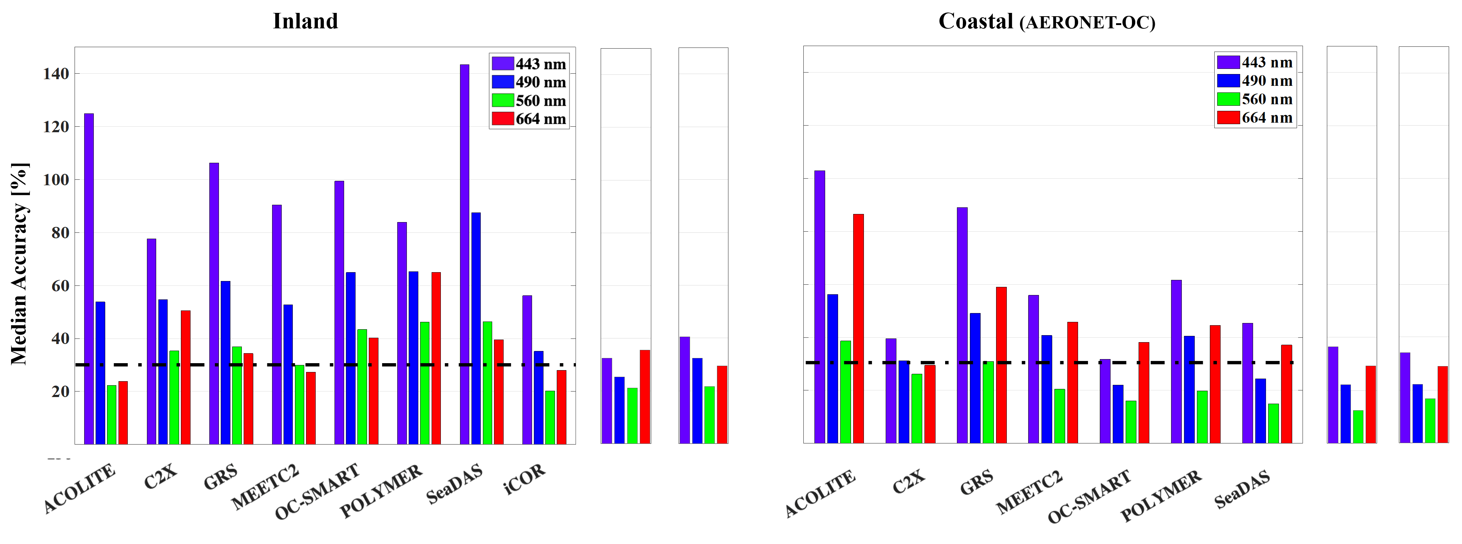
Performance summary
AQUAVERSE MSI
AQUAVERSE MSI
AQUAVERSE OLI
AQUAVERSE OLI

Slide 8
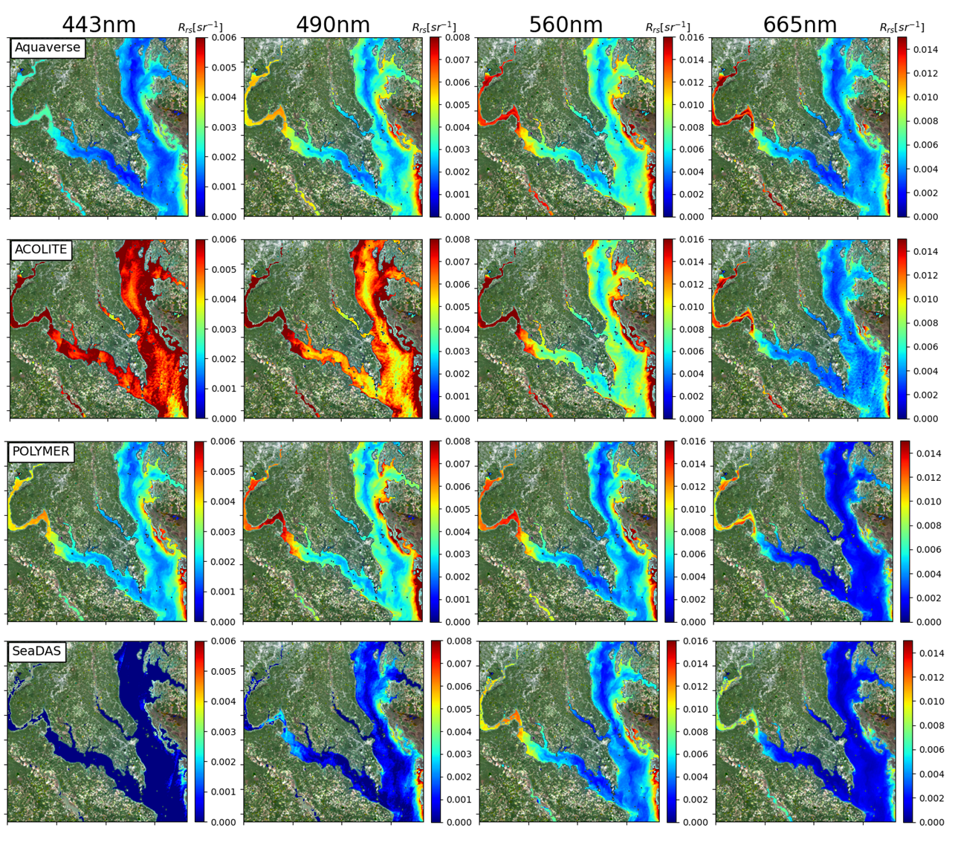
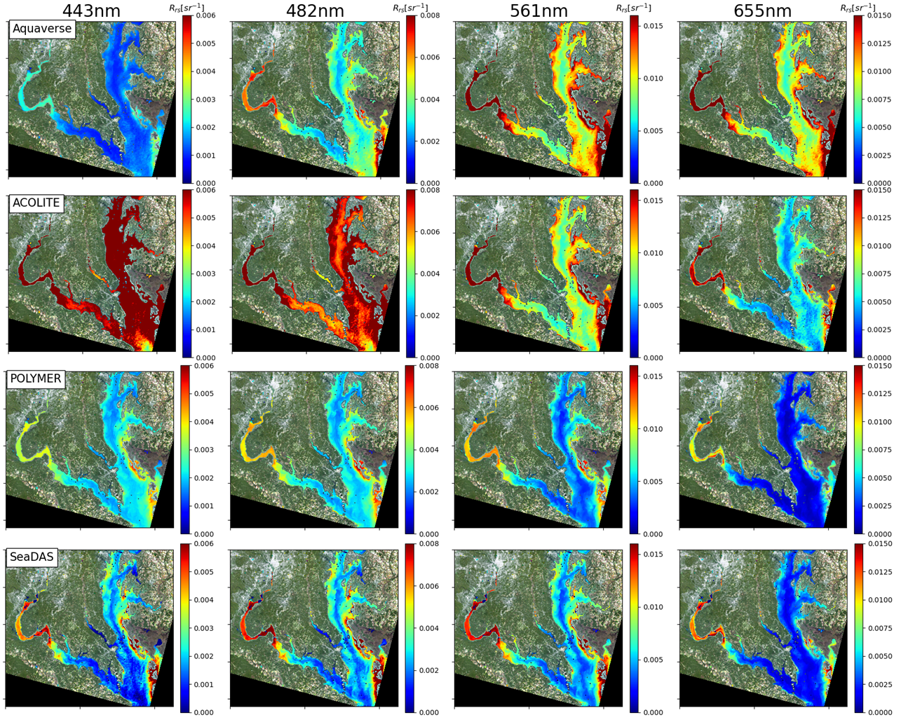
Visual assessment: Chesapeake Bay
MSI (17/10/2020 16:02 GMT)
OLI (17/10/2020 15:45 GMT)

Slide 9
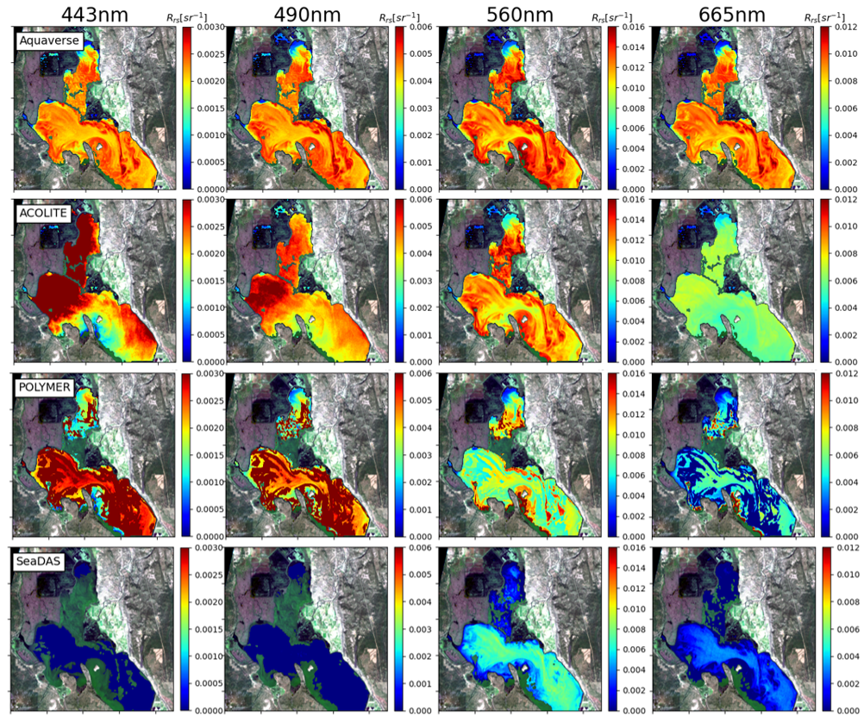
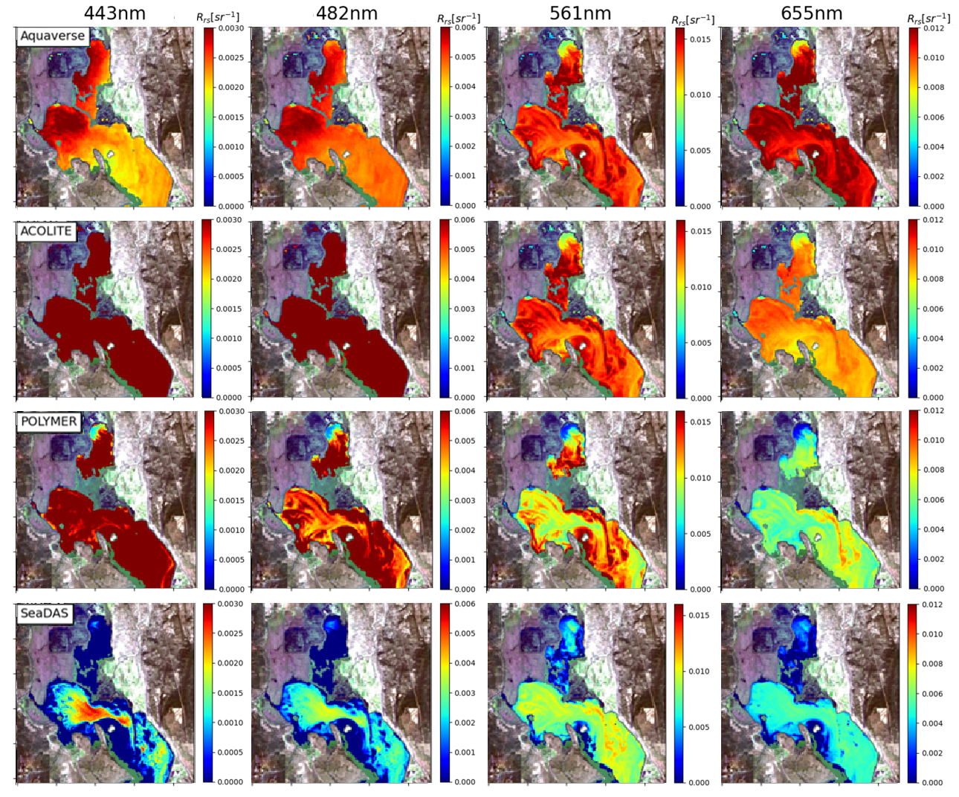
Visual assessment: Upper Klamath Lake
MSI (07/29/2019 19:02GMT)
OLI (07/29/2019 18:50GMT)

Slide 10
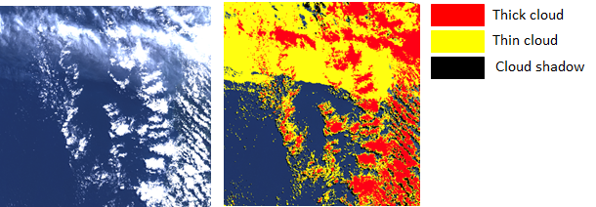
Ongoing/future work
Extend retrievals beyond 800 nm.
Improve the angular resolution of our training set.
Enhance the optical representation of our input spectra.
Evaluate downstream products.
Devise and integrate a robust cloud-masking approach.

Slide 11

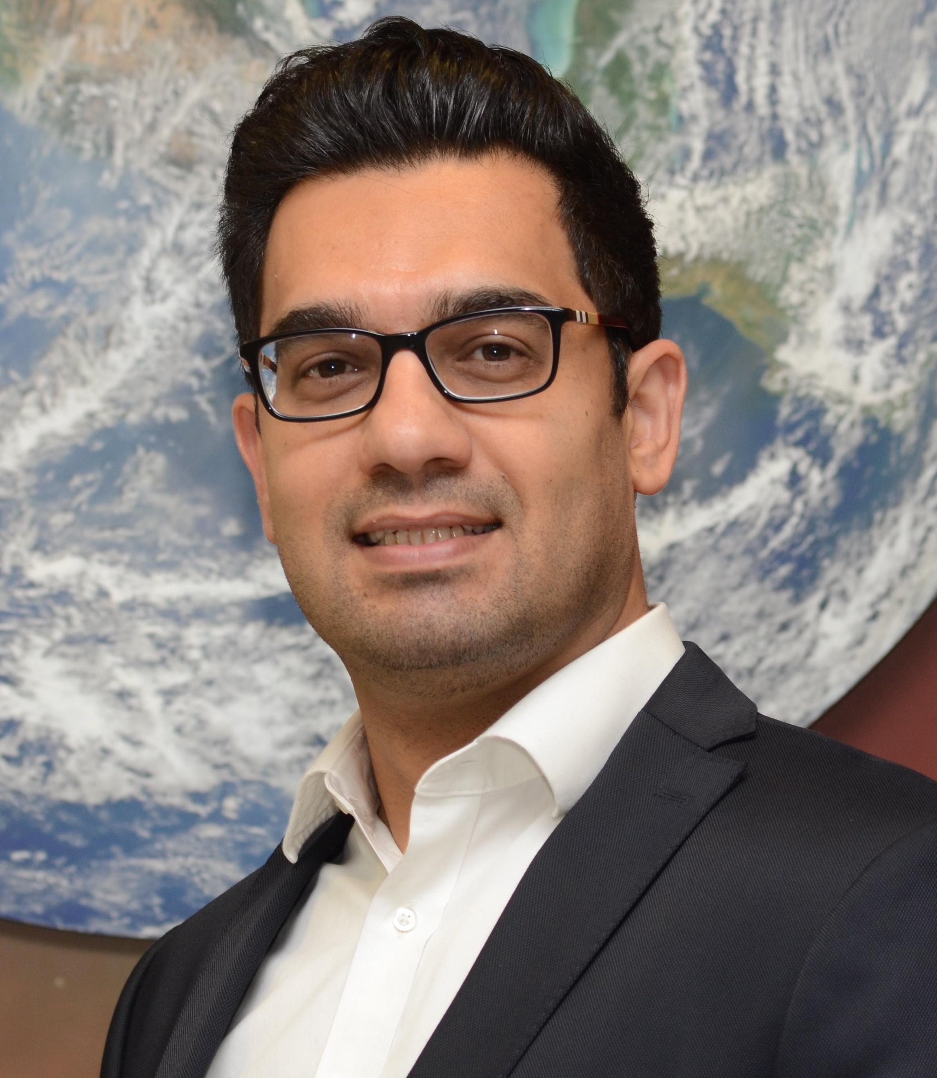
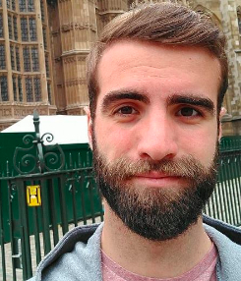




Acknowledgement
NASA Earth Science Programs
Ocean biology and Biogeochemistry
Remote sensing of water quality
United States Geological Survey
Landsat Science Team
Dr. Nima Pahlevan
Mr. Brandon Smith
Dr. Arun Saranathan
Mr. William Wainwright
Mr. Sakib Kabir
Dr. Peng-Wang Zhai
Contact:
Akash Ashapure
Email: akash.ashapure@nasa.gov

