Slide 1
Cross-calibration of ocean color sensors in polar orbit using an intermediary geostationary sensor
Jing Tan (UCSD/SIO)
Robert Frouin (UCSD/SIO)
Hiroshi Murakami (JAXA)

Slide 2
Introduction
-Radiometric cross-calibration of optical (e.g., ocean-color) instruments: Important activity to ensure product consistency and generate climate data records.
-Defined as viewing the same radiance at the same time, but this is difficult to achieve during in flight operations of different sensors on different orbits.
-Apart from viewing the Moon, one must rely on measuring the solar radiation reflected by the Earth-atmosphere system at the same time and location.
-BRDF of the Earth-atmosphere system requires observing under the same solar and viewing geometry (i.e., same line of sight).
-If the spectral bands to be compared do not have the same or close definition, some empirical transformation must be applied to make the cross-calibration.

Slide 3
Methodology
-To realize the same line of sight, one may use an intermediary GEO sensor of reference.
-Compared with other cross-calibration techniques (Moon, desert sites), precise coincidences in time and geometry are easier to find (i.e., more numerous).
-Many coincidences occur over oceanic regions, allowing the cross-calibration to be performed at radiance levels encountered in ocean-color remote sensing.
-Cross-calibration coefficients between each polar-orbiting sensor and the geostationary sensor, A_{1i} and A_{2j}, can be written:
A_{1i} = ρ_{ref}(t) / f_{1i}[ρ_{1i}(t)] ; A_{2j} = ρ_{ref}(t’) / f_{2j}[ρ_{2j}(t’)]
-Differences between A_{1i} and A_{2j} indicate that calibration of the two sensors is not consistent and, therefore, needs to be adjusted.
Methodology was applied to cross-calibrate SGLI onboard GCOM-C and MODIS onboard Terra and Aqua after system vicarious calibration (SVC) using AHI onboard Hiwamari-8 as intermediary sensor.

Slide 4
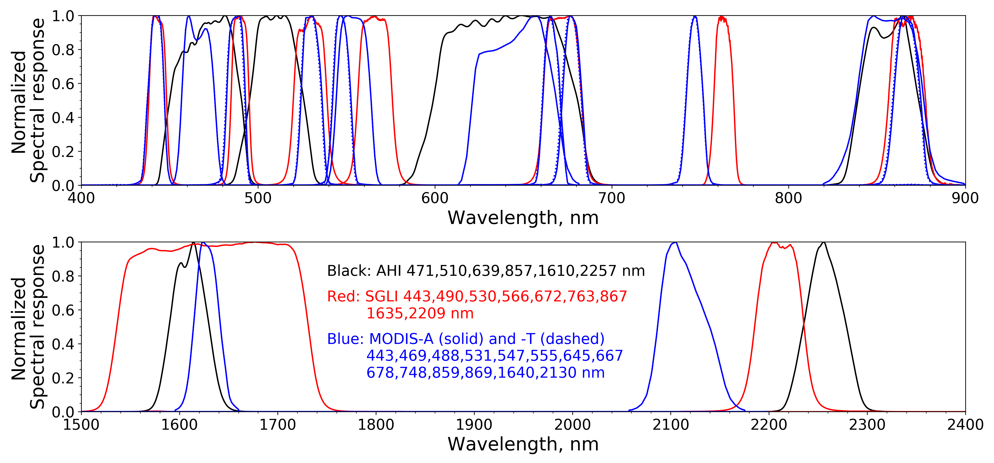
Spectral band matching
Combinations of SGLI, MODIS-A, and -T bands used for estimating reflectance in AHI bands.
AHI bands (nm) | SGLI bands (nm) | MODIS-A bands (nm) | MODIS-T bands (nm)
471 | 443&490 | 443&469, 443&488, 469&488, 469 | 443&469, 443&488, 469&488, 469
510 | 490&530 | 469&531, 469&547, 469&555, 488&531, 488&547, 488&555 | 469&531, 469&547, 469&555, 488&531, 488&547, 488&555
639 | 672 | 645, 667, 678 | 645, 667, 678
857 | 867 | 859, 869 | 859, 869
1610 | 1635 | 1640 | 1640
2257 | 2209 | 2130 | 2130
In general, the RMSD of spectral band matching are quite small, i.e., less than 0.7%.
Only AHI 471, 510, and 639 nm are used. Longer wavelengths are not of interest due to relatively large AHI image noise and that the SVC makes assumptions about radiometric calibration in the near infrared.

Slide 5
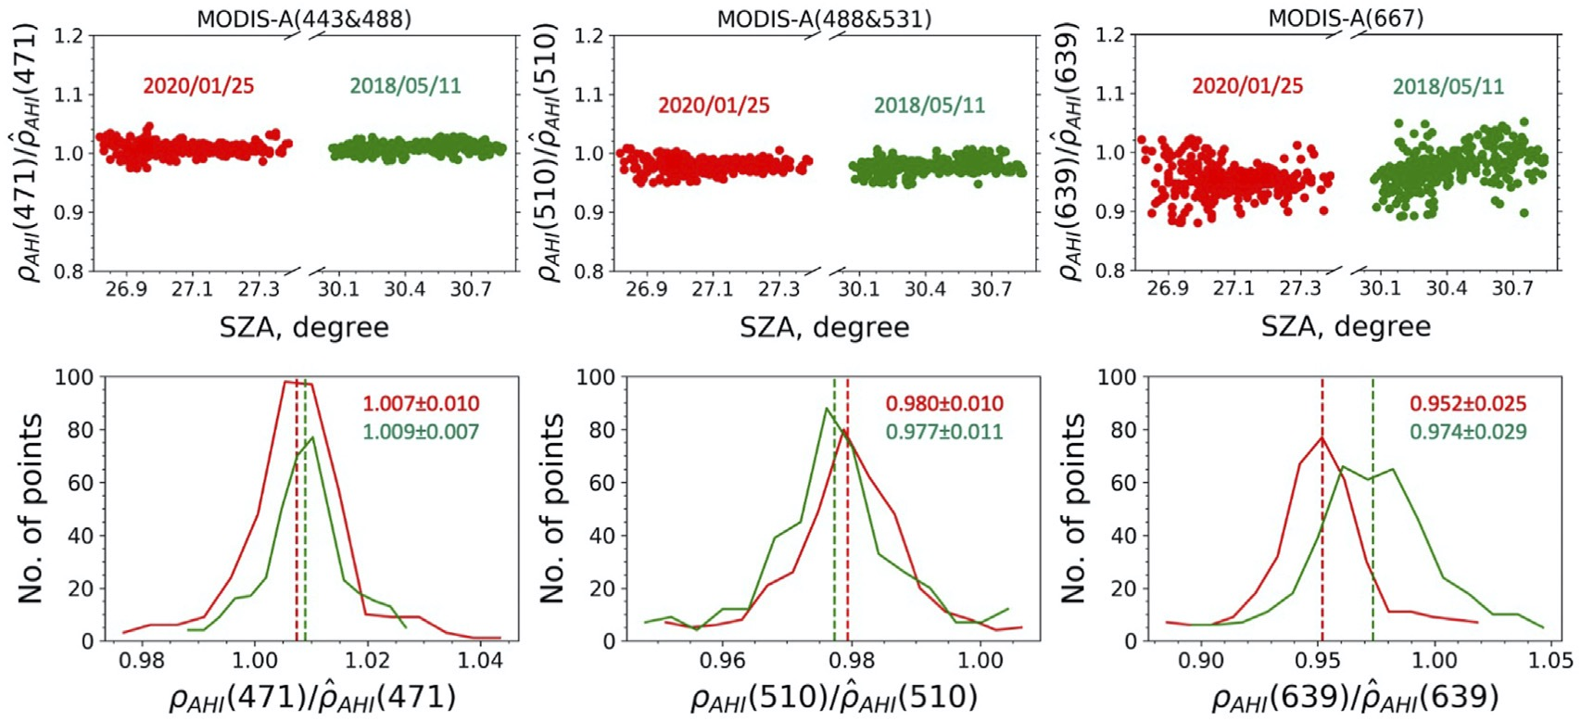
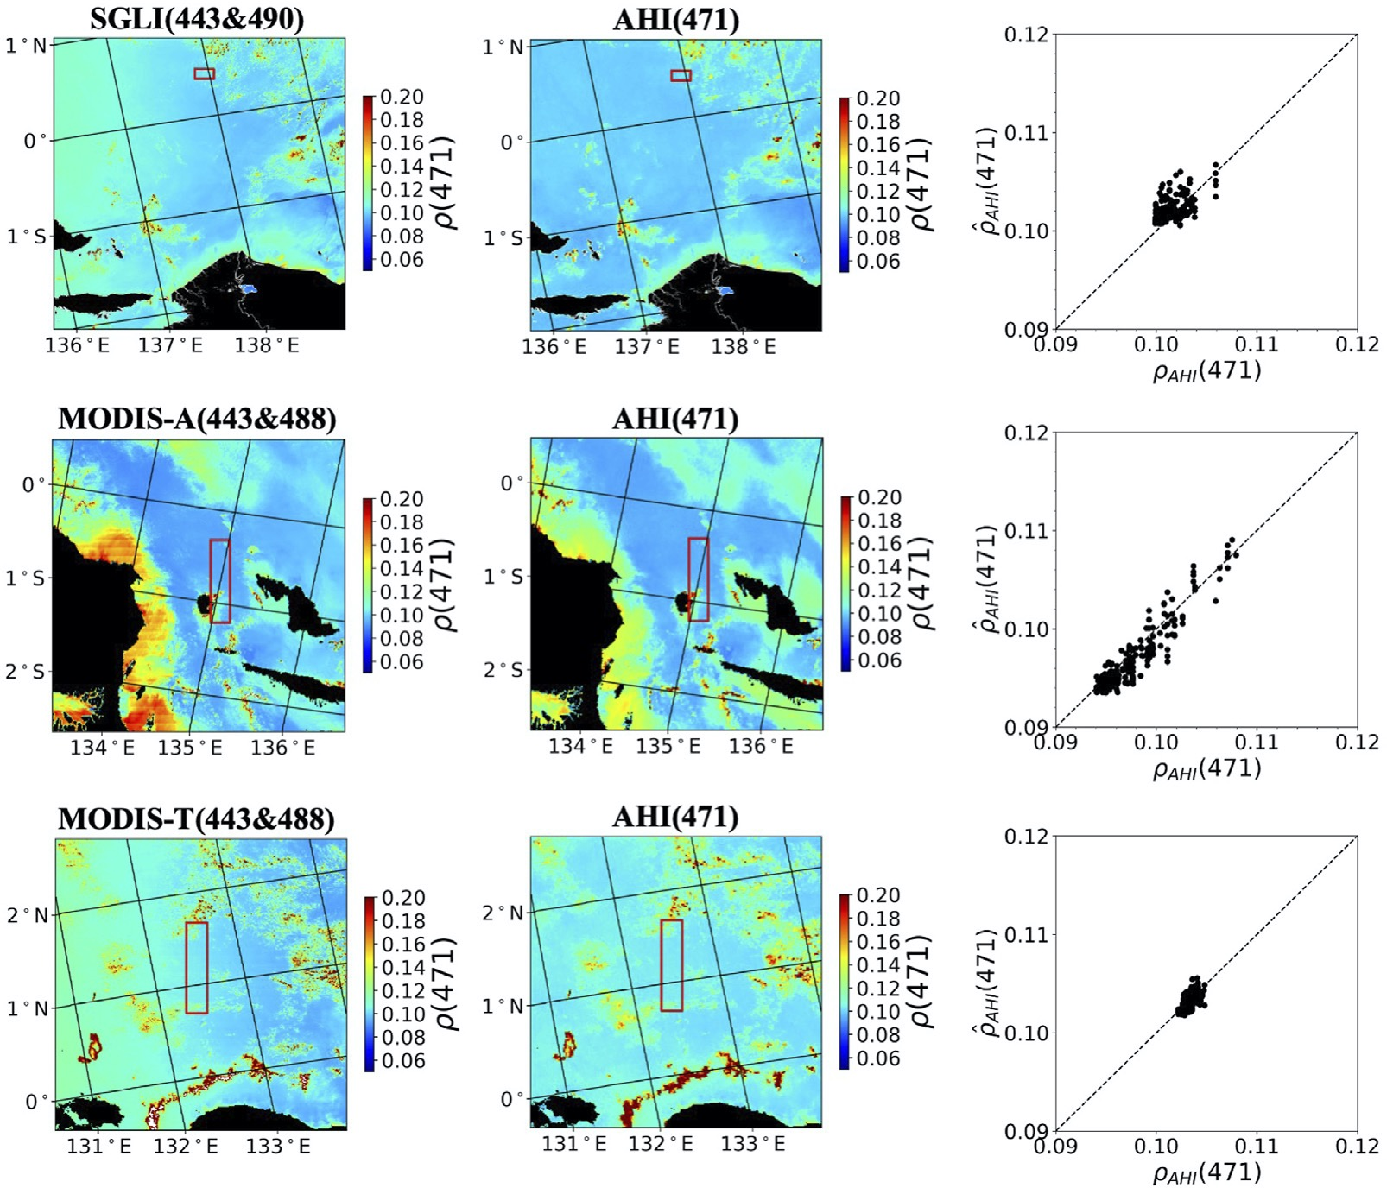
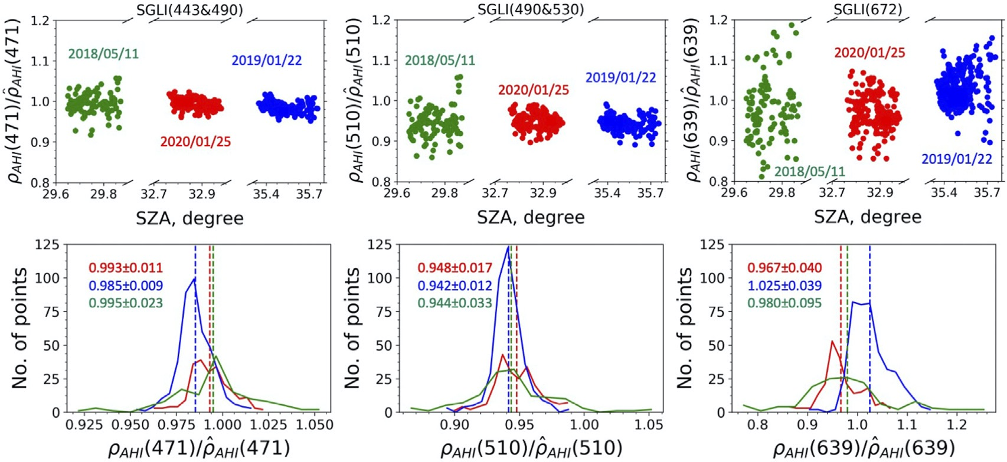
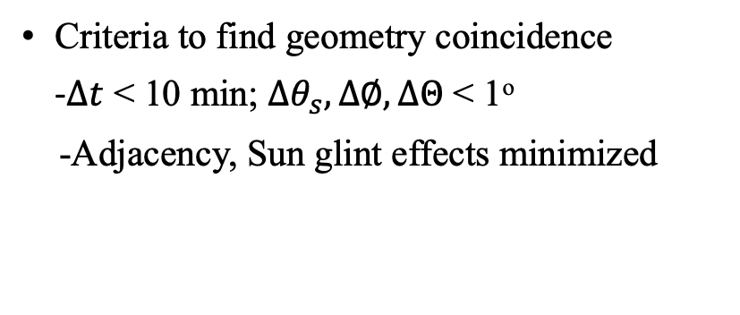
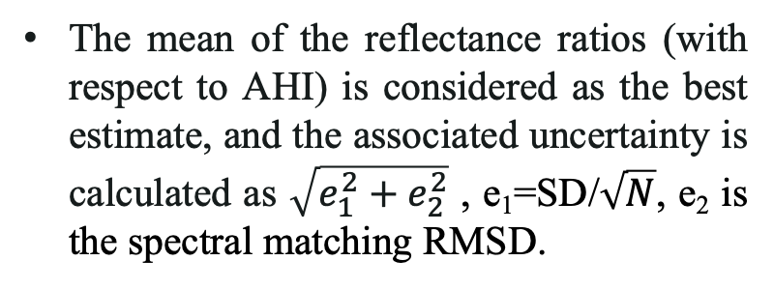
Geometry coincidence
Criteria to find geometry coincidence
-$∆t$ < 10 min; ${∆θ}_{s}, ∆∅, ∆Θ$ < 1º
-Adjacency, Sun glint effects minimized
The mean of the reflectance ratios (with respect to AHI) is considered as the best estimate, and the associated uncertainty is calculated as $\sqrt{e_{1}^{2}+e_{2}^{2}}$ , e₁=SD/$\sqrt{N}$, e₂ is the spectral matching RMSD.
If we know A/B and A/C (A is the geostationary sensor, B and C are the polar orbiting sensors), we know the cross-calibration coefficient C/B, and the associated errors can be propagated.

Slide 6
Results and conclusions
MODIS-A and MODIS-T after SVC are well cross-calibrated in the bands of reference, with differences of about 1% from unity, generally within the uncertainties, for all band combinations.
SGLI shows larger cross-calibration differences, i.e., 1.4%, 3.4%, and 1.1% with MODIS-A and 1.5%, 4.6%, and 1.5% with MODIS-T, respectively.
Such differences may introduce significant discrepancies between ocean-color products generated from SGLI and MODIS data, although some compensation may occur because different atmospheric correction schemes are used to process SGLI and MODIS imagery, and SVC is based on the selected scheme.
Band combinations | Cross-calibration coefficients A
 | SGLI/MODIS-A | SGLI/MODIS-T | MODIS-A/MODIS-T
A(471) 469 |  |  | (0.991, 0.984) 0.988±0.010
A(471) 443&488/443&490 | (1.014, 1.014) 1.014±0.010 | (1.018, 1.018, 1.008) 1.015±0.008 | (1.004, 0.994) 0.999±0.006
A(471) 443&469 |  |  | (0.993, 0.988) 0.991±0.007
A(471) 469&488 |  |  | 0.997, 0.991 0.994±0.009
A(510) 488&531/490&530 | (1.035, 1.033) 1.034±0.010 | (1.043, 1.051, 1.041) 1.046±0.008 | (1.008, 1.008) 1.008±0.006
A(510) 488&547 |  |  | (1.004, 1.009) 1.007±0.006
A(510) 488&555 |  |  | (1.005, 1.010) 1.008±0.006
A(510) 469&531 |  |  | (1.007, 1.005) 1.006±0.006
A(510) 469&547 |  |  | (0.999, 1.002) 1.000±0.006
A(510) 469&555 |  |  | (0.999, 1.005) 1.002±0.006
A(639) 645 |  |  | (1.002, 0.989) 0.995±0.007
A(639) 667/672 | (0.994, 0.984) 0.989±0.023 | (0.999, 0.977, 0.980) 0.985±0.019 | (1.005, 0.996) 1.001±0.007
A(639) 678 |  |  | (1.006, 1.001) 1.004±0.007
Proposed method is general and can be applied operationally, and to other optical sensors operating in polar orbit. It can also be performed prior to SVC, as this calibration may be considered as part of the atmospheric correction process.
Cross-calibration coefficients obtained on each day are accurate (with small uncertainties), and time series allows one to observe changes in cross-calibration between polar orbiting sensors with time.
The methodology has great potential in the future in view of new GEO sensors, which will have improved performance and characteristics, allowing a more accurate and complete cross-calibration of polar-orbiting optical sensors, e.g., cross-calibrating PACE OCI with VIIRS, OLCI using GLIMR.

