Slide 1
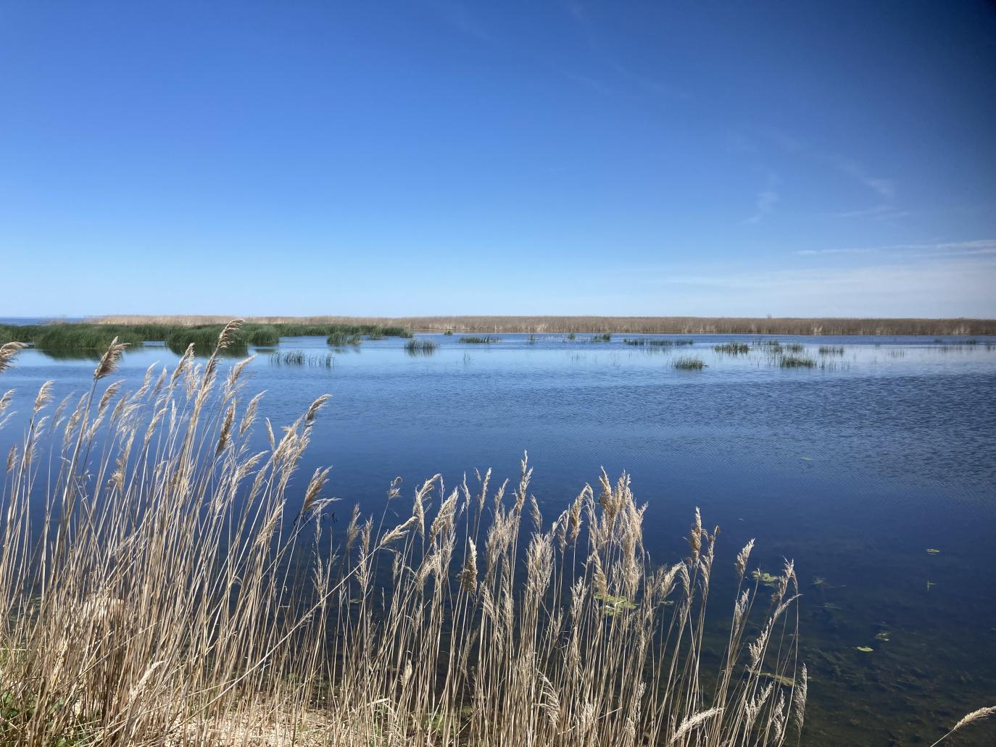






2023 NASA Carbon Cycle and Ecosystems Joint Science Workshop
Integrating Systems Models and Remote Sensing to Explore Aquatic Ecosystem Vulnerability to Global Change in Lake Huron
Clementina Calvo, Michael Battaglia, Laura Bourgeau-Chavez, William S. Currie, Kenneth Elgersma, David Hyndman, Anthony Kendall, Michael Sayers,
Jason P. Martina

Slide 2
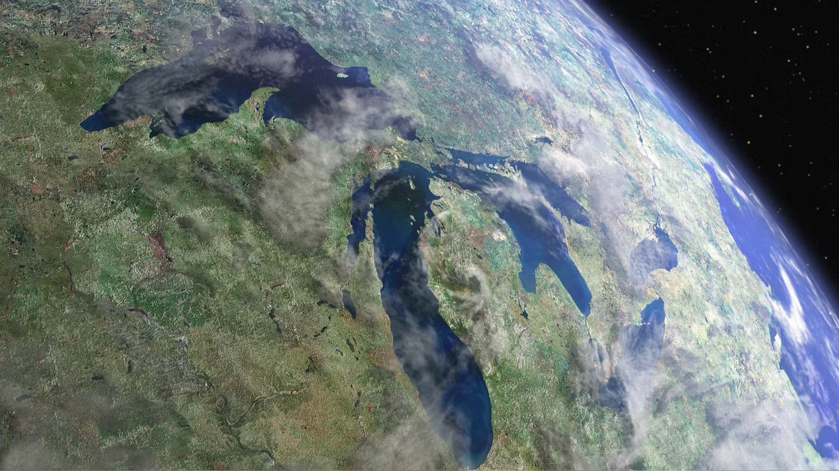
Great Lakes
Earth's largest surface freshwater reserve
20% of the world’s surface freshwater
90% in the United States
40 million residents of the United States and Canada depend on this system for clean drinking water

Slide 3
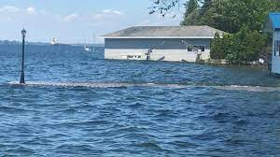
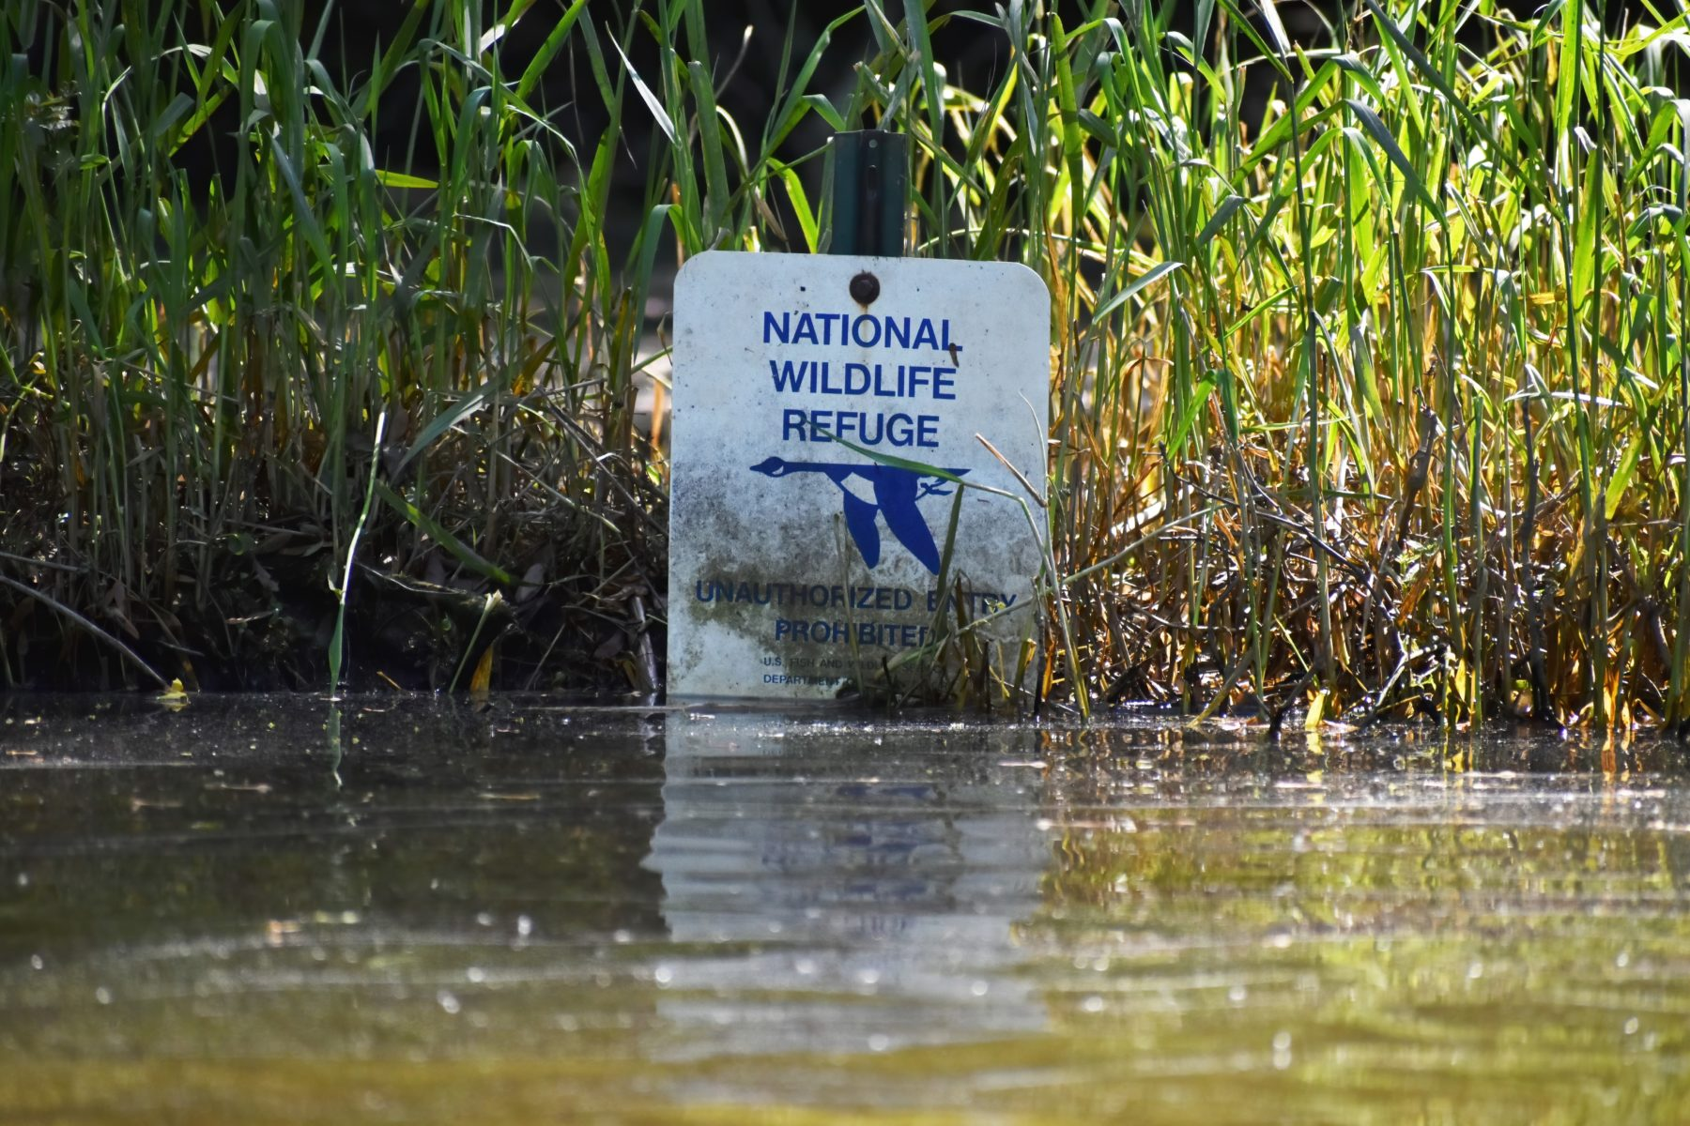
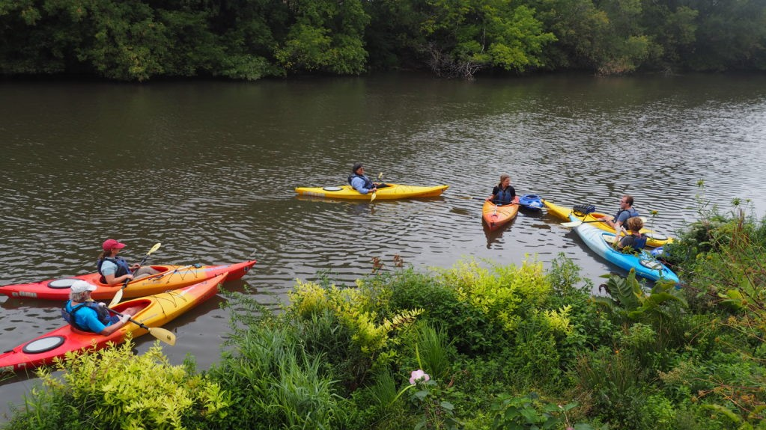
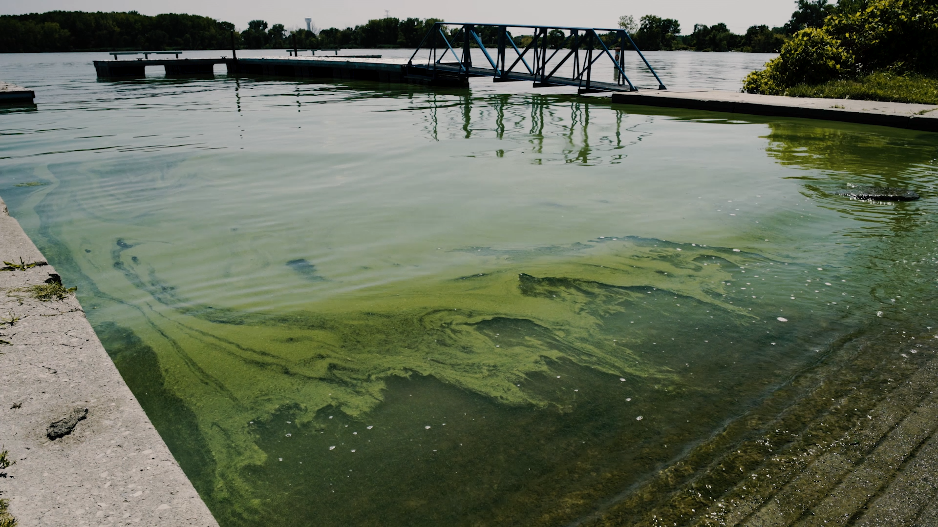
Coastal wetlands in the Great Lakes
17000 km of coastline
Important role:
Habitat for wildlife
Flood protection
Recreational and tourism opportunities
Buffer excess nutrients originating from upland
Under increasing pressure from climate change, nutrient loading, invasive plants, and water level changes

Slide 4
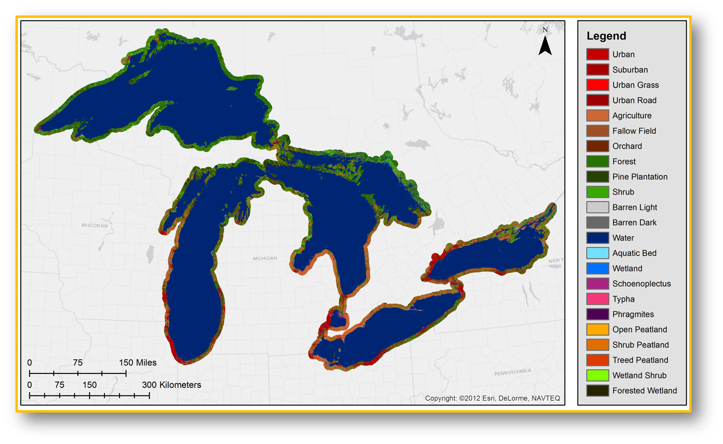
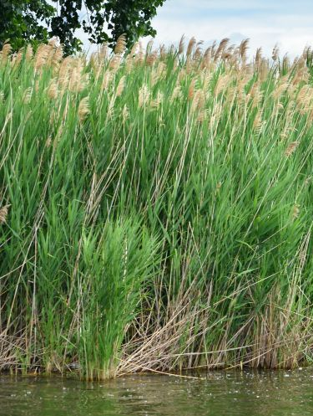
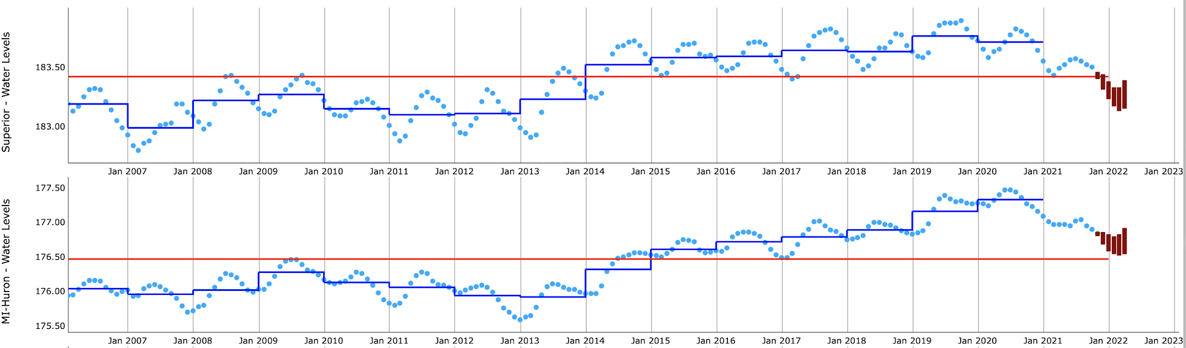
Land cover across the the Great Lakes
Invasive Phragmites australis
Water level in Lake Superior and Lake Huron

Slide 5

Our primary goal is to quantify the function and role of Great Lakes coastal wetlands in controlling the vulnerability of nearshore aquatic ecosystems to disturbance

Slide 6
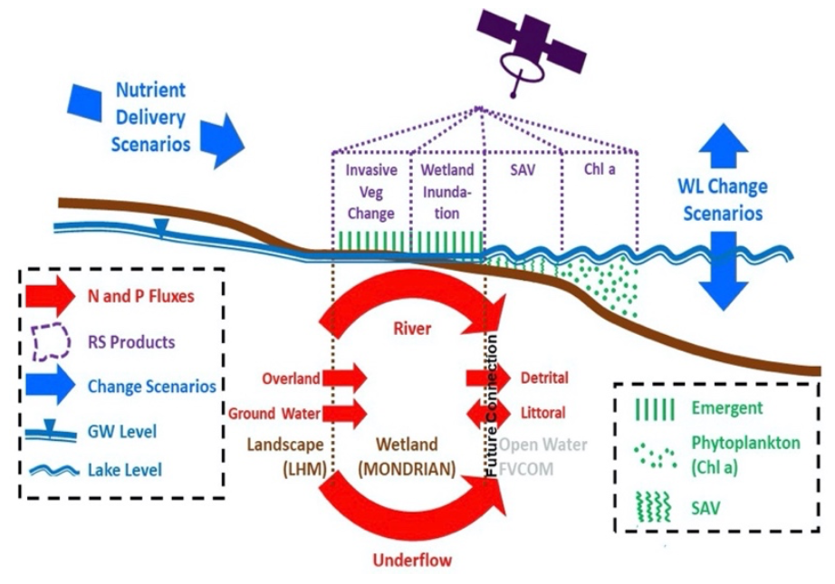
→ Main hypothesis: coastal wetlands play a large role in buffering Great Lakes biogeochemistry*
→ We predict that rising water levels (which drown out vegetation) will cause many coastal wetlands to switch from being nutrient sinks to sources
How?
Merge remotely-sensed data products of physical and biological conditions with systems models
Quantify how nutrients are transported to the land-water interface (wetland systems), and then altered and dispersed into the open water.
While broadening the participation of underrepresented groups in STEM research.

Slide 7
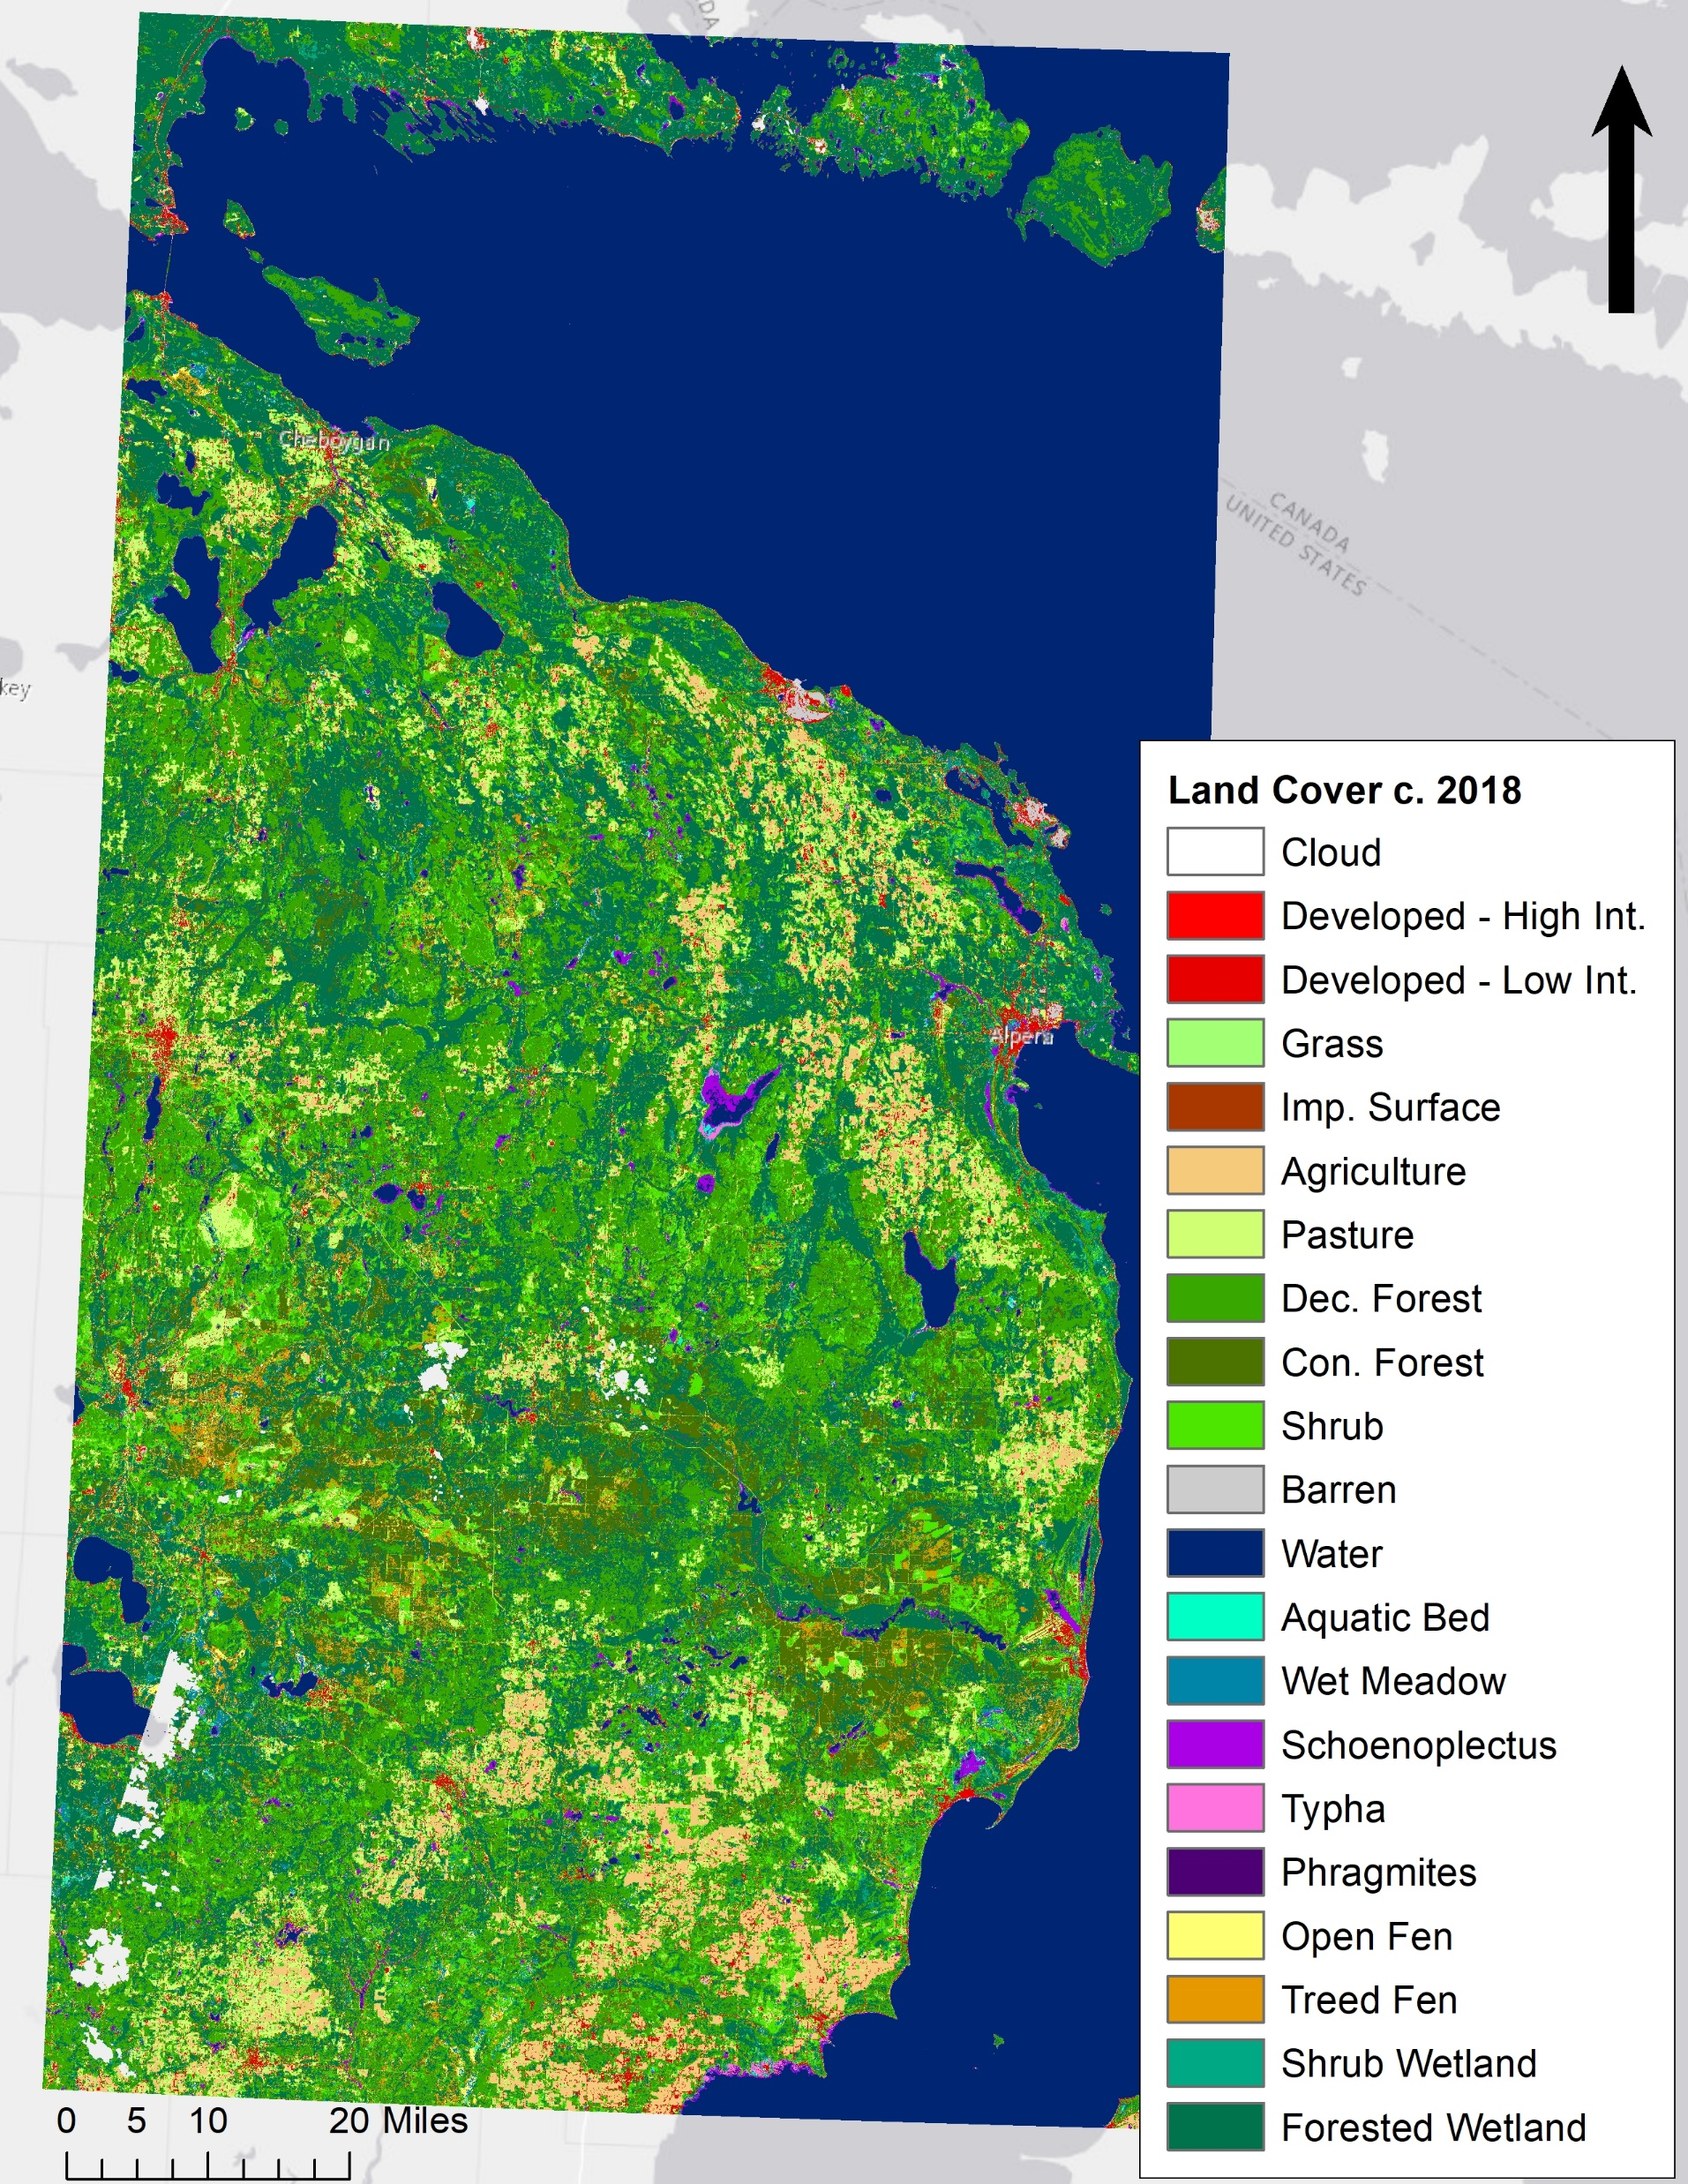
Remote sensing
Objective 1. Map the multi-decadal responses of aquatic ecosystems to shifting Lake Huron water levels and mounting invasion pressure.
Circa 2018 land cover for the US side of Lake Huron.
Created using time series Landsat and Sentinel-1 data with training and validation data generated from field data collections.
Google Earth Engine was used to run the classification algorithm.

Slide 8
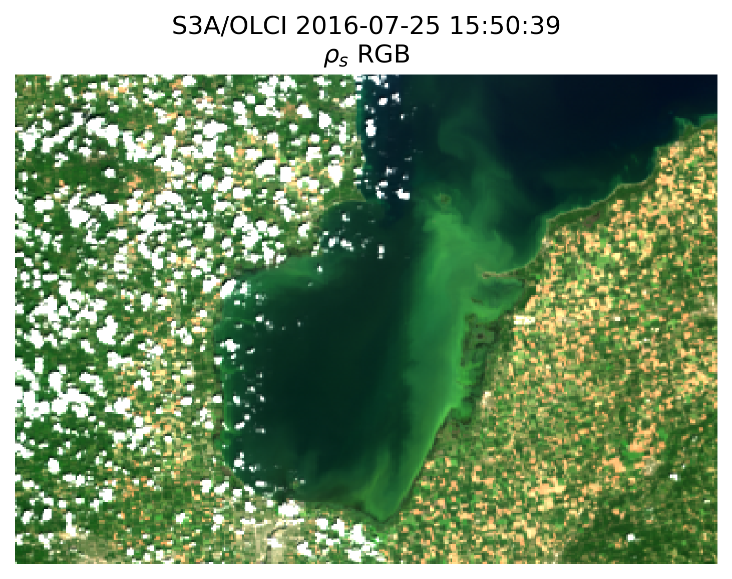
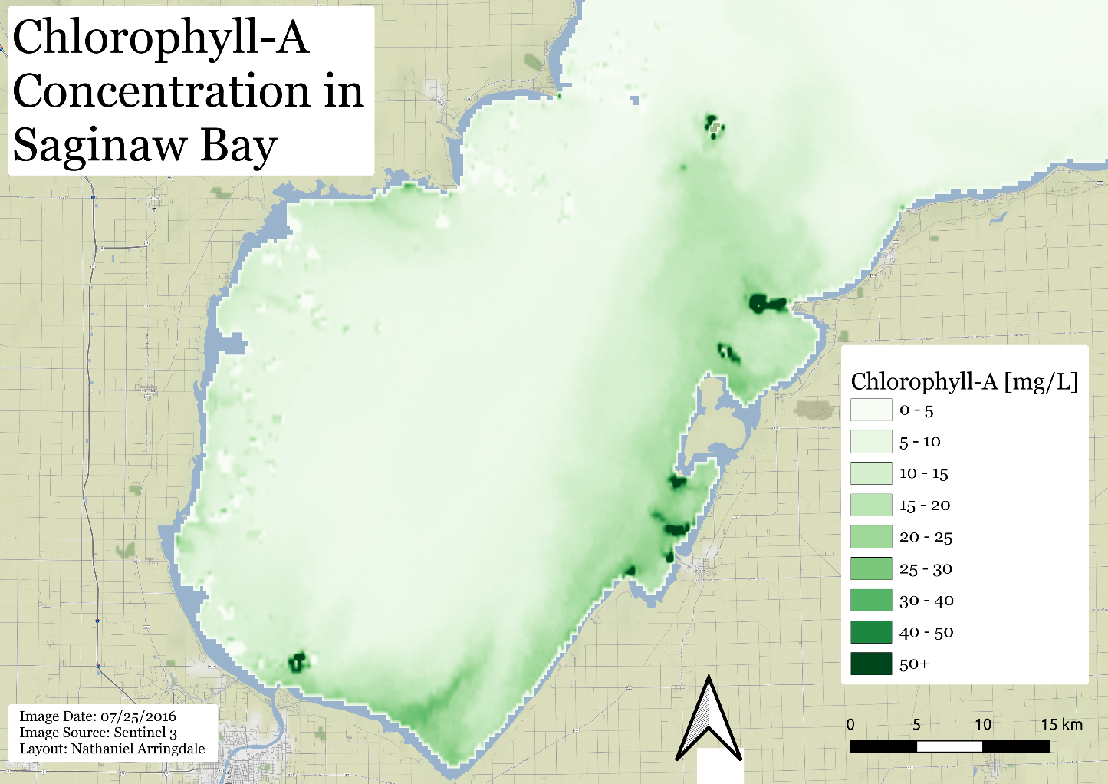
Map nearshore water quality
Left panel - Chlorophyll-a retrieved from Sentinel-3 OLCI data using the Color Producing Agent Algorithm (CPA-A) semi-analytical model.
Right Panel - Natural color image produced using the ACOLITE atmospheric correction model (same day).

Slide 9

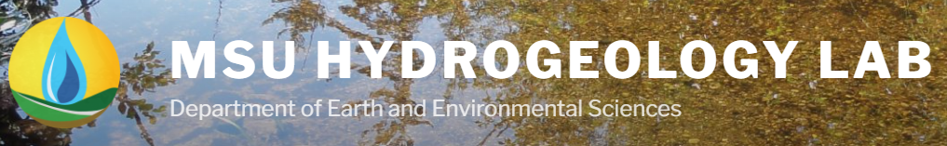
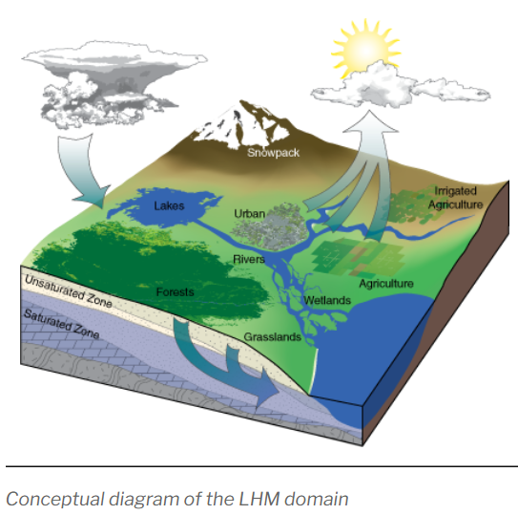
Metamodel
Objective 2. Improve and link Landscape Hydrology and Wetland Ecosystem models.
For the Mondrian meta-model we have simulated 45,000 unique scenarios of wetland conditions spanning:
  range of nitrogen and phosphorus inputs
  water depths and flushing rates
  mean annual temperatures
  growing season lengths and vegetation types (including Typha and Phragmites invasions)
We summarized the results of these simulations using machine learning techniques including MARS, M5Prime, regression trees, and random forest models.

Slide 10
Remote sensing and process-based models coupled to:
Objective 3. Understand how Lake Huron water level changes affect coastal wetland ecosystem composition and nutrient cycling.
Factorial set of Mondrian simulations to determine when global change factors flip coastal wetlands from nutrient sinks to sources
Compare N and P retention and output to Lake Huron in:
→ CONTROL wetlands (low-medium N and P input, native community, stable water level, no disturbance)
→ Wetlands experiencing a range of N and P loading, invasive species propagules (Phragmites and Typha), and hydrologic conditions (including long periods of high-water levels).

Slide 11
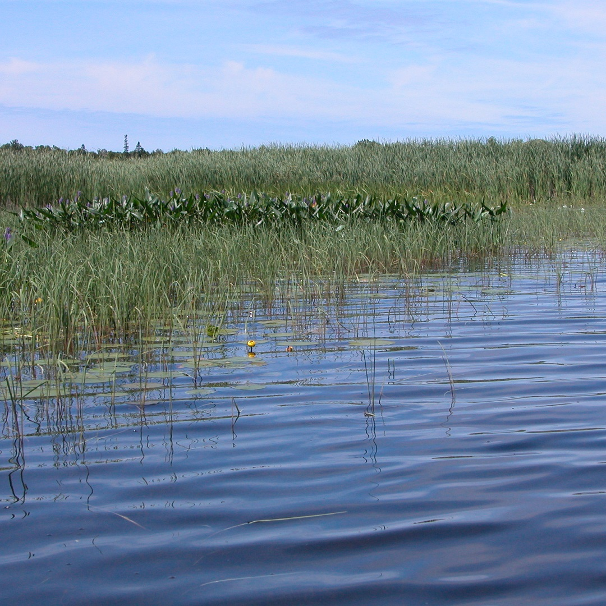
Objective 4. Quantify responses and vulnerability of open-water ecosystems to landscape inputs and disturbance, buffered by coastal wetlands.

Slide 12
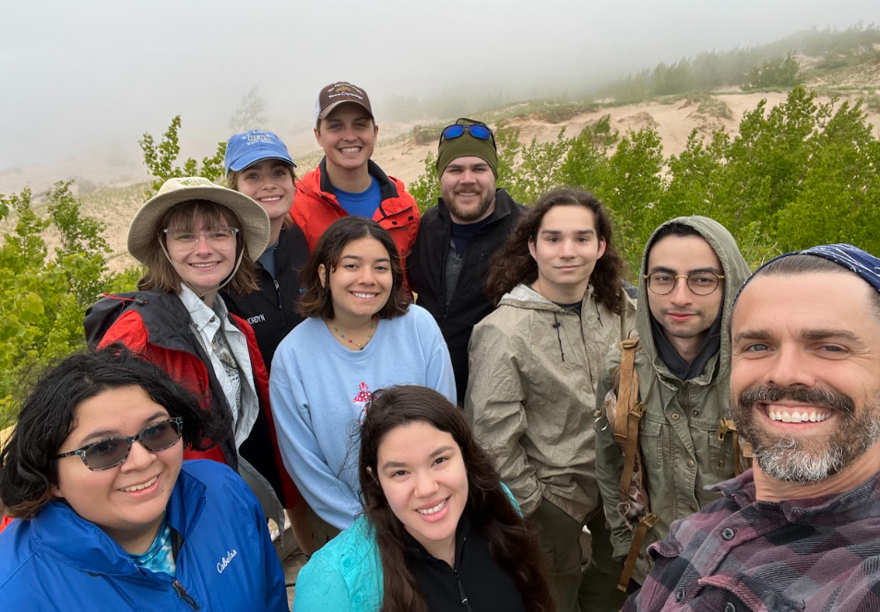
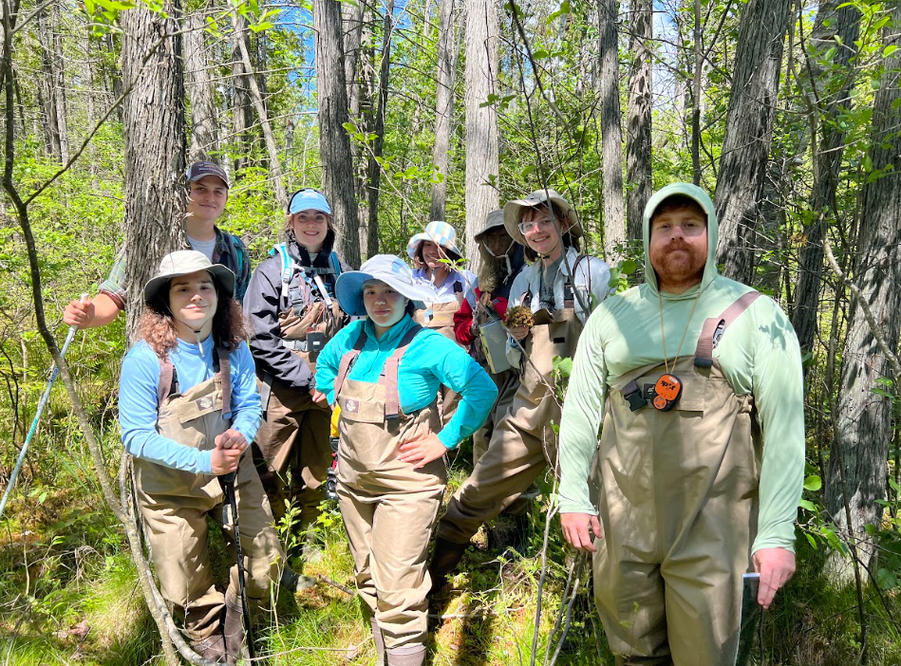
Coastal Ecohydrology Training Undergraduate Program (CETUP)
Objective 5. Increase engagement of underrepresented groups in STEM research
2-year cross-institutional cohort of five underrepresented undergraduate students per year (2022 and 2023)
Working directly with the project’s PIs
Also getting field experience in the Great Lakes

Slide 13
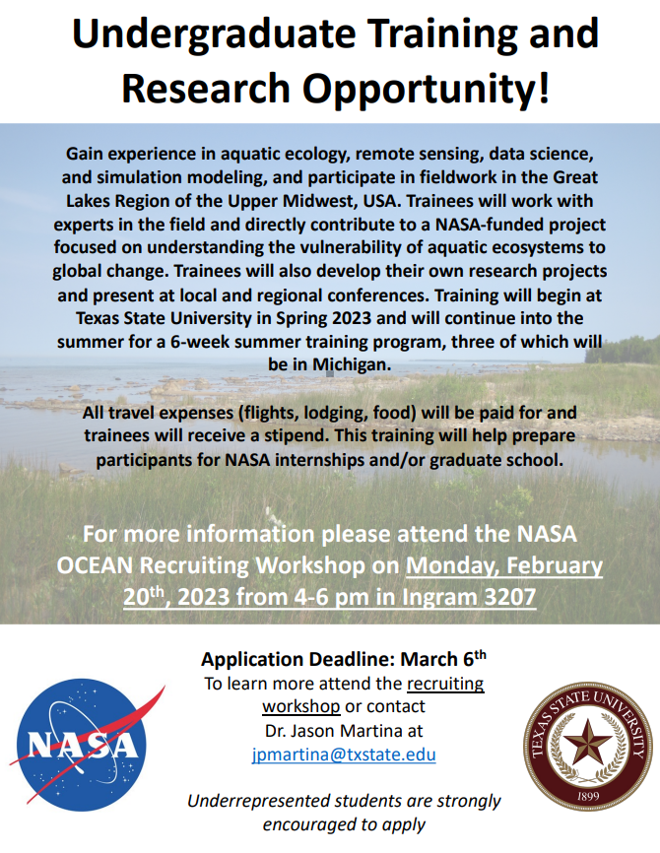
Recruitment
Through various organizations at TXST that support underrepresented groups
One-day Recruitment Workshop on TXST campus to recruit high quality candidates
Selection
Five students based on academic background and a personal statement
Build a diverse team with a variety of interests

Slide 14
Activities
CETUP-TXST (spring)
→ Training includes the basics of research, scientific literature comprehension, aquatic science, remote sensing, data science, and simulation modeling (8 weeks).
→ Virtually meet with different Principal Investigators on the project to discuss various topics, assignments, modules, and other components related to their training.

Slide 15
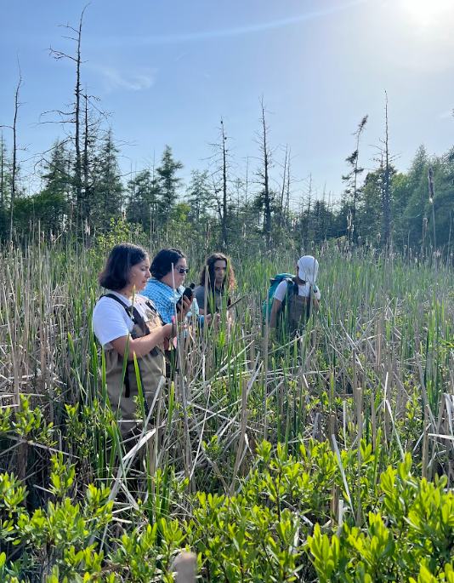
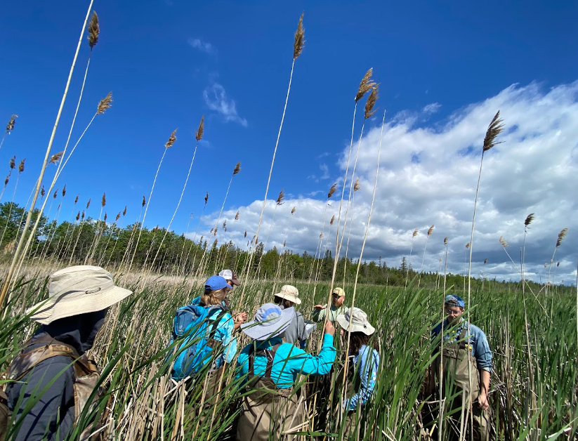
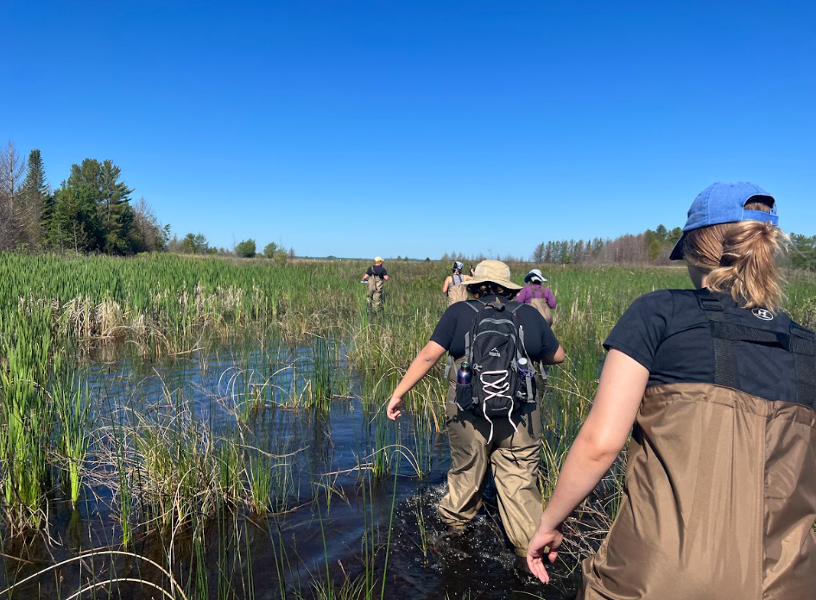
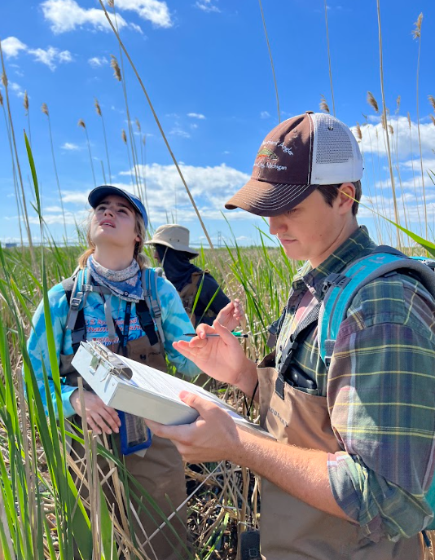
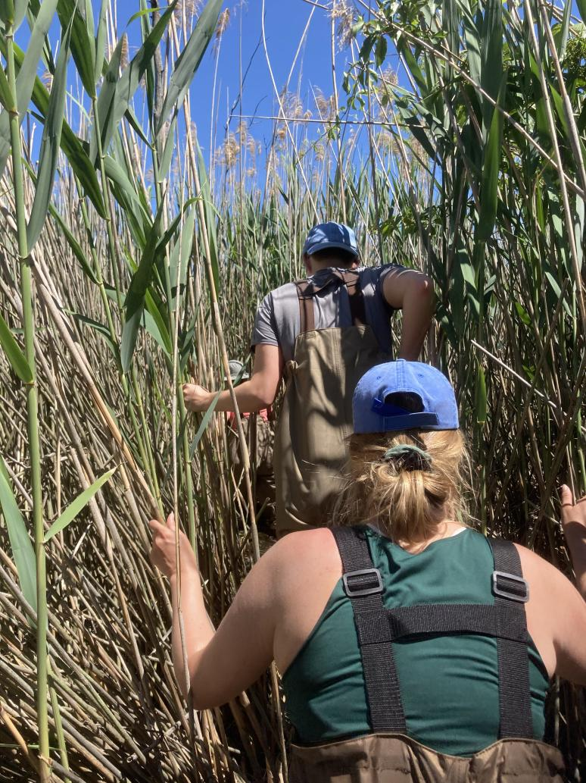
Summer-CETUP
1. One week of pre-training at TXST
Preparatory sessions aimed at providing context and preparing students for fieldwork in Michigan
2. Students travel to Michigan for three weeks
Training on data science and simulation modeling (MSU), training in remote sensing (MTRI)
Lake Huron coast collecting vegetation and soil nutrient data

Slide 16
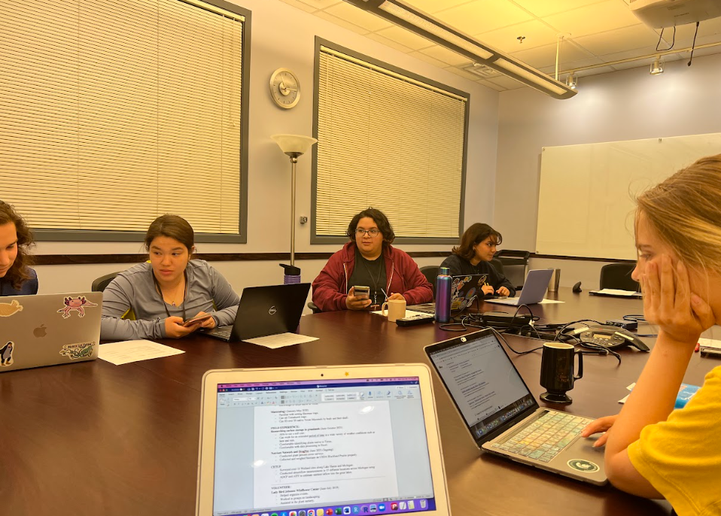
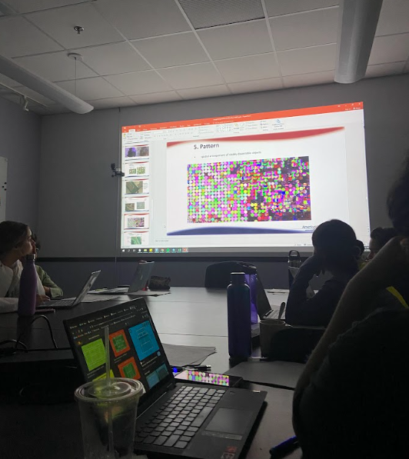
3. One-week follow-up training session at TXST
Synthesizing and integrating the previous weeks to the broader goals of each individual project.
During the summer:
Time for formal and informal mentoring to have authentic conversations about career paths in data science, remote sensing, and associated STEM fields and NASA careers.
Structured and unstructured recreation time to promote a better appreciation of the surrounding environments and teambuilding.

Slide 17
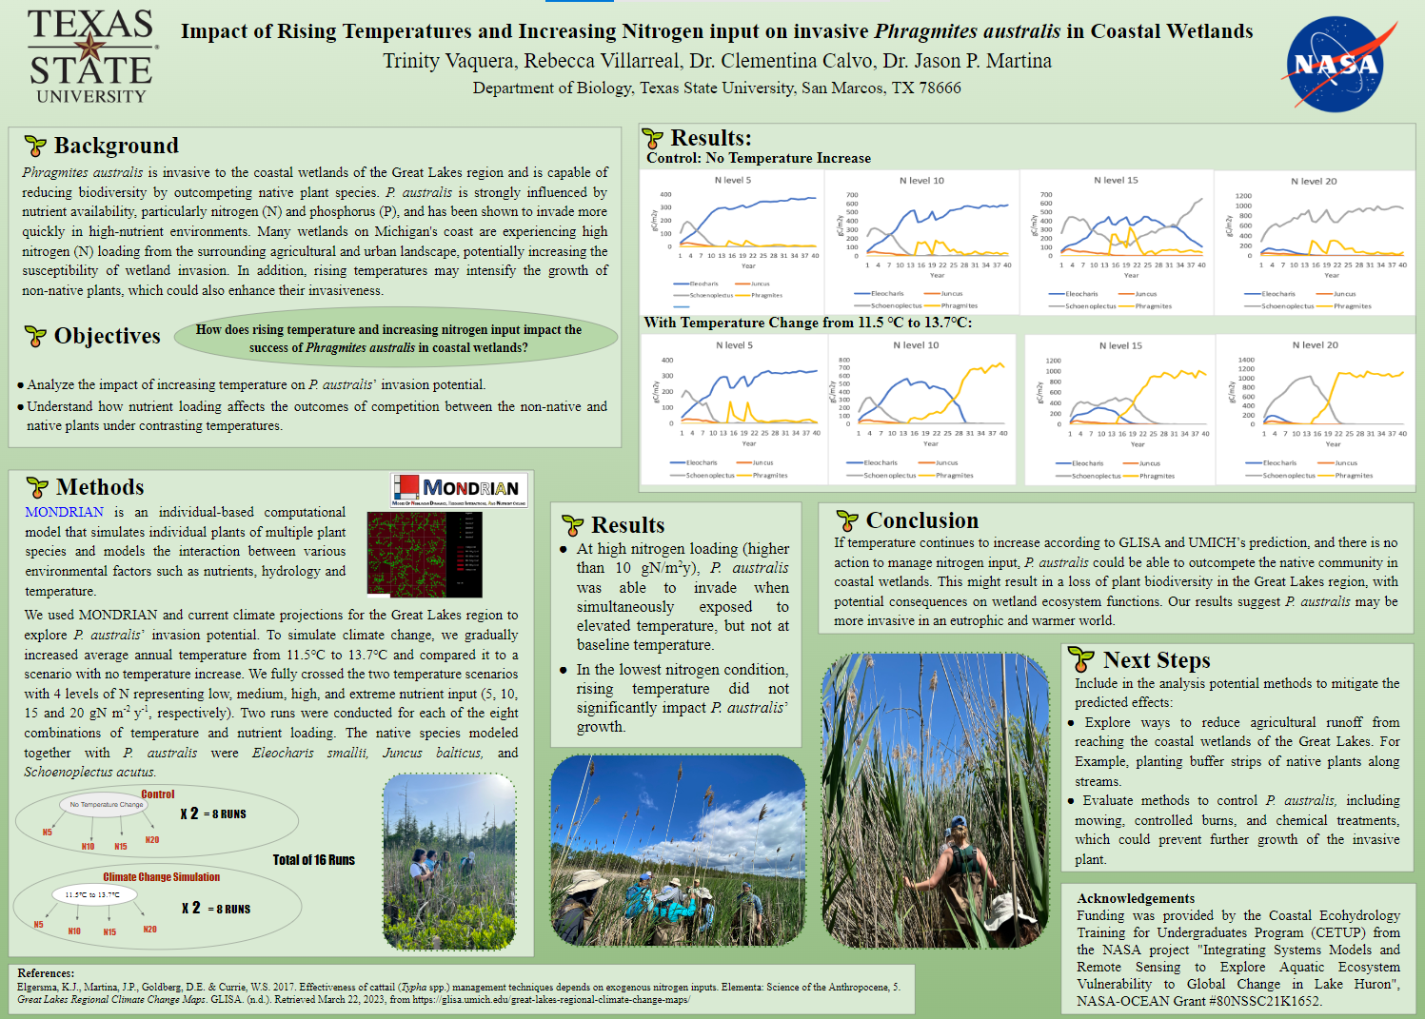
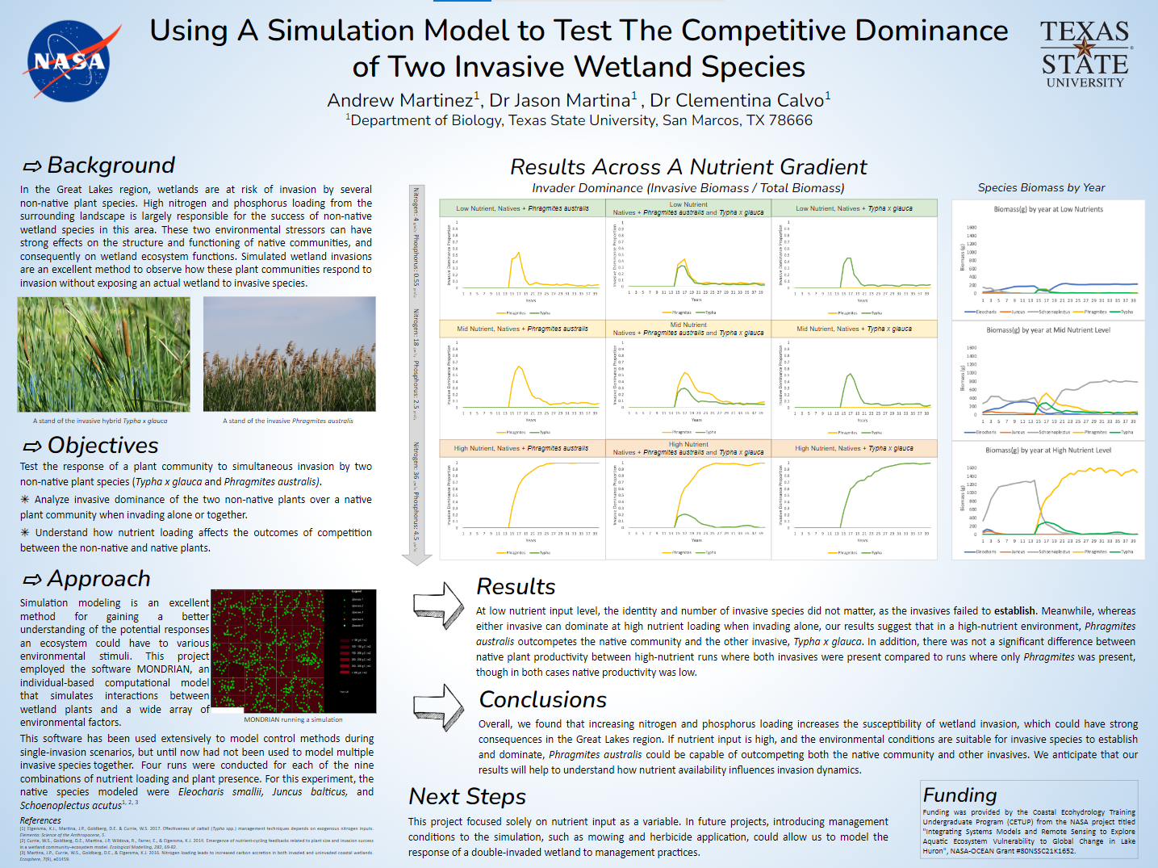
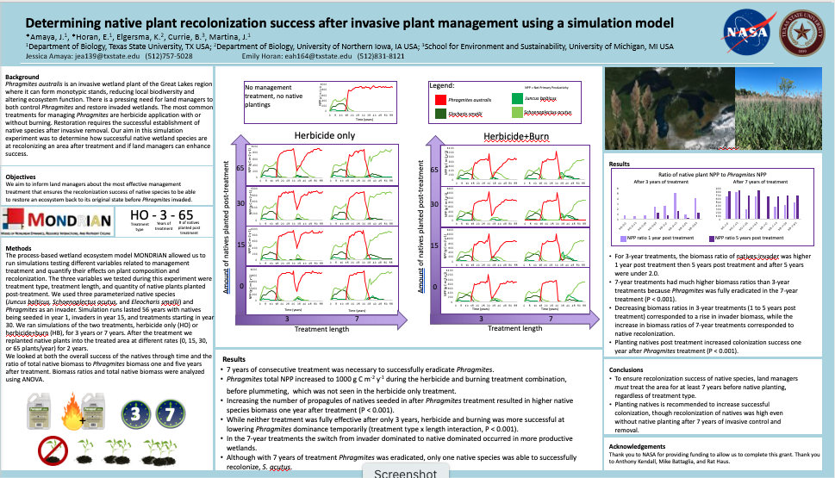
CETUP-TXST (fall)
→ 6-months follow-up to work on their own projects associated with the main NASA project tasks
→ Present at local and regional conferences
The 2022-cohort successfully completed their research projects and presented at regional conferences.

Slide 18
2022-cohort testimonials:
“…the motivation I received from feeling that I was capable of learning…”
“…understanding the fundamentals of conducting and interpreting research is beneficial to me and my future career”
“and I feel like CETUP brought me closer to accomplishing my dream of becoming an Aquatic biologist”
“This trip confirmed and strengthened my aspiration to further my education in graduate school”
“…this program is crucial for students to be able to better be prepared to succeed in their field”
“Having a diverse group of people tackling a problem from different angles seems to me now as a no brainer”

Slide 19
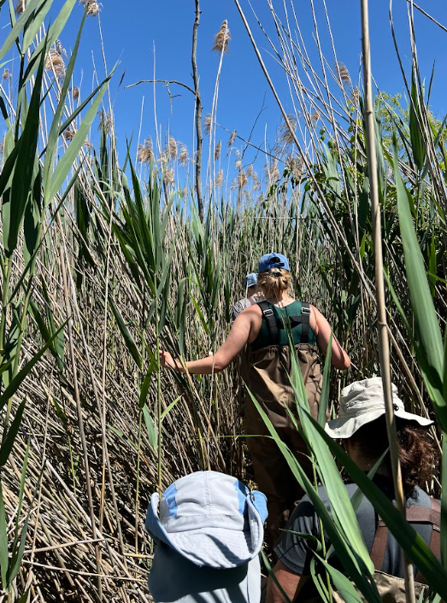

2023-cohort its starting with the modules and preparing for the summer trip
Thanks!
clementinacalvo@txstate.edu

