Slide 1


Sea Surface pCO₂ Reconstruction and Assessment in the Western Arctic Ocean under a Changing Climate
Tianyu Zhou, Yun Li, Zhangxian Ouyang, Zelun Wu, and Wei-Jun Cai
School of Marine Science and Policy, University of Delaware
OBB Annual Meeting
May 8, 2023
UMD, College Park
Notes:
This work is done in collaboration with my colleagues …. We are grateful for the support provided NASA and UD-CEOE. We currently finished the first-year work for this study, and we are excited to share the method and early results with you.

Slide 2
Environmental Settings
The AO contributes to about 5-14% of global oceanic carbon uptake (Bates et al., 2009)
Oceanic carbon cycles in the AO are regulated by both abiotic and biotic factors
Climate change and variability
Notes:
Due to the cold-water temperature that favors high CO2 solubility, and its strong biological production, AO contribute to 5-14% of oceanic carbon uptake despite its small spatial area.
The conceptual diagram on the left shows the complexity of oceanic processes that affect CO2 uptake. The west Arctic receives pacific inflow through Bering strait and has been experiencing changes in ice cover and ocean state, including abiotic factors such as sea surface temperature and salinity, and biological uptake related to chlorophyll concentrations. On top of that, sea ice cover variability virtually affect nearly every components in this system.
In the past one day and a half, we have learnt about the historical and ongoing changes and variabilities in this region. Due to time limit, I am not going to reiterate all the details but only mention a couple facts that directly link to the oceanic CO2 uptake.

Slide 3
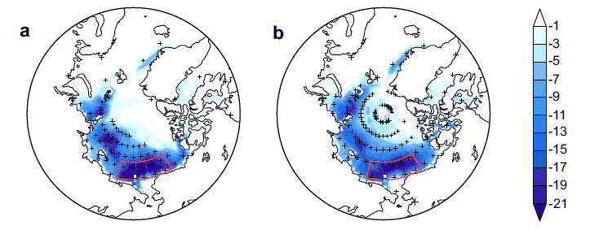
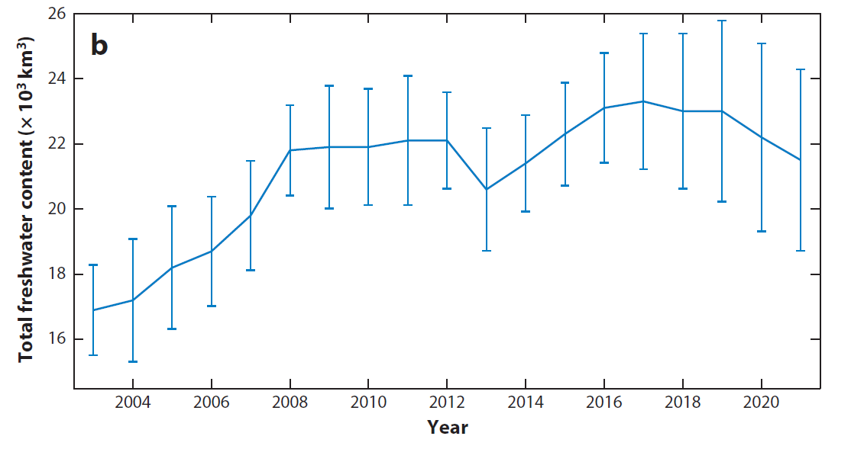
The Changing Western Arctic
Rapid decline of sea ice cover associated with strong interannual fluctuations
The freshwater content reflects the regime shift of circulations in the western AO
2004 2006 2008 2010 2012 2014 2016 2018 2020
SIC trend
(% yr⁻¹)
(Timmermans and Toole , 2023)
(Liu et al., 2021)
Notes:
Over long-term, sea ice loss is profound in the western Arctic Ocean among all, exceeding 10% per year in the past five decades. While a low sea ice inventory, the sea ice become more mobile and experienced stronger interannual variability in this region.
Associated with the sea ice change and river flow, the freshwater contents in the past two decades have shown decadal oscillations with plus or minus 20% of its mean content, reflective of the salinity change in this region.

Slide 4
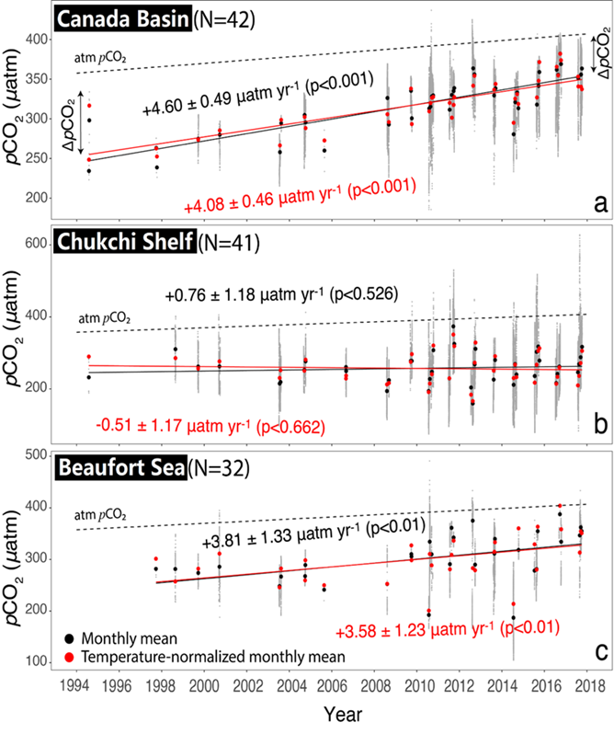
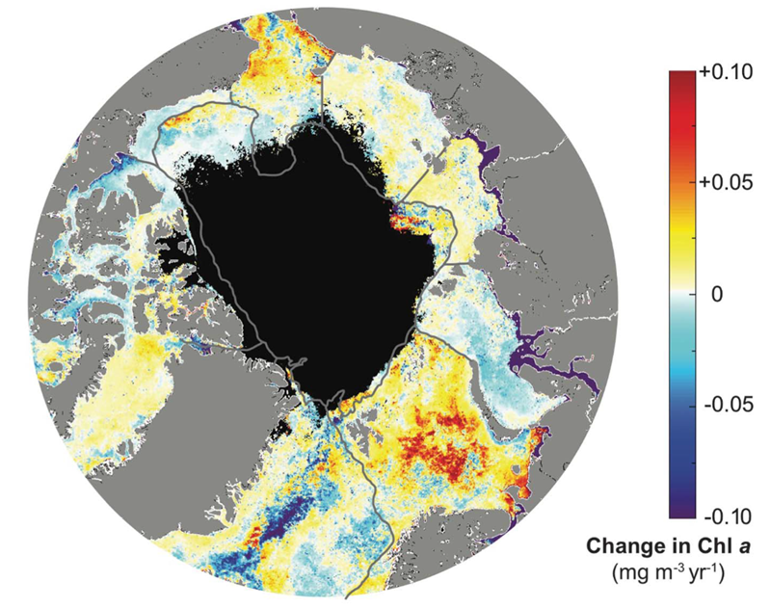
The Changing Western Arctic
These physical and biological changes lead to heterogeneous pCO₂ responses
Significant long-term increase of Chl a in most part of the western AO
Chl a trend
(mg m⁻³ yr⁻¹)
(Lewis et al., 2020)
(Ouyang et al., 2020)
Notes:
Apart from the abiotic factors, biological uptake is also pronounced yet patchy. Generally, there is an increase of chla level in the inflow shelves, but a decrease trend in the deep-basin area. Due to the changes of biotic and abiotic factors, and the complex interactions between them, the response of pCO2 is largely heterogeneous. Looking at three different subregions in the western Arctic over 1994-2019 time period, the observations show an increase of pCO2 in the Canada basin, and a nearly …

Slide 5

Existing Models and Approaches
Ecosystem Model: $153±14$ TgC yr⁻¹ (Manizza et al., 2019)
Atmospheric Inversion Model: $400\sim 600$ TgC yr⁻¹ (Wanninkhof et al., 2013)
Machine-Learning Model
A data-based approach with consideration of underlying dynamic factors
Summertime
(Tu et al., 2021)
Notes:
To assess the overall oceanic carbon uptake, different models and approaches that have been developed. For example, ecosystem model that depend on prescribed dynamics estimated 153+- 14 TgC/year for the entire arctic ocean, while the atmospheric inversion models provide 400~600 TgC/yr. The discrepancy between existing approaches make us wonder: to reconcile the discrepancy across methods, whether there exists a ***data-based*** approach with potential consideration of underlying dynamical factors?
With the advancement of computation power and algorithm, a regional study based on machine-learning showed promising results to derive summertime pCO2 maps for the chukchi sea and beaufort sea. Being motivated by this approach, we developed our machine learning model for the west Arctic ocean, and aim to resolve early season pco2 patterns in addition to summer time.

Slide 6
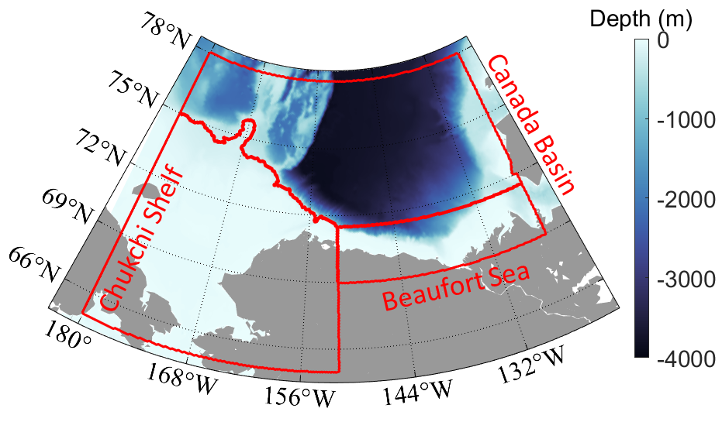
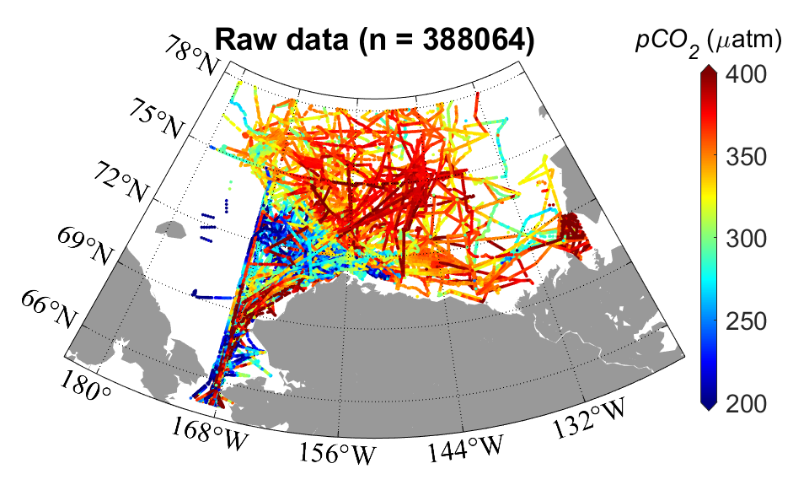
Machine Learning Model
pCO₂ observation
Environ. Predictors (X₁,X₂,...)
Sorting and Matchup
Training
Cross-validation
About 0.4 million pCO₂ measurements in the past decade
Strong shelf-to-basin gradient
Random Forest Model
Reconstruction
(SOCAT; Bakker et al., 2020)
Notes:
To begin with, we need data… a lot of data … to be able to train the ML model with baseline information of pCO2.
Fortunately, with increasing measurement of sea surface pCO2 in the western Arctic Ocean in the recent decade, there are >0.4 M measurements from SOCAT and other publicly available sources.
We selected the study period between 2008 and 2019, as measurements became more routinely over the season.
The map here demonstrate all the locations over this time period. When combined with the bathymetry, there is a clear and strong shelf-to-basin gradient between 72 and 75 degree N. Following the convention, we divided the study region into three parts: chukchi shelf, beaufort sea and Canada Basin.
From this dataset, we can already identify a strong gradient from .. To ..

Slide 7
Machine Learning Model
Environmental Predictors (2008-2019) | ECCO2 | 3-day | 1/4º
SSS | ECCO2 | 3-day | 1/4º
SST | OISST | Daily | 1/4º
Chla | GlobColour | 8-day | 1/24º
Daylength | Theoretical values | Daily | 1/4º
Wind² | CCMP | 6-hourly | 1/4º
SIC | NSIDC | daily | 1/4º
Machine-Learning Model Resolution |  | 8-day | 6 km
pCO₂ observation
Environ. Predictors (X₁,X₂,...)
Sorting and Matchup
Training
Cross-validation
Random Forest Model
Reconstruction
Notes:
Recall the biotic and abiotic factors we mentioned several slides ago, to keep our baseline model informative yet simple, we constructed our environmental predictors based on six variables that are relevant to CO2 dynamics.

Slide 8
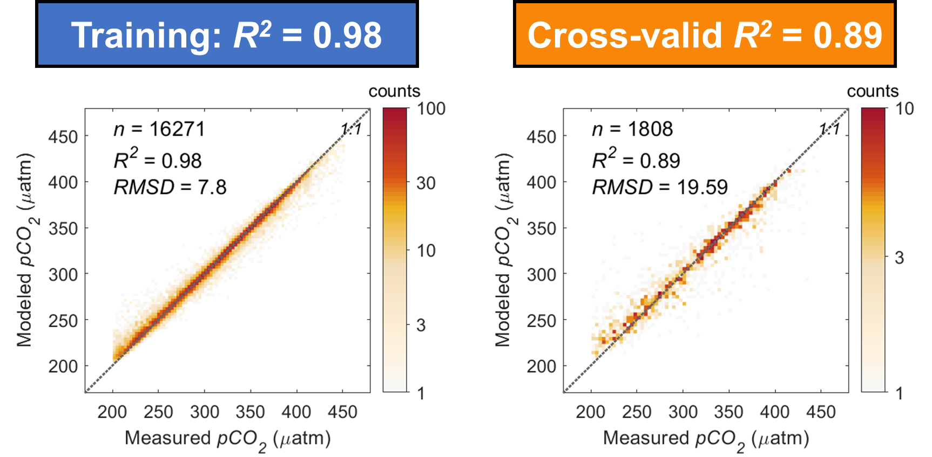
Machine Learning Model
Environmental Predictors (2008-2019) | ECCO2 | 3-day | 1/4º
SSS | ECCO2 | 3-day | 1/4º
SST | OISST | Daily | 1/4º
Chla | GlobColour | 8-day | 1/24º
Daylength | Theoretical values | Daily | 1/4º
Wind² | CCMP | 6-hourly | 1/4º
SIC | NSIDC | daily | 1/4º
Machine-Learning Model Resolution |  | 8-day | 6 km
pCO₂ observation
Environ. Predictors (X₁,X₂,...)
Sorting and Matchup
Training
Cross-validation
Random Forest Model
Reconstruction
Training
Cross-Validation
Notes:
These environmental predictors are sorted and then matched with concurrent and collocated in situ pCO2 data.
The matchups are split into a training and a cross-validation sets and are used to train a random-forest model. Here are the model performance: measured pCO2 on the x-axis and modeled pCO2 on the y-axis. Here is the 1-to-1 ratio line. The model explained 98% of the pCO2 variations in the training data and 89% variations in the cross-validation.

Slide 9
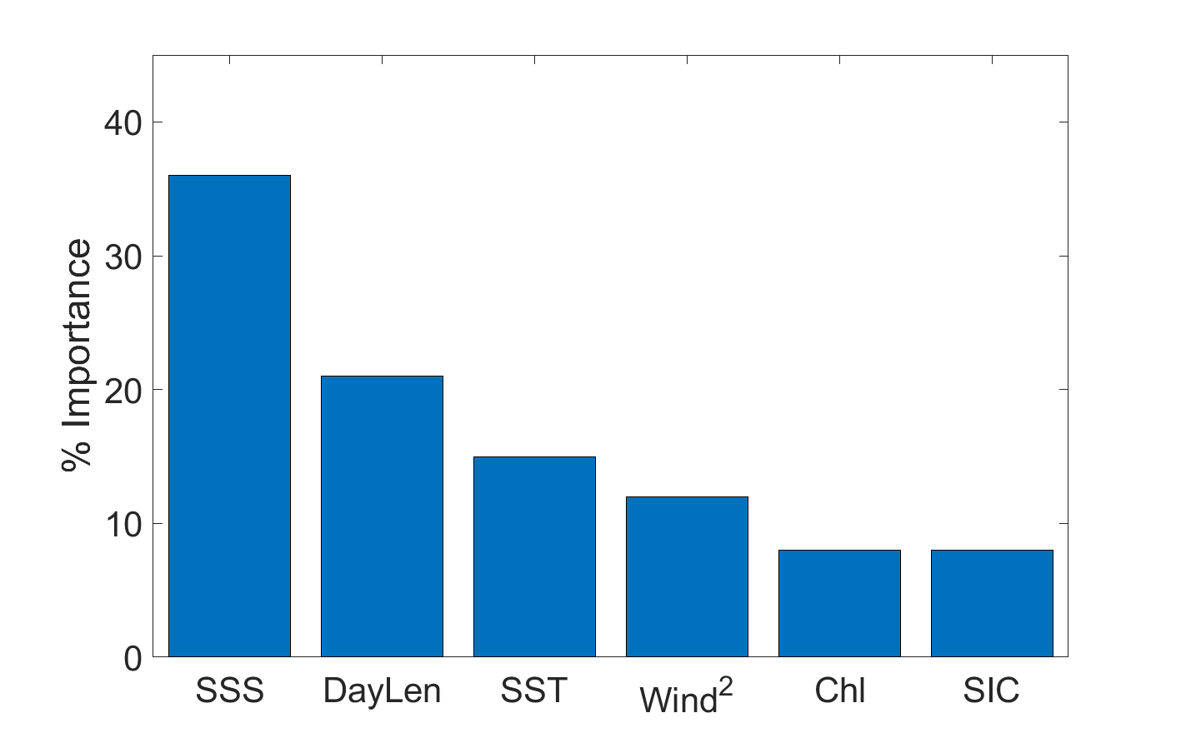






Machine Learning Model
$$p{CO}_{2}=f(SSS,Daylength,SST,{wind}^{2},Chl,SIC)$$
pCO₂ observation
Environ. Predictors (X₁,X₂,...)
$$SSS$$
Sorting and Matchup
$$Daylength$$
$$SST$$
$${Wind}^{2}$$
Training
Cross-validation
$$Chla$$
$$SIC$$
Random Forest Model
Four dominant environmental predictors explained >80% of data variability.
Reconstruction
Notes:
Further, the 6-variable random forest model rank the environmental predictors based on their contribution to explaining data variations. Sea surface salinity, daylength, sea surface temperature, and wind2 combined can explain >80% of the data variability.

Slide 10
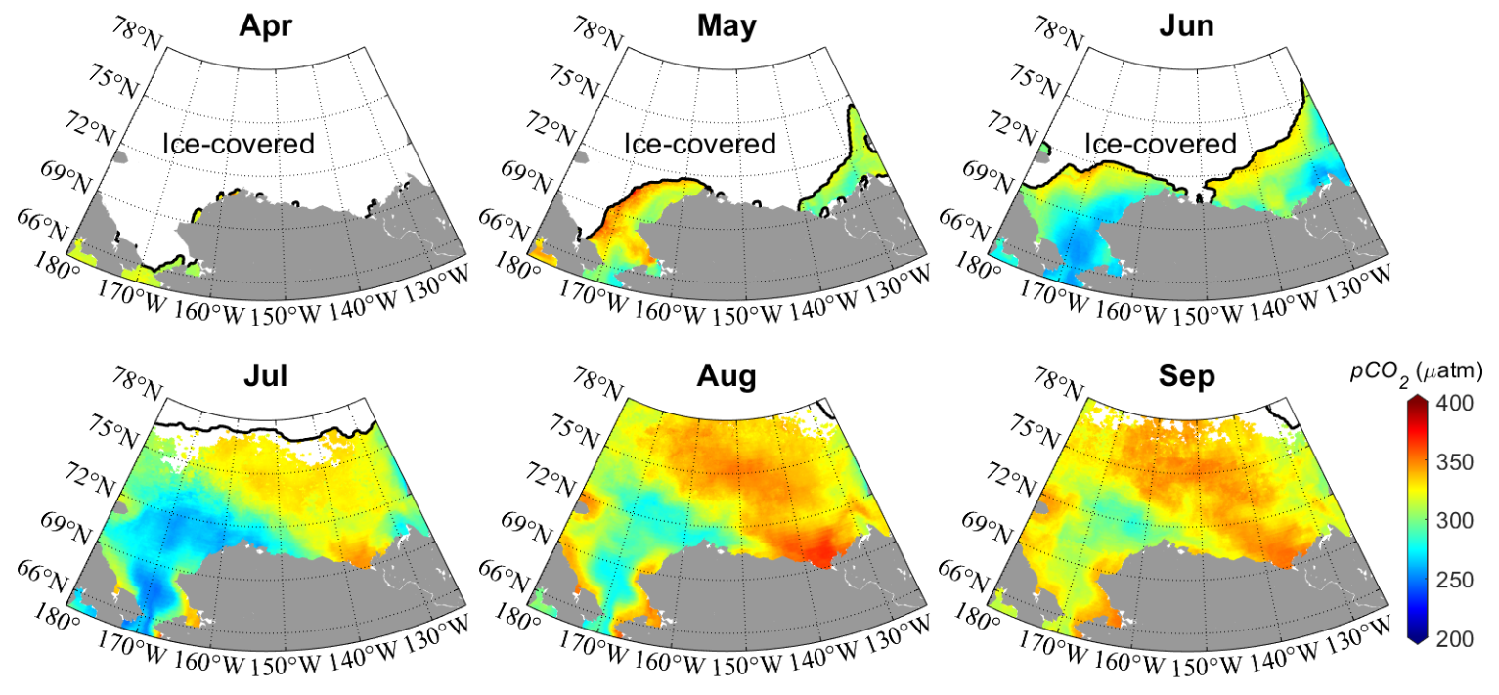
Research Question 1: Spatio-Temporal Pattern of pCO₂ in the Early Season
Summertime (Jul to Sep)
strong regional contrasts between the shelf (low) and the basin (high)
pCO₂ increases with seasonal warming (Ouyang et al., 2020; 2022)
early-season patterns?
Notes:
However, while most studies focus on the summertime, what the pCO2 patterns look like in the early season during sea ice retreat?

Slide 11
Seasonal Climatology
Early season during ice retreat (Apr to Jun)
reversed spatial gradients at low latitudes
high pCO₂ in the newly opened water along sea ice edge
Notes:
Interestingly, with the departure of sea ice cover, there is a reversed spatial gradient in the chukchi sea, with high pCO2 along sea ice edge in the newly opened surface water. This compensate the later gradient developed in summer time. To assess the annual net carbon uptake, this needs to be incorporated to avoid over or underestimate that is biased toward summertime.

Slide 12
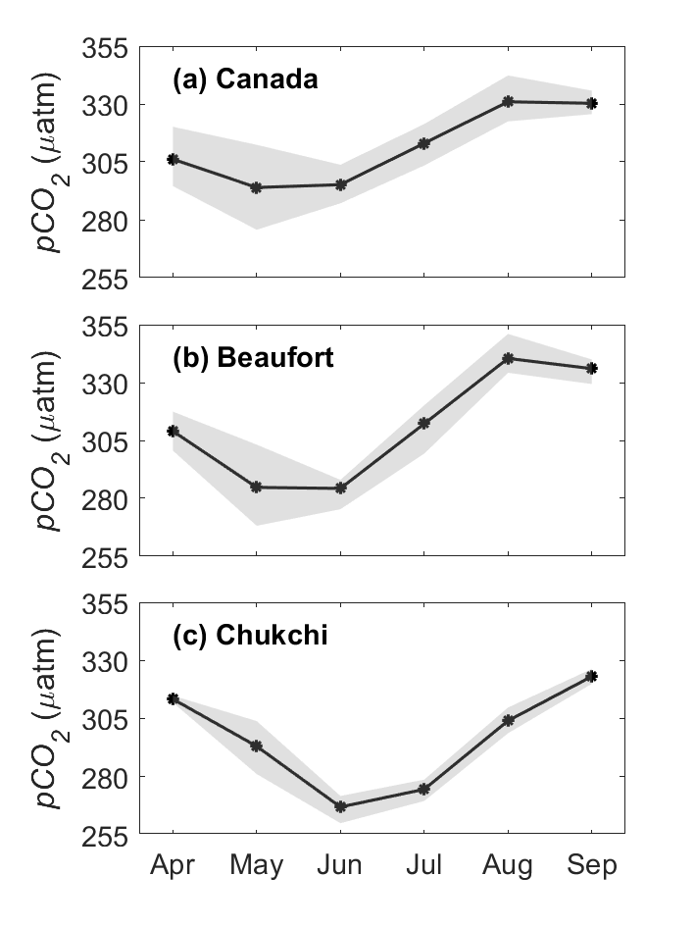
Regional Seasonality
Canada Basin
High pCO₂ during sea ice retreat
Bio-drawdown dominates in Chukchi
pCO₂ increases with seasonal warming
Beaufort Sea
Chukchi Shelf
Notes:
If lumping all years together …., we have a seasonal cycle in each subregion
Once again ….

Slide 13
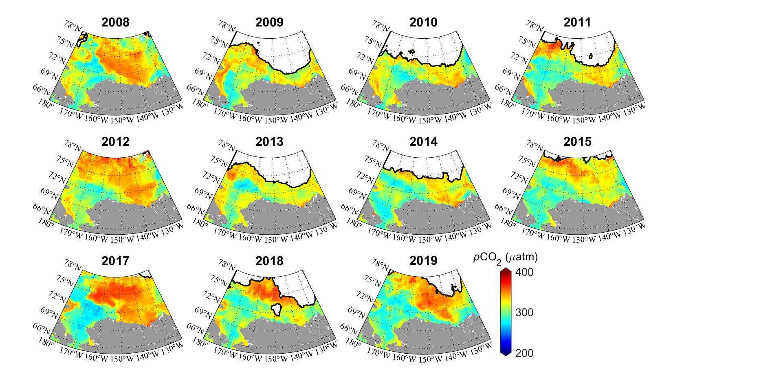
Research Question 2: Interannual Variability
High pCO₂ generally corresponds to low sea ice cover in the Canada Basin

Slide 14
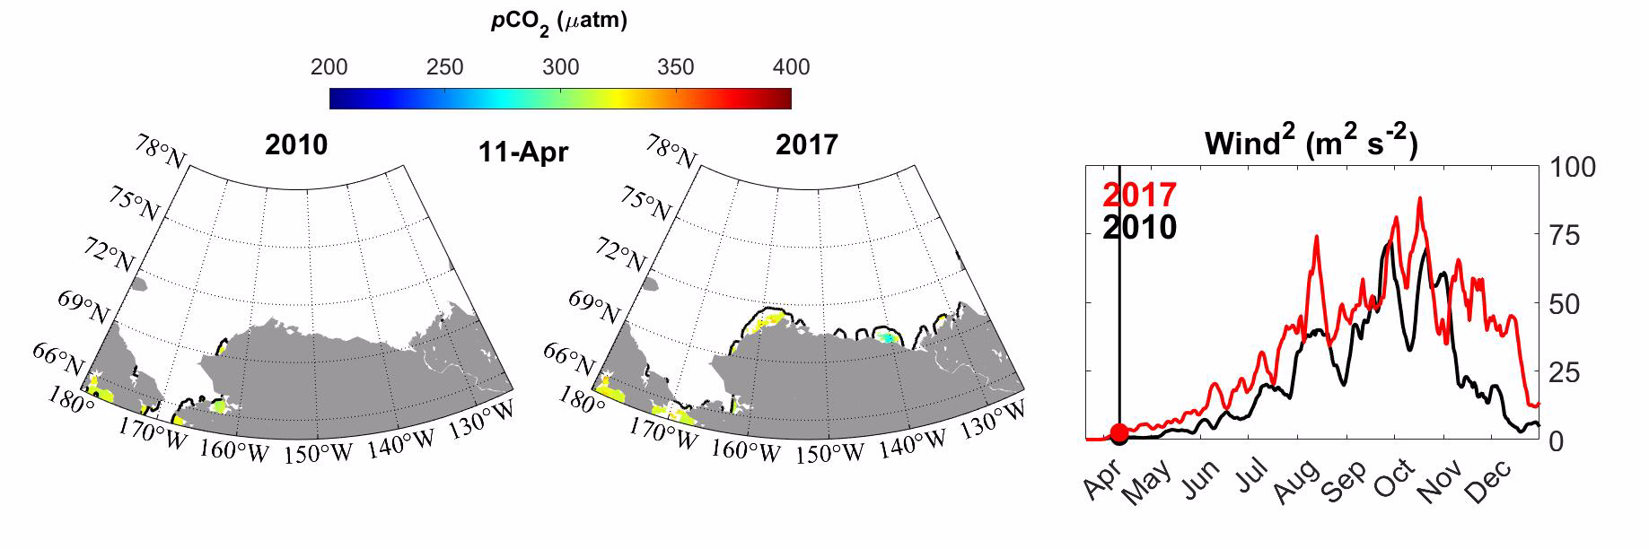
Year-to-Year Variations
Winds acting on newly opened water are responsible for higher pCO₂
Notes:
As time accumulates, this effect becomes more significant toward later seasons

Slide 15
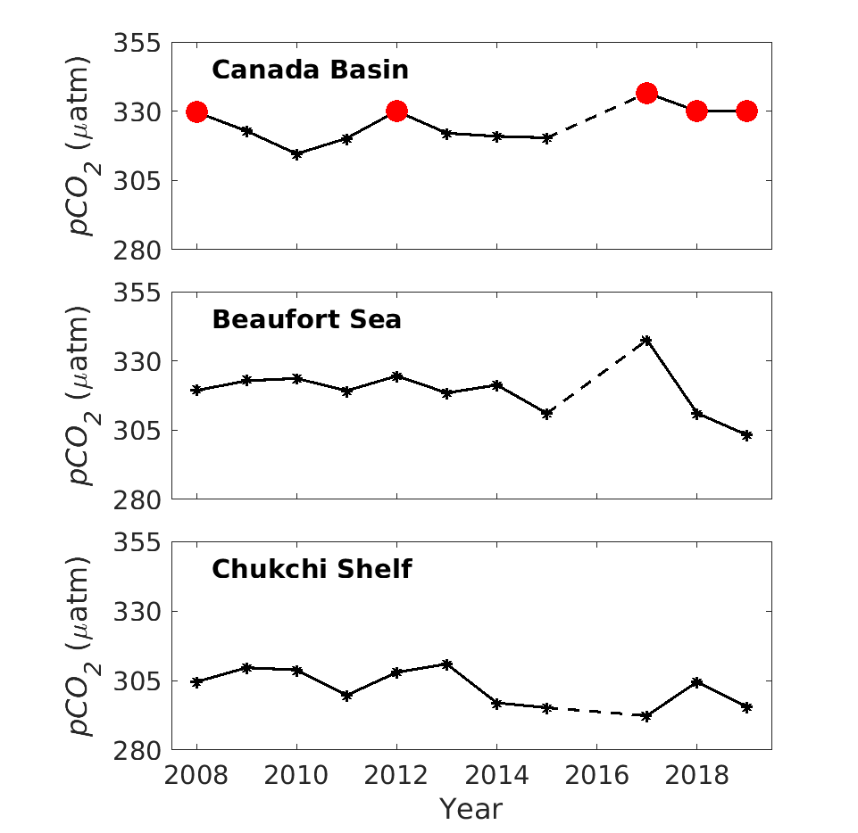
Interannual Variability in Subregions
Low sea ice years
No significant trend over 2008 to 2019
Relatively strong interannual variations of pCO₂

Slide 16
Summary and Conclusion
Machine learning models provide a plausible way to develop data-based pCO₂ reconstruction
Summertime pCO₂ needs to be combined with the early season pCO₂ to assess annual oceanic carbon uptake
2008 to 2019 is marked by relatively strong interannual variations of pCO₂ yet a weak trend
Compound effects of early ice retreat and winds on open water cause high pCO₂ at high latitudes
Year 2 (future) developments:
Compare different machine learning algorithms
Expand current 6 factors to a suite of environmental predictors

