Slide 1
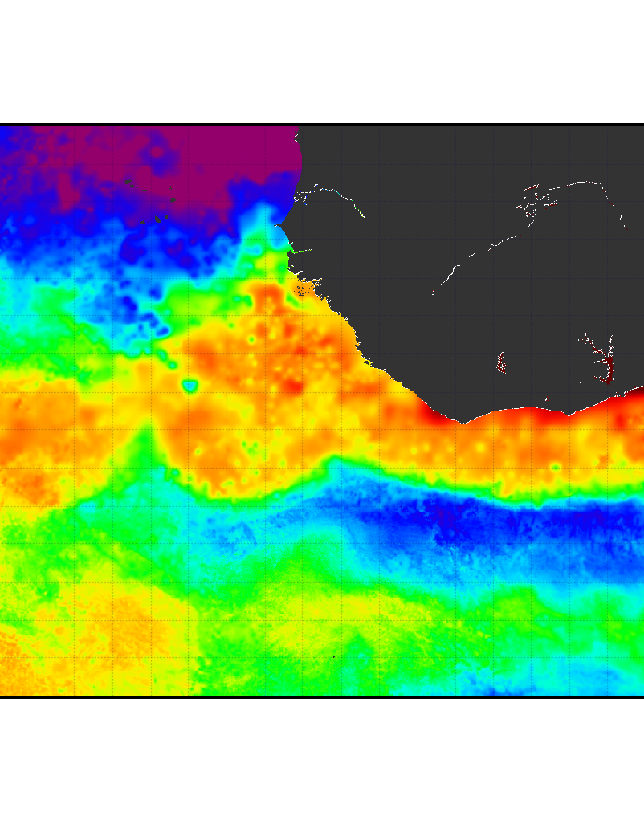
NASA OBB Annual Meeting 2023
Phytoplankton Biomass in the Equatorial Atlantic – Who, How much, and why?

Slide 2
Acknowledgments
Joe Montoya (Georgia Tech)
Ana Fernandez-Carrera (Baltic Sea Research Institute – IOW)
Peter Brandt (GEOMAR)
Rainer Kiko (GEOMAR)
Maren Voss (Baltic Sea Research Institute – IOW)
Ina Schmidt (University of Bremen)
Gordon and Betty Moore Foundation (M118 cruise along 23W)
National Science Foundation (EN614, EN640 cruises in the Amazon River Outflow)
NASA OBB (M181 zonal cruise on the Equator)
German Colleagues & Subramaniam family (M130, M145 cruise along 23W, M158 zonal cruise on the Equator, M174 cruise in the Amazon River Outflow)
Crystal Thomas and NASA HPLC Lab crew

Slide 3
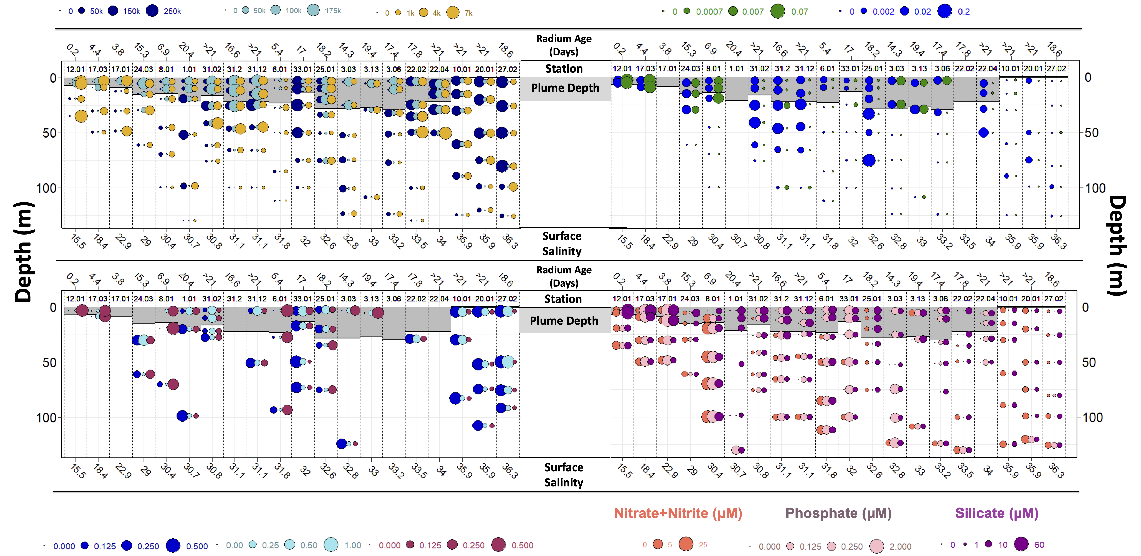
Prochlorococcus
(cells/ml)
Synechococcus
(cells/ml)
Picoeukaryotes
(cells/ml)
Green Water
Synechococcus
Blue Water
Synechococcus
DVChla/TotalChla
(mg/m³)
Zea/TotalChla
(mg/m³)
Fuco/TotalChla
(mg/m³)

Slide 4
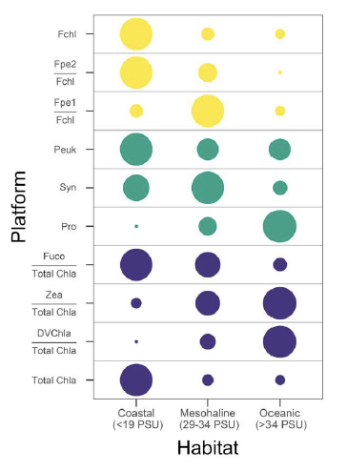

Slide 5
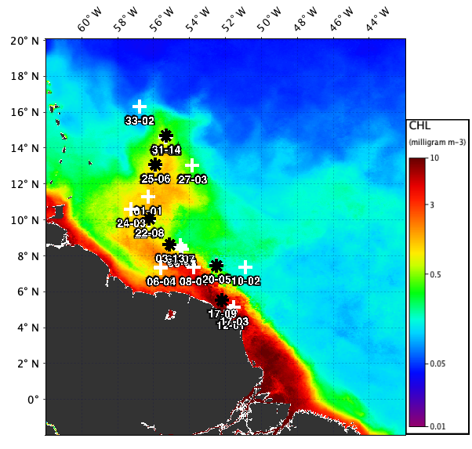
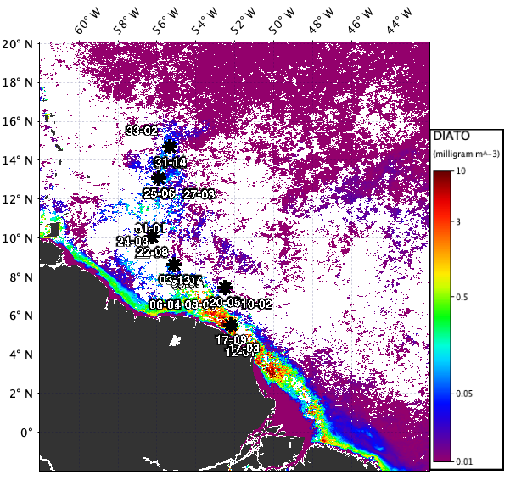
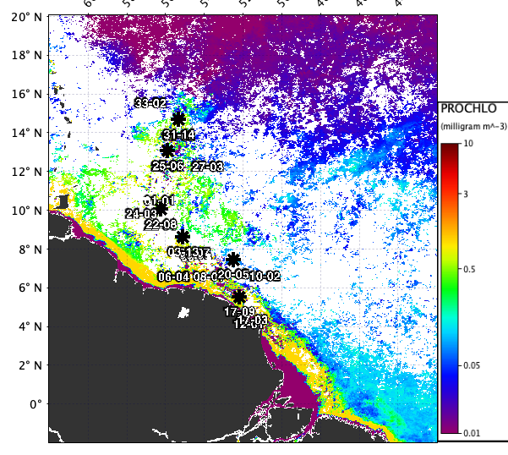
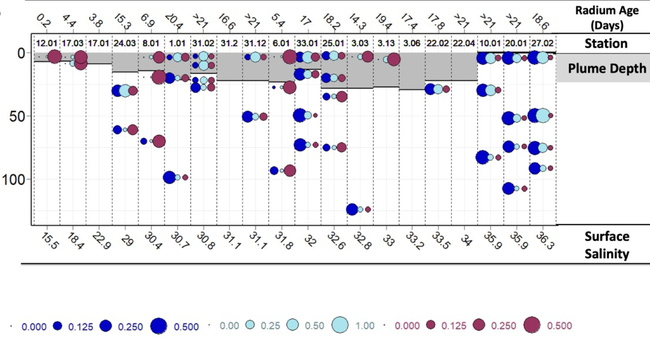
DVChla/TotalChla
(mg/m³)
Zea/TotalChla
(mg/m³)
Fuco/TotalChla
(mg/m³)

Slide 6
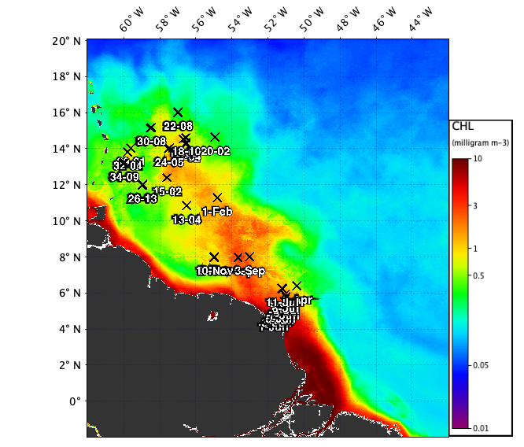
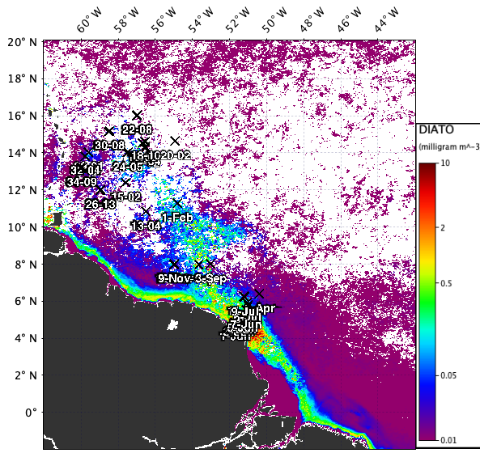
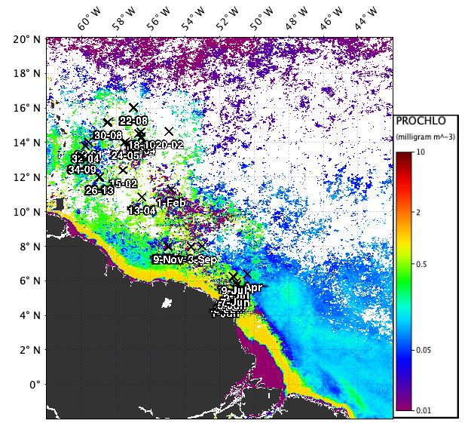
June
2019

Slide 7
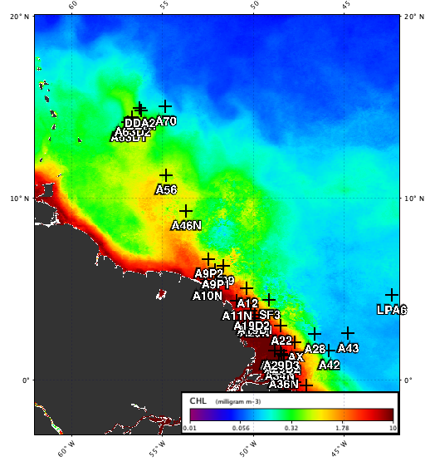
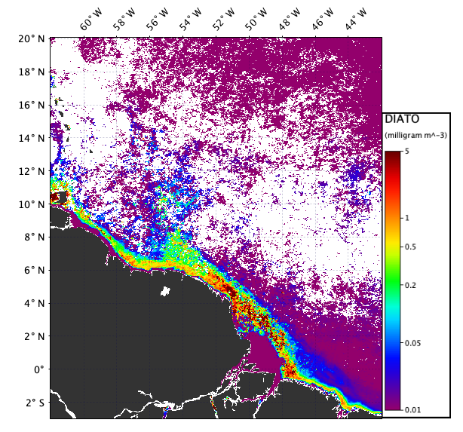
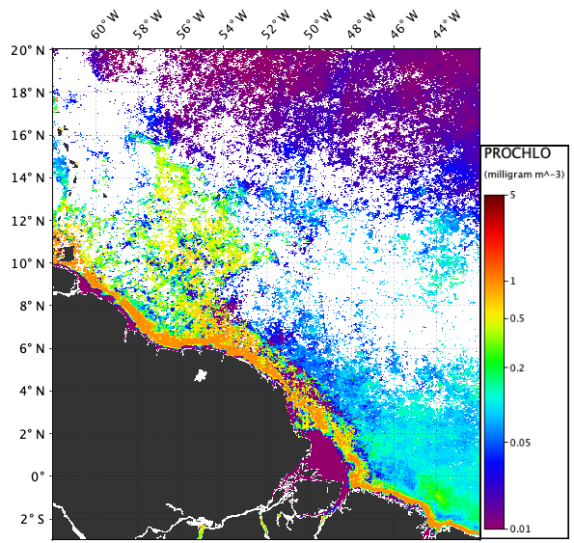
May
2021

