Slide 1
A Land to Sea Paradigm: Impact of Spatially and Temporally Varying Nutrient and Freshwater Fluxes on Coastal Carbon Dynamics in the northern Gulf of Mexico
Michelle Gierach (JPL)
Dustin Carroll (MLML)
Cedric David (JPL)
Philip Townsend (UWMadison)
Zong-Liang Yang (UTAustin)
Dimitris Menemenlis (JPL)
(Michelle cannot attend --- so I will use the time slot to discuss the ECCO-Darwin global-ocean biogeochemistry contribution to project.)

Slide 2

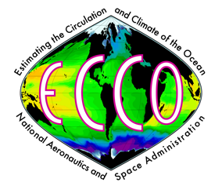
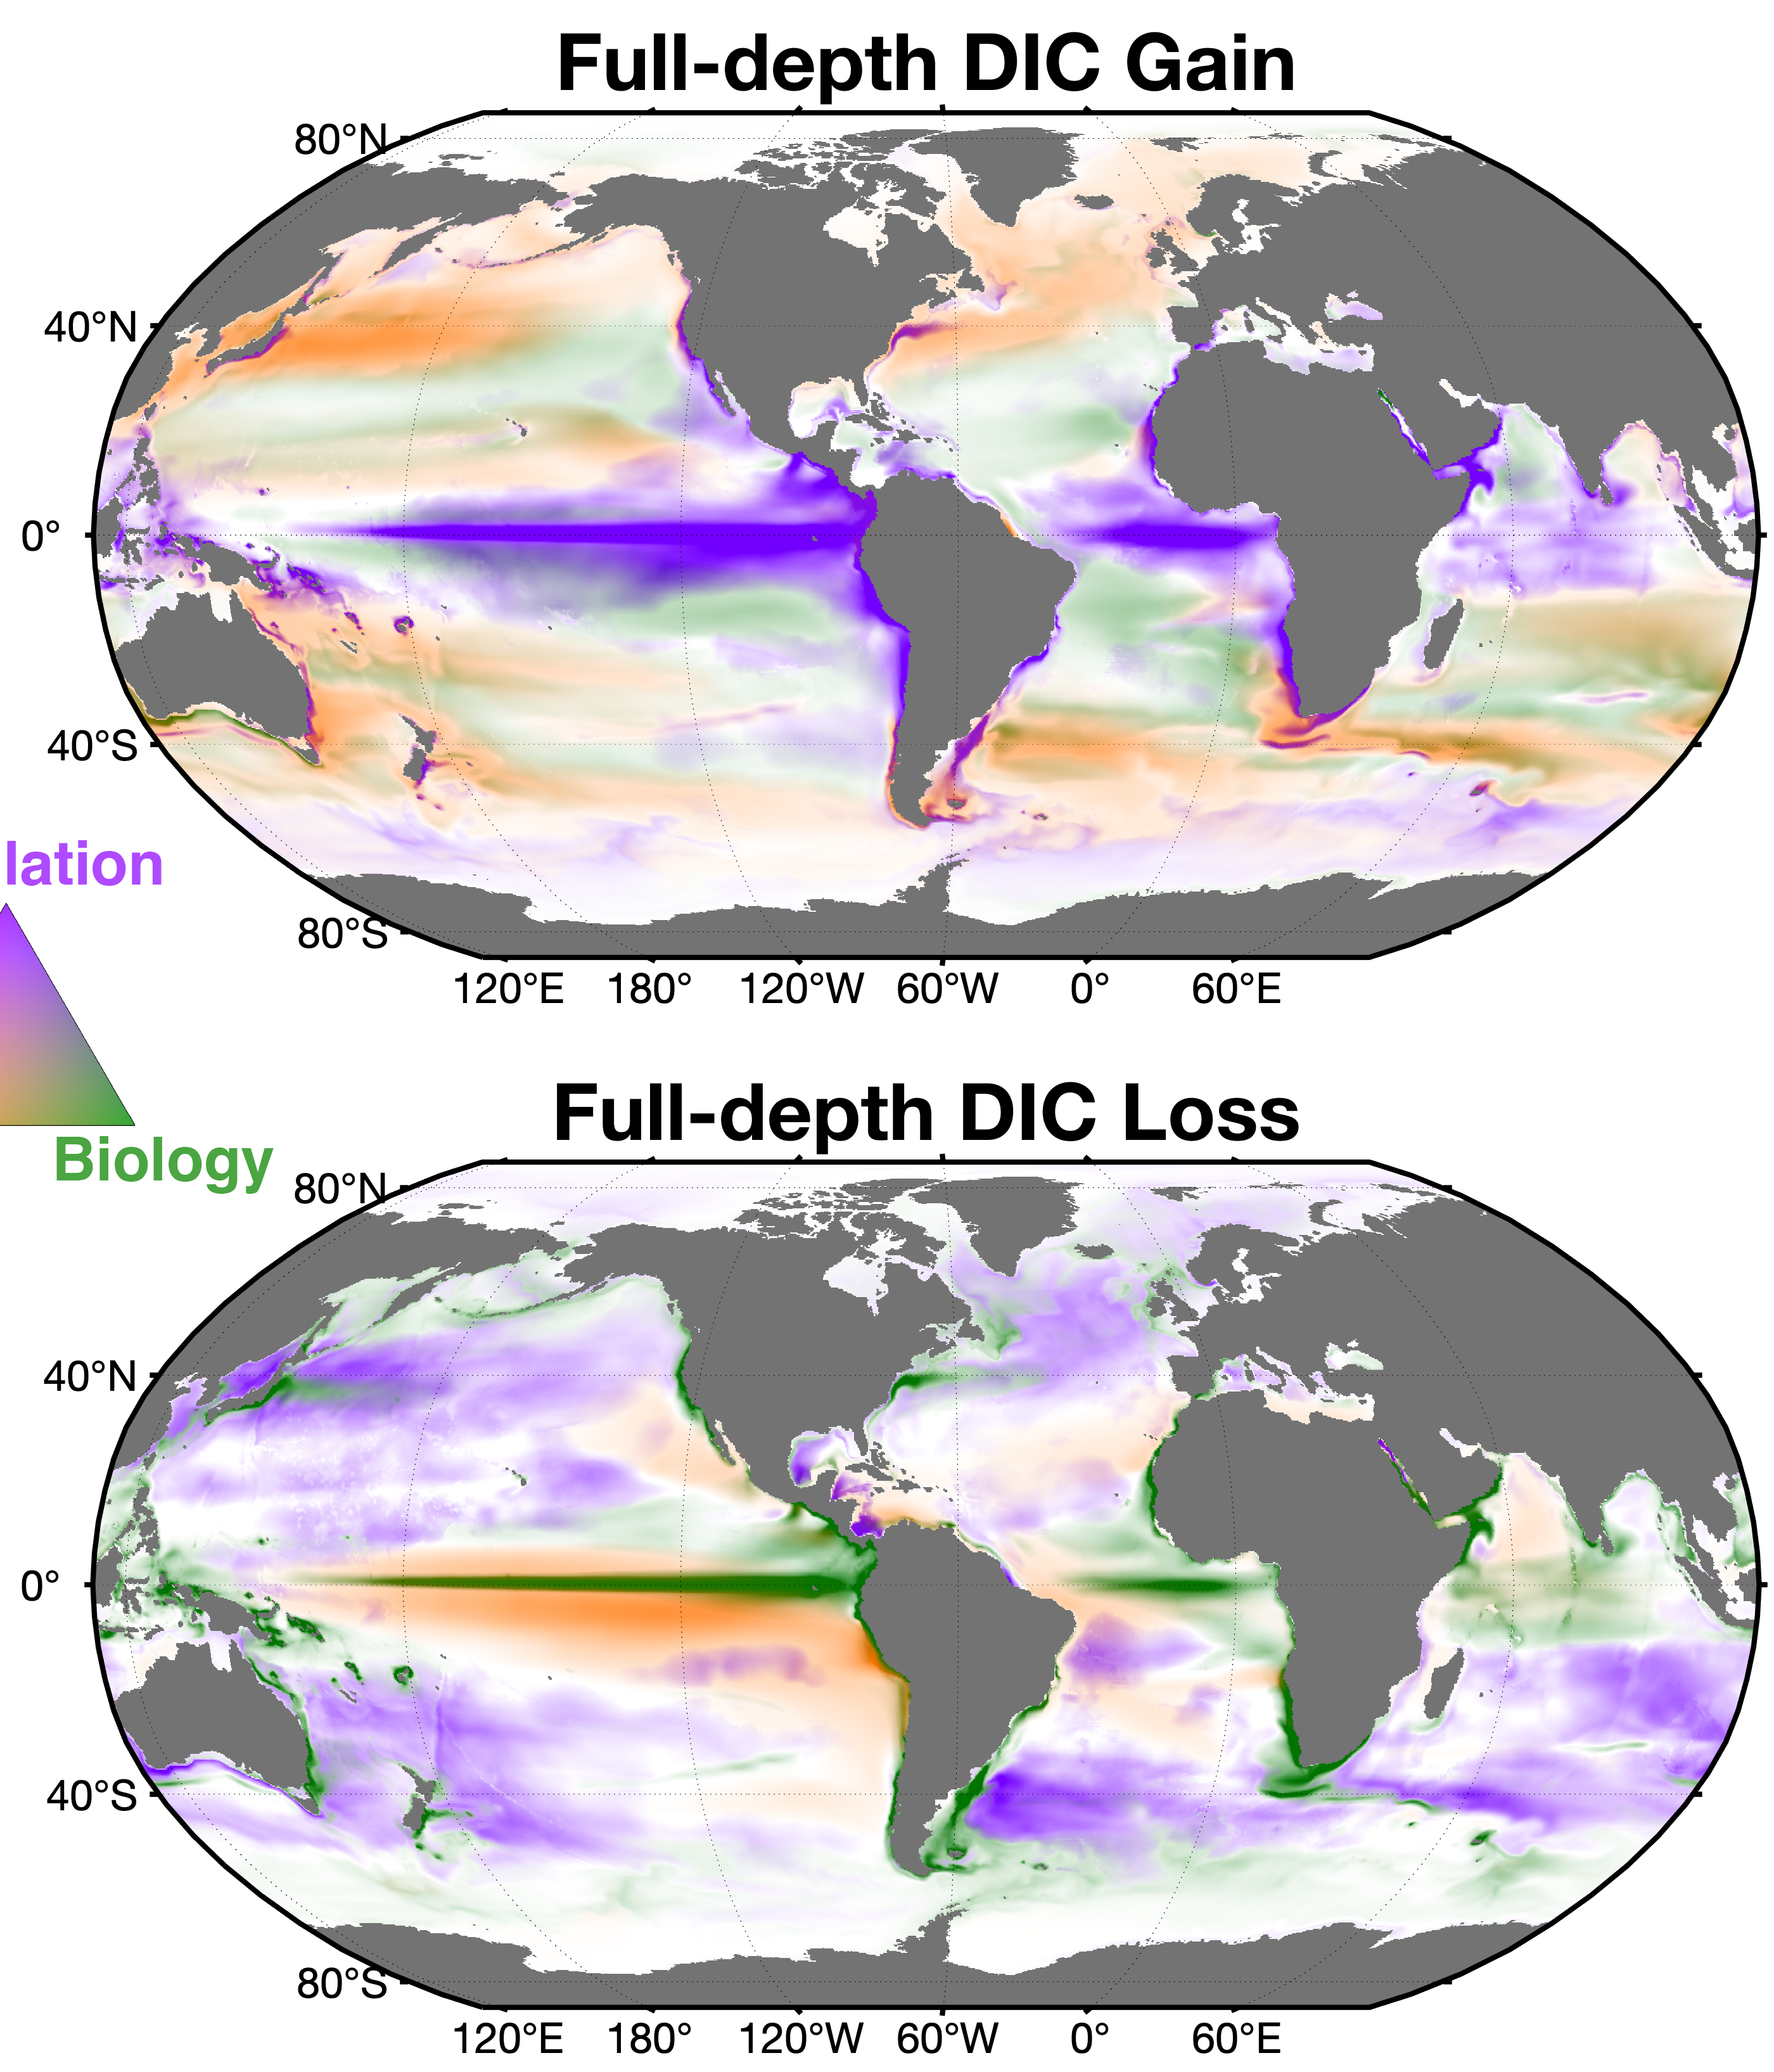
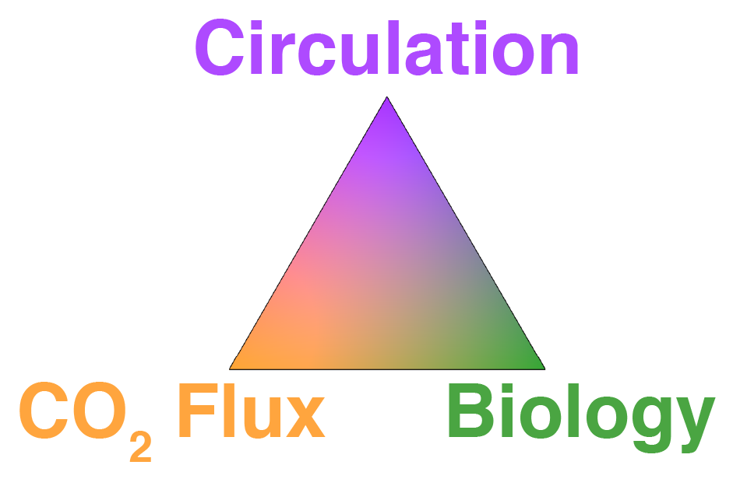
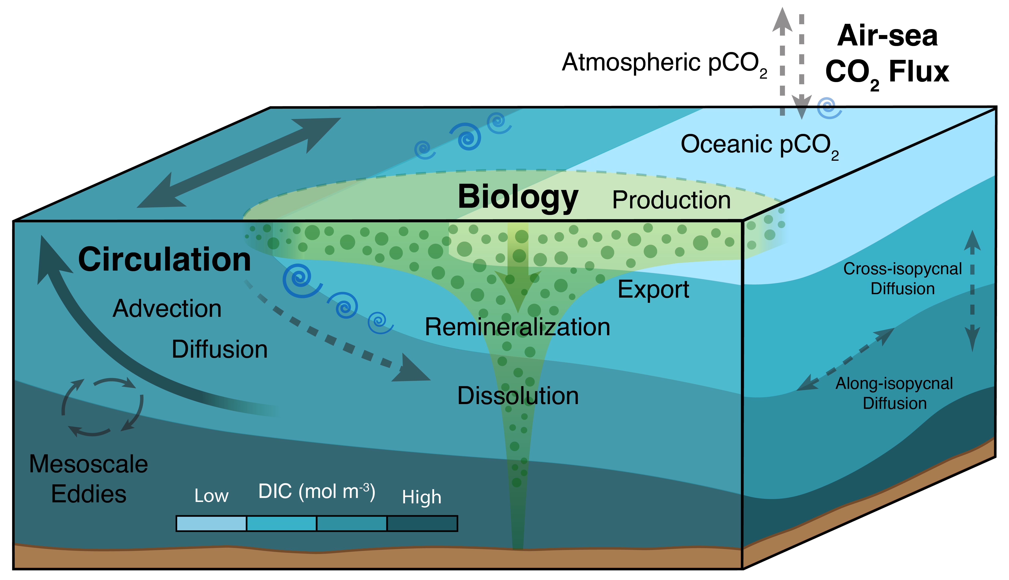
Attribution of Space-time Variability in
Global-ocean Dissolved Inorganic Carbon
Objectives:
Patterns of Dissolved Inorganic Carbon (DIC) gain (top) & loss (bottom) in full-depth-ocean
Develop a state-of-the-art ocean biogeochemistry state estimate (ECCO-Darwin) that can be used for NASA science objectives, missions (e.g., PACE and SBG), and carbon inversion systems (e.g., CMS-Flux)
Quantify drivers of global-ocean carbon sequestration
Understand the climate-related sensitivity of marine ecosystems
DIC gain from air-sea CO₂ flux occurs in boundary currents, subpolar regions, and the Southern Ocean, while losses occur along the equator
Biology provides a gain of DIC from deep remineralization, concentrated in subtropical
gyres, and a loss at the equator from plankton blooms
DIC loss from circulation highlights the extratropical divergence (downwelling) required to balance equatorial convergence of DIC-rich waters (upwelling)
Approach:
Use ECCO 1/3° state estimate to represent ocean circulation and hydrography from 1992 to near-present
Combine with a marine ecosystem and carbon chemistry model developed by the MIT Darwin Project
Optimize ocean biogeochemistry using a Green’s Functions approach and a suite of in-situ observations
Key Deliverables:
Data-constrained, multi-decadal estimate of ocean carbon sequestration for 1992–2018
Closed 3-D budgets for key biogeochemical quantities (DIC, macro and micronutrients, plankton biomass)
Improved global-ocean biogeochemistry estimates that will become increasingly more accurate and useful as ECCO state estimates evolve and are extended in time
ECCO-Darwin can be used to separate and quantify the mechanisms that drive ocean carbon variability
Carroll et al., 2022. Attribution of Space-time Variability in Global-ocean Dissolved Inorganic Carbon. Global Biogeochemical Cycles, 36, e2021GB007162

Slide 3
(from Carrol et al. CMS project)

Slide 5
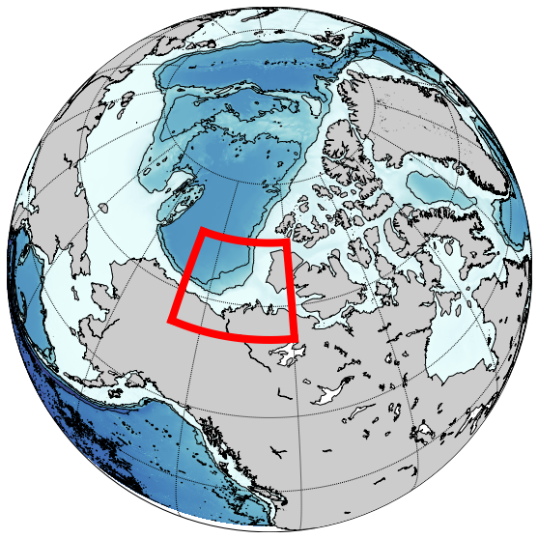
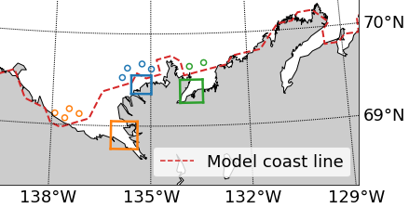
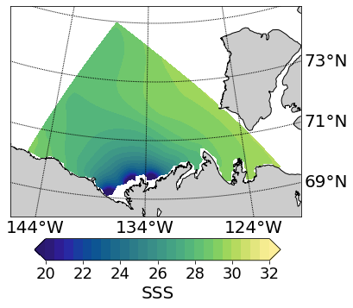
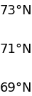
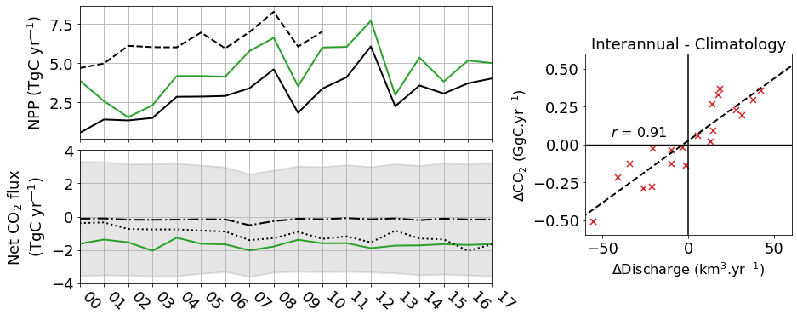
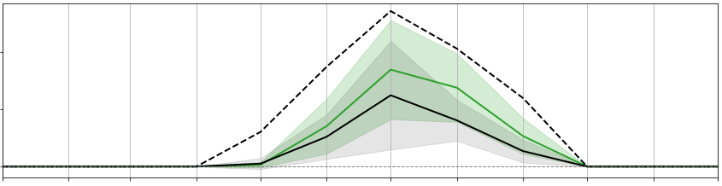
Clément Bertin (La Rochelle Université), Biogeochemical River Runoff Drives Intense Arctic Ocean Outgassing (just published, Geophysical Research Letters)
  Based on LLC 270 ECCO-Darwin (Carroll et al., 2020)
  2 DOC pools
  Daily terrestrial runoff from the Mackenzie River (2000–2019): Freshwater, river temperature, and 6 biogeochemical tracers
  Interannual DOC, DIC, and alkalinity runoff
Lewis et al. (2020)
Belanger et al. (2013)
All Interannual
Model reproduces Southeast Beaufort Sea dynamics
Simulated surface-ocean DOC agrees well with satellite observations
Captures the observed seasonal-to-interannual NPP and CO₂ flux amplitude and variability
2
NPP (TgC mth⁻¹)
1
0
Jan Feb Mar Apr May Jul Aug Sep Oct Nov Dec

