Slide 1


Operational Highlights of the EXport Processes in the Ocean from RemoTe Sensing (EXPORTS) North Atlantic 2021 Field Campaign
EXPORTS Science Team

Slide 2
Goal & Science Questions
EXPORTS’s goal is to improve predictions of the export and fate of ocean NPP using satellite data & numerical models.
Q1:How do upper ocean ecosystems determine the flux of organic matter from the surface ocean?
Q2: What controls the efficiency of vertical transfer of organic matter below the well-lit surface ocean?
Q3: How can the knowledge gained be used to reduce uncertainties in contemporary & future estimates of the export and fates of NPP?.

Slide 3
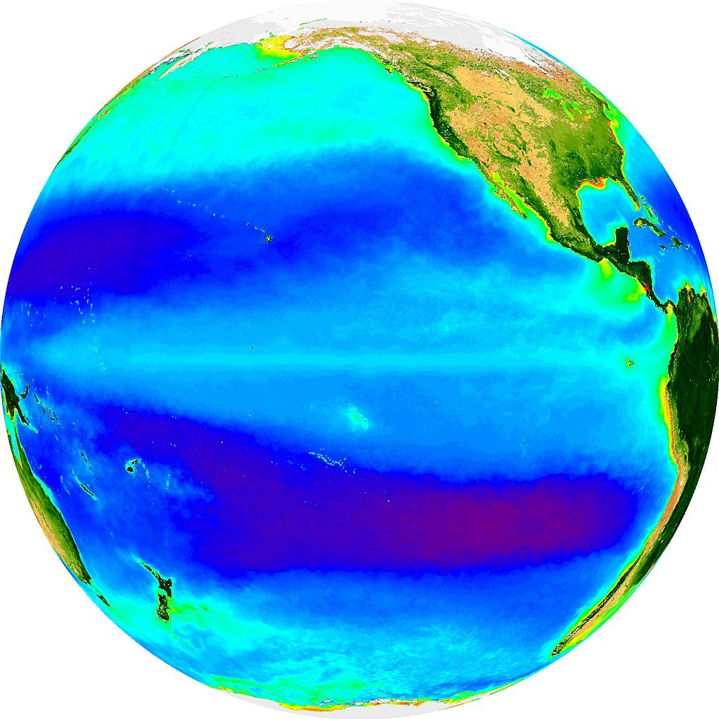
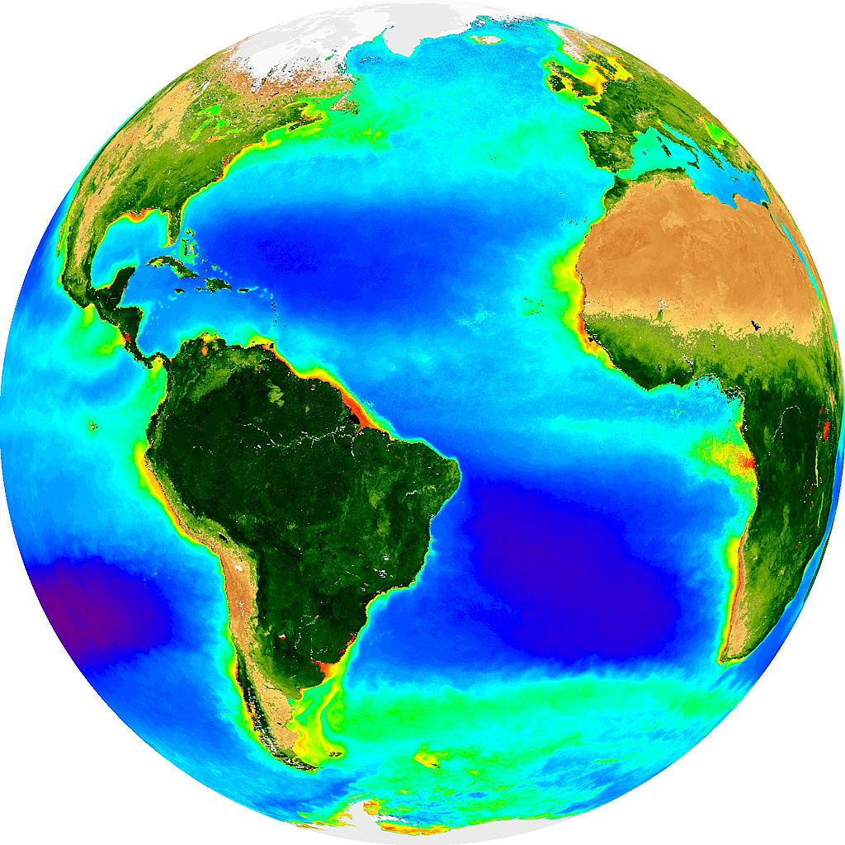
Overall Project Plans
Two Phases: Field campaign followed by modeling & synthesis phase
Focus on Pathways & Fates:
Controls on the 3 dominant export pathways - sinking, migration & advection
Assess BGC impacts
Link to remote sensing variables for satellite algorithms
Field Program:
Two cruises: Station P & North Atlantic
Coordinated sampling with two ships & multiple AUVs
Dedicated data management team
Documented protocols for all measurements
Station P
PAP Observatory
Aug 2018 May 2021

Slide 4
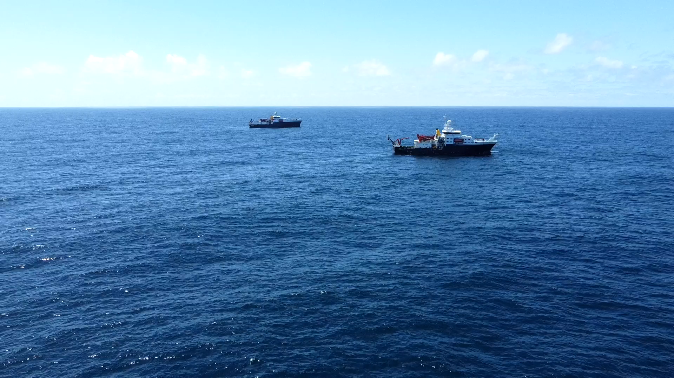
North Atlantic Field Program
Goals
Contrasting endmember to 2018 NE Pacific cruise
Big biomass & export signal & low flux attenuation
Goal - observe the demise of the North Atlantic Spring bloom
High mesoscale & sub-mesoscale energy driving patchiness in biomass & subduction
Siting & Observational Platforms
Near NOC’s PAP Observatory in a retentive eddy
On site (~49N 15W) for 25 days of May 2021
Three Ships - RRS James Cook (Process), RRS Discovery (Survey) & R/V Sarmiento de Gamboa (WHOI’s OTZ)
3 Gliders, 2 BioARGOs, 1 Lagrangian Float, Sediment Trap & WireWalker arrays, & multiple NBSTs, & more…

Slide 5
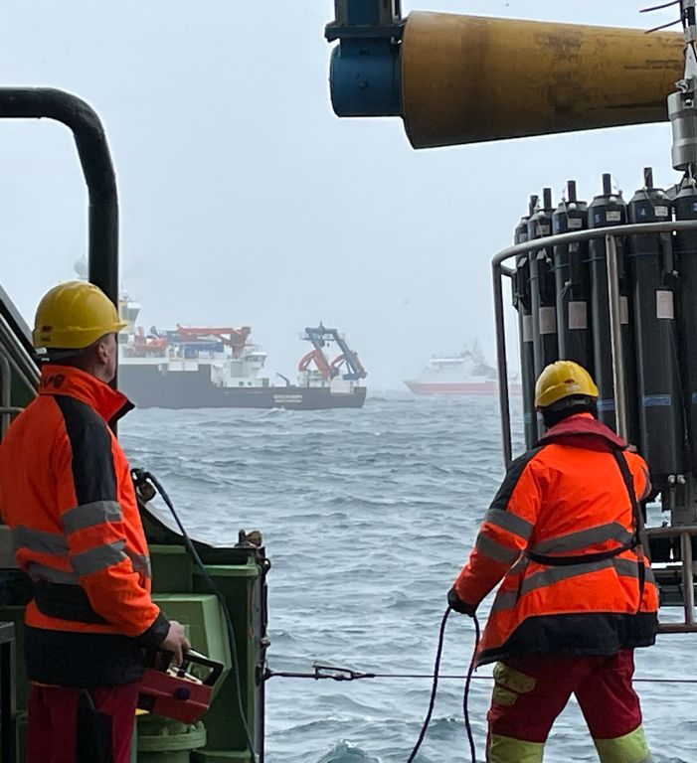
Process Ship – RRS James Cook
Missions
Assess export pathways & their proximate causes over time in a Lagrangian frame of reference – following the Lagrangian Float (which sets experimental center)
Integrate with other components to provide end-to-end assessment of the carbon cycle impacts of food web processes
Link pathway / food web / BGC observations to remotely sensible quantities
Operations
Focus on sinking & active migrant carbon fluxes
Characterize plankton / microbial community composition
Make rate measurements to determine the flow of energy within upper ocean and mesopelagic food webs
Address the roles of the food web in three export pathways

Slide 6
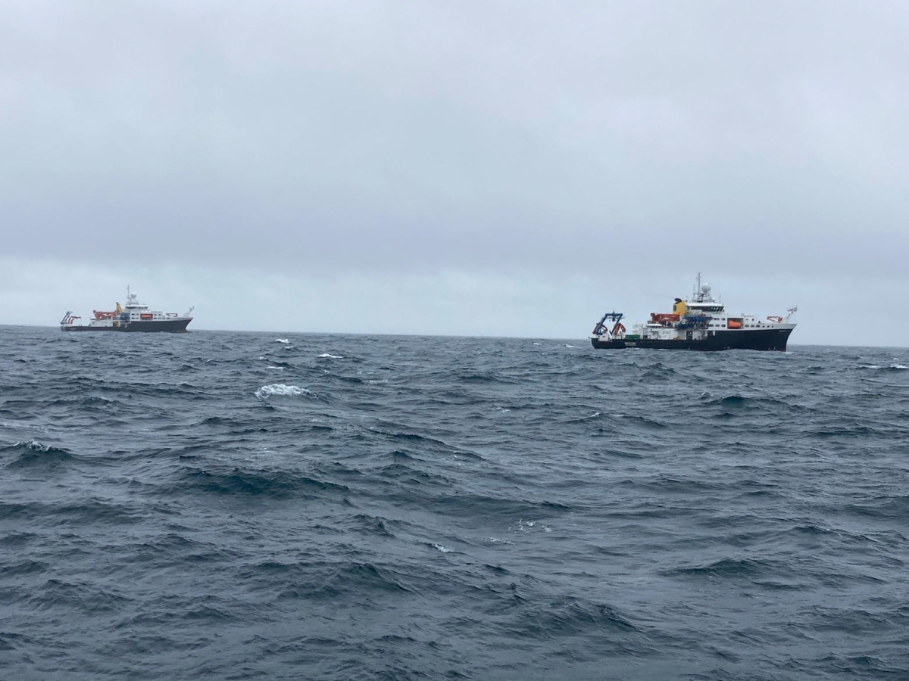
Survey Ship – RRS Discovery
Missions
Provide spatial/temporal-physical/BGC context from CTD/rosette & UW surveying,
Complete the Process Ship’s measurement suite,
Collect optical & other data to ground truth & build satellite algorithms,
Contribute to the assessment of advective export fluxes of POC & DOC, and
intercalibration across the platforms
Operations
Conduct spatial surveying & noon optics casts w/ CTD & UW systems,
Conduct ²³⁴Th flux, PSD, TMC sampling & incubations & high-volume pump profiles to support the Process Ship,
Sample frontal features to assess advective export fluxes (incl. UCTD),
Conduct 2-day “edge experiment” with the R/V Sarmiento, and
Perform intercalibration casts among the various sensor data sets.

Slide 7
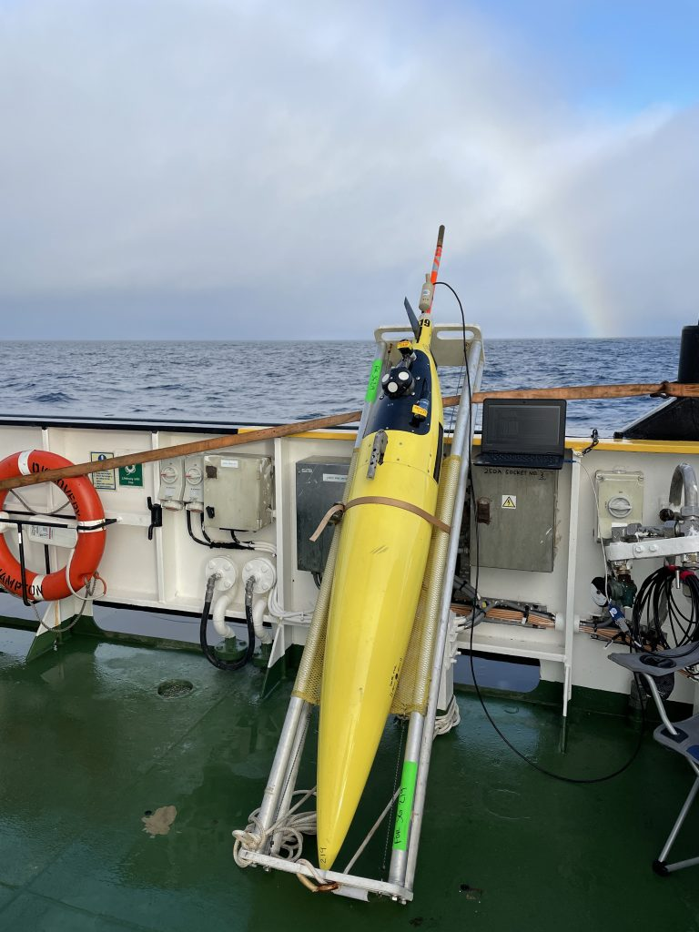
AUVs – Gliders, BioARGOs & the Lagrangian Float
Missions
Provide spatial/temporal physical/BGC oceanographic context on scales missing from ships (smaller space, longer time & broader extent),
Lagrangian Float is the geographic center of the program,
Contribute to the assessment of advective export fluxes of POC & DOC,
Help assess the retentiveness of the eddy feature before ships arrive, and
Linkage for intercalibration exercises.
Operations
Deploy three gliders from DY130 to three target sites,
Deploy two BioArgo floats and the Lagrangian Float from DY131, and
Coordinate operations with shore, ships, the WHOI OTZ and NOC.

Slide 8
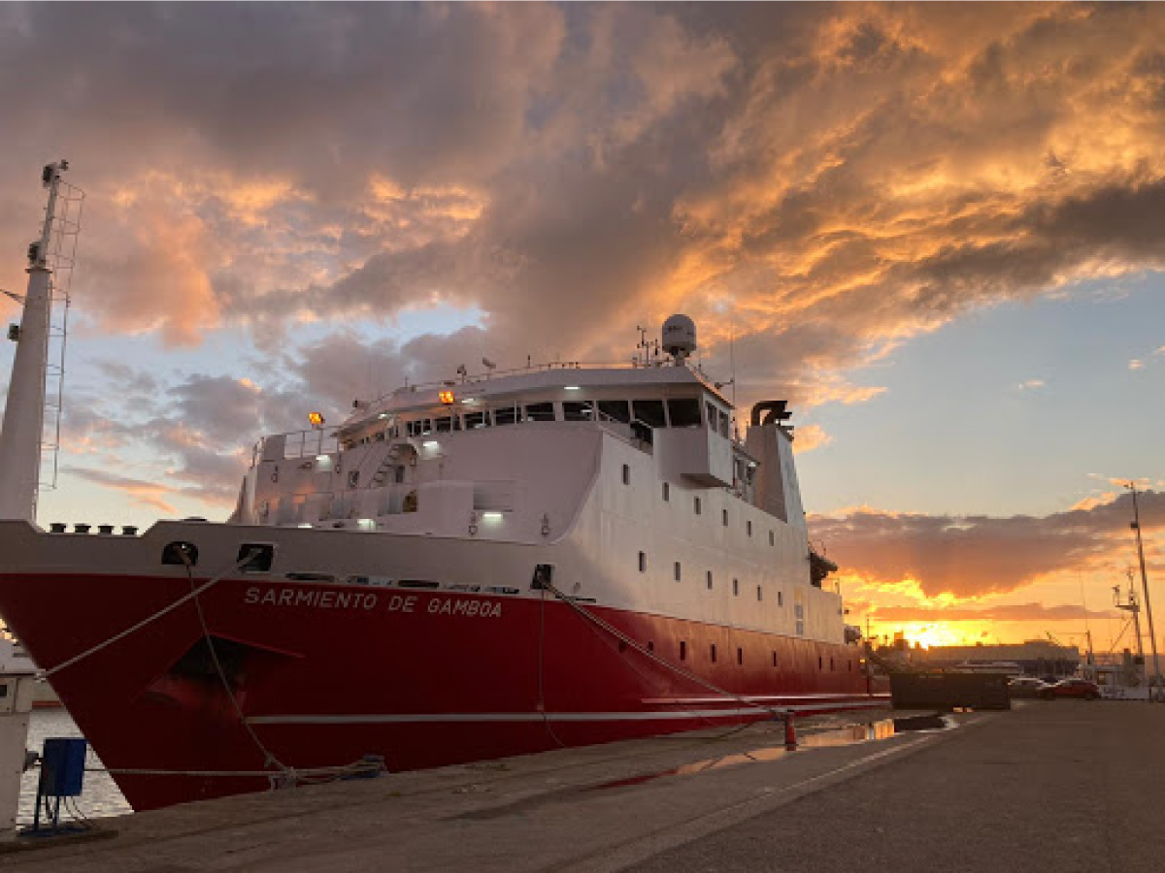
Partnerships – NOC & the WHOI OTZ program…
Missions
Extend the trophic and space / time sampling of the experiment,
Prove the utility of novel instrumentation for assessing twilight zone processes,
Help quantify advective fluxes using OTZ’s Stingray towed sled (edge experiment)
Contribute data from PAP mooring (incl. deep sea sediment fluxes)
PAP cruise (DY130) occurred before EXPORTS (collected samples & deployed gliders)
Operations
WHOI OTZ - R/V Sarmiento de Gamboa on site May 6-18
  CTD/rosette/UVP, MOC-10 nets & Stingray towed system
  Focus on higher trophic levels & novel instrumentation - Minions & Twilight Zone Explorer
DY130 cruise was March 25-April 14 (DY130) - benthic science focus – turnaround BGC mooring – will help extend the EXPORTS time baseline
Operate NOC’s Slocum glider & provide real-time data for mission planning

Slide 9

Site Selection & Sampling
Chose a retentive eddying feature near PAP
Logistically simpler & reduce roles of advection on the interpretation of rate / stocks measurements
Created “eddy selection” team with selection criteria & democratic process – became “shore team”
Assessed many eddies in 2021 as well as “dry lab” feature selection process using previous years
Deployed 3 gliders to sample potential targets from DY130 (first deployed April 1)
Conducted a consensus feature selection process and elected feature (A2) was an anticyclone
All assets were tracked (N=49) - locations & ship/AUV data shared with shore & ships
Erickson et al 2022, Erickson et al, in review

Slide 10
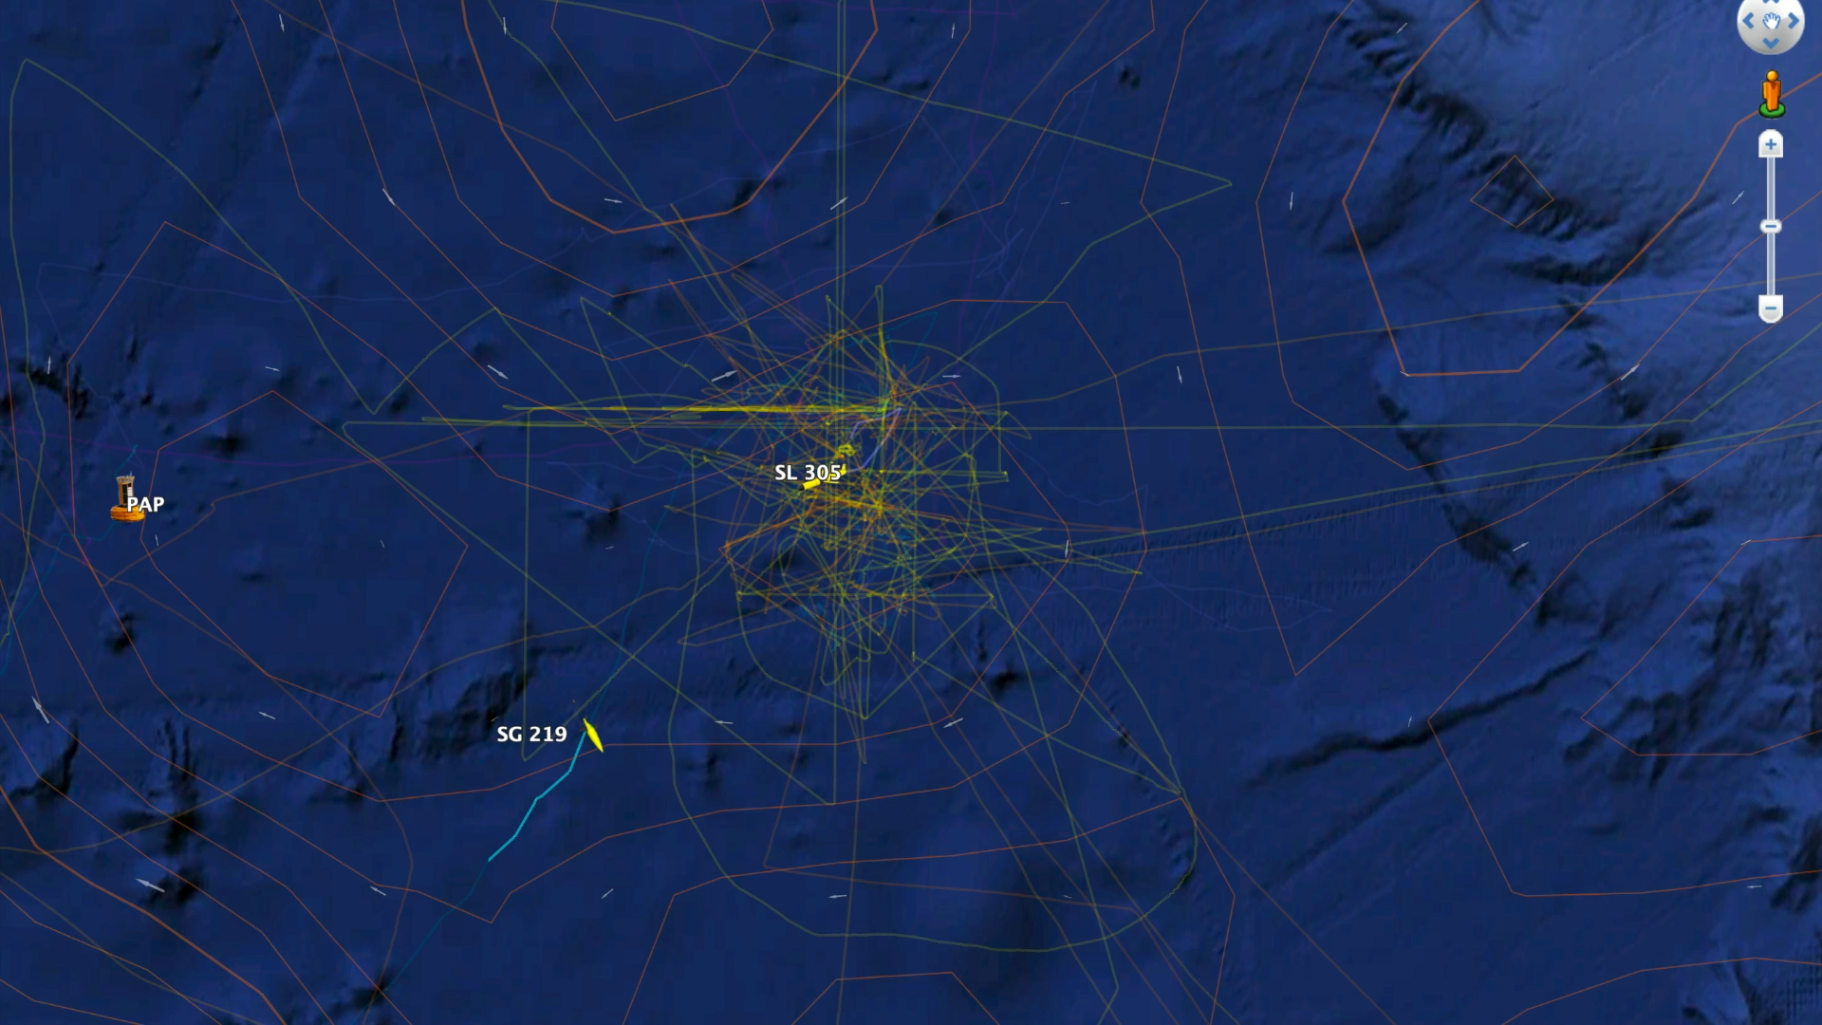

Slide 11
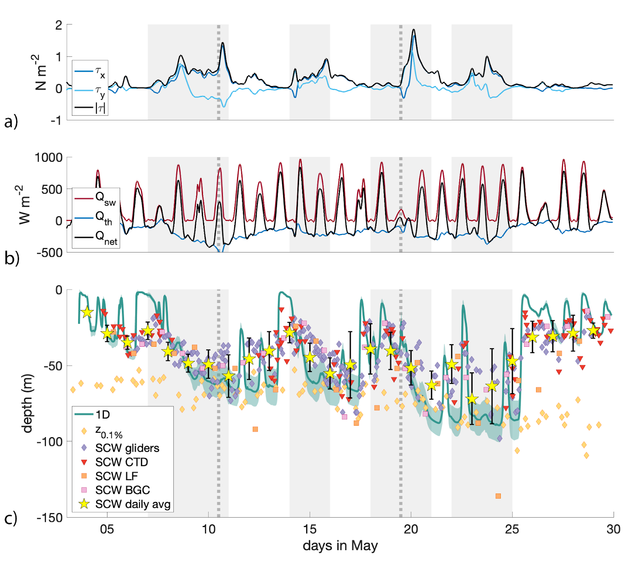
Background
STORMS
EPOCH
Anticyclone A2
A2 remained coherent & retentive throughout
Lagrangian float stayed in the eddy Core
Weather
Four major storm events (≥ 40 kts)
Lost 7.5 days of sampling (>7 m SWH!)
Johnson et al, in prep

Slide 12
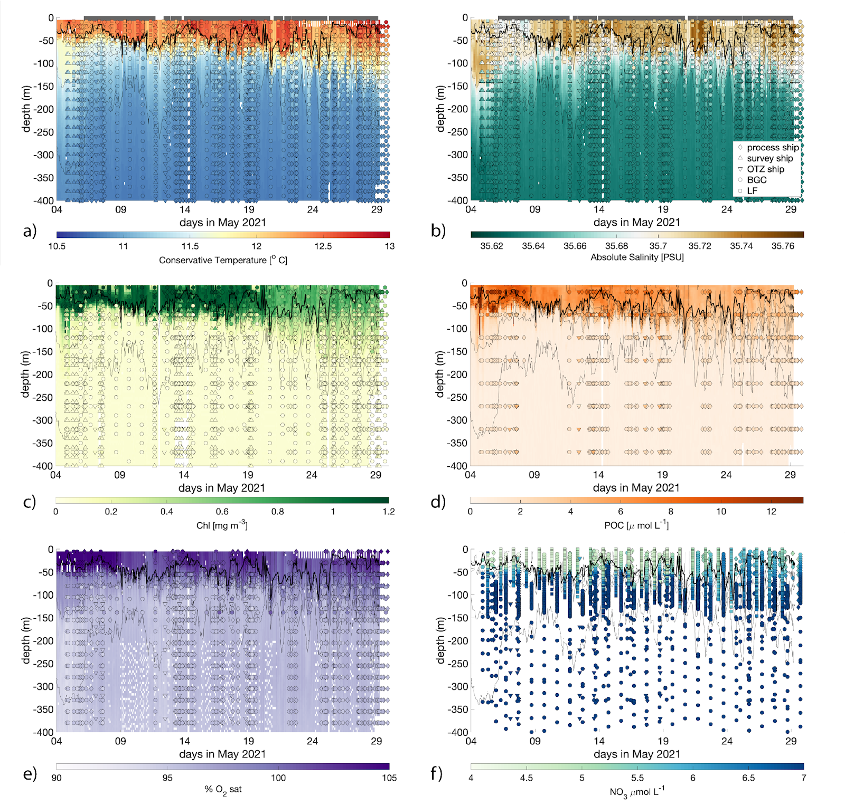
Upper Ocean Evolution
Mixed layer deepened & Chlorophyll/POC decreased over time
Vertical mixing dominates the physically modulated changes in eddy center nutrients during the field campaign.
This differs from the physical properties where horizontal advection plays a leading order role on the T/S evolution in the eddy core
Johnson et al, in prep

Slide 13
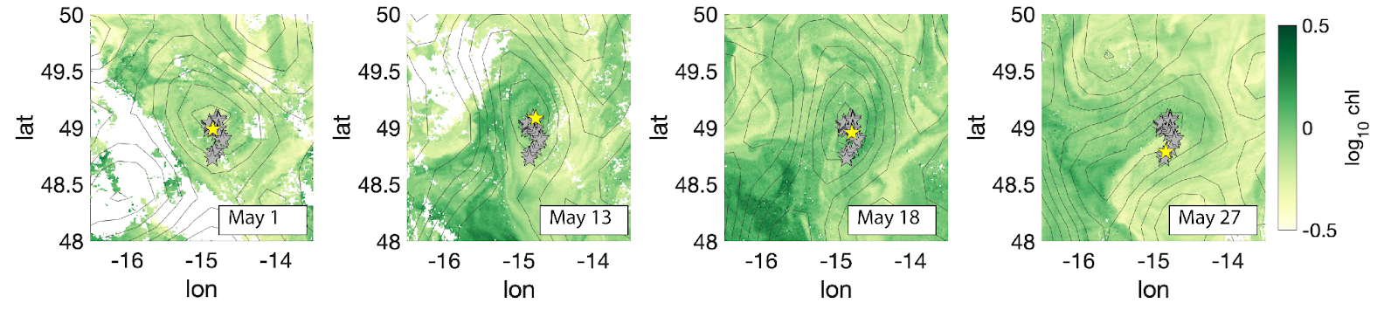
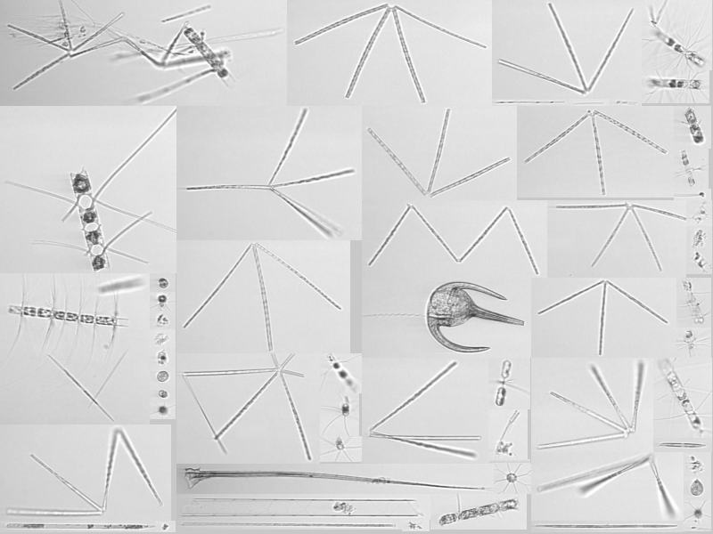
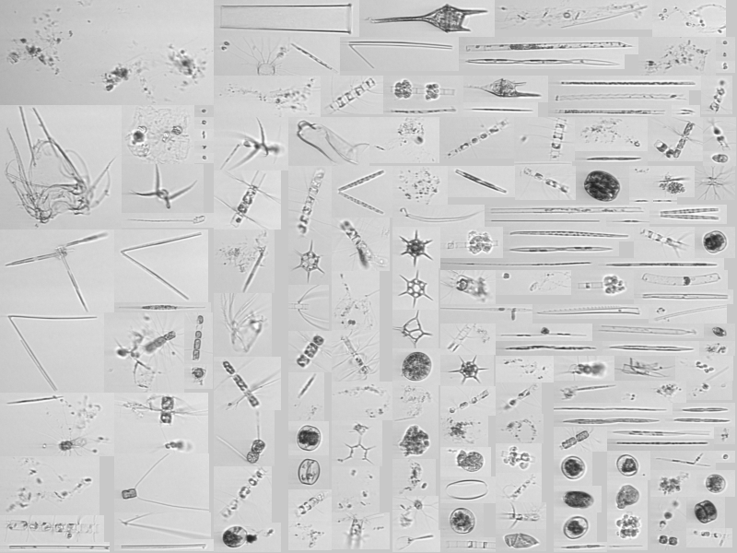
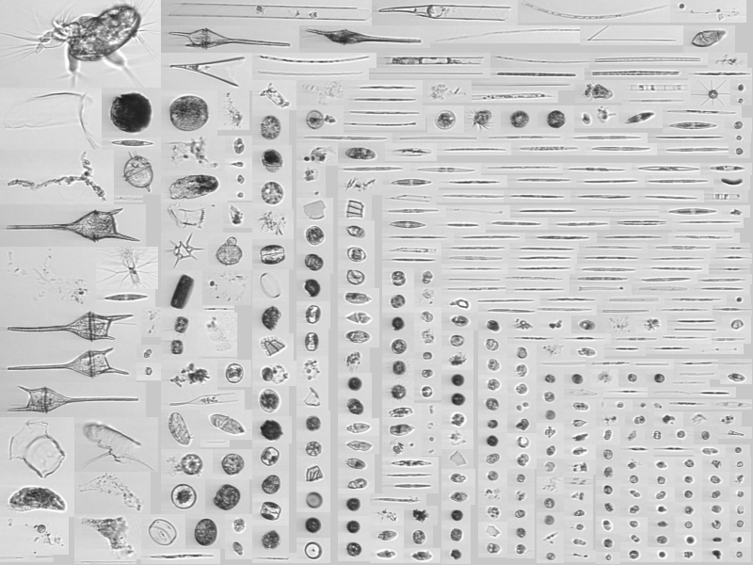
Spatio-temporal changes
CHL
MAY 5 MAY 12 MAY 28
DY131 IFCB dashboard – Sosik/Roesler
Surface phyto community evolved from end of the diatom bloom to smaller taxa in time

Slide 14
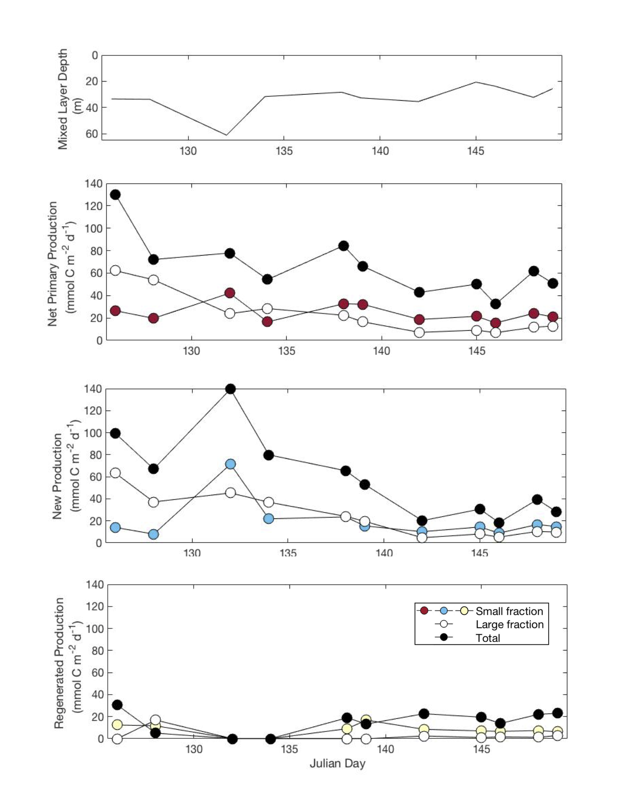
Spatio-temporal changes
CHL
NPP
>5 µm
<5 µm
total
NPP dominated by new production (regenerative prod was small)
New PP
>5 µm
<5 µm
total
JC214 - Meyer/Marchetti
Notes:
NPP by ¹³C-DIC & New PP by ¹⁵N-NO₃ incorporation

Slide 15
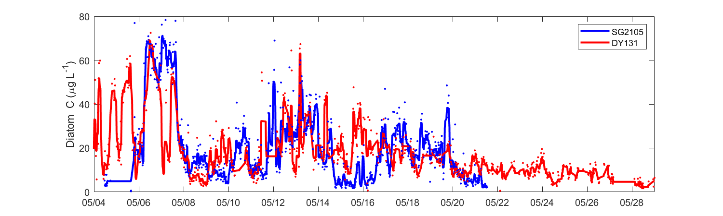
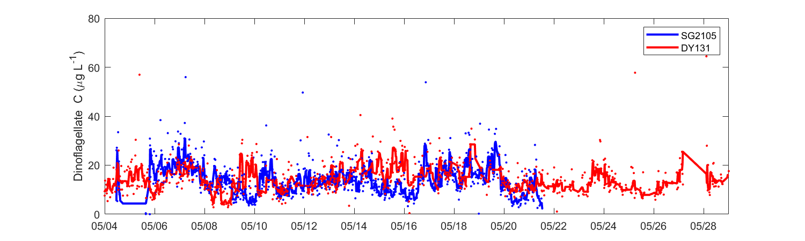
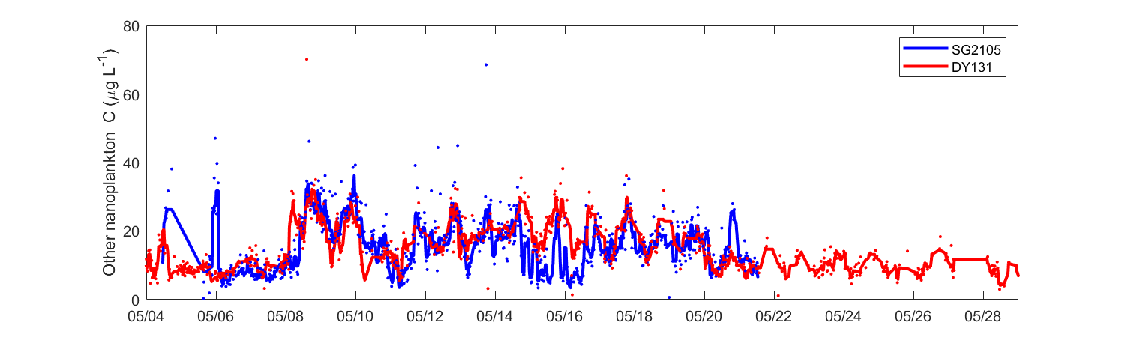
Zooplankton Day-Night Biomass
Plankton Composition
Diatom C Biomass
amphipods
SdG
DY131
Dinoflagellates
Steinberg / Maas
Large changes in Phyto biomass in time
Zoop day/night differences shows large migrant biomass
Large pelagic snails (pteropods) were conspicuous & abundant
Other nanoplankton
Carson & Hansell
IFCB C biomass - Sosik/Roesler

Slide 16
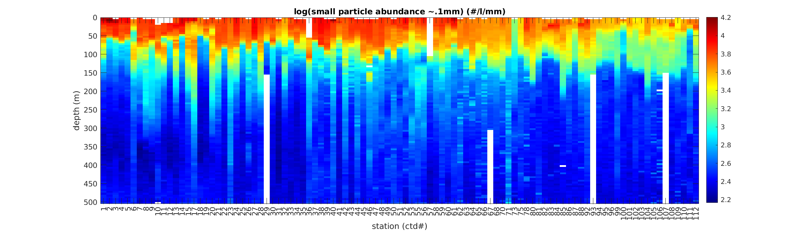
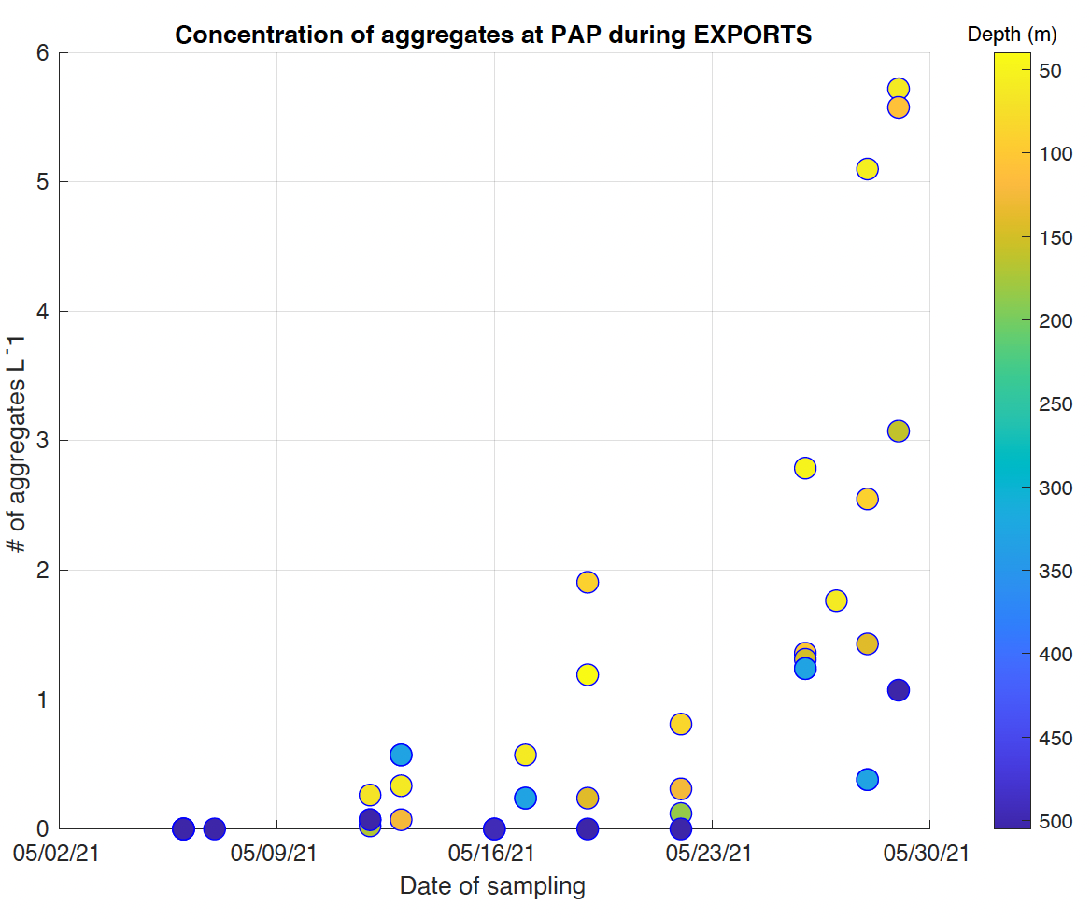
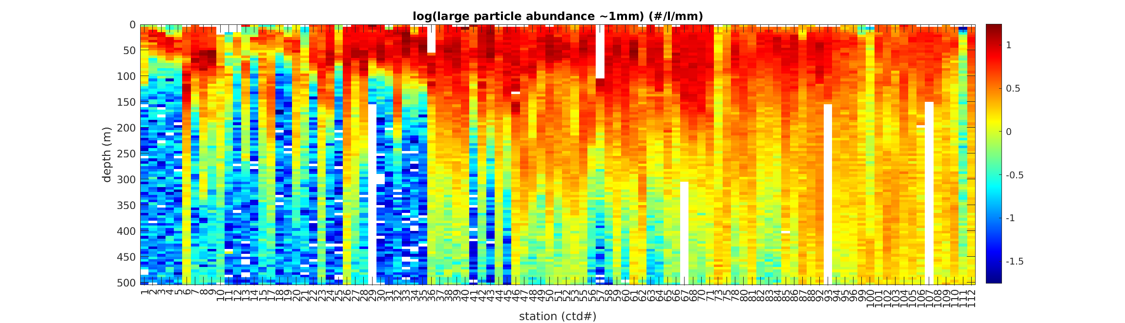
Sinking Particles & Marine Snow
Aggregate concentrations from Marine Snow Catcher deployments
Romanelli, Giering & Passow
log(0.1 mm particles)
log(1 mm)
DY131 UVP5 PSD in cast sequence – McDonnell / Siegel
UVP-5 PSD show decrease of small particles in mixed layer but a substantial increase in large particles especially at depth
Number of marine snow aggregates collected show large increase in time

Slide 17
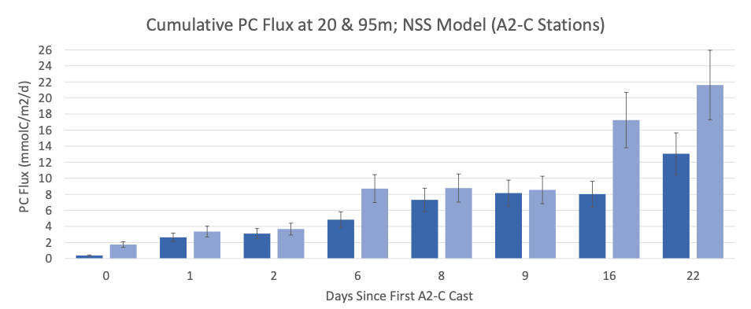
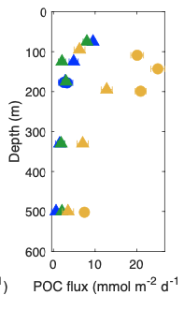
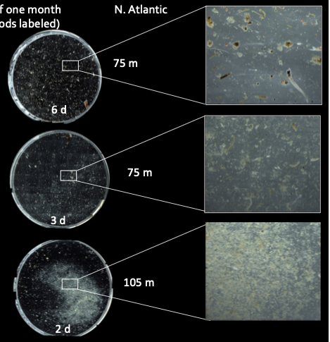
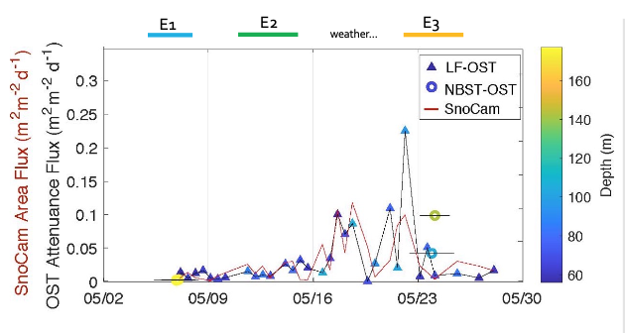
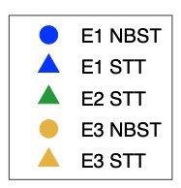
Sinking Particle Export Fluxes
²³⁴Th Particulate Carbon Fluxes @ eddy center
Clevenger, Benitez-Nelson & Buesseler
Trap POC fluxes – Estapa Gel Trap Images - Durkin
E1
E2
E3
Sinking particle flux proxies Estapa / Omand
Export increases over time in both trap, 234Th & optical proxy fluxes (esp. Epoch 3)
Active fluxes by migrating zooplankton were very large (~30% sinking POC fluxes)

Slide 18
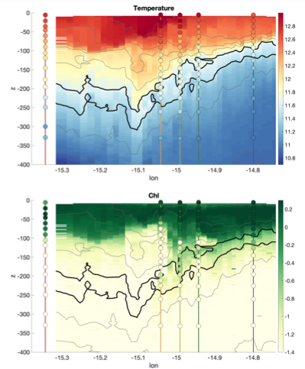
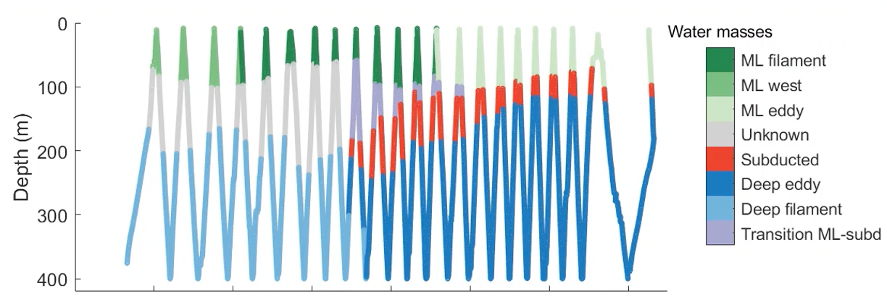
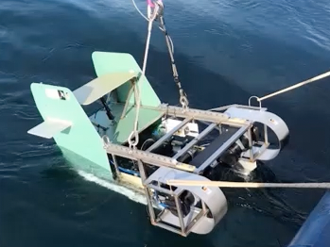
Edge Experiment…
Conducted an “edge experiment” at a strong front at the edge of the eddy to assess the mixing pump component
Two-day intensive survey with the R/V Sarmiento & RRS Discovery
R/V Sarmiento towed a profiling sled with CTD & an ISSUS shadowgraph camera system
RRS Discovery followed behind & targeted sampling based on real-time info from the Sarmiento
In the subducting waters, there were elevated Chl, anomalous nutrient ratios, shallow microbial communities (via 16S) & very large (2-16 mm) aggregates
Johnson & Sosik - leads

Slide 19
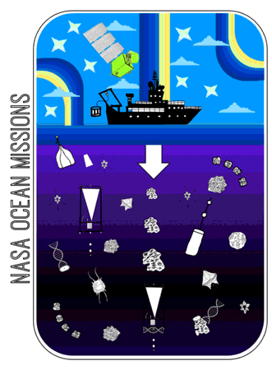
EXPORTS North Atlantic…
EXPORTS North Atlantic was successful (beyond our dreams…)
Planning (eddy selection, situational awareness, governance, COVID) was critical
Saw demise of a diatom bloom & enhancement of export as cruise went on
Should be able to assess all 3 export pathways
Focus now on interpreting physical oceanographic context (retentiveness of the eddy, entrainment from storms, etc.) and synthesis among observables

Slide 20
EXPORTS next steps + Legacy
Publications, presentations
  >70 papers published (and many more in review/to come)
Data
  SEABASS- >420 different parameters with total of 7852 data files
  BCO-DMO 10 datasets + NCBI 6 datasets
Continuing international collaborations (e.g., APERO, JETZON)
Future funding?
  Keep your eyes open

