Slide 1
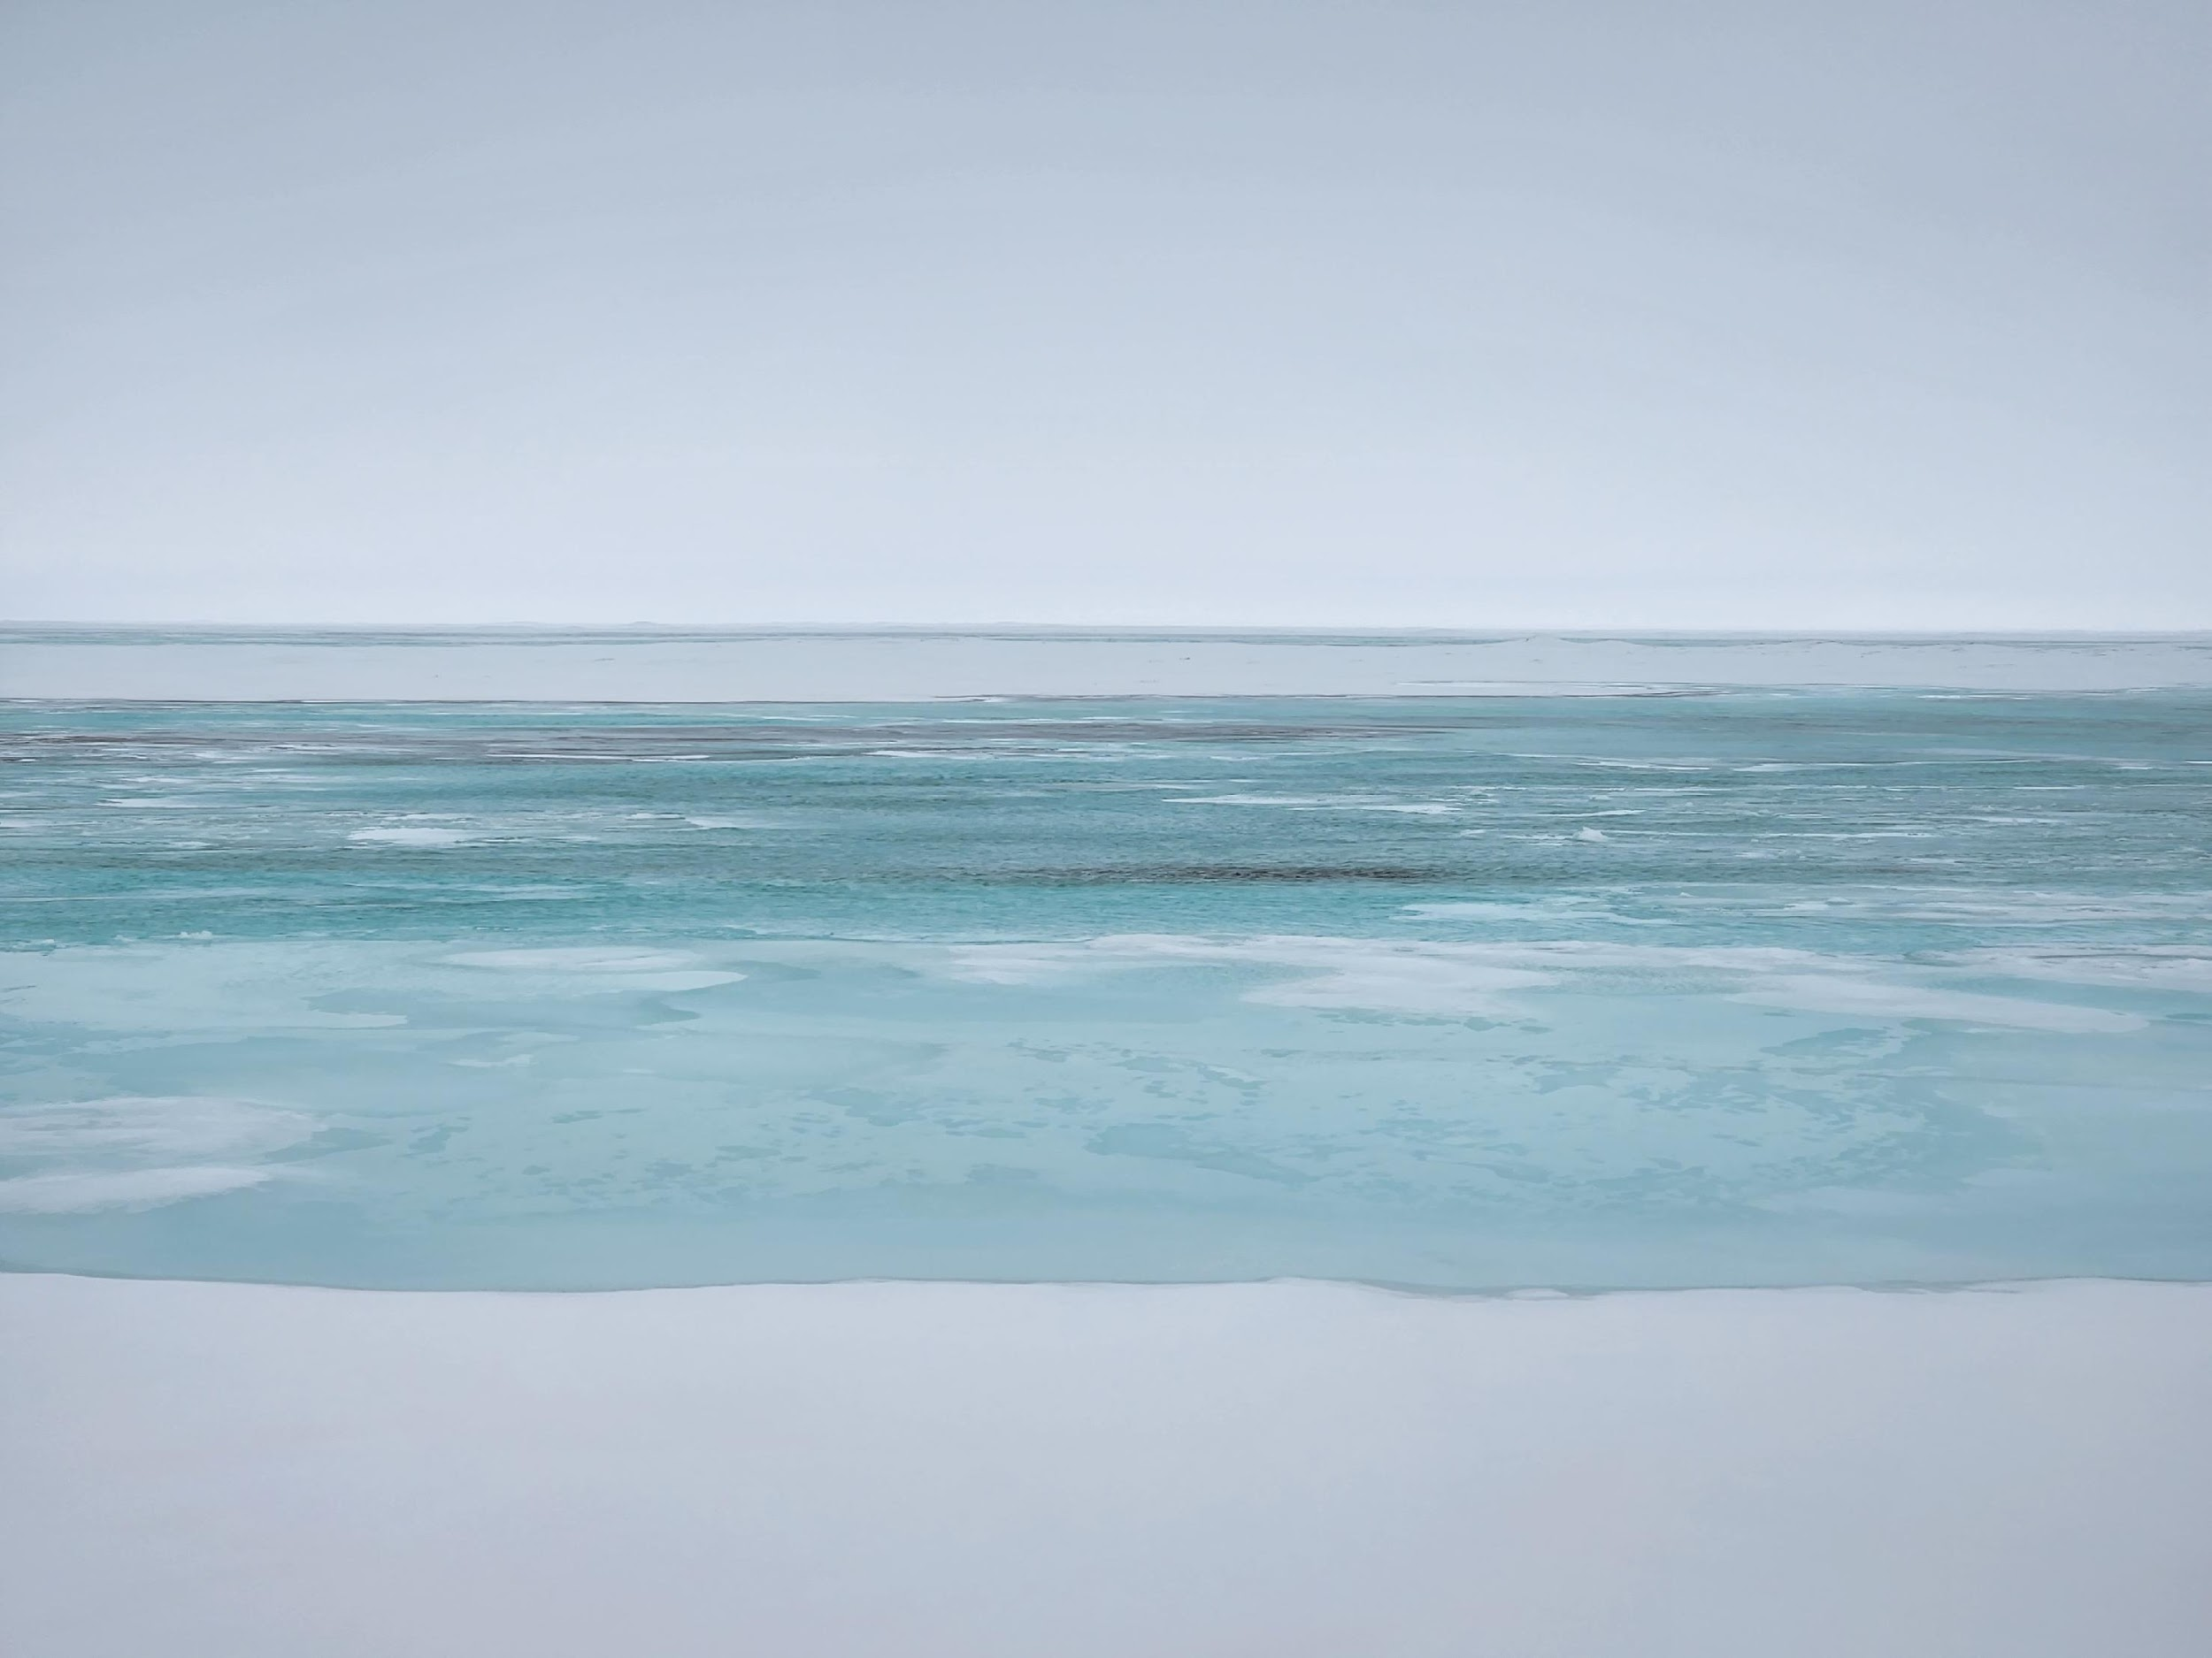
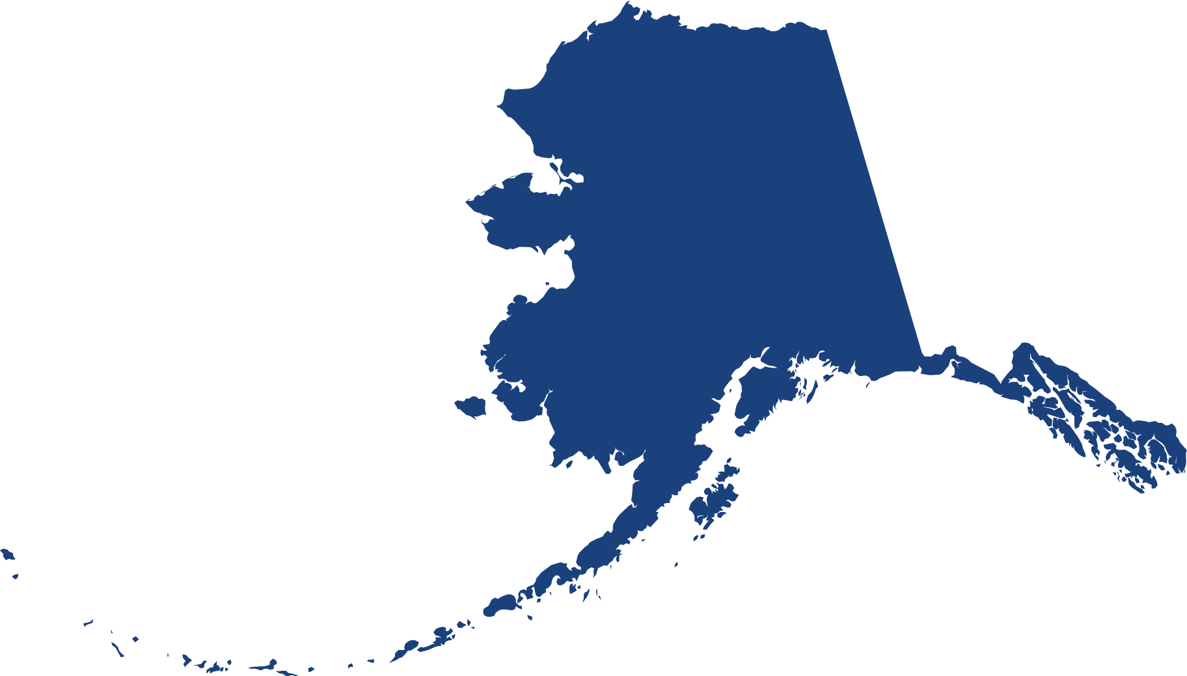


Characterizing Northern Alaskan river runoff over sea ice during spring freshets using remote sensing reflectance spectra
L. Catipovic^{1,*}, S.R. Laney²
¹Massachusetts Institute of Technology / Woods Hole Oceanographic Institution Joint Program, Woods Hole, MA, USA
²Woods Hole Oceanographic Institution, Woods Hole, MA, USA
*Correspondence: Luka Catipovic, lcatipovic@whoi.edu
Carbon Cycle & Ecosystems
Joint Science Workshop
OBB: Icy Ecosystems
College Park, Maryland
May 8, 2023

Slide 2
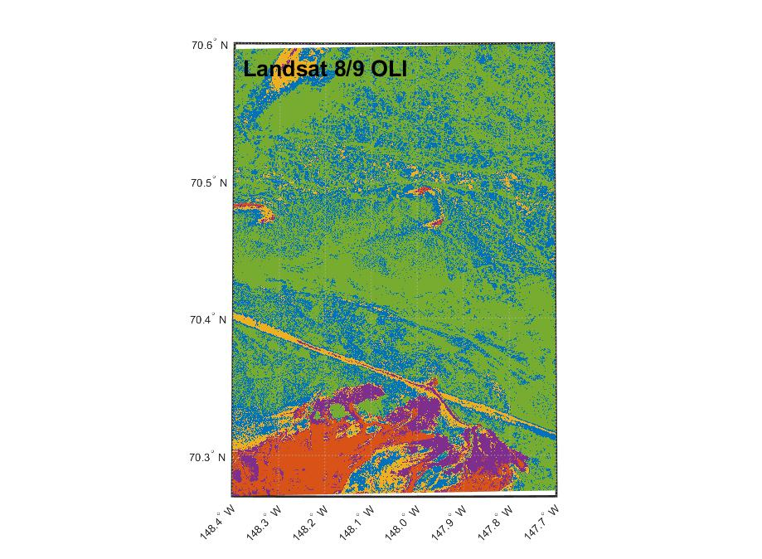
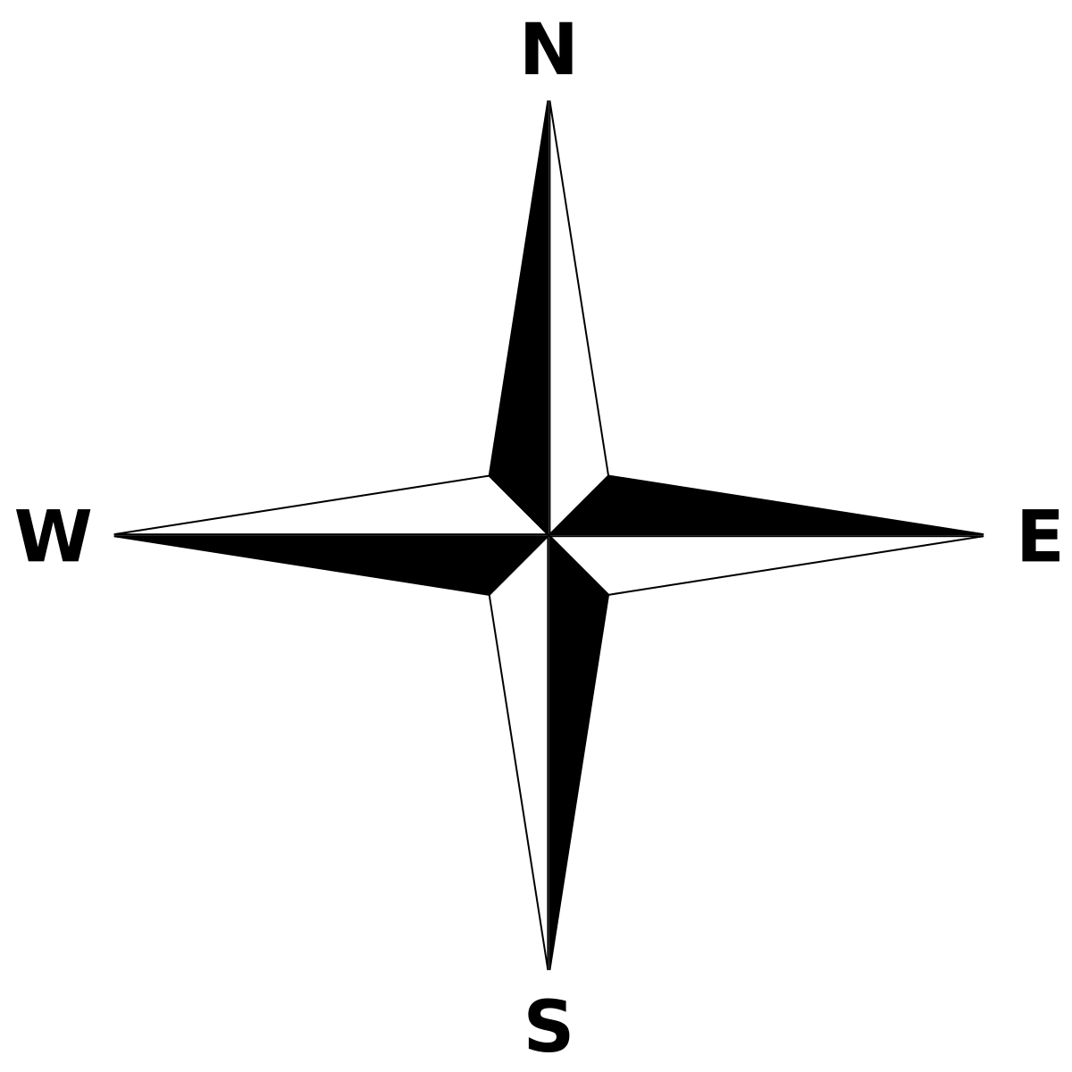
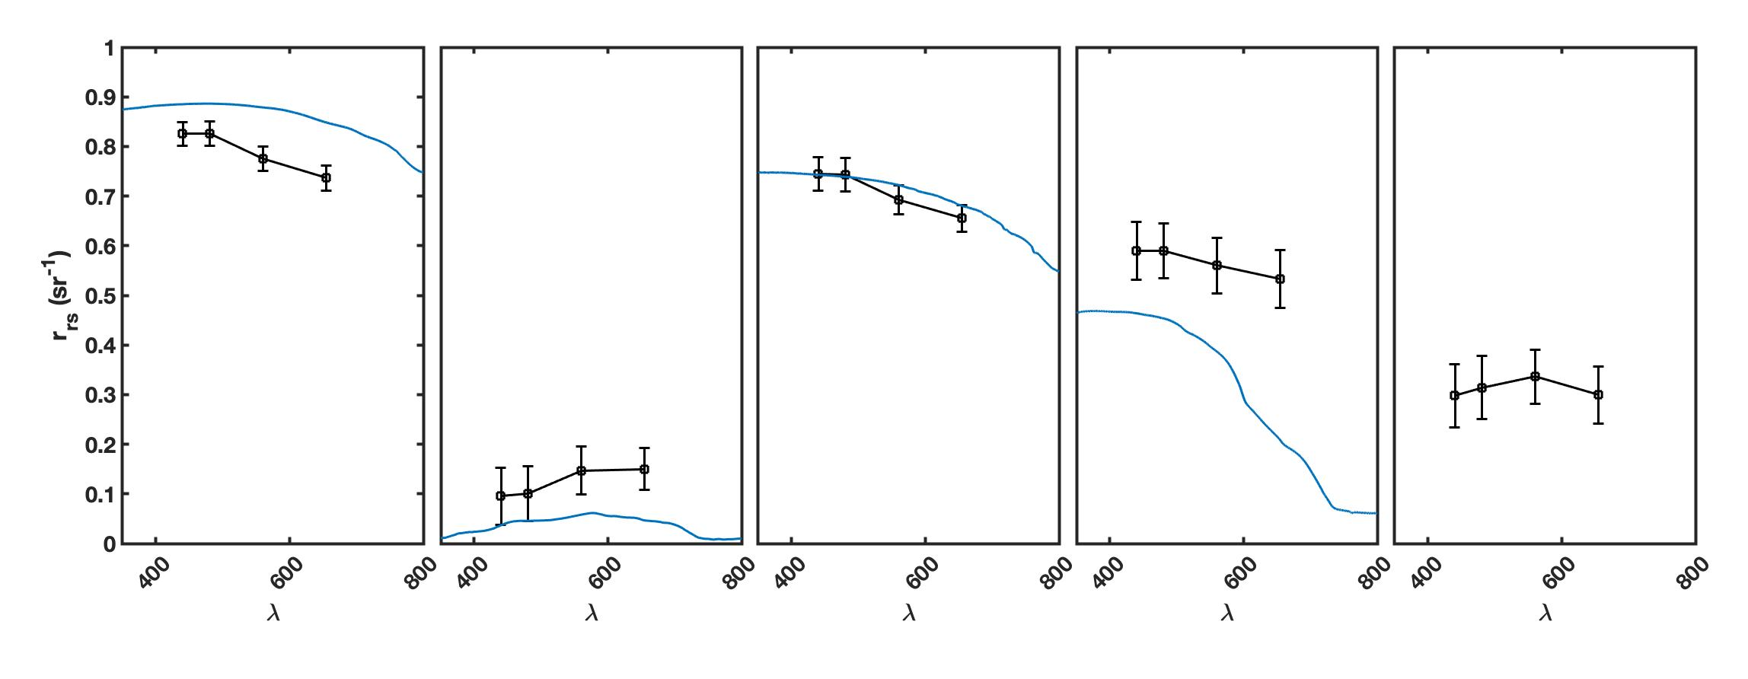
Over-ice flooding | Seasonal melt dynamics | Characterization | Acknowledgements
Sea ice covered by freshet flooding in late Spring
Landsat 8 OLI
Sagavanirktok River
May 12, 2016
Spring freshet waters on sea-ice
Applying clustering techniques identifies different water and ice types
Dry ice
Open water
Wet ice
Blue ice
Freshet overflow
Notes:
Start on this slide

Slide 3
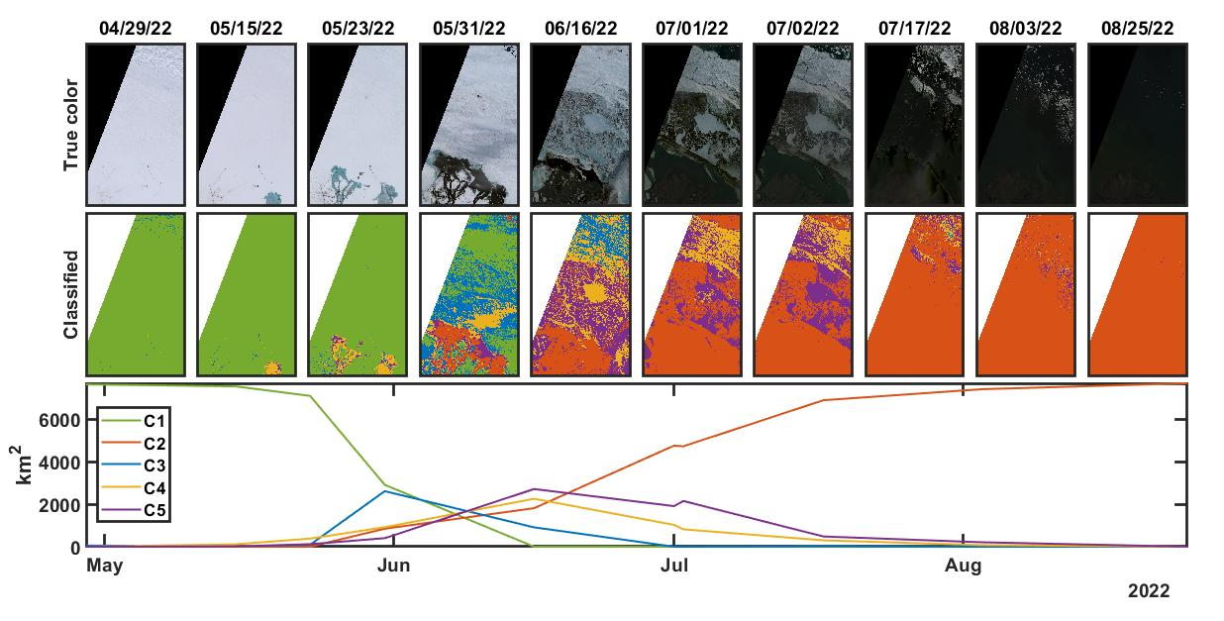
Over-ice flooding | Seasonal melt dynamics | Characterization | Acknowledgements
Temporal evolution of 2022 freshet from a cluster perspective
All ice
All open water
Notes:
Use the Euclidean distance from each point to a centroid, each pixel is assigned a cluster based on it having the minimum distance to that centroid

Slide 4
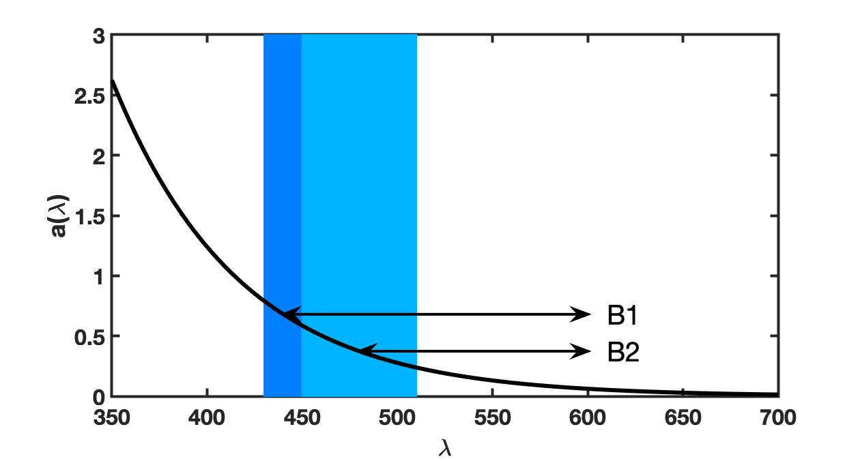
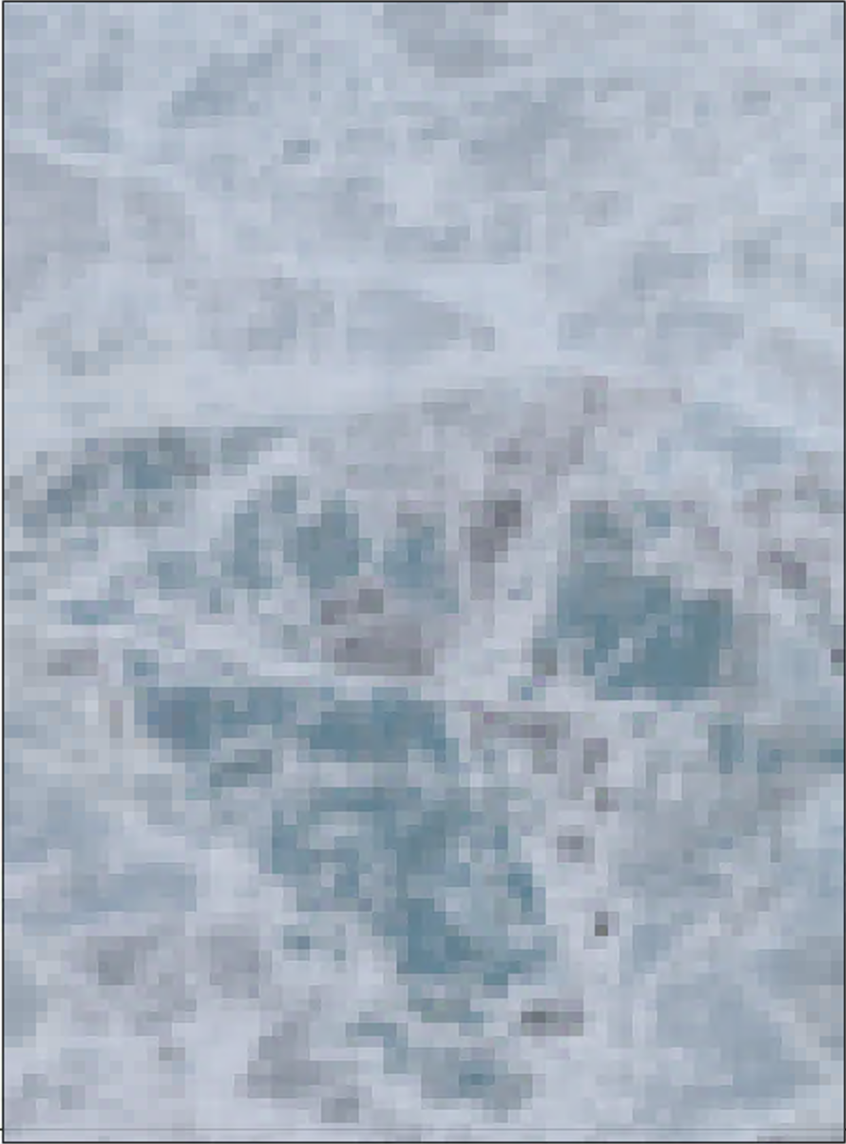
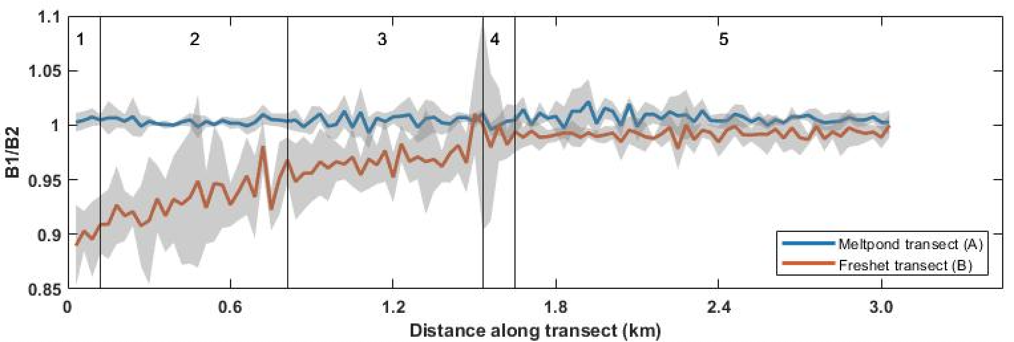
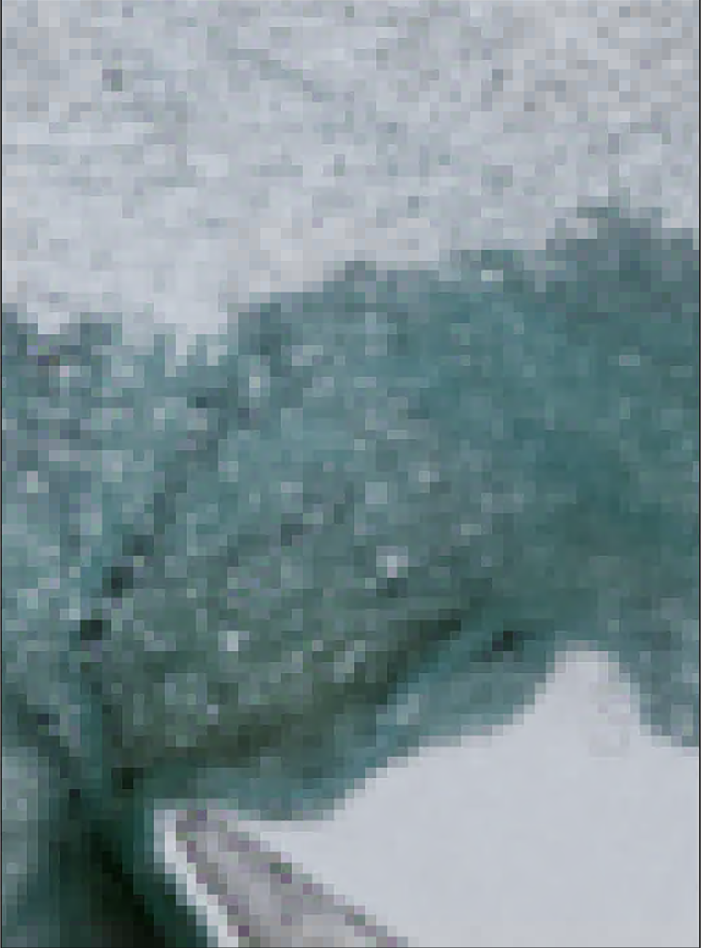
Over-ice flooding | Seasonal melt dynamics | Characterization | Acknowledgements
Freshet CDOM content?
OLI B1/B2 < 1 indicates absorption by CDOM
Melt pond/ blue ice/ multiyear ice contains no detectable CDOM
Freshwater 🡪 river overflow shows CDOM as expected

Slide 5
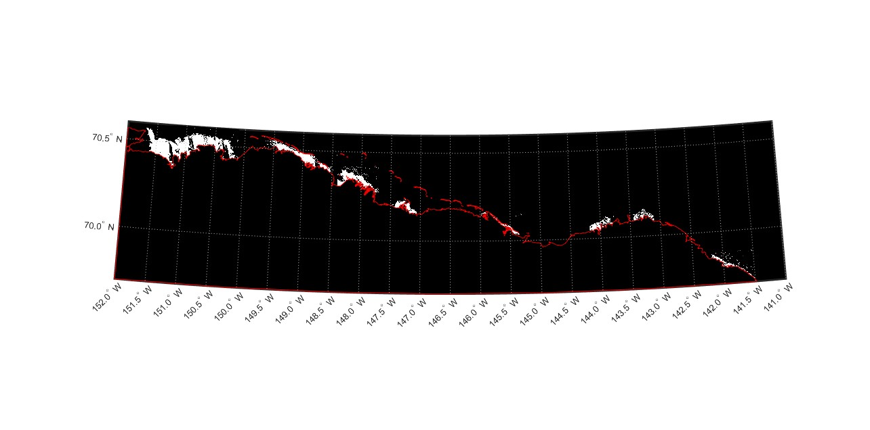
Spring freshet overflow across the Alaskan Arctic coast
Over-ice flooding | Seasonal melt dynamics | Characterization | Acknowledgements
May freshet overflow area
Kuparuk R.
2020
Colville R.
2020
Sagavanirktok R.
2020
Kavik R.
2015
Canning R.
2015
Jago R.
2020
Kongakut R.
2017
Hulahula R.
2022
Northern Alaskan rivers drain ~ 195,000 km² of watershed across the North Slope & Brooks Range.
Differing watershed characteristics may affect spring freshet organic content.

Slide 6
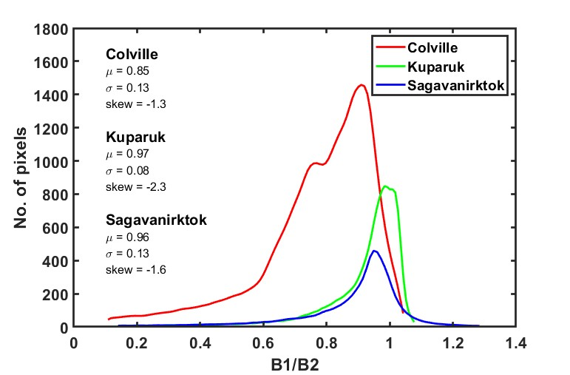
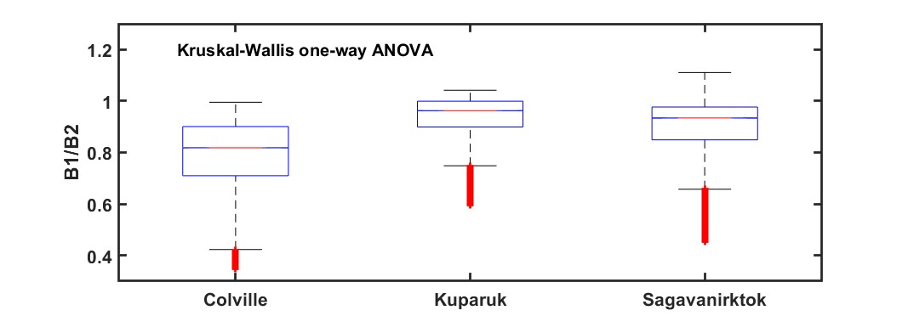
B1/B2 ratios of three rivers’ freshets differ. Why?
Over-ice flooding | Seasonal melt dynamics | Characterization | Acknowledgements
Differing drainage basin provide floodwaters with variable DOC levels
PDF skew provides insight into CDOM concentrations within freshets
Next step: continue examining CDOM B1/B2 distributions in all freshets shown in prior slide
Notes:
If the points are below the 1-1 line in both tails as in then the pattern should be identified as a left skew.
Heavy tailed sitributions -The other problematic pattern is to have more spread than a normal curve as in Figure2-12(e) and (f). This shows up with the points being below the line in the left tail (more extreme negative than expected by the normal)
Light tailed distribution – colville - the left tail above the line and the right tail below the line suggests less spread (lighter-tailed) than a normal as in Figure 2-12(g) and (h). This pattern is relatively harmless and you can proceed with methods that assume normality safely.

Slide 7
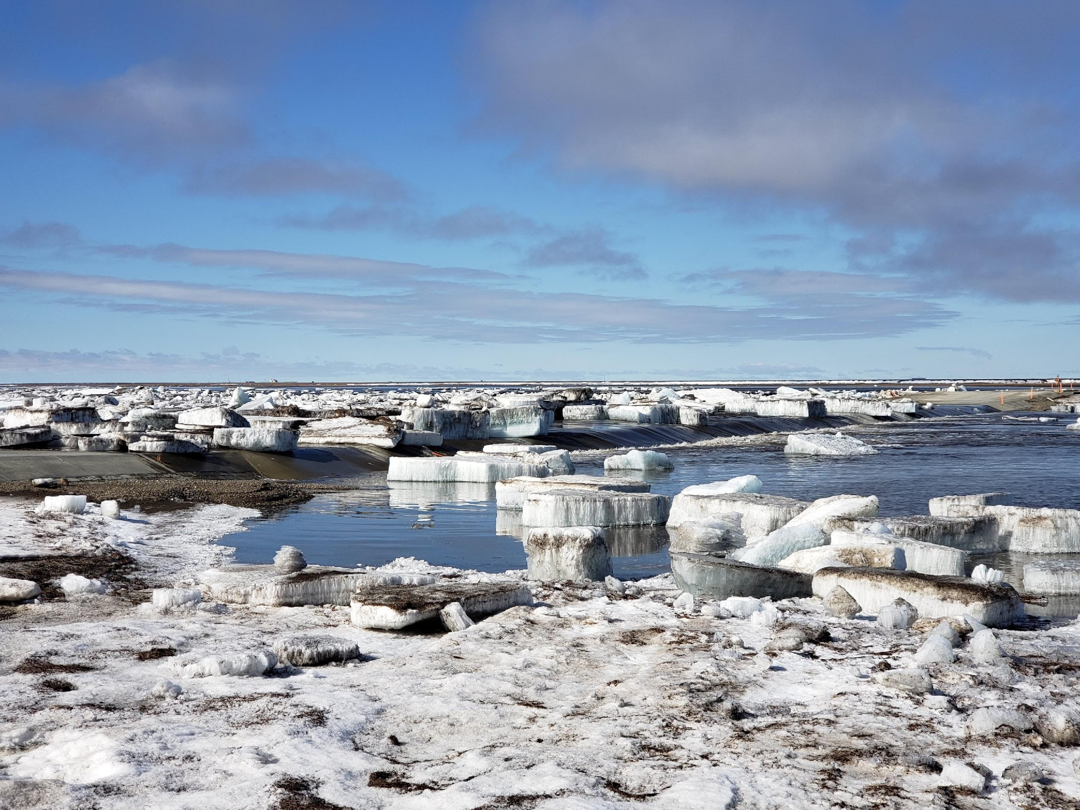

Over-ice flooding | Seasonal melt dynamics | Characterization | Acknowledgements
Acknowledgements
This interdisciplinary graduate research is supported by NASA’s Interdisciplinary Research in Earth Science program (Project #NNH19ZDA001N-IDS, PI S. Laney).
Questions?

