Slide 1
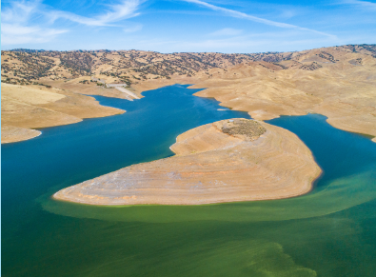
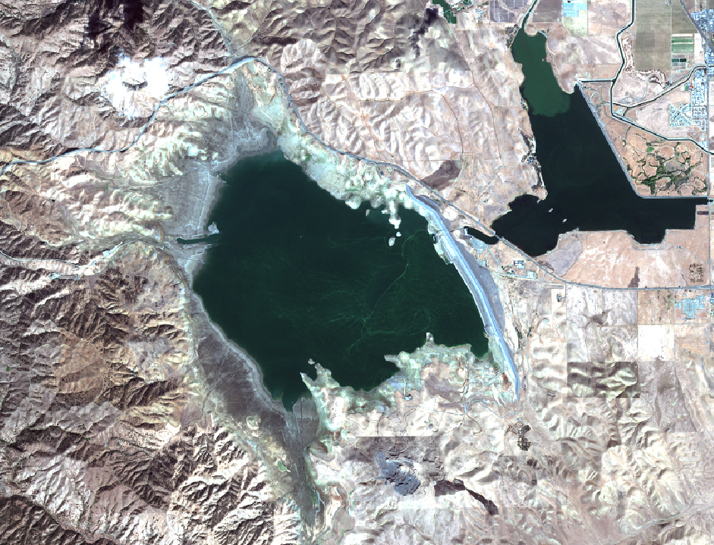



Evaluating the Use of Satellite Remote Sensing for cyanoHAB Public Health Warnings
NASA CCE Joint Science Workshop
Presenter: Brittany Lopez Barreto¹
blopezbarreto@ucmerced.edu
Co-authors: Dr. Erin L. Hestir¹, Dr. Christine Lee², Dr. Marc Beutel¹
¹University of California, Merced
²NASA JPL Terrestrial Hydrology Group

Slide 2
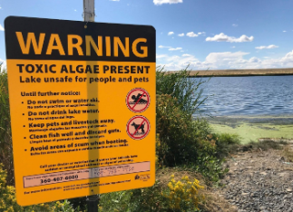
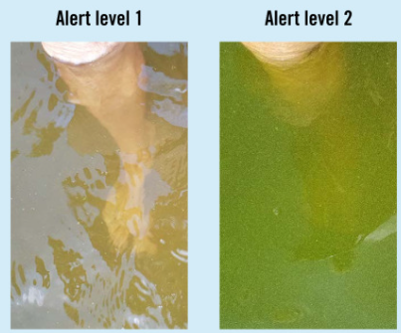
Guideline Values for Cyanobacteria in Recreational Waters
Authority | Quantity | Guideline Value Classification | Method
CA DWR | 0.8 - 5.99 µg/L Microcystins | Caution | Field Sampling
 | 6 - 19.99 µg/L Microcystins | Warning
 | 20 µg/L ≤ Microcystins | Danger
WHO (2021) | Chl-a ≤ 24 µg/L | No Alert | Sentinel-2
 | Chl-a ≥ 24 µg/L | Alert
WHO (1999) | ≤ 20,000 cyanobacterial cells/ml or ≤ 10 chl-a µg/L | Low | Sentinel-3
 | 20,000-100,000 cyanobacterial cells/ml or 10.1 - 50 chl-a µg/L | Moderate
 | ≥ 100,000 cyanobacterial cells/ml or ≥ 50 chl-a µg/L | High
No Alert
Alert
Source: TCiW, Chorus & Testai (2021)

Slide 3
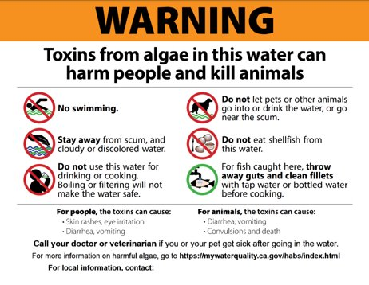
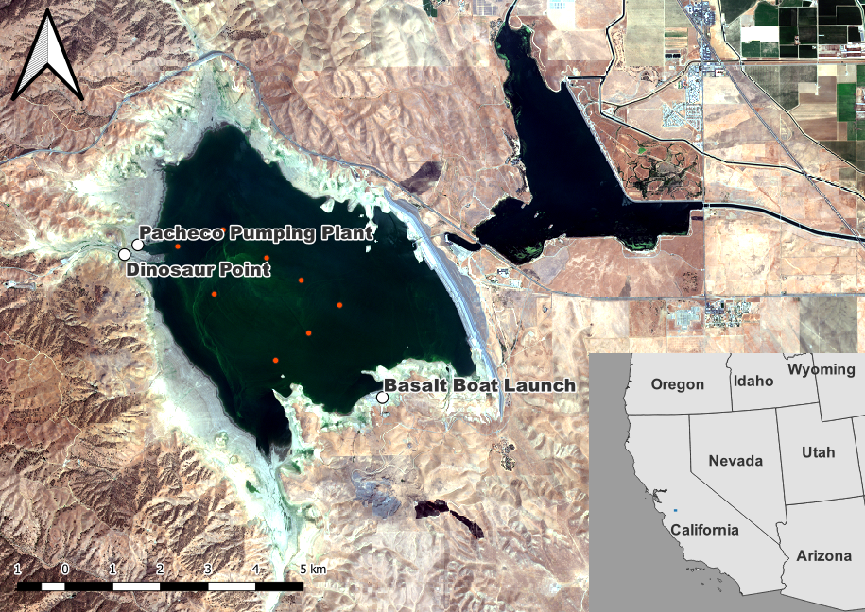
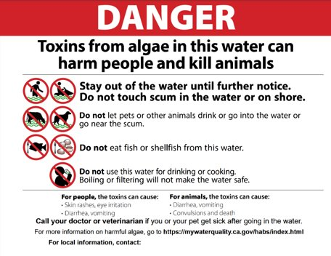
San Luis Reservoir (SLR)

Slide 4
Algorithm Matters
Remote Sensing or Field Campaign |  | DWR ​
 | ​ | No Alert​ | Elevated Alert​
 | No Alert​ | Total Agreement​ | Under-predicted Advisory​
Remote Sensing or Field Campaign | Alert​ | Over-predicted Advisory​ | Total Agreement​ ​

Slide 5
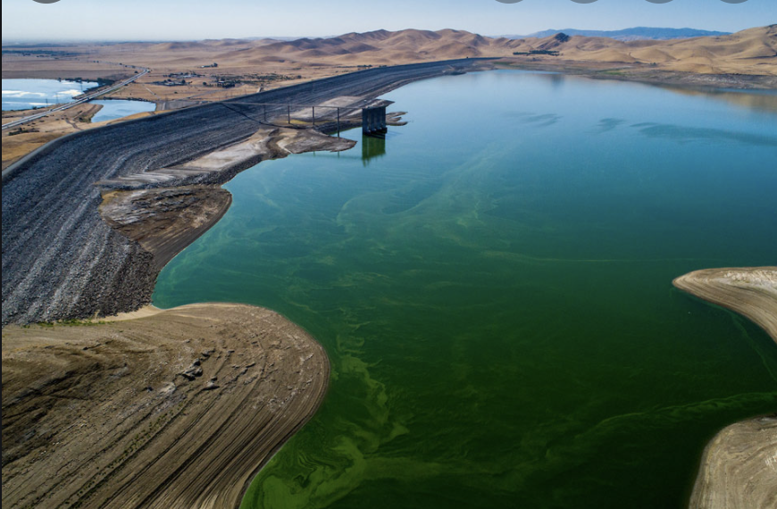
Final Remarks
SRS can become an important tool in aiding in public health alerts of potential exposure to cyanotoxins
  SRS can measure areas where DWR does not collect samples, and during the times of the year they do not measure
Chl-a products as a proxy for cyanotoxins may work best for the detection of blooms rather than as a measure of their intensity
This study provides a framework for evaluating public health utility of SRS for enhancing cyanotoxin monitoring globally
Notes:
Chla products as a product
We used SLR as a
Mention poster,

Slide 6
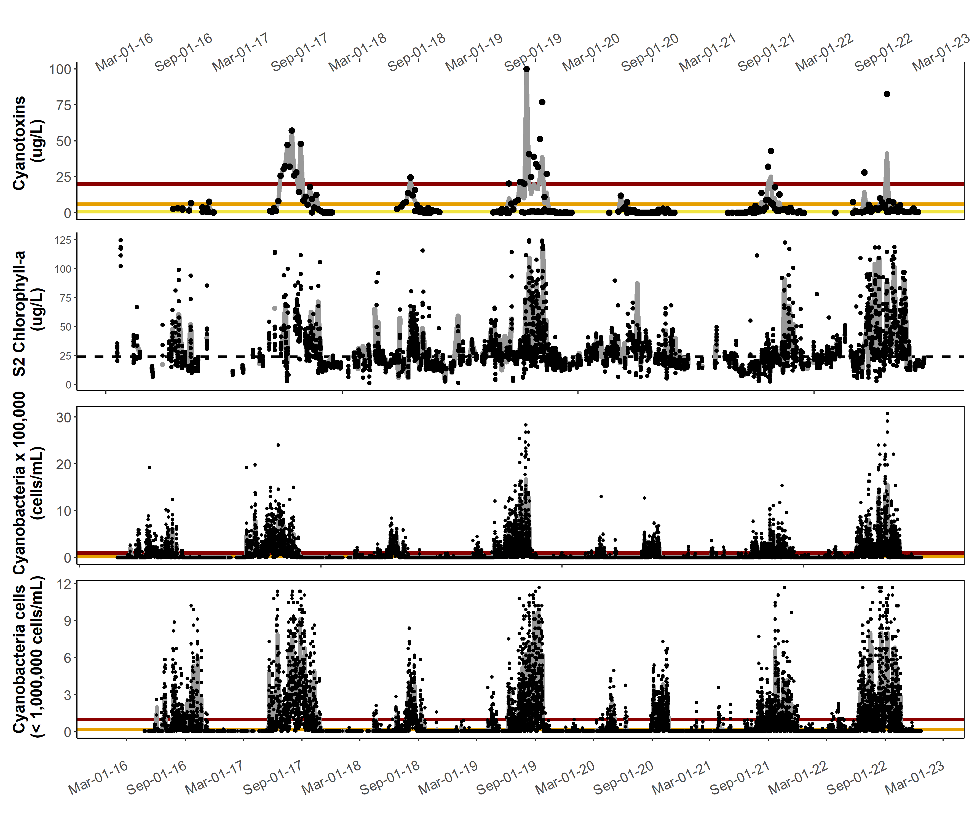
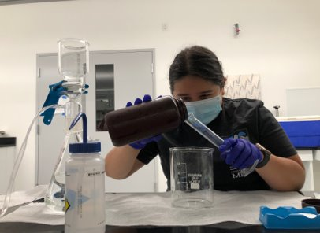
Additional Questions?
Poster Presentation on Wednesday from 5-7 PM
Title: Remote Sensing-based Chlorophyll-a as a Proxy for Harmful Algal Bloom Public Health Advisories
Thank you!

