Slide 1
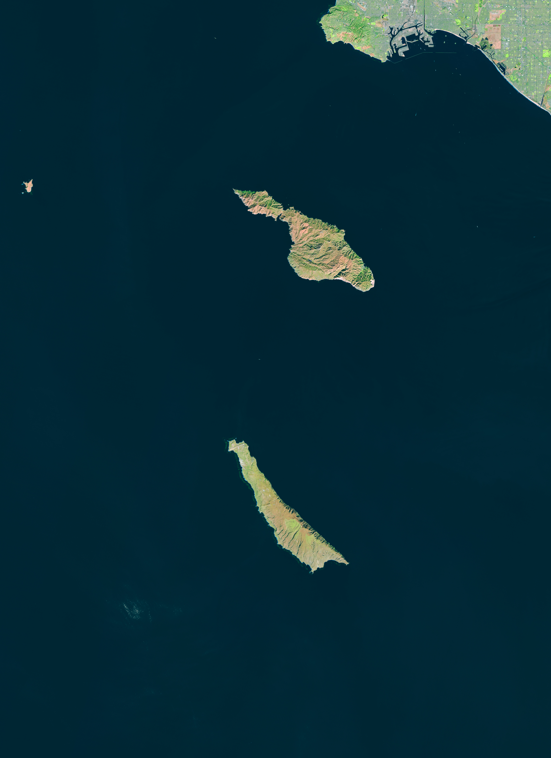
Toward Understanding the Drivers of Global Kelp Forest Dynamics
PI: Tom Bell (WHOI), Kyle Cavanaugh (UCLA), Jarrett Byrnes (UMass Boston)
Postdoc: Henry Houskeeper
Graduate Student: Katherine Cavanaugh

Slide 2
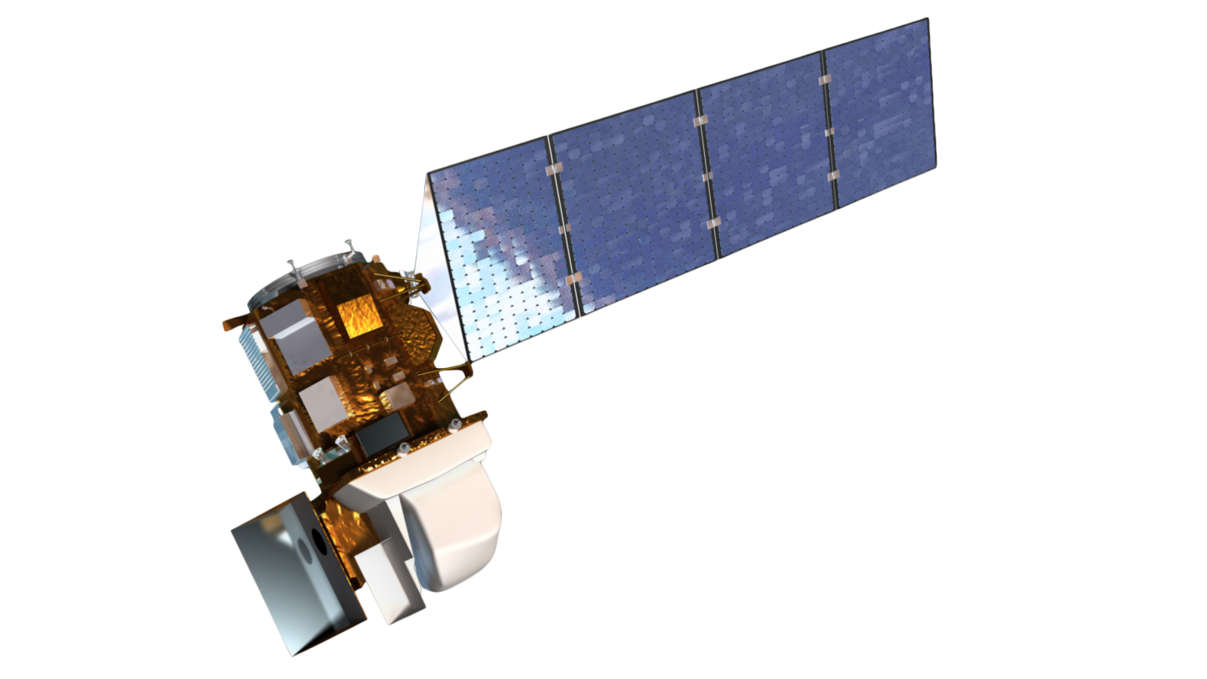
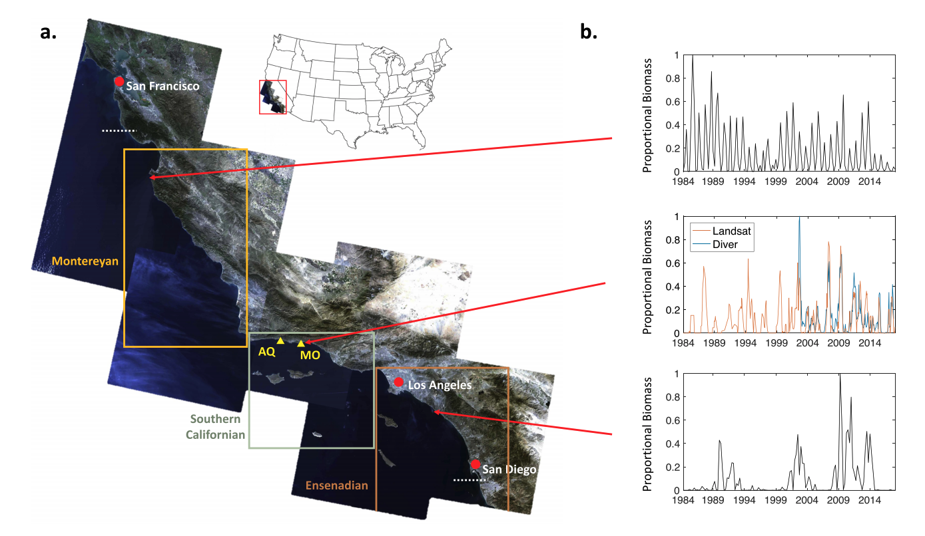
Long-term, large spatial extent monitoring of kelp canopy dynamics from the Landsat satellites
Temporal Coverage
1984 – present
8 – 16 day repeat
Spatial Resolution
30m pixel res.
Bell et al. 2020 RSE

Slide 3
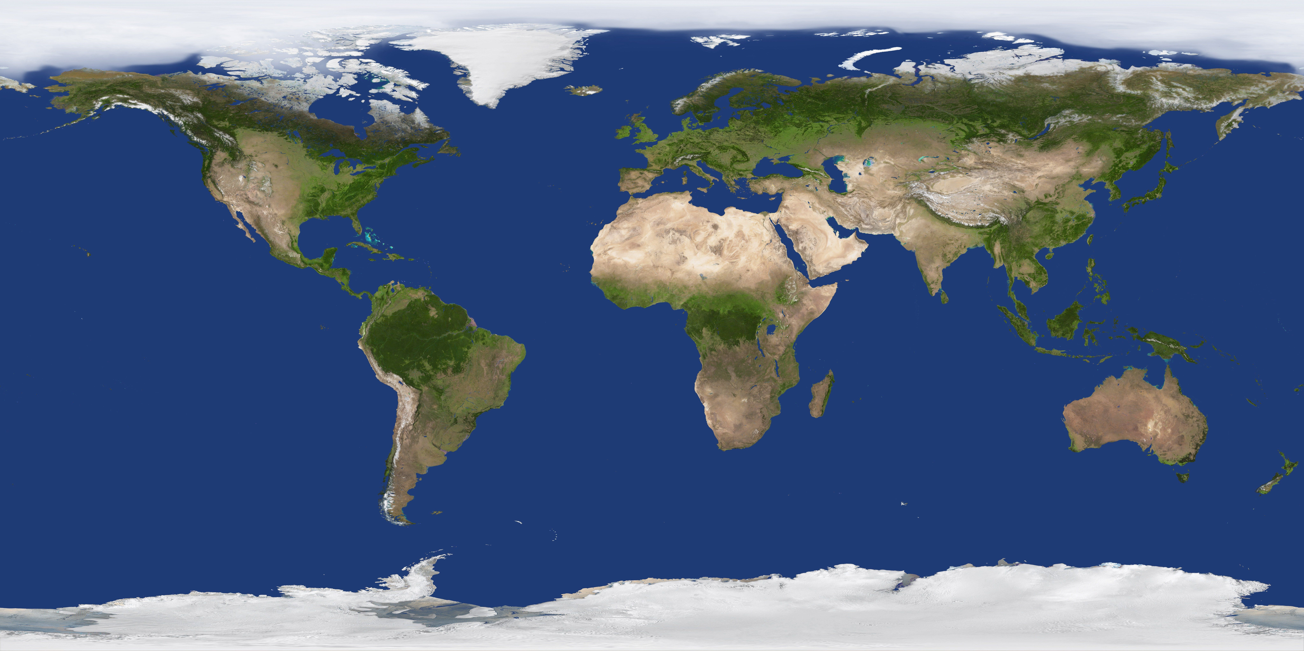

Slide 4
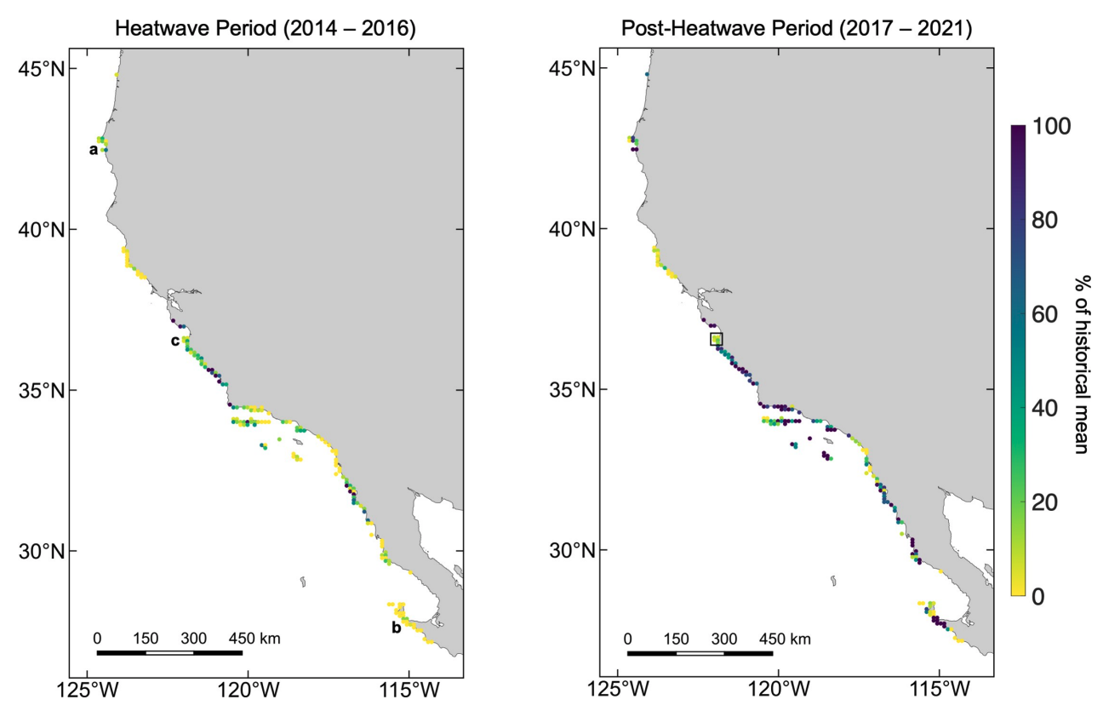
Resistance and Resilience of Kelp to Marine Heat Waves
Bull Kelp
Giant Kelp
Bell et al. 2023 PLOS One
Notes:
We recently published a paper examining the resistance and resilience of kelp canopy to the unprecedented marine heat waves from 2014 – 2016 in the NE Pacific. This paper was also a case study showing how Kelpwatch.org can be used.
We used data directly accessed from Kelpwatch to divide the cost into 209 10km cells and found that during the heatwave period the majority of cells declined to less than half of their historical mean, but that the trends were significantly related to latitude for each species.
However, when we examined the resilience of kelp after the heatwave, we found that the latitudinal relationship was much weaker for giant kelp with examples of high local and regional resilience across the range (S. Baja, N. Baja, SoCal, CenCal).
We found that the kelp around the Monterey Peninsula displayed much less resilience than the rest of the central coast.

Slide 5
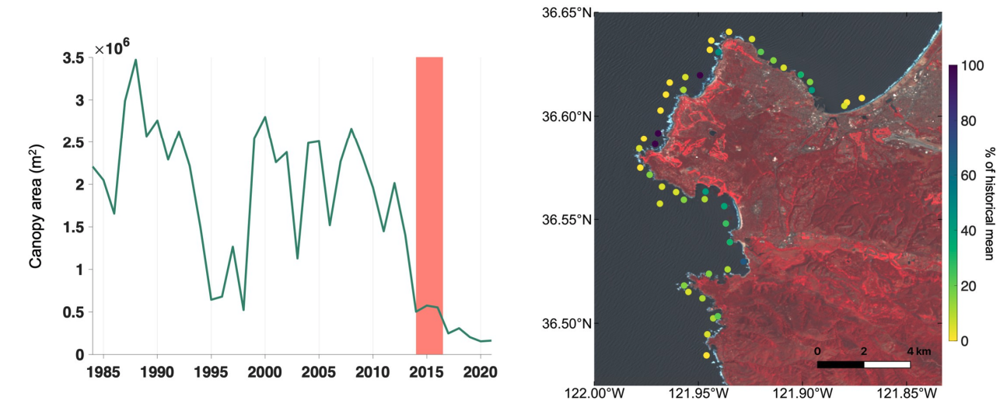
Kelp on the Monterey Peninsula has collapsed…
Bell et al. 2023 PLOS One
Notes:
The graph on the left shows the maximum annual canopy area for the Monterey Peninsula with the heat wave period shown in red and several years of low and declining canopy after the heatwave.
When we zoomed in to the Monterey Peninsula at a 1km scale, we found that much of the area had collapsed and this was confirmed by diver surveys showing high sea urchin densities which had denuded the reef.

Slide 7
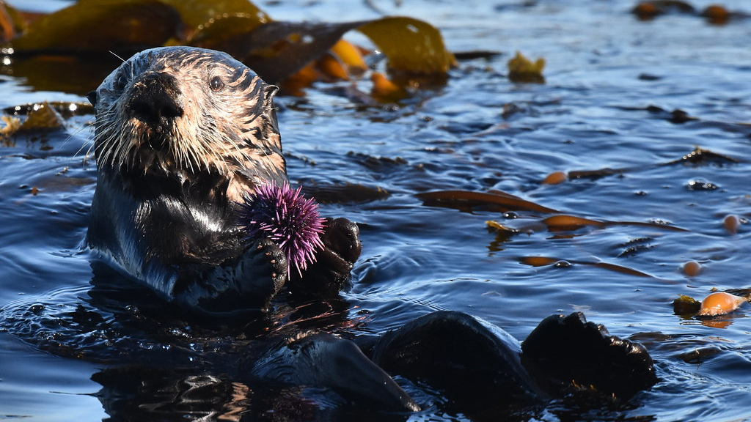
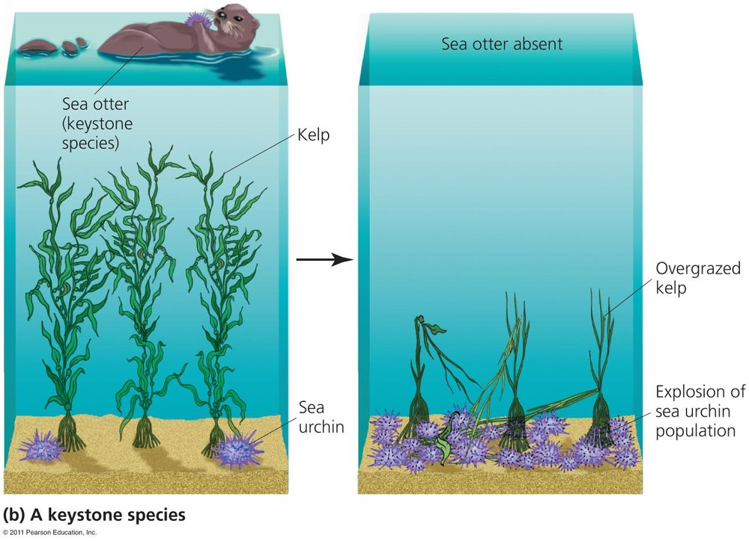
delphinusorca
Notes:
Sea otters have a unique relationship with kelp forests and can exert a strong top-down pressure on kelp herbivores leading to the classic trophic cascade described by Estes and Palmisano.
Especially in areas without other major sea urchin predators.

Slide 8
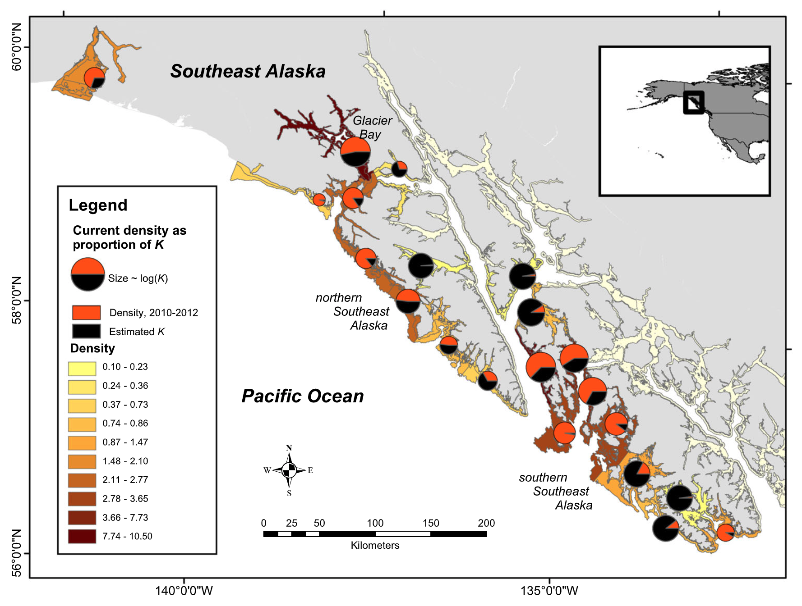
K
Related otter population model to kelp canopy
dynamics in 8 subregions in SE Alaska
Glacier Bay
N07
N08
Admiralty Island
N02
N03
N04
Sitka Sound
Tinker et al. 2019
Notes:
Here is a map of SE AK and we built timeseries of kelp canopy cover for the three regions in the red boxes: Sitka Sound (in the north), NW Prince of Wales Island (in the center), and the outer coast of Dall Island in the south.
All of these areas have different histories of otter recolonization, with Sitka Sound having an early growth in otter population peaking around 1990, with frequent harvest by hunting.
NW Prince of Wales Island had a later population increase, slowing in the late 1990’s, and Dall island recolonization started in the late 1990’s with high population growth starting in the mid-2000’s.
We used the Landsat satellites measure the presence, density, and area of kelp canopy in each of the three regions.
The Landsat satellites have provided imagery of these regions since 1984, with an image every 16 days, at a pixel resolution of 30m.
We recently implemented a novel land masking method that removes the large intertidal areas in this region.

Slide 9
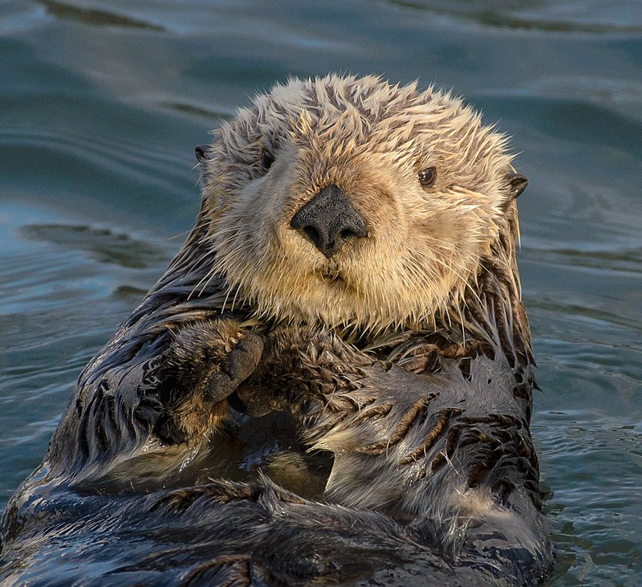
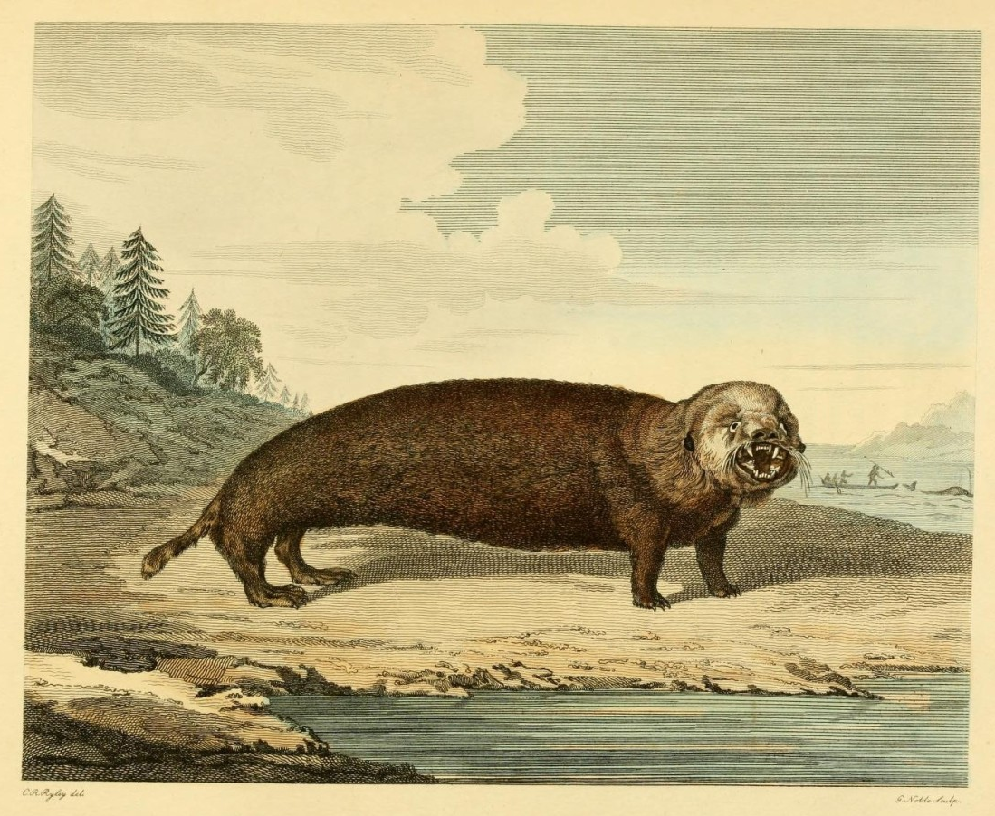
Theoretical Expectations
Kelp Has Been Present
No New Areas Appearing
Kelp Canopy Detected Early in Time for the Vast Majority of Areas
New Kelp Areas are Appearing
Kelp Canopy Detected in New Areas throughout Time
Hedin
Hedin
Smithsonian

Slide 10
Increase in Otters = New Kelp Canopy Areas
Glacier Bay
N03
Hedin
N04
Sitka Sound
Bell et al. in prep

Slide 11
No Increase in Otters = No New Kelp Areas
Hedin
N08
Admiralty Island
Bell et al. in prep

Slide 13
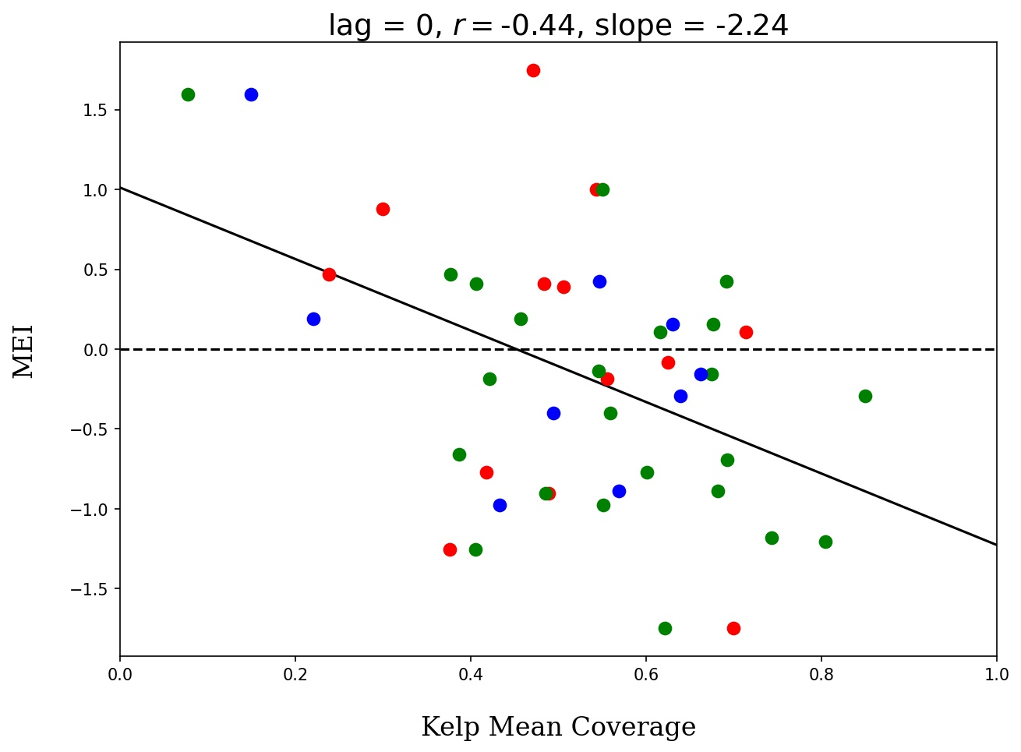
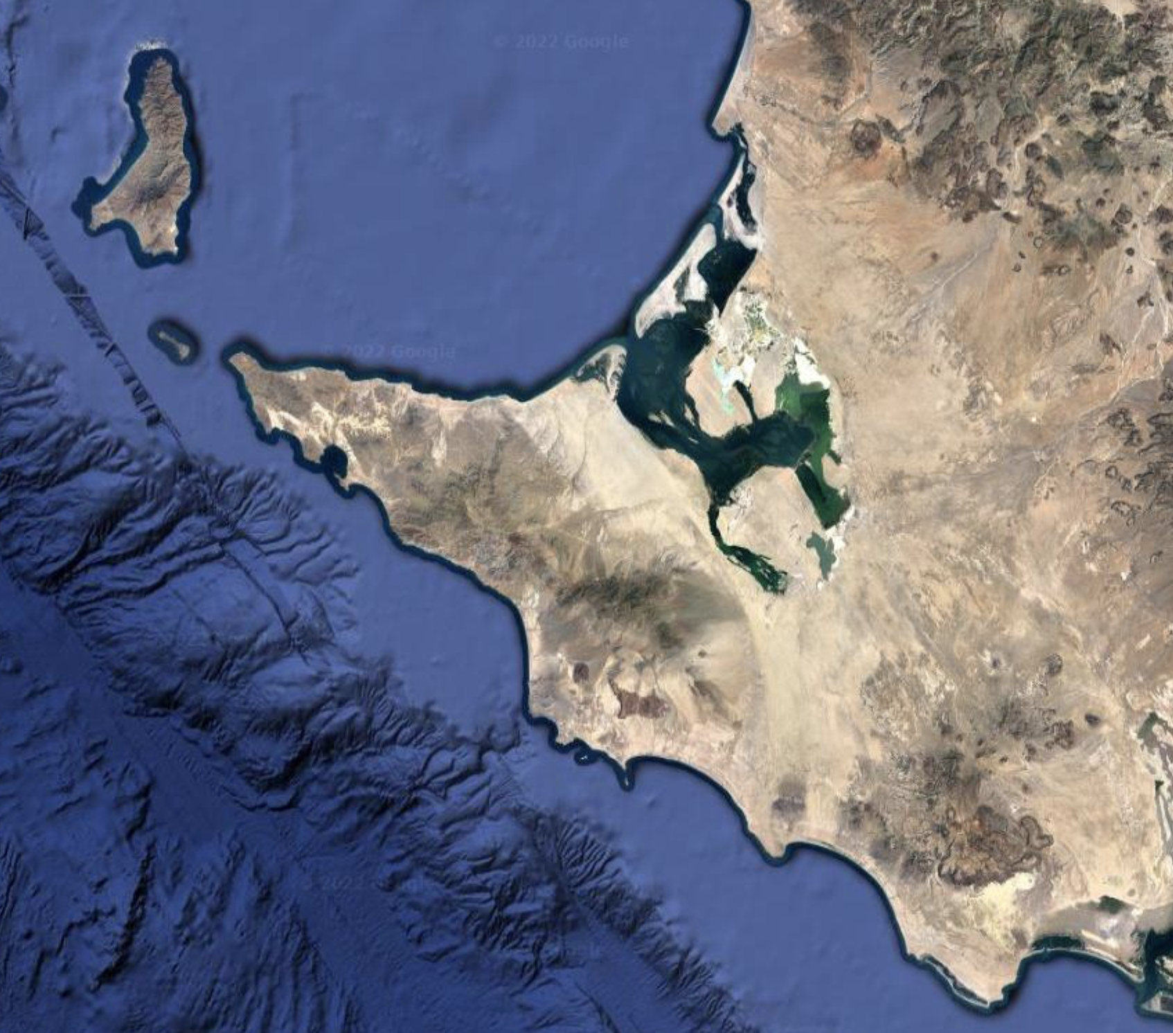
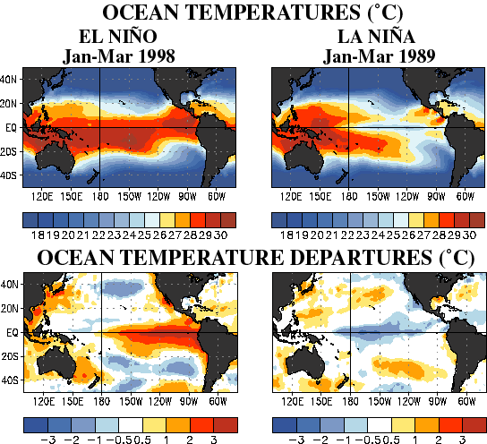
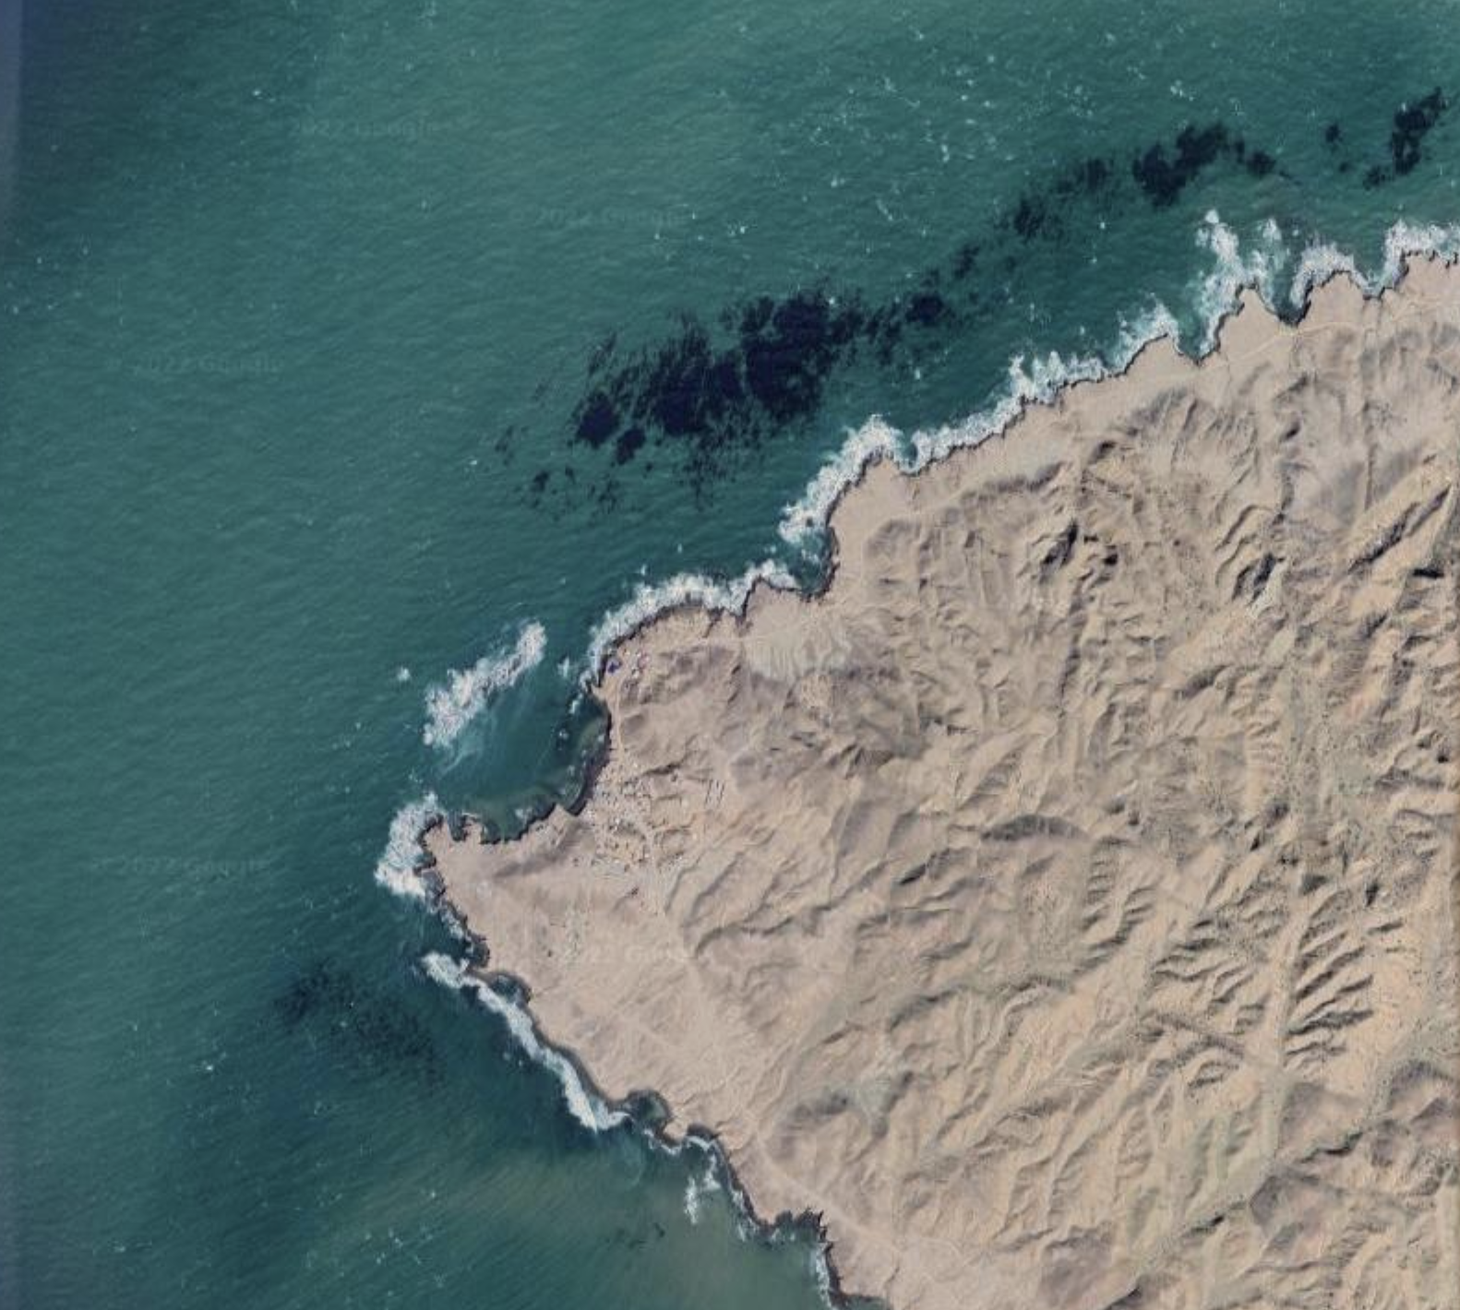
Punta Eugenia
Baja California Sur
No high-kelp observations during severe El Nino
No low-kelp observations during severe La Nina
El Niño
SST Anomaly
Landsat
5
7
8
La Niña
SST Anomaly
Historical ENSO SST Anomaly Maps from NOAA Climate Prediction Center
Houskeeper et al. in prep
Notes:
https://www.cpc.ncep.noaa.gov/products/analysis_monitoring/ensocycle/ensocycle.shtml

Slide 14
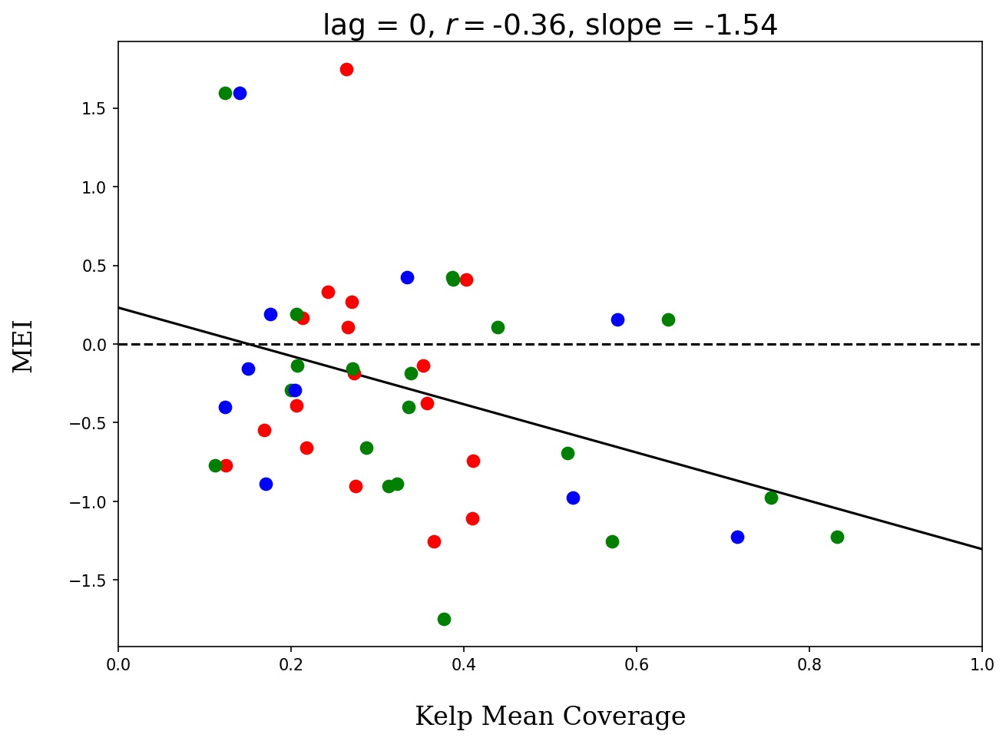
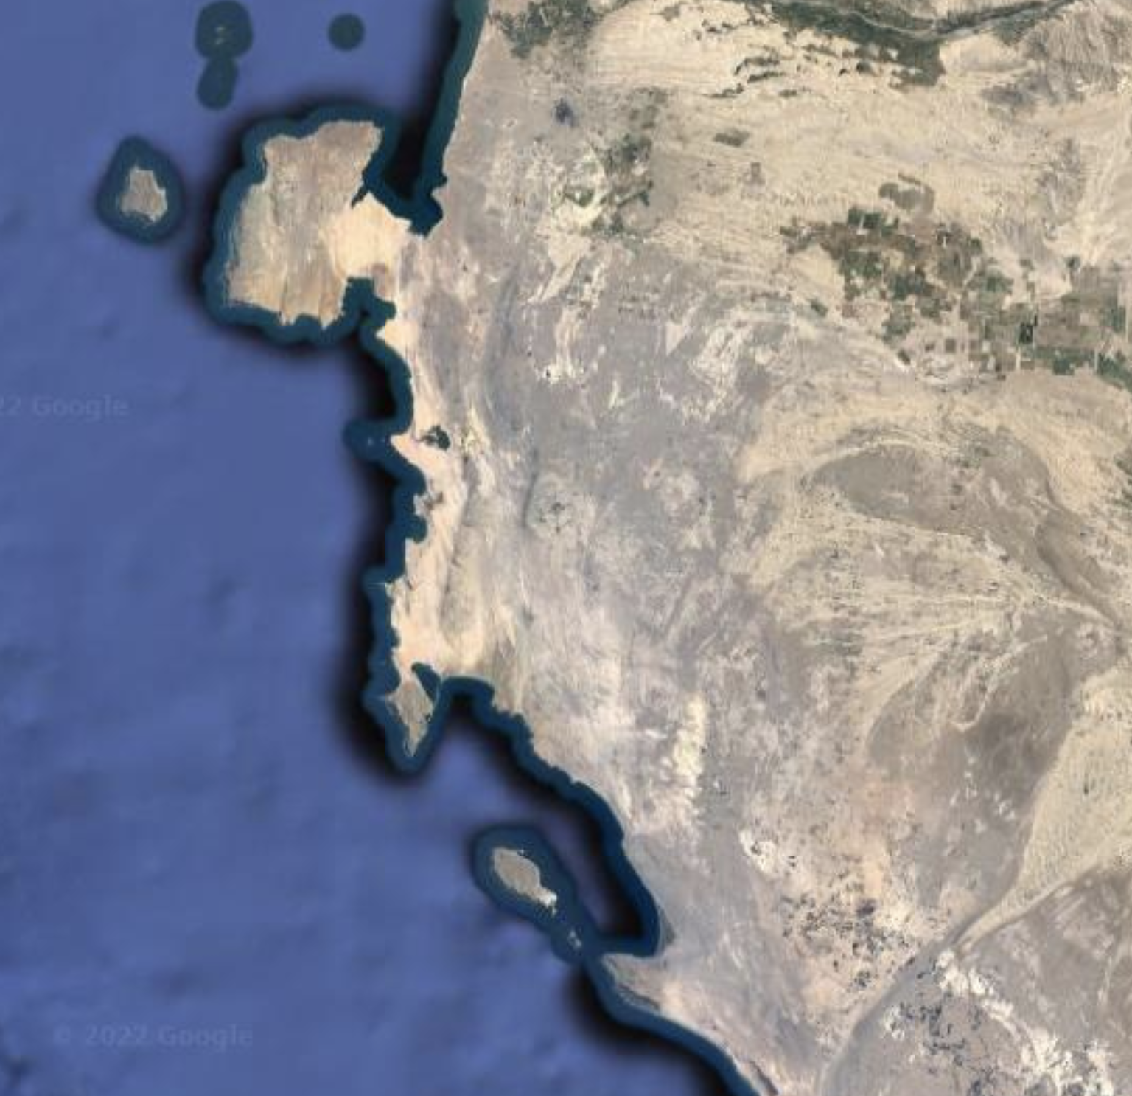
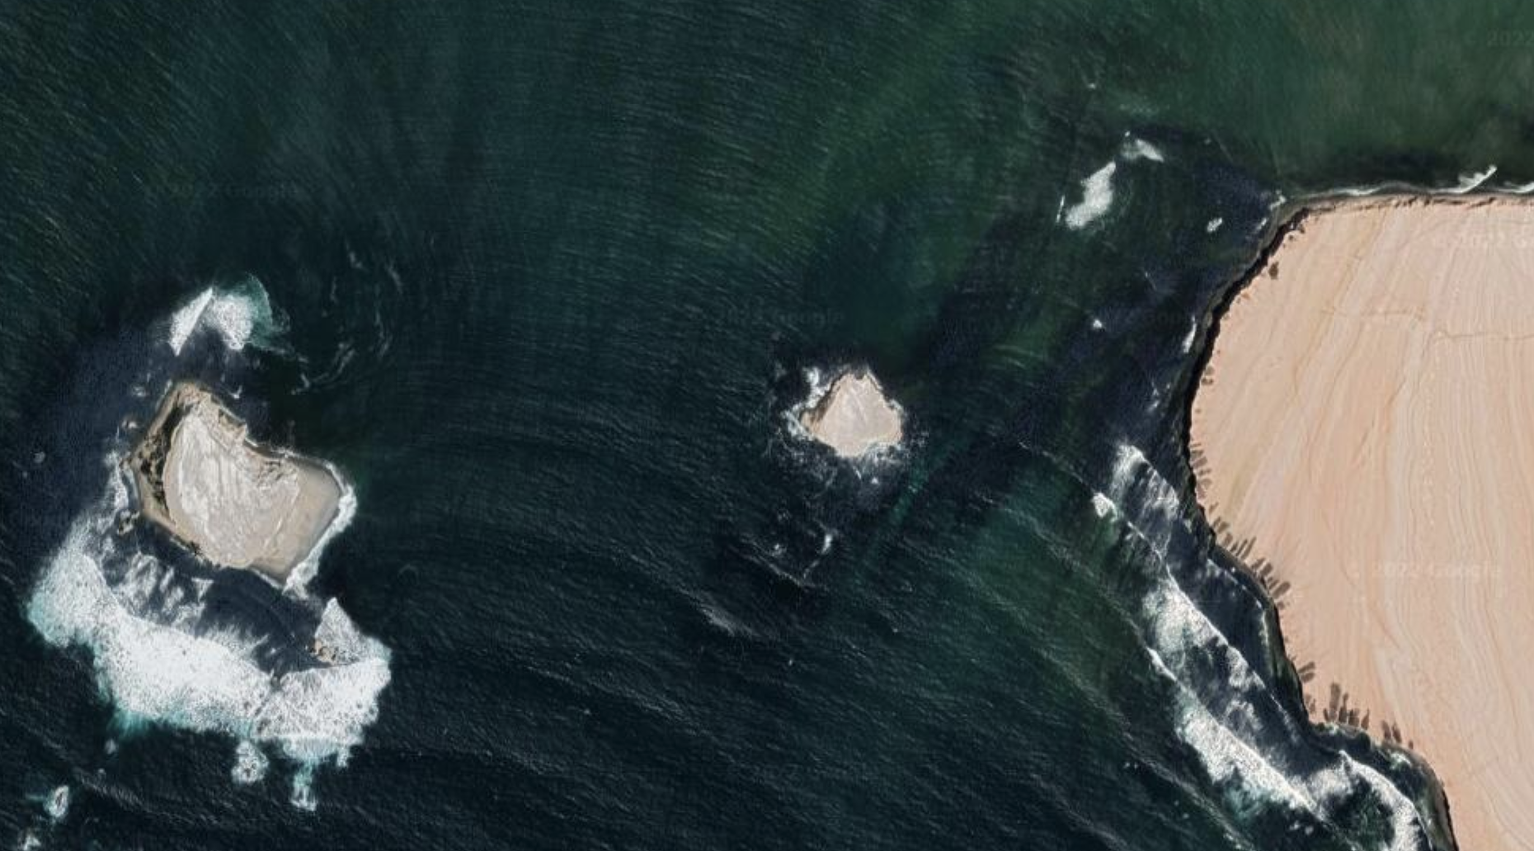
Playa El Puente
Southern Coastal Peru
No high-kelp observations during severe El Nino
Kelp canopy (and SST) more variable during La Nina
El Niño
SST Anomaly
Landsat
5
7
8
La Niña
SST Anomaly
Historical ENSO SST Anomaly Maps from NOAA Climate Prediction Center
Houskeeper et al. in prep
Notes:
https://www.cpc.ncep.noaa.gov/products/analysis_monitoring/ensocycle/ensocycle.shtml

Slide 15
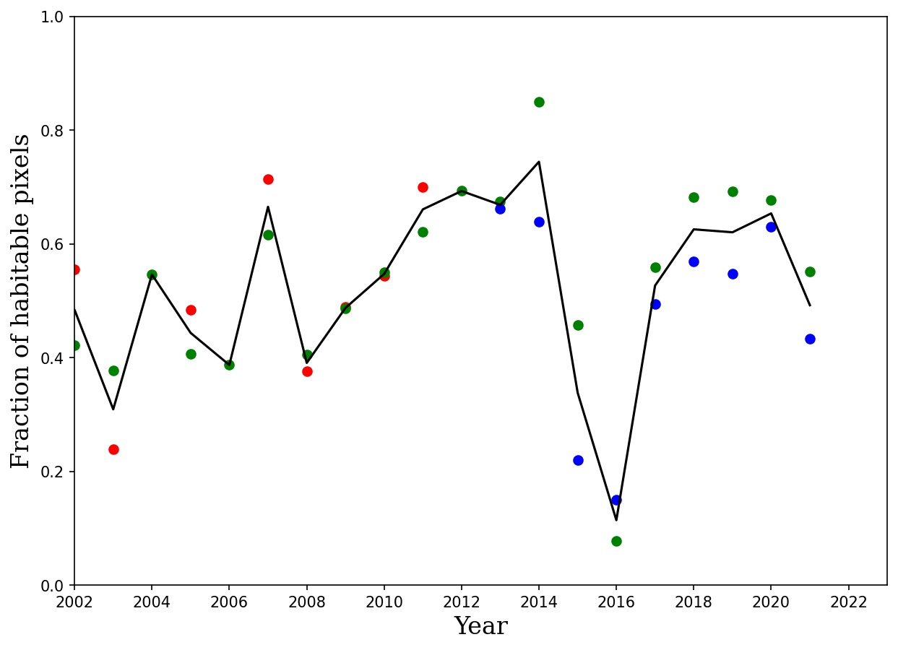
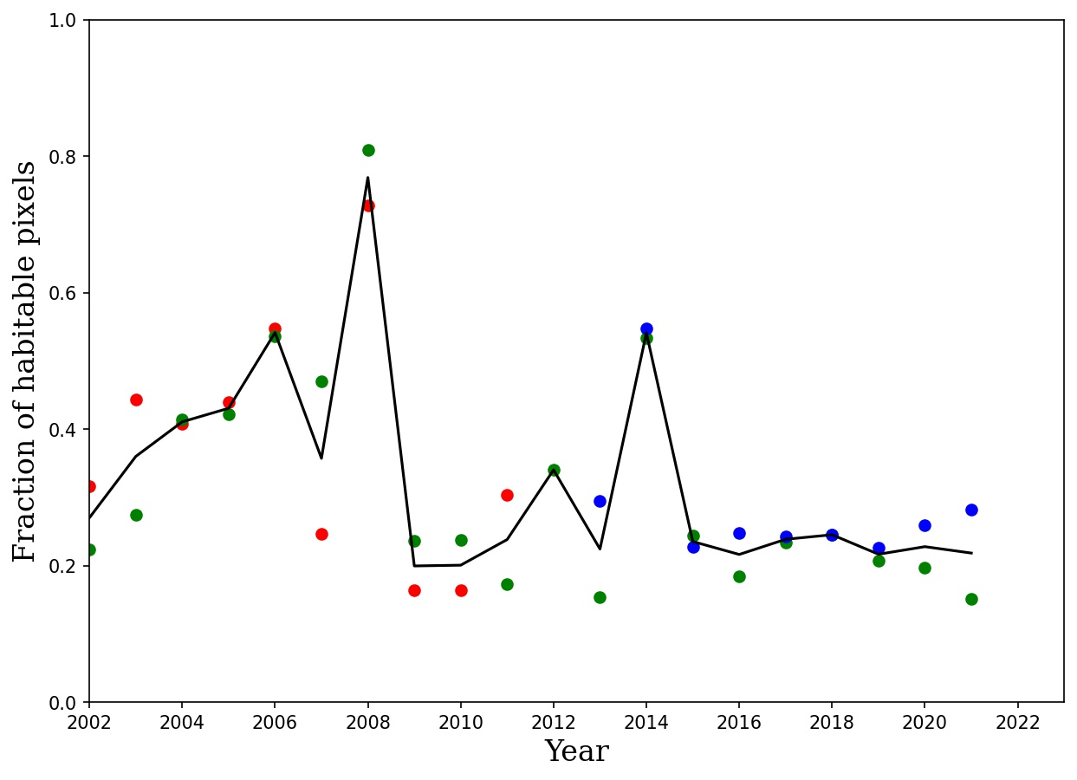
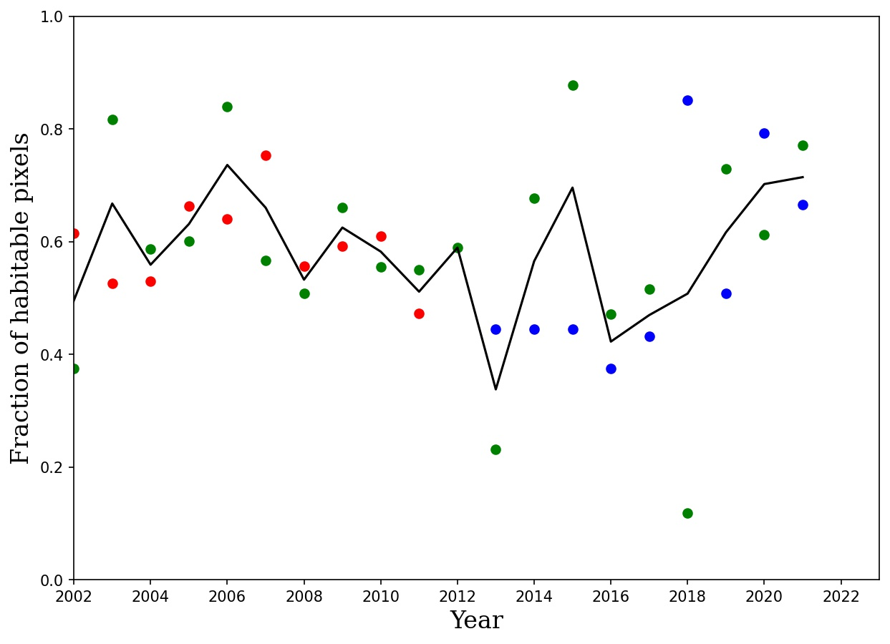
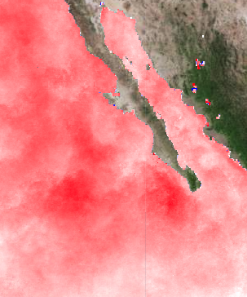
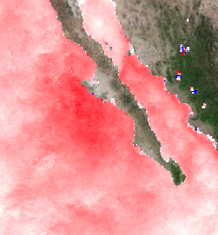
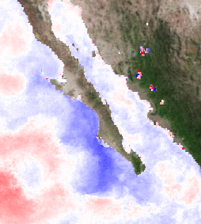
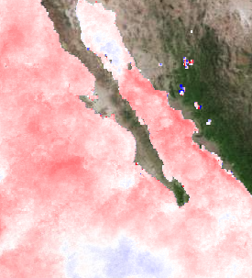
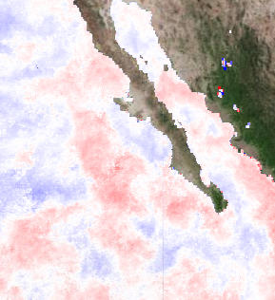
Time Series Results – Baja California Sur
Landsat
5
7
8
M1
M2
M3
El Niño
SST anomalies
“Blob”
2015
2016
2017
2018
2019
Guerrero Negro
M1
M2
15 Km
M3
Houskeeper et al. in prep

Slide 16
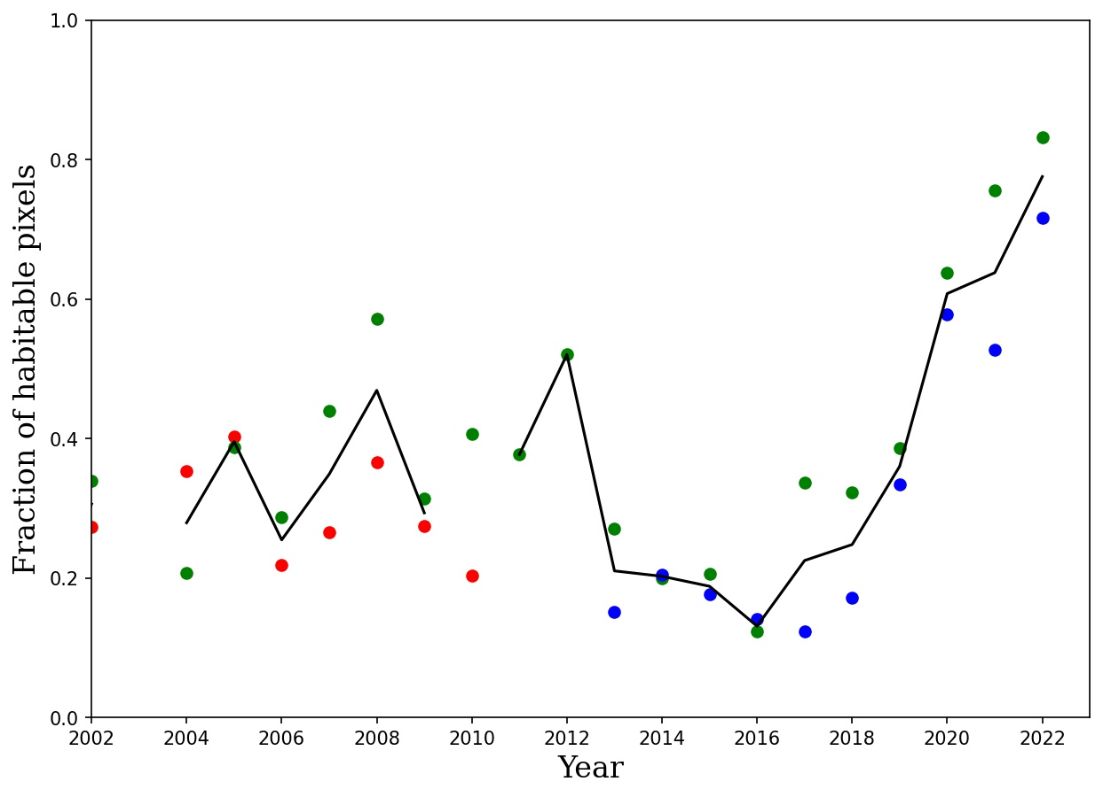
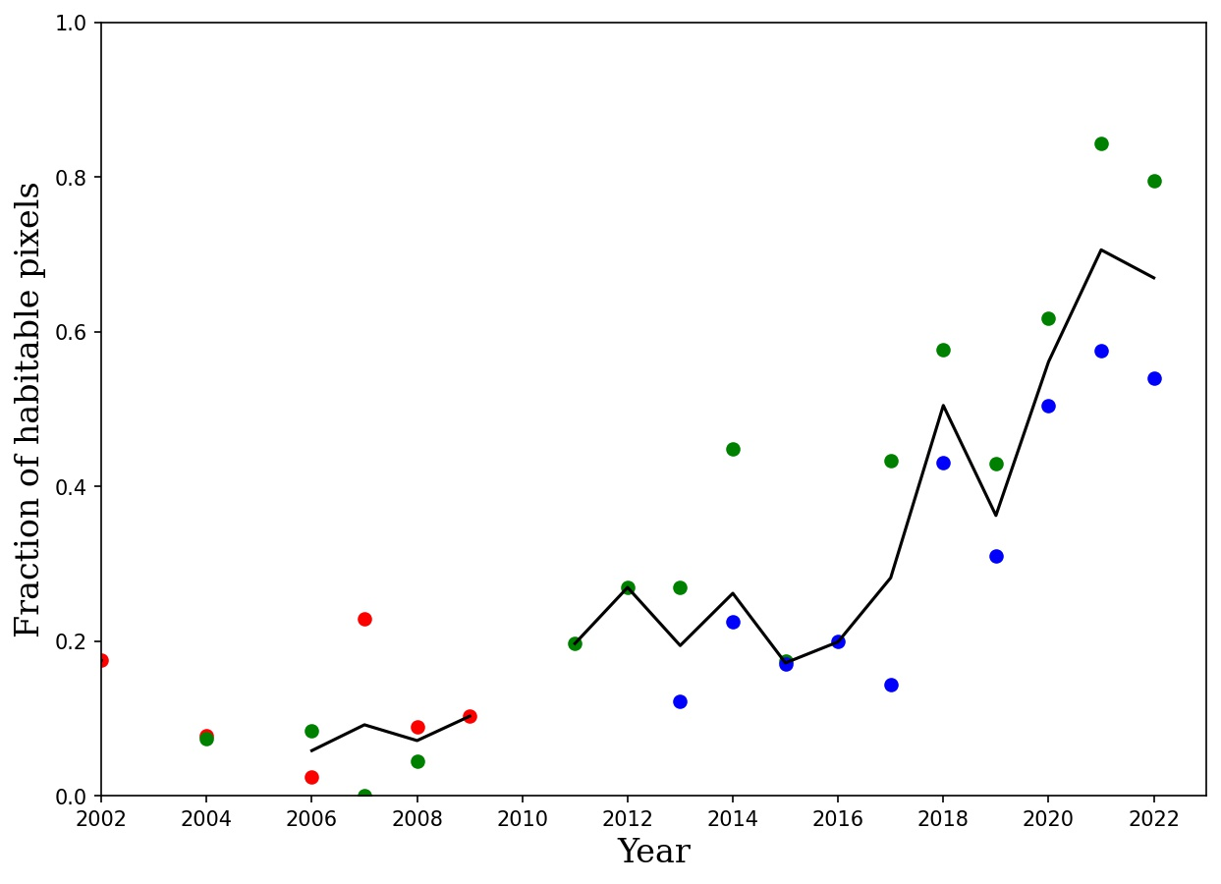
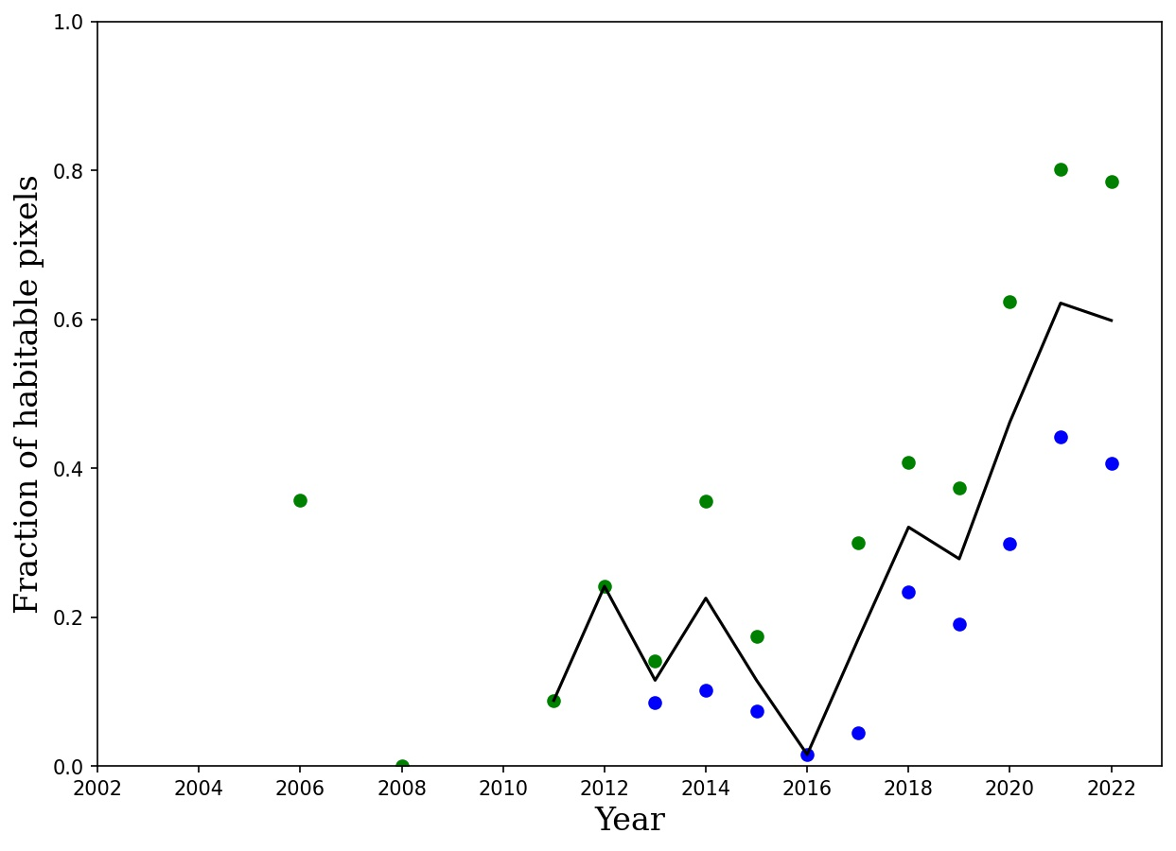
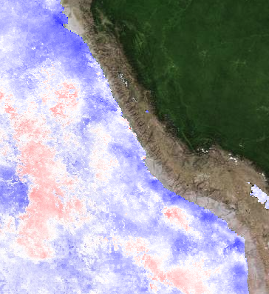
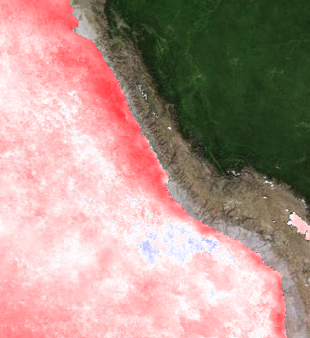
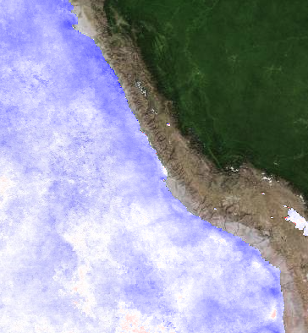
Time Series Results – Southern Peru
Potential recent increases
P1
P2
P3
Pisco
Landsat
5
7
8
2011
2016
2022
P1
MEI > 1.5
P3
MEI < -1.5
15 Km
P2
Houskeeper et al. in prep

Slide 18
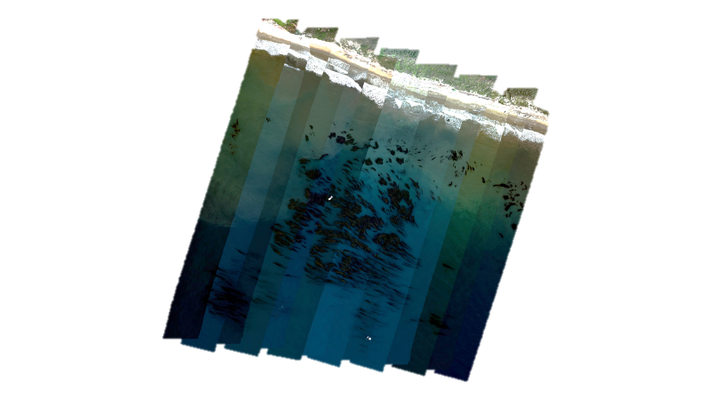
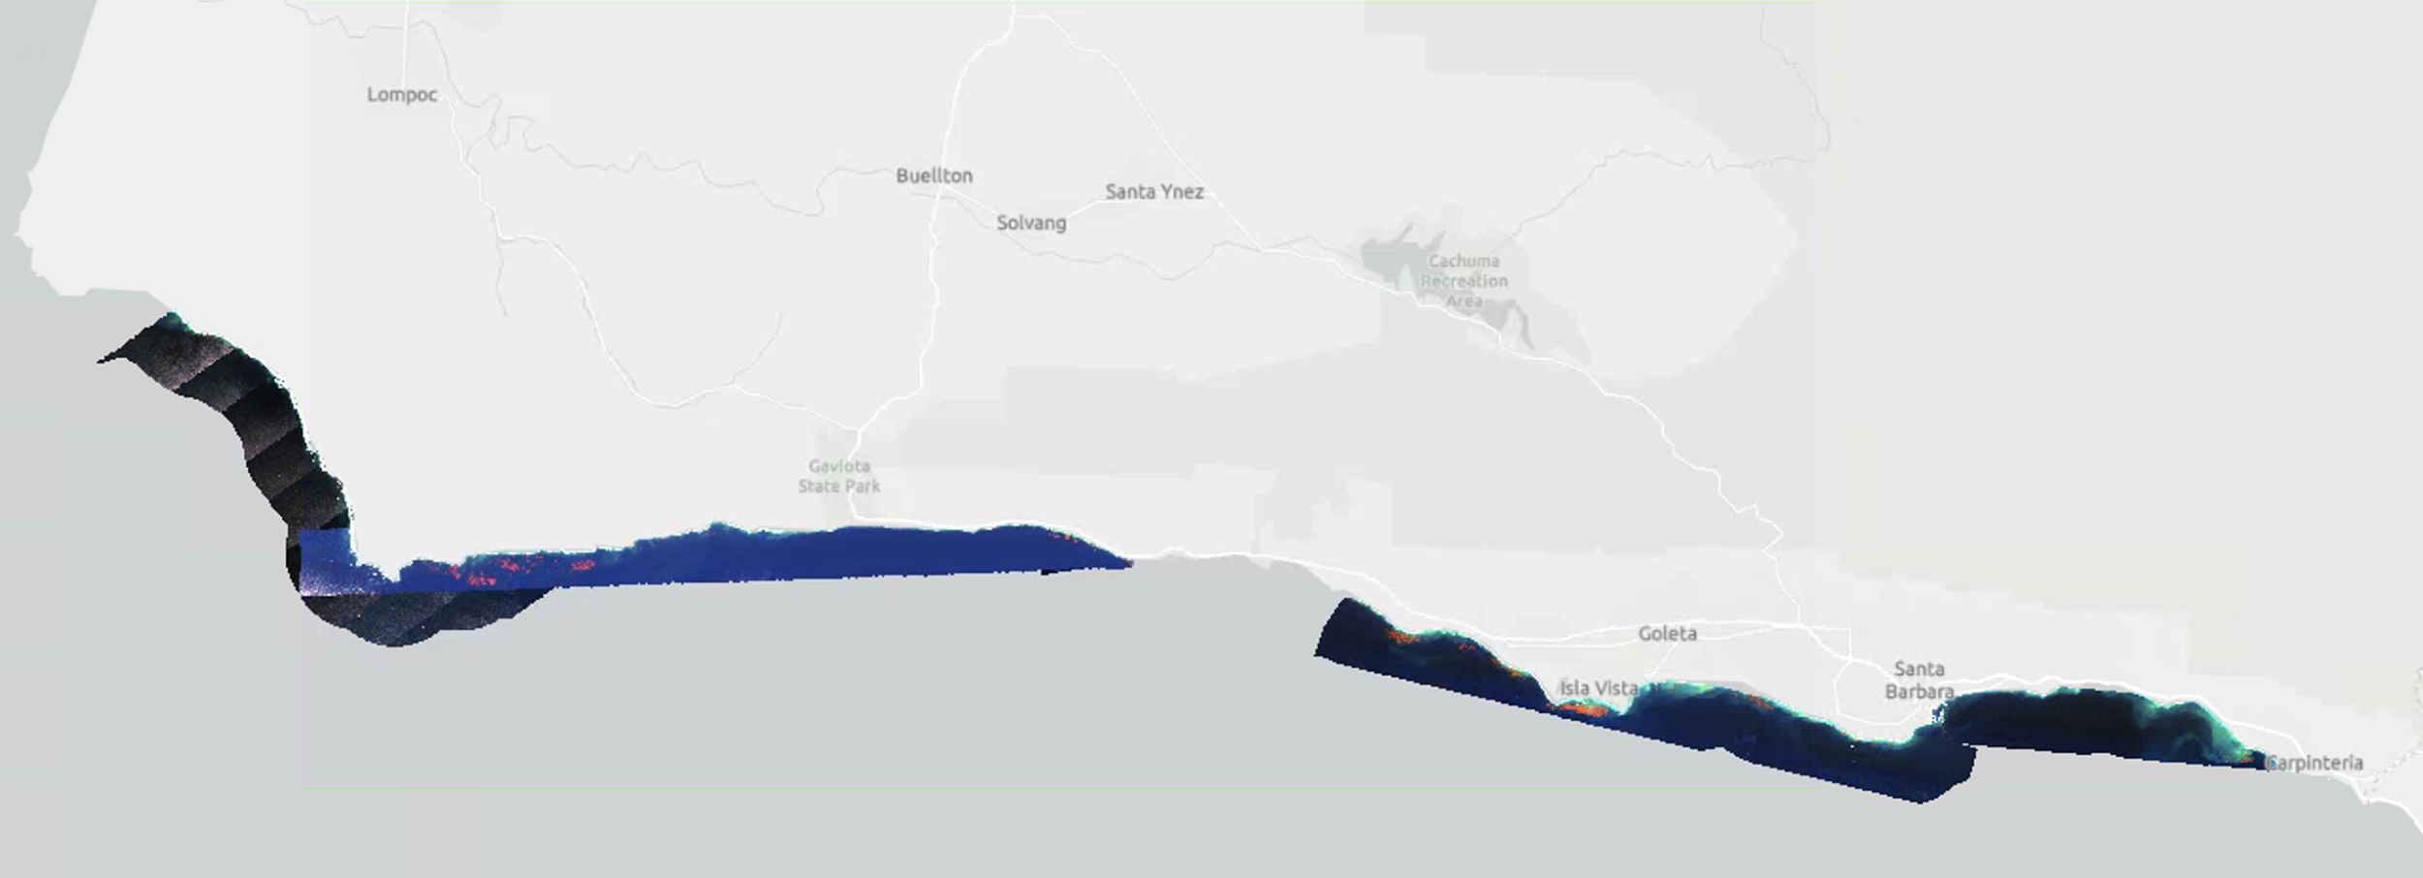
Hyperspectral Drone Imaging of Kelp Canopy During SHIFT Campaign
Once per month from March – September
Continue time series through December
North
10 km
Katherine Cavanaugh et al. in prep

Slide 19
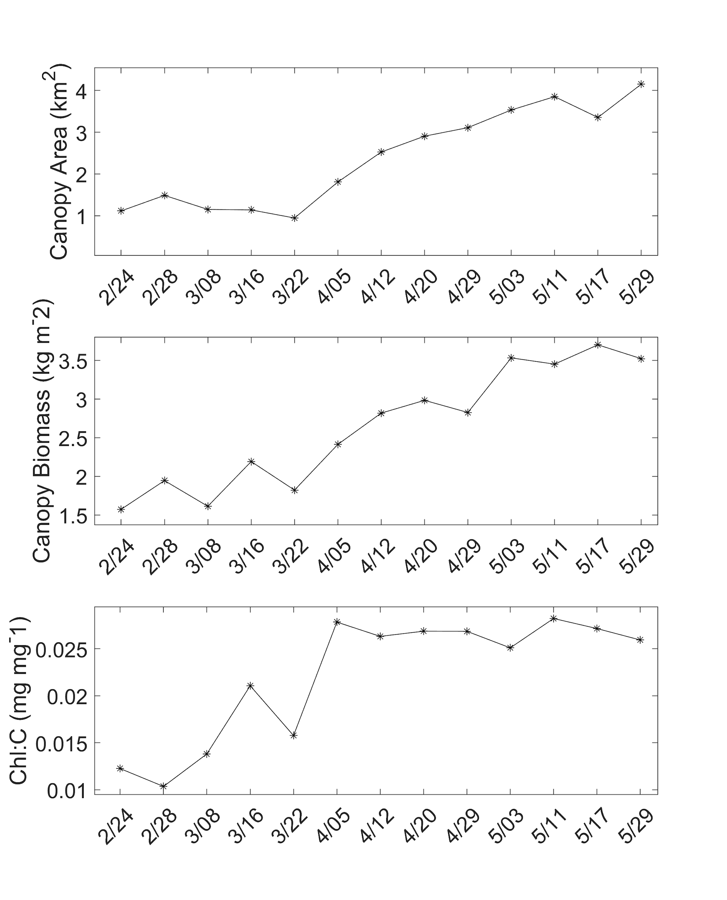
Kelp canopy biomass increases with physiological condition
North
10 km
Katherine Cavanaugh et al. in prep

Slide 20
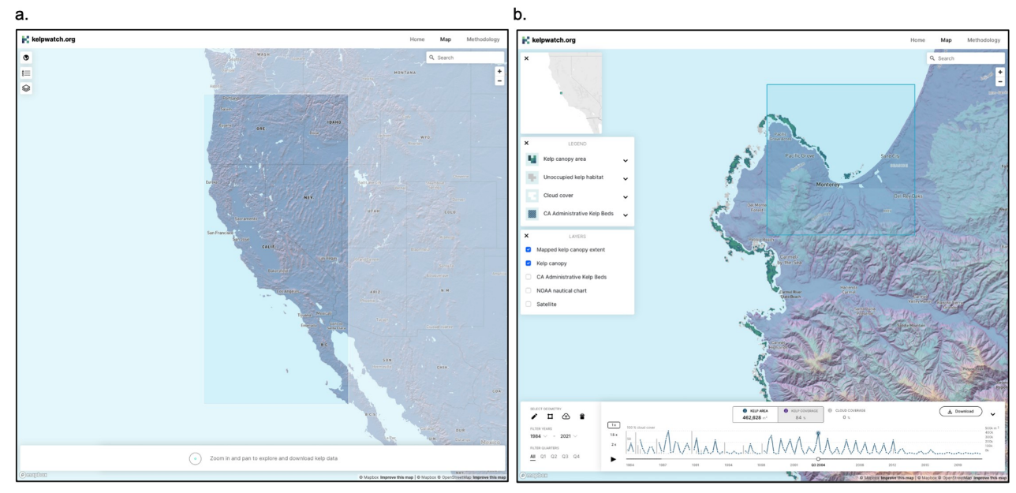
Kelpwatch.org: Data visualization and Access
Bell et al. 2023 PLOS One
Notes:
Since we first produced our initial time series of kelp canopy dynamics in Southern California, it has been difficult to visualize and share the data with others, especially those not used to working with large datasets.
In 2019, we partnered with The Nature Conservancy to develop Kelpwatch.org, a web-based data visualization and download platform, so that anyone can access these data and see how kelp has changed through time at their location of interest.

Slide 21
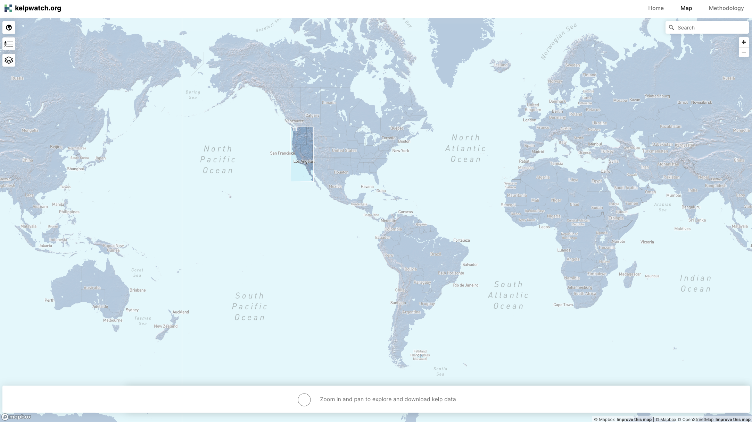
2022
2023
2024
Notes:
In 2021, we were funded by NASA to translate our code to Google Earth Engine and expand our map of canopy forming kelp dynamics globally and add them to Kelpwatch.org. In the next month we will add SE Alaska and the Falkland Islands to the map, with Peru and British Columbia being added later this year.
In 2024, we will add Chile, Argentina, Australia, New Zealand, South Africa, and NW Alaska.
This will enable researchers globally to understand the drivers of kelp canopy dynamics and the resilience to climate change.
My postdoc, Henry Houskeeper, published a paper last year examining the long term dynamics of kelp around the Falkland Islands and will be submitting a paper next month focusing on Peru.

Slide 23
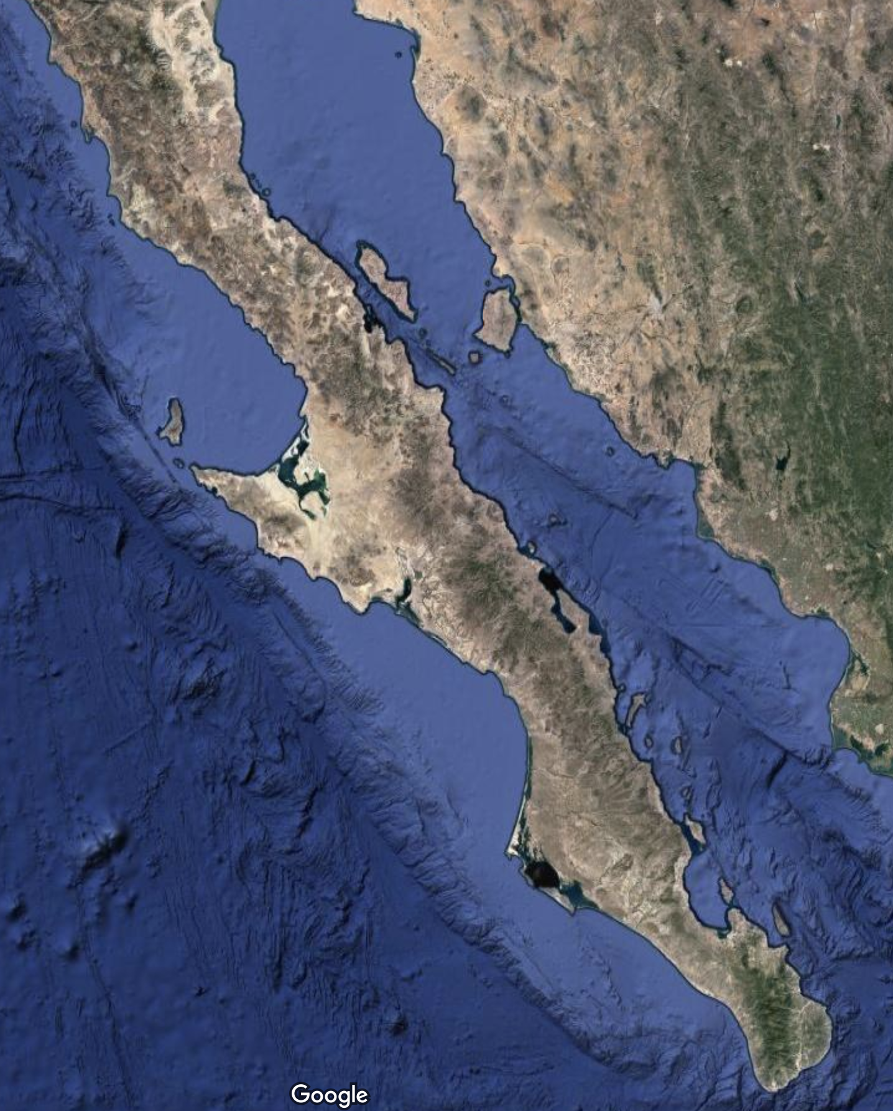
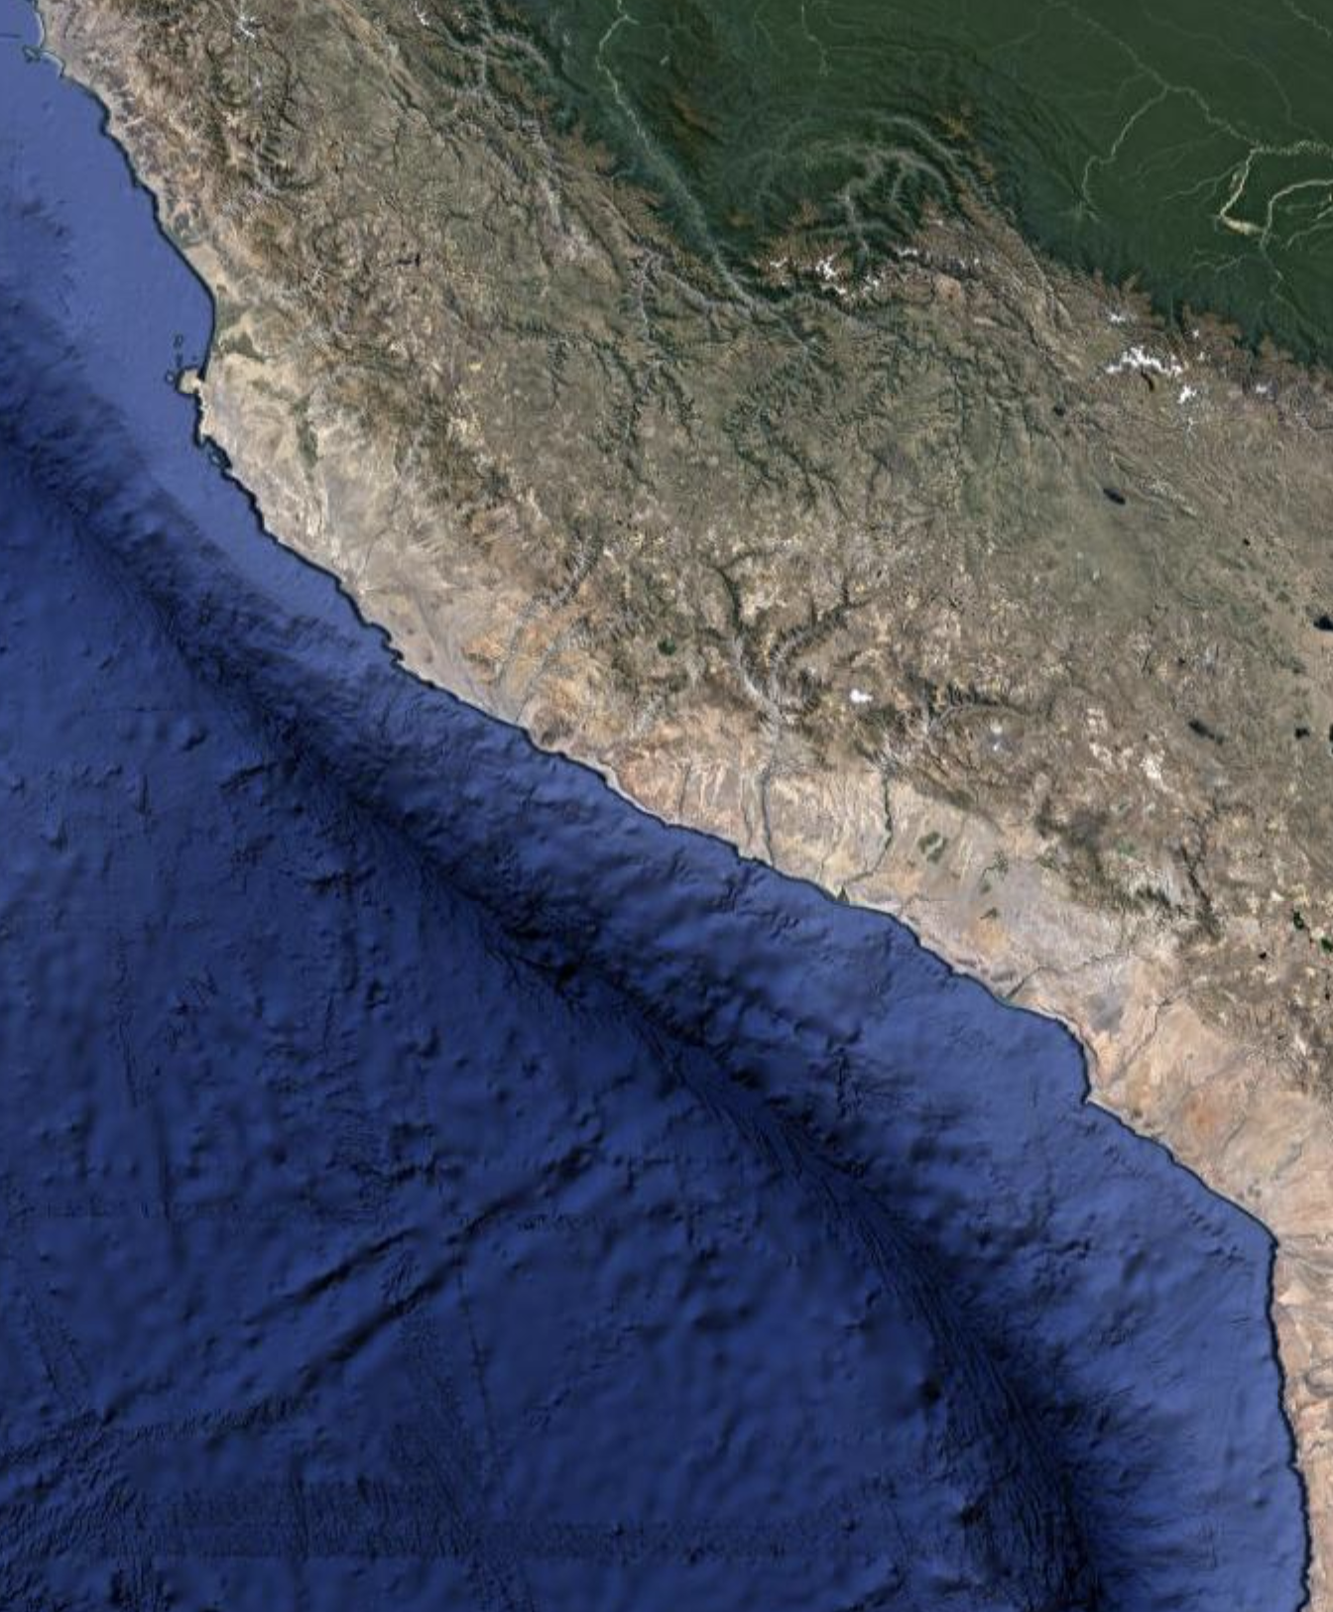
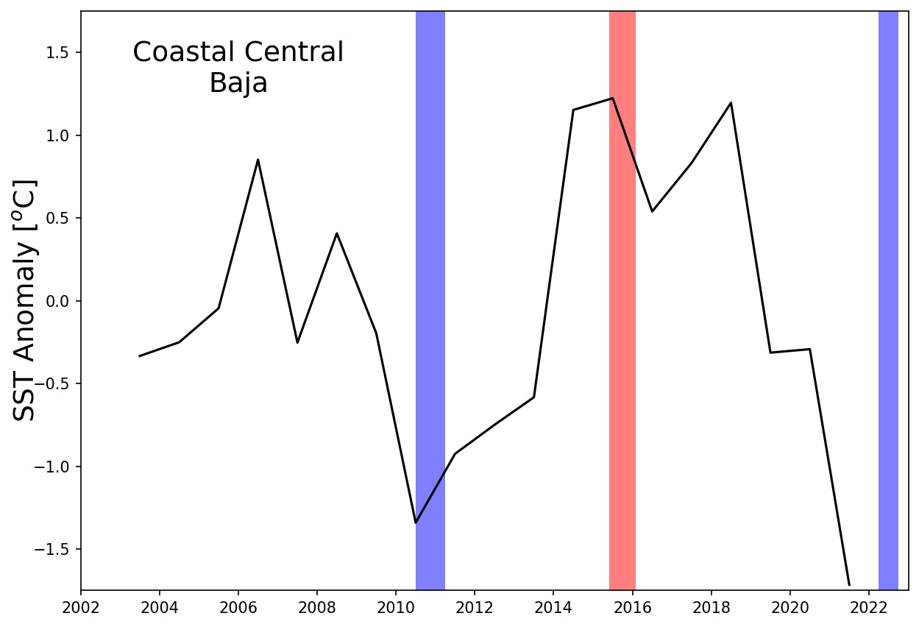
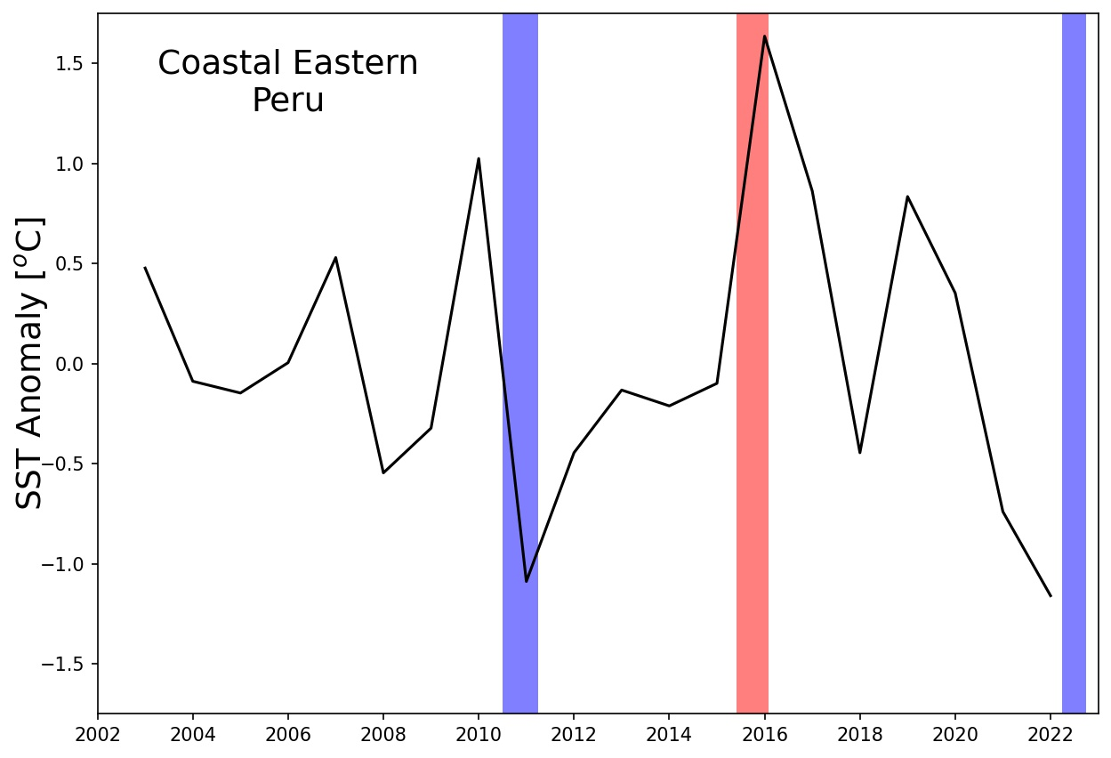
MODIS Summertime SST Anomalies
80 Km
80 Km
Baja California
Southern Peru
The
“Blob”

Slide 24
Summer Project Plans: w/ NASA SARP
Transfer learning takes an AI model developed using a large dataset (e.g., NASA Floating Forests) and ”transfers” learning to a small dataset.
Recent collaboration produced open-access AI to detect kelp trained on NASA citizen science data products.
https:github.com/ramanakumars/patchGAN/
Potential high-impact SARP project possible by:
Adding a transfer layer to Floating Forests AI
Leveraging highly accurate, expert-labeled data.
Goal: add spatial information to classification
Mantha et al. (2022) ACM CIKM
Houskeeper et al. (2021) PLoS One

Slide 25
Severely warmer under El Niño conditions
Mildly warmer or cooler under La Niña
NOAA Climate Prediction Center
Notes:
https://www.cpc.ncep.noaa.gov/products/analysis_monitoring/ensocycle/ensocycle.shtml

