Slide 1
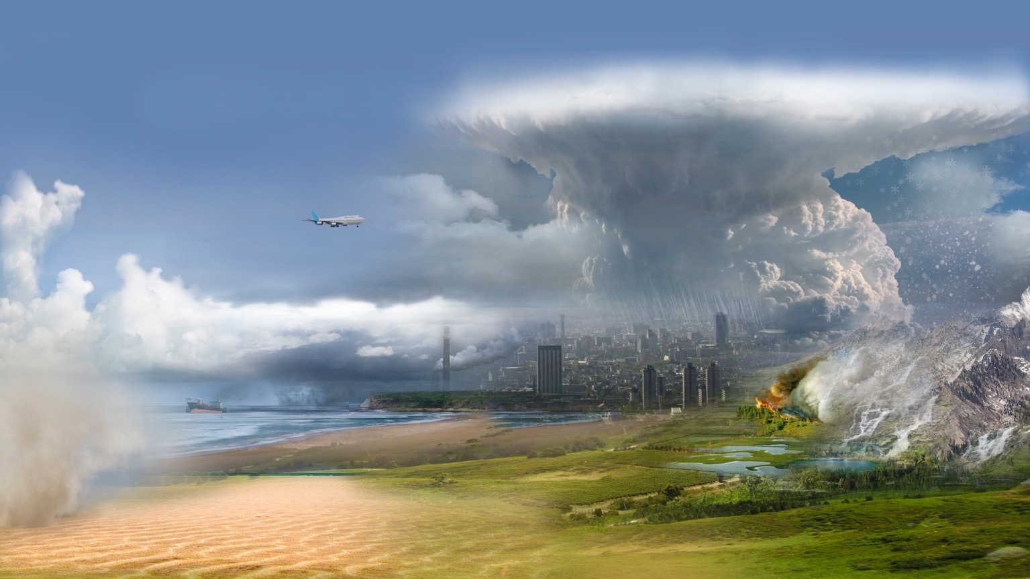
A brief overview of the Atmosphere Observing System (AOS)
Kirk Knobelspiesse*
Ocean Ecology Laboratory
NASA/Goddard Space Flight Center
(*) with contributions from Scott Braun, Arlindo da Silva
and many others in the AOS Team
Carbon Cycle & Ecosystems Joint Science Workshop
Ocean Biology and Biogeochemistry section
College Park, MD, May 8-12, 2023

Slide 2
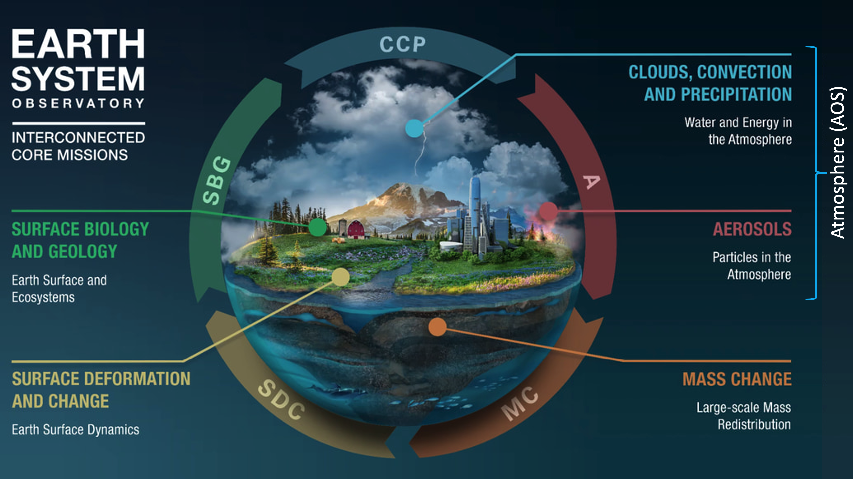

Slide 3
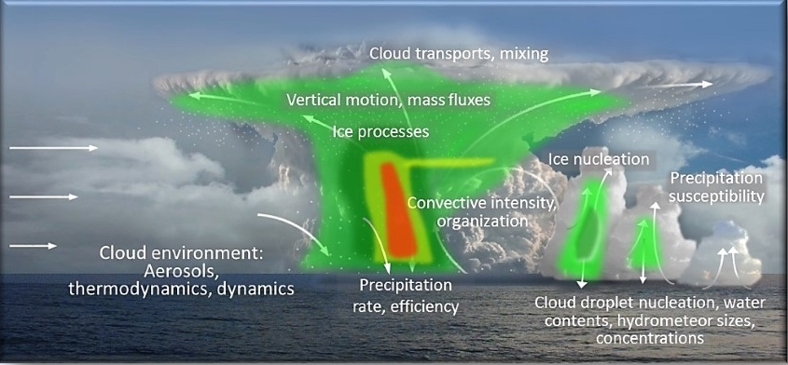

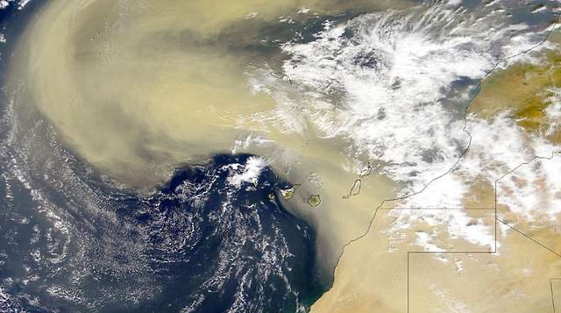
AOS Objectives Focus on Three Themes
IPCC AR6 Report
Chapter 4
Climate sensitivity and feedbacks
  Low and high cloud feedbacks
  Aerosol direct & indirect effects
  Cold clouds and precipitation
Absorption
(warming)
Scattering
(cooling)
Convective Storm Formation Processes
  Coupled storm dynamics and microphysics
  Importance of diurnal cycle
  High cloud properties
Aerosol processes and distributions
  Air quality and aerosol attribution
  Aerosol vertical redistribution and processing (from emission to removal)
Notes:
Third party images:
Figure from Chapter 4 of the IPCC AR6 Report (top left), Chapter 4, Figure 4.2. IPCC copyright policy is that the figure can be used for non-commercial purposes without permission (https://www.ipcc.ch/copyright/).
Aerosol skyline and Saharan dust images (bottom left and right, respectively) have CC Public Domain Mark 1.0 license.

Slide 4
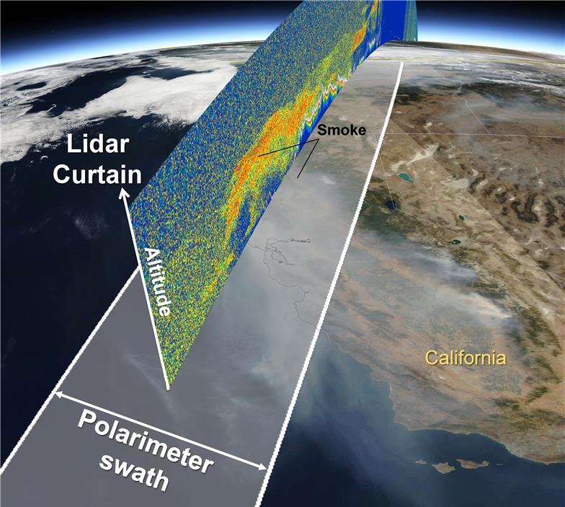
Building An Observing System
Factors shaping the architecture
  Cost-capped mission that utilizes relatively mature measurement capabilities
  Microphysical understanding requires synergistic multi-instrument approaches for the best geophysical variable retrievals
  International partnerships
  Continuity desired (but not required) to the extent practical
  Applications considered from early stages
AOS still in mission concept phase with refinements likely going into formulation based on cost and technical readiness risks
Lidar+polarimeter synergy for aerosols: provides significant retrieval advances over lidar alone
Lidar
Cloud Radar
Doppler radar+lidar+passive sensor synergy: adds dynamical information to cloud/precipitation profiling and passive properties

Slide 5
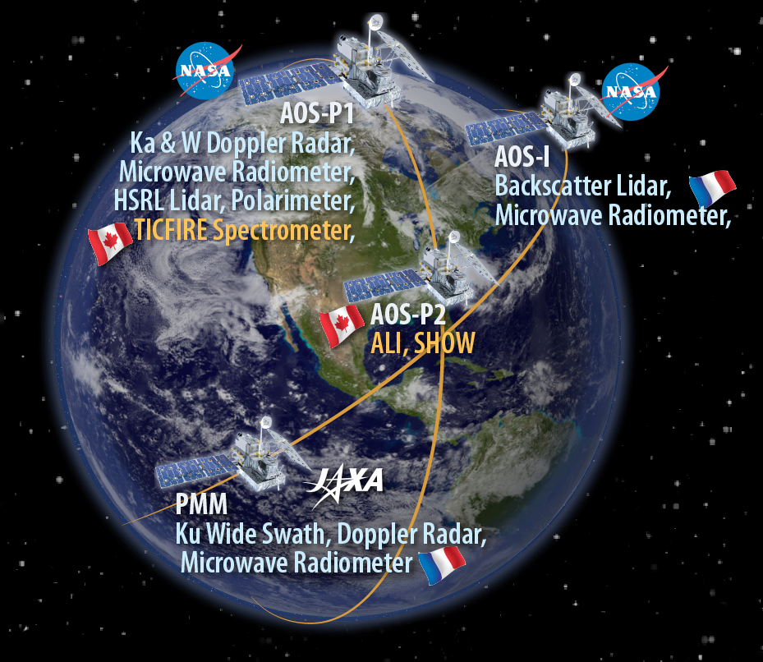
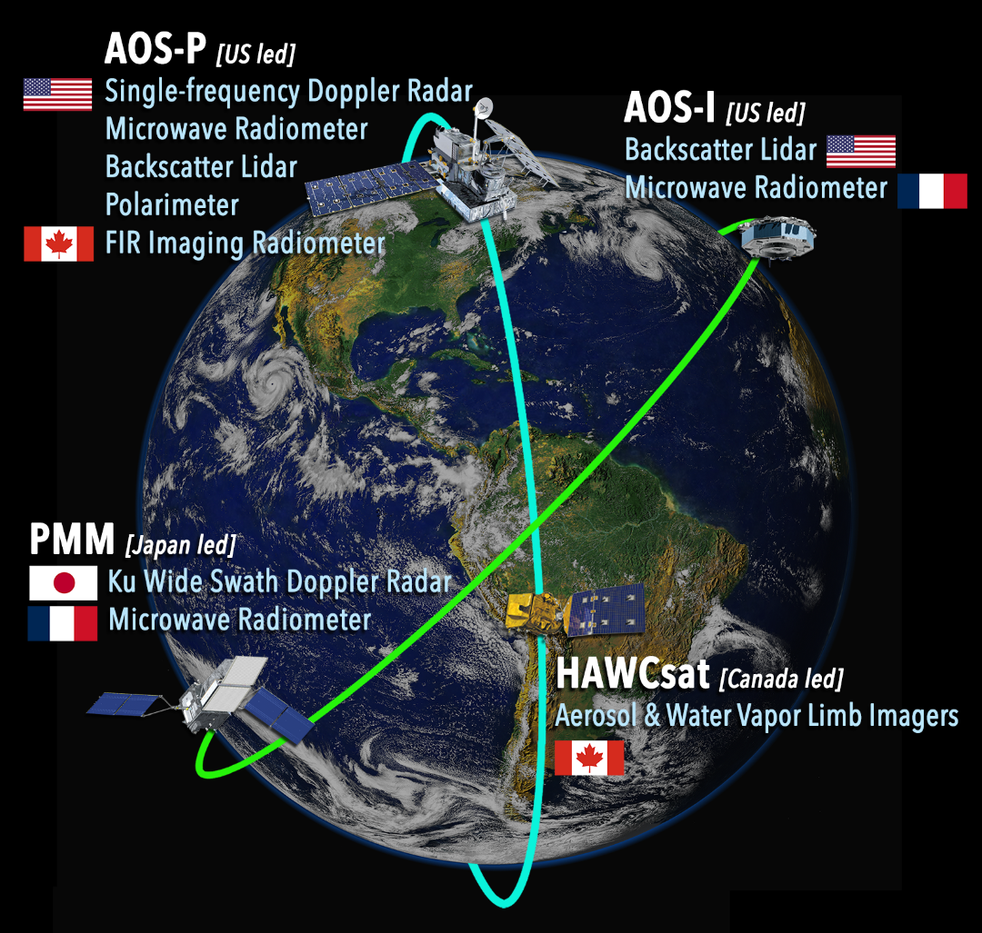

AOS Architectures after Independent Review Board (IRB) assessment + HQ phase A guidance
MCR: Mission Concept Review, May 2022
Key trade studies in Phase A
(HAWCSat)
May 2022
MCR
Jan 2023
KDP-A
See: https://www.nasa.gov/sites/default/files/atoms/files/eso_irb_documents.pdf

Slide 6
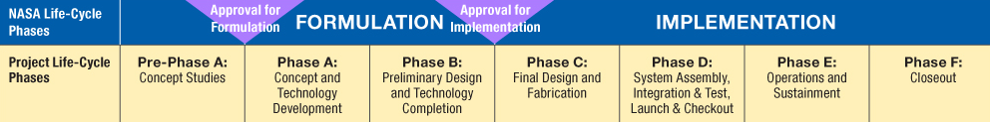
Elements of potential interest to OBB
UV-SWIR multi-angle polarimeter: simultaneous retrieval of atmospheric column aerosol and ocean optical properties from polar orbit
Backscatter lidar(s): the project is considering several options, which may (or may not) be capable of in-water profiles
Other instruments: primarily addressing observations of clouds and precipitation
Inclined launch early 2029
Polar launch late 2031
We are here

Slide 7
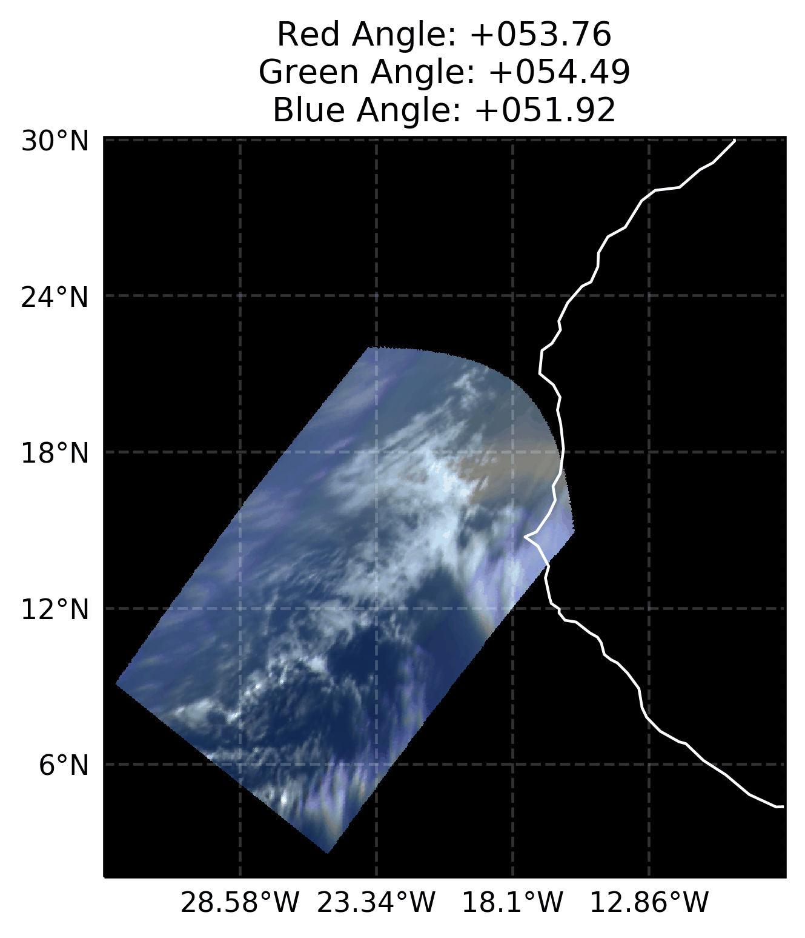

UV-VIS multi-angle polarimeter
HARP Cubesat RGB imagery, West Africa with Saharan dust, glint, clouds 2020 / 06 / 13
AOS to procure for AOS-P
Passive radiometer with measurement characteristics
multi-spectral (UV-VIS-NIR-SWIR)
multi-angle (10-60 views per pixel)
accurate polarization sensitivity
500m (baseline) nadir spatial resolution, 300km swath
Animation through multi-angle views
Addresses climate, weather and air quality objectives with measurements of cloud and aerosol properties
Ocean optical properties retrieved as a byproduct
Typically retrieve 12-15 parameters describing aerosol properties, ocean surface wind speed, in-water properties like Chl-a and a_{ph}, a_{dg}, b_{bp} B_{p} in coastal areas
PACE will be the polarimeter pathfinder for AOS
Algorithms:
GRASP: 10.5194/essd-12-3573-2020
MAPP: 10.1364/AO.57.002394
RemoTAP: 10.5194/amt-2019-287
fastMAPOL: 10.5194/amt-2020-507
Not shown are hyperangle and polarimetric data. The AOS polarimeter would have UV, SWIR and better spatial resolution. From: https://esi.umbc.edu/hyper-angular-rainbow-polarimeter/

Slide 8
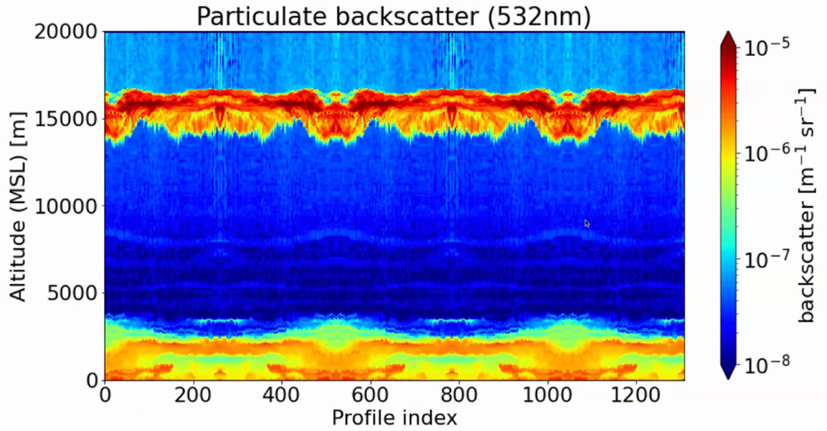
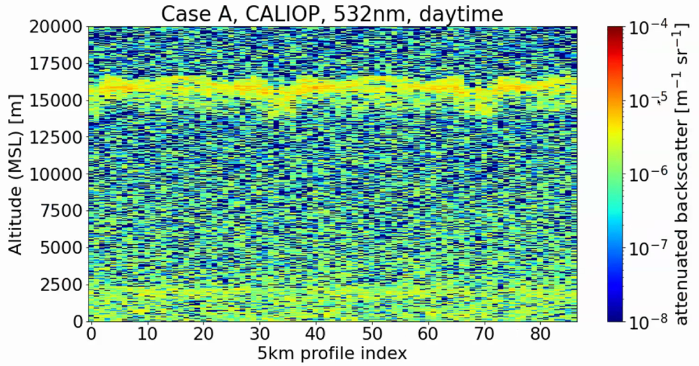
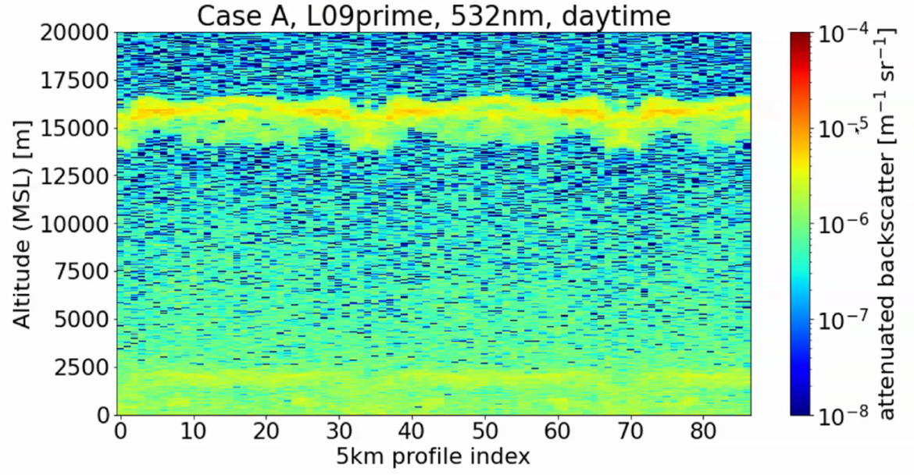
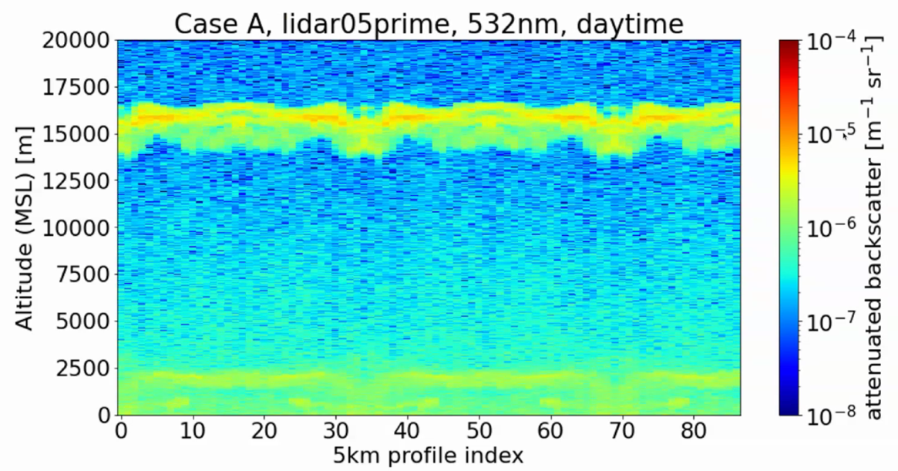
Lidar provides profiles + day/night observations
Lidar characteristics for AOS-P and AOS-I TBD
CALIPSO Simulation
Simulated daytime conditions
Suborbital data
Cirrus Clouds
Aerosol Layer
Backscatter Lidar Simulation
HSRL Simulation
Simulations produced by ACCP Lidar Working Group
Notes:
Might need to say something about the HSRL case, that while we won’t have the HSRL, this case likely represents the very high end of what might be achievable with a backscatter lidar. Our target performance for the polar lidar is daytime SNR equivalent to CALIPSO nighttime SNR. Minimum and target vertical resolution are 30 and 10 m, respectively.

Slide 9
Lidar ocean profiling capability
Limitations will depend on selected designs
Neukermans, G., et al, Harnessing remote sensing to address critical science questions on ocean-atmosphere interactions, Elementa: Science of the Anthropocene, 6 , https://doi.org/10.1525/elementa.331, 2018.
See also:
Behrenfeld, et al, 2013, doi:10.1002/grl.50816
Jamet, C., et al., 2019, doi: 10.3389/fmars.2019.00251

Slide 10
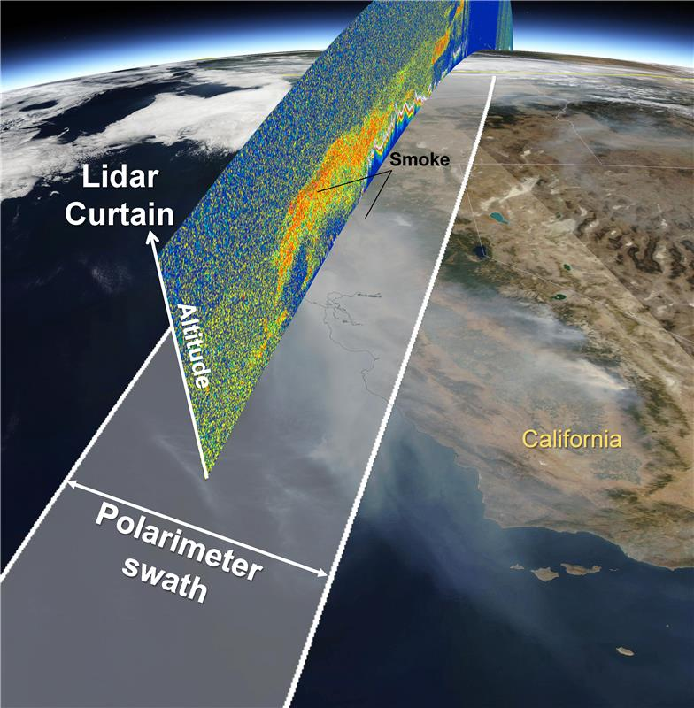
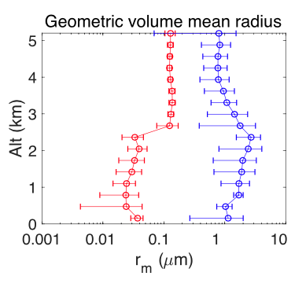

AOS polarimeter + lidar synergy
Synergistic polarimeter and lidar algorithms under development
Example of one of several
retrieved parameters in F. Xu et al.
doi: 10.3389/frsen.2021.620871
multiangle, polarimetric UV-VIS-NIR observations
With Lidar synergy
Aerosol optical depth (GV12)
Aerosol absorption optical depth (GV13)
Aerosol fine mode effective radius (GV14)
+other aerosol microphysical properties
Vertically resolved micro-physical properties
+ horizontal context

Slide 11
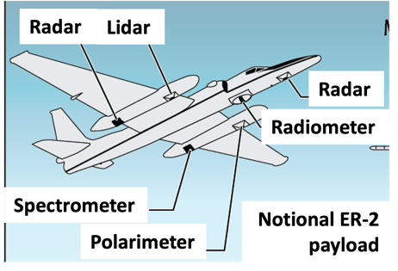
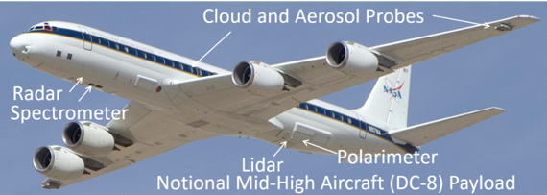
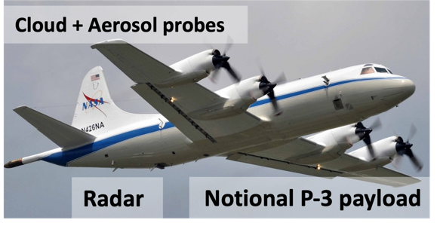
AOS Suborbital Element:
Airborne Campaign Concepts
Low Clouds: Microphysics, precipitation initiation
Convection/High Clouds: Microphysics and dynamics, anvil cirrus lifecycle.
Aerosol-Cloud-Radiation Interactions: Vertically resolved aerosol-cloud-radiation interaction processes and lifecycle.
Payloads depicted are notional… instruments to be prioritized / deconflicted for each campaign
Large airborne campaigns
Mid-latitude continental, 2029 or 2030
Oceanic, 2032-2033
Campaigns after launch to enable calibration - validation
Notes:
AOS will implement a multi-year suborbital program that focuses on three core themes: low clouds, convection and associated high clouds, and aerosols and aerosol-cloud-radiation interactions. Campaigns are expected to begin after launch of the inclined and polar projects. While the implementation details are still to be defined, notional examples of aircraft and instrument suites are shown here and include high flying aircraft capable of serving as satellite simulators and lower flying aircraft capable of both remote sensing and in-situ sampling of aerosol and cloud and precipitation microphysics.

Slide 12

Summary
AOS is a phase-A (concept and technology development) effort to launch multiple spacecraft and instruments into LEO in 2029-31
AOS science objectives cover the role that aerosols, cloud, convection and precipitation play in climate, weather, and applications
OBB relevant measurements will also be made by AOS, most likely from the lidar and polarimeter
https://aos.gsfc.nasa.gov/

Slide 13
Extra slides…

Slide 14

Decadal Survey Recommendations
The 2017 Decadal Survey recommended a new program element called Designated Observables with cost-caped missions to provide measurements essential to a comprehensive collection of Earth Science questions.
AOS combines 2 Designated Observables
Aerosols
Aerosol properties, aerosol vertical profiles, and cloud properties to understand their effects on climate and air quality
Backscatter lidar and multi-channel, multi-angle imaging polarimeter
Clouds, Convection, and Precipitation
Coupled cloud-precipitation state and dynamics for monitoring global hydrological cycle and understanding contributing processes including cloud feedback
Radar(s), with Doppler, with multi-frequency passive microwave and sub-mm radiometer
Observable Priorities
Desired Observables

Slide 15
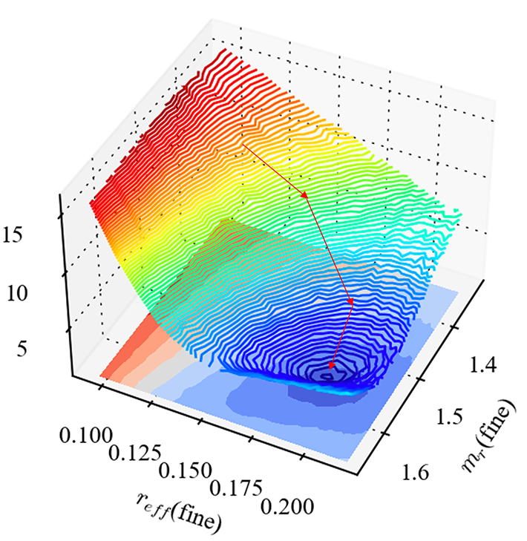
UV-VIS multi-angle polarimeter
Simultaneous retrieval of multiple parameters
Algorithms:
GRASP: 10.5194/essd-12-3573-2020
MAPP: 10.1364/AO.57.002394
RemoTAP: 10.5194/amt-2019-287
fastMAPOL: 10.5194/amt-2020-507
Radiative transfer simulations are iteratively adjusted until the simulation - measurement ‘cost function’ is minimized
Cost function
(Simulation – measurement)
Typically retrieve 12-15 describing aerosol optical properties, ocean surface wind speed, in-water optical properties like Chl-a and a_{ph}, a_{dg}, b_{bp} B_{p} in coastal areas
The PACE polarimeters will benefit AOS polarimeter maturity by furthering algorithm development

Slide 16
UV-SWIR multi-angle polarimeter
Instrument to be procured - requirements described below could change
Summary of instrument characteristics:
Spatial resolution of 500m at nadir, cross track swath of 300km
Total uncertainty: radiometric < 3%, Degree of Linear Polarization (DoLP) < 0.005
Multiple retrieval categories
Aerosol: multiangle, polarimetric UV-VIS-NIR observations to determine aerosol optical depth and aerosol microphysical properties.
Science driver | Wavelength range | # of bands | # of viewing angles per pixel
Aerosol | UV: 360 – 390 nm | 1 | 10
Aerosol, bi-spectral cloud | VIS-NIR: 410 – 750 nm | 2 | 10
Cloudbow cloud retrieval | Hyperangle: 670 – 870 nm | 1 | 60
Water vapor measurement | NIR: 900 – 960nm | 1 | 10
SWIR cirrus cloud detection | SWIR: 1350 – 1400nm | 1 | 10
Aerosol, bi-spectral cloud | VNIR-SWIR:870 – 1570 nm | 3 | 10
HARP2 is a coarser resolution version of this
+ ocean optical property byproducts
Bi-spectral Cloud: pairs of NIR/SWIR channels to determine cloud optical depth and droplet effective radius
Multi-angle, polarimetric measurements for all channels
Cloudbow Cloud: hyperangle polarimetric VIS/NIR observations to determine cloud optical depth and droplet effective radius and variance.
Water vapor channel to characterize water vapor profile applied to correct water vapor response in other channels
Cirrus cloud detection channel in strong water absorption feature to detect thin cirrus clouds that impact other retrievals

Slide 17
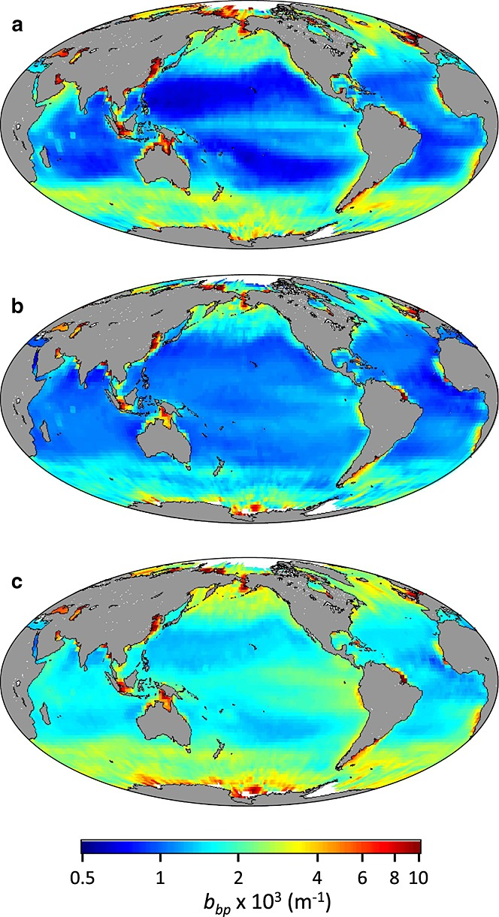
Lidar can have ocean profiling capability
Limitations will depend on selected designs
Global distributions of surface particulate backscattering coefficients (bbp). (a) CALIOP‐based bbp. (b) MODIS‐based bbp from the GSM algorithm. (c) MODIS‐based bbp from the QAA algorithm. Data in each panel are climatological annual averages for the 2006–2012 period. All data have been standardized to 2° latitude × 2° longitude pixels.
Behrenfeld, M. J., Hu, Y., Hostetler, C. A., Dall'Olmo, G., Rodier, S. D., Hair, J. W., and Trepte, C. R.: Space-based lidar measurements of global ocean carbon stocks, Geophys. Res. Lett., 40(16), 4355--4360 , 2013. doi:10.1002/grl.50816
Notes:
Here we show simulated capabilities of the backscatter lidar in the inclined orbit and the HSRL lidar in the polar orbit compared to simulated CALIPSO data in daytime conditions. Ground-based lidar data is used to generate the simulated fields and contains both a cirrus layer and low-level aerosol layer. One can see that the backscatter lidar provides significantly enhanced signal to noise compared to CALIPSO and the HSRL lidar provides even further improvement. The HSRL lidar will also provide measurements of aerosol backscatter and extinction to better characterize particle properties.

