Slide 1
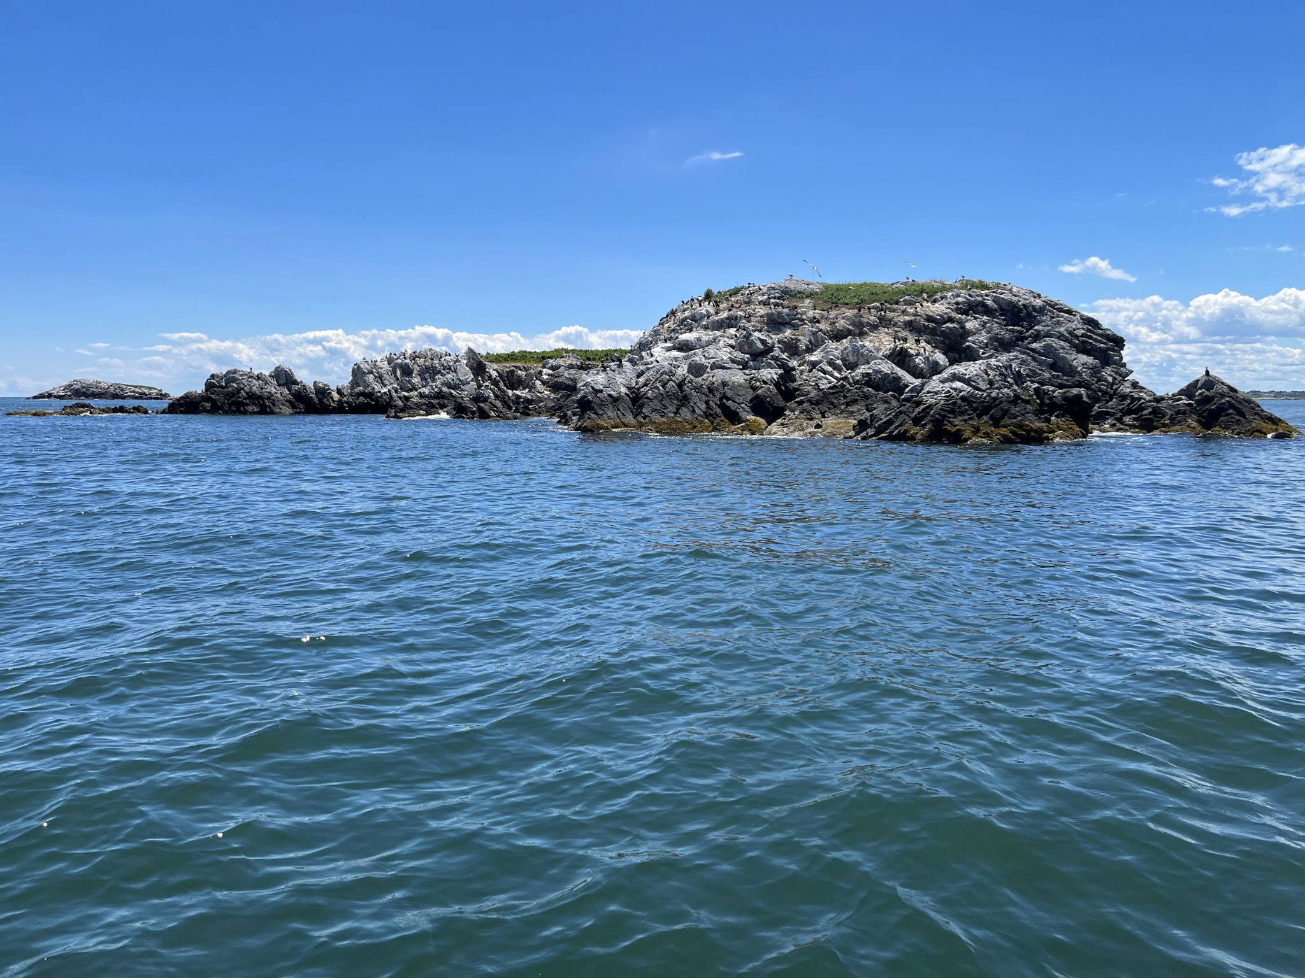


Building and Evaluating Pipelines to Identify Submerged Kelps in New England from Remote Sensing Imagery
Jarrett Byrnes¹, Meredith McPherson¹, Alexis Wilkes¹, Pedro Guy¹, Mark Borrelli¹, Tom Bell⁴, Rodrigo Garcia^{1,2}, Nima Pahlevan^{1,2,3}, Crystal Schaaf¹, Robert Chen¹, Arthur Elmes¹
1 - University of Massachusetts Boston, 2 - NASA, 3 - Science Systems and Applications Inc., 4 - Woods Hole Oceanographic Institute

Slide 2
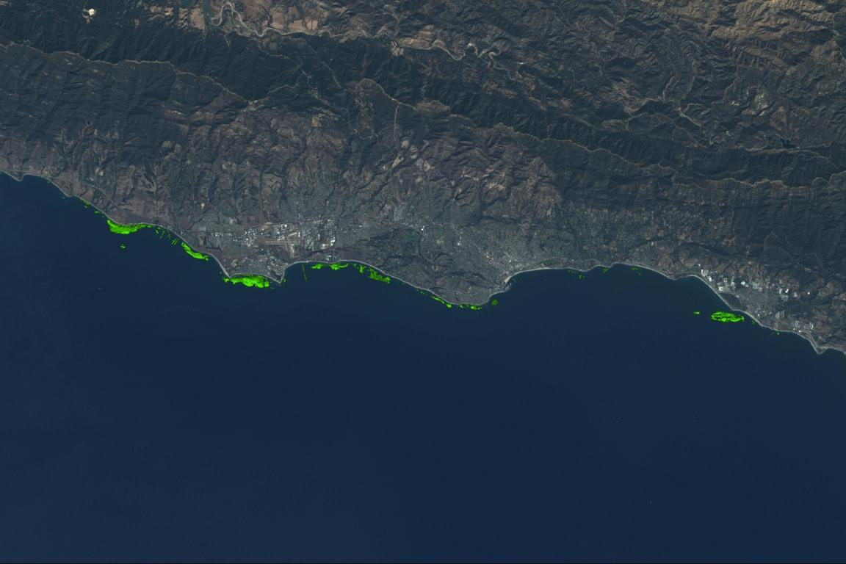
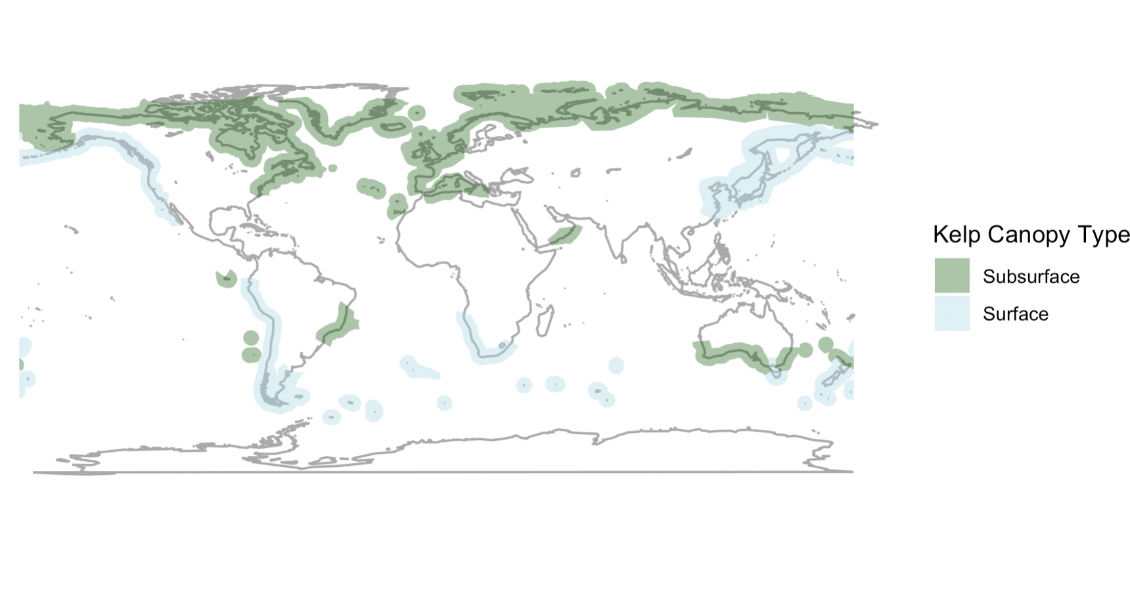
We’ve Begun Surveying Timeseries of Coastal Kelps with Landsat, but…
UCSB
Santa Barbara, CA
Most kelps around the world do not come to the surface
Cavanaugh et al. 2011, Bell et al. 2015

Slide 3
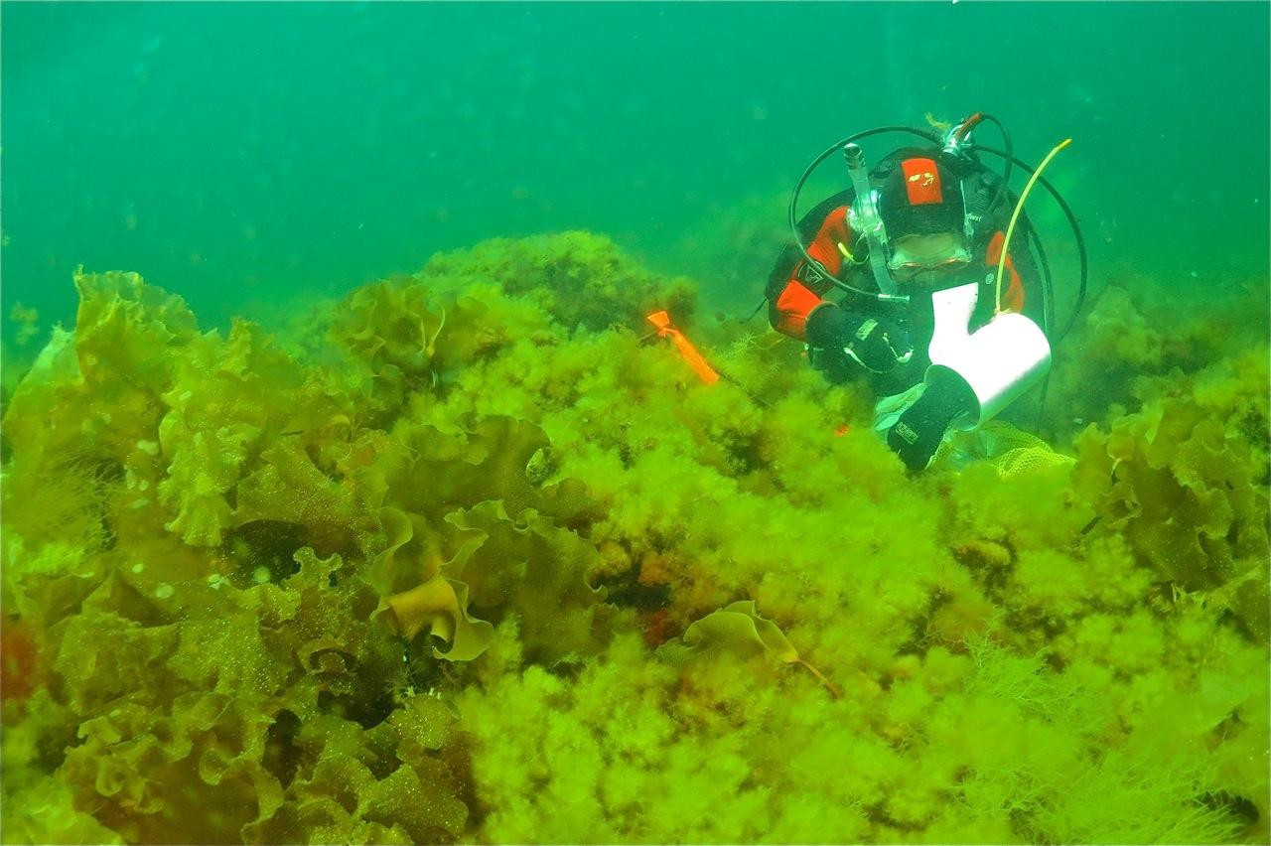

Slide 4
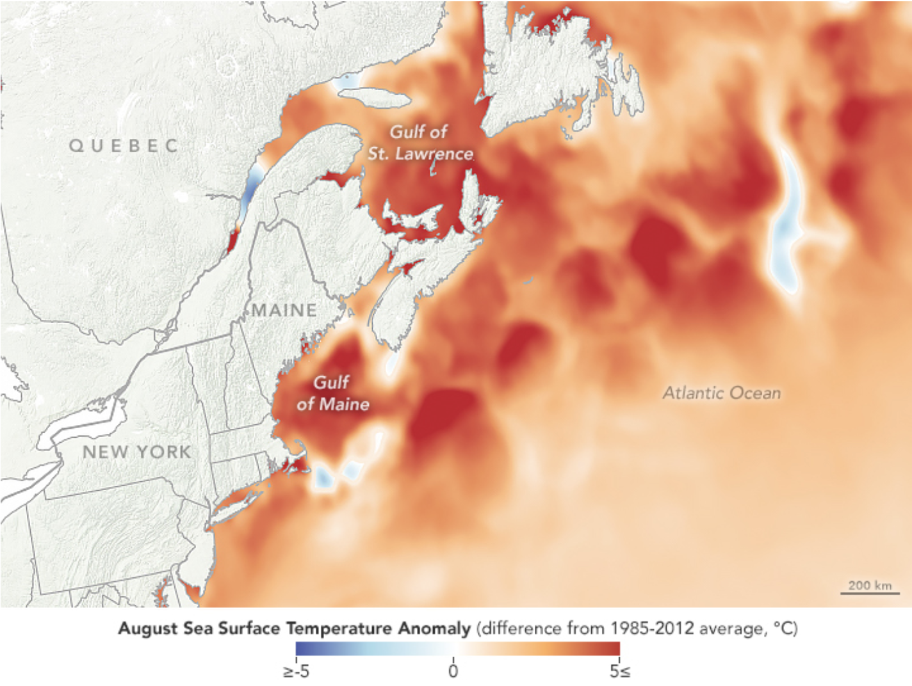
We Focus on the Gulf of Maine as it is one of fastest warming regions on the planet
Notes:
Why tackle this problem?

Slide 5
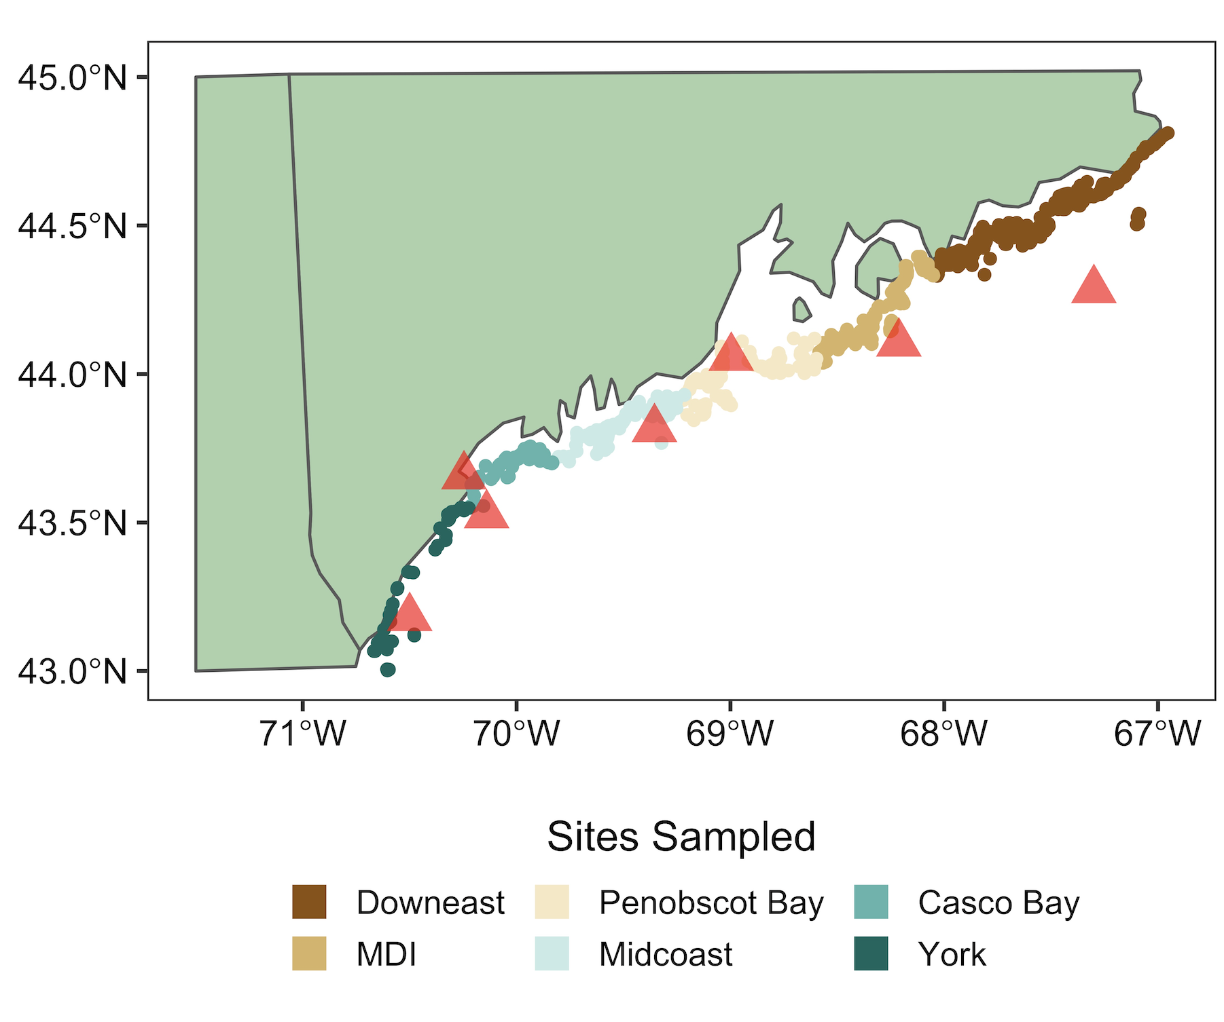
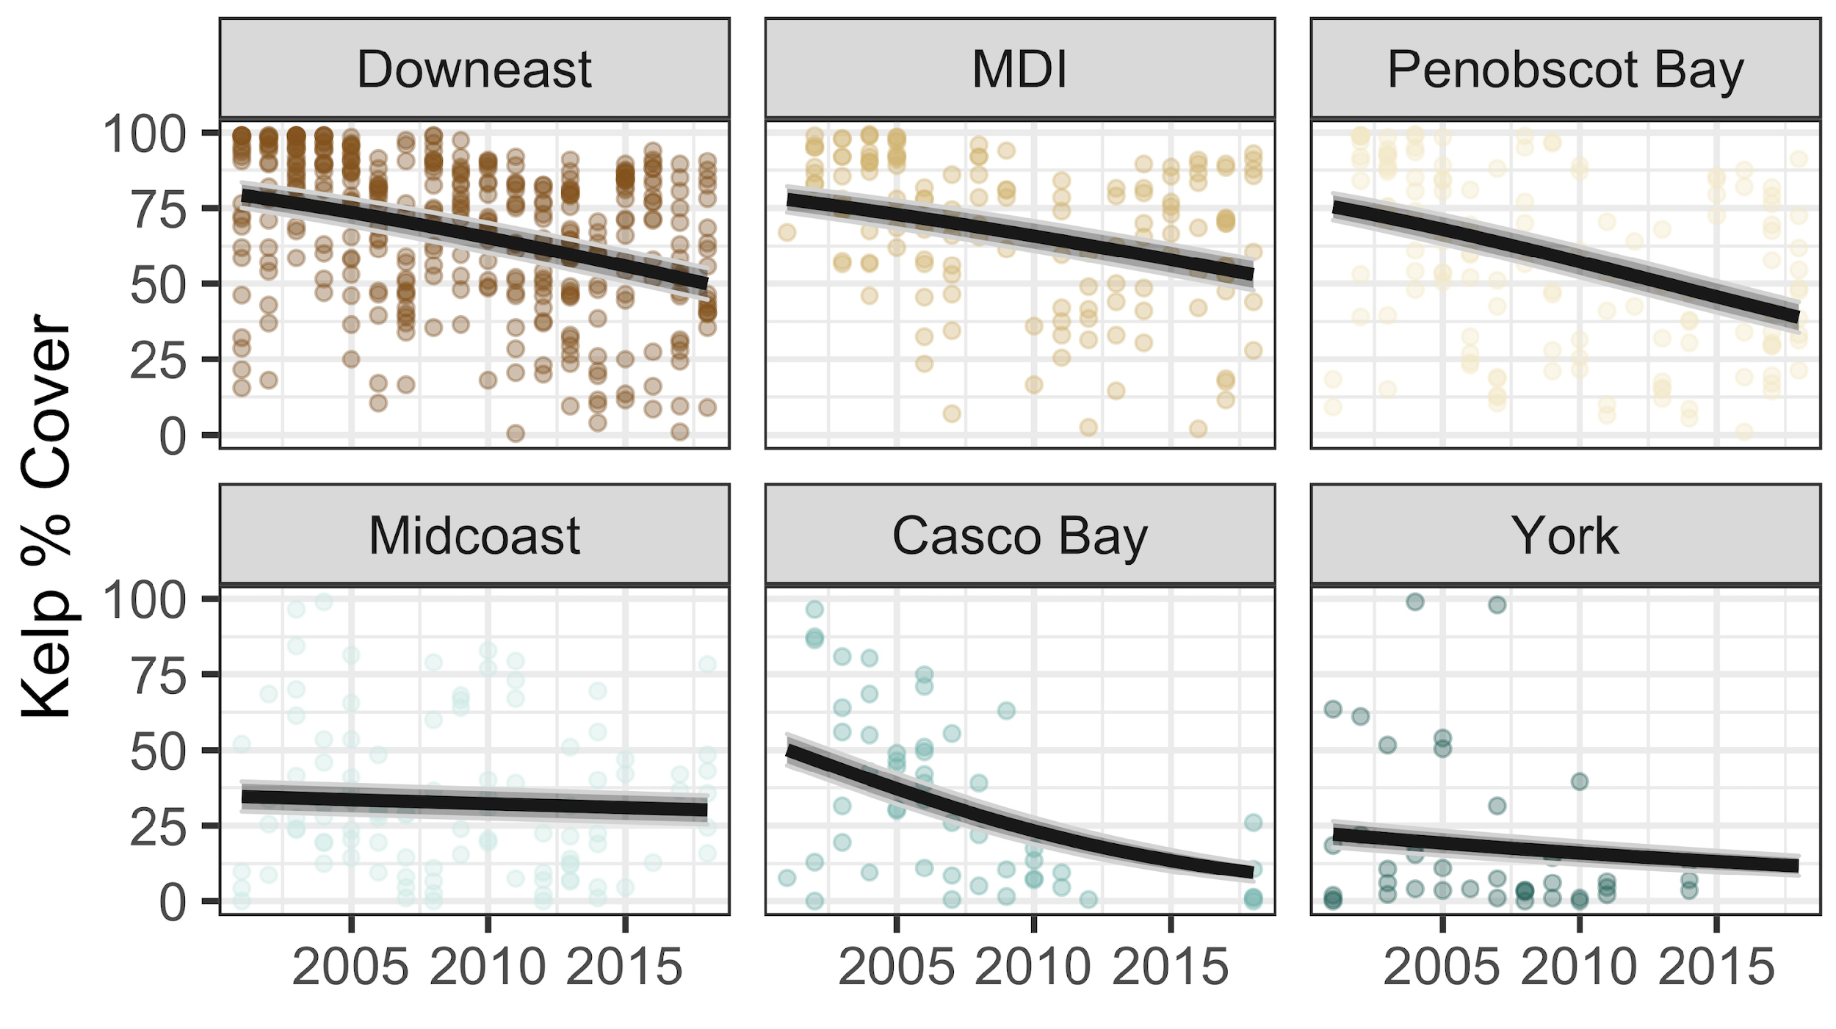
Gulf of Maine Kelps are Currently Declining Due to Warming
Suskewicz, Byrnes, Steneck, and Rasher In Prep.
Notes:
Why tackle this problem?

Slide 6
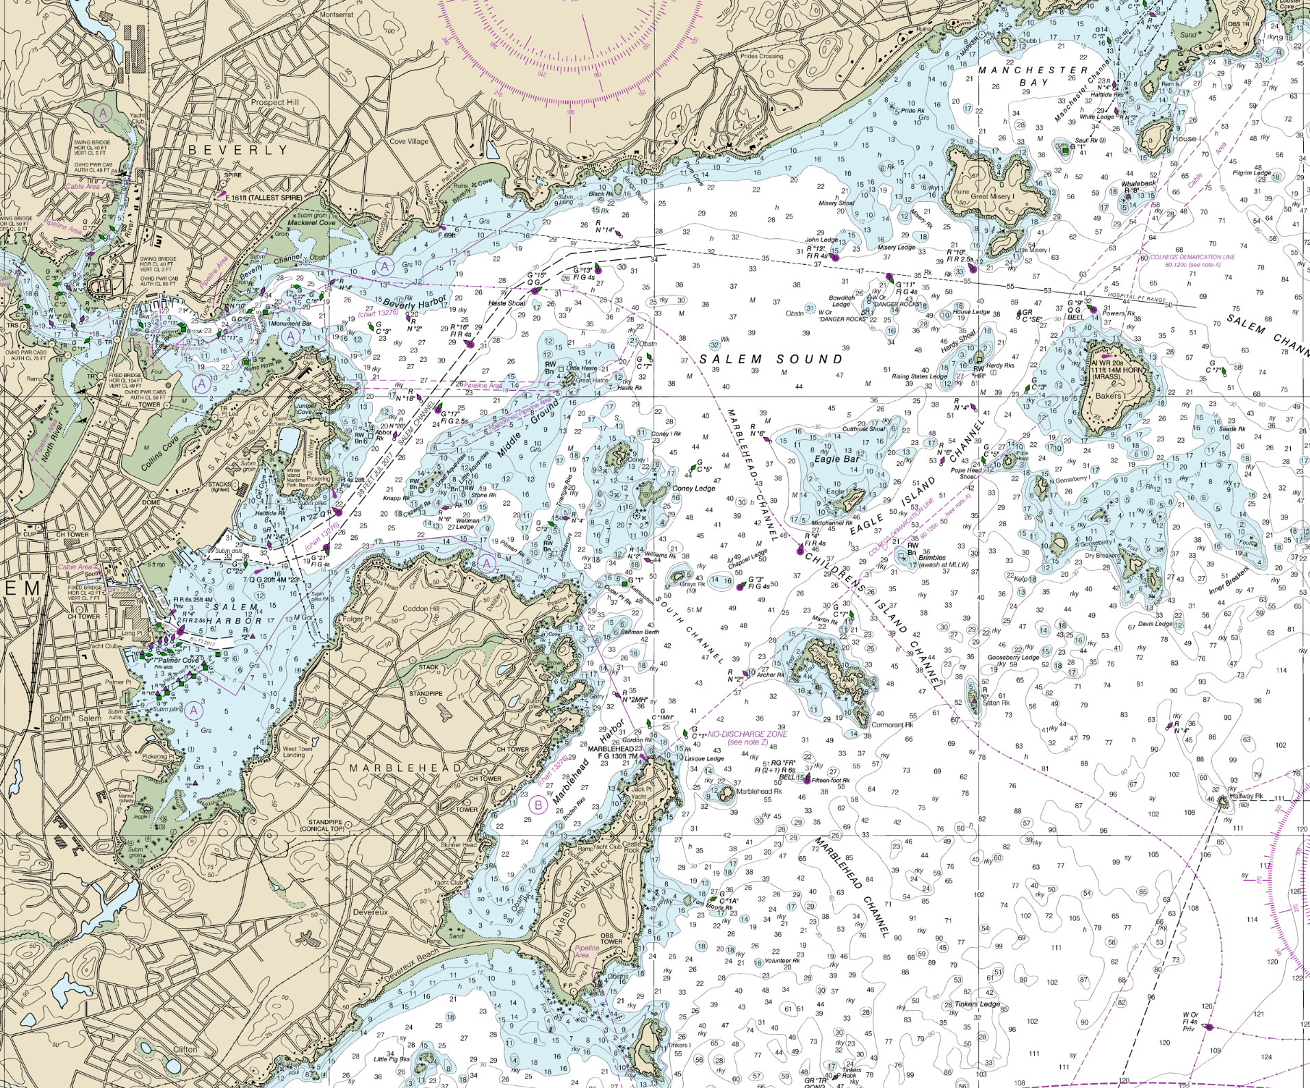
Salem Sound: Target Sites based on shallow shelf bathymetry depth < 5 m
Ram Island
Children’s Island
GooseberryIslands and Dry Breakers
Castle Rock
Notes:
Map of salem sound. Different boxes for different measurements

Slide 7
Our Pipeline Towards Kelp Detection and Mapping
Drop Camera Surveys
Scale Up
Sidescan Sonar
Scale Up
Hyperspectral Drone Overflight
Scale Up
PRISMA or Other Hyperspectral Satellite

Slide 8
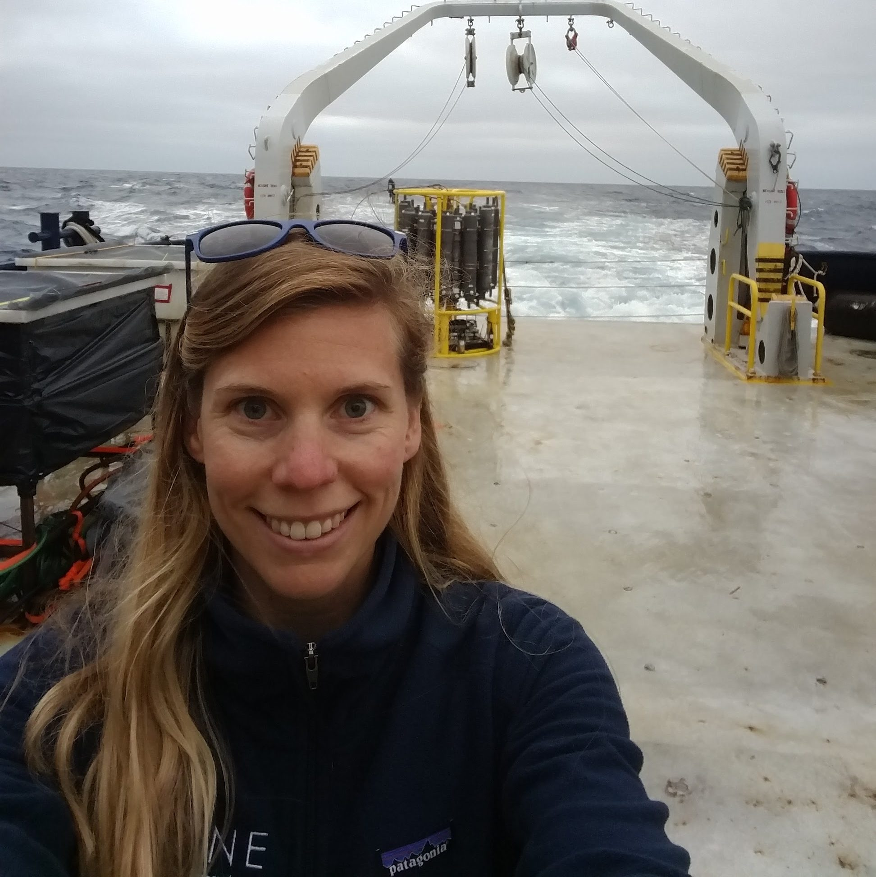
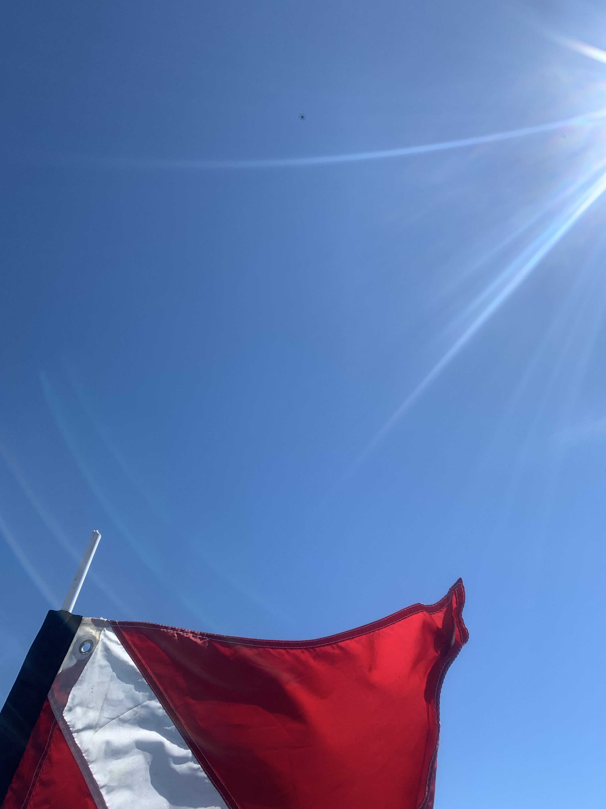
Building the Kelp Mapping Pipeline
Data Streams:
Satellite: 3 PRISMA overpasses in summer 2022
Drone Mapping: 5 Hyperspectral flights
Sidescan Sonar: 3 Sidescan large-scale surveys
Visual Observation: 142 Drop Camera Tracks
Cross-Calibration: 156 in situ algal reflectance measurements
Diver Validation: 6 kelp biomass surveys
Modeling
Physics-Based techniques
Machine Learning Approaches
Dr. Meredith McPherson

Slide 9
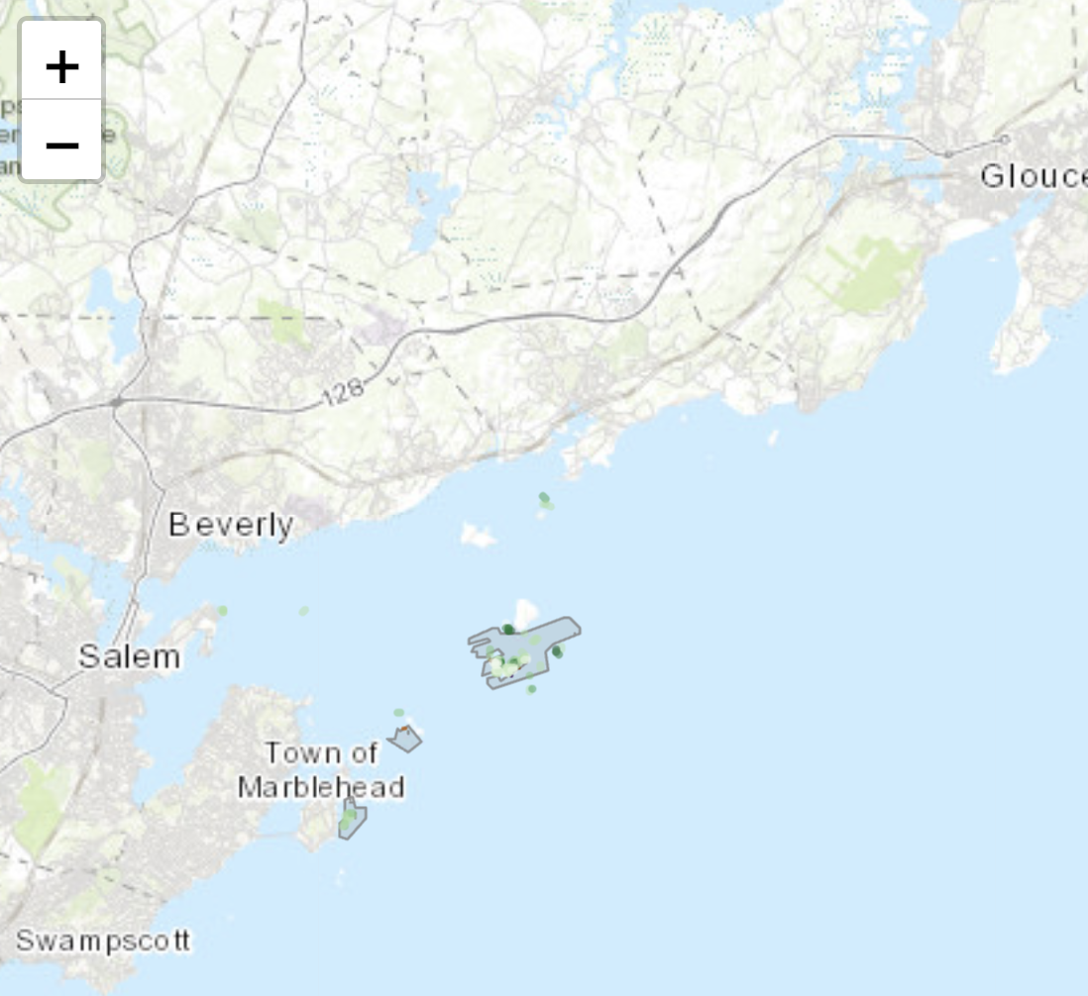
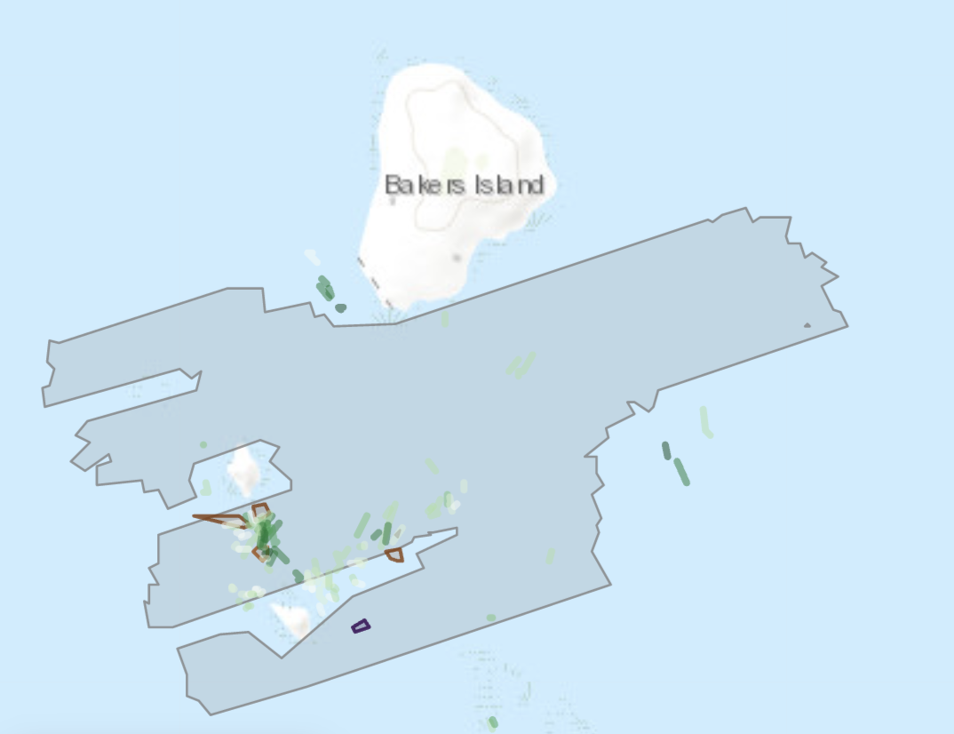
Sidescan Area
Dropcam Tracks
Diver Surveys
https://shiny.umb.edu/shiny/users/jarrett.byrnes/murep_dropcam/

Slide 10
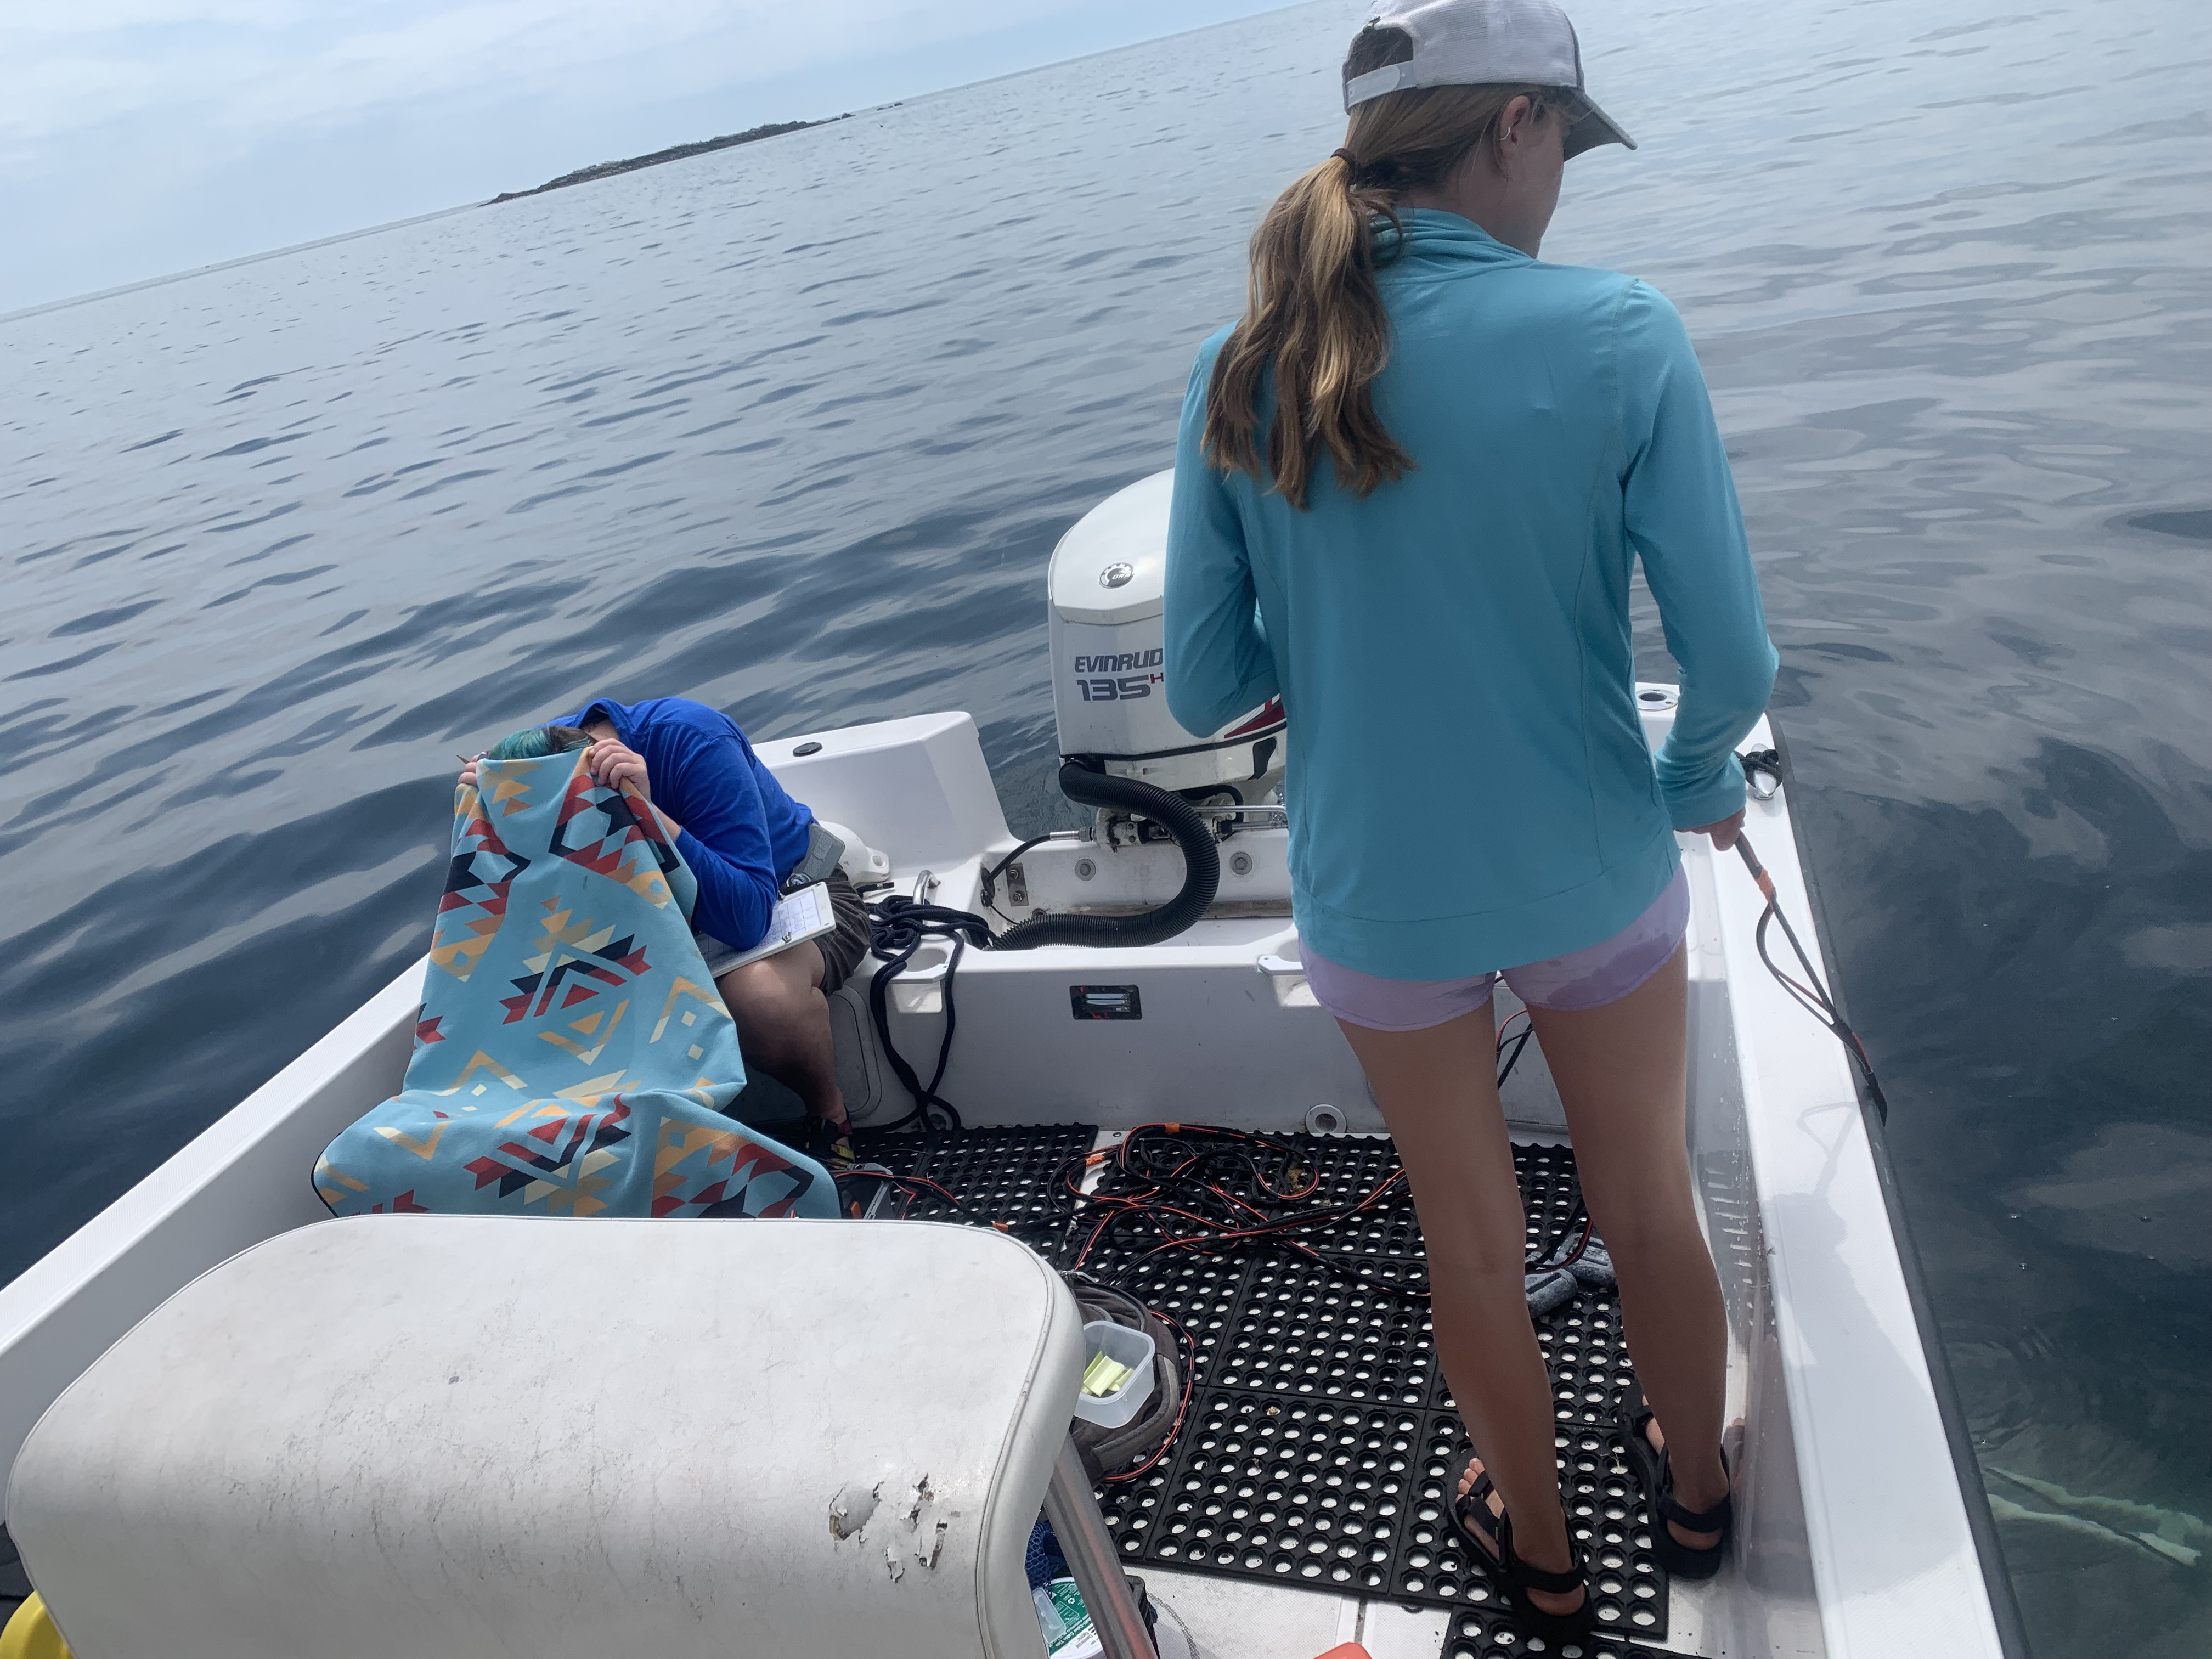
Drop Camera Measurements to Establish a Baseline
Continuously recording GoPro Camera on weighted frame
142 tracks taken around Salem Sound
Focus on depths < 5m MLW
Imagery of algal beds, sand beds, kelp forests, and more

Slide 11
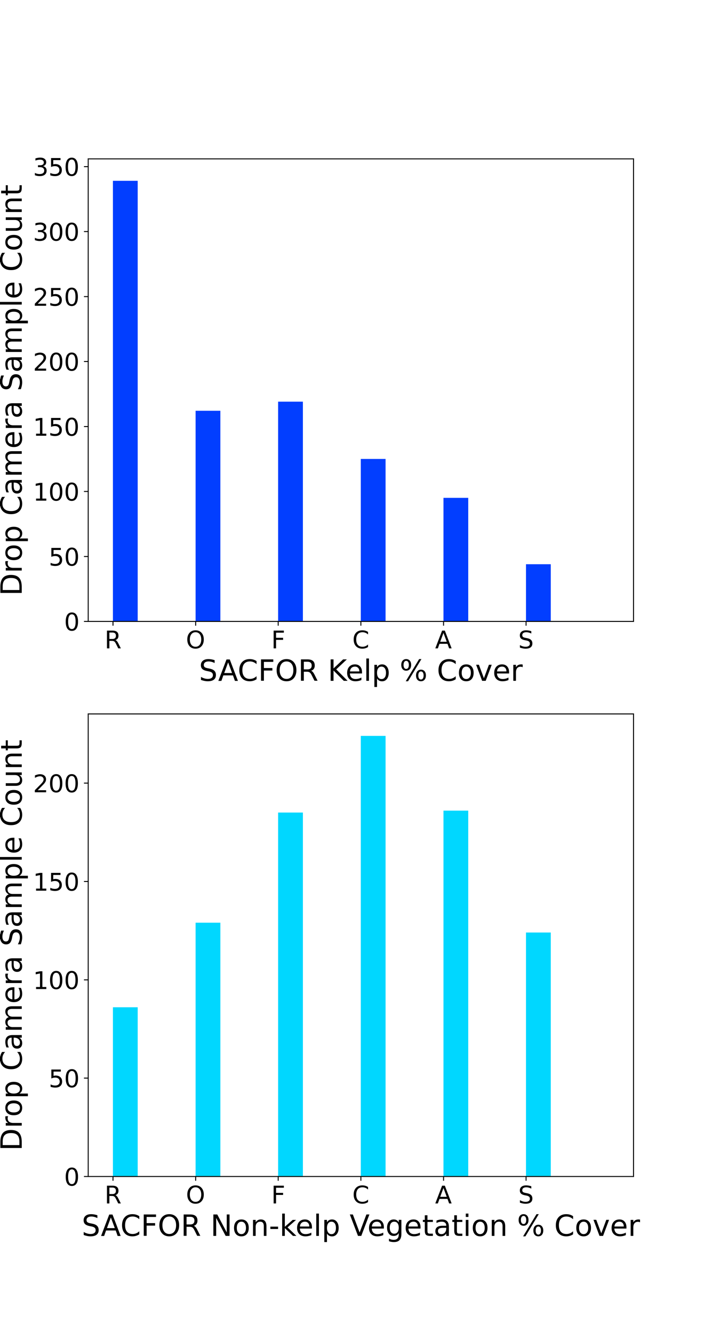
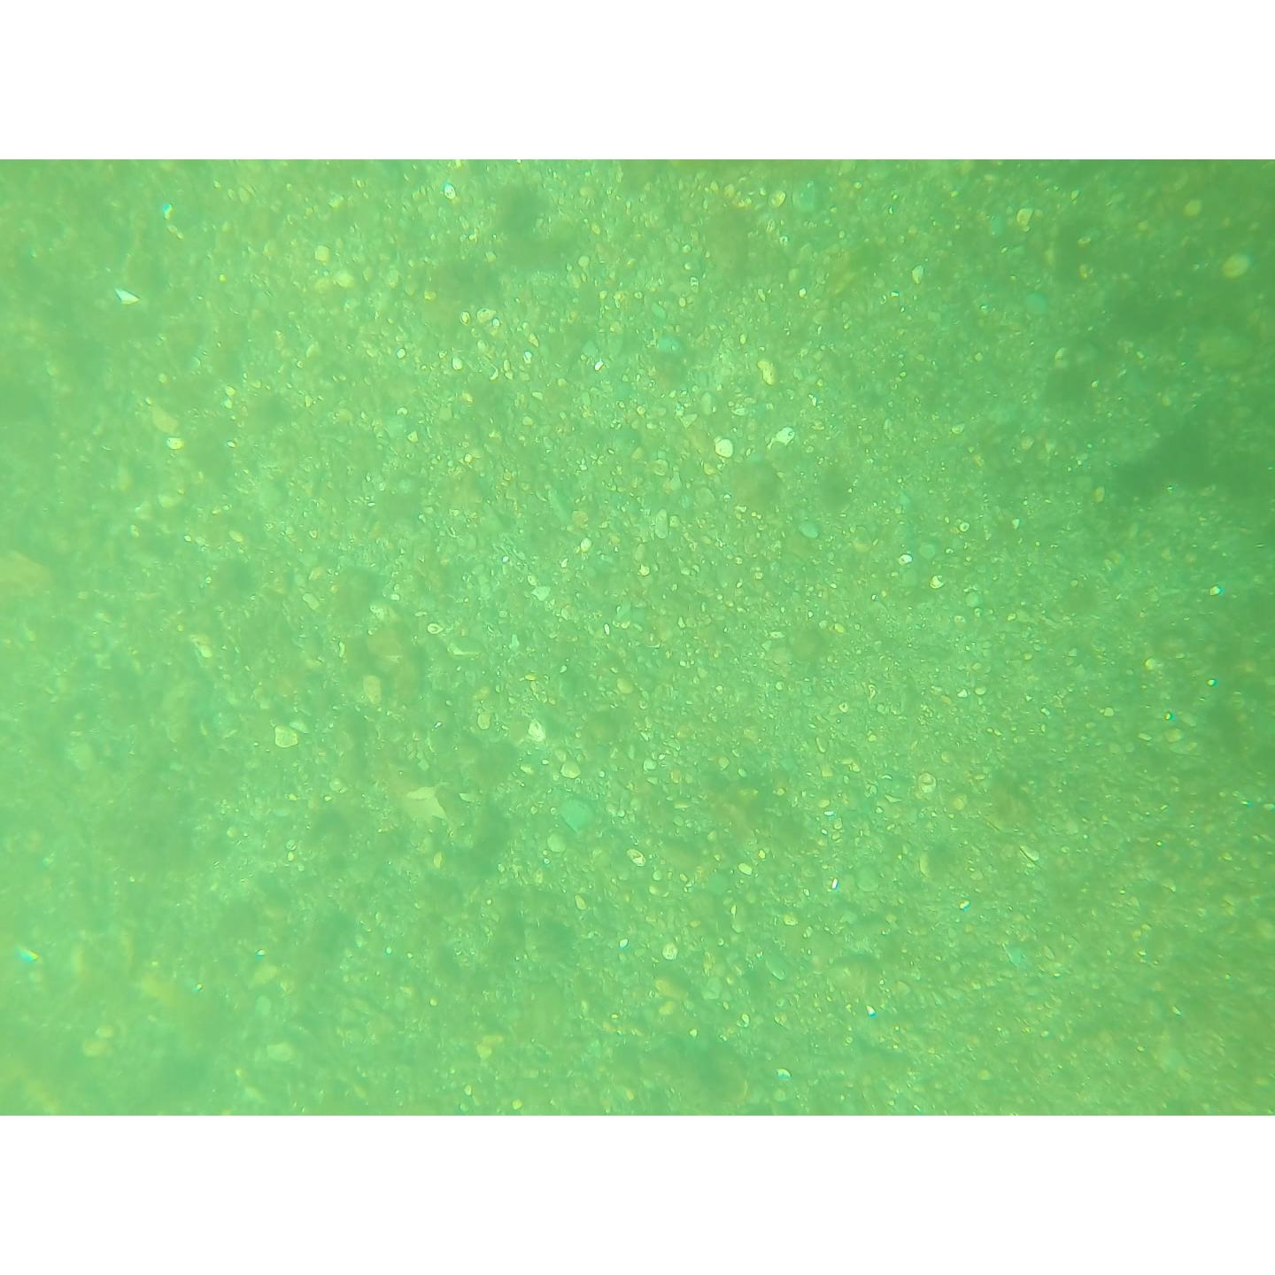
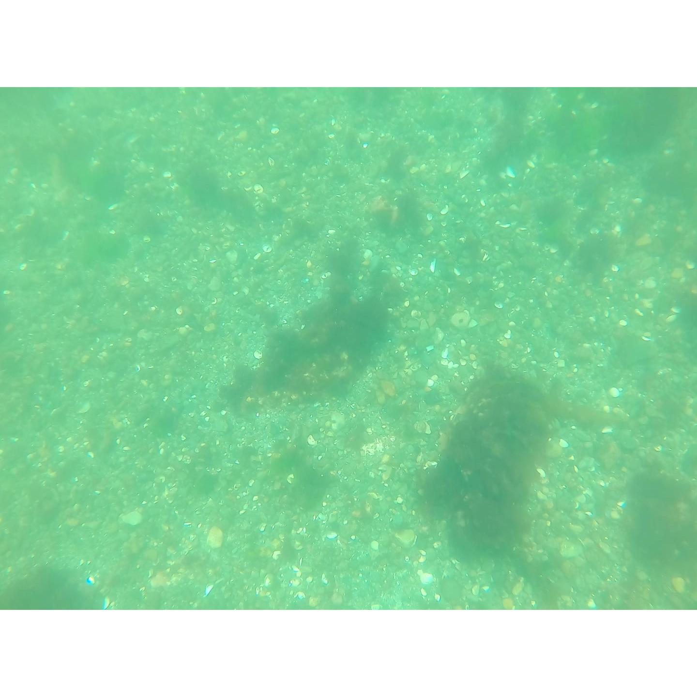
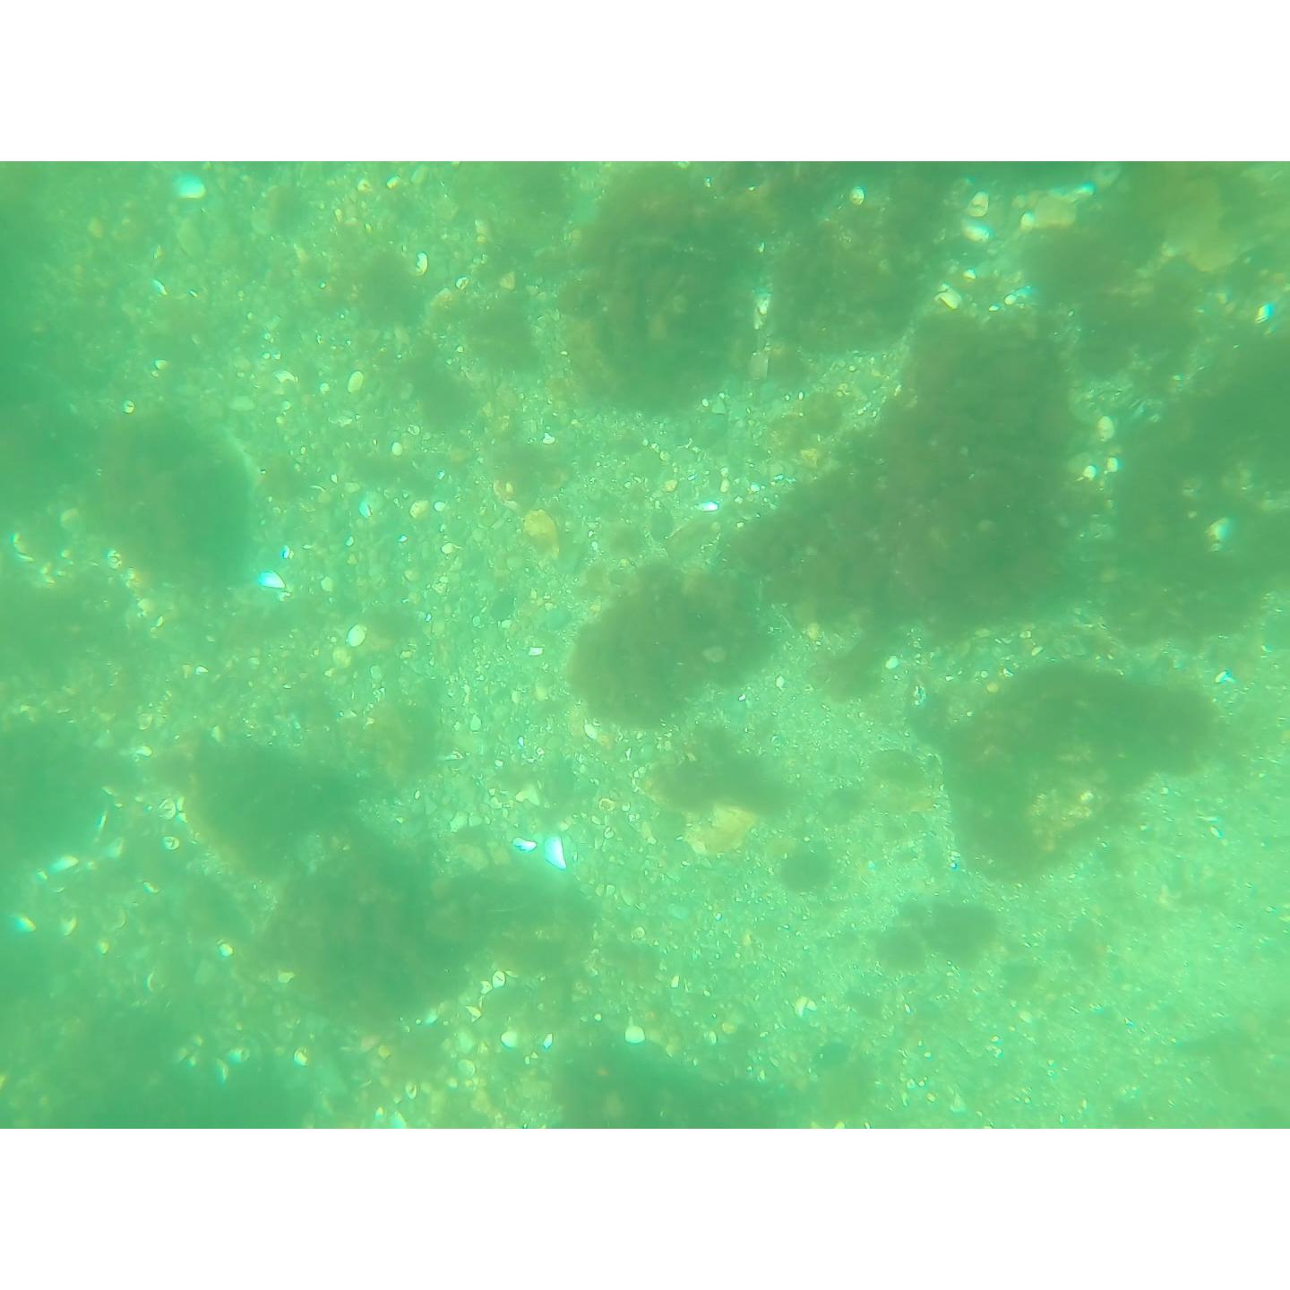
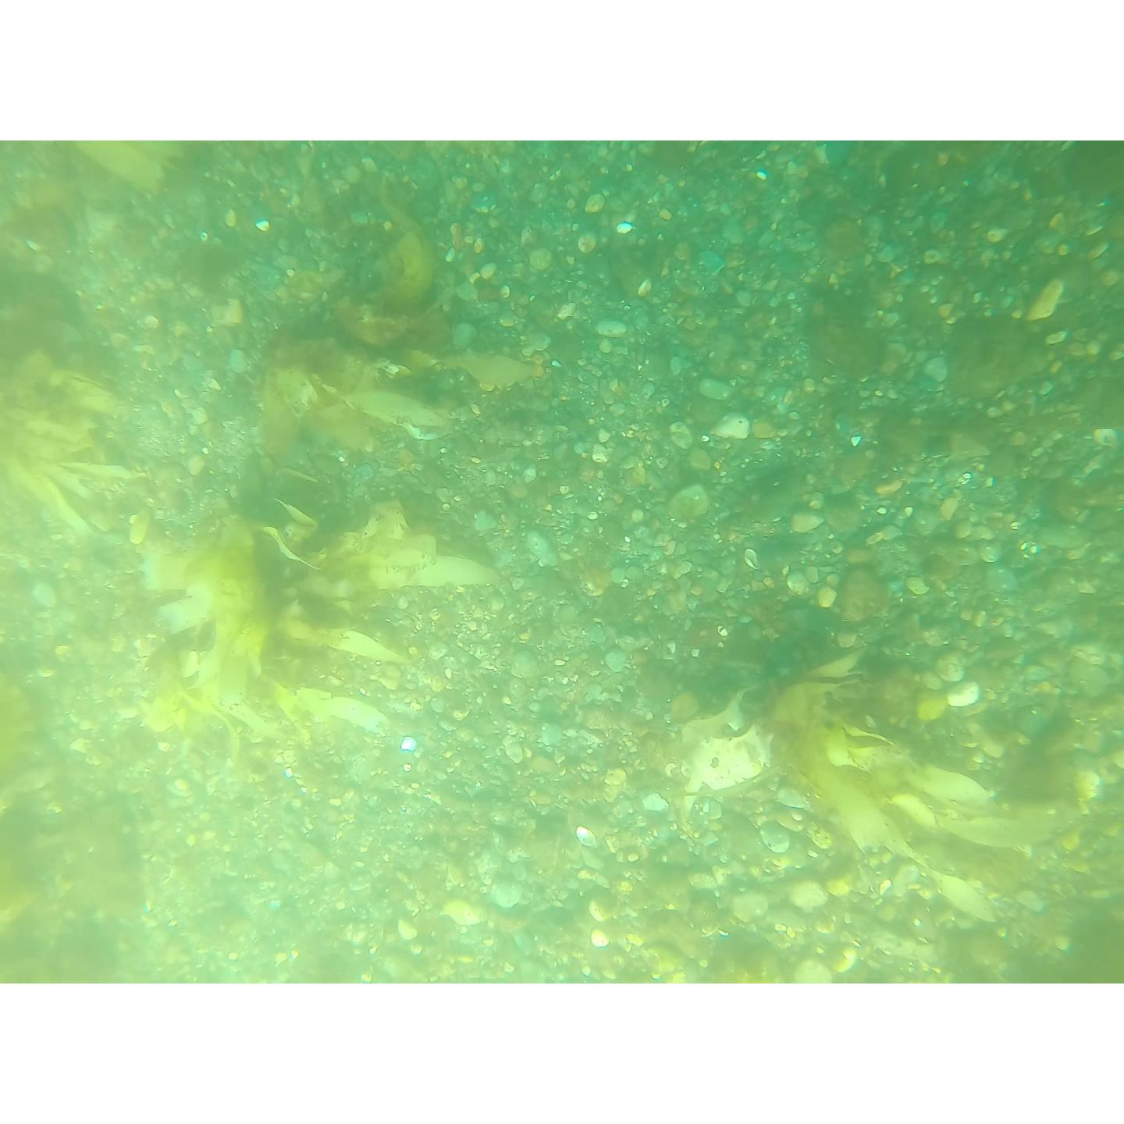
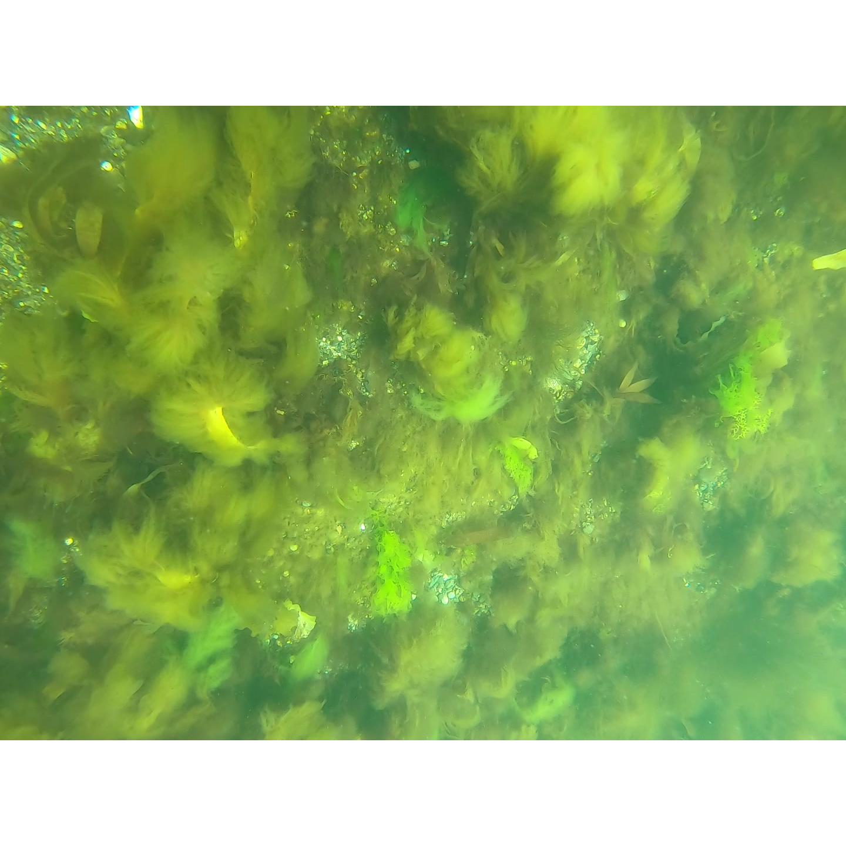
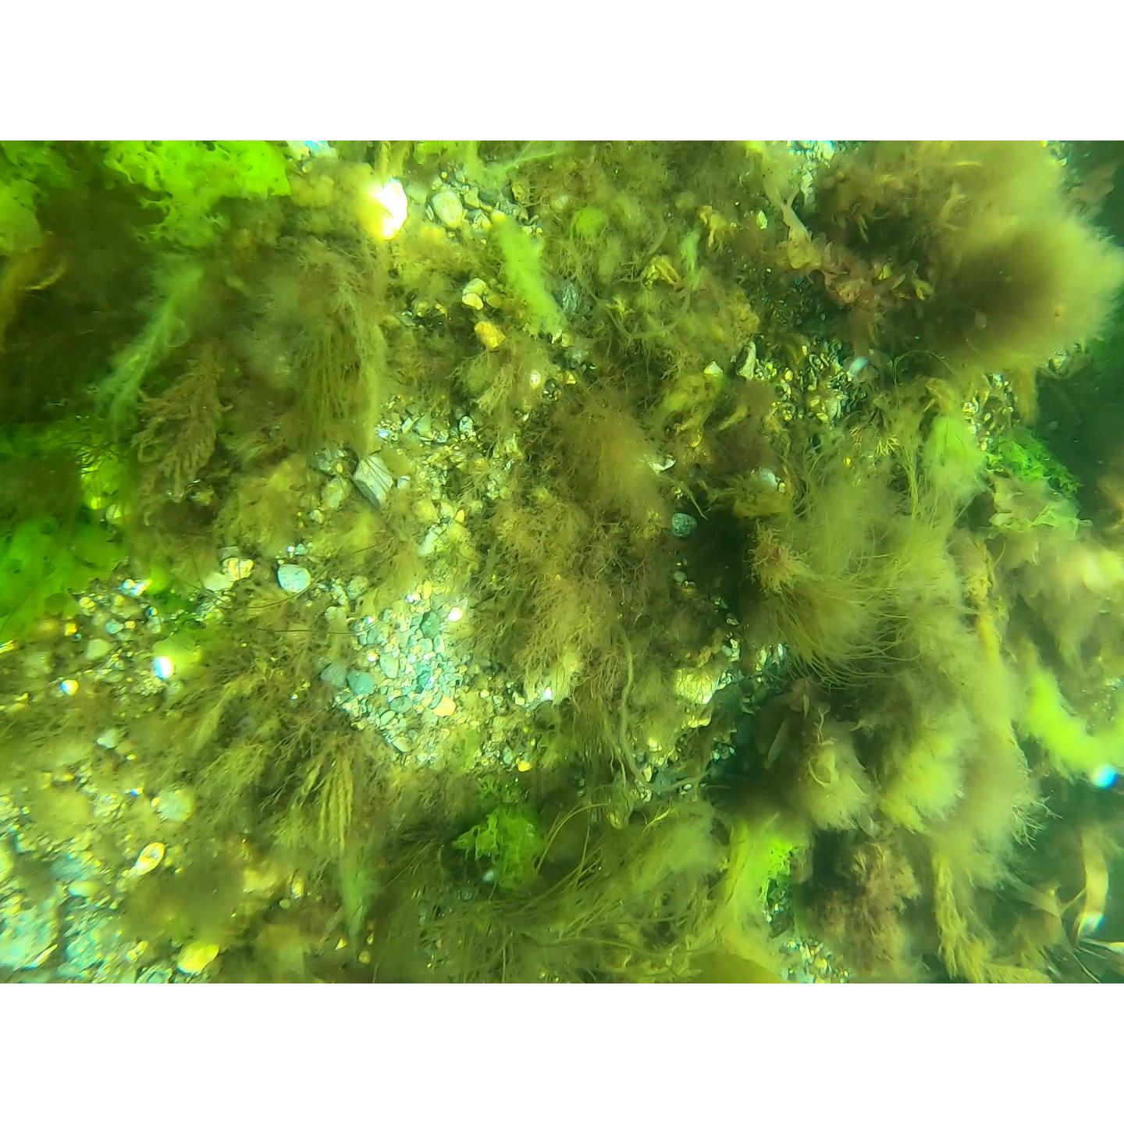
SACFOR Scale for Quick Analysis and Calibration of Pipeline
Rare
1 - 5%
Occasional
5 - 9%
Frequent
10 - 19%
Common
20 - 39%
Abundant
40 - 79%
Super-
abundant
>80%

Slide 12
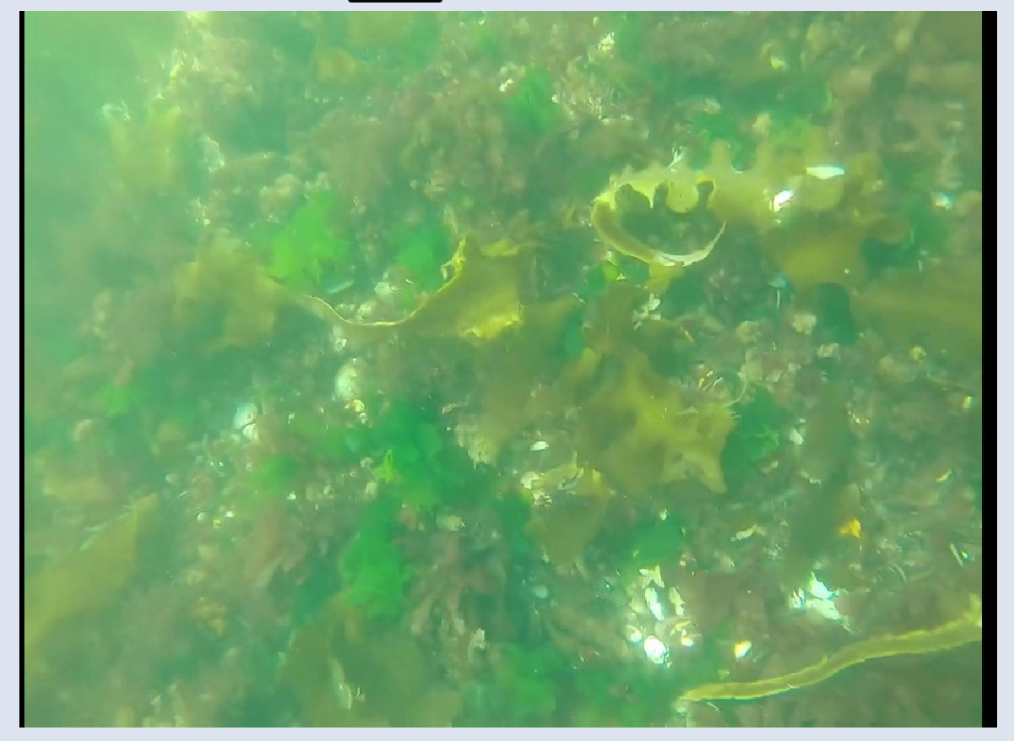
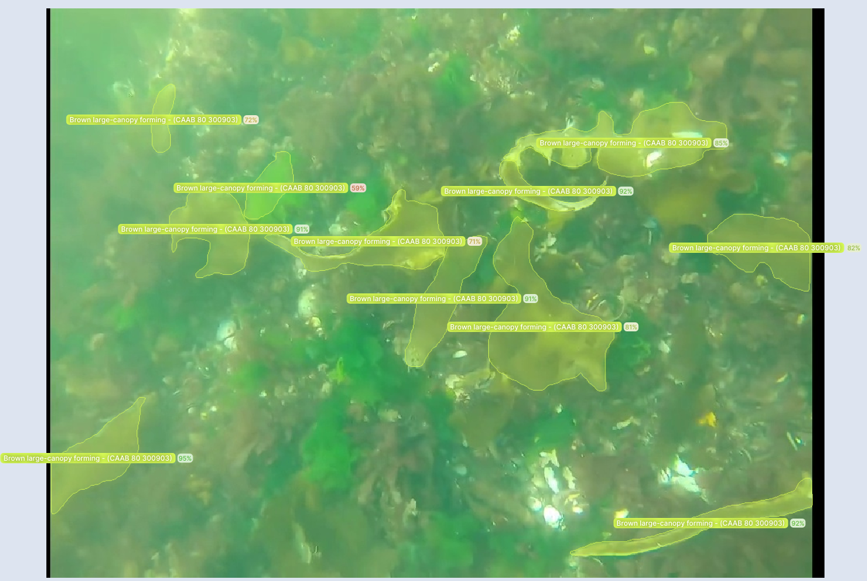
Kelp Forest Reading Group to Generate Segmented imagery for Convolutional Neural Networks
475 images, 3.5K blades segmented, Currently ~55-60% Accuracy with untuned V7 model

Slide 13
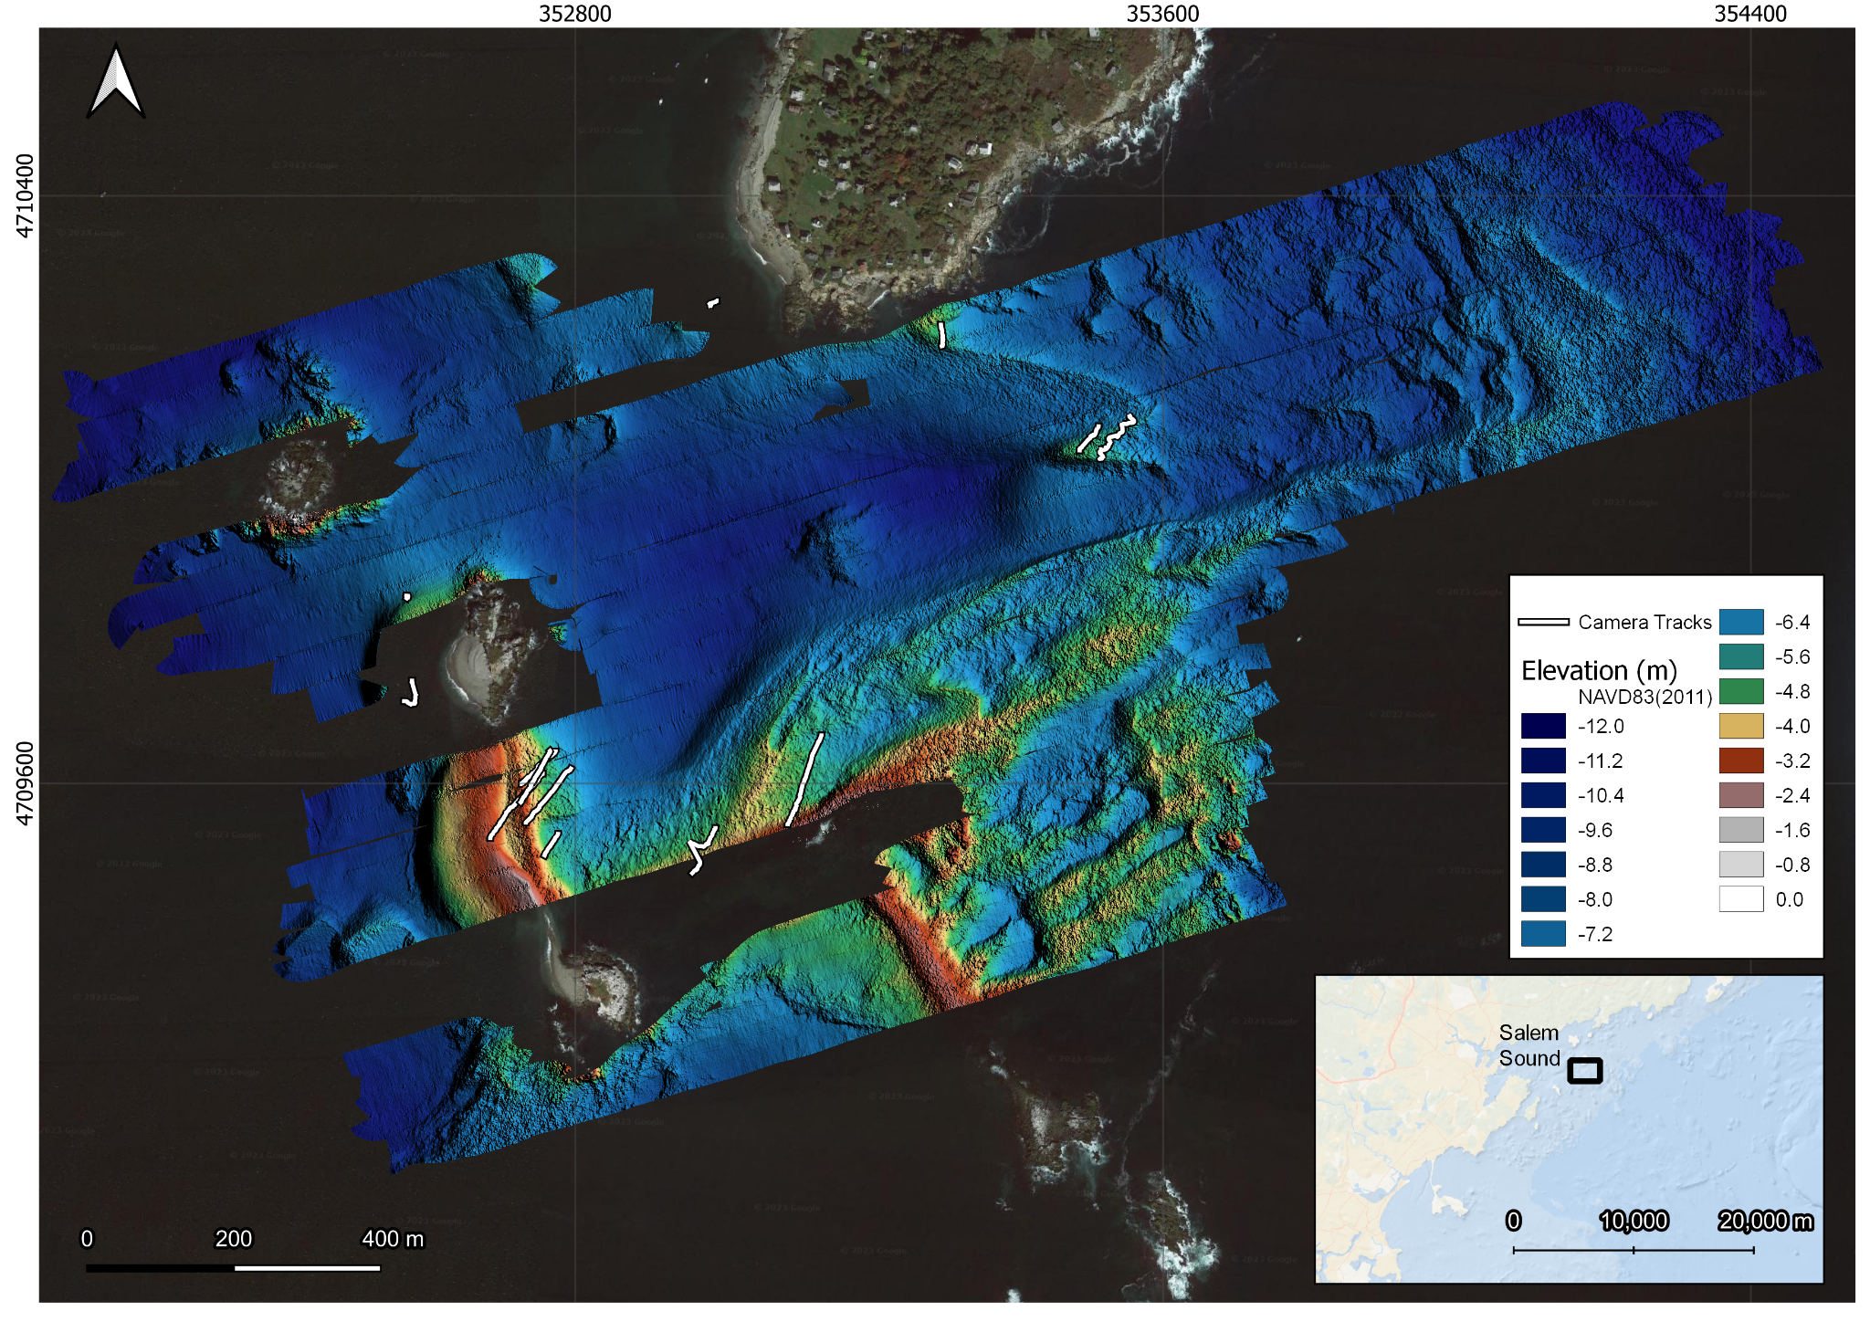
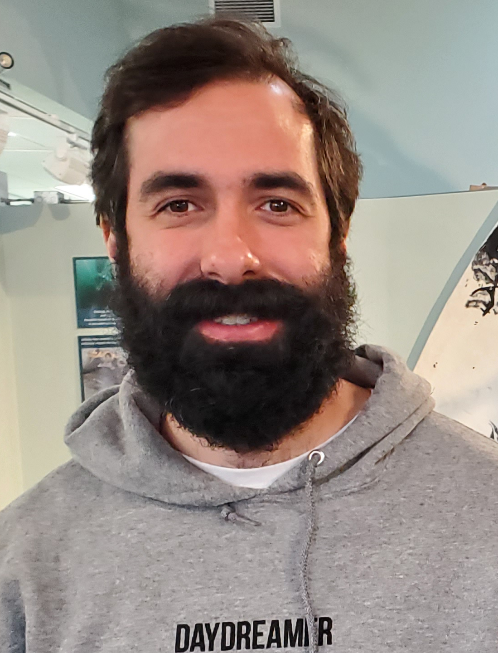
Sidescan Sonar Surveys to Map at Scale and Depth
Partnership with Center for Coastal Studies
Edgetech 6205 Phase-Measuring Sidescan Sonar
Pedro Guy

Slide 14
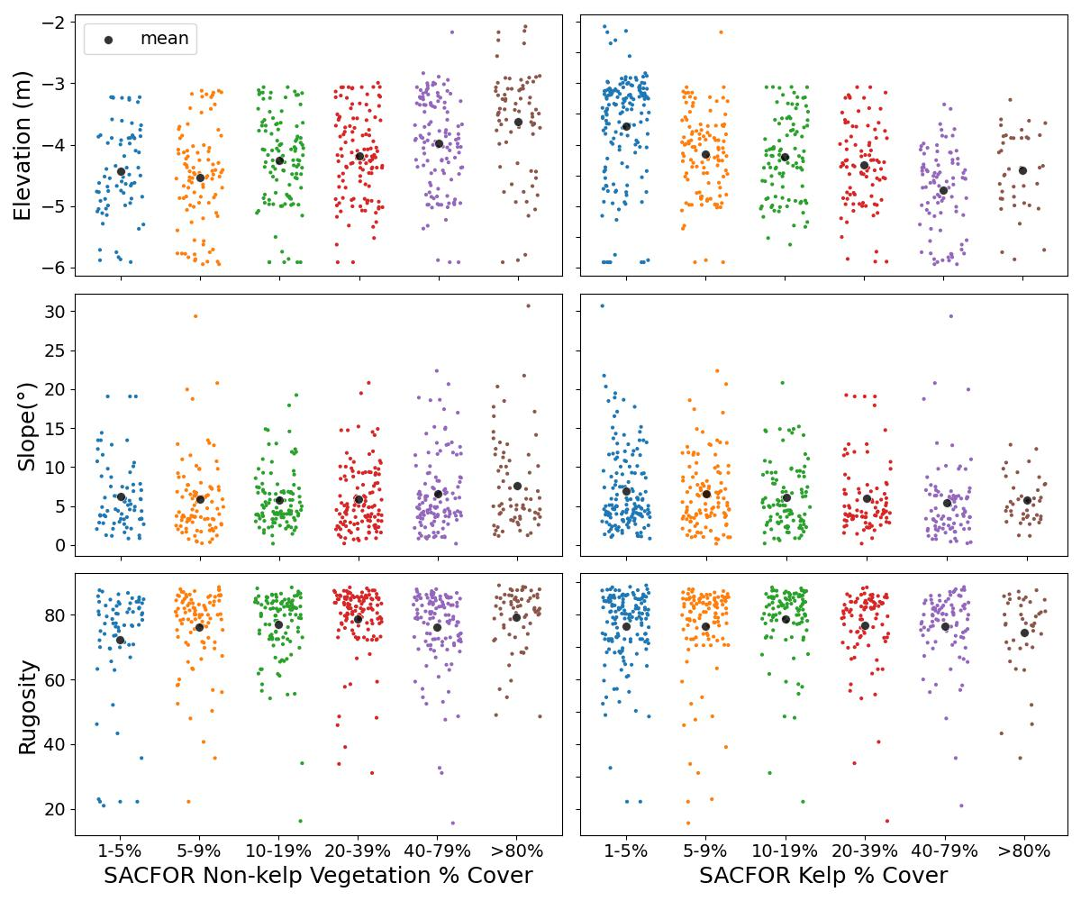
Cross-Calibration of Sidescan and Drop Camera Imagery Shows Habitat Preferences
From ~900 SACFOR images
Kelp comes to 2m depth, but is typically in the 4-5m range
Kelp is concentrated on flat areas
Kelp mainly occurs on rocky substrates

Slide 15
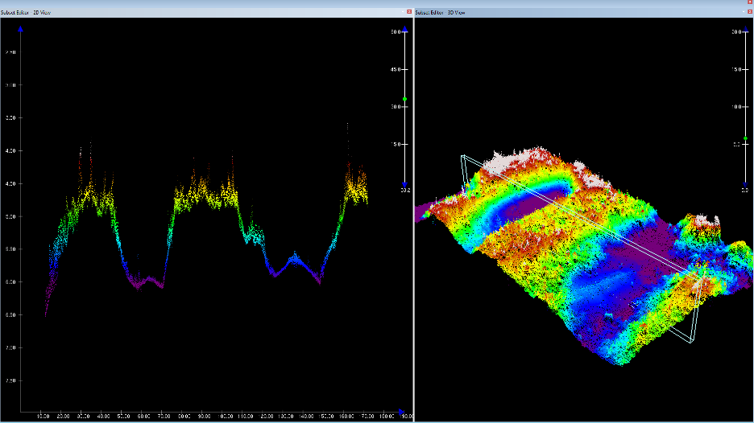
Machine Learning to Identify Kelp Signal in Raw Sidescan Data
KELP

Slide 16
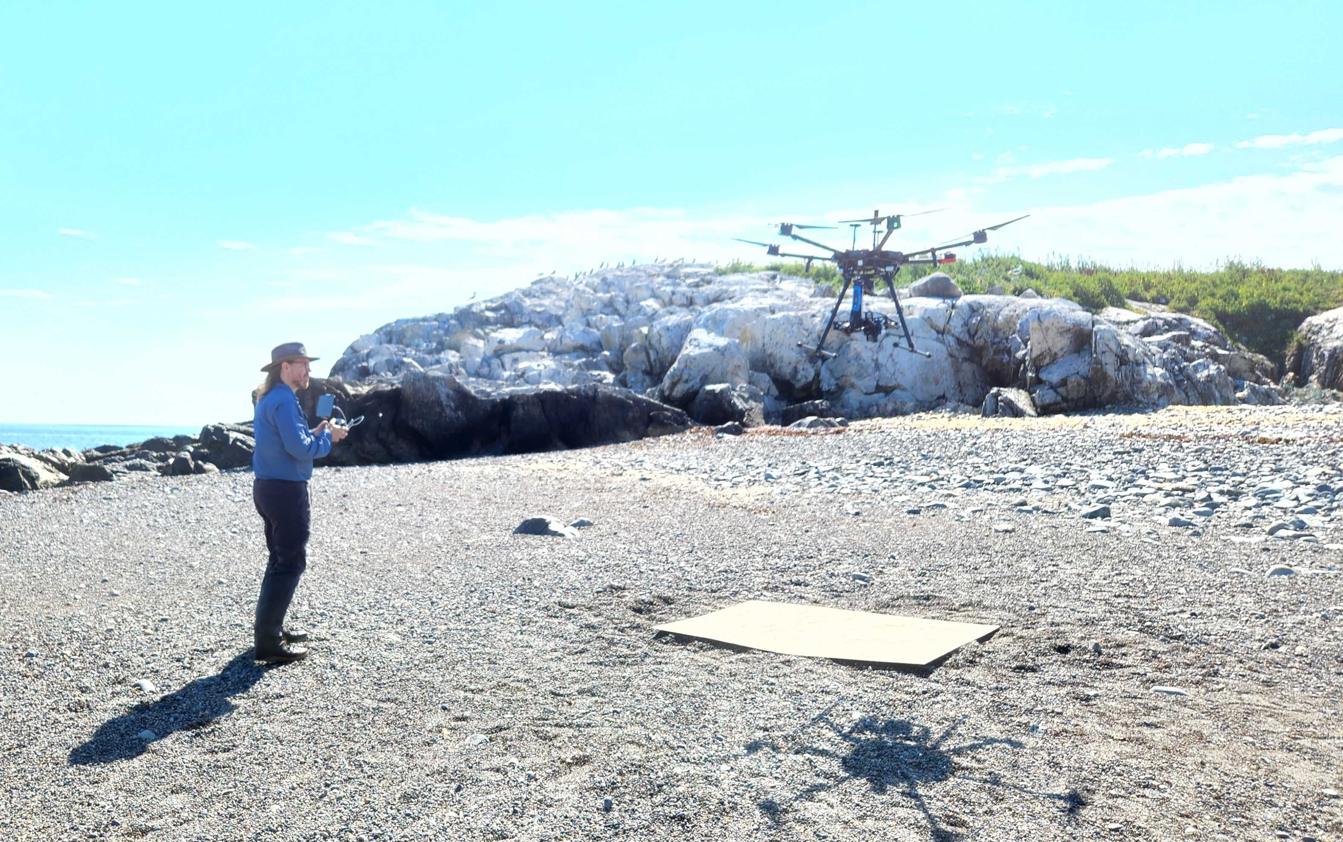
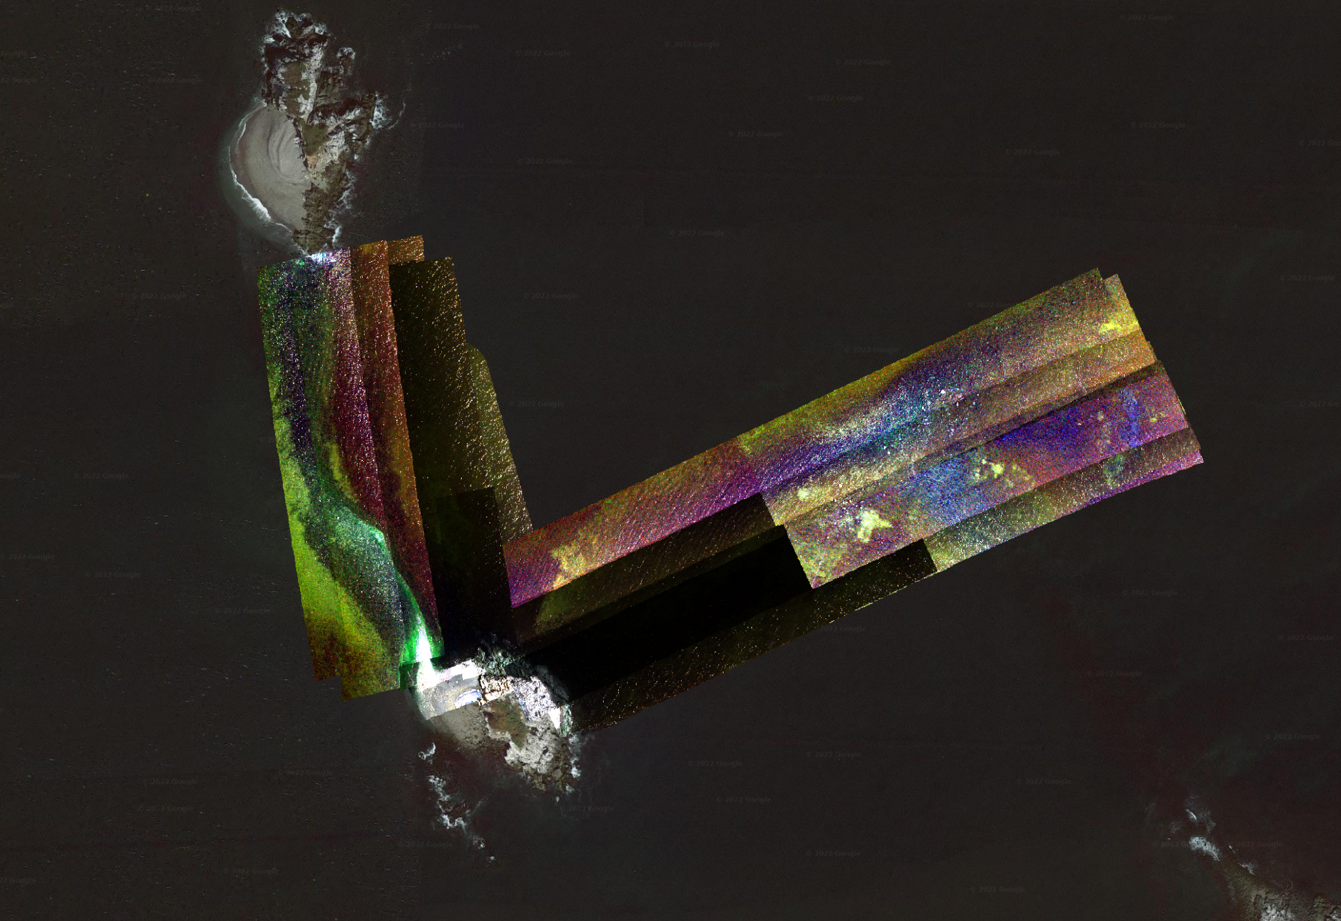
Headwall Drone Overflights to Lineup with Drop Camera and Sidescan Data
Tom Bell
Headwall Swaths at 0.7 cm resolution

Slide 17
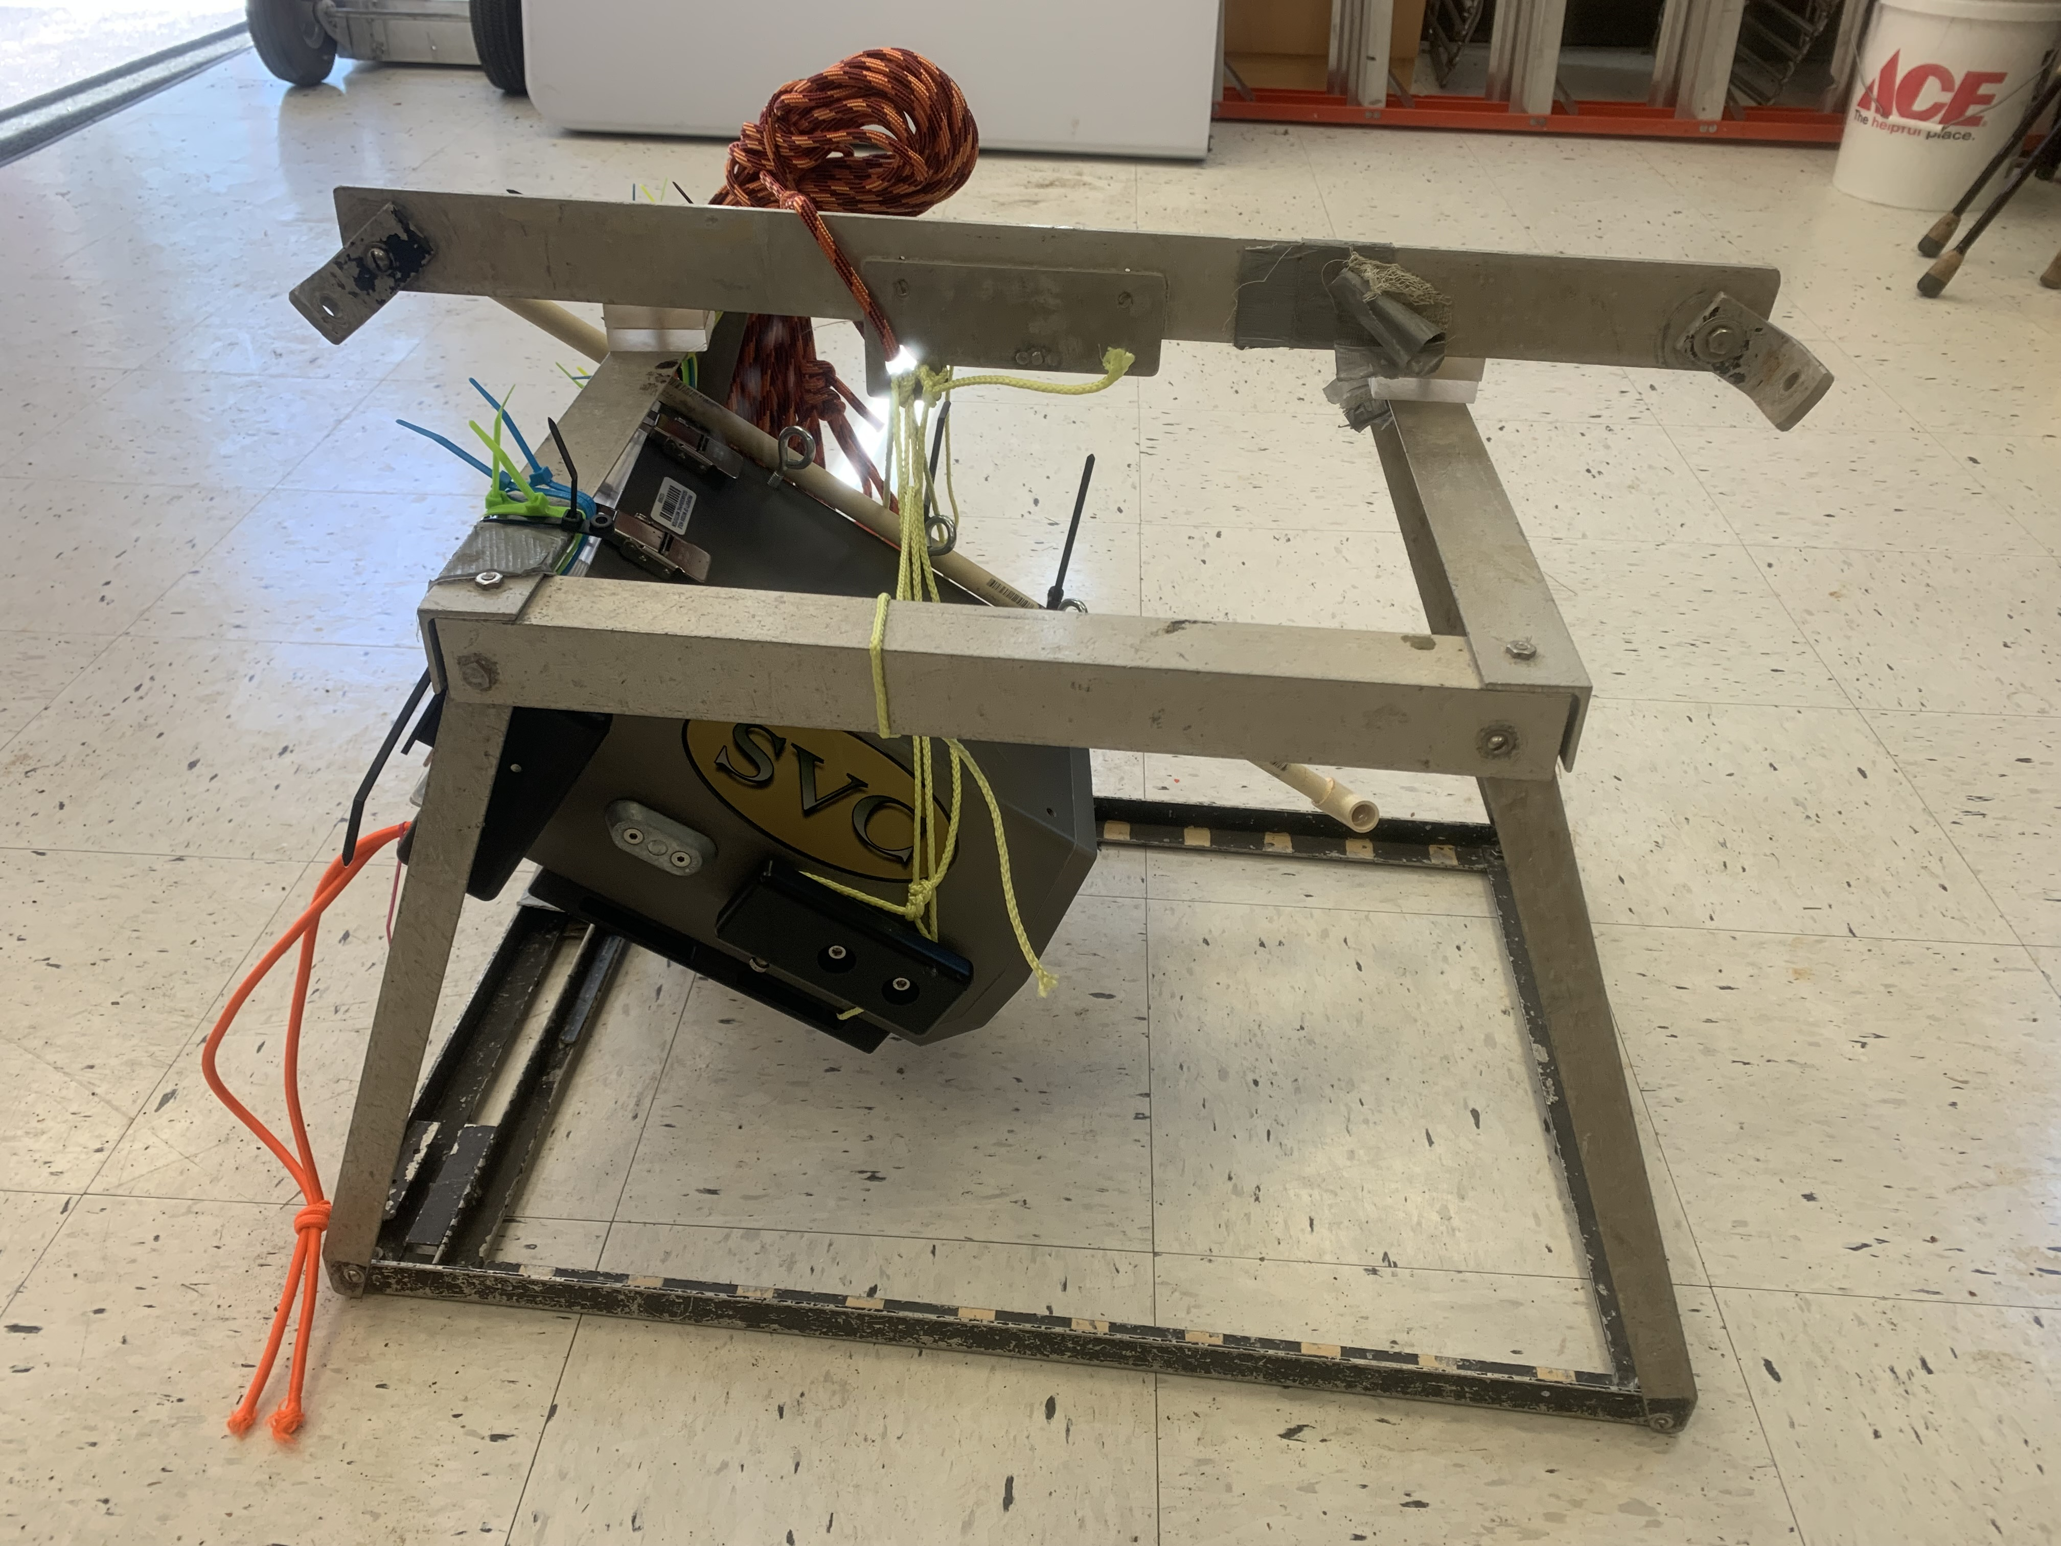
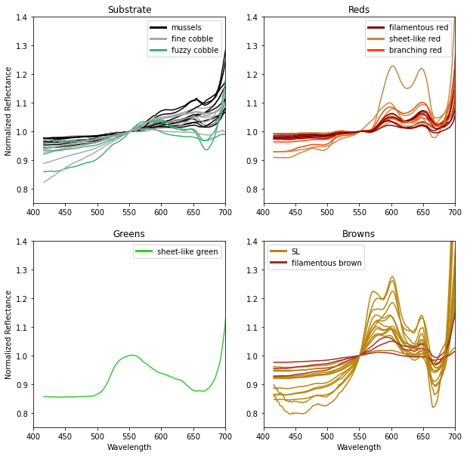
Spectral Library of Kelp Forests of the Gulf of Maine
Kelp
Building spectral library of nearshore benthos in the GOM
Led to collaboration with Leigh Tate and others to build a larger shallow water spectral library
Talk to me if interested!
Other Browns

Slide 18
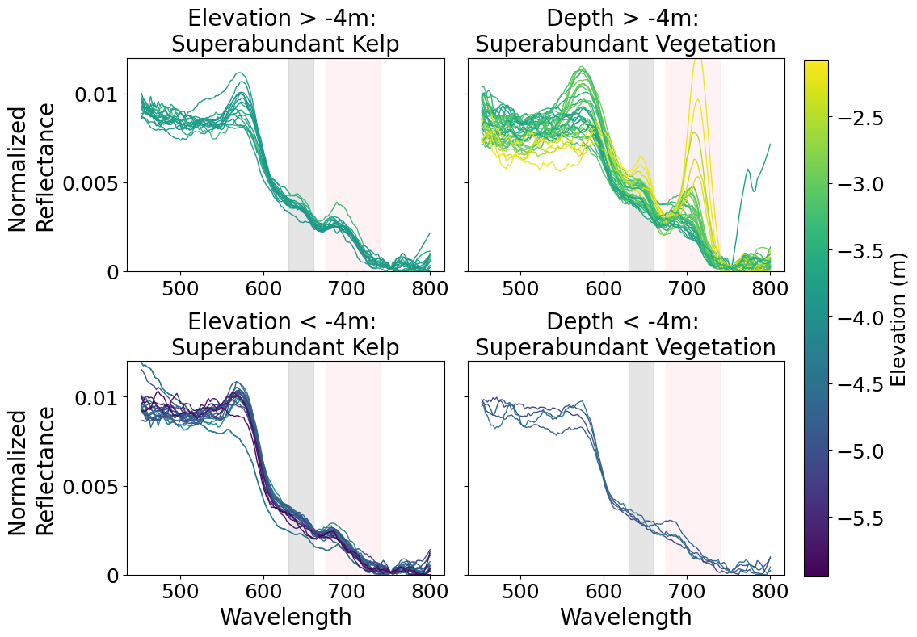
Spectra So Far Match Vegetation, and Perhaps have Kelp Signal
Peaks match those from emerging spectral library
More endmembers needed, but promising
Worst case, good vegetation mapping

Slide 19
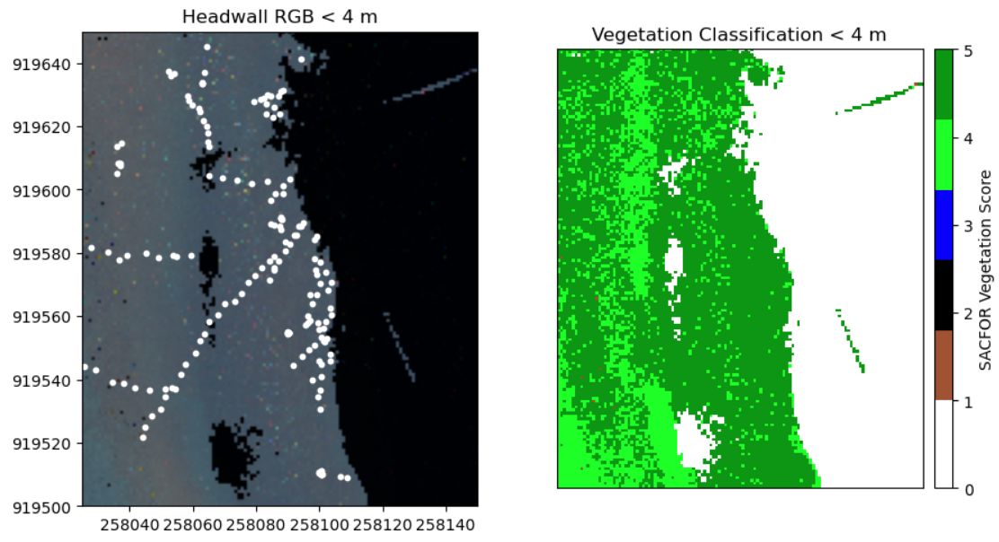
Random Forest Models with Drop Camera SACFOR Imagery Show Vegetation Mapping is Good

Slide 20
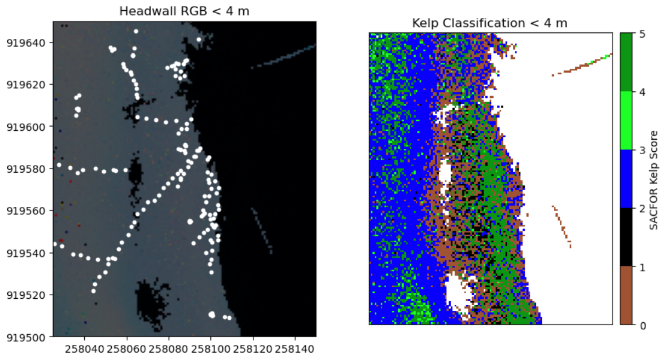
Random Forest Models with Drop Camera SACFOR Imagery Show Kelp Mapping Possible

Slide 21
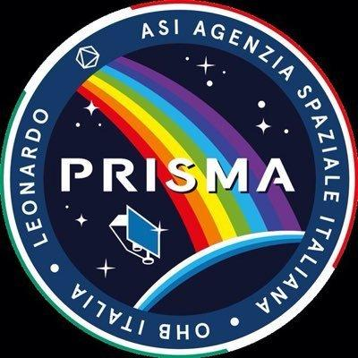
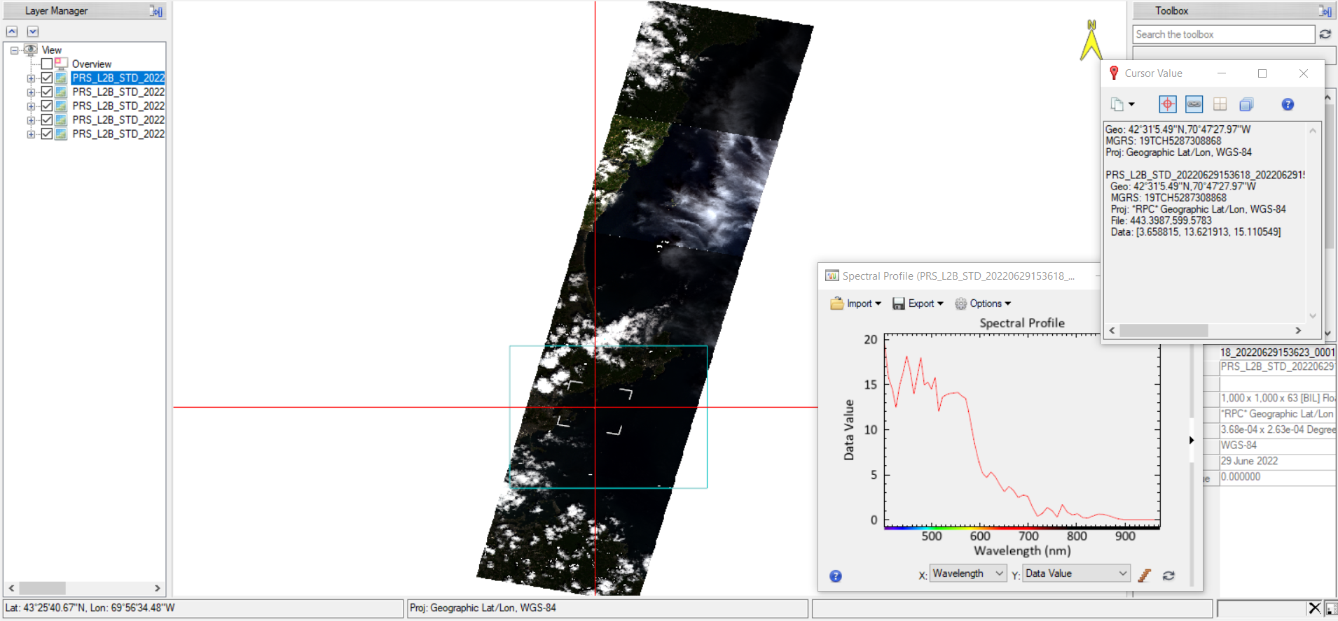
Linking Classified Results to PRISMA using Endmembers
Salem Sound
Notes:
PRISMA dates:

Slide 22
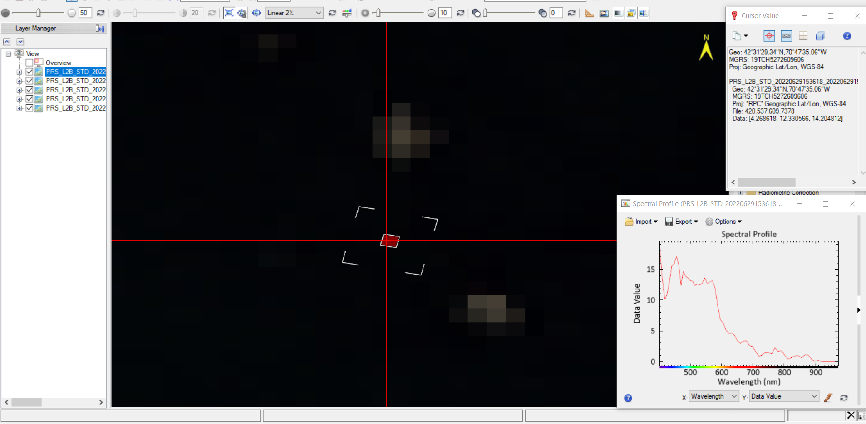
Gooseberries Optically Shallow Water - Vegetated?

Slide 23
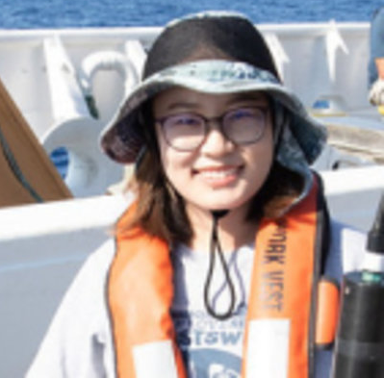
Do We Have a Pipeline or Pieces of a Puzzle? Summer 2023 Will Tell…
Drop Camera Surveys
Sidescan Sonar
Hyperspectral Drone Overflight
PRISMA or Other Hyperspectral Satellite
Ideal for fast low cost mapping of many small areas
Not limited in depth
Mapping of areas of moderate size
Can map kelp >5m in depth
Misses very shallow kelp
Moderate area mapping, but <5m
Kelp mapped into the lower intertidal and challenging environments for boats
Large area shallow water mapping?
Stay tuned!
(And is winter better with Sentinel – Shuai Zhang’s thesis chapter forthcoming!)
Where do AUVs fit into this puzzle?

Slide 24
Thank you!
Kelp-o-Tron Team: Jillian Hubbard, Alannah Dodd, Shuai Zhang, Lexi Wilkes, Wendi White, Becca Selden
Use of Property and Boats: Elizabeth Moore, Essex Heritage Museum, Salem YMCA Children’s Island Summer Camp, Massachusetts Department of Marine Fisheries at Cat Cove, The People of Bakers Island
Robert Scheibling

