Slide 1
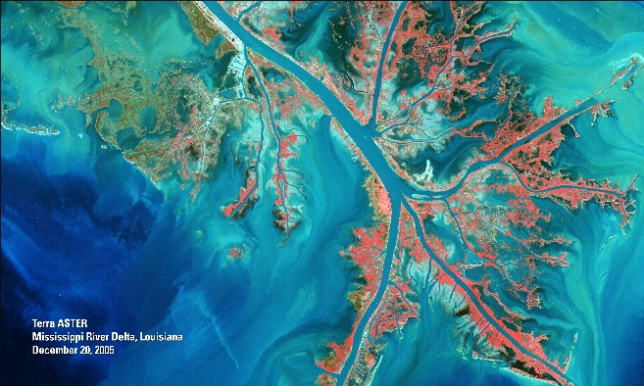
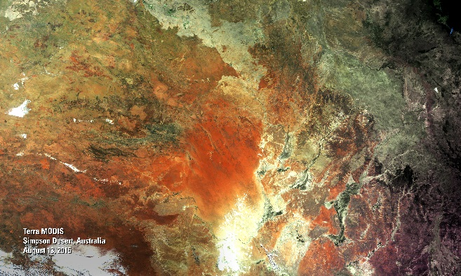
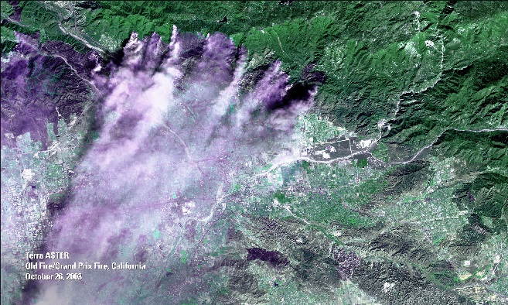
Getting to Know Land Data from NASA’s LP DAAC
Danielle Golon
Innovate! Inc., contractor to the U.S. Geological Survey (USGS) Earth Resources Observation and Science (EROS) Center
Sioux Falls, South Dakota
*Work performed under USGS contract G15PC00012 and NASA contract NNG14HH33I
1

Slide 2
Overview
What is NASA’s LP DAAC?
What types of data are publicly available?
Use Case Examples
Observing land cover changes in the Nez Perce - Clearwater National Forests
Observing the Pioneer Fire with vegetation, burned area, and fire data
How can users access the data?
Live Demo: AppEEARS
2

Slide 3
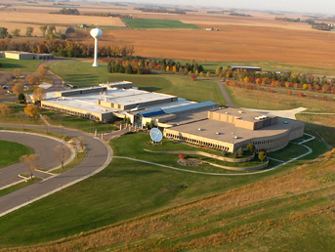
What is NASA’s LP DAAC?
Land Processes (LP) Distributed Active Archive Center (DAAC)
https://lpdaac.usgs.gov
Located at the USGS Earth Resources Observation and Science (EROS) Center in Sioux Falls, SD
Established in 1990
3

Slide 4
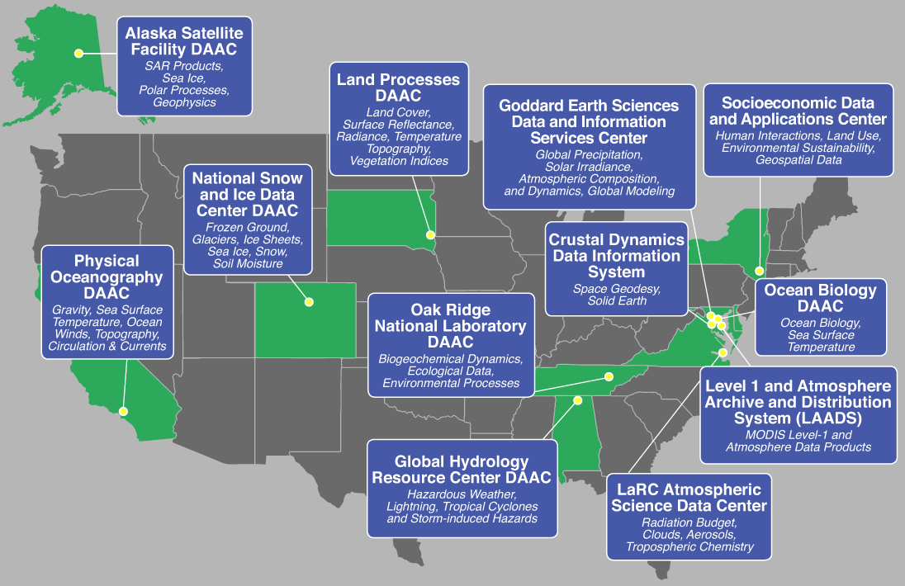
4

Slide 5
LP DAAC Data Fast Facts!
Access to 4.7 petabytes of land data
Data available from 1981 to present
Data provides information about the Earth from 1 millimeter to 5,600 meters per pixel
All data and resources available at no cost
ASTER: AST_L1T Kurnool Ultra Mega Solar Park, India
DOI 10.5067/ASTER/AST_L1T.003 15 meter
VIIRS: VNP09CMG Globe
DOI 10.5067/VIIRS/VNP09CMG.001
5,600 meter
5

Slide 6
What Types of Data Are Available?
BRDF
Vegetation Indices
Albedo
Burned Area
NPP
Elevation
Land Cover
Emissivity
LAI
ET
Thermal Anomalies and Fire
FPAR
AOD
GPP
LST
VCF
Reflectance
Unprocessed
Radiance
Cropland
Canopy Characteristics
Water Use Efficiency
Full Waveform
Lidar
Evaporative Stress Index
6

Slide 7
Where Do the Data Come From?
Terra ASTER
NASA MEaSUREs
Community
Terra and Aqua MODIS
HLS
S-NPP
VIIRS
ECOSTRESS
GEDI
COMING SOON!
7

Slide 8
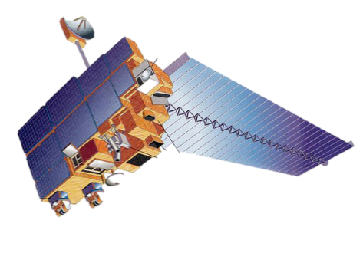
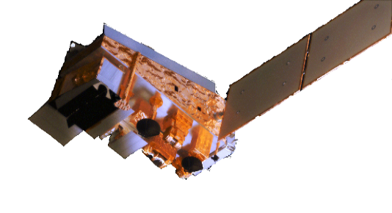
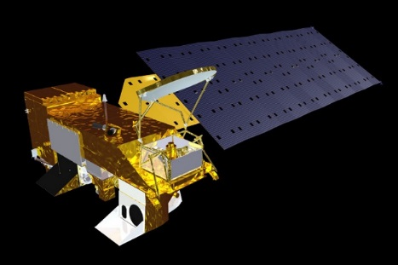
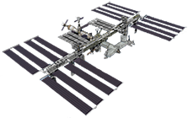
Where Do the Data Come From?
Spatial Resolution
15 m
30 m
90 m
VIIRS
30 m
70 m
25 m
250 m
500 m
1,000 m
5,600 m
500 m
1,000 m
5,600 m
Daily - Taskable
ASTER
ISS Dependent
ECOSTRESS
ISS Dependent
GEDI
Daily
4 day
8 day
16 day
Monthly
Annual
MODIS
Daily
8 day
16 day
Monthly
Annual
VIIRS
Temporal Resolution
10

Slide 9
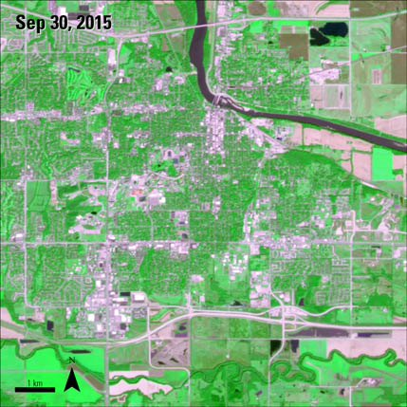
MODIS vs ASTER
ASTER: AST_L1T Lawrence, KS
DOI 10.5067/ASTER/AST_L1T.003 15 meter
9

Slide 10
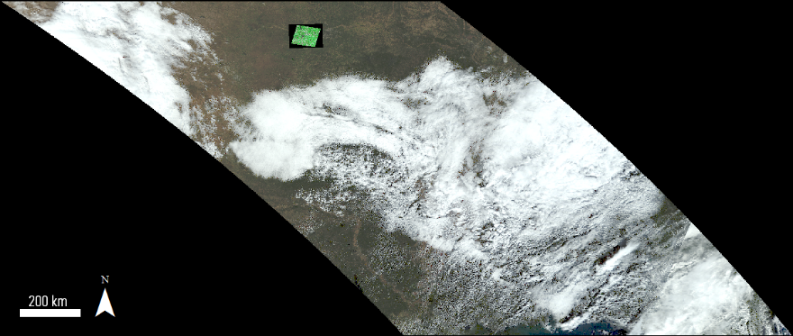
MODIS vs ASTER
ASTER: AST_L1T and MOD09GA Lawrence, KS
DOI 10.5067/ASTER/AST_L1T.003 10.5067/MODIS/MOD09GA.006 15 meter 500 meter
10

Slide 11
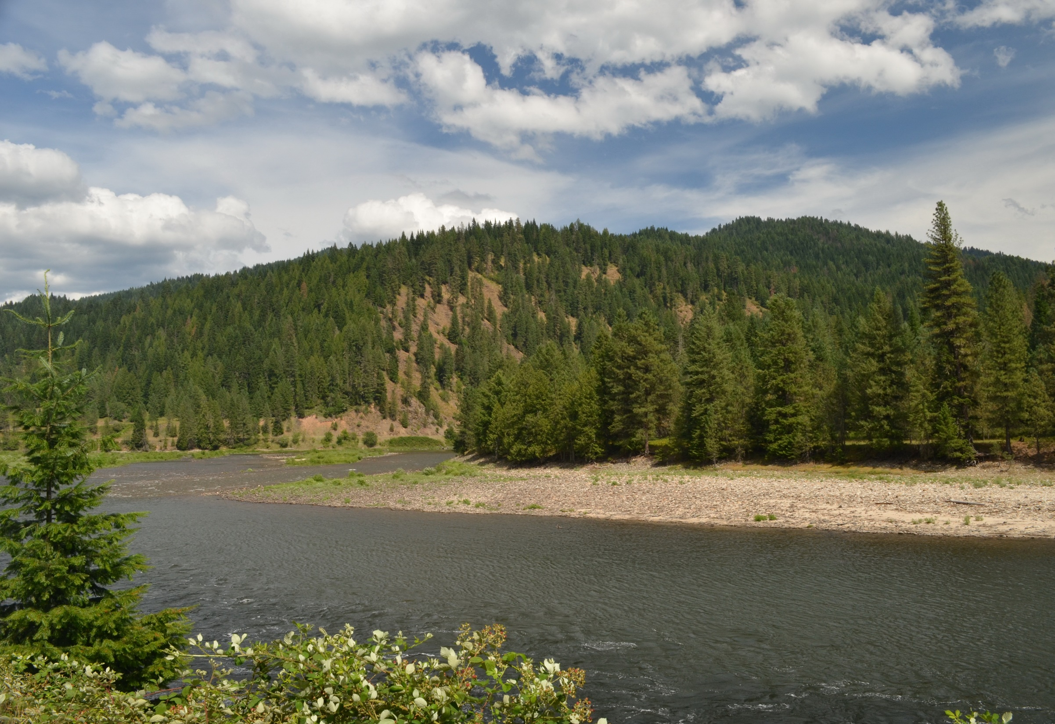
Use Case: Land Cover change over Nez Perce-Clearwater National Forests
Notes:
Image: Forest Service Northern Region: https://flic.kr/p/xgsnWZ

Slide 12
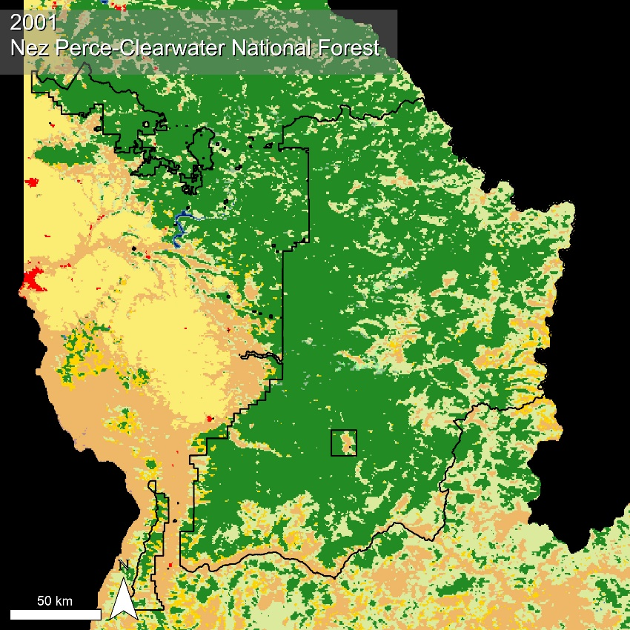
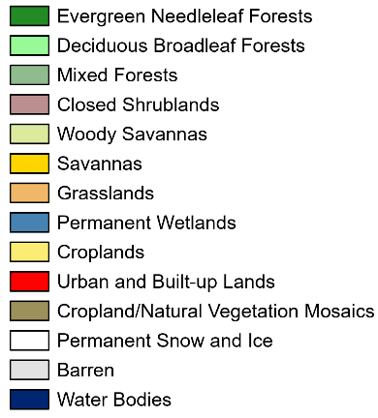
Use Case: Land Cover Change
Data:
Yearly Land Cover
MCD12Q1 - IGBP
Objective:
Identify land cover changes in the National Forests since 2001.
Finding:
Decrease in Evergreen Needleleaf Forest
Increase in Woody Savannas and Grasslands
MODIS: MCD12Q1 Nez-Perce and Clearwater NF, Idaho
DOI 10.5067/MODIS/MCD12Q1.006 500 meter
12

Slide 13
Use Case: Land Cover Change
Data:
Yearly Land Cover
MCD12Q1 - IGBP
Objective:
Identify land cover changes in the National Forests since 2001.
Finding:
Decrease in Evergreen Needleleaf Forest
Increase in Woody Savannas and Grasslands
MODIS: MCD12Q1 Nez-Perce and Clearwater NF, Idaho
DOI 10.5067/MODIS/MCD12Q1.006 500 meter
13

Slide 14
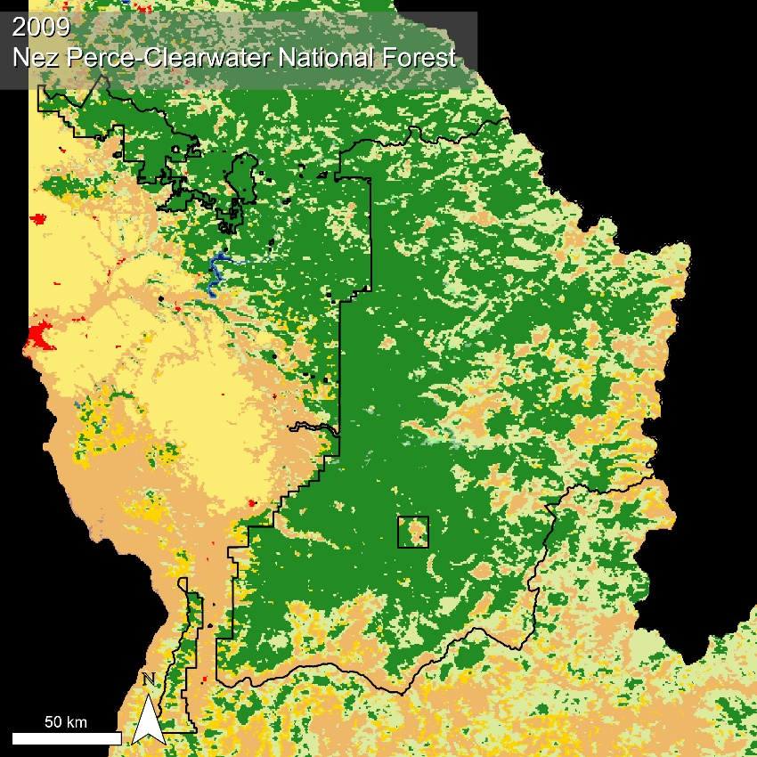
Use Case: Land Cover Change
Data:
Yearly Land Cover
MCD12Q1 - IGBP
Objective:
Identify land cover changes in the National Forests since 2001.
Finding:
Decrease in Evergreen Needleleaf Forest
Increase in Woody Savannas and Grasslands
MODIS: MCD12Q1 Nez-Perce and Clearwater NF, Idaho
DOI 10.5067/MODIS/MCD12Q1.006 500 meter
14

Slide 15
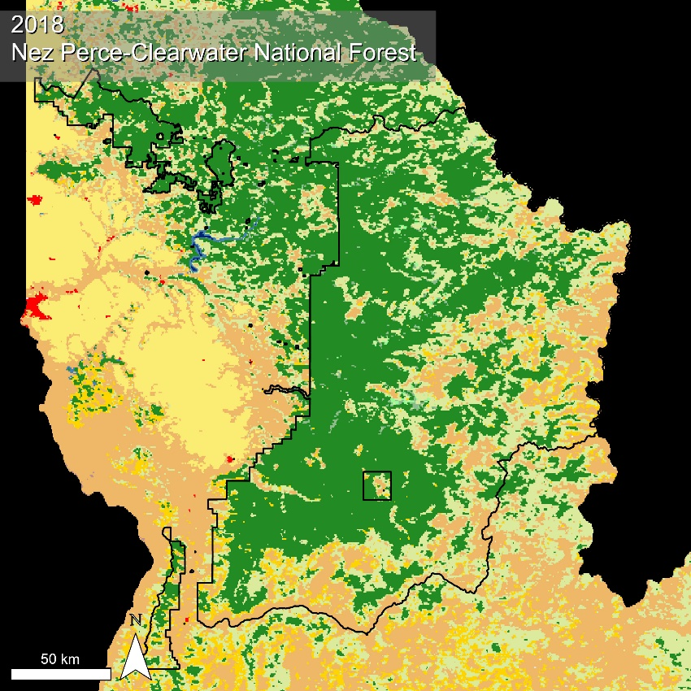
Use Case: Land Cover Change
Data:
Yearly Land Cover
MCD12Q1 - IGBP
Objective:
Identify land cover changes in the National Forests since 2001.
Finding:
Decrease in Evergreen Needleleaf Forest
Increase in Woody Savannas and Grasslands
MODIS: MCD12Q1 Nez-Perce and Clearwater NF, Idaho
DOI 10.5067/MODIS/MCD12Q1.006 500 meter
15

Slide 16
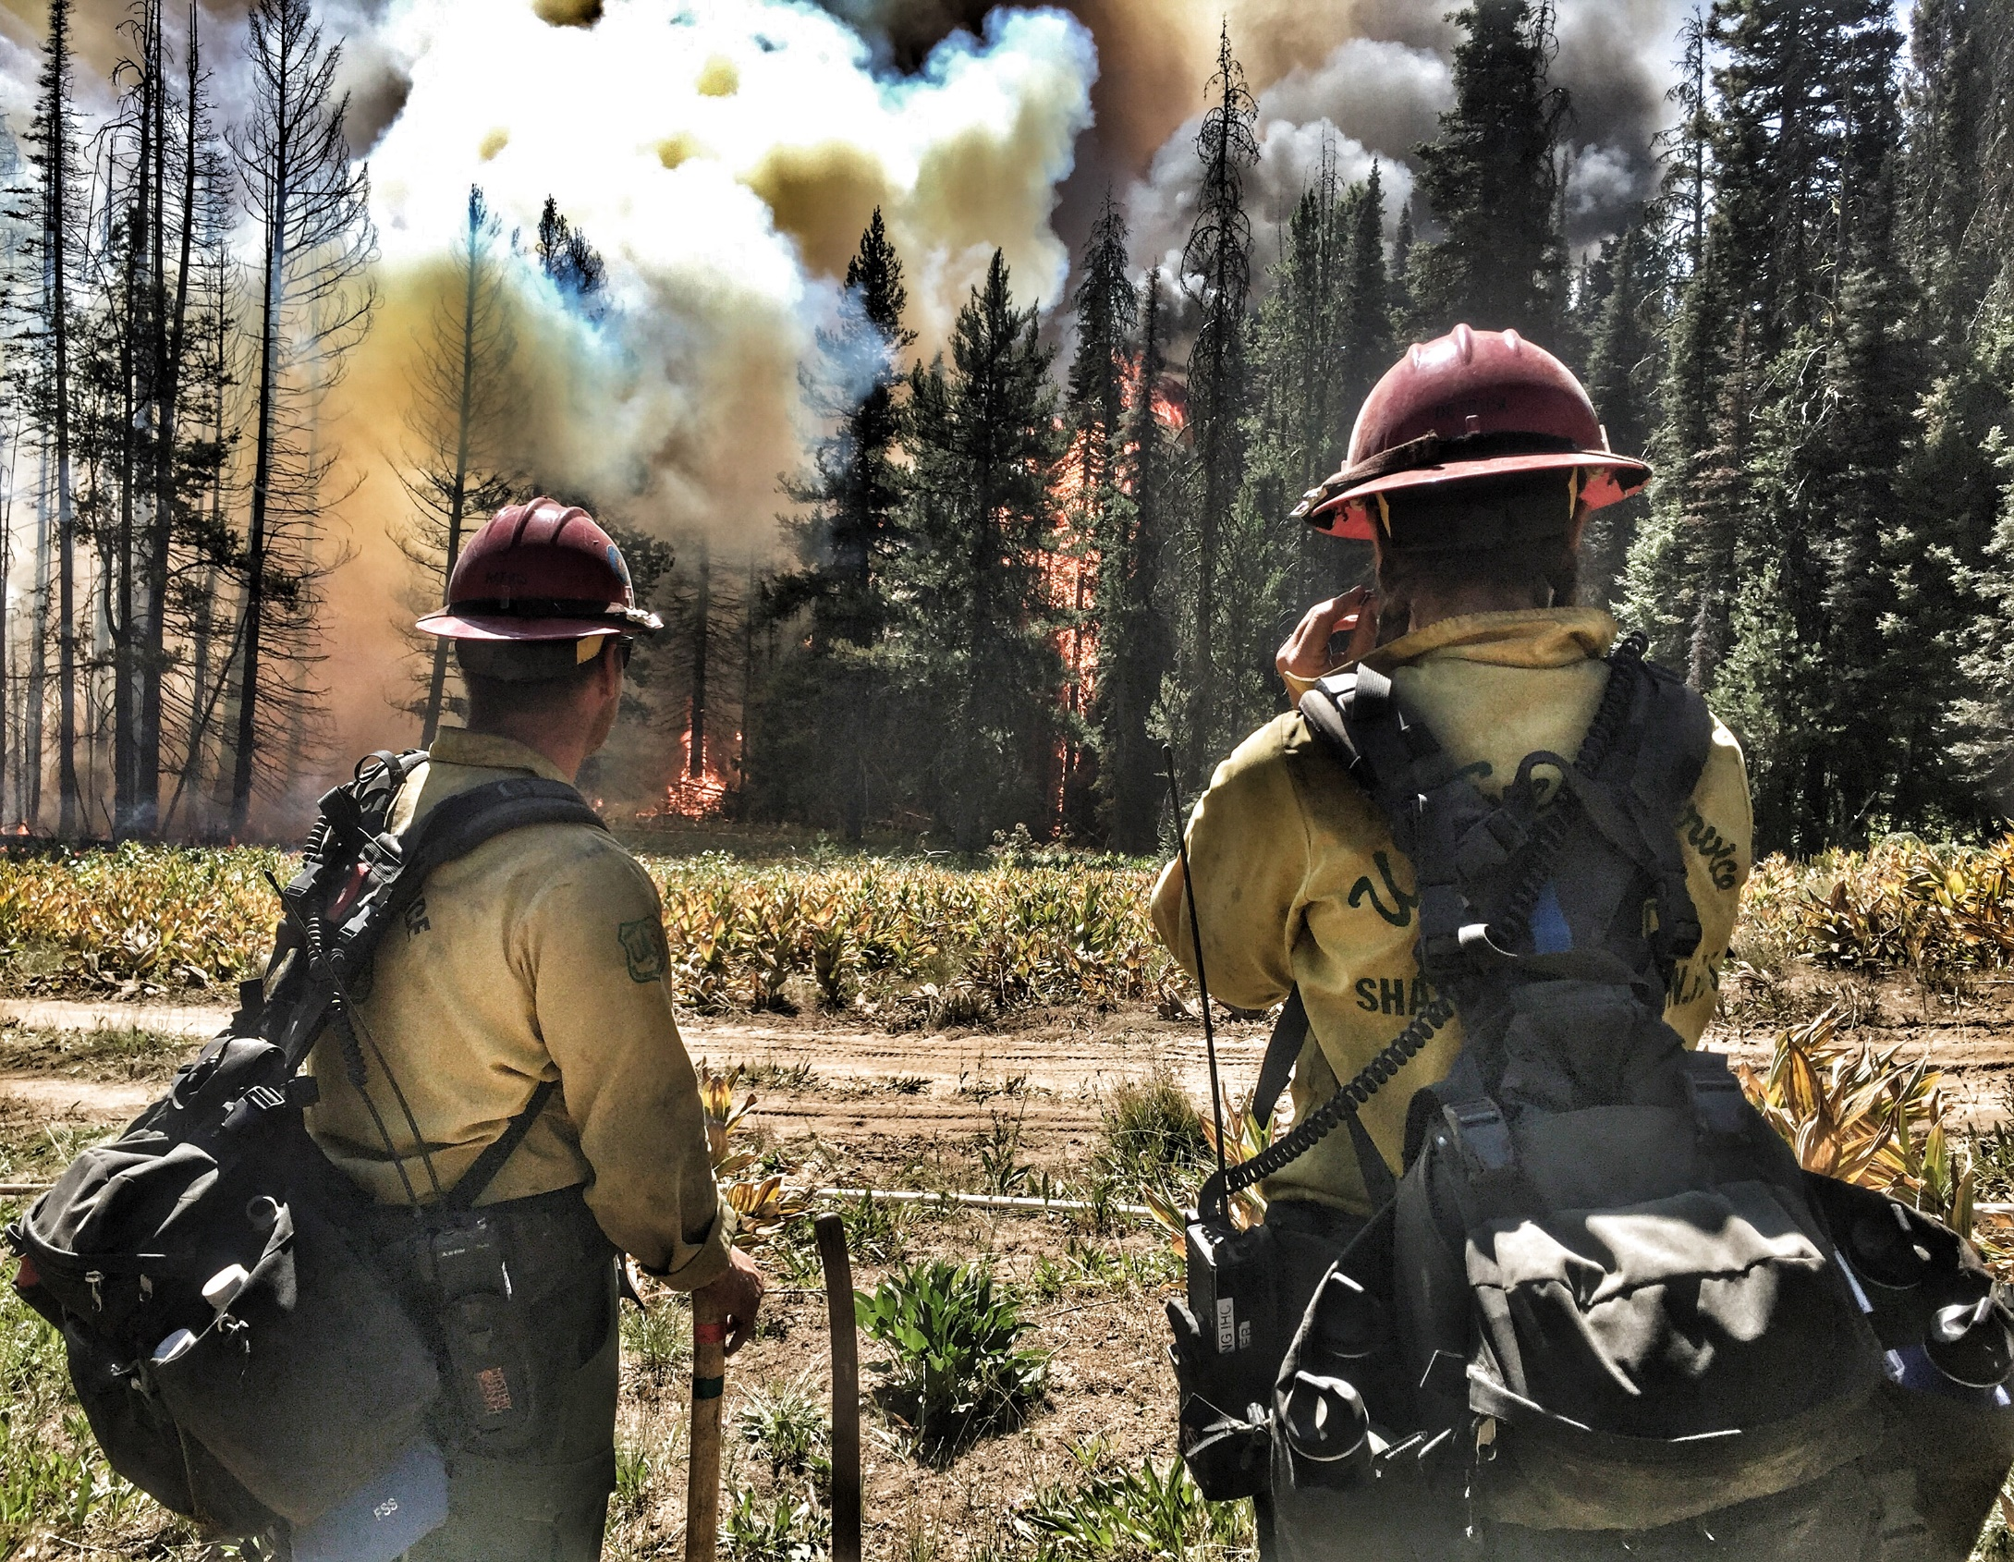
Use Case: Mapping the spread of the Pioneer Fire with NDVI and Burned Area data
Notes:
Image: Pacific Southwest Region 5 US Forest Service: https://flic.kr/p/JRYxxkFerguson Fire

Slide 17
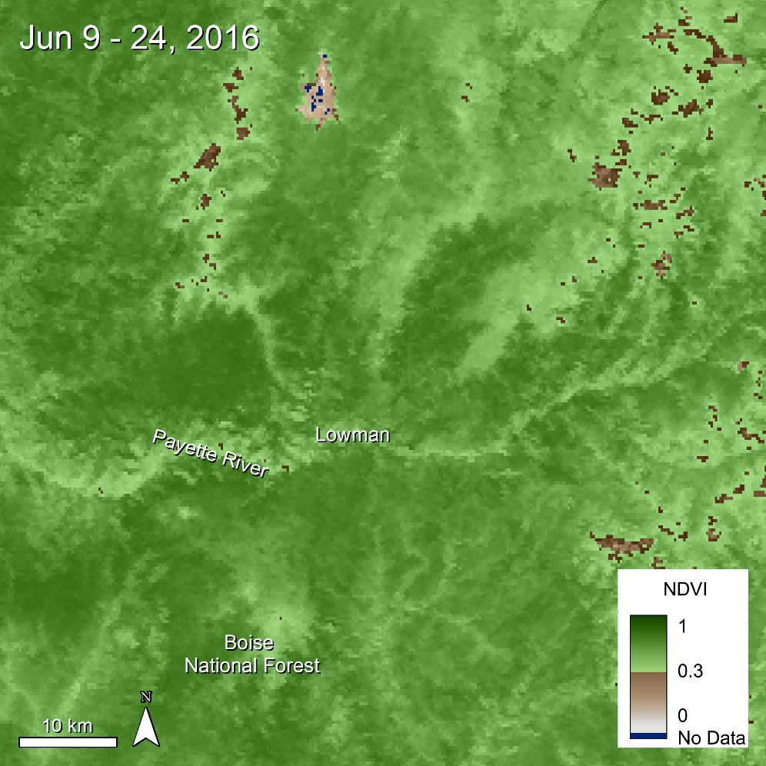
Use Case: Pioneer Fire
Data:
16 Day Vegetation Index
MOD13Q1 - NDVI
Objective:
Observe the impact on vegetation from the Pioneer Fire (July 18 – Nov 4, 2016)
MODIS: MOD13Q1 Lowman, Idaho
DOI 10.5067/MODIS/MOD13Q1.006 250 meter
17

Slide 18
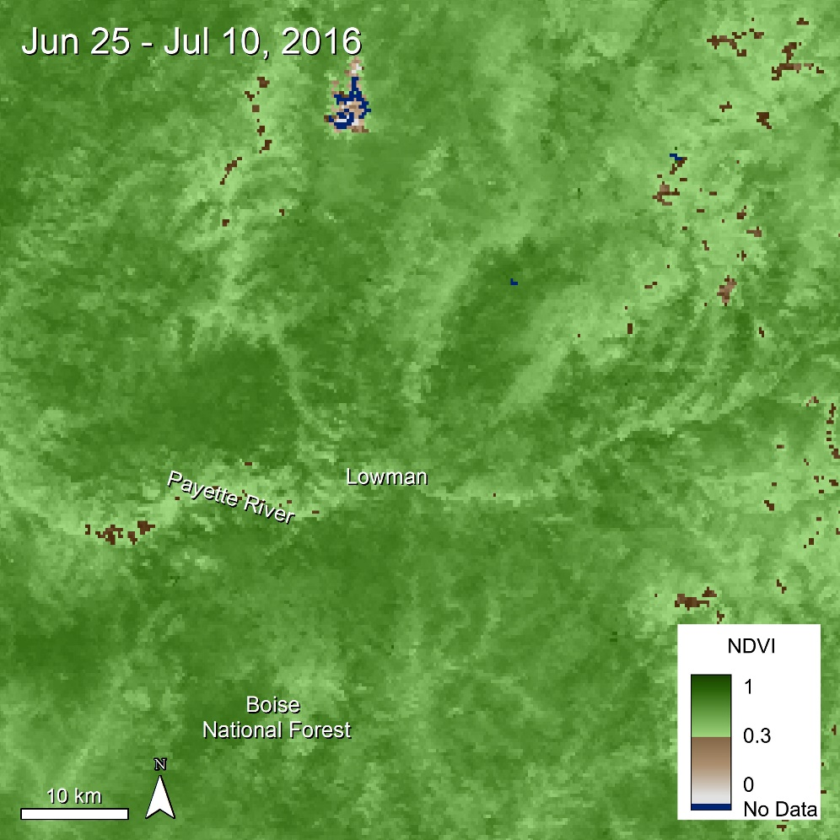
Use Case: Pioneer Fire
Data:
16 Day Vegetation Index
MOD13Q1 - NDVI
Objective:
Observe the impact on vegetation from the Pioneer Fire (July 18 – Nov 4, 2016.)
MODIS: MOD13Q1 Lowman, Idaho
DOI 10.5067/MODIS/MOD13Q1.006 250 meter
18

Slide 19
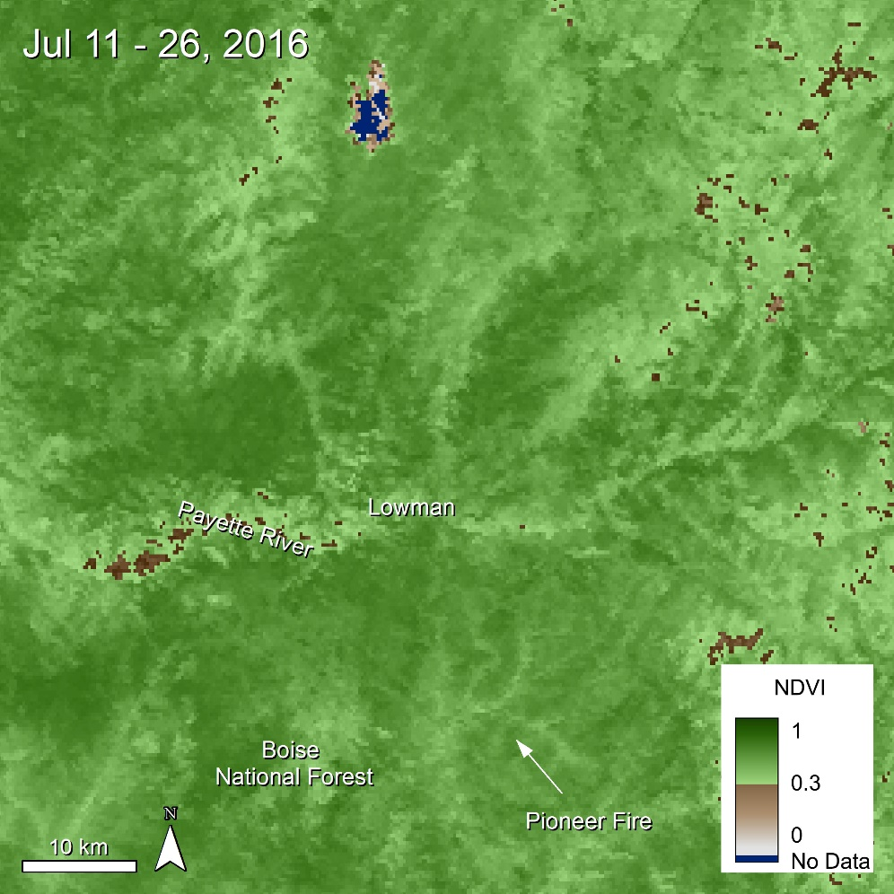
Use Case: Pioneer Fire
Data:
16 Day Vegetation Index
MOD13Q1 - NDVI
Objective:
Observe the impact on vegetation from the Pioneer Fire (July 18 – Nov 4, 2016.)
MODIS: MOD13Q1 Lowman, Idaho
DOI 10.5067/MODIS/MOD13Q1.006 250 meter
19

Slide 20
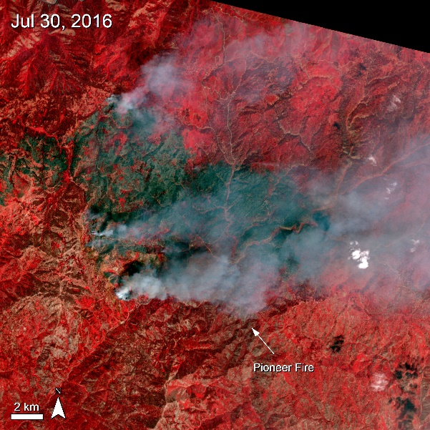
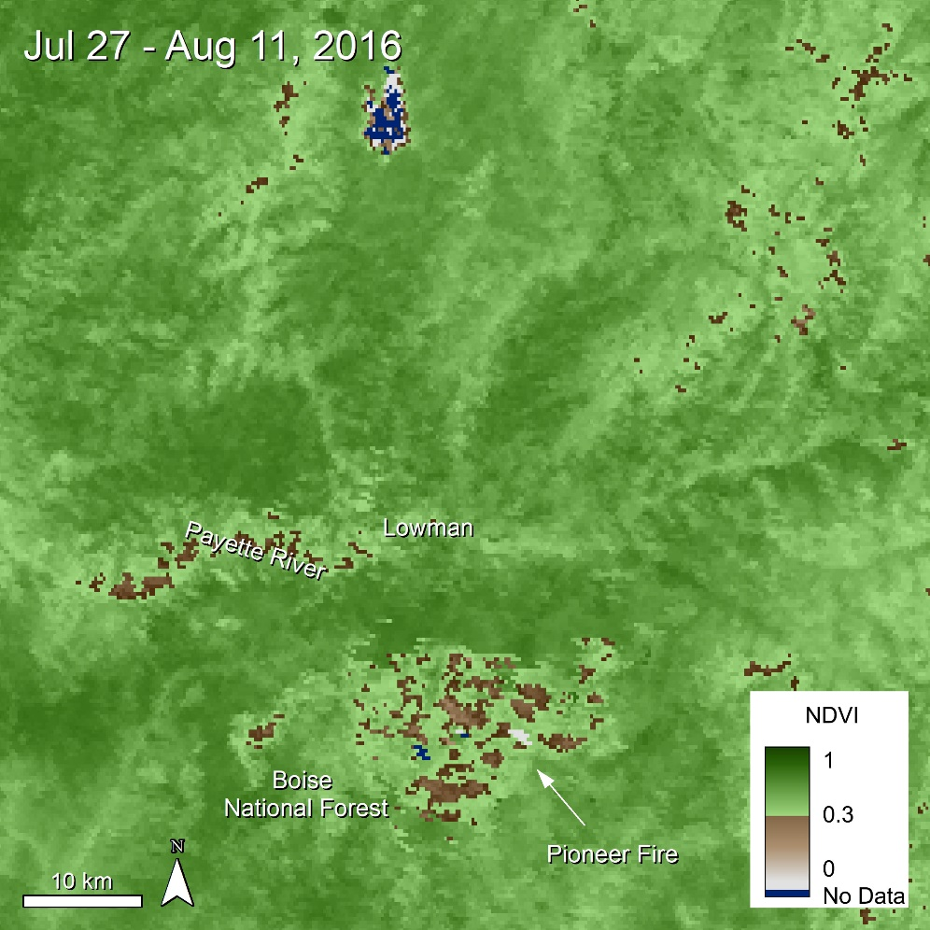
Use Case: Pioneer Fire
Data:
Bottom
16 Day Vegetation Index
MOD13Q1 – NDVI
Top
As tasked – Precision Terrain Corrected
AST_L1T – 3n-2-1
Objective:
Observe the impact on vegetation from the Pioneer Fire (July 18 – Nov 4, 2016.)
MODIS: MOD13Q1 Lowman, Idaho
DOI 10.5067/MODIS/MOD13Q1.006 250 meter
ASTER: AST_L1T Idaho
DOI 10.5067/ASTER/AST_L1T.003 15 meter
20

Slide 21
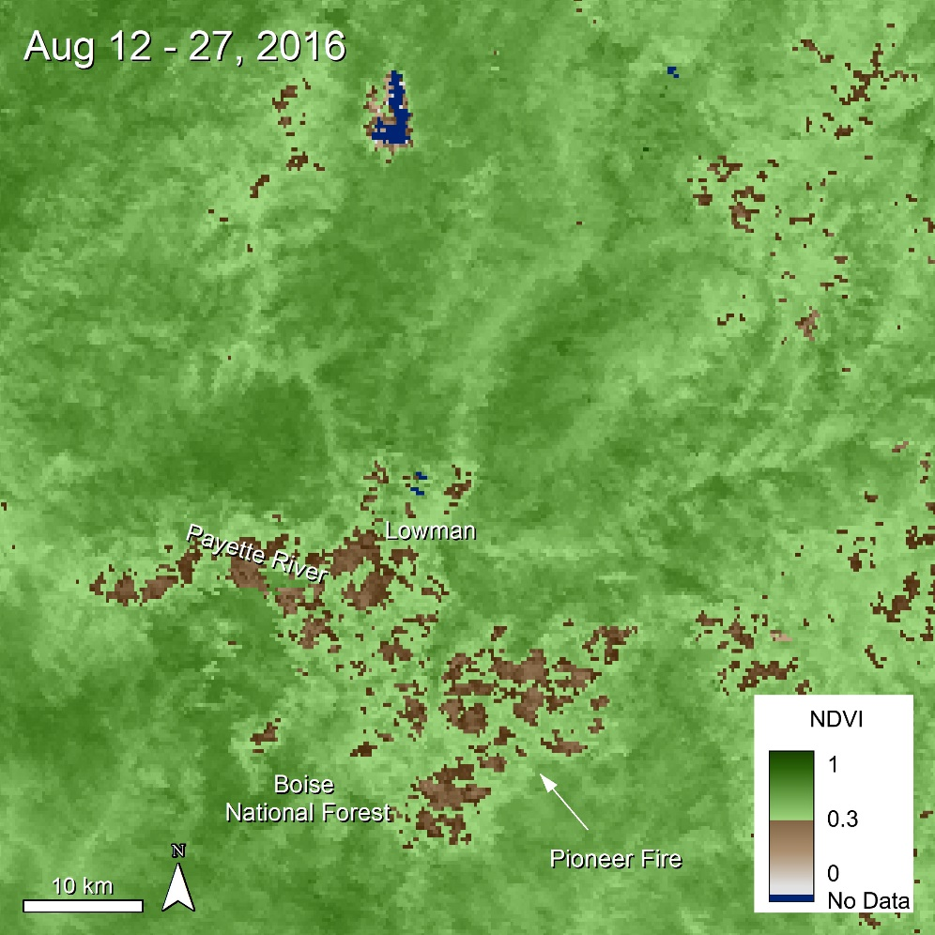
Use Case: Pioneer Fire
Data:
16 Day Vegetation Index
MOD13Q1 - NDVI
Objective:
Observe the impact on vegetation from the Pioneer Fire (July 18 – Nov 4, 2016.)
MODIS: MOD13Q1 Lowman, Idaho
DOI 10.5067/MODIS/MOD13Q1.006 250 meter
21

Slide 22
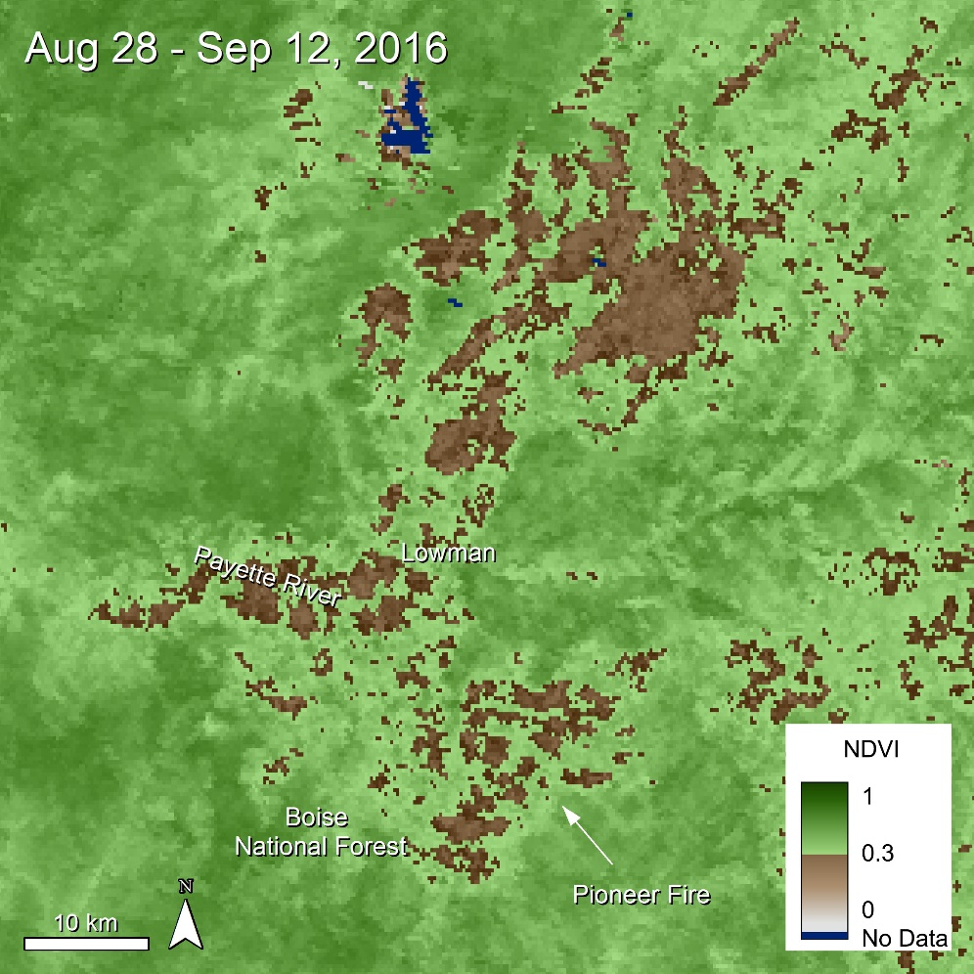
Use Case: Pioneer Fire
Data:
16 Day Vegetation Index
MOD13Q1 - NDVI
Objective:
Observe the impact on vegetation from the Pioneer Fire (July 18 – Nov 4, 2016.)
MODIS: MOD13Q1 Lowman, Idaho
DOI 10.5067/MODIS/MOD13Q1.006 250 meter
22

Slide 23
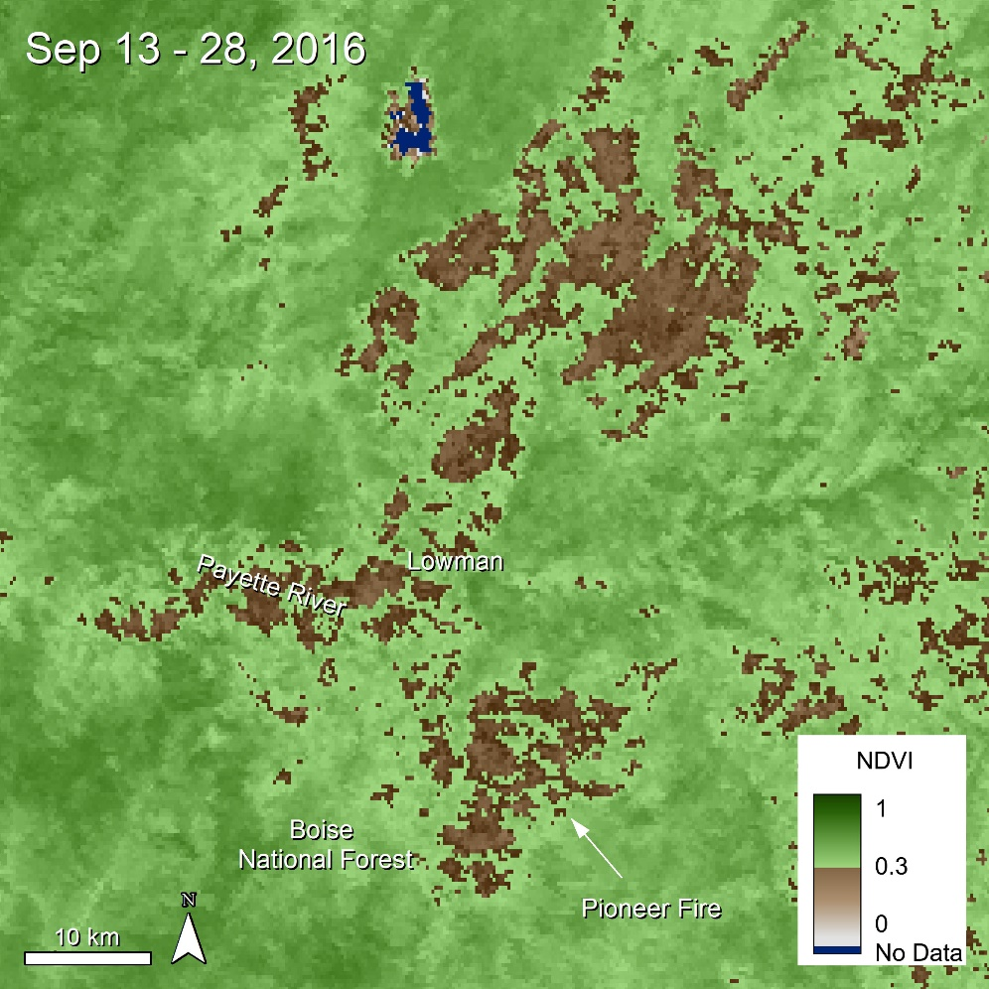
Use Case: Pioneer Fire
Data:
16 Day Vegetation Index
MOD13Q1 - NDVI
Objective:
Observe the impact on vegetation from the Pioneer Fire (July 18 – Nov 4, 2016.)
MODIS: MOD13Q1 Lowman, Idaho
DOI 10.5067/MODIS/MOD13Q1.006 250 meter
23

Slide 24
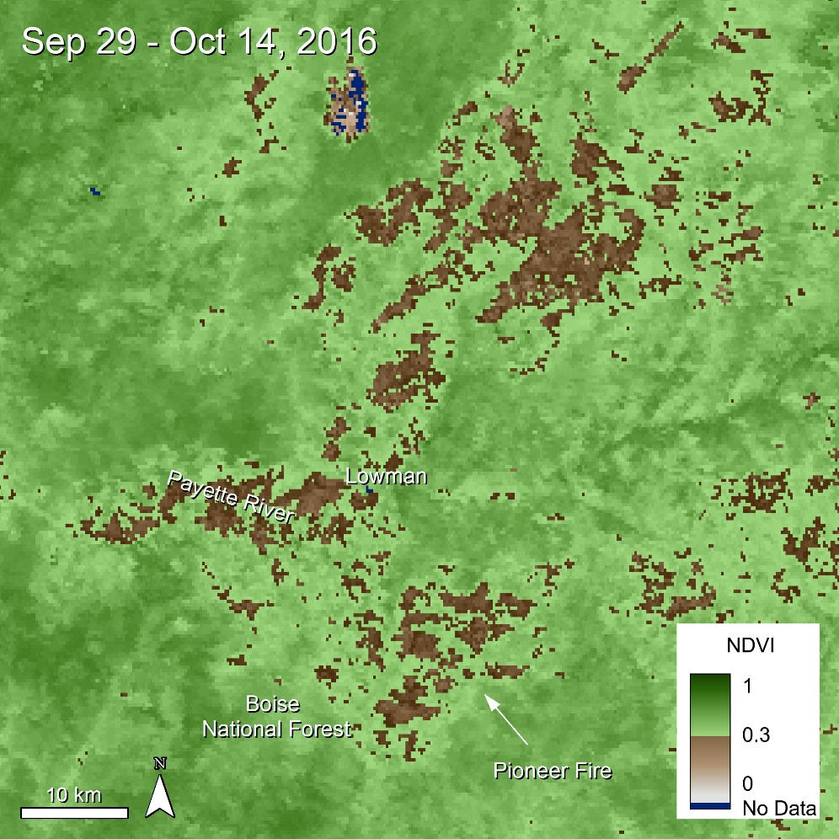
Use Case: Pioneer Fire
Data:
16 Day Vegetation Index
MOD13Q1 - NDVI
Objective:
Observe the impact on vegetation from the Pioneer Fire (July 18 – Nov 4, 2016.)
MODIS: MOD13Q1 Lowman, Idaho
DOI 10.5067/MODIS/MOD13Q1.006 250 meter
24

Slide 25
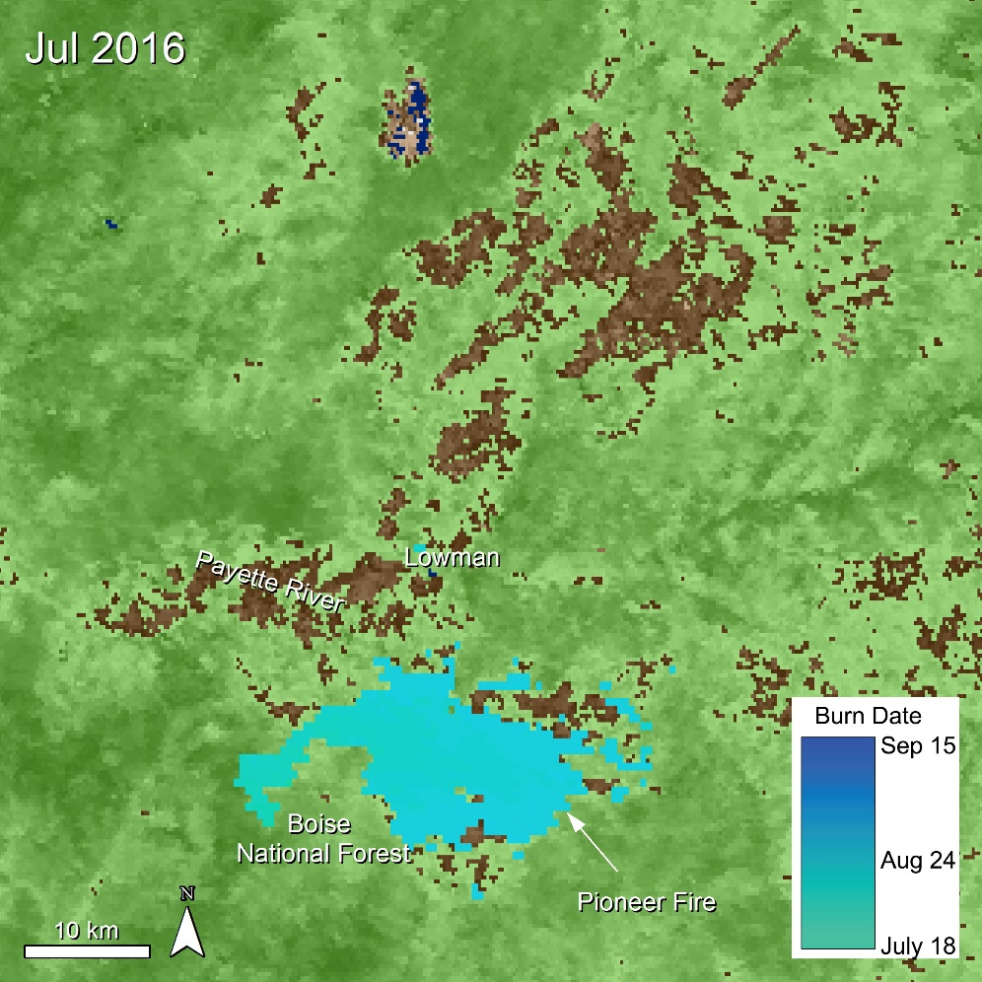
Use Case: Pioneer Fire
Data:
Monthly Burned Area
MCD64A1 - Burn Date
Objective:
Observe the burn scar from the Pioneer Fire (July 18 – Nov 4, 2016.)
MODIS: MCD64A1 Lowman, Idaho
DOI 10.5067/MODIS/MCD64A1.006 500 meter
25

Slide 26
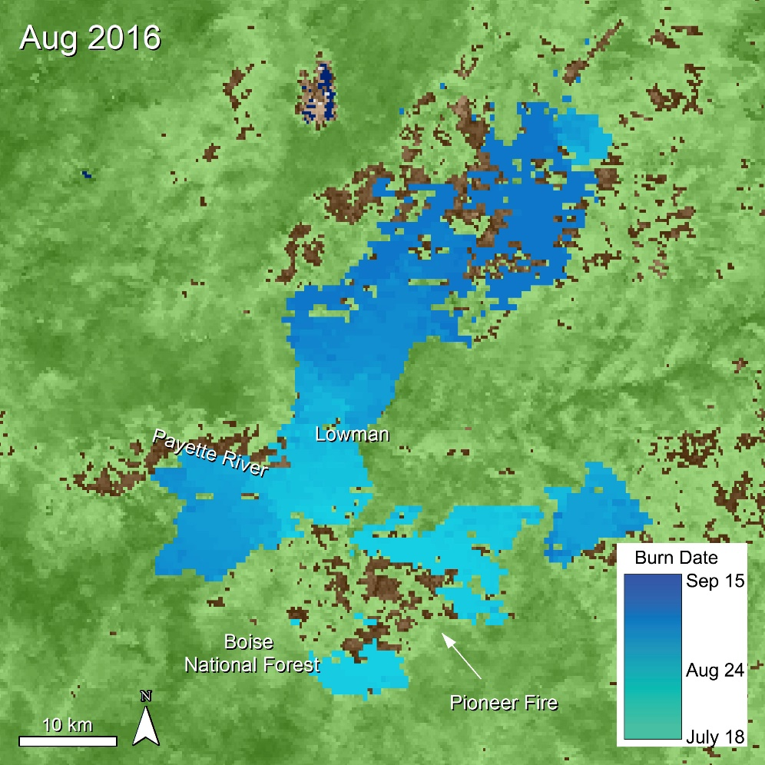
Use Case: Pioneer Fire
Data:
Monthly Burned Area
MCD64A1 - Burn Date
Objective:
Observe the burn scar from the Pioneer Fire (July 18 – Nov 4, 2016.)
MODIS: MCD64A1 Lowman, Idaho
DOI 10.5067/MODIS/MCD64A1.006 500 meter
26

Slide 27
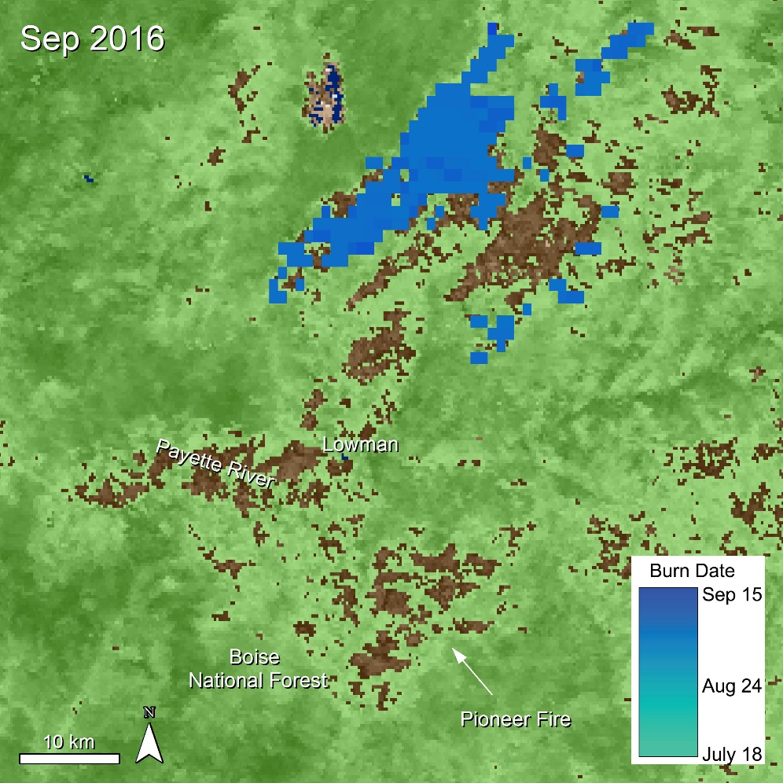
Use Case: Pioneer Fire
Data:
Monthly Burned Area
MCD64A1 - Burn Date
Objective:
Observe the burn scar from the Pioneer Fire (July 18 – Nov 4, 2016.)
MODIS: MCD64A1 Lowman, Idaho
DOI 10.5067/MODIS/MCD64A1.006 500 meter
27

Slide 28
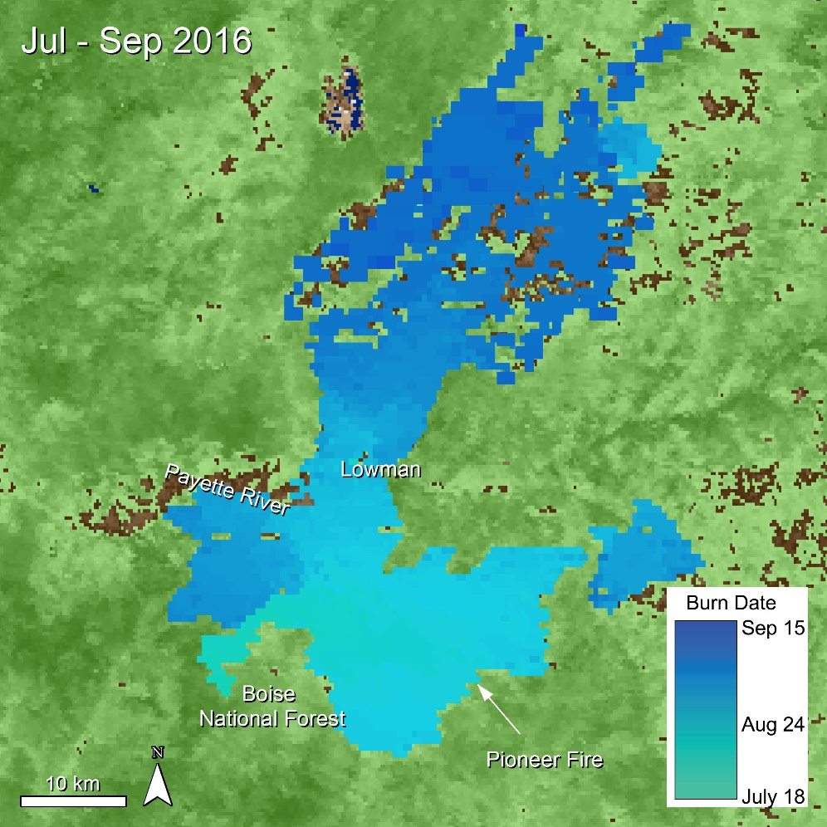
Use Case: Pioneer Fire
Data:
Monthly Burned Area
MCD64A1 - Burn Date
Objective:
Observe the burn scar from the Pioneer Fire (July 18 – Nov 4, 2016.)
MODIS: MCD64A1 Lowman, Idaho
DOI 10.5067/MODIS/MCD64A1.006 500 meter
28

Slide 29
Use Case: Pioneer Fire
Data:
Monthly Burned Area
MCD64A1 - Burn Date
MODIS: MCD64A1 Lowman, Idaho
DOI 10.5067/MODIS/MCD64A1.006 500 meter
29

Slide 30
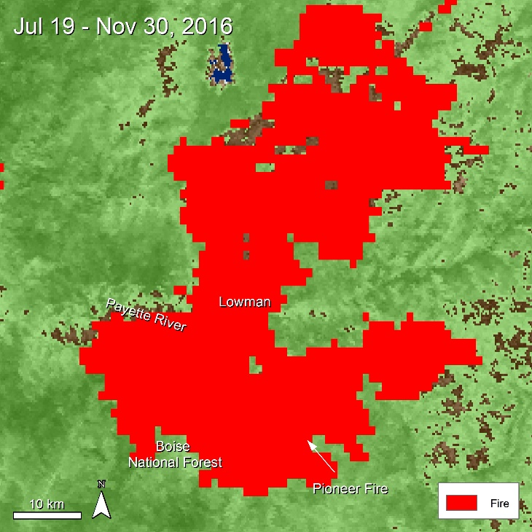
Use Case: Pioneer Fire
Data:
Monthly Burned Area
MCD64A1 - Burn Date
Data:
8-Day Thermal Anomalies & Fire
MOD14A2 – Fire Mask
MODIS: MCD64A1 Lowman, Idaho
DOI 10.5067/MODIS/MCD64A1.006 500 meter
MODIS: MOD14A2 Lowman, Idaho
DOI 10.5067/MODIS/MOD14A2.006 1,000 meter
30

Slide 31
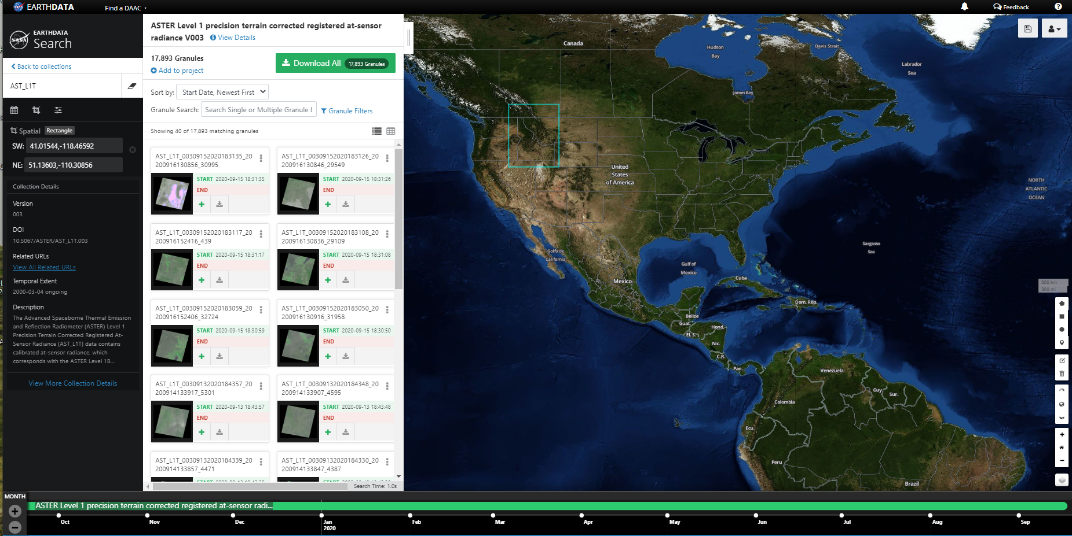
How Can Users Access These Data?
Several options tailored to user comfort
Just the data, ma’am! (Data Pool, DAAC2Disk Utility)
Where in the world is… my data? (NASA Earthdata Search, USGS Earth Explorer)
Have it your way! (AppEEARS)
All about that base map! (LP DAAC Web Map Services)
AppEEARS
Data Pool
Earthdata Search
Web Map Services
31

Slide 32
Demo: AppEEARS
Location:
Pioneer Fire near Lowman, Idaho
Time:
May 1 – Nov 30, 2015 - 2020
Data:
MCD64A1 V006 – Burn Date
MOD13Q1 V006 – NDVI
MOD14A2 V006 – Fire
32

Slide 33
User Services
Contact information:
Questions about LP DAAC data:
Voice: 605-594-6116 Toll Free: 866-573-3222 (866-LPE-DAAC) E-mail: LPDAAC@usgs.gov
Web: https://lpdaac.usgs.gov/
Join our listserv https://lists.nasa.gov/mailman/listinfo/lpdaac
33

