Slide 1
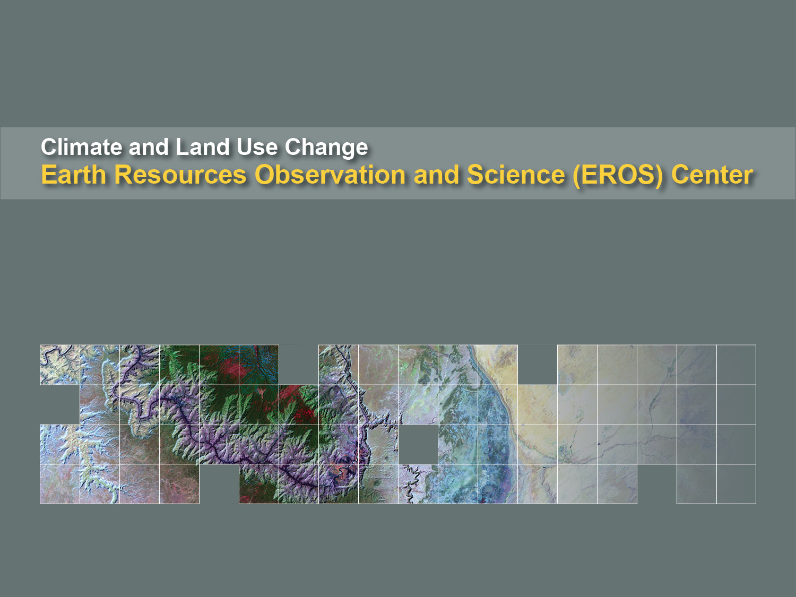

Working with Land Remote Sensing Data in a GIS Environment
Aaron Friesz and Cole Krehbiel, Innovate! Inc.
October 4, 2016

Slide 2
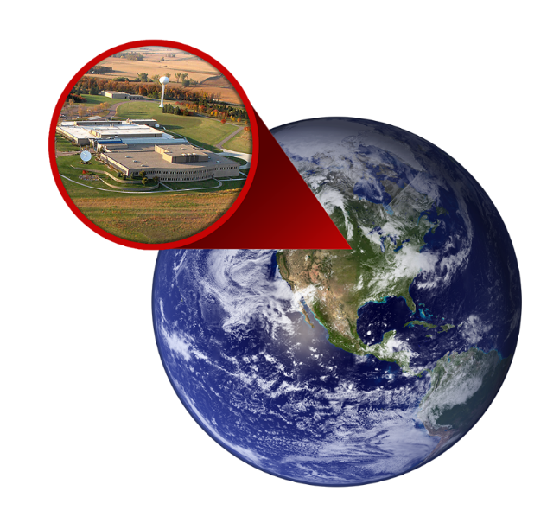

NASA’s LP DAAC
Land Processes (LP) Distributed Active Archive Center (DAAC)
  https://lpdaac.usgs.gov
Located in Sioux Falls, SD at the USGS Earth Resources Observation Science (EROS) Center
Part of NASA’s Earth Science Data Systems Program
1 of 12 NASA Earth Observing System Data and Information System (EOSDIS) DAACs

Slide 3
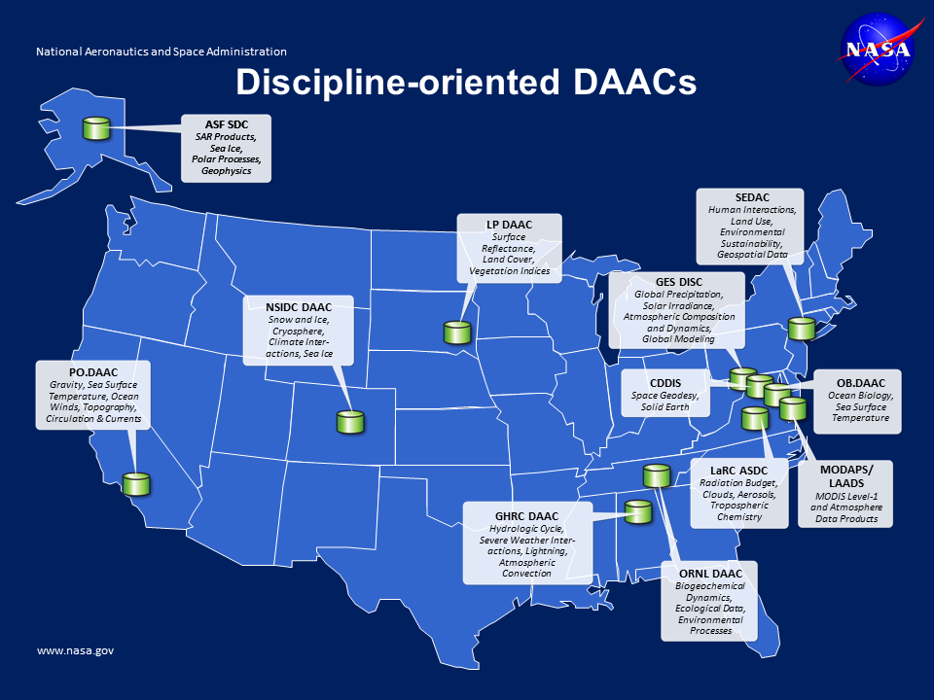
LP DAAC
Surface Reflectance, Land Cover, Vegetation Indices

Slide 4


Slide 5


Slide 6
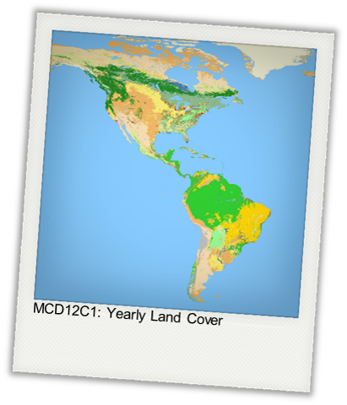
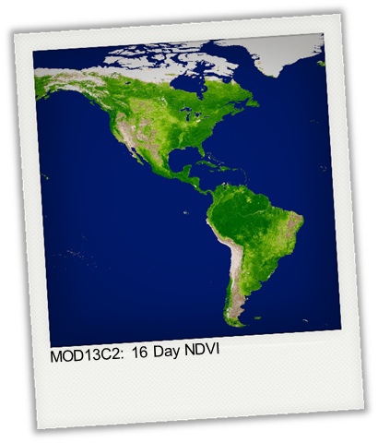
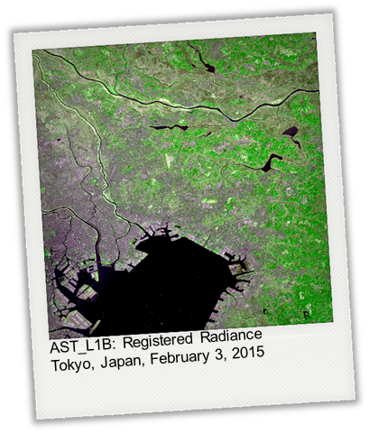
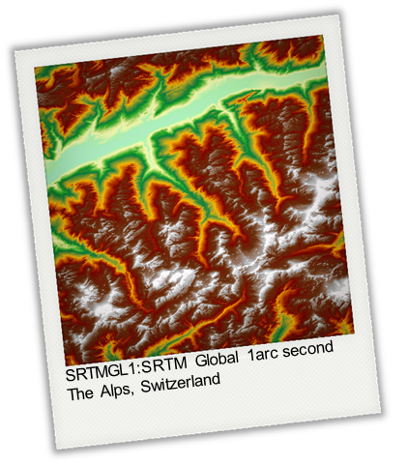
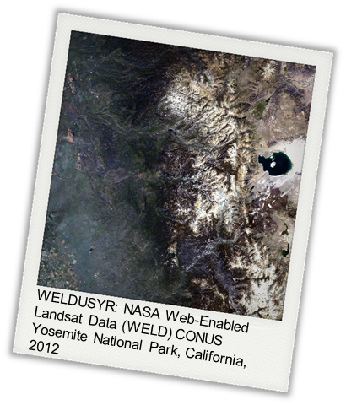
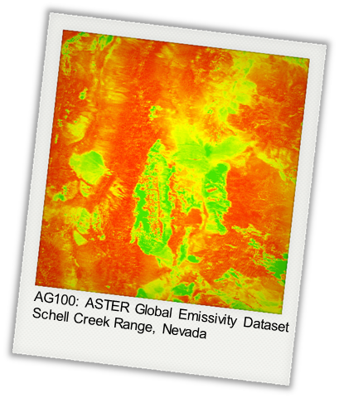
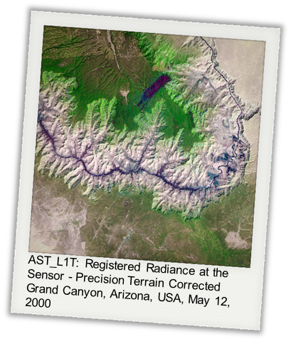
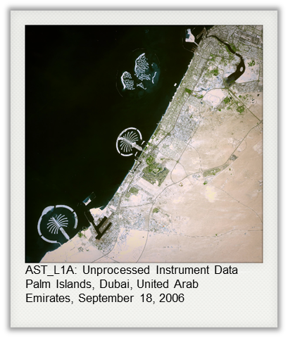
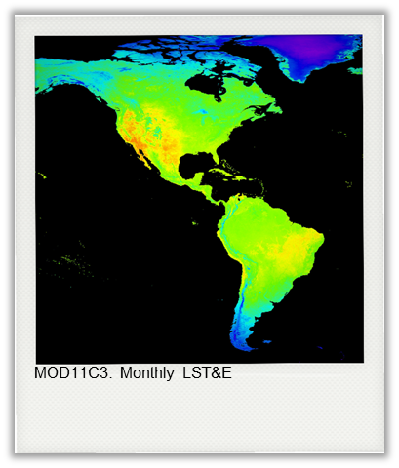

Slide 7
Data: MODIS
Moderate Resolution Imaging Spectroradiometer (MODIS)
Largest Collection
Terra, Aqua, and Combined Products
Spatial Coverage | Global
Temporal Coverage | 2000 (Terra), 2002 (Aqua) - Present
Spatial Resolution | 250 m, 500 m, 1000 m, 5600 m
Temporal Resolution | Daily, 8-day, 16-day, Monthly, Annual
Unique Products | 126 and growing!

Slide 8
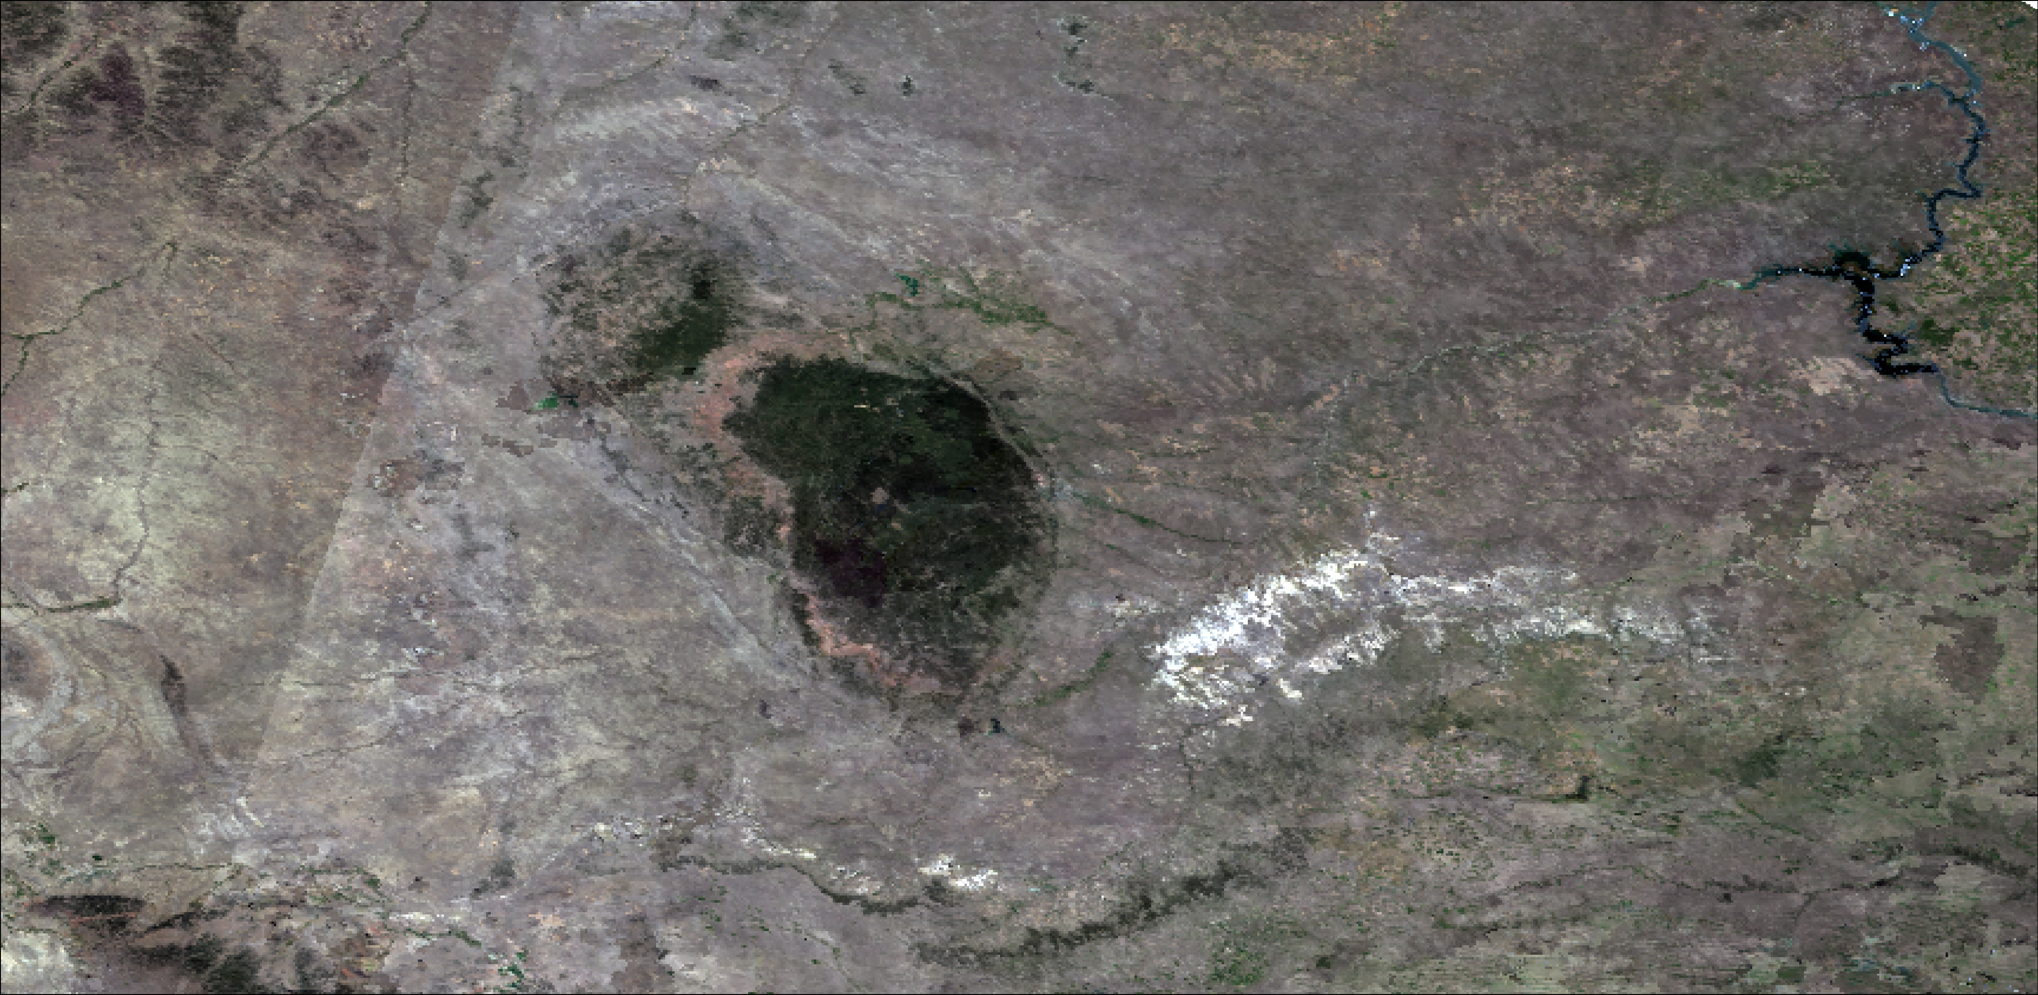
Data: MODIS Collection 6 (C6)
Geolocation Updates
Polarization Corrected L1B
New Land Water mask
Improved Cloud mask
Product specific updates
MOD09Q1.A2000241.h10v04.006 True Color
R = band 1; G = band 4; B = band 3

Slide 9
Data: ASTER
Advanced Spaceborne Thermal Emission and Reflection Radiometer (ASTER)
Global Coverage
  Taskable
  Pointable
  Expedited
Spatial Coverage | Global
Temporal Coverage | 2000 - Present
Spatial Resolution | 15 m (VNIR), 30 m (SWIR), 90 m (TIR)
Temporal Resolution
Unique Products | 6 standard, 10 on-demand

Slide 10
ASTER Data Products
Registered At-Sensor Radiance (AST_L1B)
  Precision Terrain Corrected (AST_L1T)
  Expedited (AST_L1BE)
  Orthorectified (AST14OTH, AST14DMO)
Reconstructed Unprocessed Instrument Data (AST_L1A)
  Expedited (AST_L1AE)
Global Digital Elevation Model (GDEM) (AST_GTM)
Surface Reflectance (AST_07, 07XT)
Surface Radiance (AST_09, 09XT, 09T)
Surface Kinetic Temperature (AST_08)
Surface Emissivity (AST_05)
Scene-based elevation (AST14DEM)
* On-demand higher level products

Slide 11
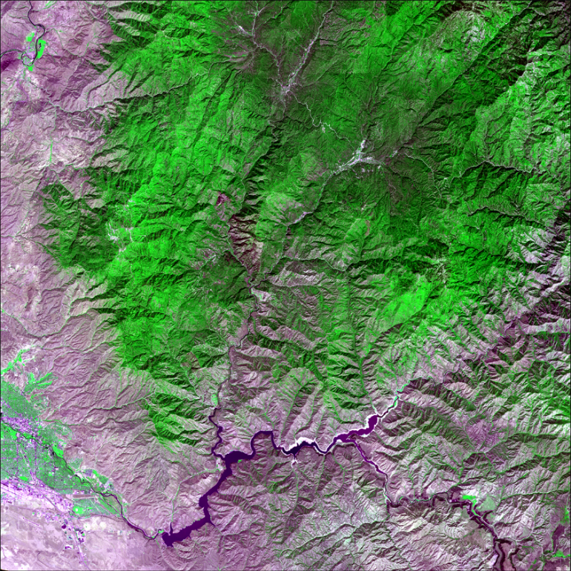
ASTER L1T
ASTER Level 1 Precision Terrain Corrected Registered At-Sensor Radiance (AST_L1T)
Generated with a single
resampling of an ASTER
Level 1A input scene
Orthorectified
Rotated north-up
Soon to be input for ASTER
higher-level products

Slide 12
Data: MEaSUREs
Making Earth System data records for Use in Research for Earth Science (MEaSUREs)
Web-Enabled Landsat Data (WELD)
Spatial Coverage | CONUS & Alaska
Temporal Coverage | 2003 - 2012
Spatial Resolution | 30 m
Temporal Resolution | Annual, seasonal, monthly, and weekly
Unique Products | 11
Shuttle Radar Topography Mission (SRTM) Version 3.0
Spatial Coverage | Global (60ºN to 56ºS latitude)
Spatial Resolution | 1 and 3 arc-seconds
Tile Size | 1º x 1º
Unique Products | 8

Slide 13
Data: Community Products
ASTER Global Emissivity Dataset (GED)
  Land surface emissivity derived from ASTER data
Spatial Coverage | Global
Temporal Coverage | 2000 - 2008
Spatial Resolution | 100 m & 1 km
Tile Size | 1º x 1º
Unique Products | 4

Slide 14


Slide 15
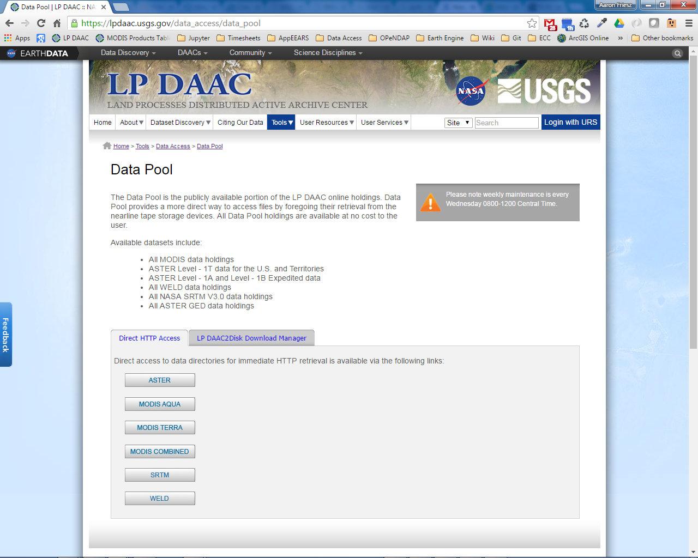
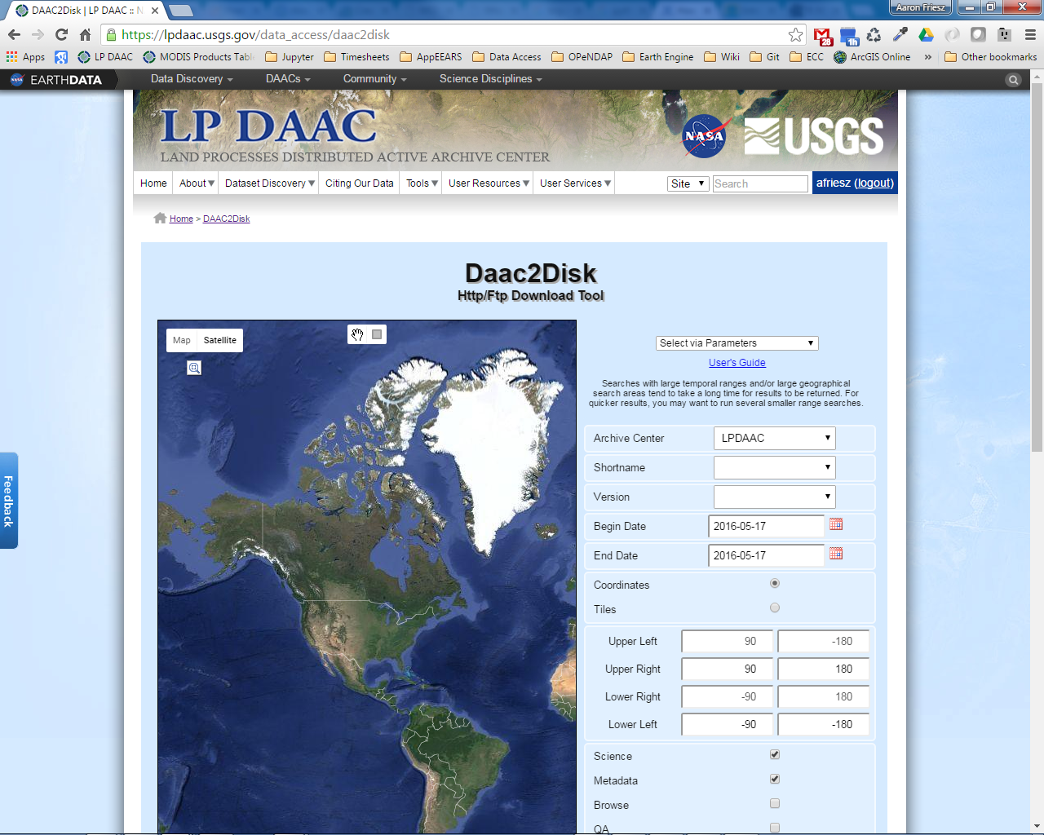
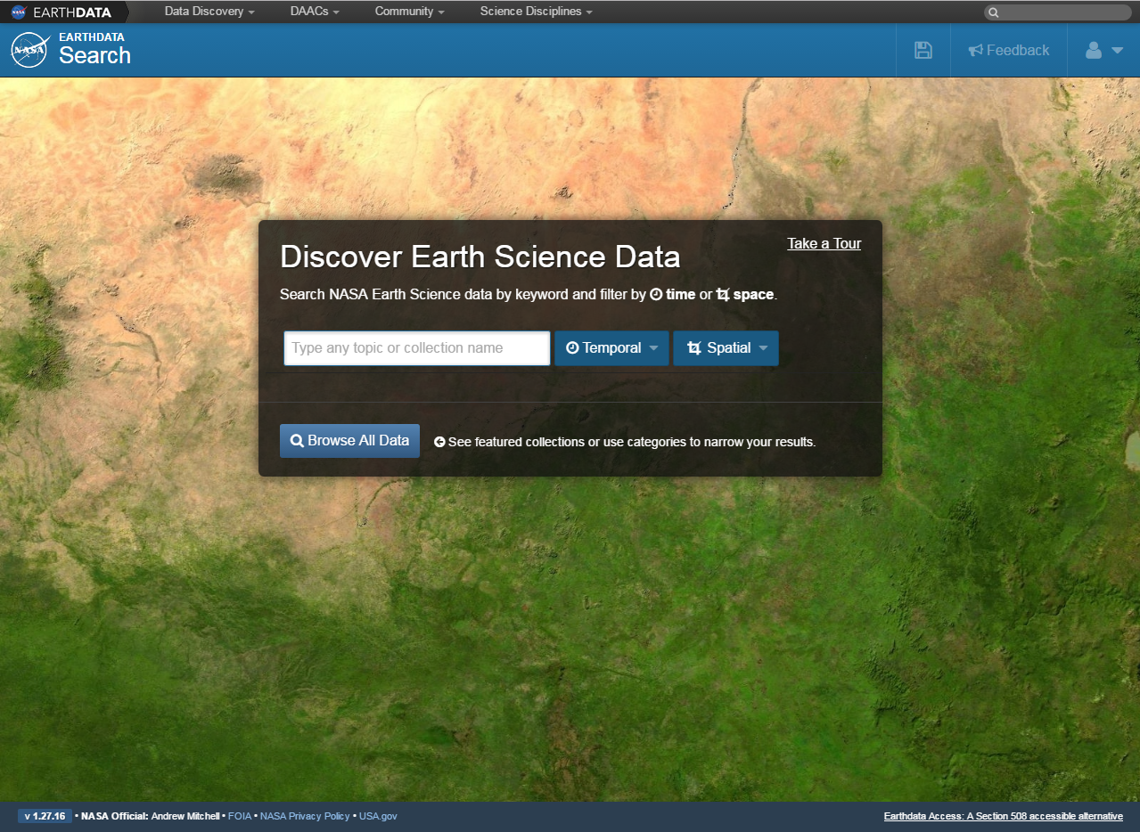
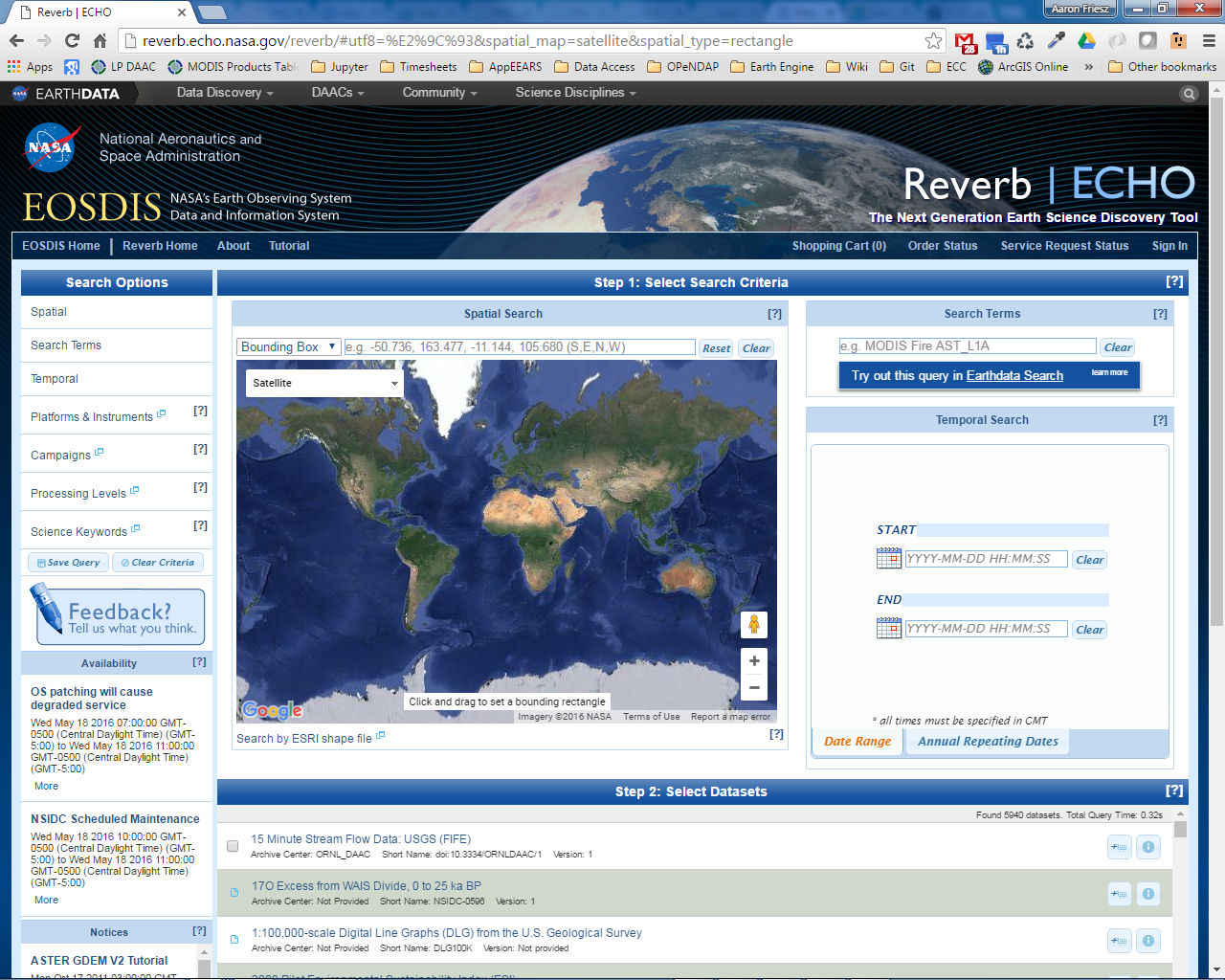

Slide 16
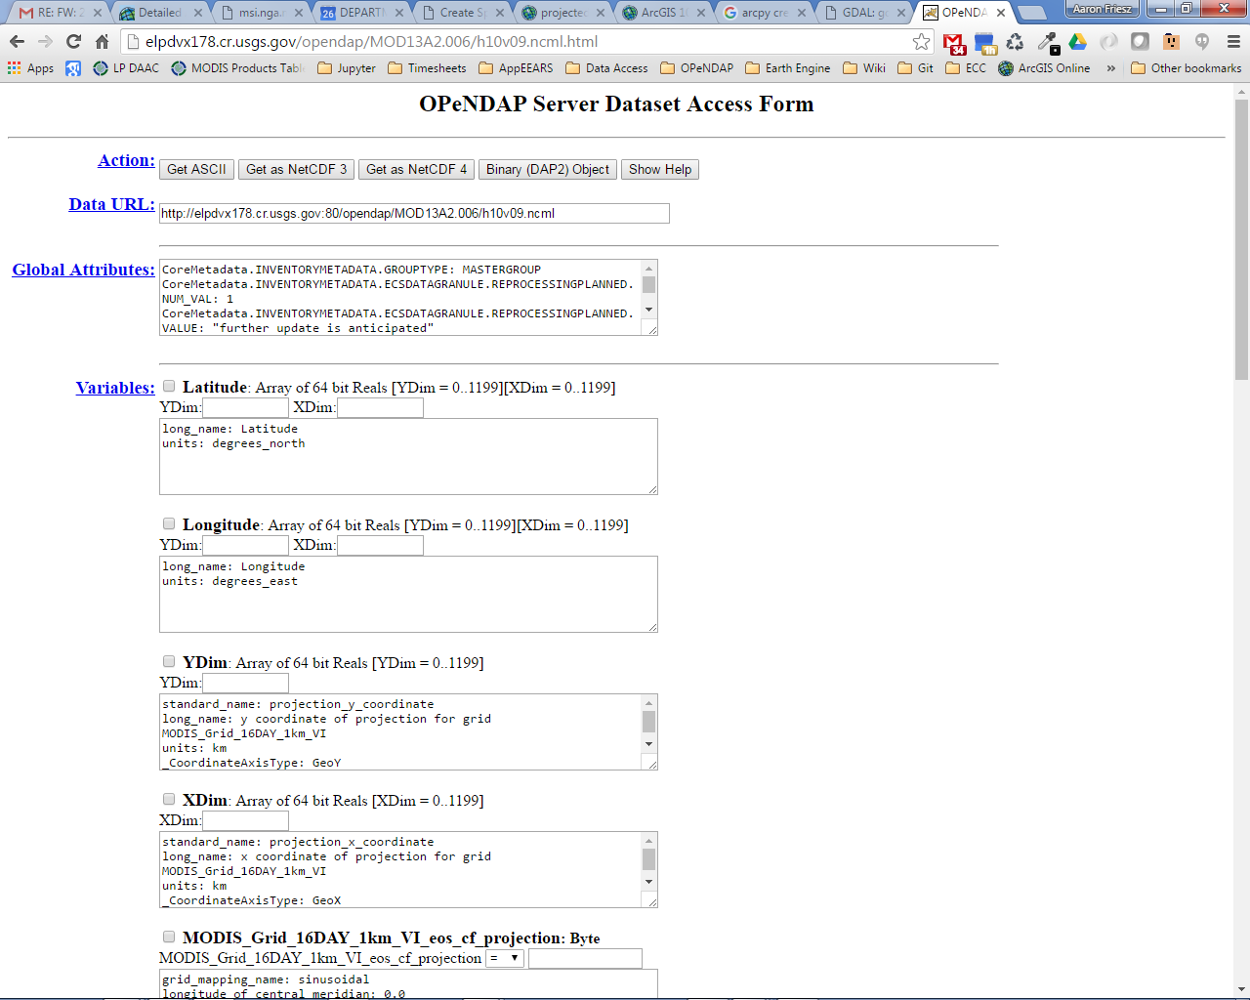
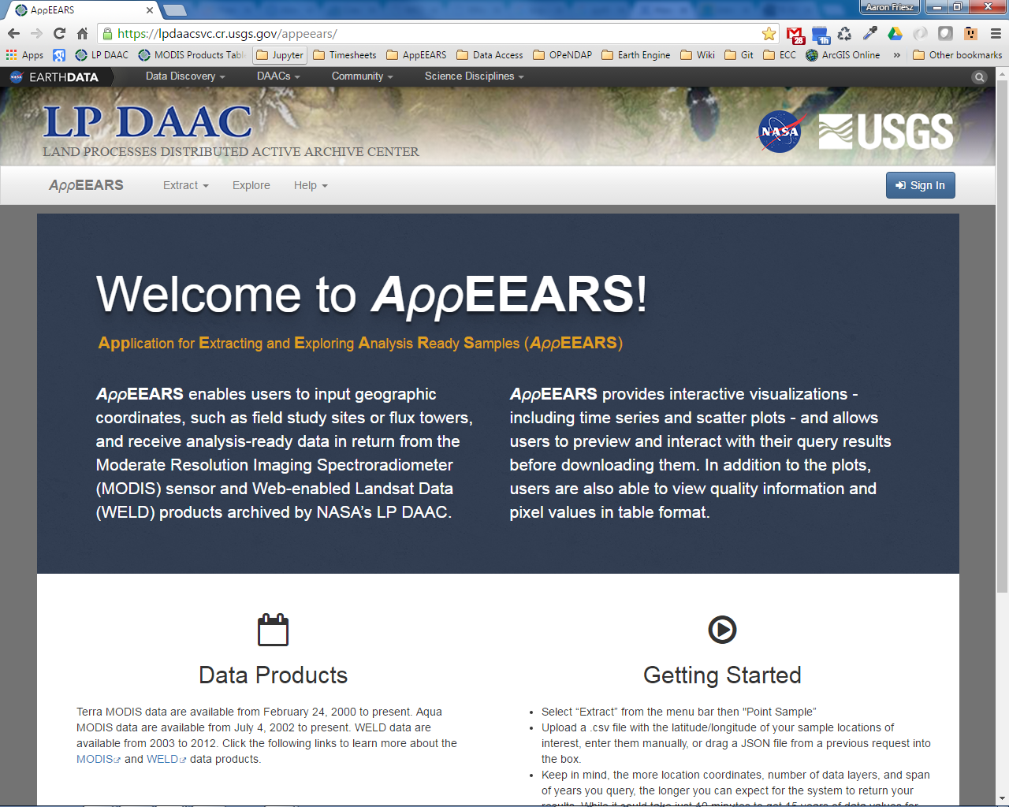
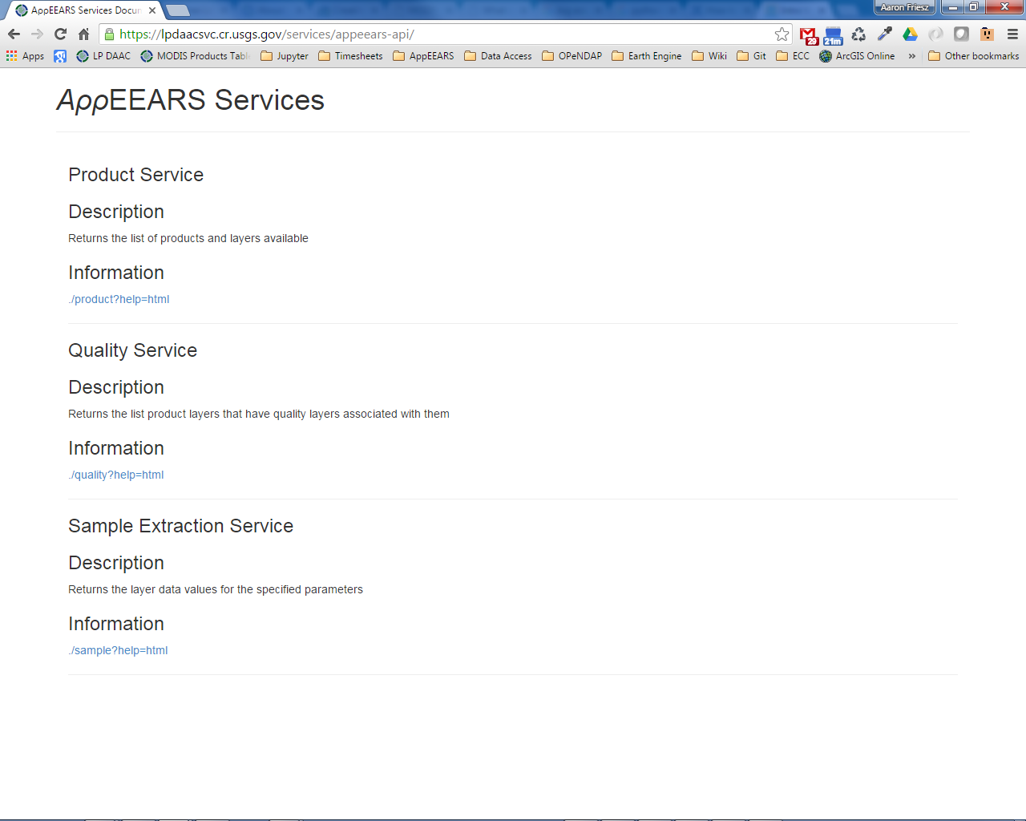

Slide 17
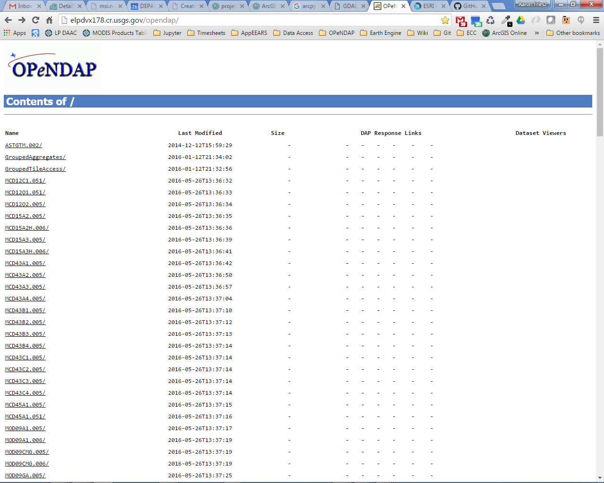
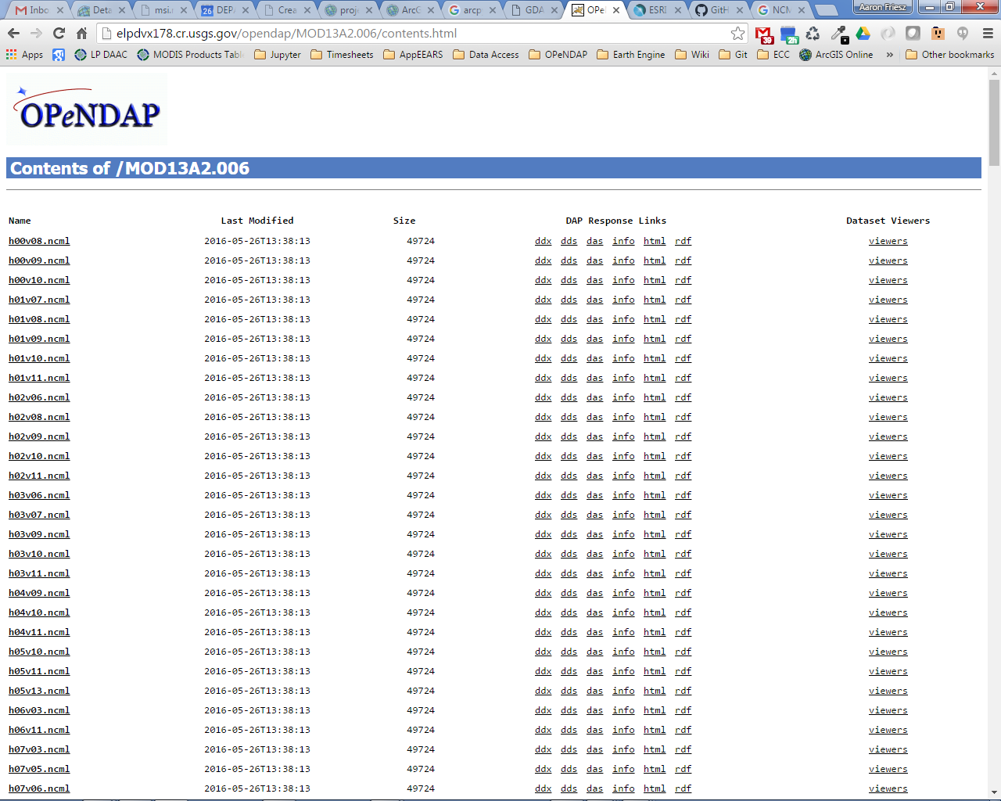
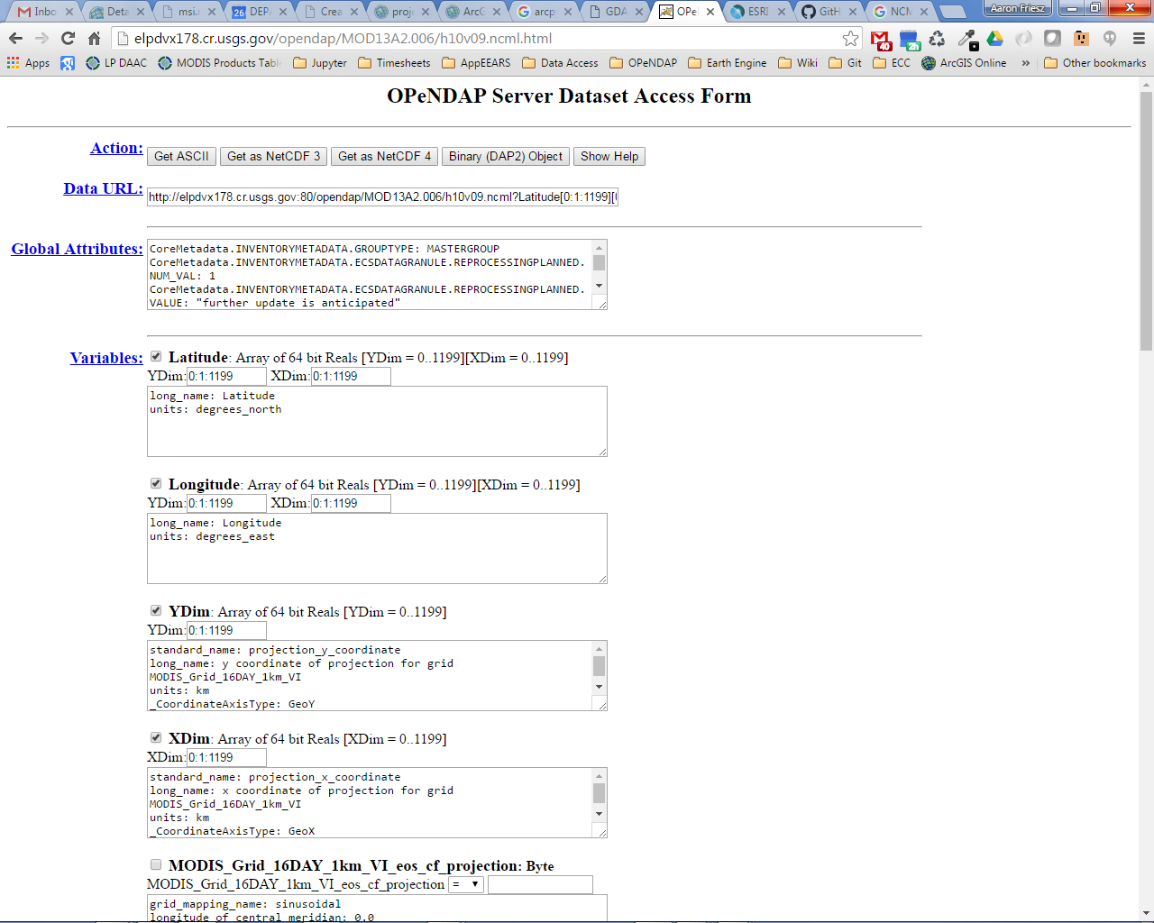
Retrieving Data Via OPeNDAP
http://elpdvx178.cr.usgs.gov:80/opendap/MOD13A2.006/h10v09.ncml?Latitude[0:1:1199][0:1:1199],Longitude[0:1:1199][0:1:1199],YDim[0:1:1199],XDim[0:1:1199],_1_km_16_days_VI_Quality[8:1:13][0:1:1199][0:1:1199],_1_km_16_days_EVI[8:1:13][0:1:1199][0:1:1199]

Slide 18
OPeNDAP Data Access
OPeNDAP URLs are complex
  Need to know:
    Syntax
    Product name
    Layer name
    Time
    Geolocation
      Tile locations (H & V) – Data is aggregated over time by tile
      Pixel location (Ydim & Xdim)
http://opendap.cr.usgs.gov/opendap/hyrax/MOD09Q1.005/h11v04.ncml.ascii?sur_refl_b01[683:1:683][2000:1:2010][2000:1:2010]

Slide 19
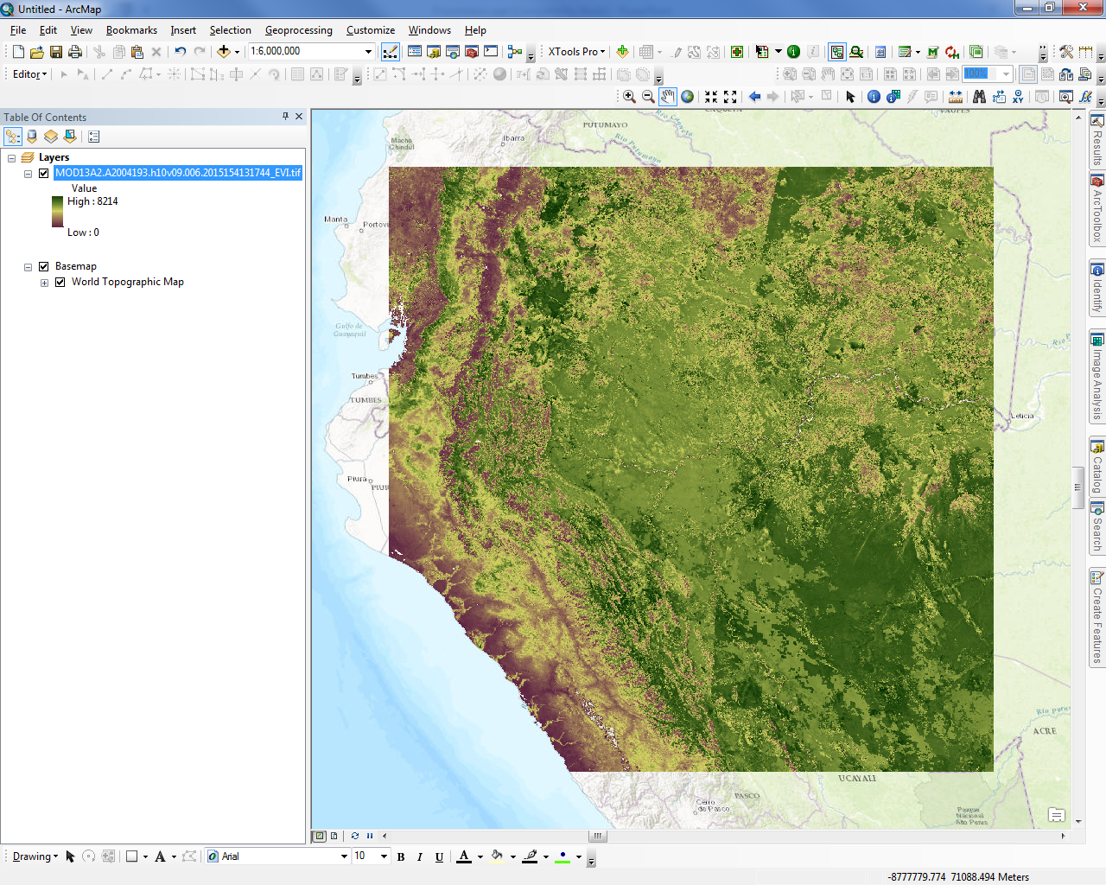
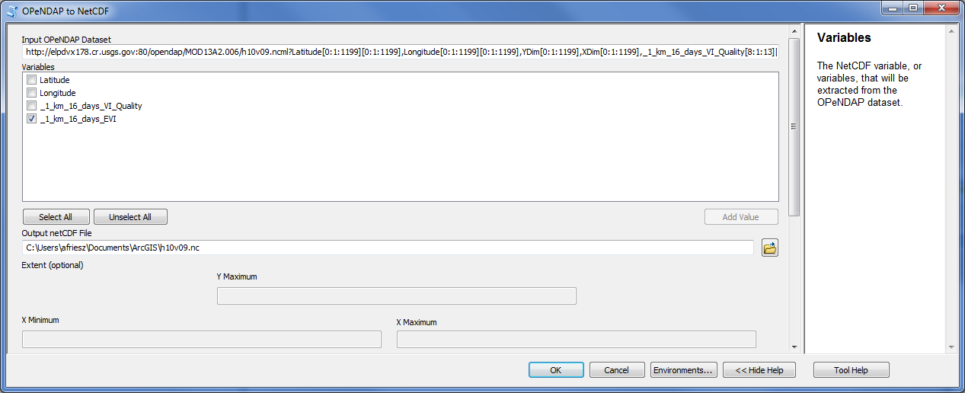
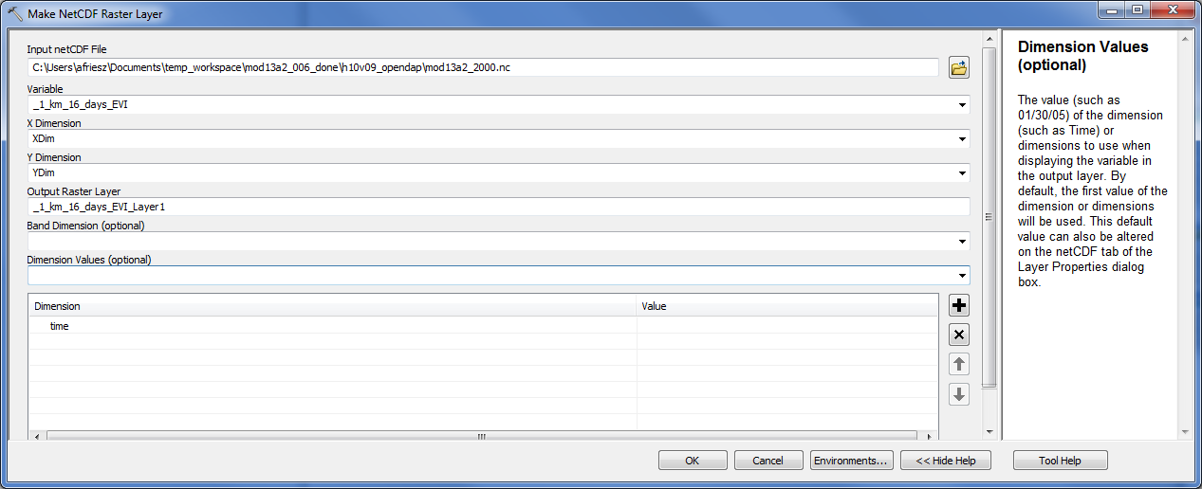
OPeNDAP to NetCDF
NetCDF to Raster Layer

Slide 20
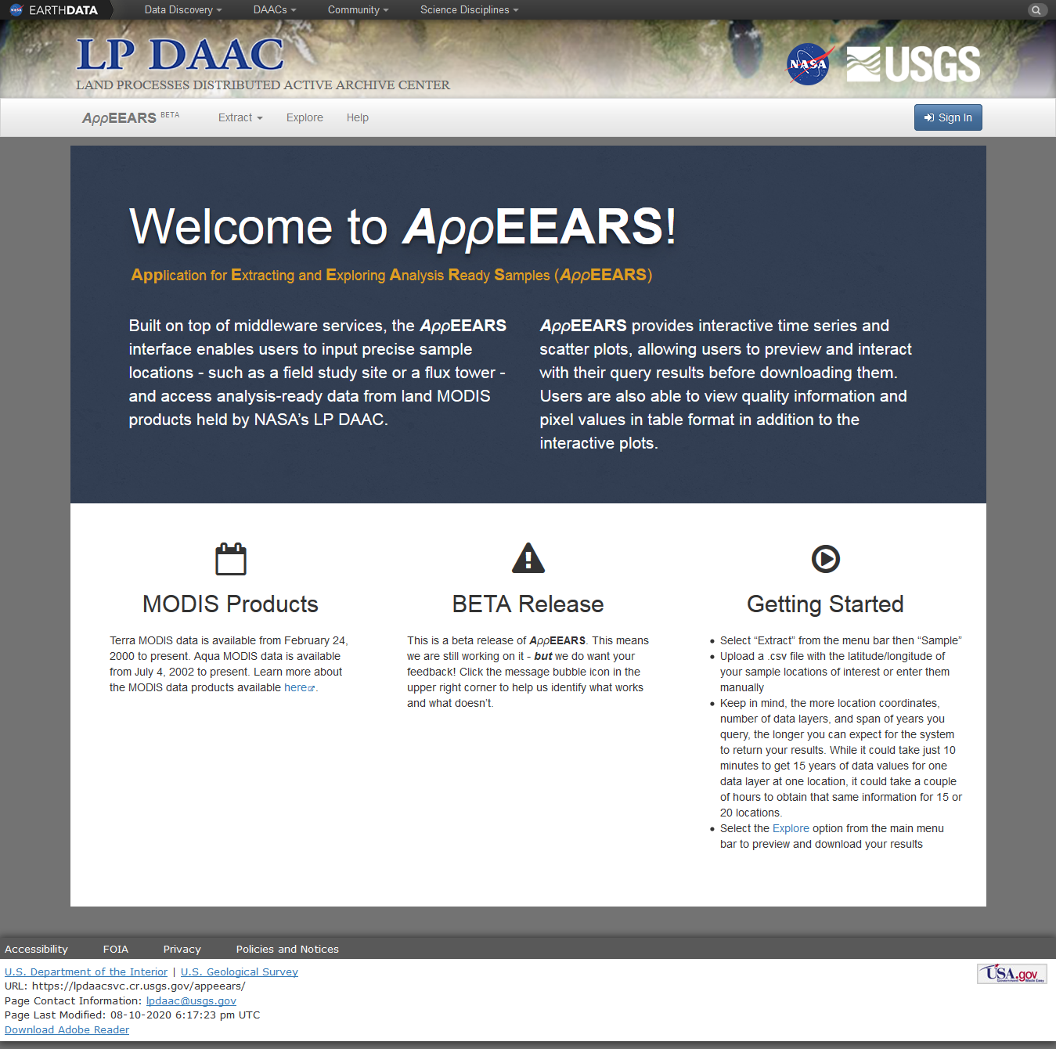
AppEEARS
Application for Extracting and Exploring Analysis Ready Samples
Web application interface for accessing and extracting LP DAAC’s tiled MODIS and WELD data

Slide 21
AppEEARS
Built on top of services and tools
Capabilities
  Easy access and selection of MODIS and WELD land data
  Extracts pixel values for sample point locations
  Data exploration and interaction
    Dynamic Graphs
    Tables
  Download Bundle
    Analysis-ready data

Slide 22
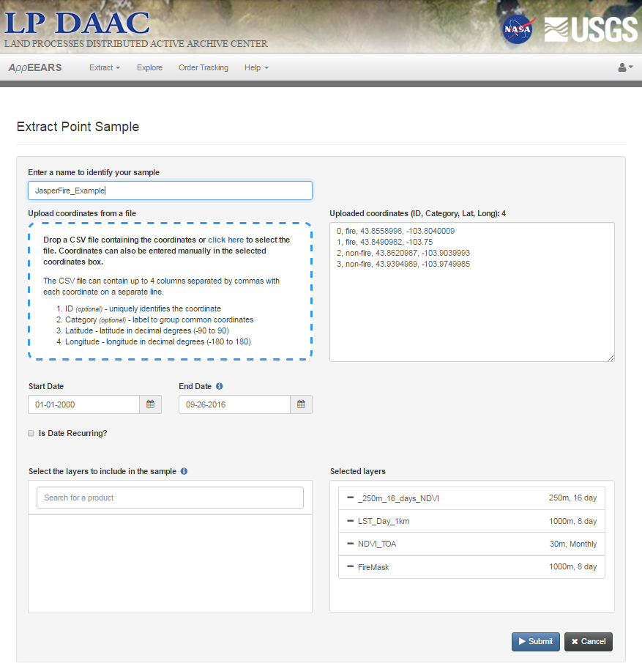
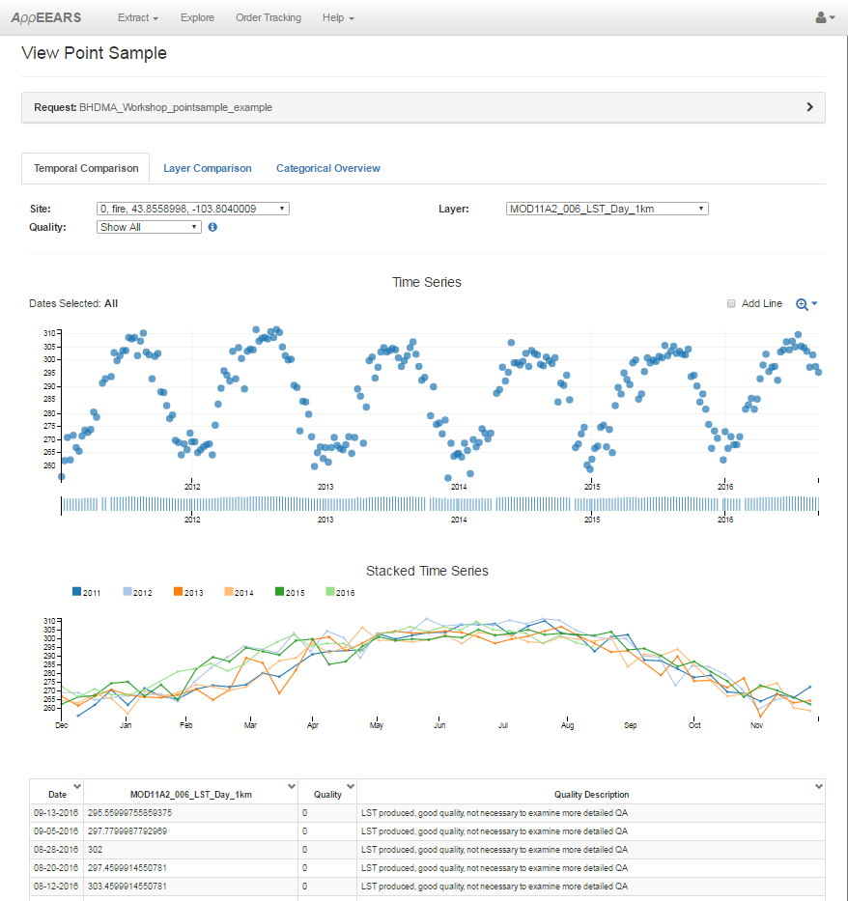
AppEEARS – Point Extraction

Slide 23
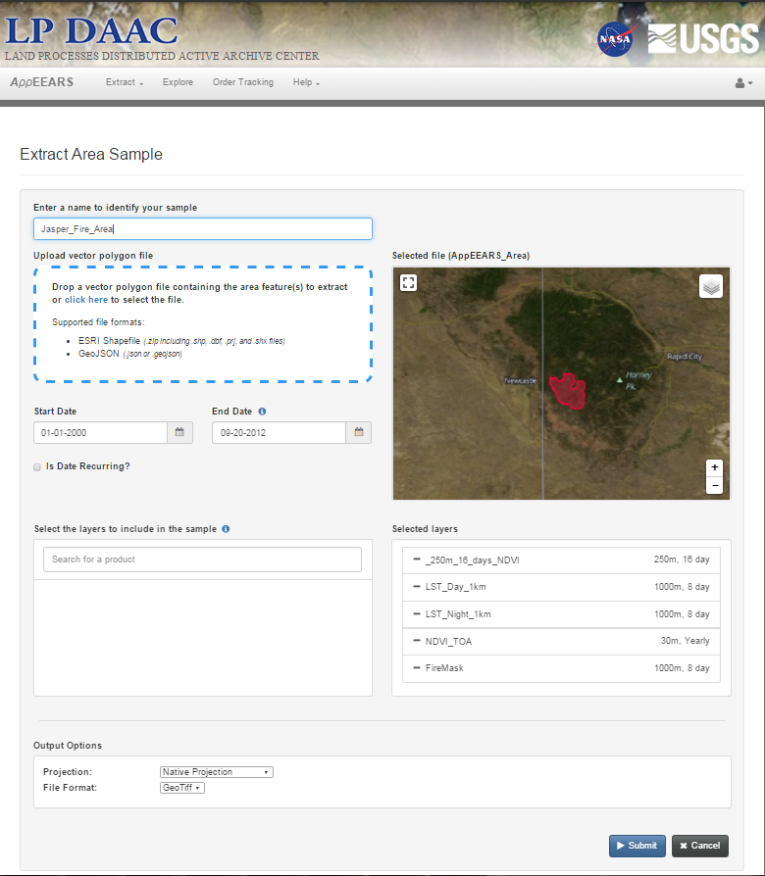
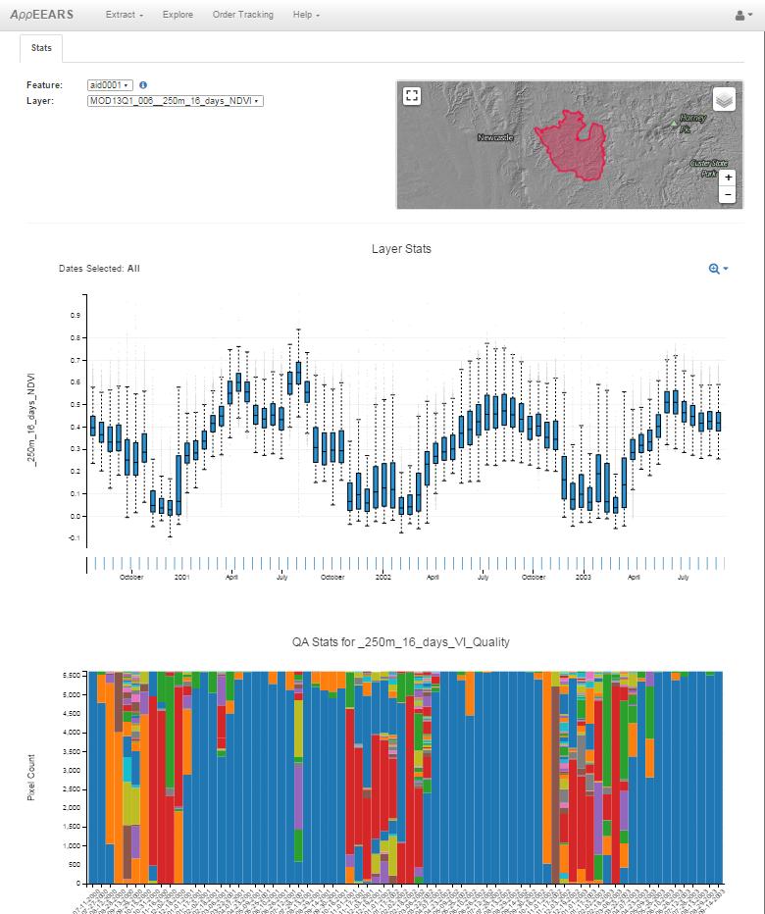
AppEEARS – Area Extraction

Slide 24
Tools and Tutorials
AppEEARS Python Toolbox
  MODIS Quality Decoder
ASTER L1T Processing Tutorials
  HDF to GeoTIFF
  Digital Numbers to TOA Reflectance
AppEEARS Web Services Tutorials
  Product
  Sample
  Quality

Slide 25
Using Quality Filtered Data
Data products include quality assurance (QA)
  Usability and usefulness of the data product
All MODIS products contain a QA layer
  Granule-level QA Stats
  QA Flags
  Pixel-level QA
Often overlook
  Difficult to decode
  Tedious to interpret

Slide 26
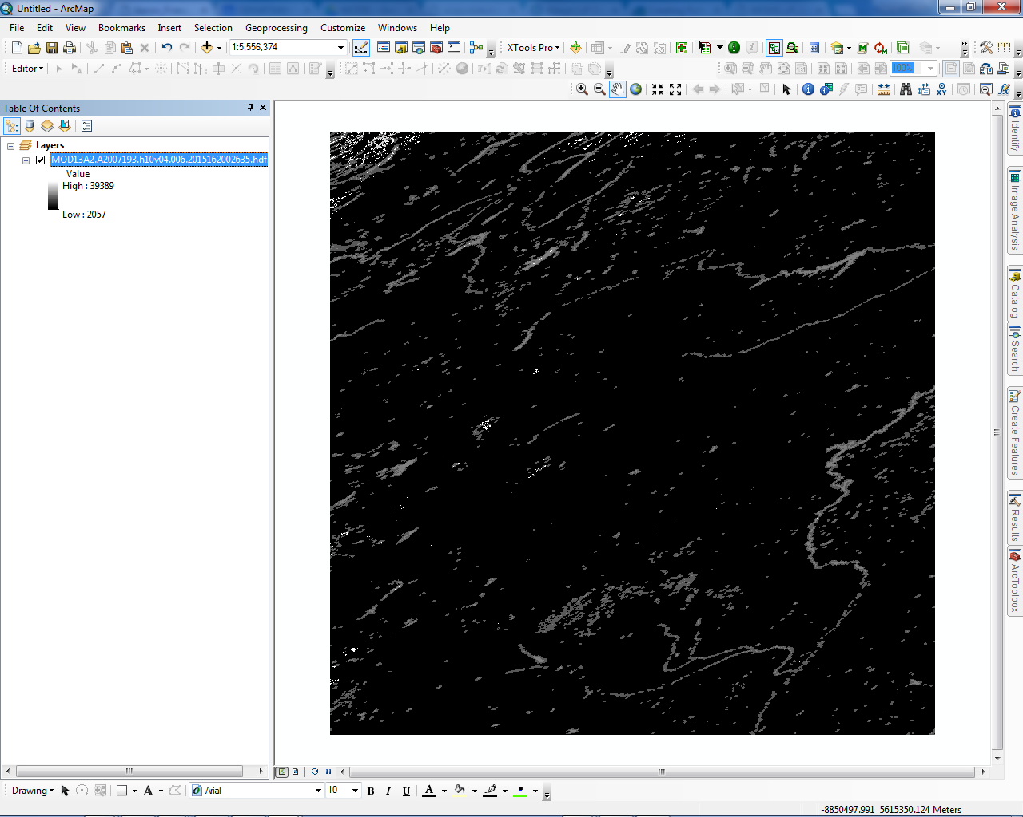
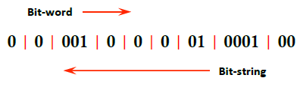
Decoding MODIS QA
VI Quality = 00, pixel produced with good quality
VI usefulness = 0001, pixel is of highest quality
Aerosol Quantity = 01, aerosol load was low
Adjacent Cloud detected = 0, no adjacent clouds detected
Atmospheric BRDF Correction = 0, no Atmosphere BRDD correction performed
Mixed Clouds = 0, pixel with no mixed clouds
Land Water Mask = 001, pixel over land
Possible Snow/Ice = 0, no snow/ice cover
Possible Shadow = 0, no cloud shadow
Pixel value:
2116
16-bit binary value: 0000100001000100

Slide 27


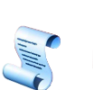
Decoding MODIS QA
ArcGIS Python Toolbox
Python Toolbox with quality decoding script
LP DAAC Web Services
Quality Decoder
AppEEARS Quality Service

Slide 28
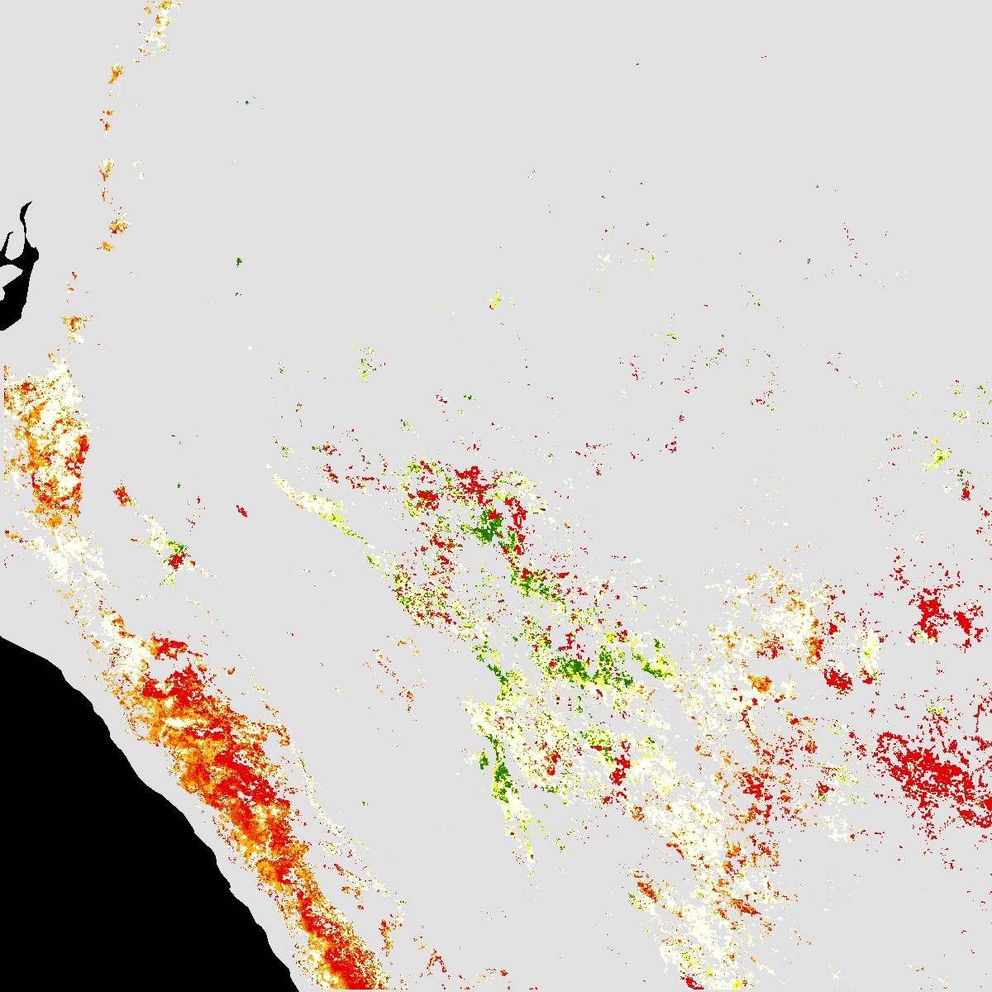
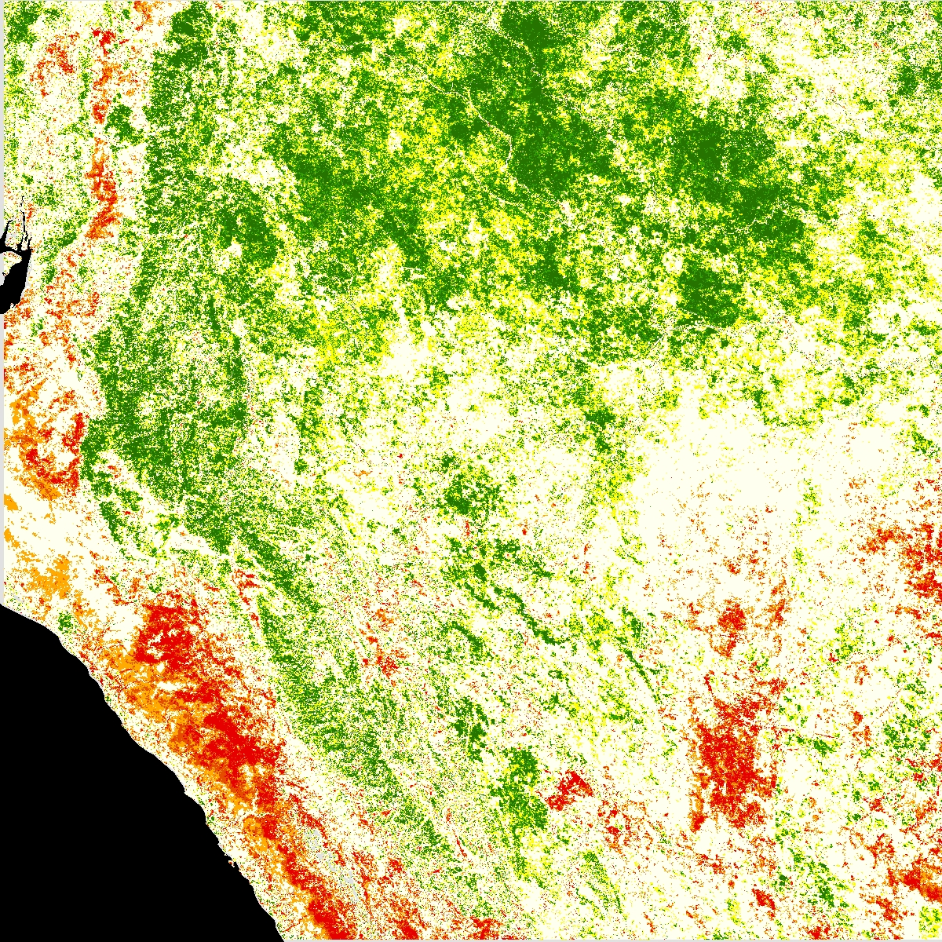
Unscreened
Screened
EVI Standardized Anomalies

Slide 29
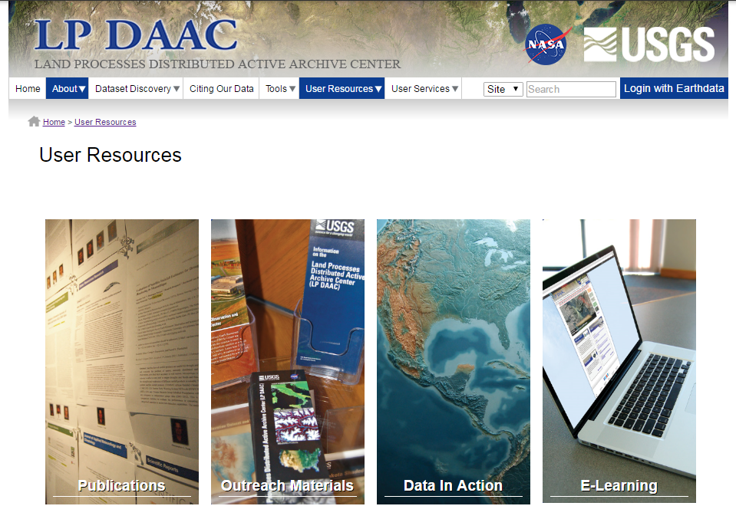
LP DAAC User Resources

Slide 30
Questions ?
For More Information about our services:
Visit our website: https://lpdaac.usgs.gov/
Subscribe to our listserv:
https://lists.nasa.gov/mailman/listinfo/lpdaac
Contact: LP DAAC User Services: LPDAAC@usgs.gov

Slide 31
Demo and Hands-on Training
Jasper Fire, Black Hills, SD
Started on August 24, 2000
Burned 83,508 acres
  90% of the Land Area of Jewel Cave National Monument
  Biggest wildfire in South Dakota History
  National Park Service, The Jasper Fire, 2016, accessed September 27, 2016 at https://www.nps.gov/jeca/learn/nature/jasperfire.htm

Slide 32
Demo #1: Searching and Downloading ASTER and MODIS Data
- Open a web browser, and navigate to: https://search.earthdata.nasa.gov/
- First, click on “Earthdata Login” box in the upper right hand corner of the page
ASTER L1T
1. Type “ASTER L1T” into the search box
2. Click on the ASTER Level 1 precision terrain corrected registered at-sensor radiance v003 collection
3. Pan the map over the Black Hills and zoom in
4. Use the Temporal filter to limit results between 2000-07-19 and 2003-09-24
4.1. Check the “Recurring?” box, and set the start date to 07-19, end date to 09-24, and Year Range from 2000-2003.
5. Use the Spatial > Point filter to mark the location of the Jasper Fire
5.1. Copy & Paste into Point box: 43.75634765625,-103.88671875
6. Find the ASTER L1T scenes from before, during, and after the Jasper Fire. Sort granules by “Start Date, Oldest first”.
6.1. Before (2000-07-19)
6.1.1. AST_L1T_00307192000181502_20150410115602_35318
6.1.2. AST_L1T_00307192000181453_20150410115552_34821
6.2. During (2000-08-29)
6.2.1. AST_L1T_00308292000180849_20150411101435_99391
6.3. After (2003-09-23)
6.3.1. AST_L1T_00309232003175325_20150430234251_100101
7. Click the in the upper right hand corner of each granule to remove unwanted granules.
8. Once the list is narrowed down to the four granules listed above, click.
9. Confirm that Select Data Access Method is set to Download and click Submit > View Download Links
9.1. Click and download the .tif and .hdf file links.
…

Slide 33
MODIS
10. On the Earthdata Request page, click on “Back to Data Access Options” > Back to Search Session
11. Type “MOD13Q1” into the search box
12. Click on the MODIS/Terra Vegetation Indices 16-Day L3 Global 250m SIN Grid V006
13. Find the MODIS VI scenes from before, during, and after the Jasper Fire
13.1. Before (2000-07-11)
13.1.1. MOD13Q1.A2000193.h10v04.006.2015138080741
13.2. During (2000-08-28)
13.2.1. MOD13Q1.A2000241.h10v04.006.2015138080732
13.3. After (2003-09-14)
13.3.1. MOD13Q1.A2003257.h10v04.006.2015153114344
14. Click the in the upper right hand corner of each granule to remove unwanted granules.
15. Once the list is narrowed down to the three granules listed above, click.
16. Confirm that Select Data Access Method is set to Download and click Submit > View Download Links
16.1. Click and download the .hdf file links.
17. Repeat steps a-g above for MODIS product MOD09A1 (surface reflectance):
18. Find the granules below:
18.1. MOD09A1.A2000201.h10v04.006.2015138114933 (before)
18.2. MOD09A1.A2000241.h10v04.006.2015138112324 (during)
18.3. MOD09A1.A2003265.h10v04.006.2015080220533 (after)
END

Slide 34
Demo #2: Opening MODIS and ASTER Data
Add MODIS data to ArcMap
1. Click on the Add Data Icon and navigate to the directory containing the MOD13Q1 hdf files
1.1. Add subdataset 0 “250m_16_days_NDVI”
1.2. Click Yes to create pyramids (do this throughout workshop).
2. Click on the Add Data Icon and navigate to the directory containing the MOD09A1 hdf files
2.1. For each MODIS hdf file, check the “Add as a RGB layer” and select subdatasets 0, 2, and 3.
Reproject MODIS Data
3. Select Arc Toolbox > Data Management Tools > Projections and Transformations > Raster
3.1. Right click Project Raster > Batch…
3.2. Edit input rasters and output names
3.2.1. Output name needs to be less than 14 characters in length
3.3. Set Output Coordinate System to WGS 1984 UTM Zone 13N
4. Insert New Data Frame with coordinate system WGS 1984 UTM Zone 13N
4.1. Drag and drop reprojected files into new Data Frame
Visualize MODIS Data
5. For each MOD13Q1 File, double click the color ramp icon in the Table of Contents (TOC)
5.1. Change the Color Ramp to: (Red to Green Diverging, Dark)
6. For Each MOD09A1 File, double-click on the file, and select the “Symbology” tab
6.1. Under the bands dropdown, change the RGB combination to:
6.1.1. R = Band1-1
6.1.2. G= Band3-1
6.1.3. B= Band2-1
Add ASTER data to ArcMap
7. Click on the Add Data Icon and navigate to the directory containing the ASTER L1T hdf files
7.1. Select one of the subdatasets to open into ArcMap
7.2. Notice the “Unknown Spatial Reference” warning
…

Slide 35
Visualize ASTER Data
8. Open the RGB (_V.tif) files from the original ASTER downloads
8.1. To remove black space, Properties > Symbology and check the “Display Background Value” box
9. For Research
9.1. Use ASTER L1T HDF 2 Tif Py/R scripting tool, Available online at:
9.1.1. https://lpdaac.usgs.gov/user_resources/e_learning/how_reformat_and_georeference_aster_l1t_hdf_files
9.1.2. https://lpdaac.usgs.gov/user_resources/e_learning/how_convert_aster_l1t_radiance_top_atmosphere_reflectance
Visually inspect image time series for the Jasper Fire
END

Slide 36
Demo #3: Accessing MODIS Quality Information
All pixels are not created equally. A quality assurance science dataset is supplied to aid the user in determining the usability and usefulness of the MODIS data layer they intend to use. However, these quality assurance dataset are often difficult to decode and interpret. Therefore, the LP DAAC has developed an ArcGIS Python Toolbox that decodes and maps the individual quality groups that are stored within the values of the quality assurance dataset.
Getting Quality Information from your MODIS Collection 6 Data Layers
- Download the MODIS Python Toolbox (zip) from https://lpdaac.usgs.gov/user_community/user_resources/e_learning/decoding_modis_version_6_quality_science_datasets_using
1. In ArcMap, Insert new Data Frame
2. Click “Add Data”
2.1. Navigate to the MOD09A1 hdf file you intend to use, and select the subdataset(s)/layer(s) and the associated quality layer(s) (qc)
2.1.1. Click “OK”
Export the quality layers as a GeoTiff
3. Right click on the quality layer > Data > Export Data…
3.1. Optional: Change Location
3.2. Optional: Change Name
3.3. Click “Save”
4. Add the GeoTiff that was just created to the Data Frame
Access the AppEEARS Python Toolbox
5. Click “Catalog”
5.1. Navigate to the location where the MODIS Python Toolbox was saved.
5.2. Double click the “MODIS_Tools” Python Toolbox (MODIS_Tools.pyt)
5.3. Select “DecodeQuality” Python Tool
6. Fill in the parameters for the “DecodeQuality” Python Tool
6.1. Add the quality layer GeoTiff as the “Input Raster Layer”
6.2. Select an “Output Workspace” to save to
6.3. Specify an “Output Raster Layer Name”
6.3.1. Multiple output file may be created as a result of running this tool. Each file will pertain to a particular decoded quality group. This name is used for all output files created.
…

Slide 37
6.4. Select the MODIS Collection 6 product from which the quality layer belongs to from the list of MODIS Collection 6 products
6.5. Select the quality layer being used from the list of quality layers
6.5.1. Usually only one quality layer appears
6.6. Leave the “Bit-Field” parameter set to “ALL” if you wish to have all the quality groups decoded OR select a specific quality group from the drop down.
6.6.1.1. Click “OK”
7. When the tool has successfully completed, add the output data to the ArcMap Data Frame
7.1. These files DO NOT add automatically
The resulting output(s) from the “DecodeQuality” tool is/are thematic raster layer(s) containing the quality group category descriptions, values, and counts. These layers can be used to make decisions on the usability and usefulness of you data. A single layer can be used to mask out undesirable pixels from an associated data layer. The outputs can also be combined using ArcGIS’ Raster Calculator tool to create a unique mask layer based on criteria set for each output quality layers.
Create Quality Mask
8. Open the attribute table from quality group name “MODLAND”.
8.1. Highlight the row specifying the best quality pixels
9. Mask the data layer (e.g., NDVI, EVI, LST, Sur_Ref …) using the highlighted category from the MODLAND quality layer.
10. Click “ArcToolbox”
11. Click Spatial Analyst Tools > Extraction > Extract by Mask
11.1. Select the data layer as the “Input raster”
11.2. Select the MODLAND quality layer (with the highlighted category still in affect) as the “feature mask data”
11.3. Specify an output location and name for the masked output
12. Add the masked output to the ArcMap Data Frame
13. Experiment with combining quality group layers to create a mask.
13.1. How can you create a mask using multiple quality layers?
13.2. Which quality layers would you use?
13.3. Which attributes would you mask by?
END

Slide 38
Demo #4: Using AppEEARS Point Sampler
- In ArcMap 10.4.1
- Activate the Data Frame containing the ASTER L1T RGB composites
Collect points to be used for as input coordinates for AppEEARS
Create Point Shapefile
1. Open ArcCatalog and navigate to your workshop folder to create new point shapefile
1.1. Feature Type: Point
1.2. Edit Spatial Reference to WGS 1984 UTM Zone 13N
1.3. Close ArcCatalog
Edit Features of new shapefile in ArcMap
2. Right click on the new point shapefile and select Edit Features > Start Editing
3. In the Editor Toolbar, select Create Features and add a few points both inside and outside of the Jasper Fire.
3.1. Click the Editor Dropdown and select Save Edits and then Stop Editing
4. Open the Attribute Table for the point layer to add three fields
4.1. Under the Table Options dropdown, select Add Field…
4.1.1. First Field:
4.1.1.1. Name: Fire
4.1.1.2. Type: Text
4.1.2. Second Field
4.1.2.1. Name: Lat
4.1.2.2. Type: Float
4.1.3. Third Field
4.1.3.1. Name: Lon
4.1.3.2. Type: Float
5. Edit Fire Field
5.1. Select the points that are located within the burned area of the fire
5.2. In the Editor Toolbar, select Start Editing
5.3. In the attribute table, under the “Fire” field, name the points within the burned area (the selected points) as “fire” and the points outside of the burned area as “non-fire”
5.4. Clear selection of only fire points.
…

Slide 39
6. Edit Lat/Lon Fields
6.1. In the Attribute Table, right click on the “Lat” Field > Calculate Geometry
6.1.1. Property: Y Coordinate of Point
6.1.2. Units: Decimal Degrees
6.2. right click on the “Lon” Field > Calculate Geometry
6.2.1. Property: X Coordinate of Point
6.2.2. Units: Decimal Degrees
6.2.3. Click the Editor Dropdown and select Save Edits and then Stop Editing
Format Points to be used in AppEEARS
7. Export Attribute Table as a text file
7.1. From the Table Options dropdown, select Export
7.2. Navigate to your workshop folder and change the “Save As” type to Text File
8. Open an Excel workbook
8.1. Under the Data Tab, select Get External Data > From Text
8.2. Navigate to the text file you exported from ArcMap
8.3. In the Text Import Wizard
8.3.1. Choose Delimited > Next >
8.3.1.1. Delimiters: Comma > Finish
8.4. Delete the “Id” column
8.5. File > Save As > Save As Type > CSV (comma delimited)
8.5.1. Click Yes
In Web Browser: Make a Sample Request in AppEEARS
9. Go to https://lpdaacsvc.cr.usgs.gov/appeears/
10. Under the Extract Dropdown, select Point Sample
11. Select “Start a new request”
12. Extract Point Sample
12.1. Enter a Name
12.2. “Drag and Drop” the csv file of point locations into the Upload coordinates from a file section
12.3. Start Date: 01-01-2000
12.4. End Date: 12/31/2004
…

Slide 40
12.5. Select the Layers to include in the sample:
12.5.1.1. MOD13Q1.006 >_250m_16_days_NDVI
12.5.1.2. MOD11A2.006 > LST_Day_1km
12.5.1.3. WELDUSMO.001 > NDVI_TOA
12.5.1.4. MOD14A2.006 > FireMask
12.5.2. Submit Request
13. Explore AppEEARS Request
13.1.1. Click on the Explore Tab
13.1.2. Once the order has completed processing, click on the request
13.1.3. Explore the data visualizations—look for changes due to fire disturbance and vegetation recovery over time!
14. Download AppEEARS Request
14.1.1. Under the Explore tab, click download link on the right hand side of your request
14.1.2. Unzip output bundle
14.1.3. Explore excel files containing output data.
Challenge: Try to join the output csv table with point shapefile attribute table in ArcMap
END

