Slide 1
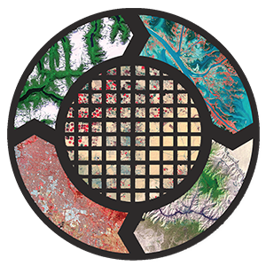
View from Terra’s
Zoom Lens:
All About the ASTER Sensor
Lindsey Harriman
SGT, Inc., Contractor to USGS EROS
Danielle Golon
Innovate! Inc., Contractor to USGS EROS

Slide 2

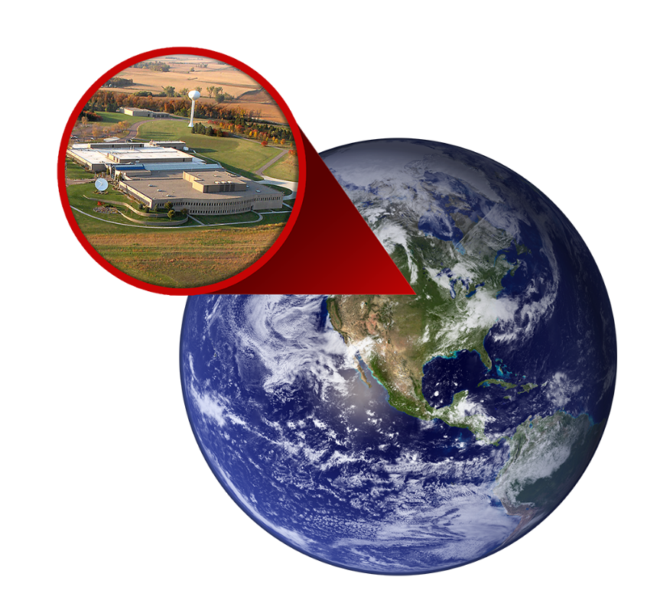

NASA’s LP DAAC
Land Processes (LP) Distributed Active Archive Center (DAAC)
  https://lpdaac.usgs.gov
Located in Sioux Falls, SD
at the USGS Earth
Resources Observation and Science (EROS) Center
Notes:
Also receive ASTER data

Slide 3

LP DAAC Mission Statement
To process, archive, and distribute land data products to NASA PI’s,
DOI land managers, and 100,000’s of users in the international earth science remote sensing community

Slide 4


NASA’s LP DAAC
1 of 12 NASA Earth Observing System Data and Information System (EOSDIS) DAACs
Part of in NASA’s Earth Science Data Systems Program
Notes:
Also receive ASTER data

Slide 5
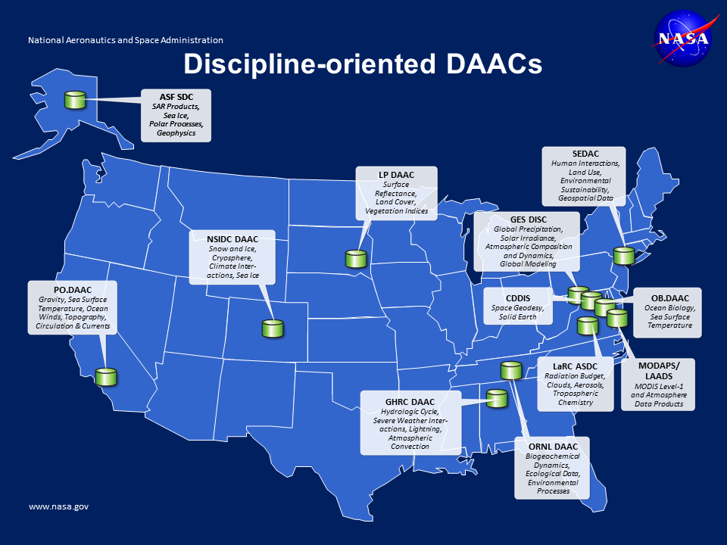
LP DAAC
Surface Reflectance, Land Cover, Vegetation Indices

Slide 6
LP DAAC Distributed Data Products
MEaSUREs
Community
MODIS
ASTER

Slide 7
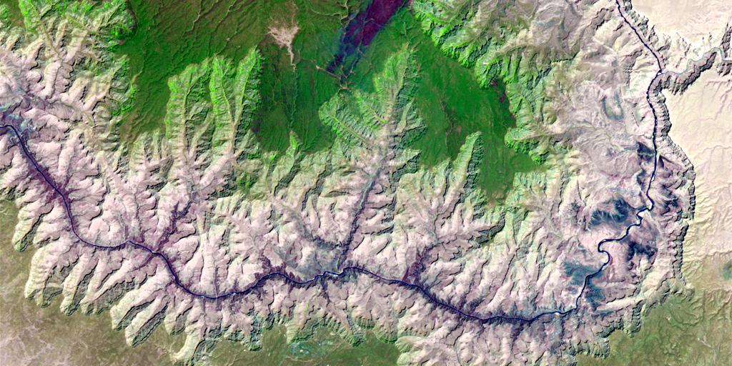
ASTER
ASTER: Advanced Spaceborne Thermal Emission and Reflection Radiometer
Partnership between NASA, Japan's Ministry of Economy, Trade and Industry (METI), Japan’s National Institute of Advanced Industrial Science and Technology (AIST), and Japan Space Systems (J-spacesystems)
On April 1, 2016, NASA and Japan announced that all ASTER products would be available to the public at no charge.

Slide 8
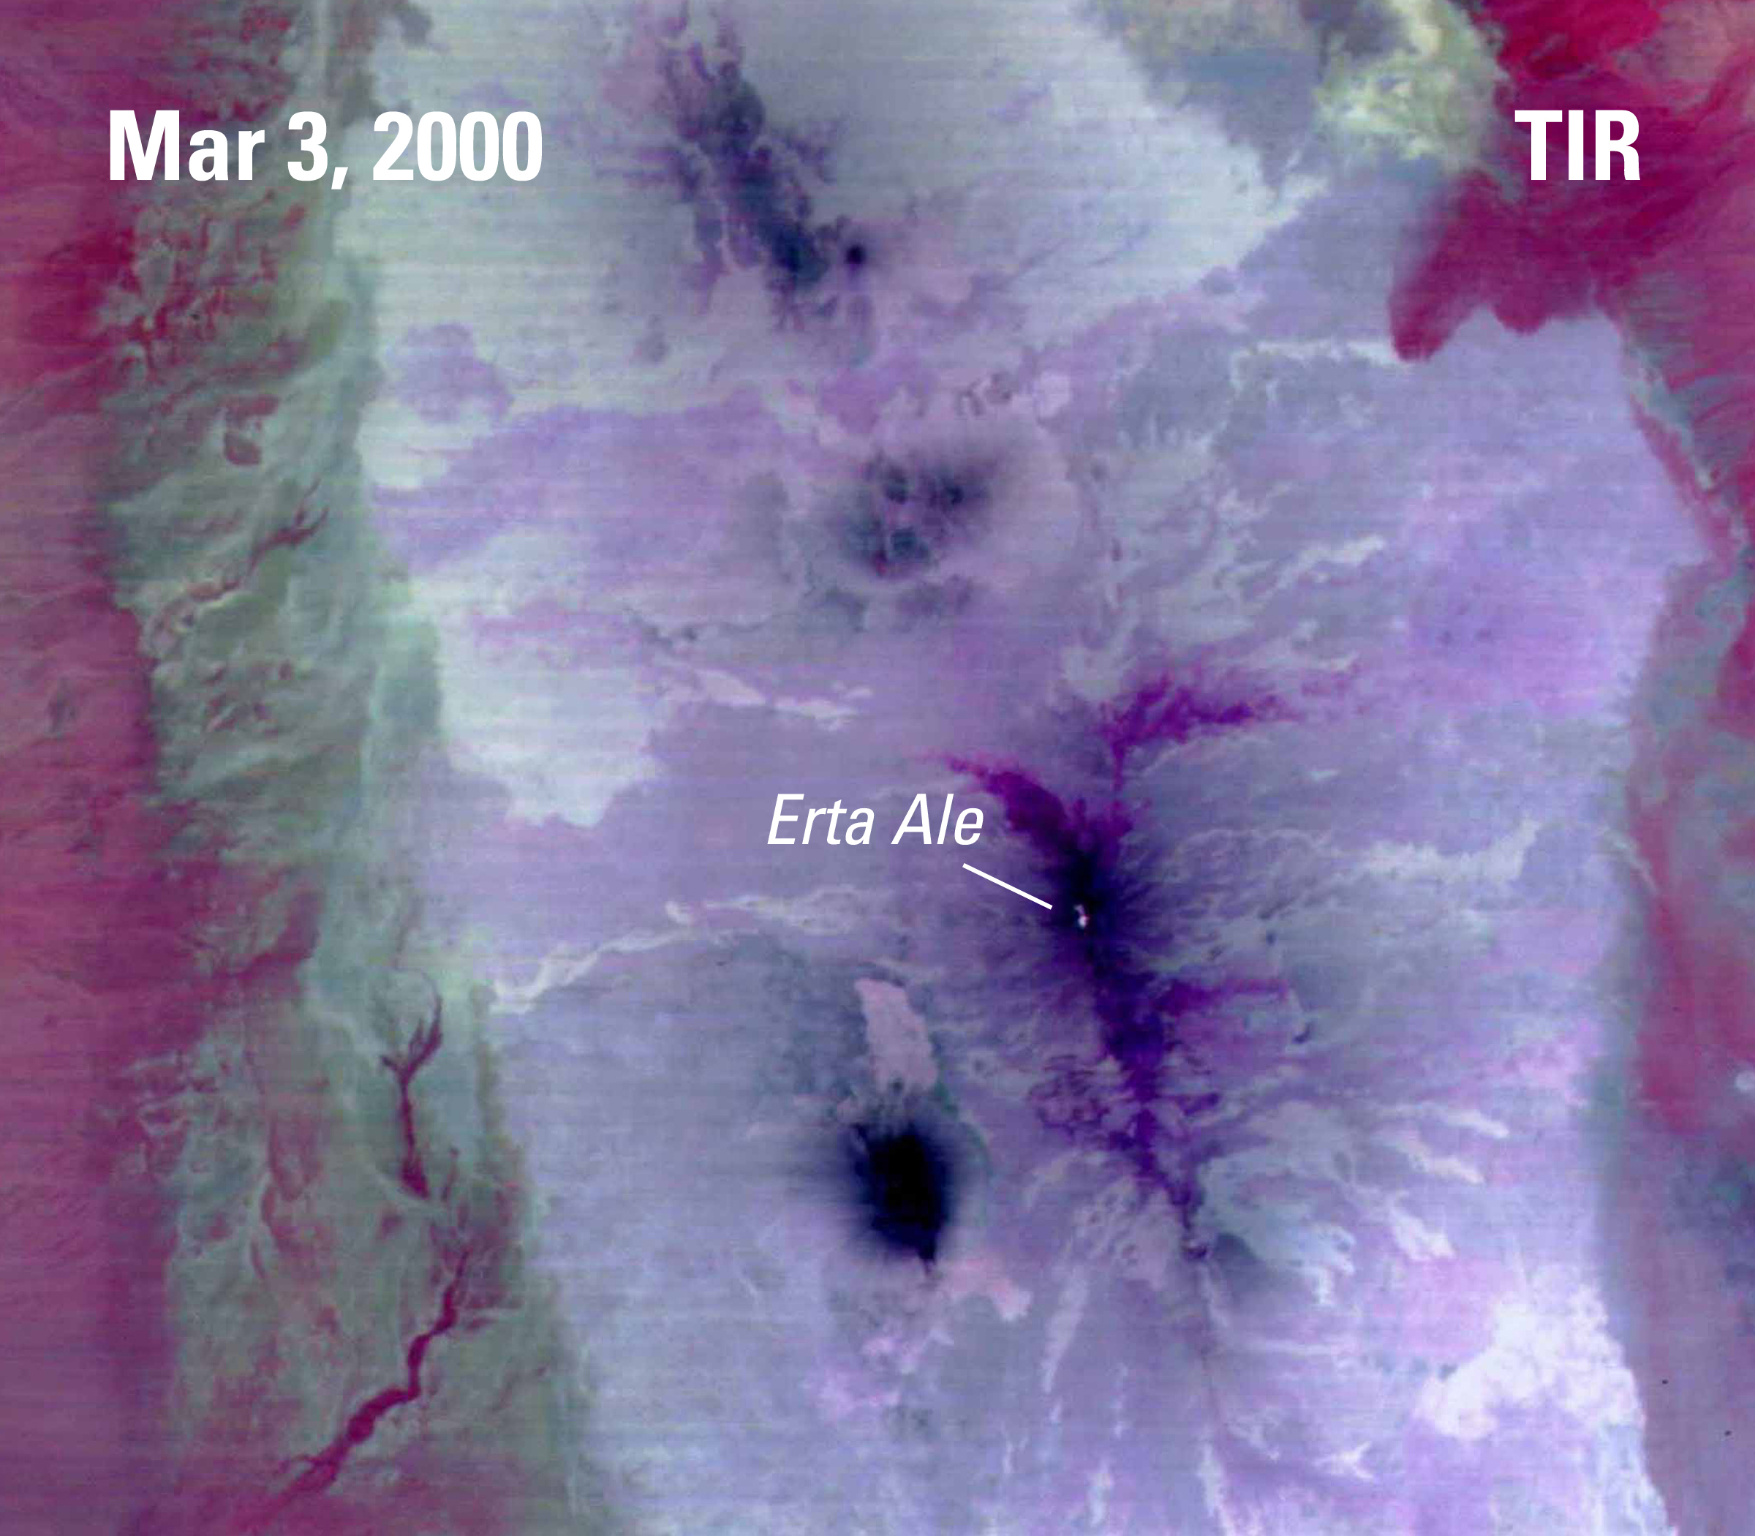
ASTER On Board
Multi-resolution instrument located on NASA’s Terra Satellite
Terra launched on December 18, 1999
ASTER captured its first image on March 3, 2000

Slide 9
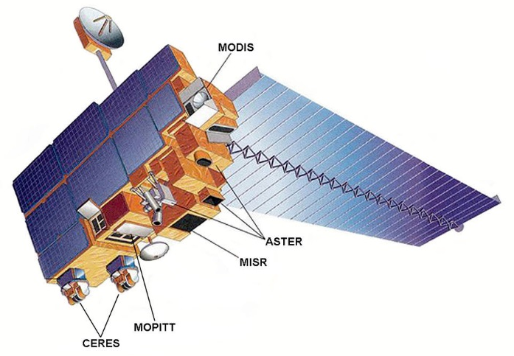
NASA’s Terra Satellite
Shortwave Infrared (SWIR)
30 m resolution
Thermal Infrared (TIR)
90 m resolution
Visible and Near Infrared (VNIR)
15 m resolution

Slide 10
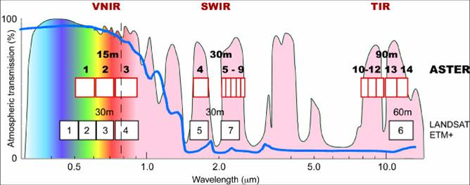
ASTER: Spectral Ranges
Source: https://asterweb.jpl.nasa.gov/images/spectrum.jpg

Slide 11
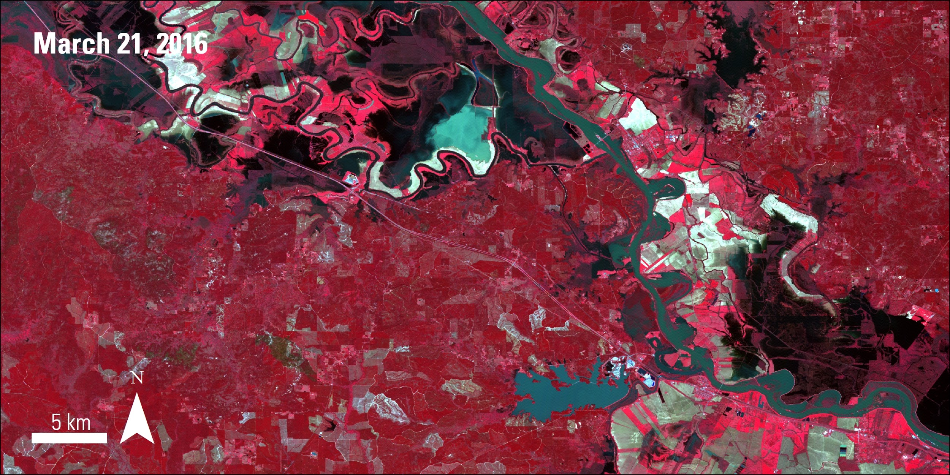
ASTER Data Acquisition
  The ASTER sensor is pointable, taskable, and can collect data at night
  Pointable: the sensor is directed where to point when an image is captured. Images are not on a defined tile reference system.
  Taskable: the sensor only
  captures images when it is
  programmed to.
Notes:
An infrared false color ASTER L1AE image of the flooding of the Red River in Colfax, Louisiana captured on March 21, 2016 after several days of heavy rain and tornadoes impacted the area. AST_L1AE is an unprocessed and expedited data product.

Slide 12
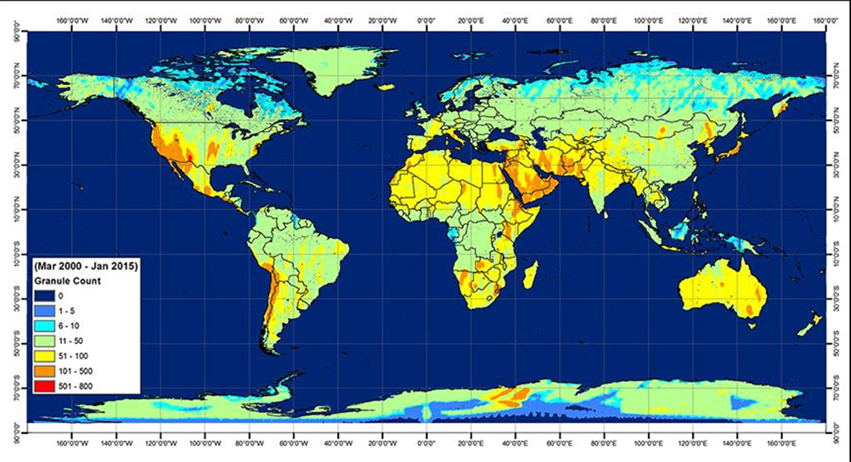
ASTER Data Coverage
~3 million scenes
~515 scenes/day

Slide 13

ASTER Applications
Geology and soils
Urban studies
Vegetation and ecosystem dynamics
Volcano and hazards monitoring
Hydrology
Land change

Slide 14
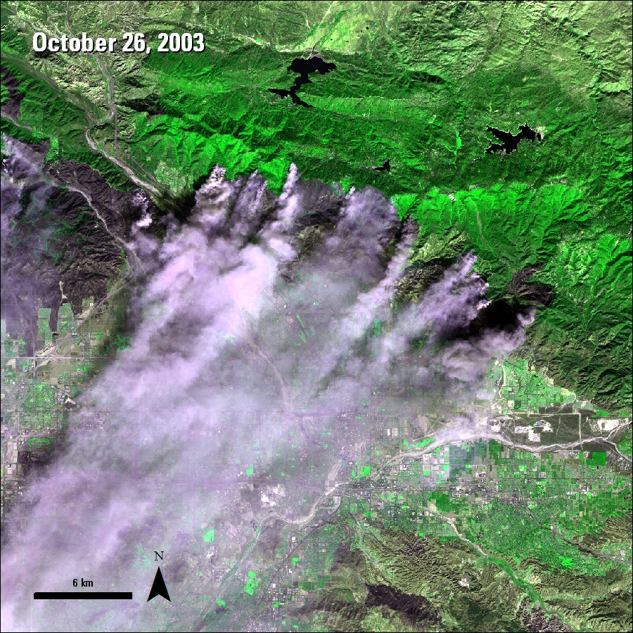
ASTER’s Telescopes: VNIR
Visible and Near Infrared (VNIR)
3 bands, 1 backward looking band
15 meter resolution

Slide 15
Source: Global Land Ice Measurements from Space (GLIMS Switzerland) http://www.geo.unizh.ch/~kaeaeb/glims/glims.html

Slide 16
VNIR Bands and DEM
VNIR Band 1
VNIR Band 2
VNIR Band 3N
VNIR Band 3B
Digital Elevation
Model (DEM)
Notes:
DEM produced from Bands 3N and 3B

Slide 17
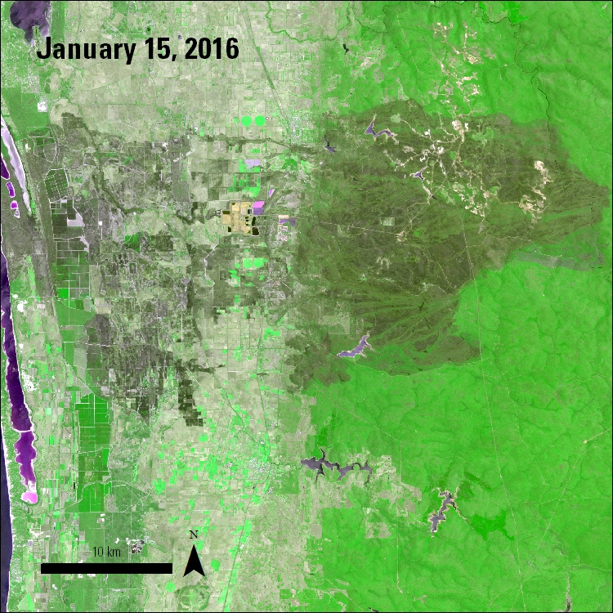
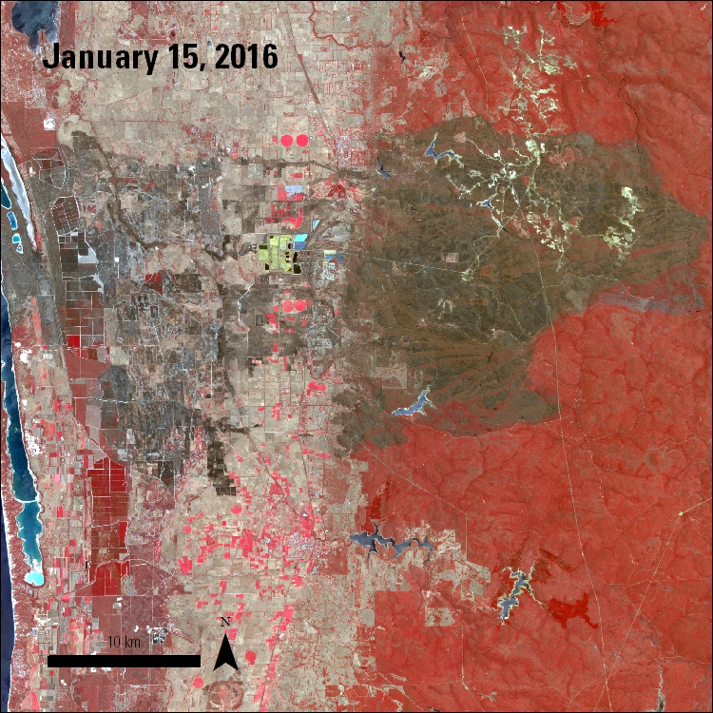
VNIR Band Combinations
Fire scar in Yarloop, Australia
RGB Bands 2-3-1
RGB Bands 3-2-1

Slide 18
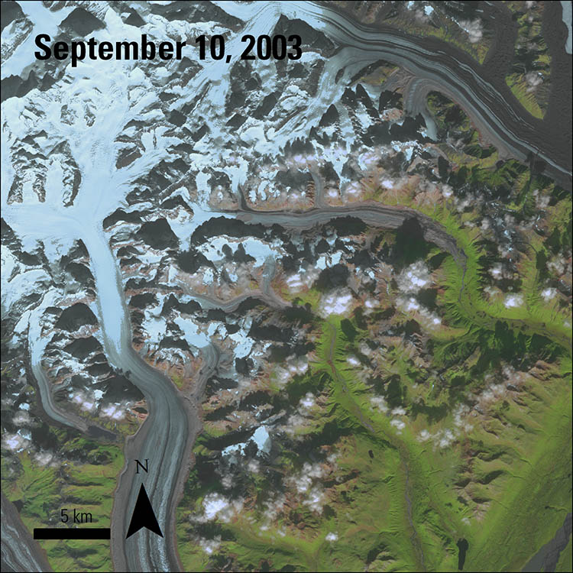
ASTER’s Telescopes: SWIR
Shortwave Infrared (SWIR)
6 bands
Data only available
March 2000 – April 2008

Slide 19
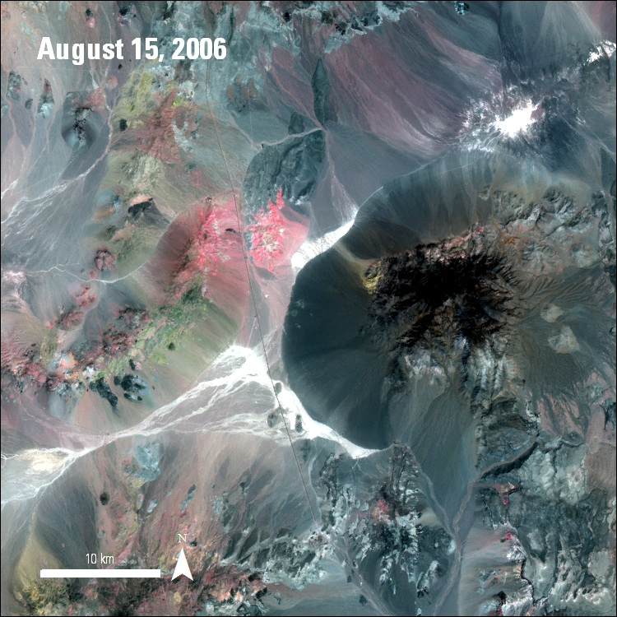
SWIR Band Combination
Cuprite Mining District, Nevada
RGB Bands 4, 6, 8
Read more about this area in the ASTER User Handbook.

Slide 20
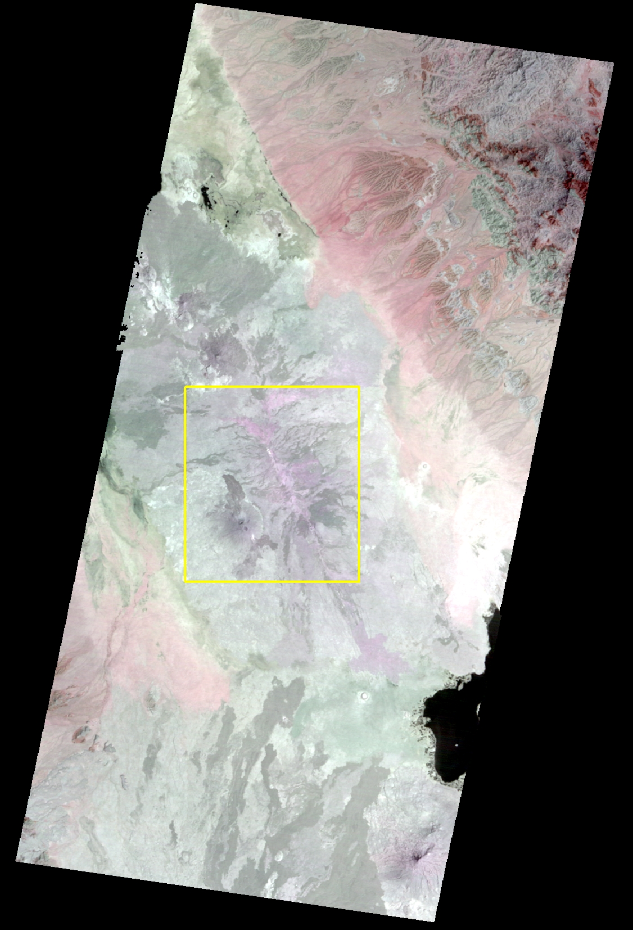
ASTER’s Telescopes: TIR
Thermal Infrared (TIR)
5 Bands
90 meter resolution

Slide 21
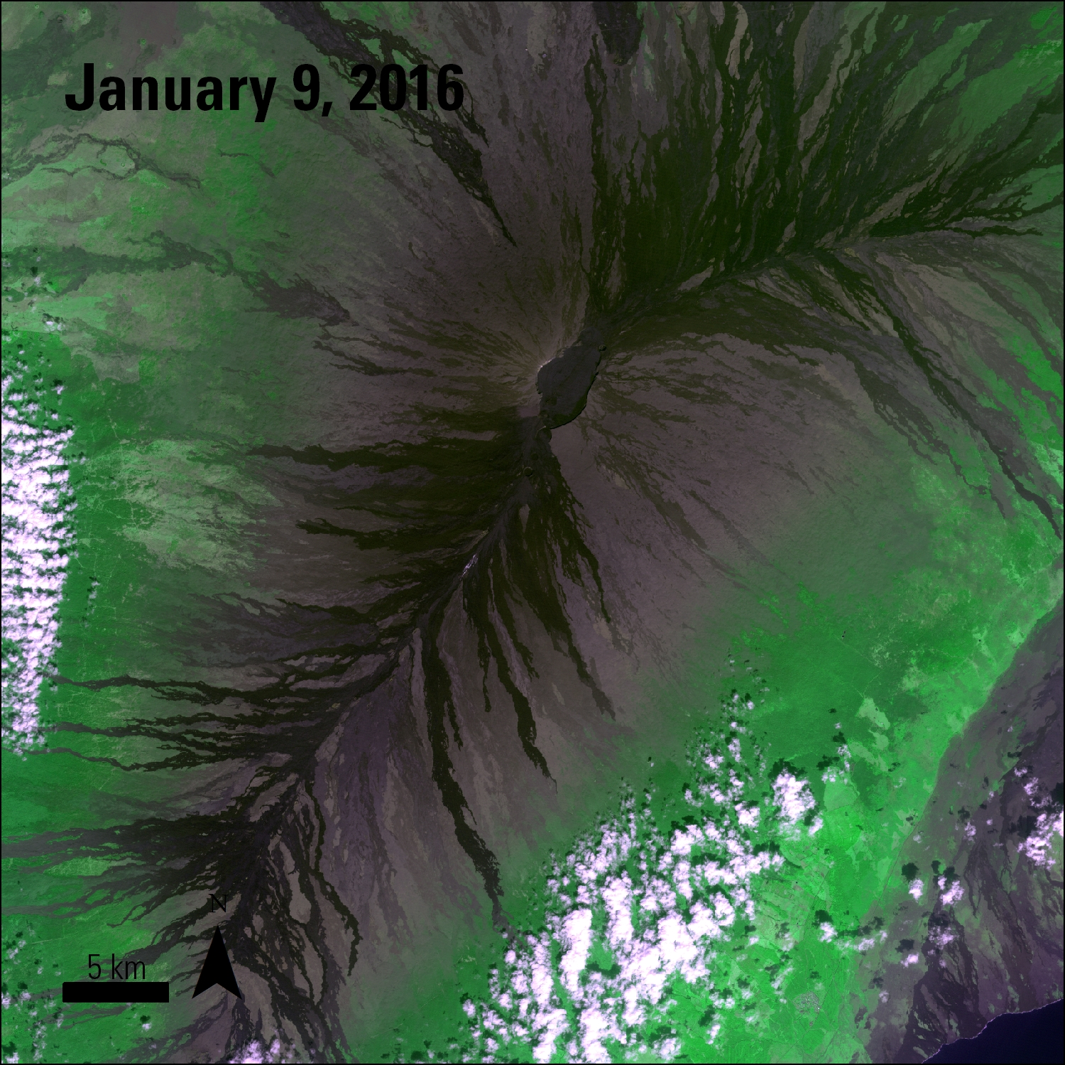
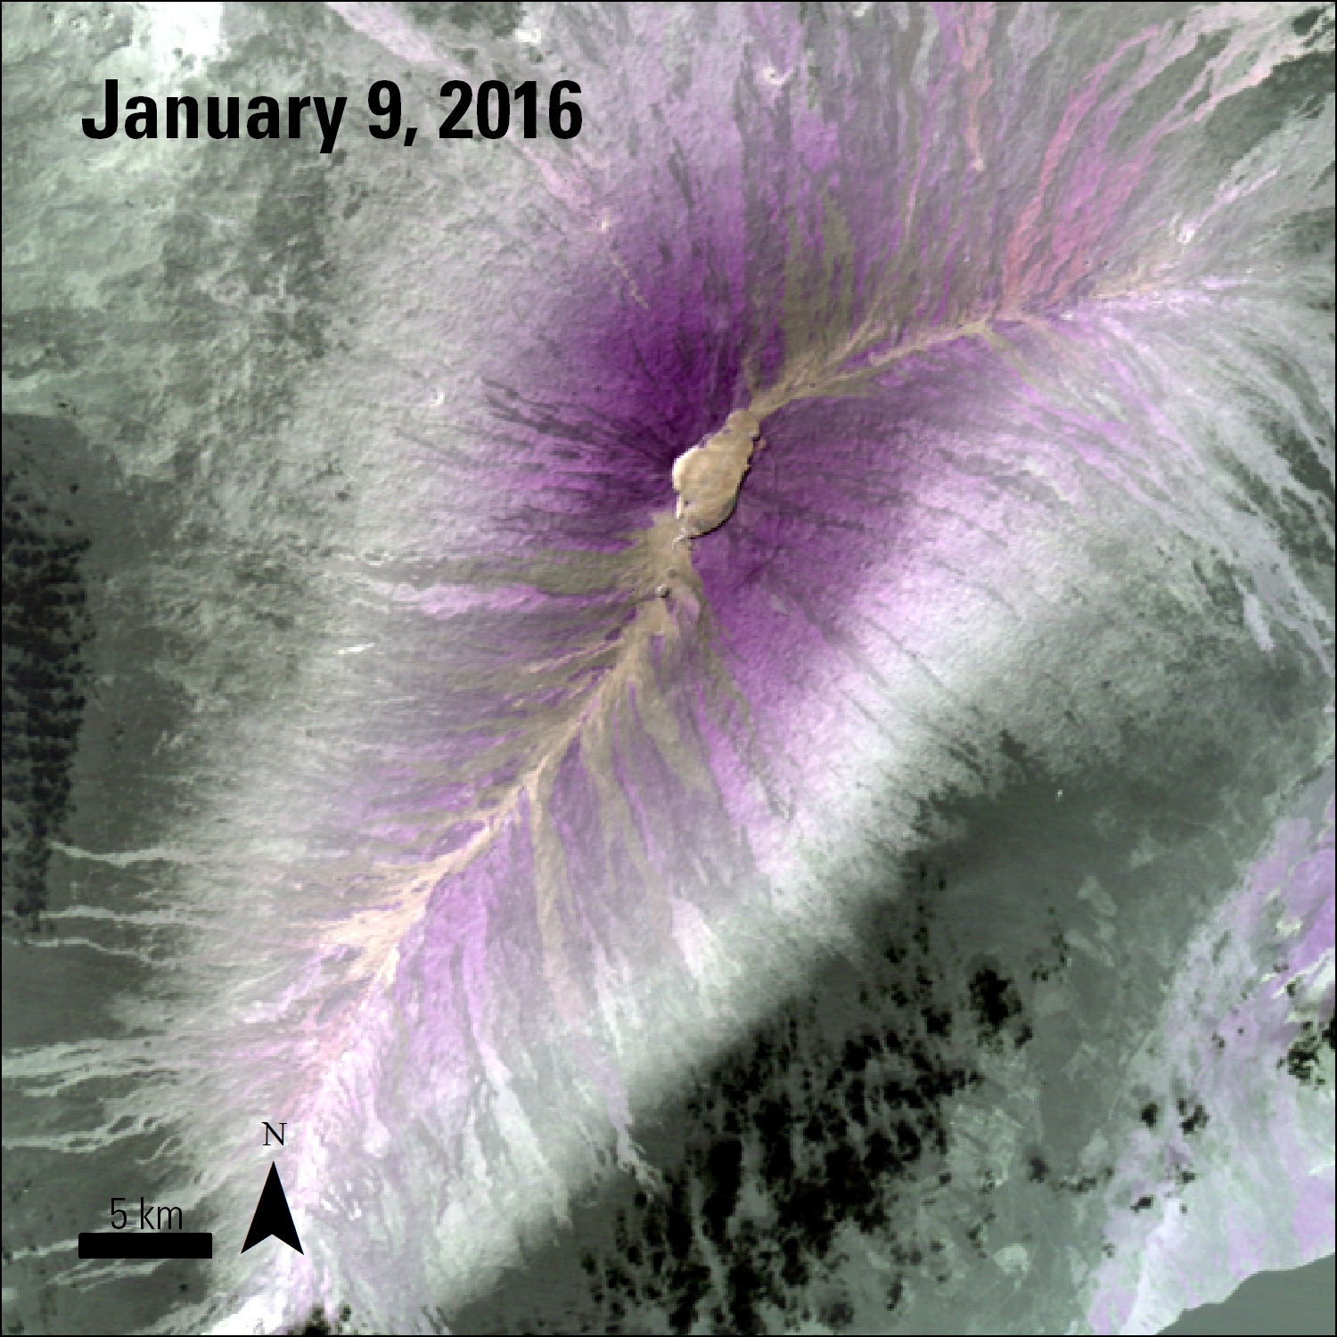
TIR Band Combination
VNIR RGB 2-3-1
TIR RGB 14-12-10
Notes:
Mauna Loa, Hawaii
Also check http://www.sciencedirect.com/science/article/pii/S1464343X10000178

Slide 22
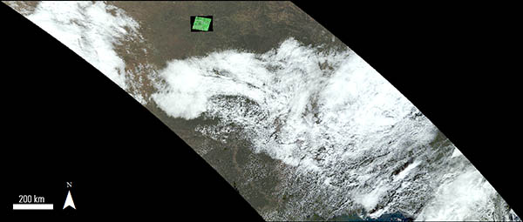
ASTER: A Postage Stamp
ASTER
60 km x 60 km
MODIS
1,200 km x 1,200 km
Notes:
MODIS scene March 21, 2016
ASTER L1T image of Lawrence, KS overlayed

Slide 23
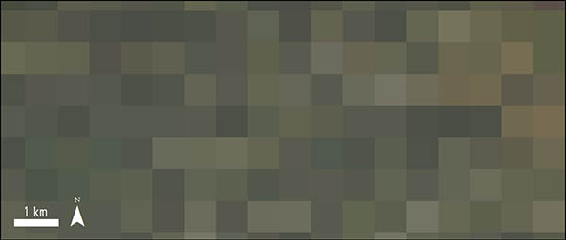
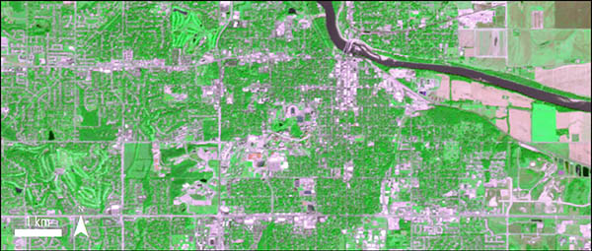
MODIS and ASTER: A Closer Look
MODIS
ASTER
Notes:
The MOD09GA scene zoomed into 1 km. At 1 km the MODIS’s 500 m spatial resolution is scene as individual pixels as compared to ASTER’s high 15 m spatial resolution.
The AST_L1T image zoomed into 1 km. The University of Kansas is featured in this AST_L1T scene.

Slide 24
ASTER Data Products
L1B Granule Structure
Data Directory
Generic Header
Ancillary Data
VNIR Data
SWIR Data
TIR Data
HDF-EOS Metadata
VNIR Band 1
VNIR Band 2
VNIR Band 3N
VNIR Band 3B
SWIR Band 4
SWIR Band 5
SWIR Band 7
SWIR Band 8
SWIR Band 9
TIR Band 10
TIR Band 11
TIR Band 12
TIR Band 13
TIR Band 14
Image
Data
Example Science Data Granule Structure for ASTER L1B
Hierarchical Data Format (HDF)
VNIR-Specific Header
VNIR Supplementary Data
Geometric Control Table
Image
Data
SWIR-Specific Header
SWIR Supplementary Data
Geometric Control Table
TIR-Specific Header
Image
Data
TIR Supplementary
Data Geometric Control Table
Notes:
Reference source: https://lpdaac.usgs.gov/sites/default/files/public/aster/docs/AST_L1B_structure.pdf

Slide 25
ASTER Data Products
Total of 16 data products
Direct Download, Restricted
(1)
Direct Download (3)
Processed On-Demand (12)
ASTER Level 1A is the lowest level data product available
Notes:
The ASTER Level-1A data set contains reconstructed, instrument digital numbers (DNs)
https://lpdaac.usgs.gov/dataset_discovery/aster/aster_products_table/ast_l1a

Slide 26
ASTER Data Products: Direct Download
Name | Short Name
Global Digital Elevation Model (GDEM) | AST_GTM
Expedited Reconstructed Unprocessed Instrument Data | AST_L1AE
Expedited Routine Registered At-Sensor Radiance | AST_L1BE
Precision Terrain Corrected | AST_L1T

Slide 27
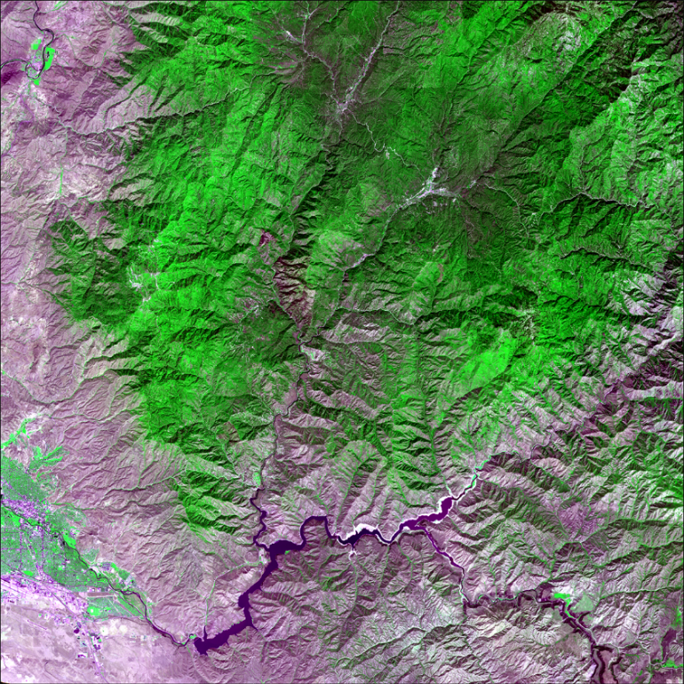
ASTER L1T
ASTER Level 1 Precision Terrain Corrected Registered At-Sensor Radiance (AST_L1T)
Applies geometric and radiometric
corrections to a single resampling
of an ASTER Level 1A scene
Uses identical calibrations and
corrections applied to L1B data
Does not contain the VNIR 3B
backward-looking band
Soon to be input for ASTER
on-demand products
Notes:
AST L1T Boise Aug 28, 2014

Slide 28

ASTER L1T Terrain Correction
Level of Correction | Corrected with DEM* (terrain) | Corrected with GCP** (precision)
Terrain+Precision | X | X
Terrain+Systematic | X
Precision |  | X
Systematic
* Global Land Survey (GLS) 2000 Digital Elevation Model (DEM)
** GLS2000 Ground Control Points (GCP)

Slide 29
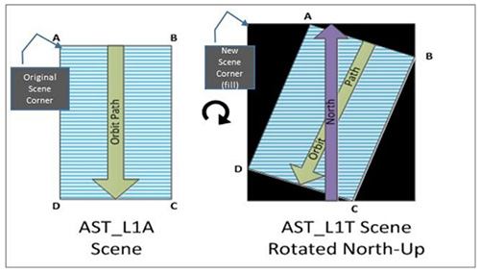
ASTER L1T Scene Rotation

Slide 30
ASTER L1T Product Contents
ASTER L1T is a multi-file product
Science Data (.HDF) and metadata (.XML)
VNIR and TIR Full Resolution Browses (GeoTIFF)
Quality Assessment (QA) file (.txt) and metadata (.XML)
Bundled Browse (.HDF) and metadata (.XML)
VNIR, TIR, and QA browses (.jpeg)

Slide 31
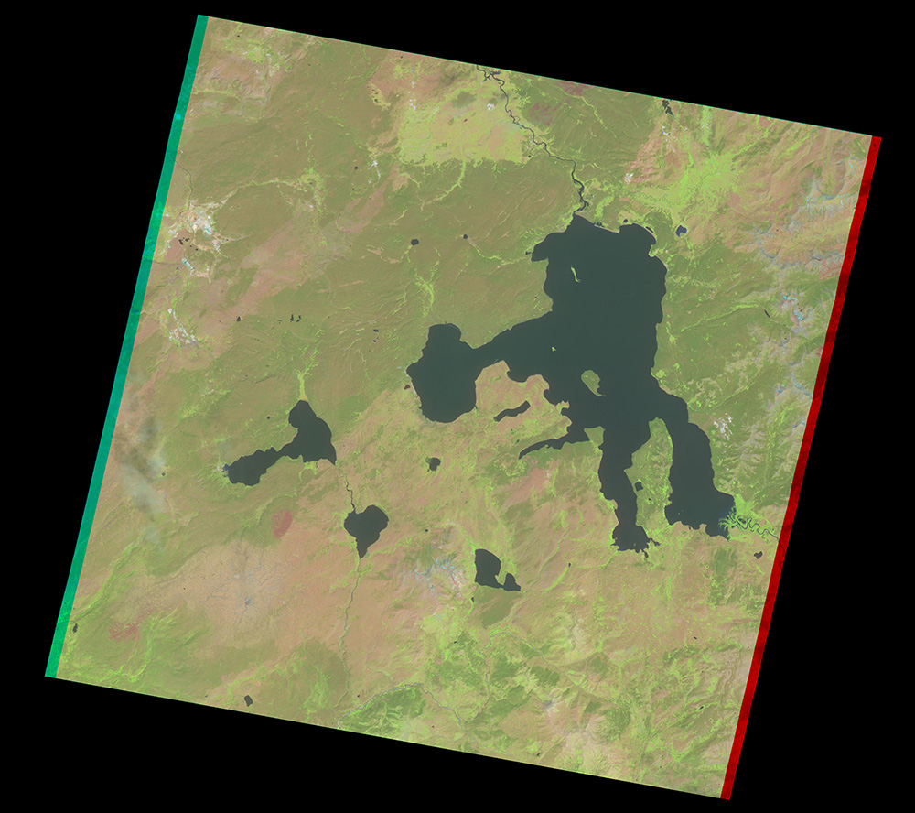
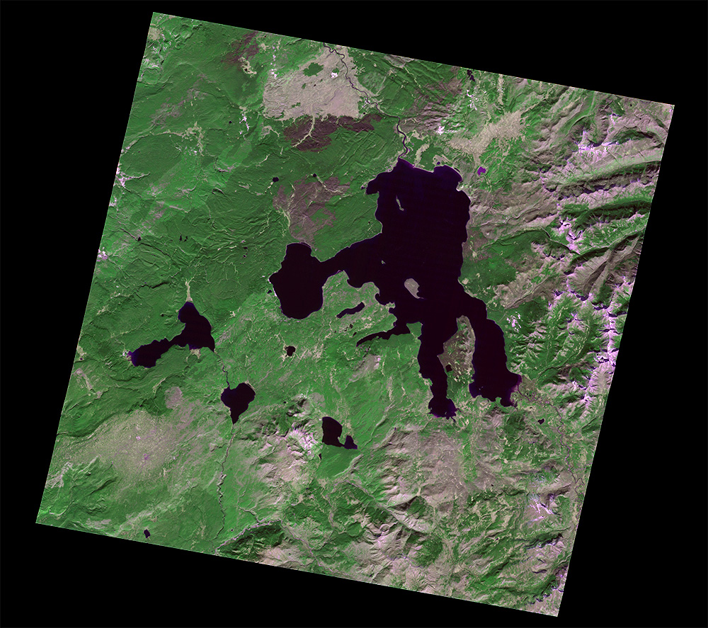
ASTER L1T GIS-Ready Browse: VNIR
July 14, 2002
October 19, 2014
With SWIR data:
Bands RGB 4-3-2
With VNIR-only data:
Bands RGB 2-3-1

Slide 32
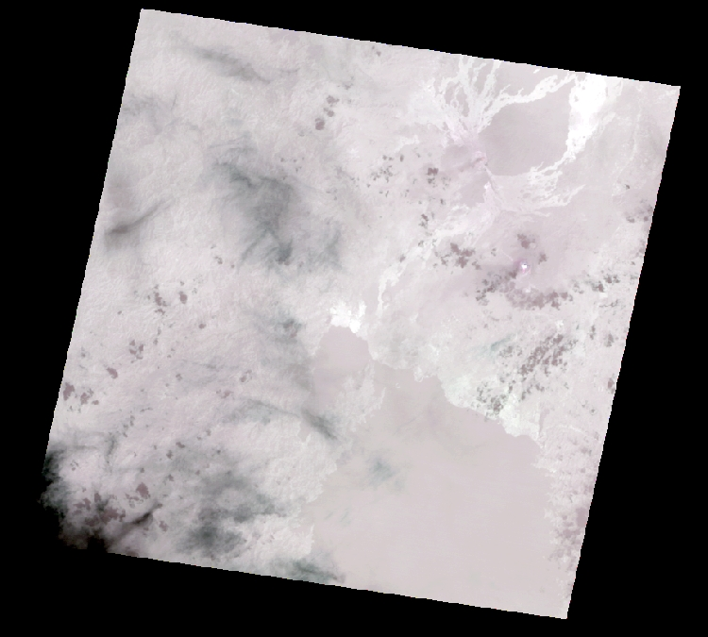
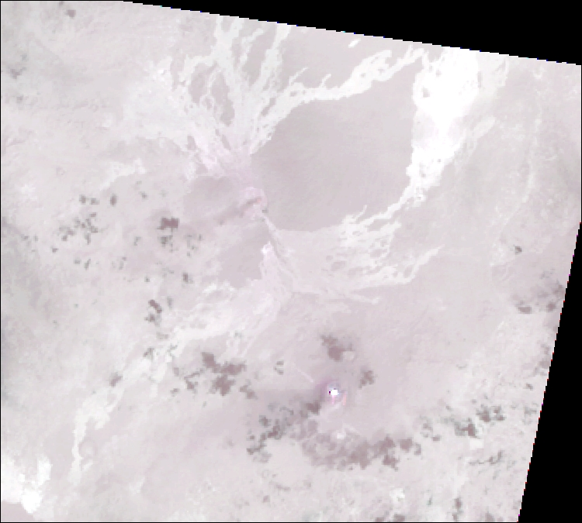
ASTER L1T GIS-Ready Browse: TIR
Bands RGB 14-12-10
January 29, 2014
Nyamuragira
Nyiragongo
Notes:
ASTER L1T TIR browse January 29, 2014

Slide 33
ASTER QA Report
Only produced if:
  Precision correction is attempted
  VNIR or SWIR telescopes collected data
  Scene was collected during the day
The report summarizes:
  Total correlated GCPs
  Mean, median, and standard deviation in pixel offset
  Mean, median, and standard deviation in RMSE by quadrant and full scene

Slide 34
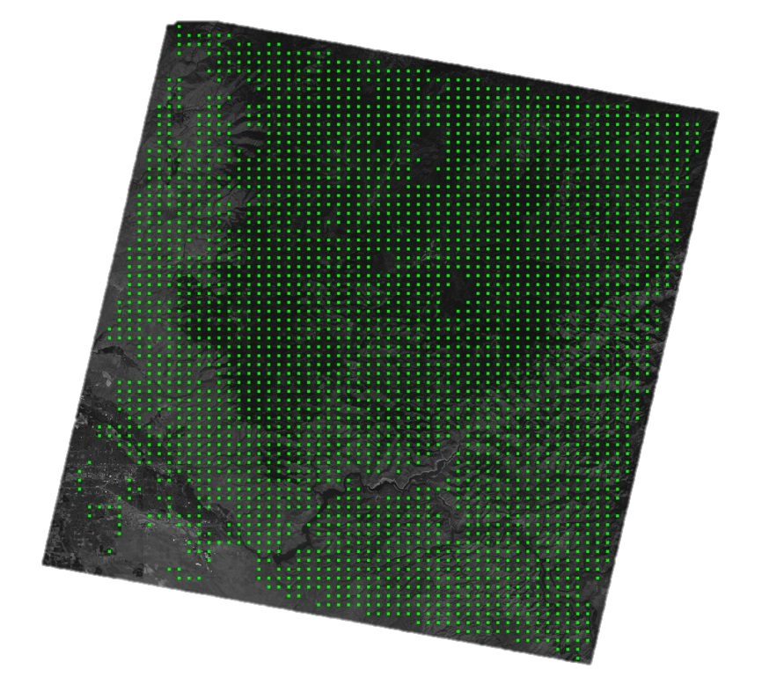
ASTER L1T Browse: Quality Assessment (QA)
Quality Assessment (QA) Browse: JPEG image with markers for GCPs used during the geometric verification quality check

Slide 35
Terra ASTER Data Products:
Processed On-Demand
Name | Short Name
Reconstructed Unprocessed Instrument Data | AST_L1A
Registered At-Sensor Radiance | AST_L1B
Surface Emissivity | AST_05
Surface Reflectance | AST_07, AST_07XT
Surface Kinetic Temperature | AST_08
Surface Radiance | AST_09, AST_09XT, AST_09T
Digital Elevation Model (DEM) (scene-based) | AST14DEM
Orthorectified Register At-Sensor Radiance | AST14OTH
Orthorectified Radiance and DEM | AST14DMO

Slide 36
Differences between ASTER products
Data Product | Radiometric Correction | Geometric Correction (satellite) | Geometric Correction (terrain) | Geometric Correction (precision) | North-up Scene Orientation | GIS-Ready Color Composite
AST_L1T | X | X | GLS2000 | GLS2000 | X | X
AST_L1B | X | X
AST14OTH | X | X | AST14DEM | AST14DEM | X

Slide 37
Additional Resources
LP DAAC ASTER Product Pages
ASTER L1T Quick Reference Guide
ASTER User Handbook
ASTER NASA Jet Propulsion Laboratory (JPL) Website
ASTER FAQs
LP DAAC Data in Action
Subscribe to our listserv

Slide 38

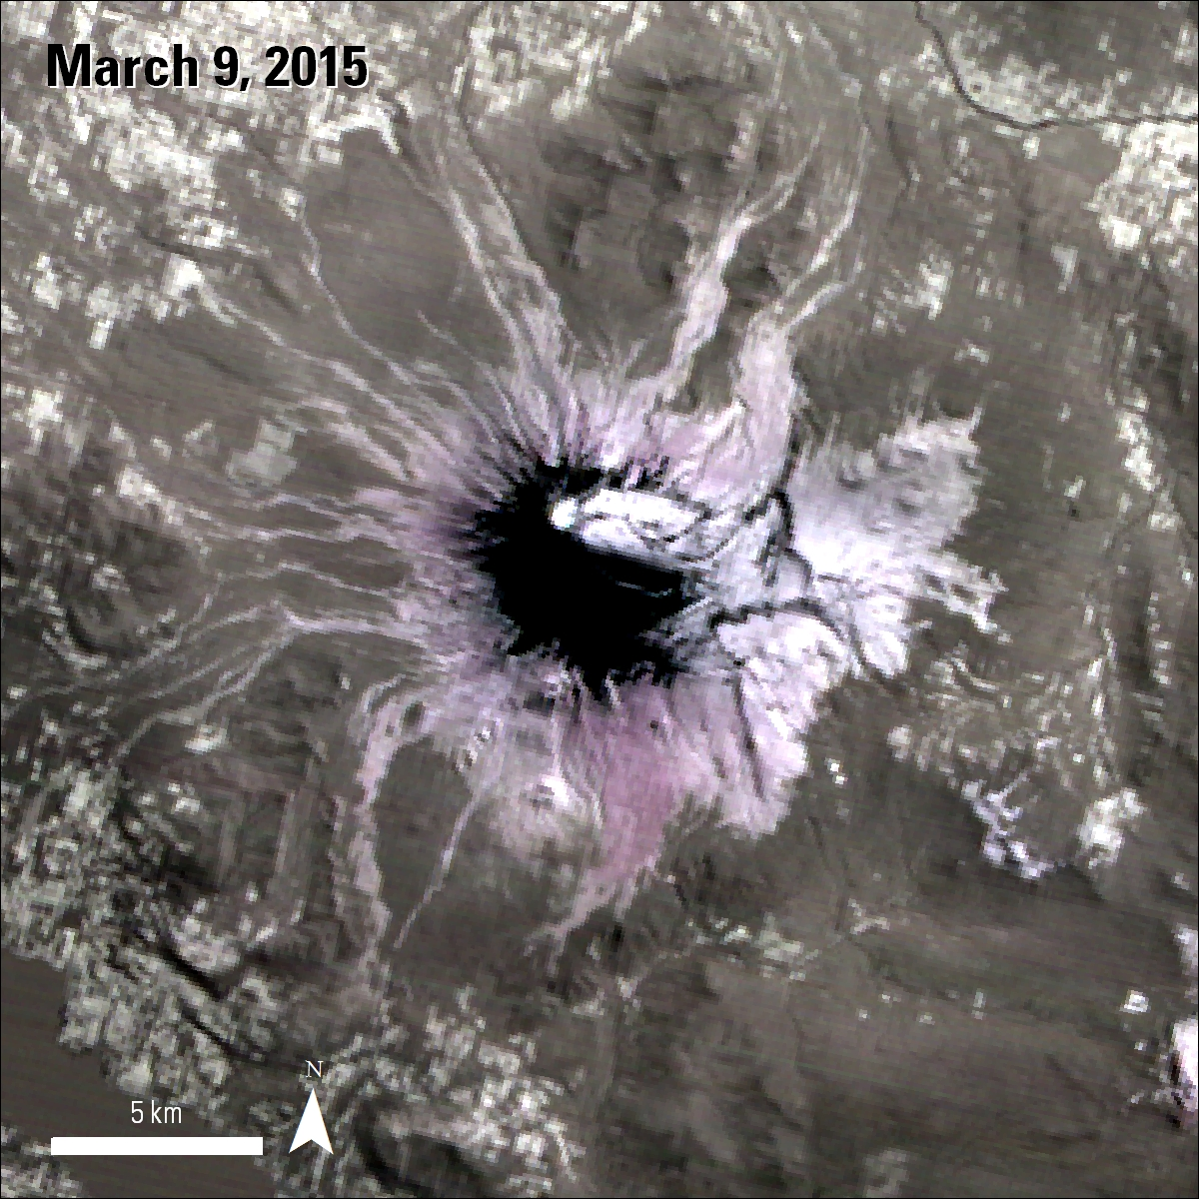
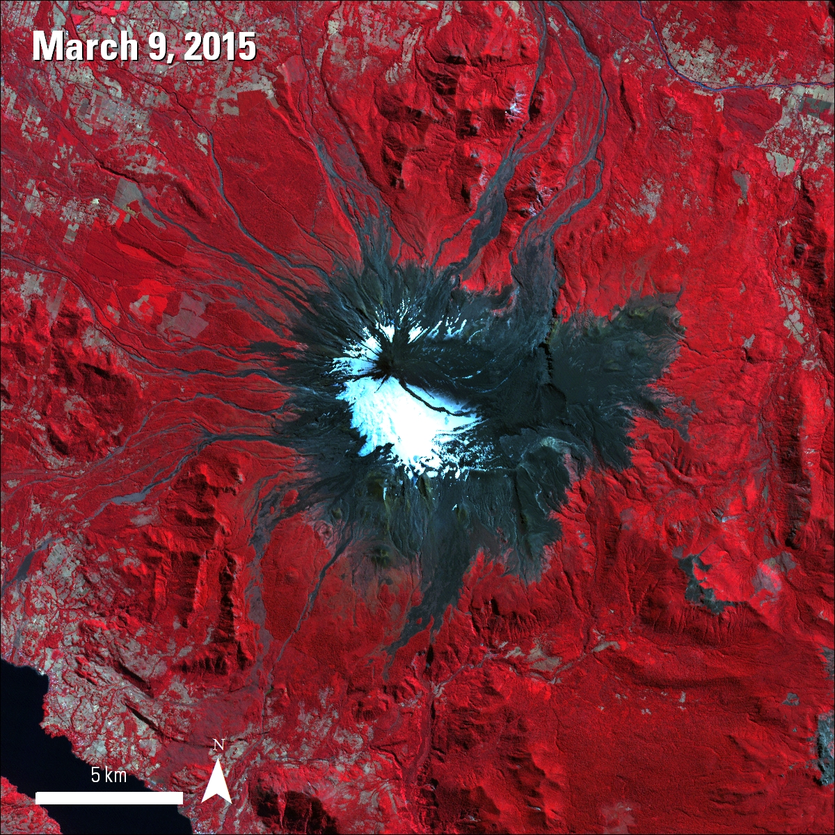
Use Case: Volcano Observation
Location: Villarrica Volcano, Chile
Data: AST_L1BE
For: Observing and analyzing many aspects of volcanic activity
Advantage of ASTER:
Pointable and taskable telescopes that can collect
high resolution data when needed. Enables pre- and
during eruption assessments as well as response efforts
Notes:
One of Chile’s most active volcanoes. Regularly monitored through the ASTER Volcano Archive (http://ava.jpl.nasa.gov/volcano.php?id=1507-12=) – this image was expedited due to new eruption. Eruption began on March 3.

Slide 39

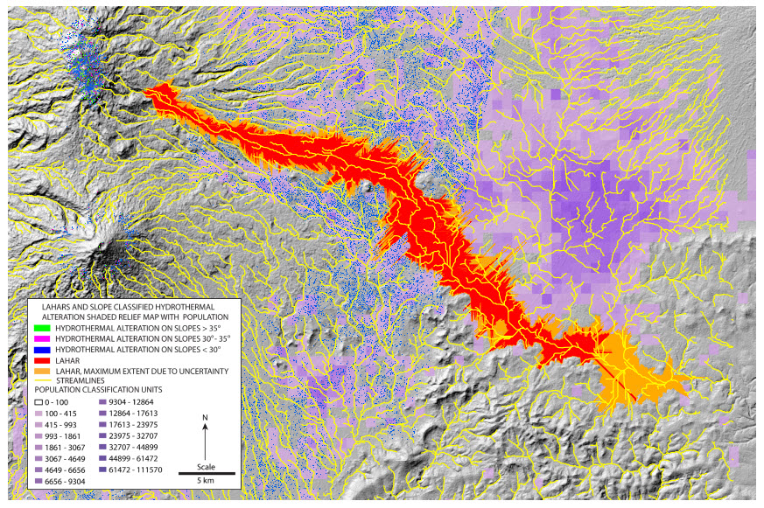
Use Case: Lahar Modeling
Location: Iztaccíhuatl Volcano in Mexico
Data: AST_L1B, ASTER GDEM
For: Observing and analyzing
potential lahar inundation areas
Advantage of ASTER:
ASTER’s high spatial resolution
and ability to collect elevation
data can aid in studying lahars
Mars, J., Hubbard, B., Pieri, D., and Linick, J., Alteration, slope-classified alteration, and potential lahar inundation maps of volcanoes for the Advanced Spaceborne Thermal Emission and Reflection Radiometer (ASTER) volcanoes archive, accessed March 21, 2016, at http://www.dx.doi.org/10.3133/sir20155035.

Slide 40

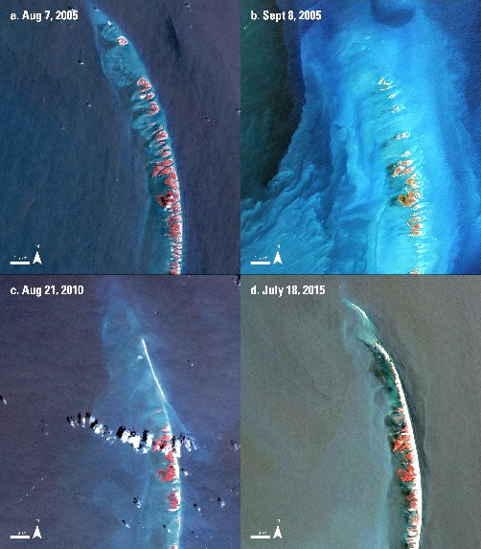
Use Case: Land Change
Location: Chandeleur Islands, Louisiana
Data: AST_L1B
For: Observing and analyzing the Chandeleur Islands for changes over time due to hurricane activity
Advantage of ASTER: High spatial resolution; spectral range for observing changes in vegetation
Notes:
The degradation and regeneration of the Chandeleur barrier islands was captured by ASTER before, immediately after, 5 years after, and 10 years after Hurricane Katrina.

Slide 41

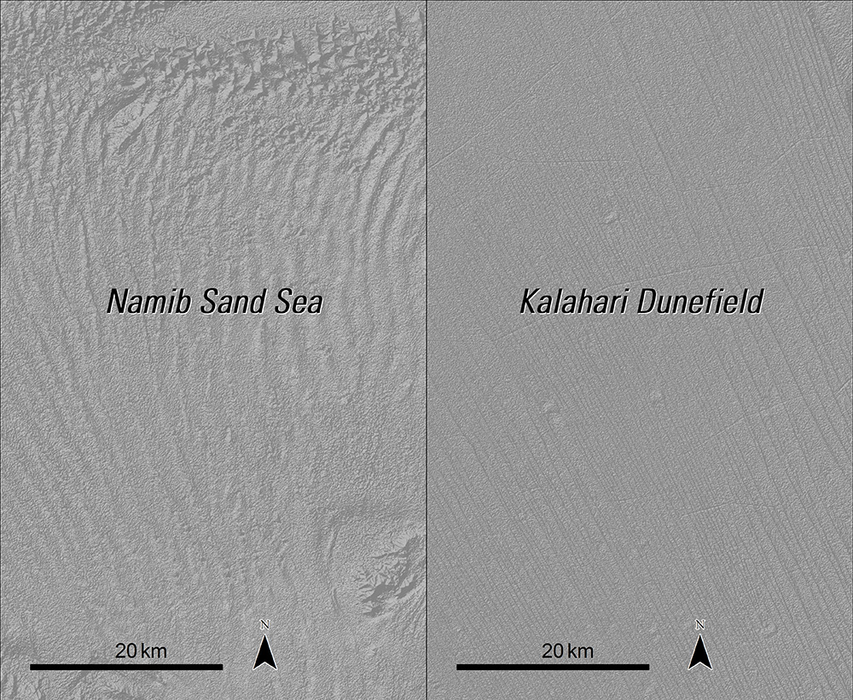
Use Case: Terrain Mapping
Location: Kalahari Dunefield and Namib Sand Sea, Namibia
Data: ASTER GDEM (AST_GTM)
For: Observing and analyzing patterns of height and spacing in two different types of dune fields
Advantage of ASTER: Global availability of elevation data at 30 meter resolution
White, K., Bullard, J., Livingstone, I., & Moran, L., 2015, A morphometric comparison of the Namib and southwest Kalahari dunefields using ASTER GDEM data: Aeolian Research, vo. 19, part A, 87-95. http://dx.doi.org/10.1016/j.aeolia.2015.09.006

Slide 42
ASTER Data Access
Tool | ASTER L1T Direct Download | On-Demand Product Ordering
LP DAAC Data Pool/DAAC2Disk | X
NASA Earthdata Search Client | X | Coming soon!
NASA Reverb | X | X
USGS Earth Explorer | X
USGS GloVis | X | X

Slide 43
Data Access Demonstrations
LP DAAC Data Pool
  HTTP download of individual data granules
  Need to know your granule ID
  No immediate browse preview
LP DAAC DAAC2Disk
  Easy way to bulk download from Data Pool
  Do not need to know granule ID, use search parameters instead
NASA EOSDIS Earthdata Search
  Preview browse data before download

