Slide 1

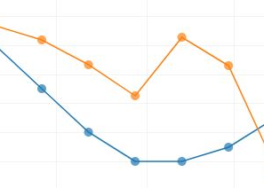
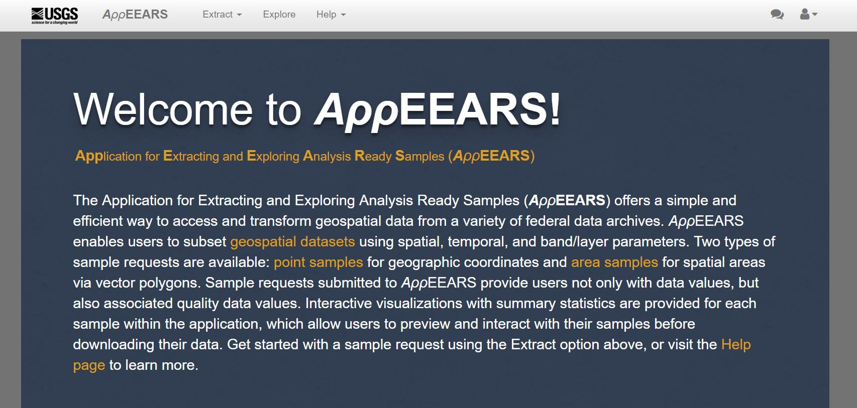
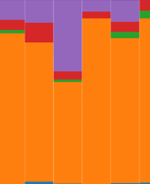
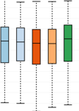
Fast Track Your Data Extraction Experience with AppEEARS!
Danielle Golon
Innovate Inc., contractor to the U.S. Geological Survey (USGS) Earth Resources Observation and Science (EROS) Center
Sioux Falls, South Dakota
*Work performed under USGS contract [G15PC00012]

Slide 2
Agenda
Background on the LP DAAC, the data we’ll be using, and the Application for Extracting and Exploring Analysis Ready Samples (AρρEEARS)
Complete a walkthrough of an AppEEARS Area request as a group
Complete a walkthrough of AppEEARS Point request
Questions
2

Slide 3
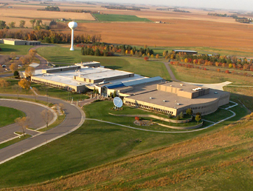
What is NASA’s LP DAAC?
Land Processes (LP) Distributed Active Archive Center (DAAC)
  https://lpdaac.usgs.gov
Located at the USGS Earth Resources Observation and Science (EROS) Center in Sioux Falls, SD
Established in 1990
4

Slide 4
LP DAAC Data Fast Facts!
Access to 4.9 Petabytes of land data
Data available from 1981 to present
Data provides information about the Earth from 1 millimeter to 5,600 meters per pixel
All data and resources available at no cost
ASTER: AST_L1T
Kurnool Ultra Mega Solar Park, India
DOI 10.5067/ASTER/AST_L1T.003I:
15 meter
VIIRS: VNP09CMG
Globe
DOI 10.5067/VIIRS/VNP09CMG.001:
5,600 meter
4

Slide 5
What Types of Data Are Available?
BRDF
Vegetation Indices
Albedo
Burned Area
NPP
Elevation
Land Cover
Emissivity
LAI
ET
Thermal Anomalies and Fire
FPAR
AOD
GPP
LST
VCF
Reflectance
Unprocessed
Radiance
Cropland
Canopy Characteristics
Water Use Efficiency
Full Waveform
Lidar
Evaporative Stress Index
5

Slide 6
Where Do the Data Come From?
Terra
ASTER
NASA MEaSUREs
Community
Terra and Aqua MODIS
HLS
S-NPP
VIIRS
ECOSTRESS
GEDI
Provisional
7

Slide 7
How can you access this data? The Answer is AppEEARS!
https://lpdaacsvc.cr.usgs.gov/appeears/
7

Slide 8
Benefits of AppEEARS?
  Snow
  Temperature
  Vegetation
Access to 120 data products from several federal archives, including:
  Population
  Weather
  Fire
Ability to subset data (spatial, temporal, band/layer)
Request data via:
  Point (coordinates) – pixel based time series
  Area (polygons) – mosaicking and clipping done for you!
Interact with data values and decoded quality info prior to download
Download via GeoTIFF or NetCDF-4
Ability to modify and repeat a request
  Soil Moisture
  Elevation
  Water
8

Slide 9
Let’s dive in!
Area
Point
Topic: Observe fire and NDVI trends in Glacier National Park
Data
  Thermal Anomalies / Fire (MOD14A2)
  Vegetation Indices (MOD13Q1)
Temporal
  2003 – Present
Topic: Observe bus stops in the Phoenix metro area that would benefit from adding a heat shelter.
Data
  Daytime Land Surface Temperature (MOD11A1)
  Nighttime Land Surface Temperature (MOD11A1)
  Air Temperature (DAYMET)
  Vegetation (eMODIS NDVI)
Temporal
  2015 - Present
9

Slide 10
But first!
If you don’t have an Earthdata Login Account please create one:
  https://urs.earthdata.nasa.gov/
Info:
  Earthdata Accounts are available at no cost
  Your Earthdata Account provides you access to thousands of no cost datasets and is a single mechanism for user registration and profile management for all Earth Observing System Data and Information System (EOSDIS) system components (DAACs, Tools, Services)
  Your Earthdata login also helps the EOSDIS program better understand the usage of EOSDIS services to improve user experience through customization of tools and improvement of services
Then download the materials from: https://git.earthdata.nasa.gov/projects/LPDUR/repos/2020-agc-workshop/browse
3

Slide 11
User Services
Contact information:
  Questions about LP DAAC data:
Voice: 605-594-6116
Toll Free: 866-573-3222 (866-LPE-DAAC)
E-mail: LPDAAC@usgs.gov
Web: https://lpdaac.usgs.gov/
Join our listserv https://lists.nasa.gov/mailman/listinfo/lpdaac
33

